Slide 1

East Area Renovation Kick-off meeting
Project Organization and Next Steps
Sébastien Evrard / EN-EA, 22-07-2016

Slide 2
Project management(I)
The East Area Renovation is a Cost to Completion (CtC) project, separated from ATS Consolidation program and fully driven by the EN-EA Group.
Core project team in EN-EA with the following roles:
  Project Leader [PL]: Sebastien Evrard
  Implementation Coordinator (Beams and Infrastructure) [IC]: Michael Lazzaroni
  Site Manager [SI]: Aboubakr Ebn Rahmoun
  Beam Physicist [BP]: Lau Gatignon (support: Johannes Bernhard)
  Planning Officer [PO]: Quentin Bouirek
  Support Engineer [SE]: Erwan Harrouch
  Safety Coordinator [SC]: tbd
  Project Safety Officer [PSO]: tbd

Slide 3
Project management (II)
Documentation:
  The full project (CDR like): https://edms.cern.ch/document/1471844/0.1
  The roadmap document: https://edms.cern.ch/document/1608373/1
Mandate ready, being approved by ATS management
Project Management Plan in preparation, to be approved by GL’s
Reporting lines: IEFC and ATS management (on request)

Slide 4
Budget
The allocation for the EA Renovation is as follows:
 | 2016 | 2017 | 2018 | 2019 | 2020 | 2021 | Grand Total
EAC-EA | 279 | 1,497 | 7,205 | 6,854 | 7,470 | 532 | 23,837
This includes the part for the building and covers the PVC cable replacement.
The profile shall be updated after the Cost and Schedule Review (CSR) later this year.
Budget in line with the request in the roadmap document.
Budget code(s) per group being established.

Slide 5
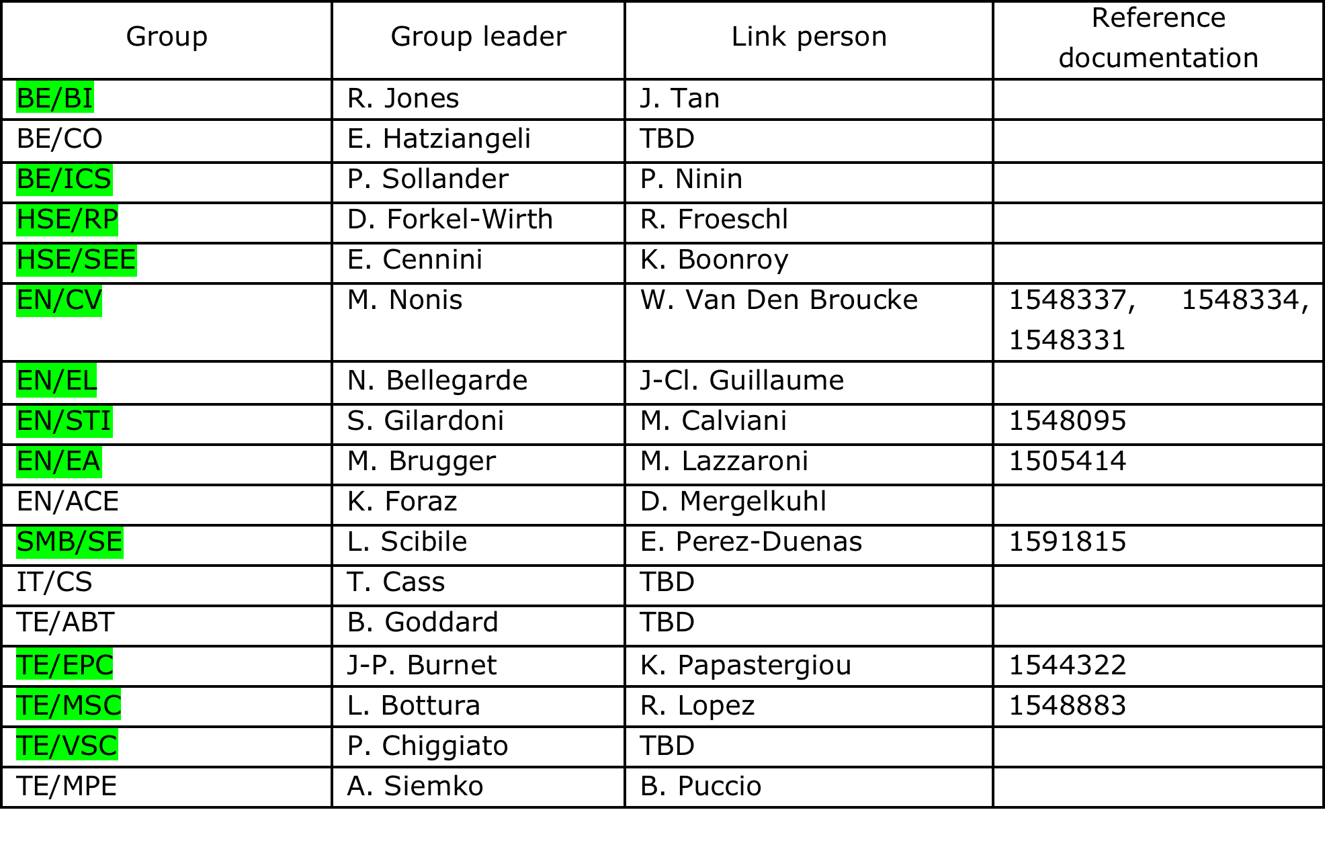
Responsibility matrix
GL Roadshow in progress

Slide 6
Master Schedule
SHUTDOWN/TS | PROTON PHYSICS |  | 2 | 0 | 1 | 6 |  |  |  |  |  | 2 | 0 | 1 | 7 |  |  |  |  |  |  |  |  | 2 | 0 | 1 | 8 |  |  |  |  |  |  |  |  | 2 | 0 | 1 | 9 |  |  |  |  |  |  |  |  | 2 | 0 | 2 | 0 |  |  |  |  |  |  |  |  | 2 | 0 | 2 | 1
COMMISSIONING | IONS | J | A | S | O | N | D | J | F | M | A | M | J | J | A | S | O | N | D | J | F | M | A | M | J | J | A | S | O | N | D | J | F | M | A | M | J | J | A | S | O | N | D | J | F | M | A | M | J | J | A | S | O | N | D | J | F | M | A | M | J | J | A | S | O | N | D
Group | Activity
TE-EPC | Procure Power Converter
TE-MSC | Prepare new yokes
TE-MSC | Remove magnets
TE-MSC | Modify magnets
TE-MSC | Re-install magnets
EN-EL | Renovate AC&DC distribution
EN-CV | Renovate cooling systems
SMB-SE | Building
TE-EPC | Install new power converters
EN-EA | Change beam line layout + vacuum beam pipe
EN-ACE | Survey
All | Commission new facility

Slide 7
Next steps
Initialize
Study
Design
Build
Commission
Finalize
We’re somewhere here
WP analysis
As from mid August’16
Goal: Reach the same level of preparation (study/design) in each group
Integration
As from September’16
Goal: review WP’s transversally, freeze final layout
CSR
Early December’16
Goal: Fine tune resources ( budget & manpower) and schedule, identify risks → Project baseline

Slide 8
WP analysis meetings
A questionnaire will be sent to all the groups involved
Replies analysis in dedicated WP meetings
Inputs for
    Schedule
    Procurement
    Manufacturing
    Logistics
    Design/integration
    Interfaces
    Resources (manpower & budget)
    Safety (hardware, operation, safety file)

Slide 9
Integration meetings
Some examples where integration is required
  New powering scheme
    Electrical circuit
    design
  Building envelope refurbishment: impact on CV and EL equipment
  Shielding walls and roof versus RP simulations
Courtesy of K. Papastergiou

Slide 10
Summary
The East Area Renovation project is a CtC project separated from the Consolidation Program.
First important milestone: CSR in early December’16.
  Work package analysis meetings as from mid August
  Integration meetings as from September
A lot of activities involving all infrastructure, equipment and support groups
Anticipation of many activities in EYETS and YETS to relieve LS2 period. However, LS2 will be very challenging, especially in terms of manpower.

Slide 11
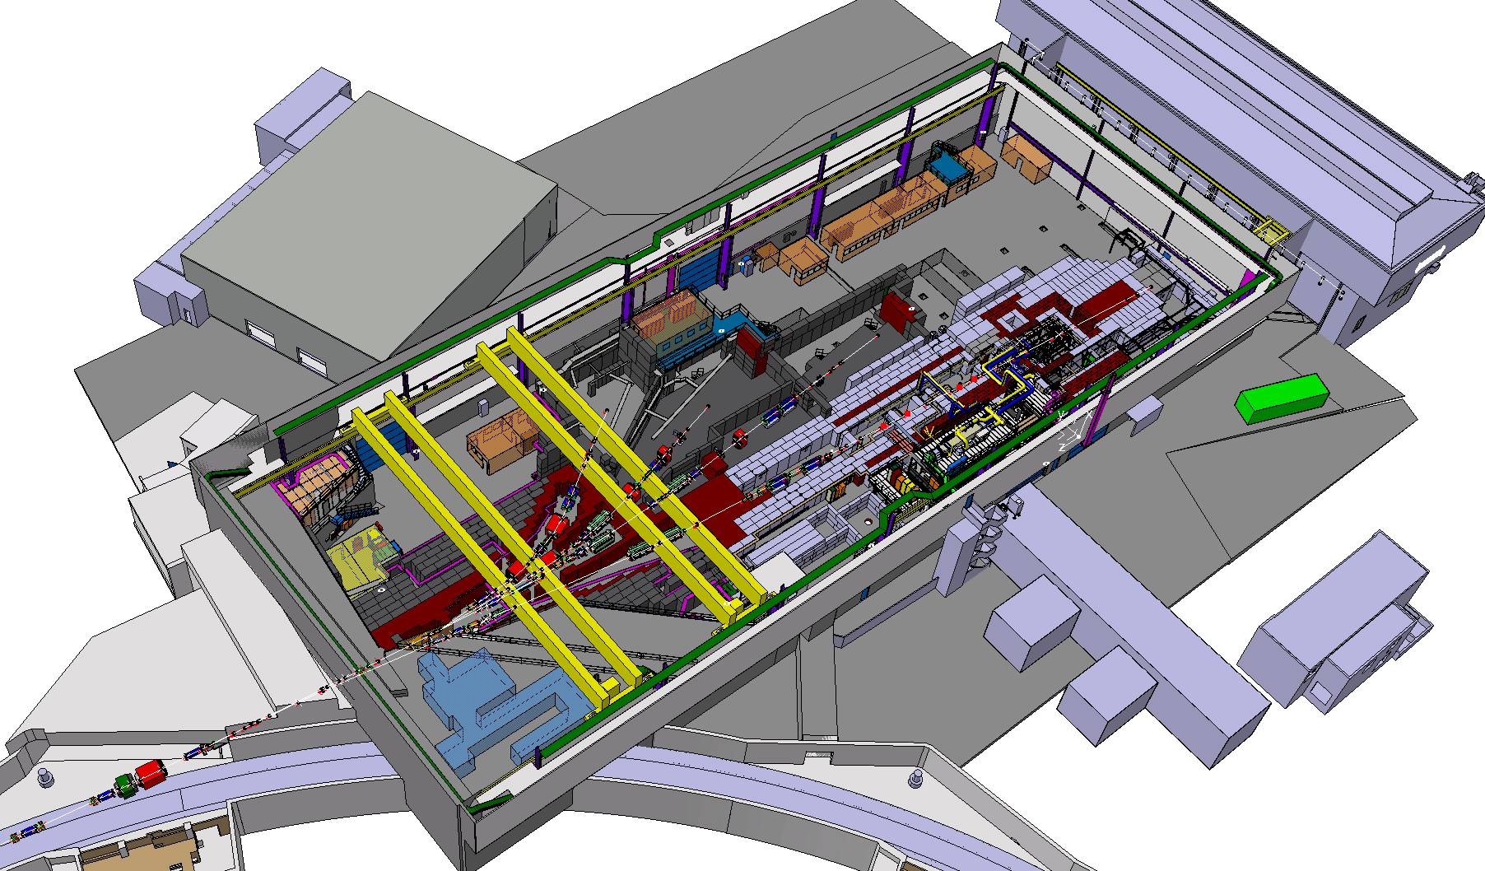
THANKS FOR YOUR ATTENTION ! QUESTIONS ?

