Slide 1

Database consistency verification for CMS meta-data
Shubham Gupta
Lightning Talks

Slide 2


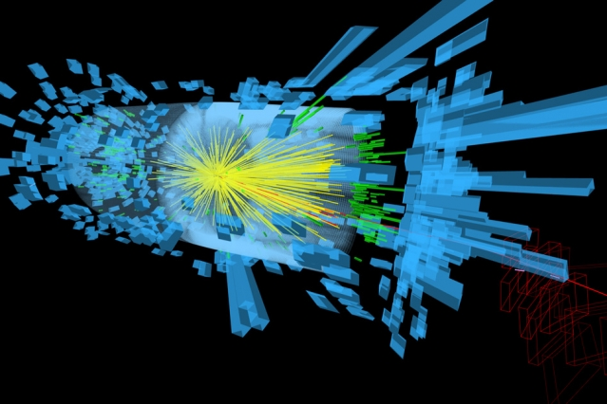
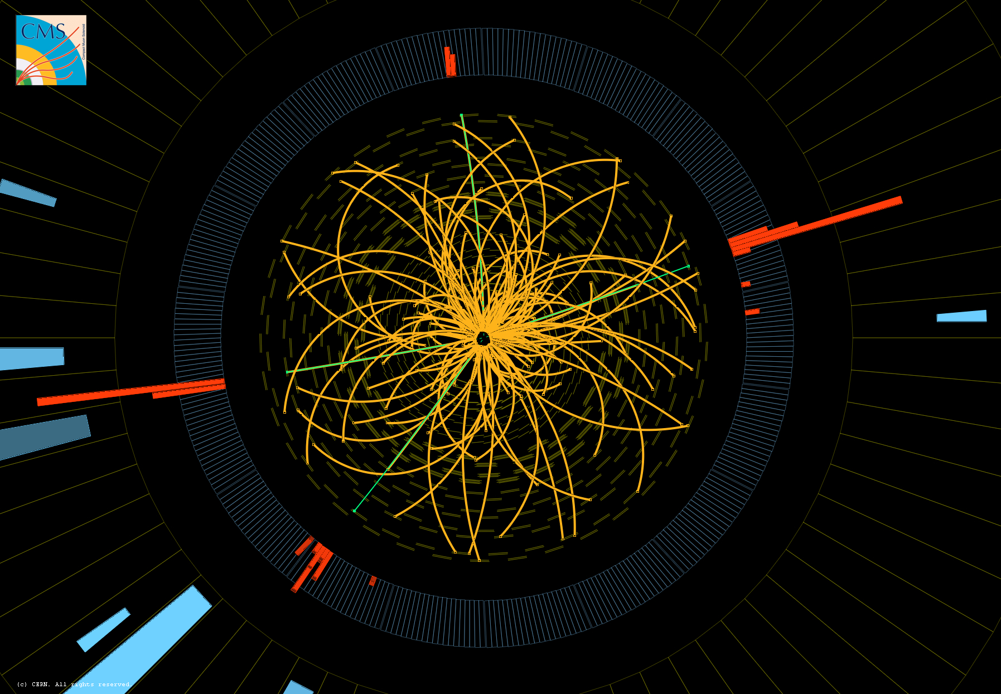
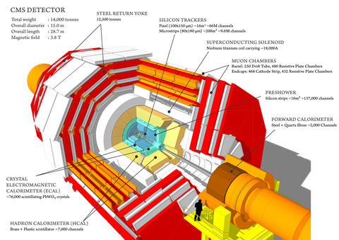
Compact Muon Solenoid

Slide 3
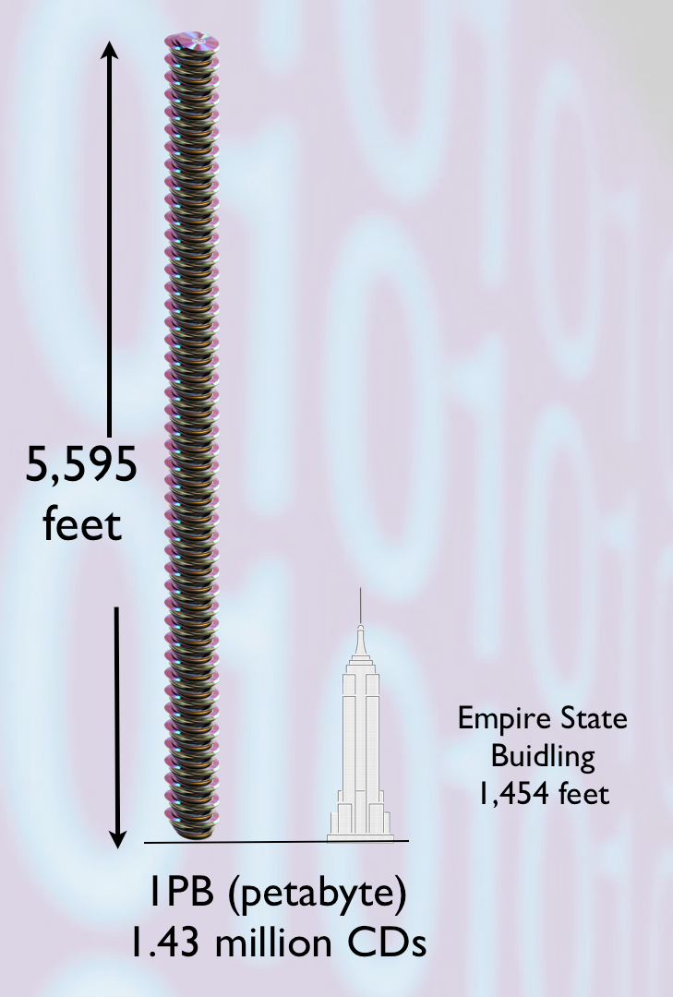

Producing Huge amounts of Data
Raw Data
600 Megabytes/second
Filtering

Slide 4
Organization of CMS Data
CMS files are grouped in blocks and datasets. Their meta data is stored in both DBS and PhEDEX.
Parameters of Blocks and files such as number of files in blocks, sizes and checksums are the causes of inconsistencies.

Slide 5
Meta Data
Metadata is data that describes data.
DBS PhEDEX
The CMS Data Bookkeeping Service (DBS) provides databases and services to store and access
metadata related to the CMS physics event data.
The Physics Experiment Data Export (PhEDEx) manages global data transfers for CMS over the Grid in a robust, reliable, and scalable way.
meta-data catalog of the data produced in CMS,
catalog of data placement

Slide 6

The Problem
Database consistency verification for CMS meta-data
Due to internal workflow organization some information may not be in sync between these databases, e.g. the number of files in each dataset etc.
Human Error

Slide 7
“Inconsistency is the only thing in which men are consistent. ”
-Horace Smith
(Inventor)

Slide 8
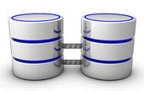
The Goal
Developing a cross-consistency tool to get periodic updates about database discrepancies.

Slide 9
The Plan
Developing Procedures in oracle database to perform tasks.
Extraction of data
Parsing data fields
Comparison of Data
Storing Results in tables
Repeat all of this for Blocks, Files and invalid data blocks.
Develop a CLI to produce CSV result files.

Slide 10
Scale
Started with test procedures to get an idea about time taken to traverse and compare the databases.
Size Comparison:
DBS – 5 Million Blocks, 70 Million Files
PhEDEX – 4 Million Blocks , 53 Million Files

Slide 11
Some of the Choices
Usage of implicit cursors instead of explicit cursors, using indexed columns for searching.
The python CLI is also made with the help of Argparse and is designed to be able to handle multiple types of queries.

Slide 12
Results
The number of inconsistencies was 966,142 inconsistent blocks of which 133,643 were found to be invalid. 104,868 blocks have differences in file count, size or block open/close status
Most inconsistencies are with the oldest data.

Slide 13

Current position
Ready Now.
CSV files produced on demand.
Expected to be regularly to resolve inconsistencies.

Slide 14


Future
Using spark and hdfs and compare its performance with the Oracle tools to obtain the best performing Solution among them.

Slide 15
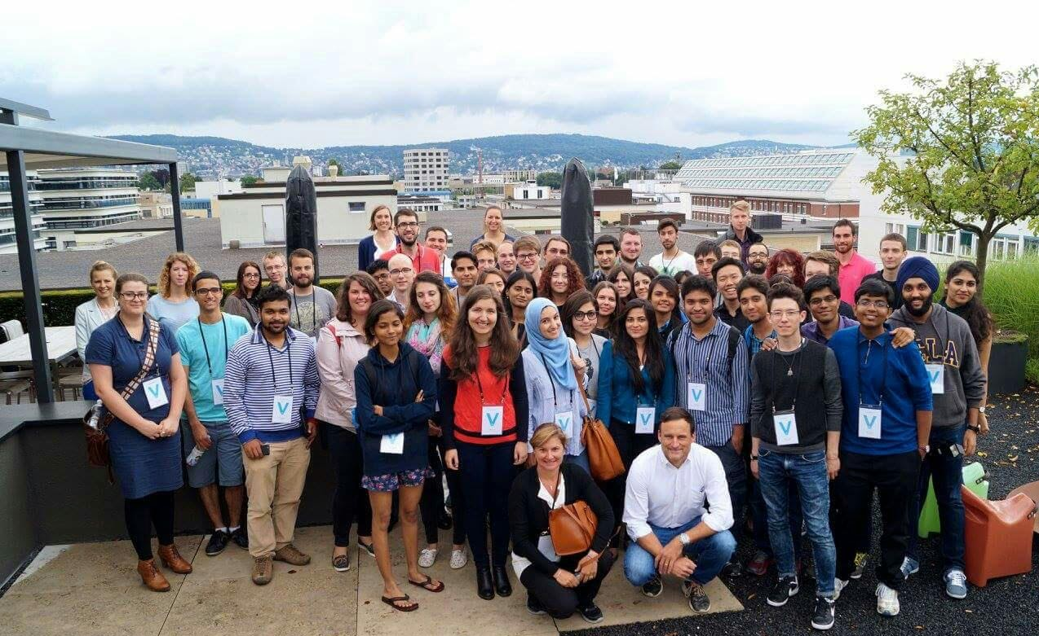
A journey measured in Friends

Slide 16


Thank you !
Special thanks to Valentin, Kate and Nicolo for guiding and helping me out through my journey here.
@shubham0075_1
shubham0075@gmail.com
Fb.com/shbhm

