Slide 1
OAuth protocol for CERN Web Applications
CERN openlab Summer Student
Supervisor: Luis Rodriguez Fernandez
IT-DB-IMS
Emil Kleszcz (emil.kleszcz@cern.ch)
18/08/2016

Slide 2



Goals
How CERN Java Web Application can make use of OAuth2 protocol?
Comparison of SAML2 and OAuth2 protocols,
Providing SSO (Single Sign-On),
Integrate with current infrastructure.

Slide 3

Challenges
Find the best solution: easy to maintain and secure
SAML2 has some limitations:
  For instance, logout protocol session fails if one or more participants fail in the session (solution delete cookies)

Slide 4
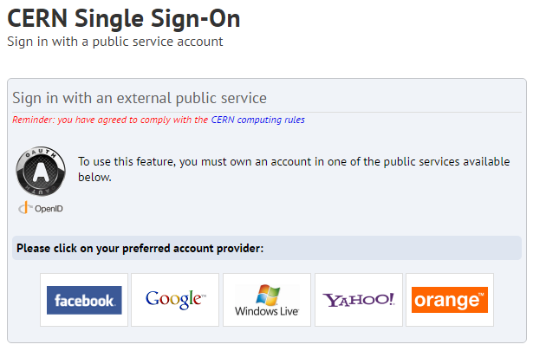
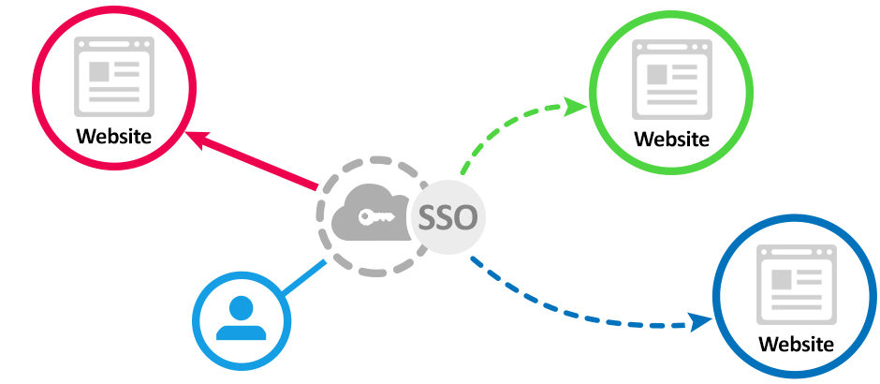
Single Sign-On (SSO)

Slide 5
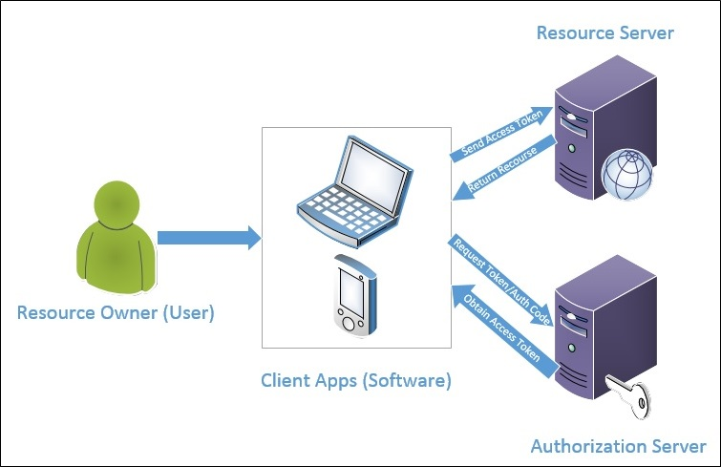
OAuth2

Slide 6
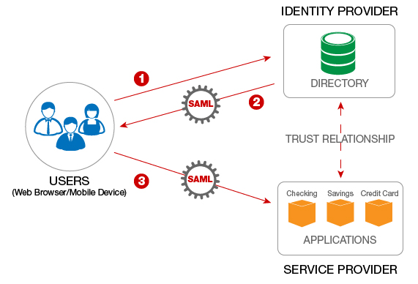
SAML2

Slide 7

Best solution?

Slide 8

Comparison (pros & cons)
OAuth 2.0 - simpler and more standardized solution (native),
SAML2 - more complete specification (web),
Both work fine for SSO,
They are complementary.

Slide 9




Results & Future
Proof of Concept: github.com/tr0k/OAuth2LibPoc
Entries on blog (db-blog.web.cern.ch)
Testing on Oracle Java Cloud

Slide 10

Thank you for attention ☺

