Slide 1
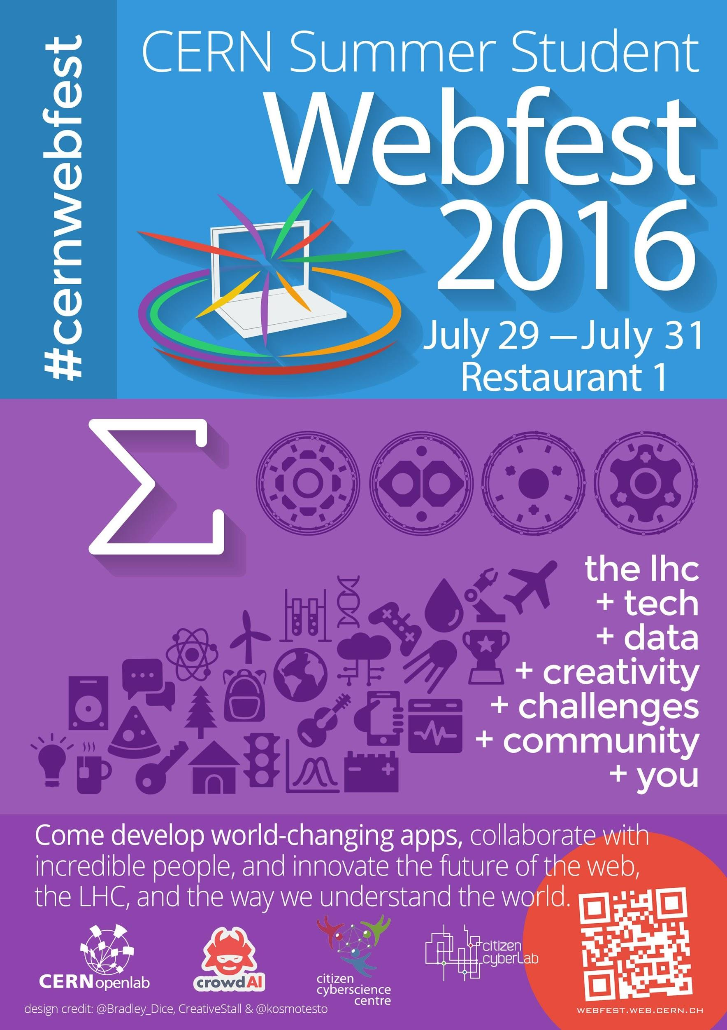
☺
S.P. Mohanty
<sp.mohanty@cern.ch>

Slide 2
Hackathon ?
¯\_(ツ)_/¯
What’s that ?

Slide 3
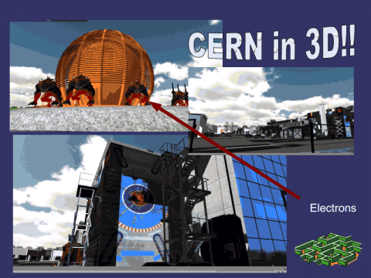
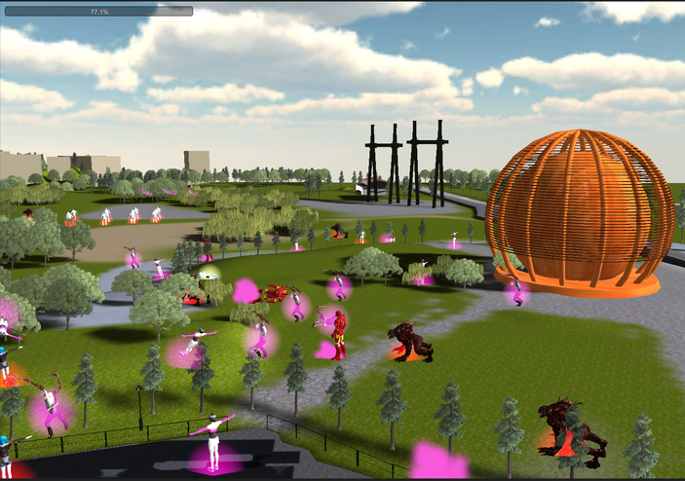
Mother Hunt

Slide 4
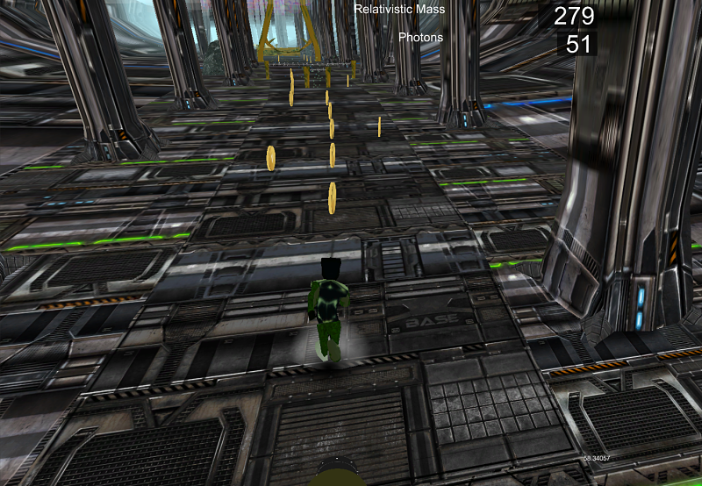
Brother Hunt

Slide 5
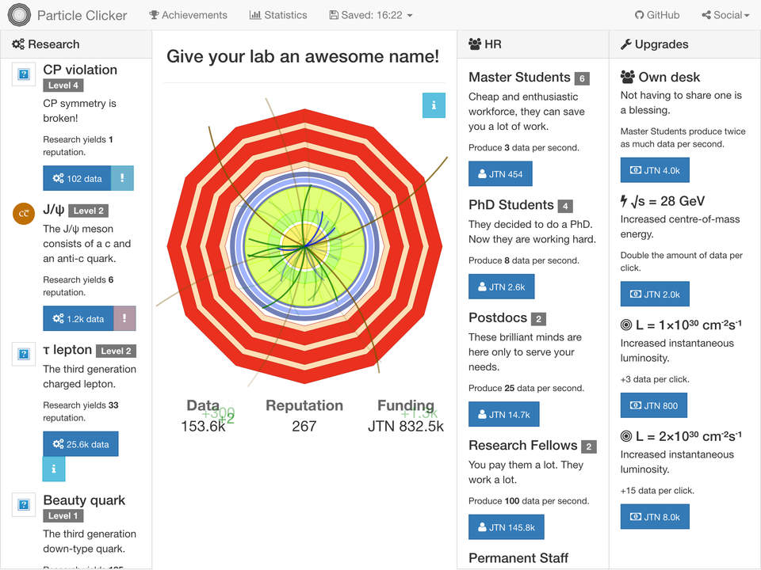
Particle Clicker

Slide 6
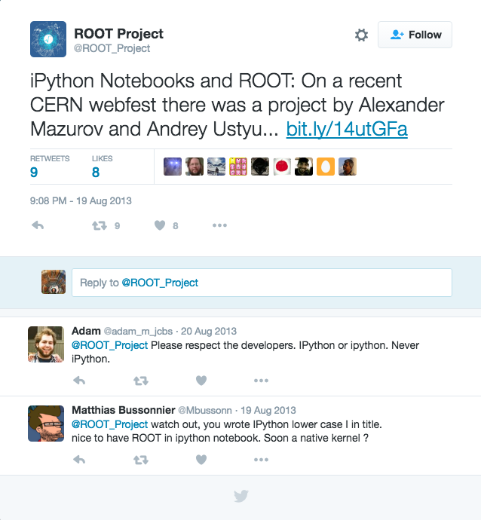
ROOT in your Browser ?

Slide 7
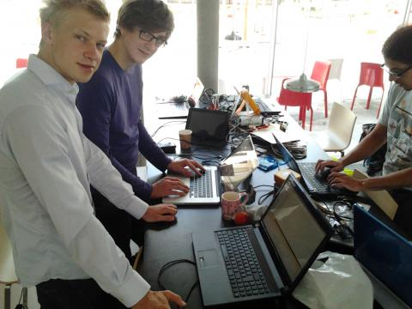
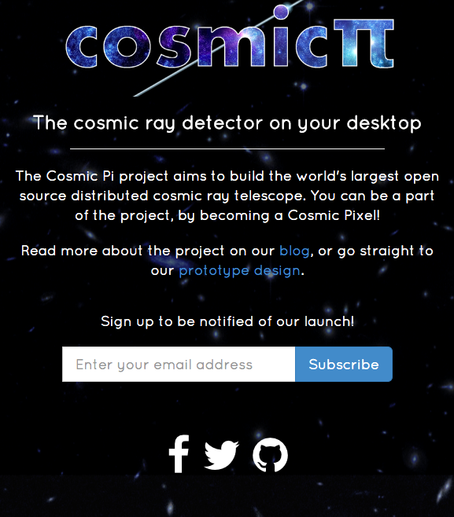
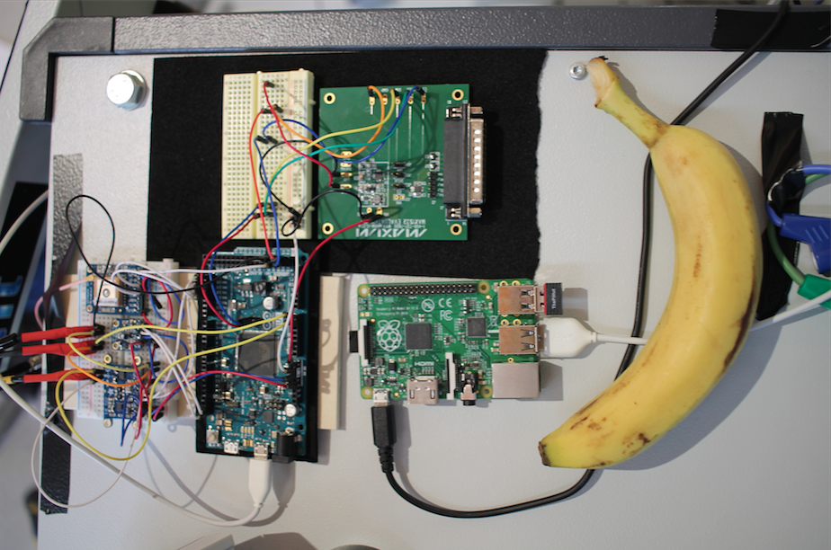
CosmicPI
http://cosmicpi.org/

Slide 8
What’s common to all of them ?

Slide 9
What’s common to all of them ?
They were NOT created by professional engineers/developers/designers !!

Slide 10
What’s common to all of them ?
They were imagined by Summer Students like YOU !!
They were created by Summer Students like YOU !!

Slide 11
Hackathon ?
o.O
What’s that ?
You come to a Hackathon with an idea....that you are passionate about !!
Then you figure out how to build it over a weekend !!
Or team-up with others who can
And learn a ton along the way……...

Slide 12
And why would you do that ?

Slide 13
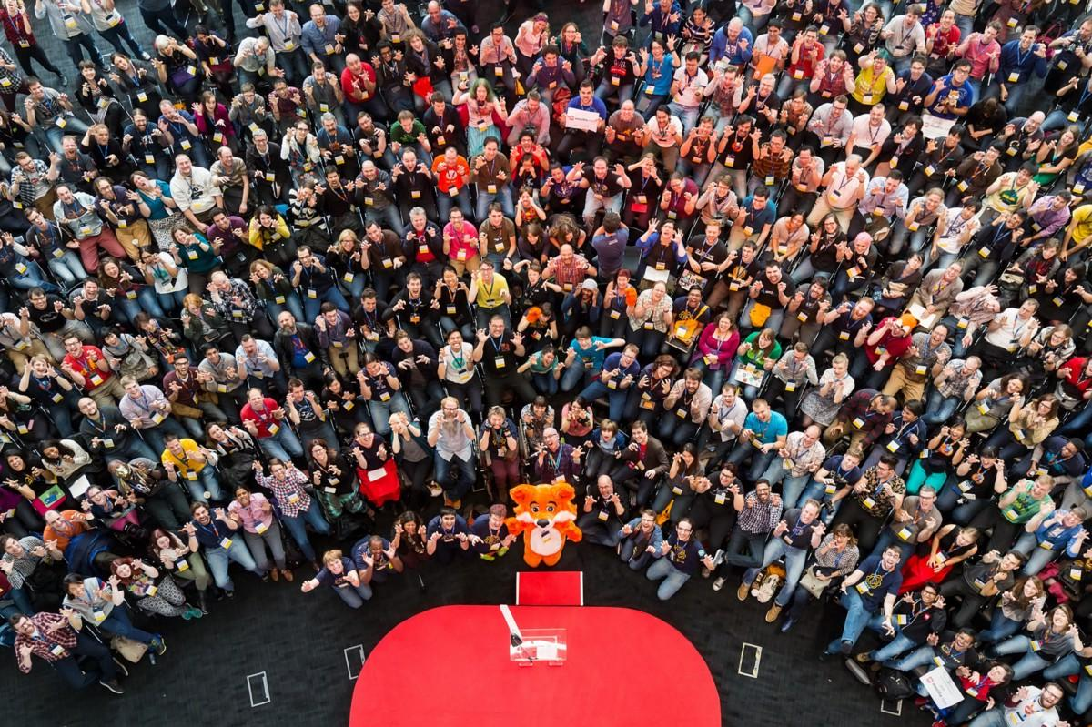
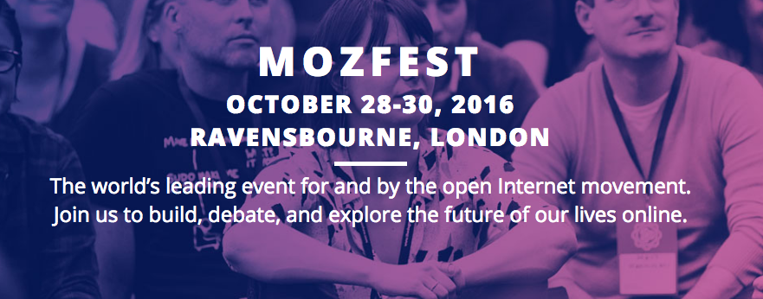
Prizes
+
Bragging
Rights
Image Source : https://blog.webmaker.org/

Slide 14
Ideas Pitching Session
July 29th(Friday), 16:00-18:00
@
IdeaSquare, CERN http://cern.ch/webfest

