Slide 1
LiC Detector Toy

Slide 2
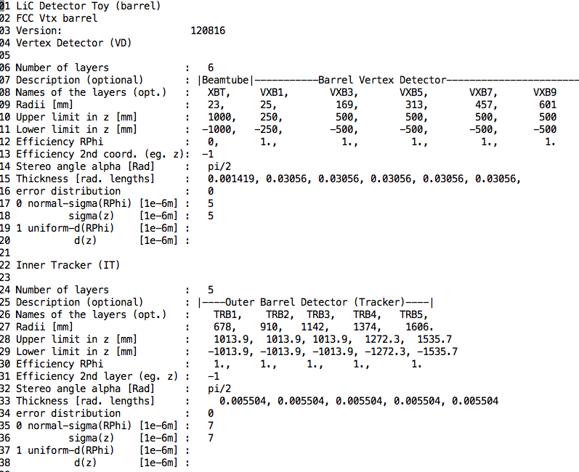
thickness should be 0.03
keep CLIC tracker thickness by now

Slide 3
BARREL region
New FCC vertex
+ tracker baseline
311 Vertex variation
Log Vertex variation

Slide 4
Pt scan (at theta=80)
Nominal
311
Log
Notes:
add tracker
log eom
add fwd disks
check inner length in z

Slide 5
Theta scan (at Pt=100 GeV)
Nominal
311
Log

Slide 6
ENDCAP
still having some trouble with definig endcap geometry, but my plan is to compare the following:

Slide 7
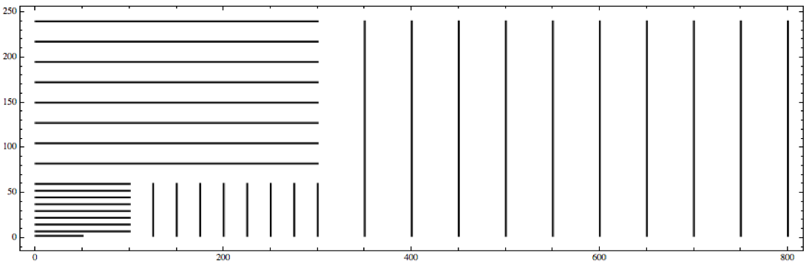
2. keep vertex detector radius and length
remove half of the layers
disclaimer: for illustration purpose only

Slide 8
4A. keep vertex detector radius and barrel length
remove half of the layers
keep tracker endcap separation

Slide 9
5A. keep vertex detector radius and shorten the barrel
remove half of the layers
one more pixel endcap layer

Slide 10
And then one can fine tune the distance to avoid gaps and keep number of hits as constant as possible

Slide 11
4B. keep vertex detector radius and barrel length
remove half of the layers
variable z spacing in tracker endcaps to keep # hits constant

Slide 12
5B. keep vertex detector radius and shorten the barrel
remove half of the layers
one more pixel endcap layer
variable z spacing in tracker endcaps to keep # hits constant

Slide 13
How large (in radius) should the vertex detector be so that most b-hadrons from 5TeV bjets decay inside it?

Slide 14
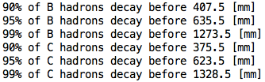
B-hadrons
C-hadrons
10TeV bjets
R(x,y)
pT
Theta
cut 0.5 – 2.5
N b-hadrons (before any cut)
N b-hadrons (after cut)

Slide 15
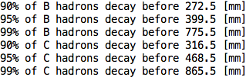
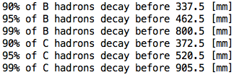
B-hadrons
C-hadrons
5TeV bjets
R(x,y)
pT
Theta
cut 0.5 – 2.5
N b-hadrons (before any cut)
N b-hadrons (after cut)

Slide 16
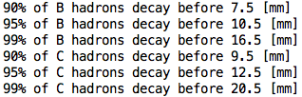
B-hadrons
C-hadrons
50 GeV bjets
(for comparison)
R(x,y)
pT
Theta
cut 0.5 – 2.5
N b-hadrons (before any cut)
N b-hadrons (after cut)

Slide 17
Can we use truth (cheat) tracks for reference in the tracking strategies optimisation?

Slide 18
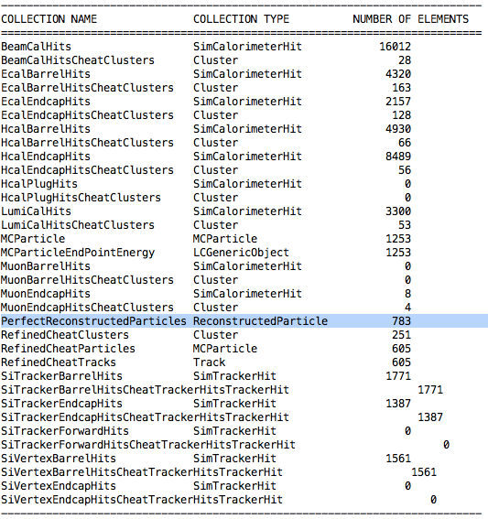
Managed to get Cheat Reco Particles
FCC_bb_50_V2ppHadMSTP8120MSTP611MSTP711_12_clic_fccvtx_barrel-prod1

Slide 19
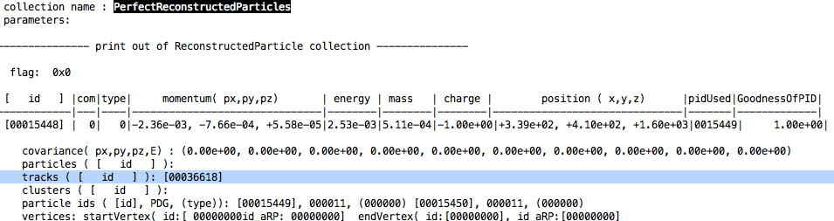
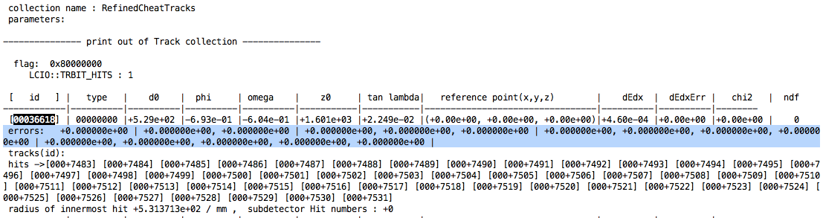
in lcsim cheat Tracks do not have an covariance matrix
FCC_bb_50_V2ppHadMSTP8120MSTP611MSTP711_12_clic_fccvtx_barrel-prod1

Slide 20
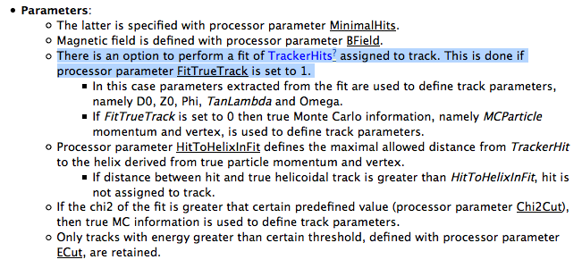
in Marlin yes, but not in lcsim
http://fpmac116.usc.es/twiki/bin/view/ILC/Cheaters

Slide 21
Backup

Slide 22
1. scale down full tracker, and remove half of the layers
(should not shrink the space for the services !?)
disclaimer: for illustration purpose only

Slide 23
3. keep vertex detector radius and barrel length
remove half of the layers
keep tracker endcap separation

Slide 24
keep vertex detector radius and barrel length
remove half of the layers
optimize position to keep # of hits constant

Slide 25
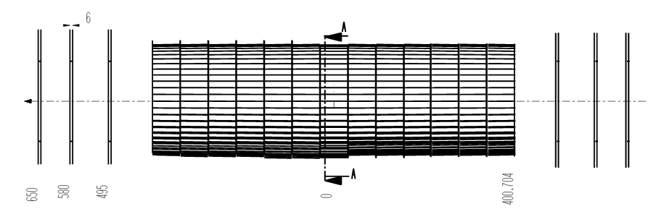
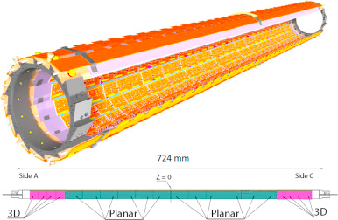
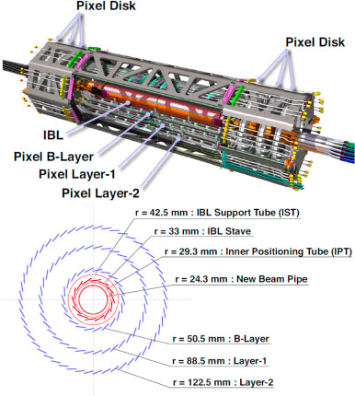
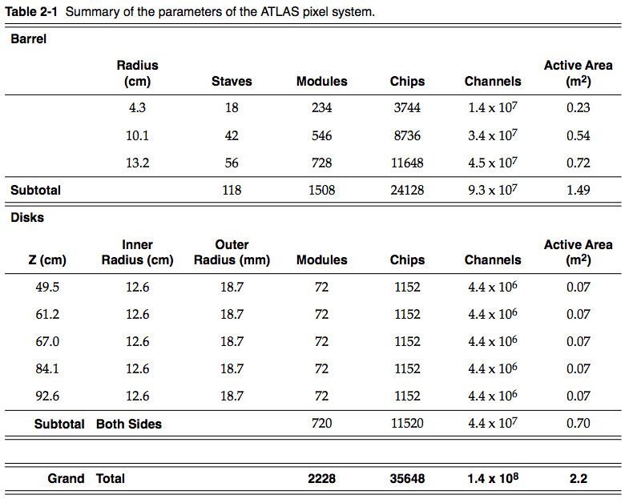
ATLAS
Run 1: With a total length of approx. 1.3 m this layout results in a three-hit system for particles with |η|<2.5.
z(IBL)=724/2=362
z(others)=400 mm
(half length)

Slide 26
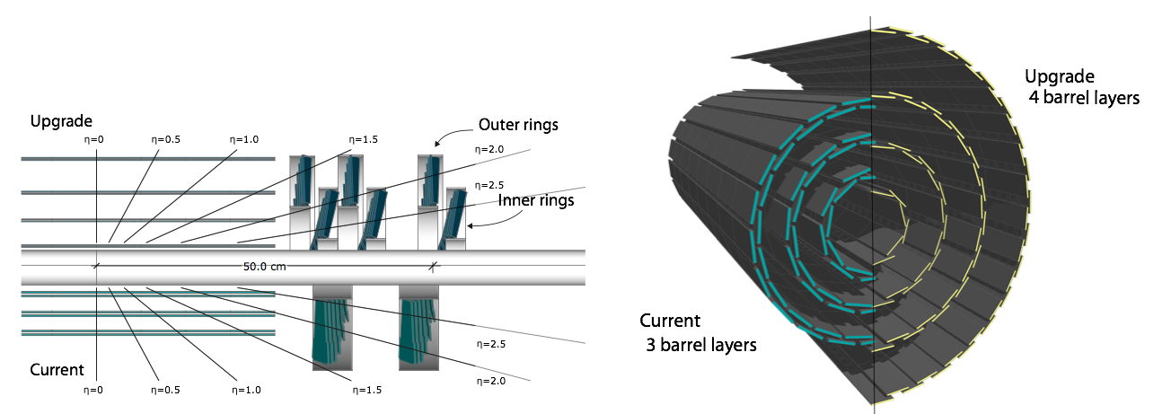
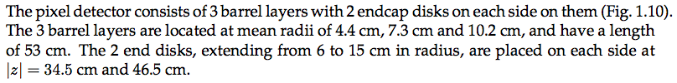
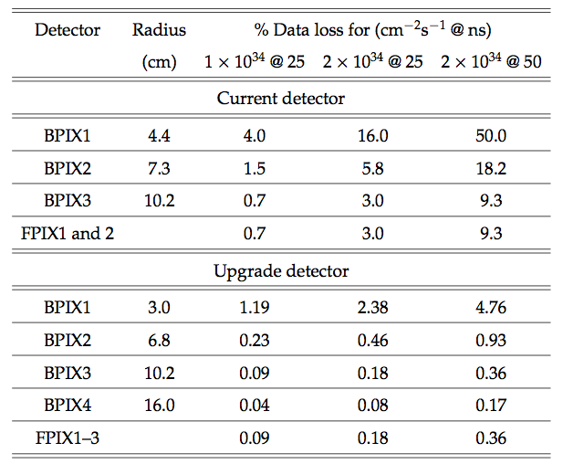
CMS
z=530/2=265 mm (half-length)

Slide 27
New FCC vertex + tracker baseline
New FCC vertex baseline
+ squeezed CLIC tracker
New FCC vertex baseline (No Tracker)

Slide 28
Pt scan (at theta=80)
Notes:
add tracker
log eom
add fwd disks
check inner length in z
read description of the plots in documentation
what is the magnetic field in the fwd

Slide 29
Theta scan (at Pt=100 GeV)

Slide 30
Vertex Geometries
1-1-1-1-1
3-1-1
2-1-1-1
2-1-1-1
2-2-1
2-2-2

Slide 31
Pt scan (at theta=80)

Slide 32
Theta scan (at Pt=100 GeV)

Slide 33
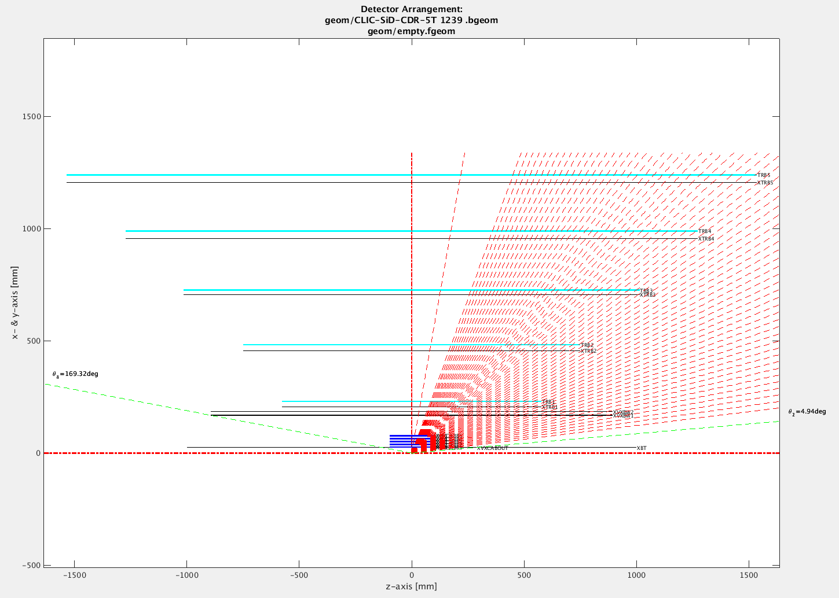

Slide 35
Change of FCC baseline
 | FCC current | FCC new | CLIC SiD
tracker env. max R | 2.5m | 1.7m (last layer 1.6?) | last layer 1.2m
Vertex last layer R | 60 cm | ? | 7.7 cm
N vtx layers | 9 | ? (total tracker =10) | 5
tracker env. max L/2 | 8m | 5m | 0.9m
What N layers and max R assume for the Vtx detector?
Notes:
----- Meeting Notes (4/8/16 14:51) -----
z spread of the pv
contact expert in lhc
bunch lenght similar, increade it
7.55 cm 1 sigma RMS bunch lenght
look at today's vertex detectors
sqrt 2 smaller.

Slide 36
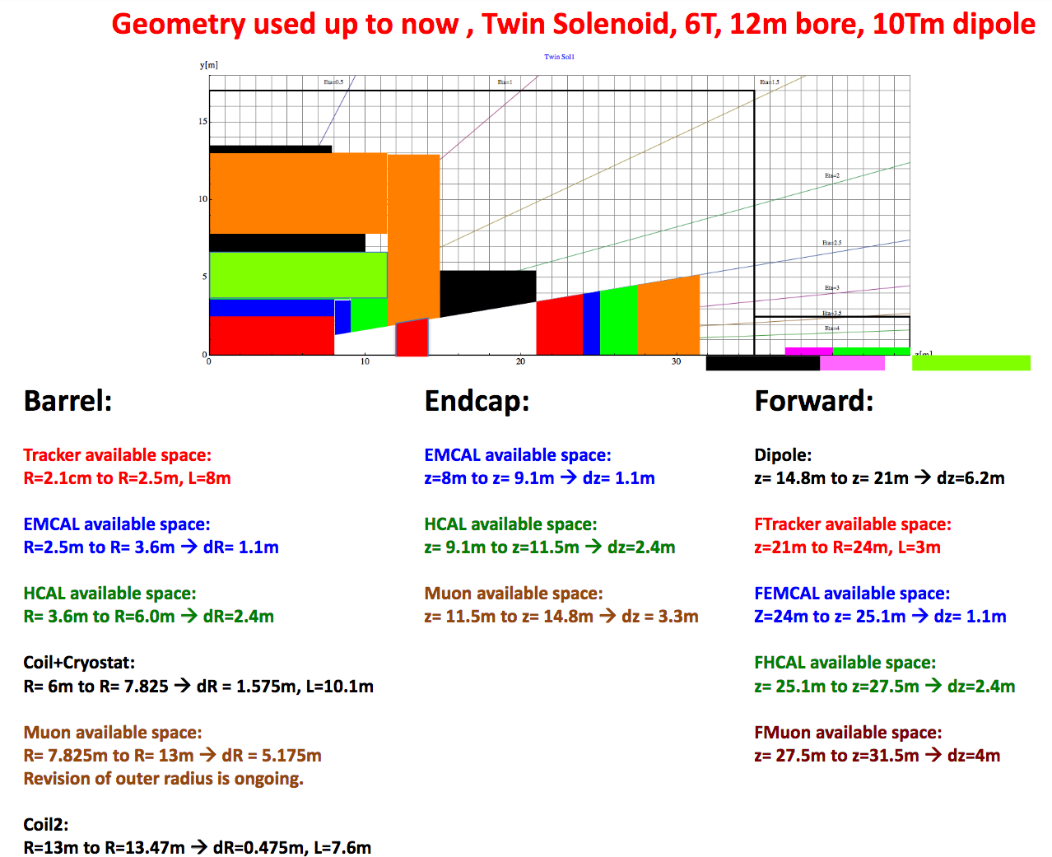

Slide 37
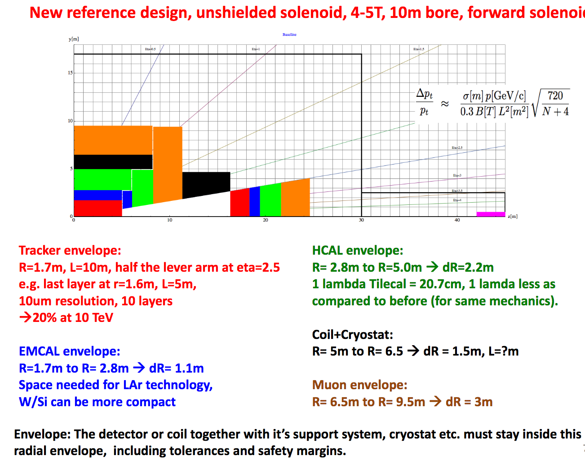

Slide 38
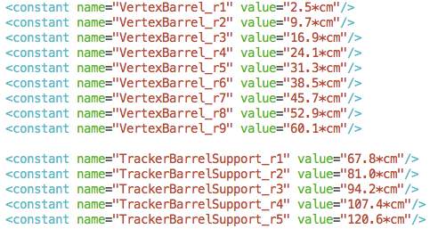
current FCC vtx detector layout
TRACKER
VTX: 9 layers, max radius 60 cm

Slide 39
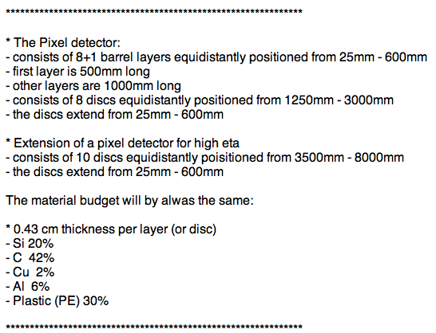
Current FCC Vertex Layout

Slide 40
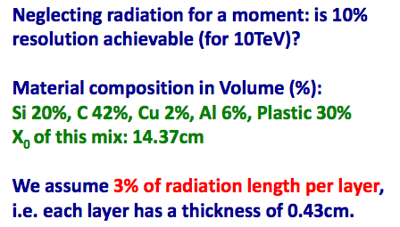
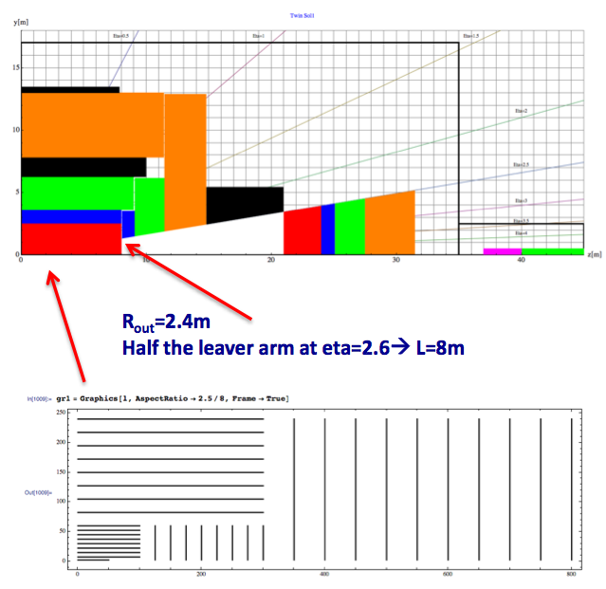
1m half length ?!?

Slide 42
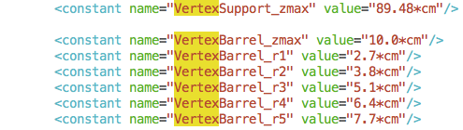
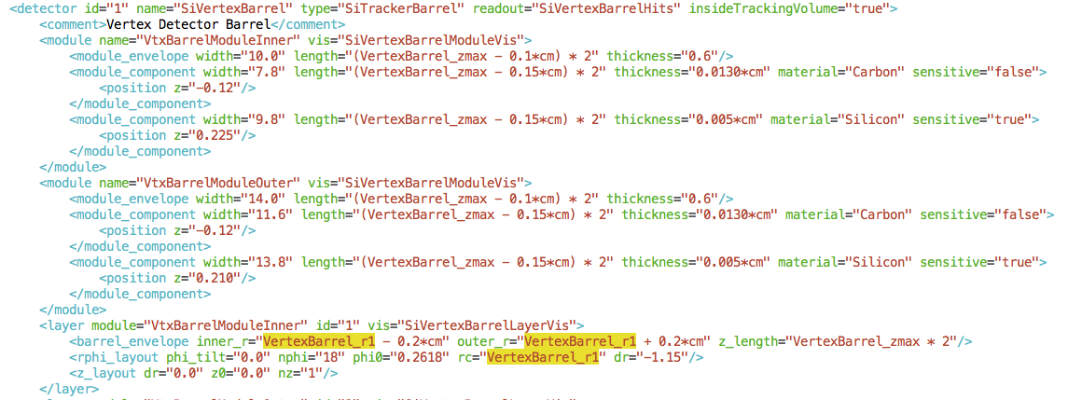
clic sid cdr

Slide 43
New FCC vertex + tracker baseline
Current FCC vertex baseline
+ squeezed CLIC tracker

