Slide 1
Tracking strategies

Slide 2
Very high pT b-jets have very displaced SV
Tracks with high D0 are not reconstructed in the std strategies
-> Loosen criteria on track reconstruction
Single mu- tracks
Dijet events

Slide 3
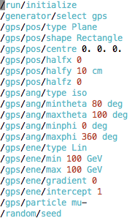
1) single tracks
generate displaced single muons
In the line y=0 to y=10cm
E=100 GeV
theta=90+/-10 degrees

Slide 4
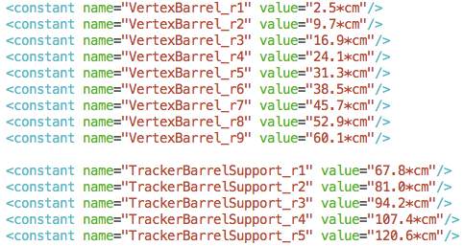
FCC“current” vtx baseline
9 vertex layers R from 25mm to 600mm
tracker: squeezed clic SiD

Slide 5
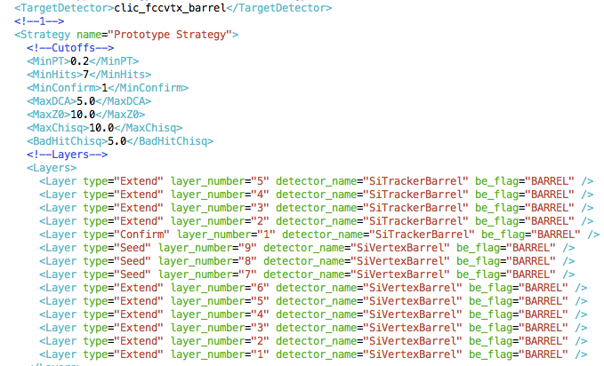
Standard strategies

Slide 6
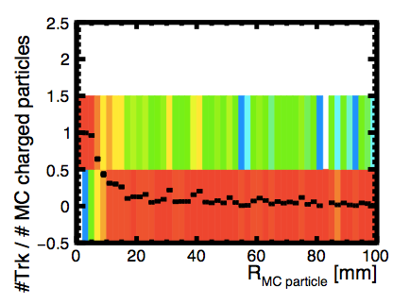
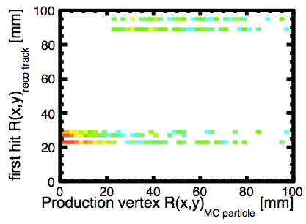
single muon, std strategies
Tracking efficiency at high R drops due to cutoffs in tracking strategies
How good is the mc particle to track matching? are there fake hits?
compare the mc production vertex transverse radius to the (transverse?) radius of the innermost hit used in the track reconstruction
tracks below diagonal have fake hits

Slide 7
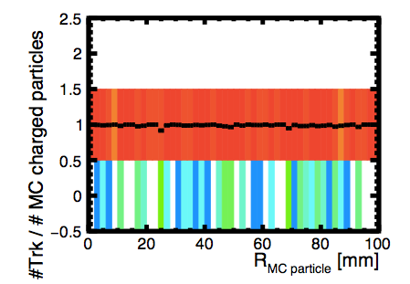
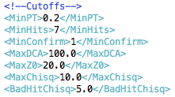
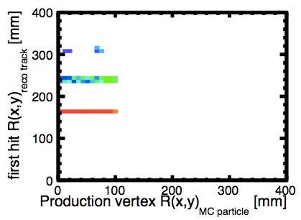
single muon, mod strategies
fully efficient
(Notice different scale!)
Innermost hit used in the tracks moved out..
due to strategy training, inner hits are not used even if they are (probably) there!?
(not understood yet)

Slide 8
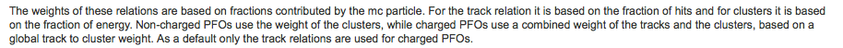
2) dijet events
MC part selection:
  generator status ==1
  charge !=0
  central in theta
  (pT>1GeV)
MC particle to track matching
  use TrackMCTruthLink collection
  weight of the link > 0.5 && < 1.0
    fraction of hits in the track that come from that mc particle
    why can the weight be >1?
  if mc particle matched to more than one of such tracks, ignore mc particle

Slide 9
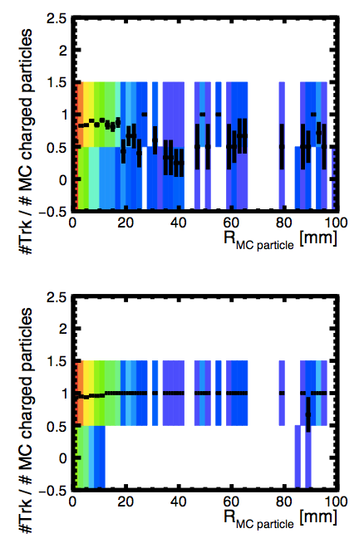
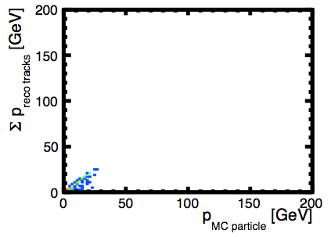
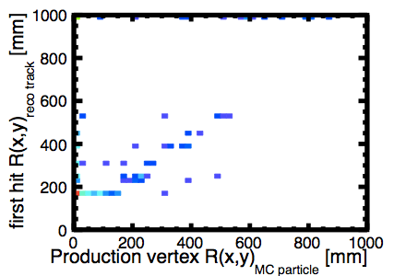
50 GeV b-jets, modified tracking, fcc geo
Efficient for tracks with pT>1GeV
Not many fake tracks
    (using only 200 evts)
mcp pT>1 GeV
mcp pT>1 GeV
mcp pT>1 GeV

Slide 10
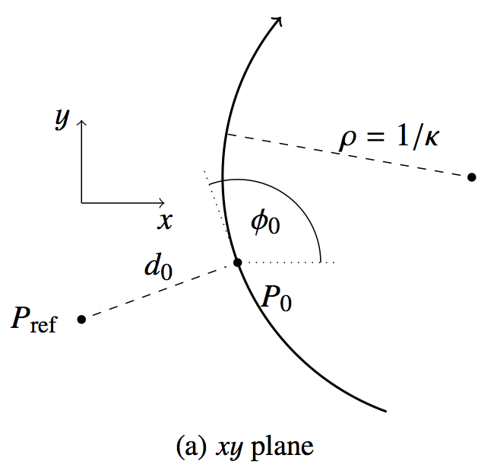
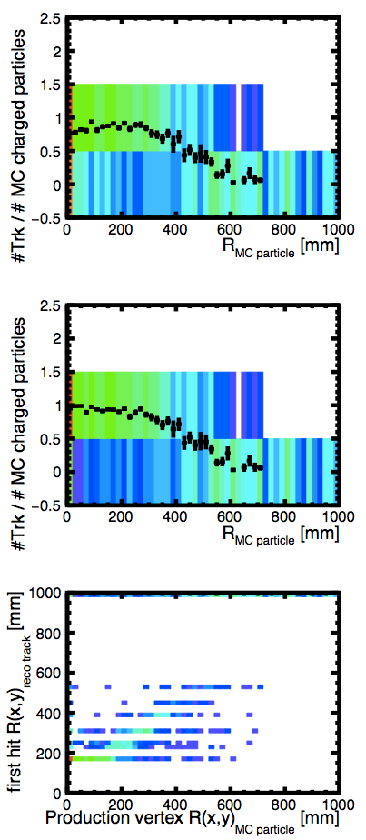
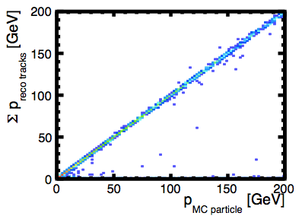
5000 GeV b-jets, modified tracking, fcc geo
(notice different x axis range)
very efficient for pT>1GeV below R<100mm
Continues to be efficient up to R~300mm
More fake hits
R
mcp pT>1 GeV
mcp pT>1 GeV
mcp pT>1 GeV

Slide 11
Next steps
Understand why inner layers are not used at all
Quantify fake hits & tracks
Find a compromise: eff for large R vs fakes
look at SV efficiency & resolution
[Some of the newest samples from Andrea seem to be with wrong kinematic cuts – ask to change and rerun]

Slide 12
LiC Detector Toy

Slide 13
Opt2
Opt4A
Opt5A

Slide 14
Theta scan (pT=100)

Slide 15
And then one can fine tune the distance to avoid gaps and keep number of hits as constant as possible

Slide 16
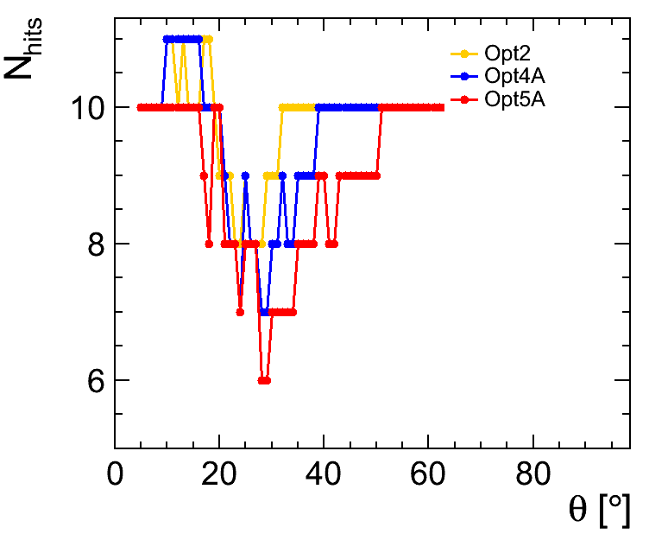

Slide 17
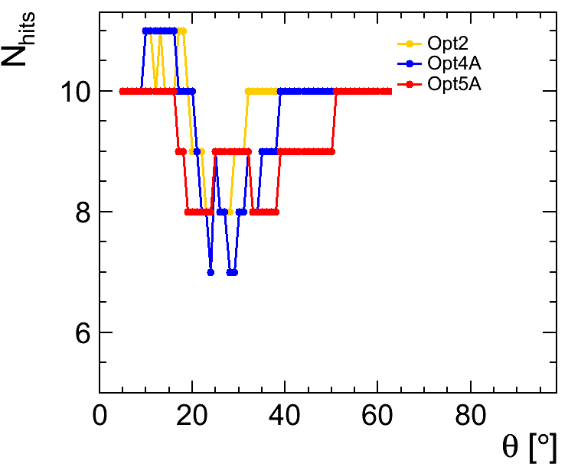
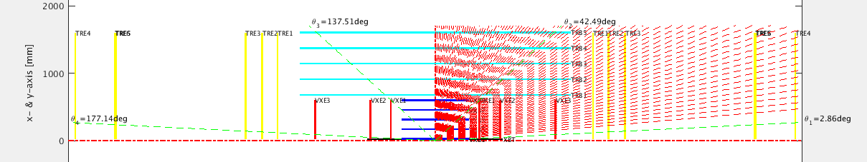
Optimized

Slide 18
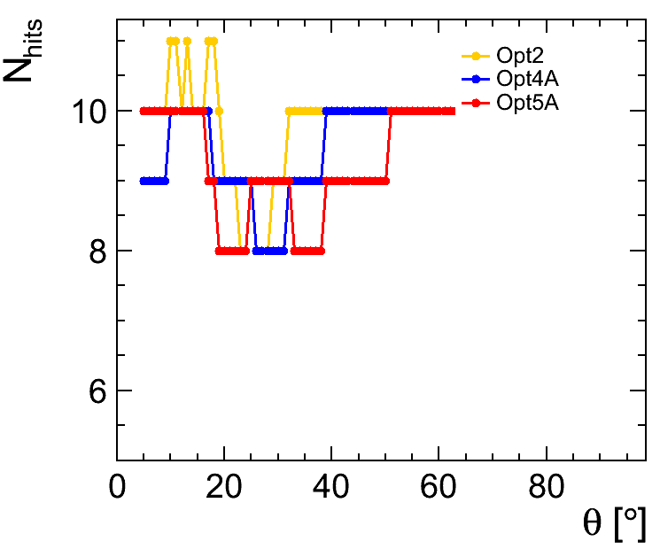
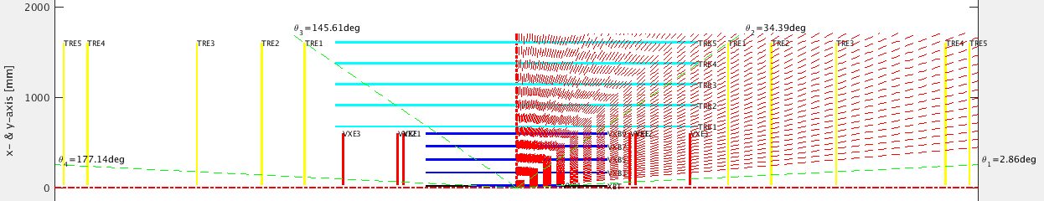
Optimized
Optimized

Slide 19
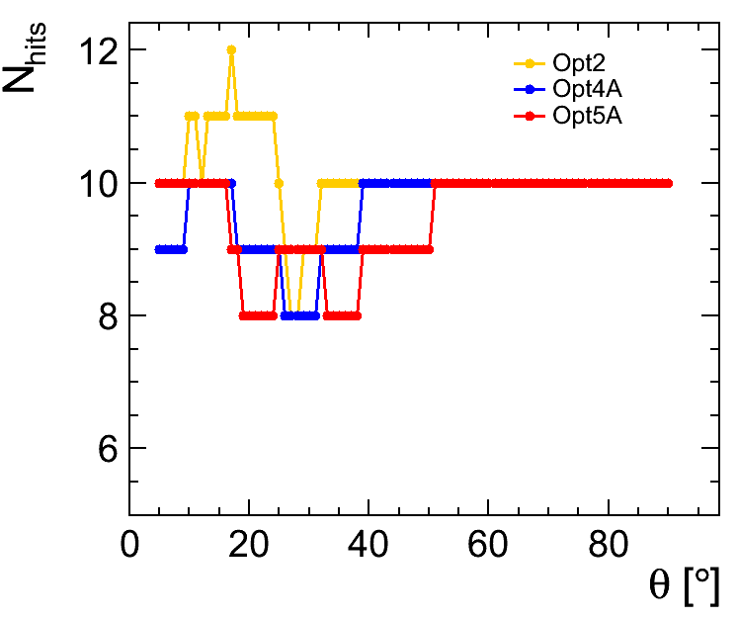
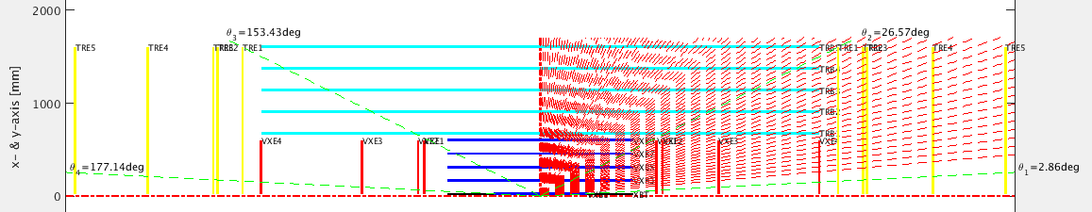
Optimized
Optimized
Optimized

Slide 20
FCC meeting yesterday
Zbynek talk on FCC tracker:
https://indico.cern.ch/event/557687/contributions/2287249/attachments/1329401/1997121/FCC-hh_tracker_Drasal.pdf
  all the relevant numbers on the fcc-tklayout web page:
    http://fcc-tklayout.web.cern.ch/fcc-tklayout/indexOption3.html
  details on the PXD (VXD) here:
    http://fcc-tklayout.web.cern.ch/fcc-tklayout/FCChh-Option3/indexInner.html

Slide 21
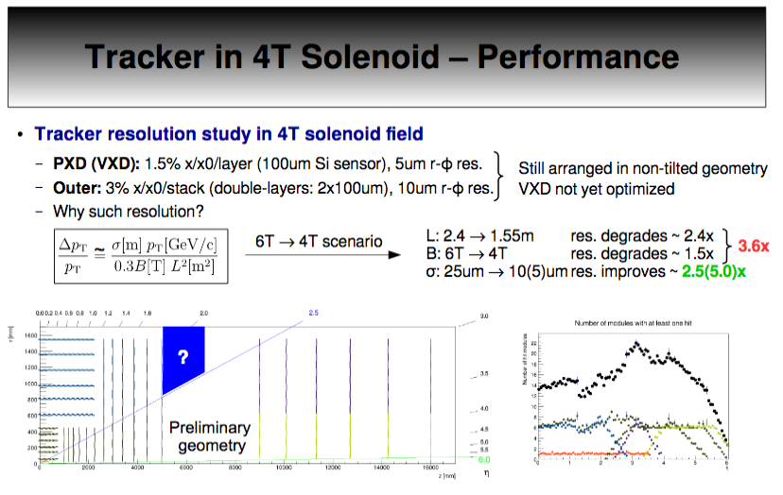

Slide 22
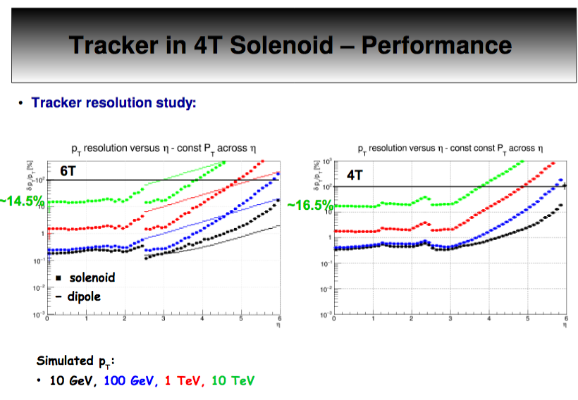

Slide 23
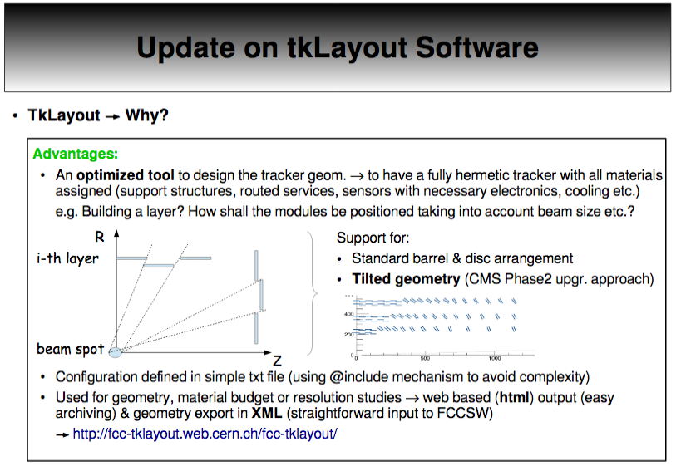

Slide 24
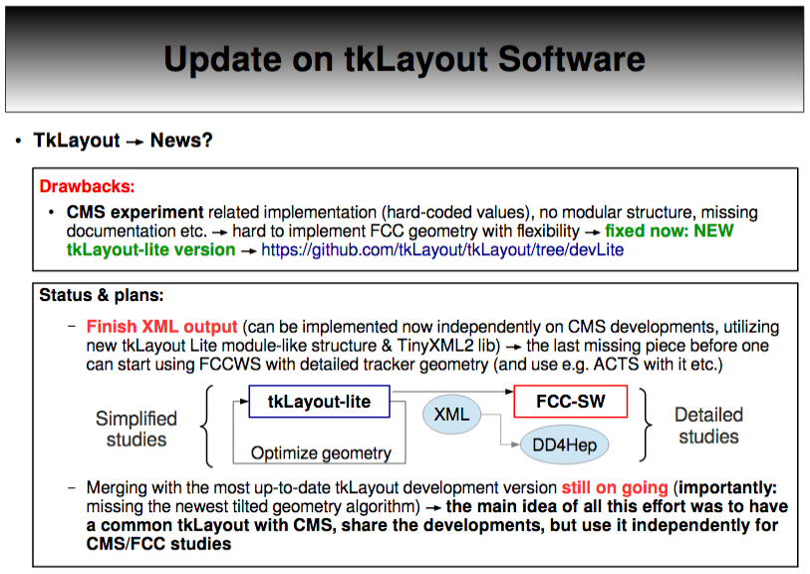

Slide 25
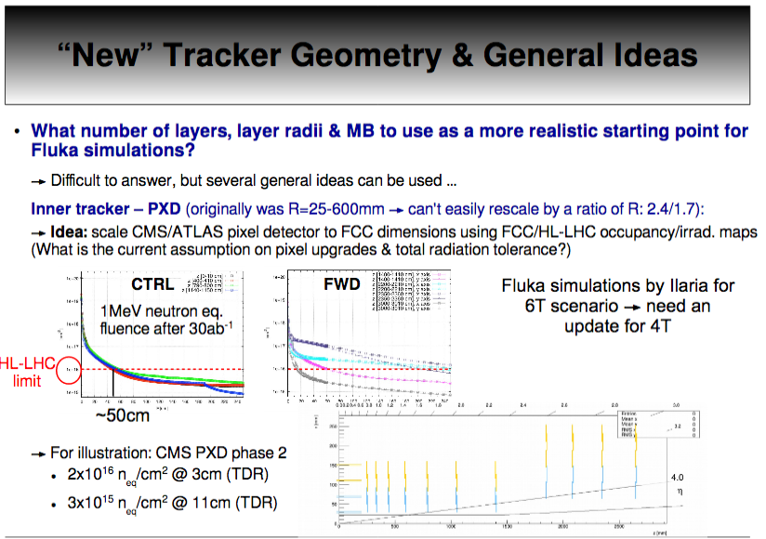

Slide 26
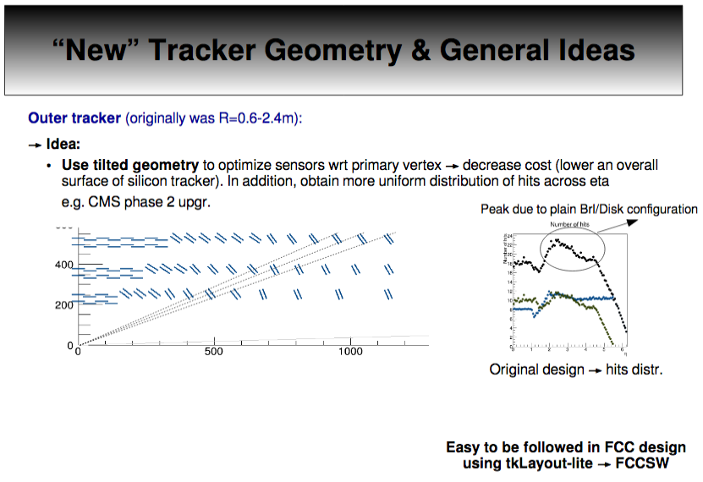

Slide 27
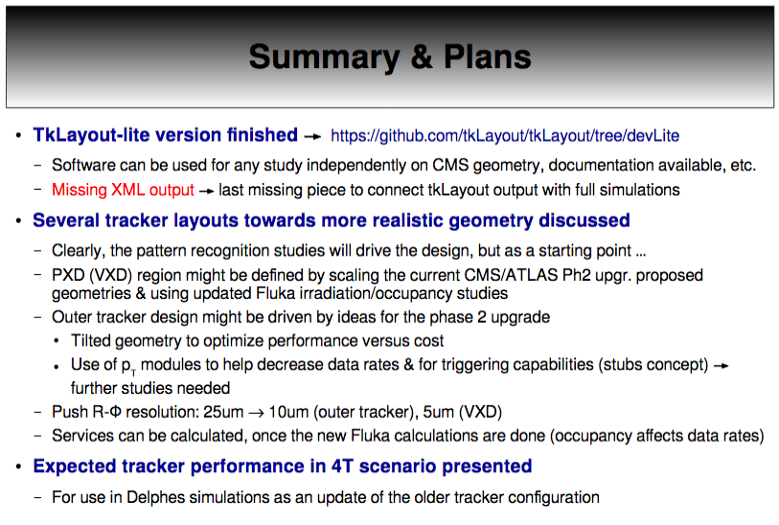

Slide 28
Next Steps
Use Zbynek lay out as baseline
  look into d0 z0 resolution
  look into different vertex layouts within those dimensions
  run full simulation on a couple of best options
  present at the next FCC meeting in end of September

Slide 29
Backup

Slide 30
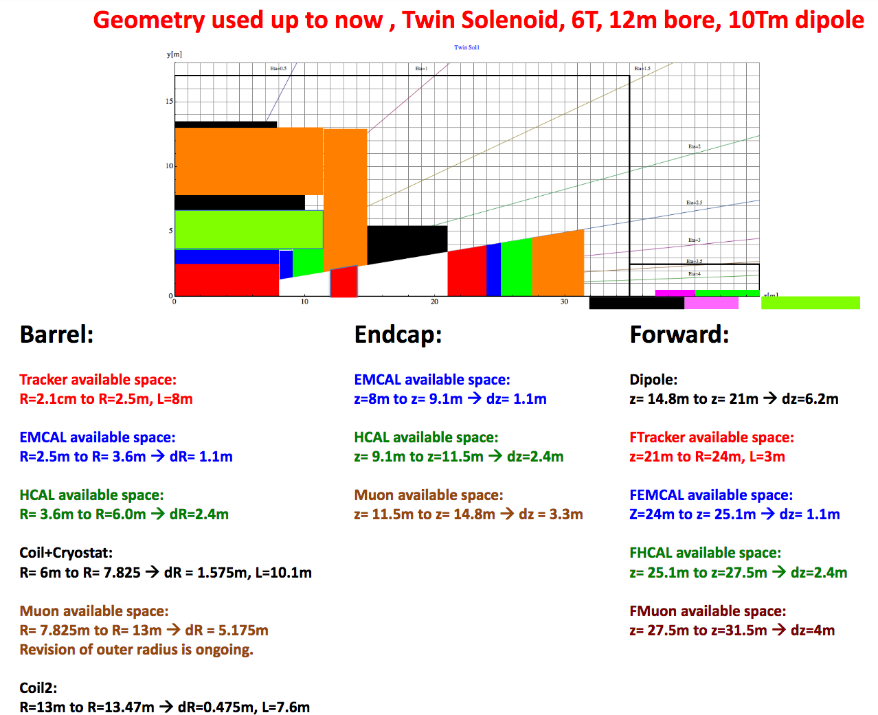

Slide 31
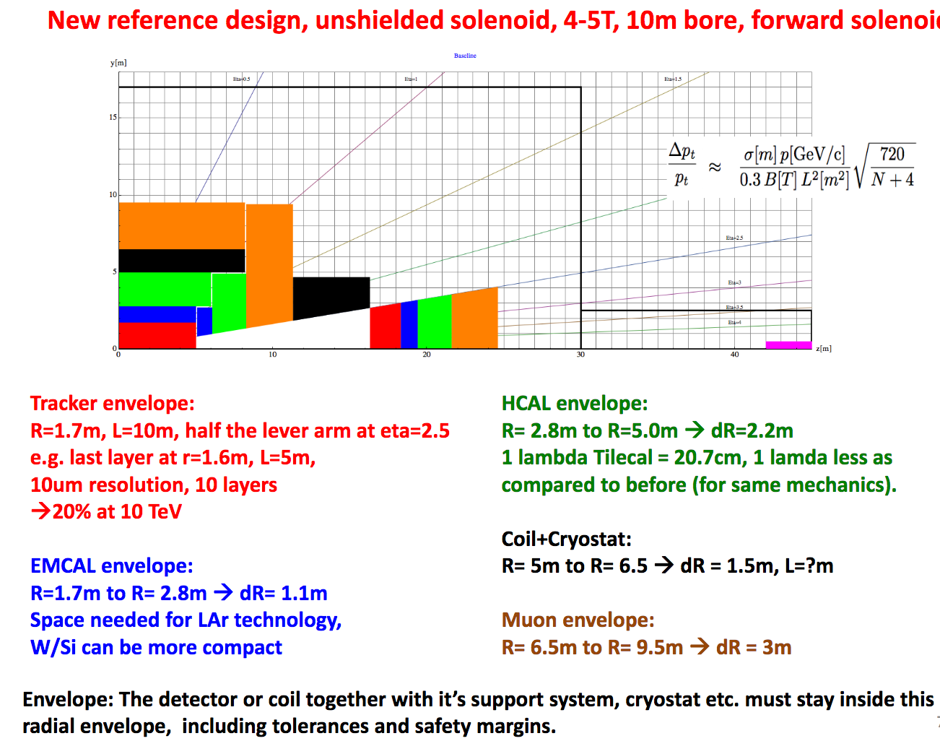

Slide 32
current FCC vtx detector layout
TRACKER
VTX: 9 layers, max radius 60 cm

Slide 33
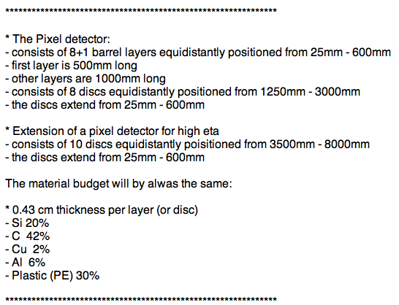
Current FCC Vertex Layout

Slide 34
BARREL region
New FCC vertex
+ tracker baseline
311 Vertex variation
Log Vertex variation

