Slide 1
Tracking Strategies
(& LiC Detector toy)
Estel Perez
15 September 2016

Slide 2
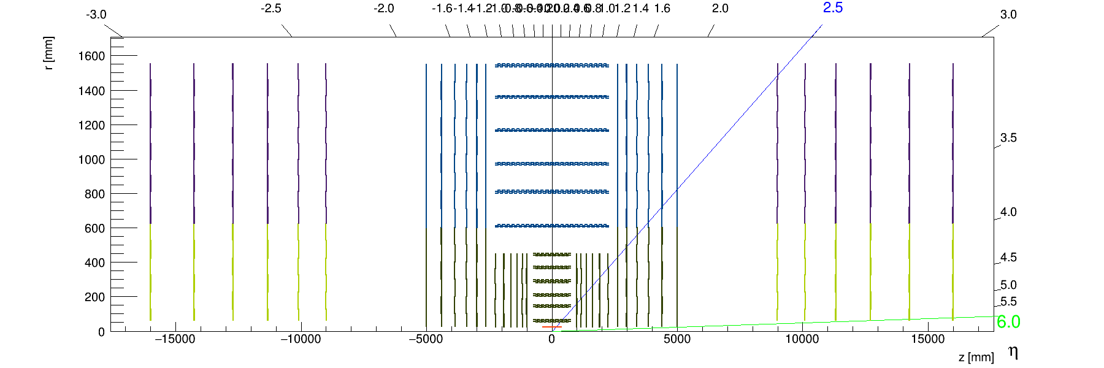

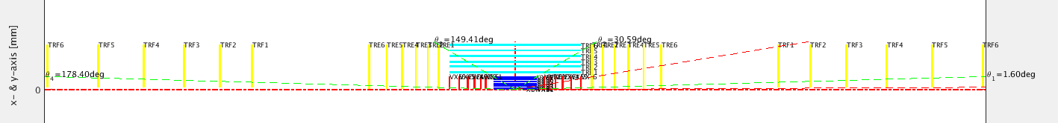
Reproducing
Zbynek-Opt3
layout in LiC Detector Toy

Slide 3
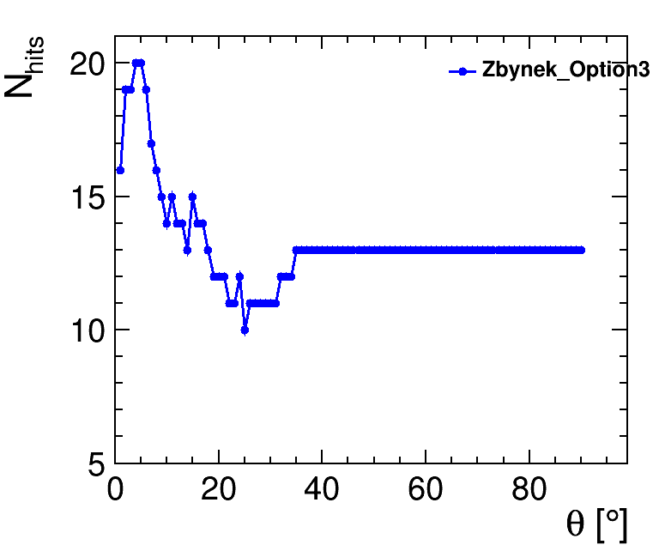
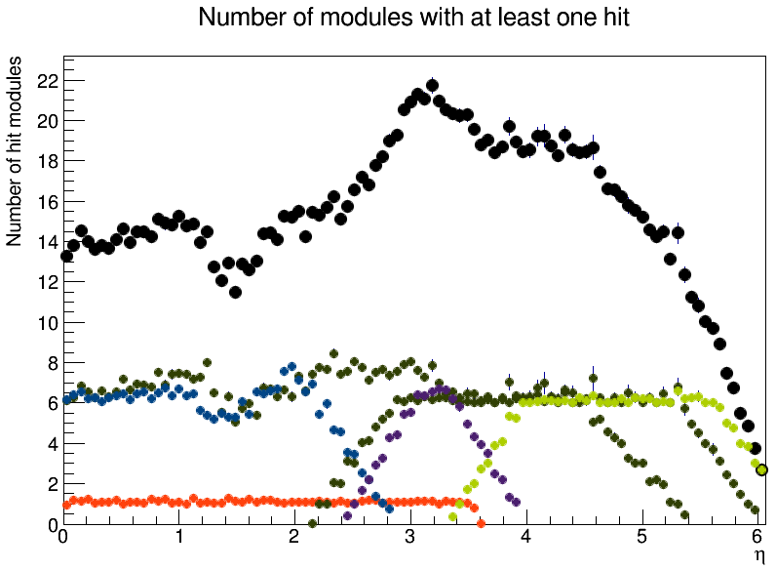
Zbynek-Opt3
has overlap between modules
Theta not Eta

Slide 4
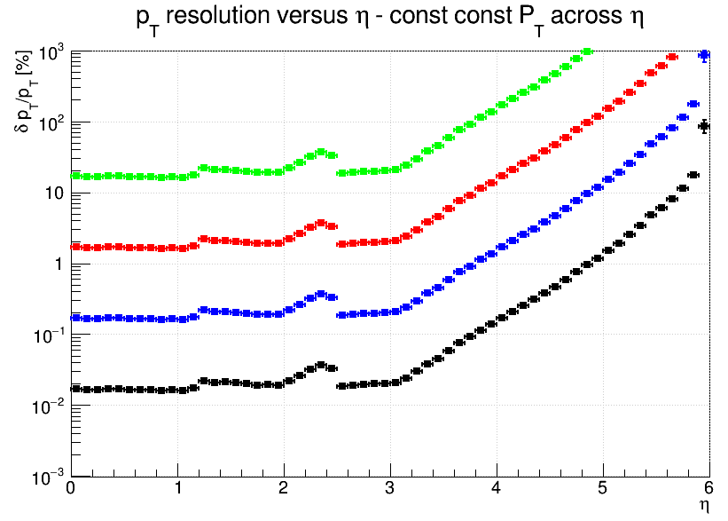
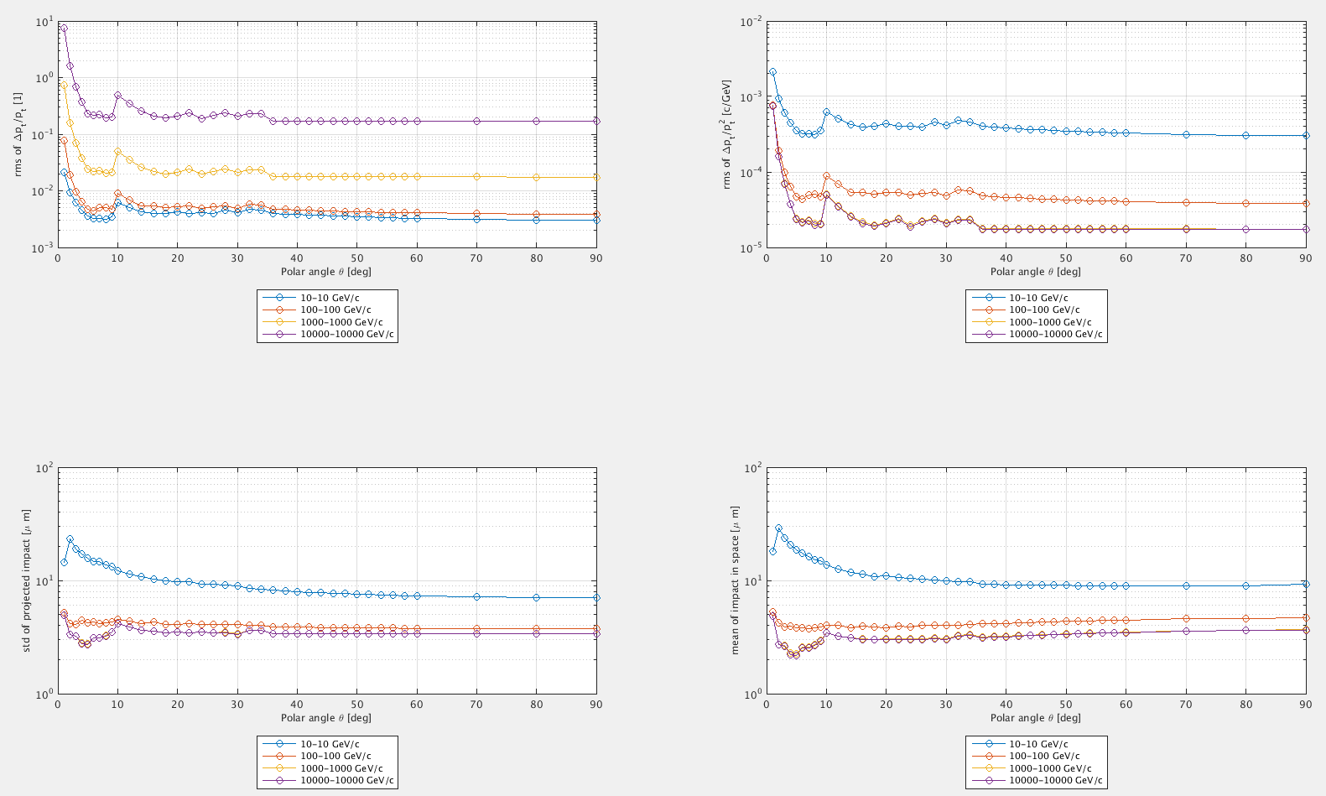
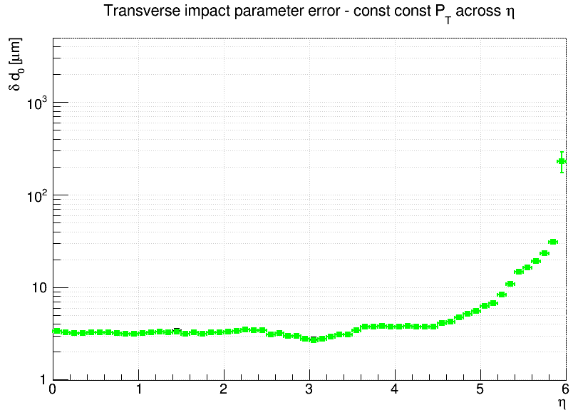
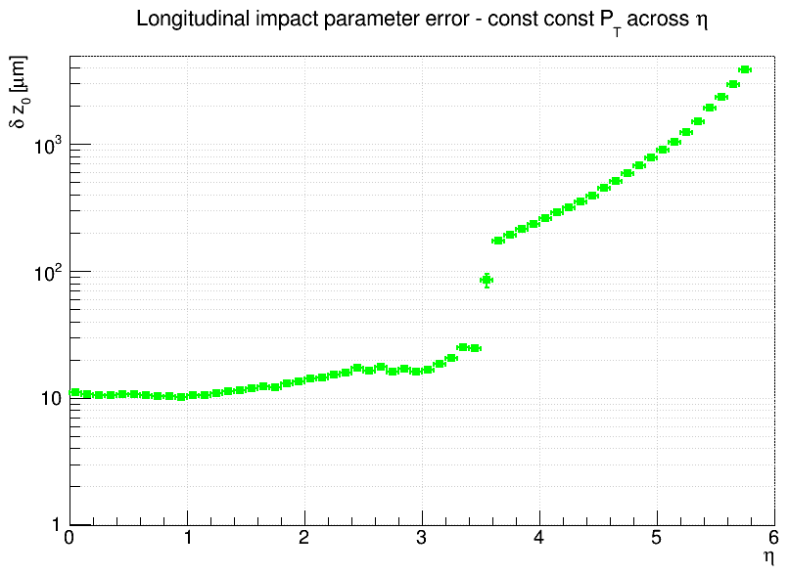
LOG
no material
includes beampipe material

Slide 5
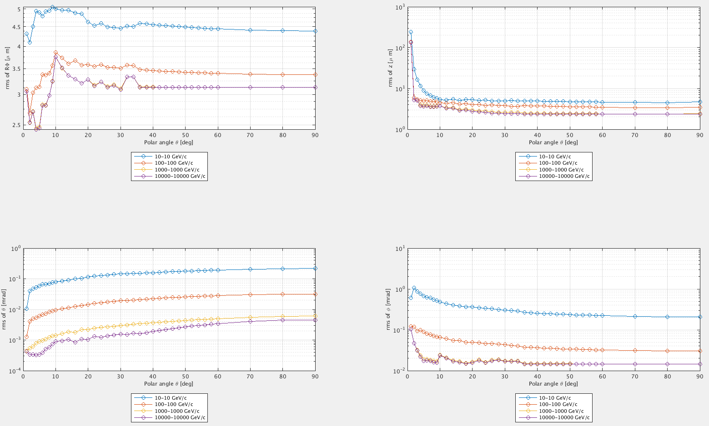
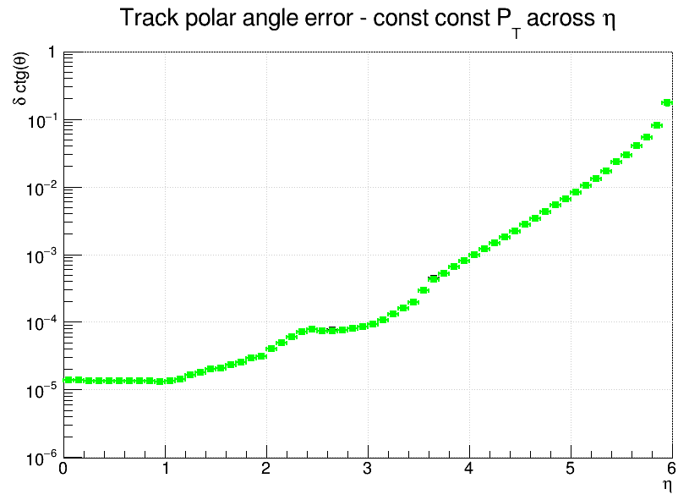
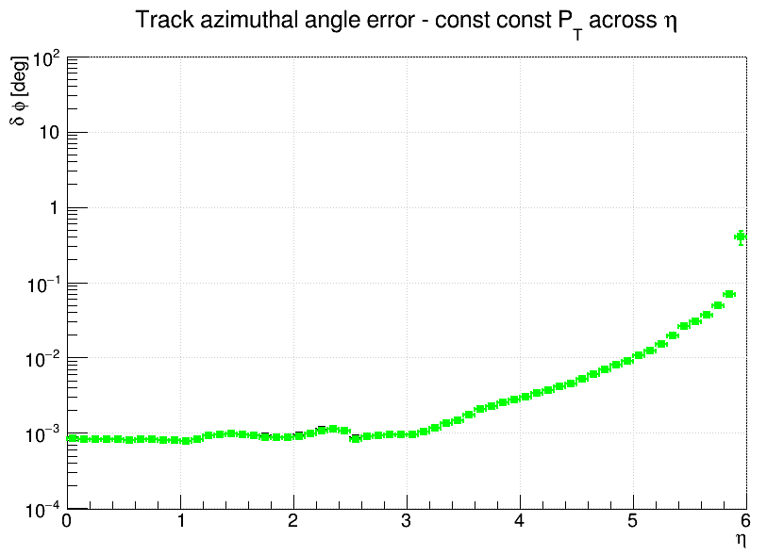
cotan(phi)

Slide 6
to do
Try (not) including material, compare resolution
Zbynek mentioned his numbers have been cross-checked against somebody else’s calculations already

Slide 7
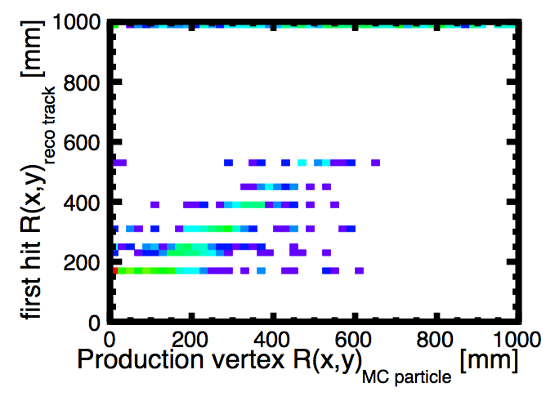
tracking with FCC
the problem:
  when I add layers and loose the max distance of closest approach (dca) cut, the hits in the first 2 layers are not used
if the production vertex of the mc particle is inside the first layer, the radius of the first hit should be the radius of the first layer
two lines missing

Slide 8
tracking with FCC
Check:
  If the hits are present
  layer weights
  strategy cuts
  tracking strategies
test tracks for training
prototype strategy (cuts on Nhits, chi2, dca,…)
trained strategies
single displaced muons
+
=
are used to reconstruct
layer weights (force inside-out or outside-in)

Slide 9
collections structure
MCParticles
Tracks
TrackMCTruthLink
HelicalTrackMCRelations
The tracks never linked to the hits in the first 2 layers
HelicalTrackHits
hits present in this collection
HelicalTrackHitRelations
VXD_TrackerHits
VXD_RawTrackerHits
hits present in this collection
TRK_TrackerHits
TRK_RawTrackerHits

Slide 10
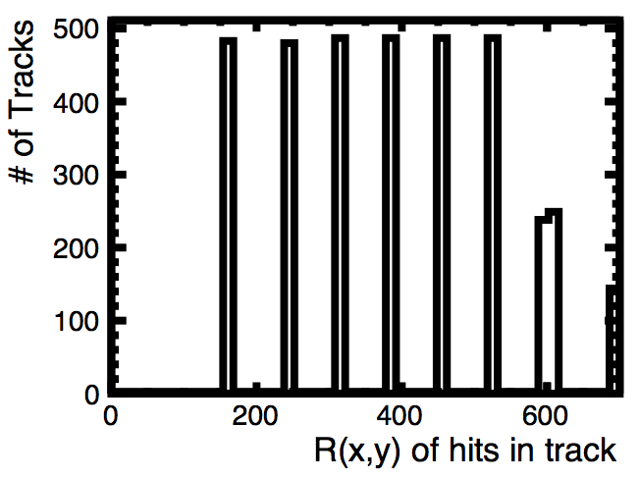
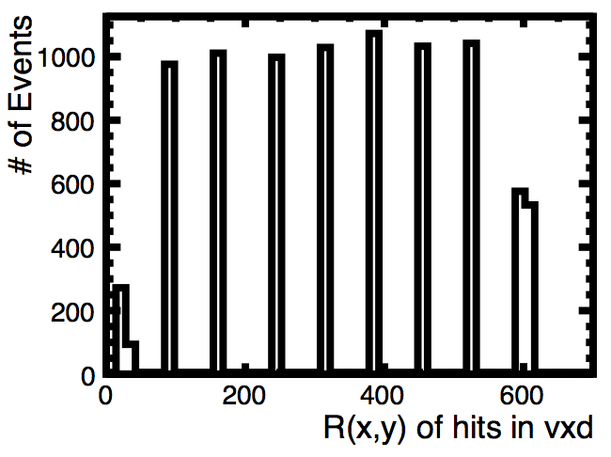
Hits linked from tracks
Hits in HelicalTrackHits collection

Slide 11
Check strategies: are the first 2 layers used?
The first 2 layers have never been used as seed or confirm (also for CLIC_SiD), precisely to allow displaced tracks. they are always used as extend though.
Their layer weight was also set to 0.(even for clic sid)
defaultStrategies_clic_sid_cdr.xml
41 41 41 41 41 0 0 0 0 41 39 37 33 33 0 0 0 0 -> number of strategies that use each layer
0 0 18 20 10 0 0 0 0 33 12 0 0 3 0 0 0 0 -> strategies that use this layer as seed or confirm
0 0 .43 .48 .24 .80 .30 0 0 .09 -> fraction of strategies that use this layer as seed/confirm
trainedStrategies/clic_fccvtx_barrel_trackingStrategies_7hits_chi2_10.xml
26 26 26 26 26 26 26 26 26 26 26 26 26 26 0 0 0 0
0 0 15 13 19 14 8 5 4 3 1 0 0 0 0 0 0 0
0 0 .57 .50 .73 .53 .30 .19 .15 .11 .03 0 0 0
trainedStrategies_9l_z20_dca100/clic_fccvtx_barrel_trackingStrategies_7hits_chi2_10.xml
24 24 24 24 24 24 24 24 24 24 24 24 24 24 0 0 0 0
0 0 15 13 17 12 8 5 4 3 1 0 0 0 0 0 0 0
0 0 .62 .54 .70 .50 .33 .20 .16 .12 .04 0 0 0
trainedStrategies_9l_z20_dca100/clic_fccvtx_barrel_trackingStrategies_7hits_chi2_50b10.xml
24 24 24 24 24 24 24 24 24 24 24 24 24 24 0 0 0 0
0 0 15 13 17 12 8 5 4 3 1 0 0 0 0 0 0 0
0 0 .62 .54 .70 .50 .33 .20 .16 .12 .04 0 0 0

Slide 12
[here I will skip here all my intermediate checks]
Break it down to the simplest:
Hack the Tracking strategies to force them to use the first two hits:
Use only one tracking strategy
give highest weights to the first two layers

Slide 13
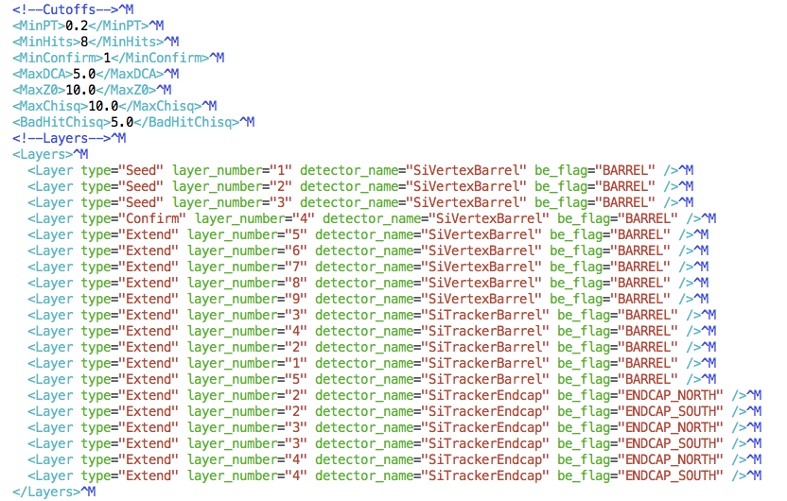
Using one single tracking strategy
Use the first 3 hits as seed
  Name it Seed-Seed-Seed-Confirm-Extend: SSSCE
low max dca cut

Slide 14
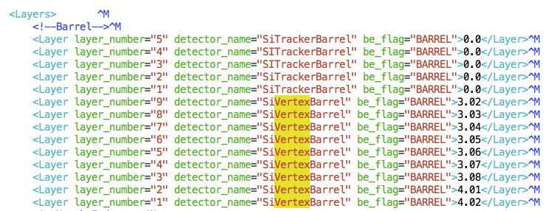
hacked weights

Slide 15
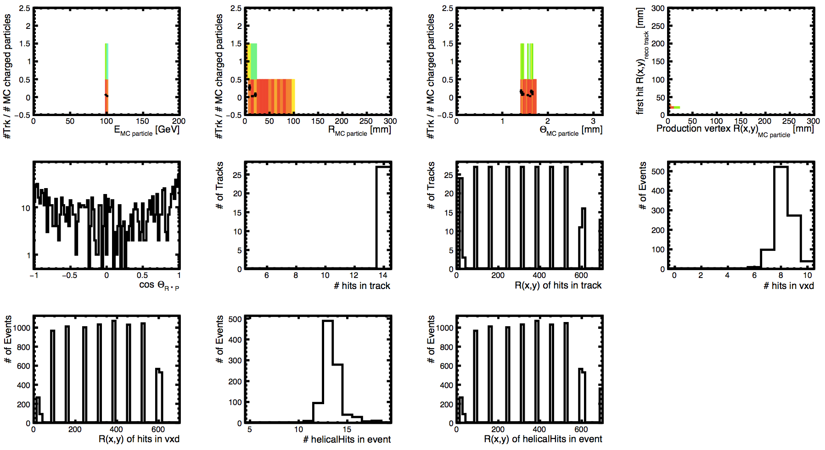
This worked! First 2 hits are used in the track
100 GeV muons
displaced 0-100mm
central in theta
R of the first hit
p required to be in the flight direction

Slide 16
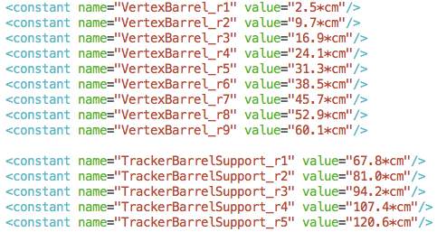
Variations on cutoff values & strategy
Increase maxDCA cut until suddenly no track is reconstructed
Strategy | MaxDCA | MinNHits | MAZZ0 | Max Chi2 | BadHitChi2 | worked?
SSSCE | 5 | 8 | 10 | 10 | 5 | YES
SSSCE | 25 | 8 | 10 | 10 | 5 | YES
SSSCE | 28 | 8 | 10 | 10 | 5 | YES
SSSCE | 29 | 8 | 10 | 10 | 5 | NO
ESSSC | 29 | 8 | 10 | 10 | 5 | YES
ESSSC | 90 | 8 | 10 | 10 | 5 | YES, but*
ESSSC | 100 | 8 | 10 | 10 | 5 | NO

Slide 17
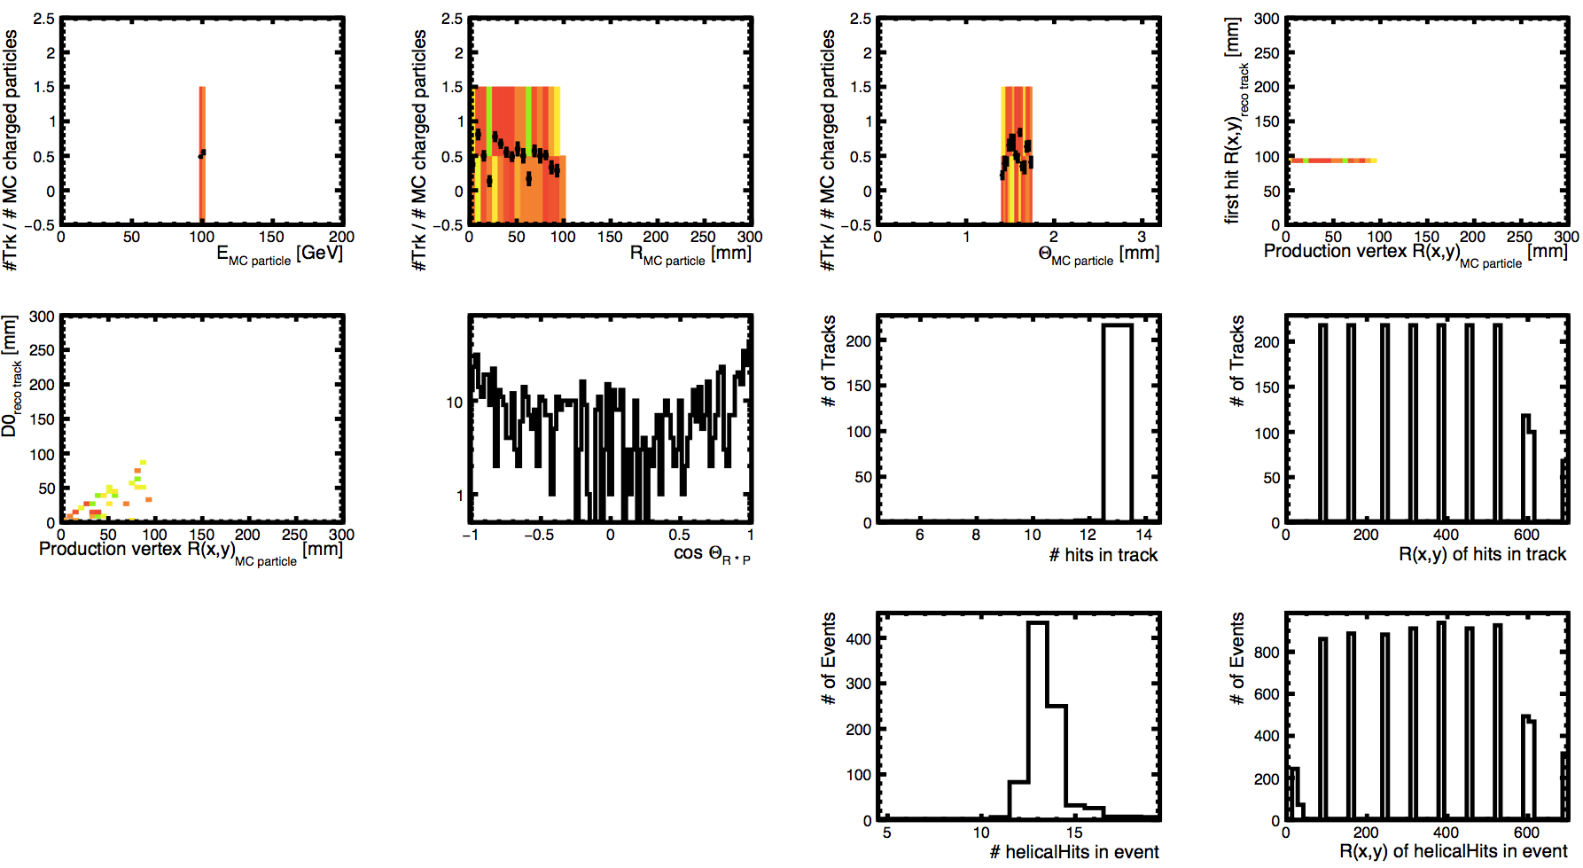
ESSSC strategy ; max DCA=90
* tracks are not extended to the first layer

Slide 18
to do
check in the code how this max dca cut is applied
ask Christian if he has additional info

Slide 19
Backup

Slide 20
fcc detector layout used

Slide 21
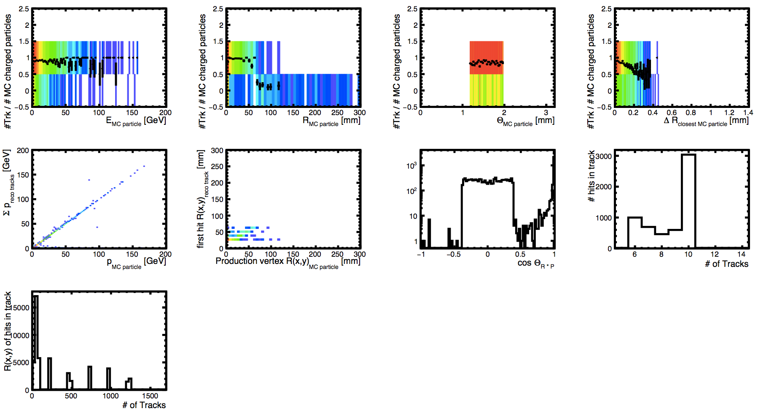
2247/bbbbbb_rec_2247_12 clic_sid_cdr
max = Nlayers = 10
I thought the minimum was 7 hits per track!

Slide 22
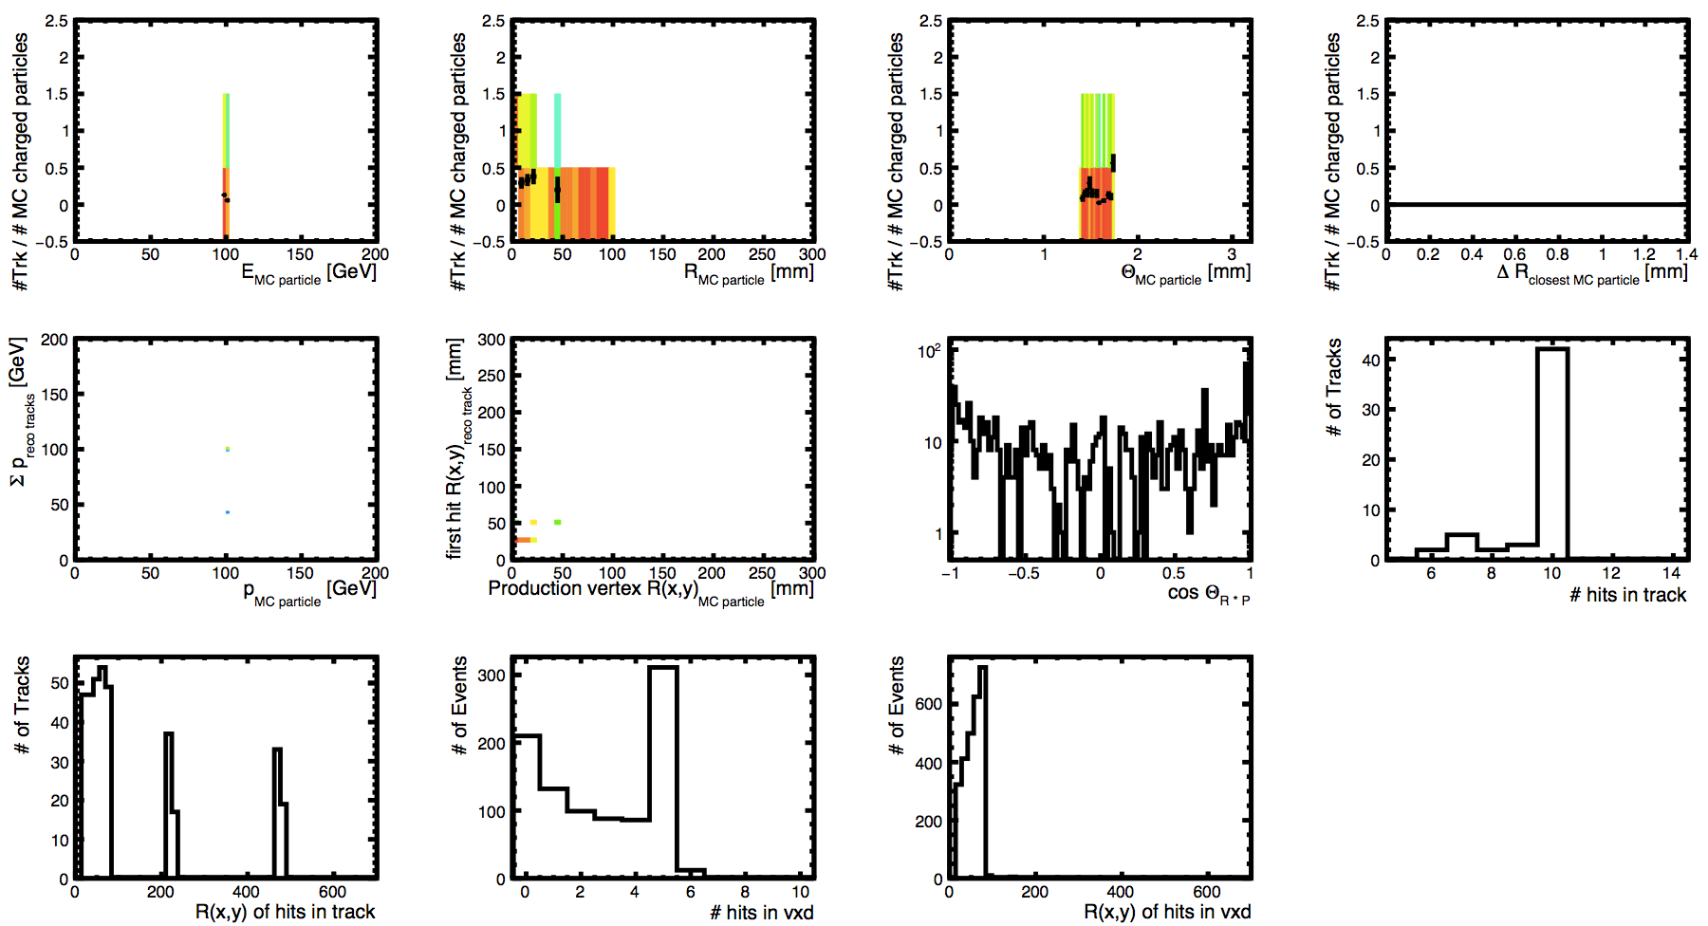
mu--clic_sid_cdr-100gev_theta80-100_vtxL1-10
_7hits_chi2_10_test
std strategies
clic detector
single displaced muon

Slide 23
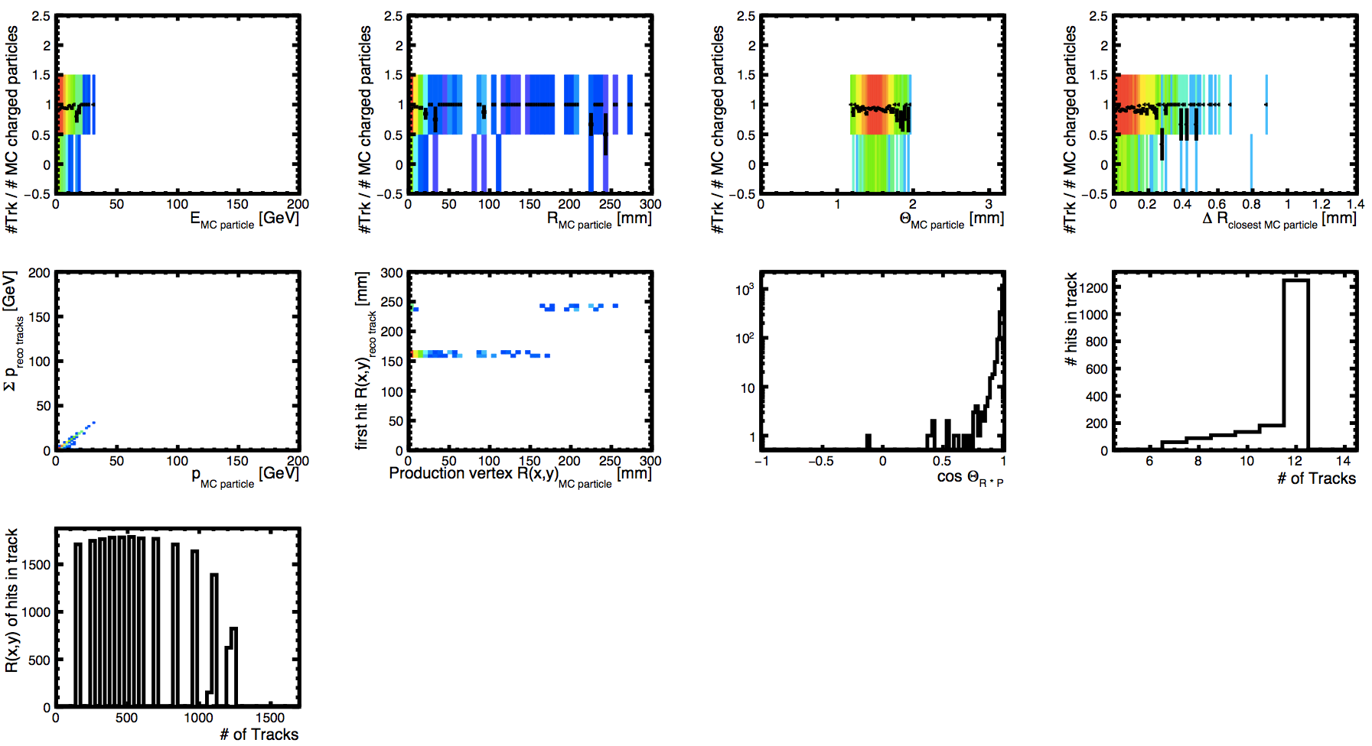
FCC_bb_50_V2ppHadMSTP8120MSTP611MSTP711
_1234_clic_fccvtx_barrel-prod1
std strategies
fcc detector
dijet 50 GeV evts
max != Nlayers = 14

Slide 24
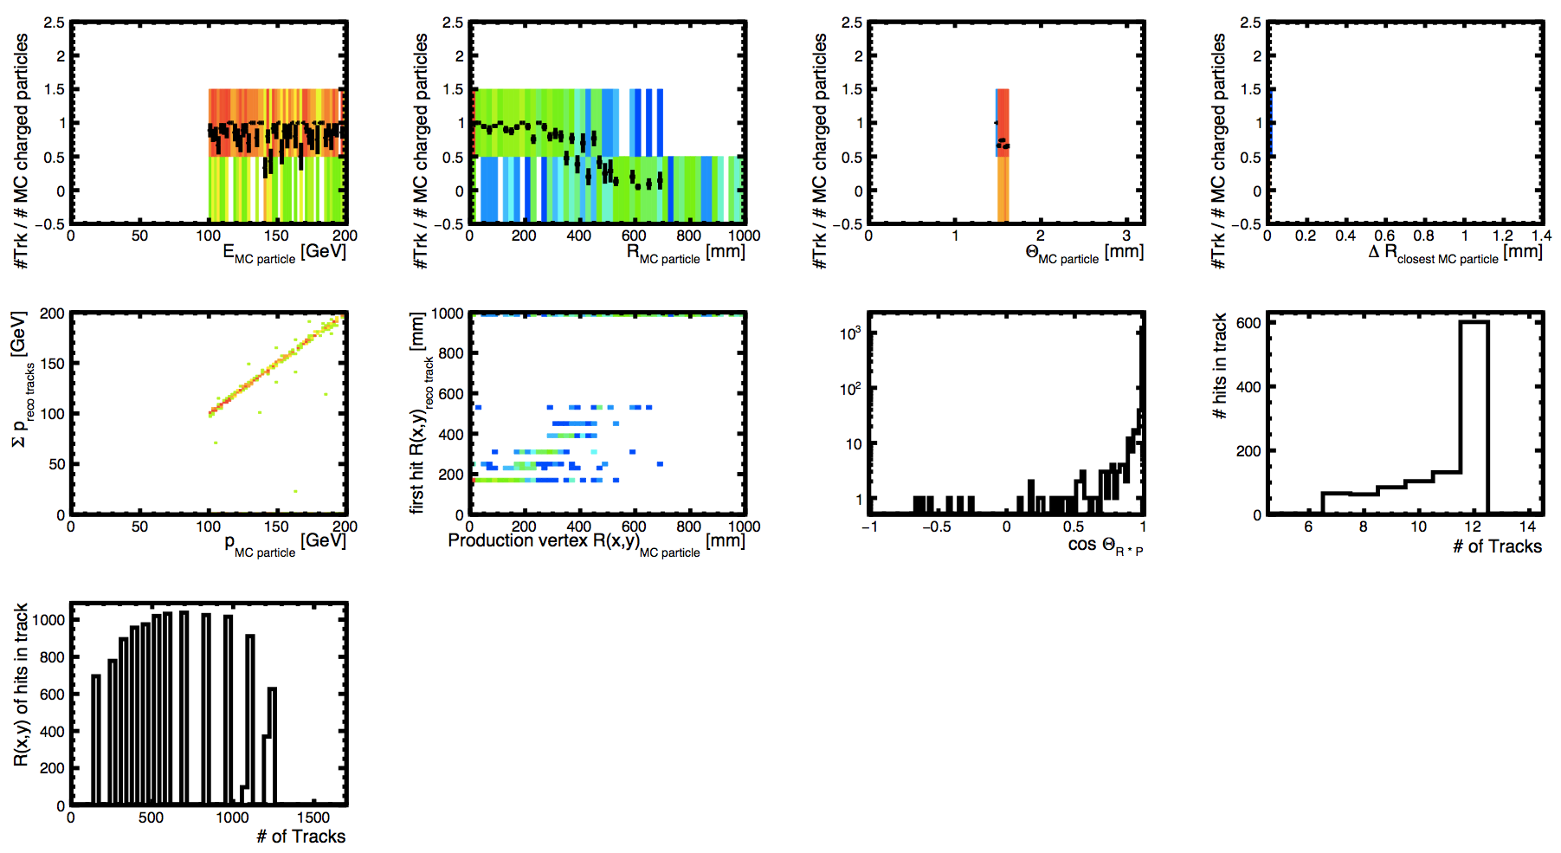
loosen strategies
fcc detector
single displaced muon
FCC_bb_5000_V1ppHadMSTP8120MSTP611MSTP711
_1234_dca100_chi2_20b8_clic_fccvtx_barrel-prod1
max != Nlayers = 14

Slide 25
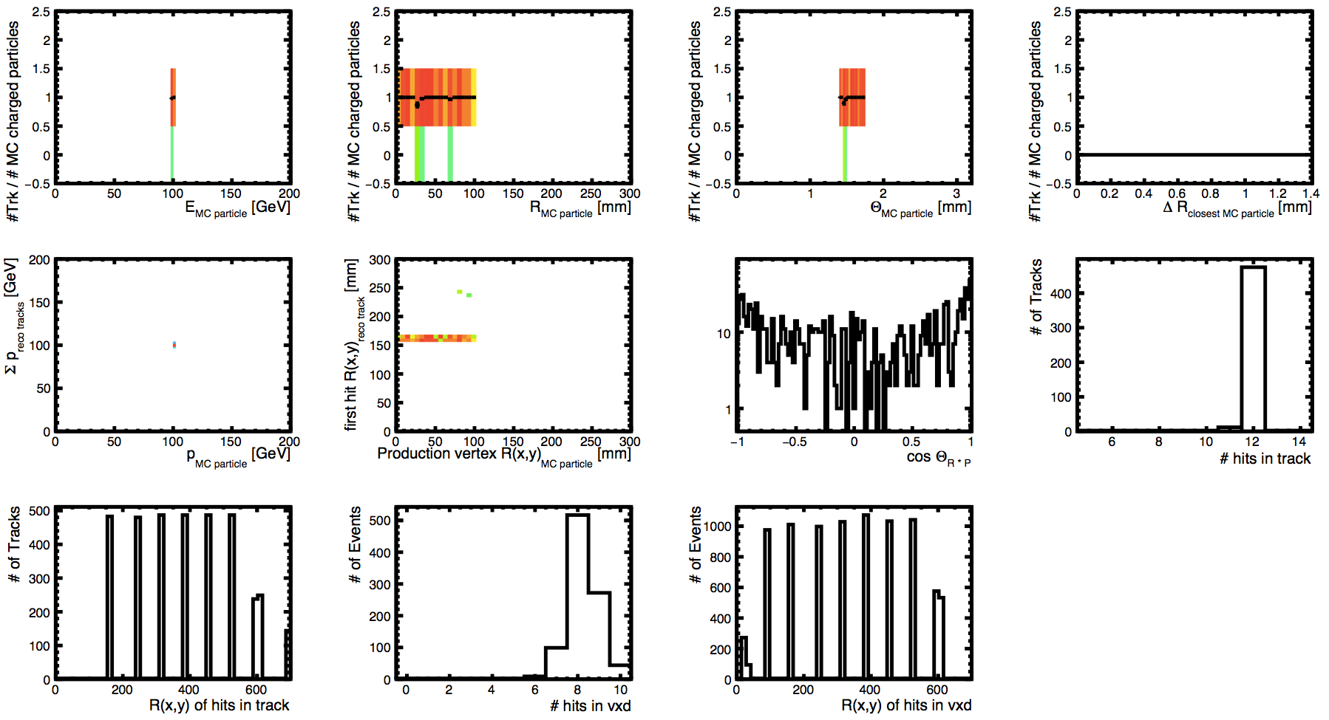
singleParticle-steps234-mu--clic_fccvtx_barrel-
100gev_theta80-100_vtxL1-10_10000_10
_11hits_chi2_50b10_9l_z20_dca100
even more loosen strategies req 11 hits
fcc detector
single displaced muon

Slide 26
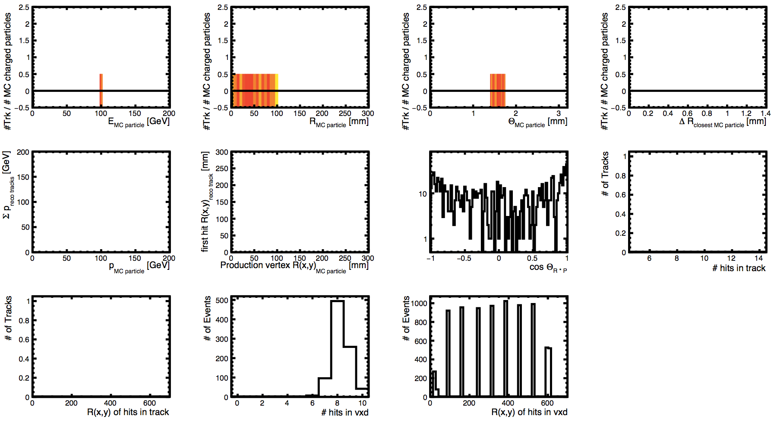
mu--clic_fccvtx_barrel-
100gev_theta80-100_vtxL1-10_10000_10_
13hits_chi2_50b10_9l_z20_dca100_DST
even more loosen strategies req 13 hits
fcc detector
single displaced muon

Slide 27
mu--clic_fccvtx_barrel-100gev_theta80-100_vtxL1-10_10000_10_
8hits_chi2_50b10_9l_z20_dca100_weight40_hacked2_DST.slcio

Slide 28
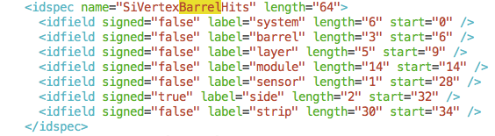
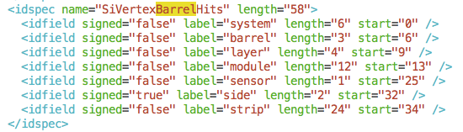
FCC
CLIC SiD

