Slide 1
FCC-ee very large detector design group
Aims and considerations

Slide 2
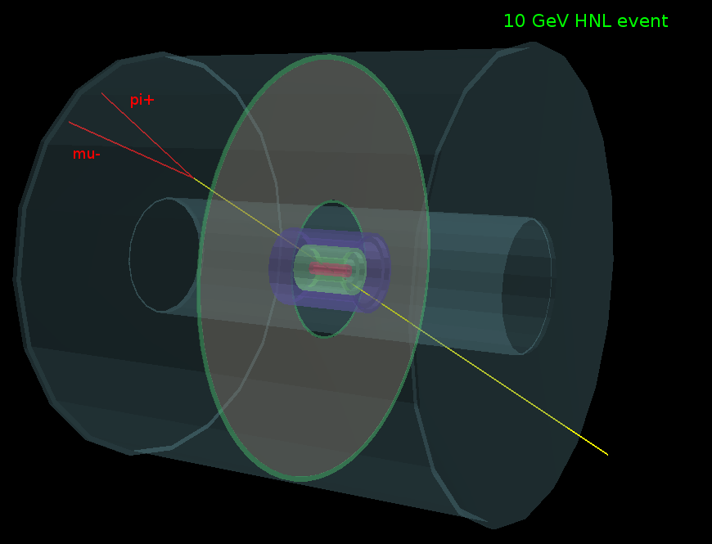
Marcin Chrzaszcz (University of Zurich)

Slide 3
Aim is to investigate a large detector able to improve the efficiency for
detached vertex configurations (RH neutrinos, dark sector, etc. etc.)
At the same time the detector should be able to perform correctly for the base
program of FCC-ee (precision measurements and invisible widths)
Considerations and starting point:
-- Tracker up to 8m radius with good timing resolution
TPC or drift/straw tubes?
interleaved with more precise timing detectors
-- vertex detector able to separate from background Z→ W*W and Z*Z
and efficient b and c tagging.
-- solenoid magnetic field that is sufficient but not very high (0.5T)
➔ challenge is to design calorimeters that are not too expensive…
-- 4π EM coverage
-- resolution may not be so essential
-- behind coil (coil as thin as possible)
-- sufficient hadron calorimenter /muon filter/return yoke
-- hermeticity for single photon detection and background reduction
(EM calorimeter/lumi detector as close as possible to beam pipe, (no gaps!))
-- large distance will help separate photons and neutrals

Slide 4
Next steps
Proposed convener: Serguei Ganjour (CEA) + Albert de Roeck (CERN)
-- some conditions apply.
SG: Full time fellow or post-doc, and a PhD student will be needed.
A number of people have expressed interest we will contact them and get started
-- theorists for evaluation of gains with volume
physics questions: rates, decay modes, decay length dependence, CP violation etc…
-- physics simulations
-- detector proposals
-- magnet proposal
-- cost estimate
-- oral reports to detector meetings etc…
-- written report for the design study report mid 2018.

