Slide 1
An ultra-light drift chamber with particle identification capabilities
F. Grancagnolo
INFN – Lecce, ITALY
WG11 Detector Design Meeting
CERN
17 October 2016

Slide 2
Road to proposal
Ancestor chamber: KLOE at INFN LNF Daϕne φ factory (commissioned in 1998 and currently operating)
CluCou Chamber proposed for the 4th-Concept at ILC (2009)
I-tracker chamber proposed for the Mu2e experiment at Fermilab (2012)
DCH for the MEG2 upgrade at PSI (under construction at INFN and to be commissioned during spring 2017)

Slide 3
"Traditional" Drift Chamber
A cylindrically symmetric gas volume with (para-)axial wires defining a strong electric field, strung under mechanical tension for electrostatic stability and fixed at their extremities to the end walls by means of feed-through.
CONSTRAINTS:
The end walls, holding the feed-through (which limit the chamber granularity), the FE electronics and the relative cabling, must be rigid enough to transfer the load due to the wire tension (of the order of several Tons) to the outer cylindrical wall, without deforming.
The inner cylindrical wall, usually, does not bear any load, to minimize the multiple scattering of incoming particles.
The gas tightness relies on the hermetic properties of all surfaces and of all their relative joints.

Slide 4
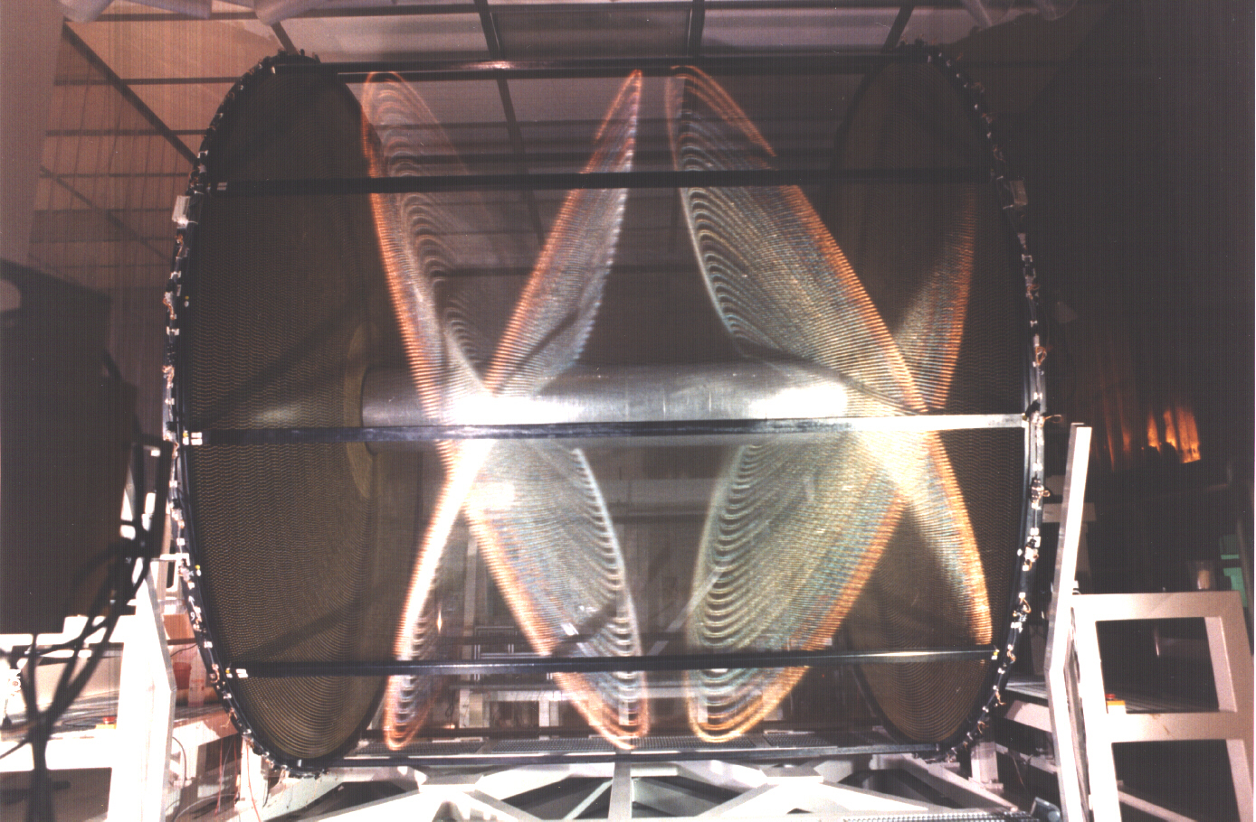
The KLOE Drift Chamber

Slide 5
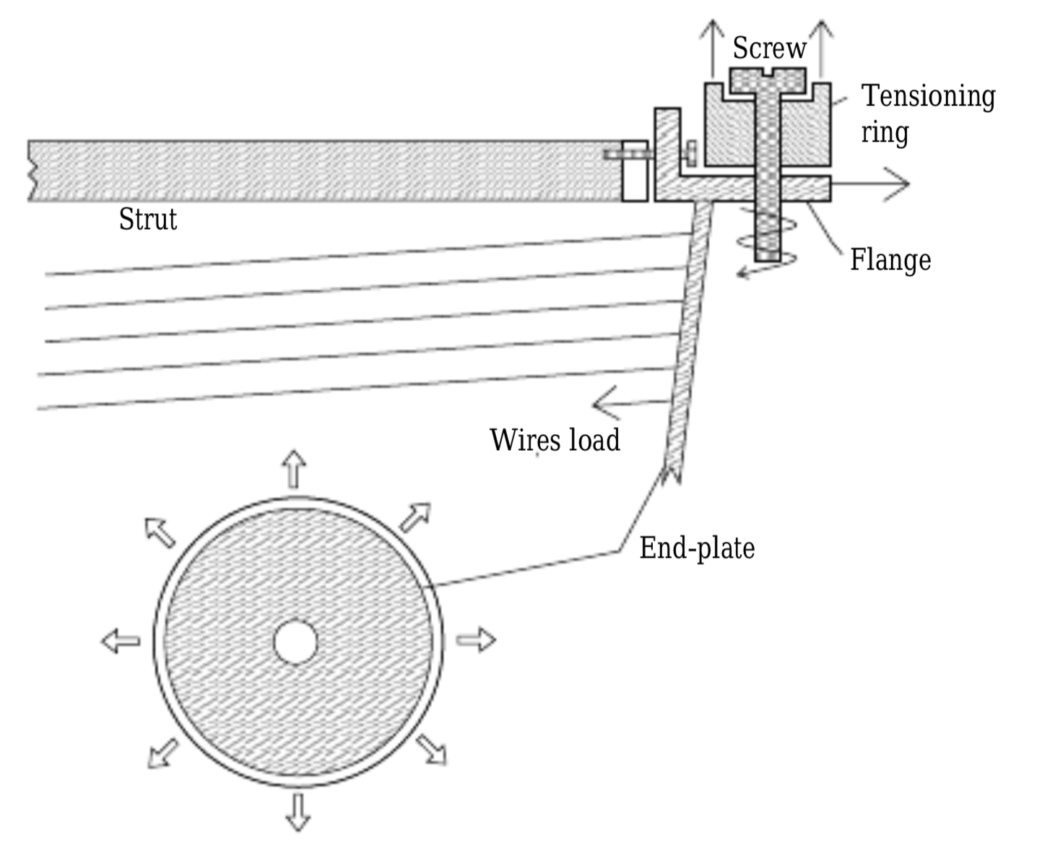
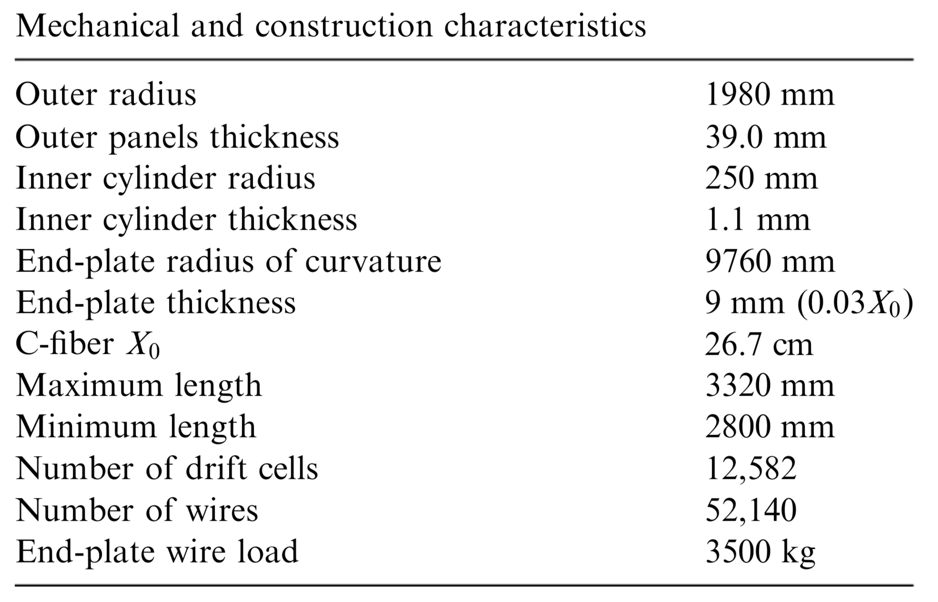
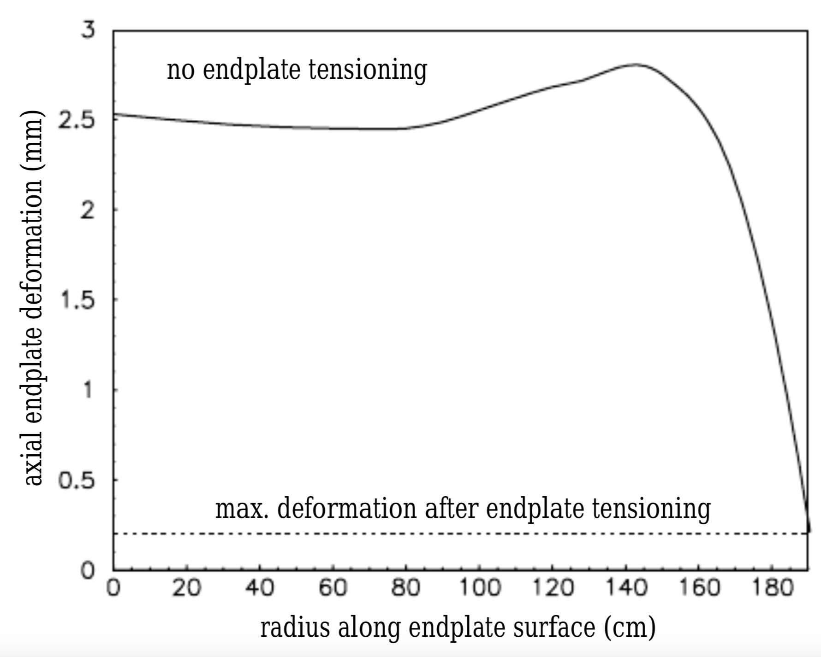
The KLOE Drift Chamber

Slide 6
Drift Chamber "Innovations"
Separating gas containment from wire support functions
Using a larger number of thinner (and lighter wires)
No feed-through wiring
Using cluster timing for improved spatial resolution
Using cluster counting for particle identification

Slide 7
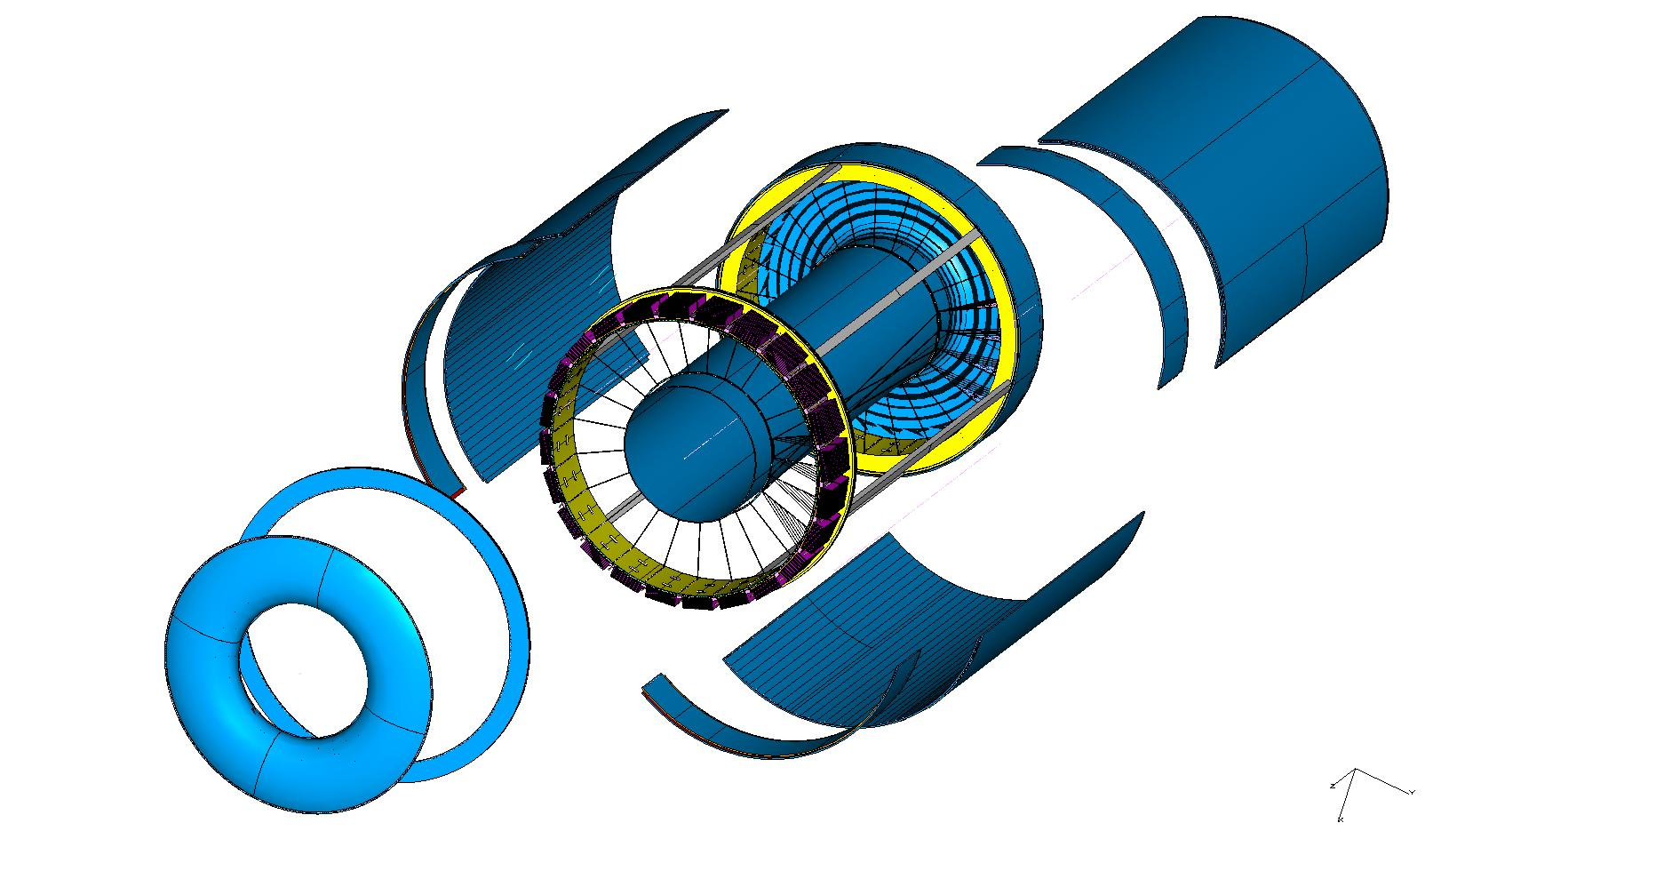
Gas containment and Wire support
Wire Cage
Gas envelope
F.E. electronics
Gas containment
Gas envelope can freely deform without affecting
the internal wire position and tension.
Wire support
Wire cage structure not subject to differential
pressure can be light and feed-through-less.

Slide 8
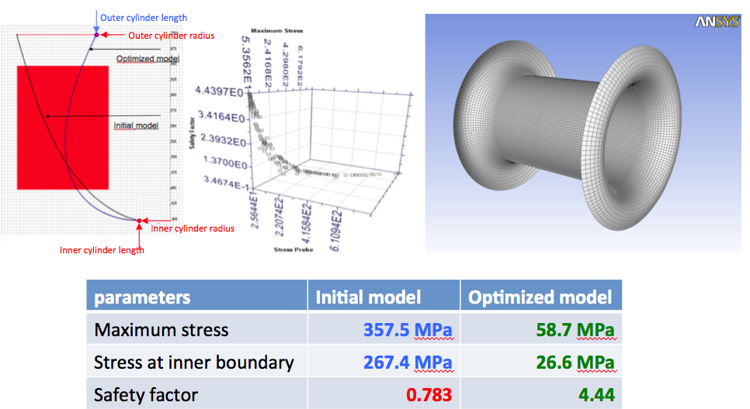
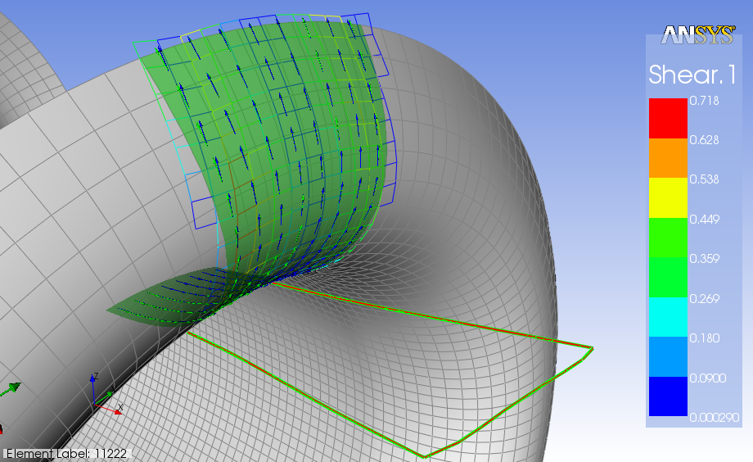
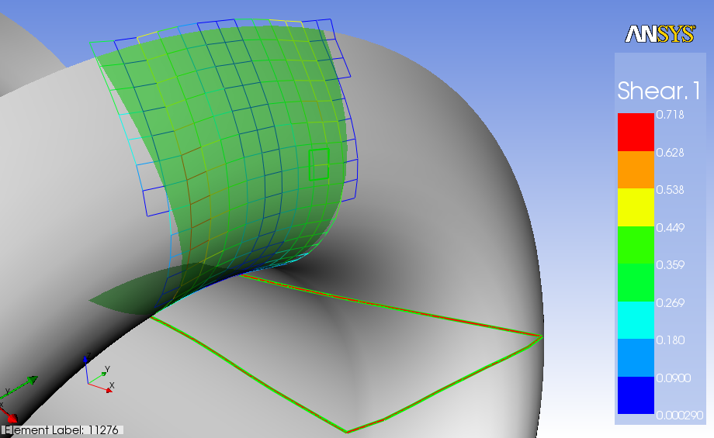
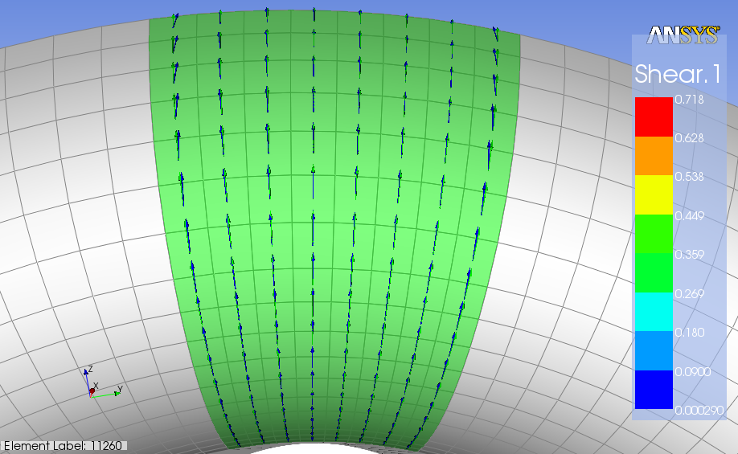
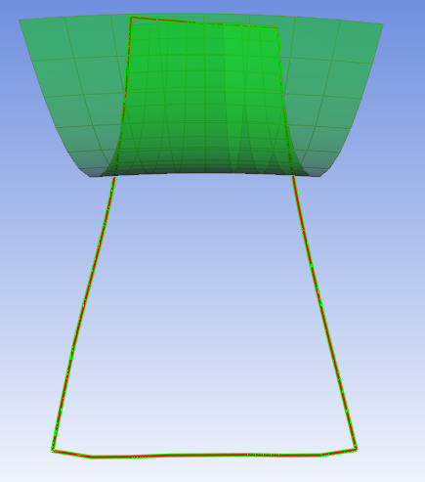
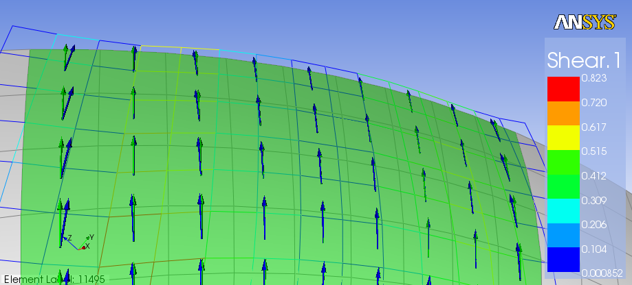
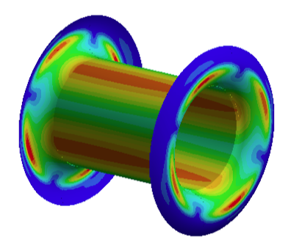
Example: The Mu2e I-Tracker proposal
Gas Envelope
A structural multivariate analysis software (ModeFrontier®) has enabled to find the optimal shape for the profile of the end plates by minimizing maximum stress and stress on inner cylinder
  ANSYS ACP® has chosen the proper unidirectional prepreg to form ply,
  draping of the laminates and flat-wrap of the optimized model
  Solve buckling problems
  of inner cylinder by
  increasing the moment of
  inertia with use of proper
  light core composite
  sandwich
End plates:
4-ply 38μm/ply
orthotropic (0/90/90/0)
0.021 g/cm²
5×10⁻⁴ X₀
Inner cylinder:
2 C-fiber skins, 2-ply,
C-foam core, 5 mm
0.036 g/cm²
9×10⁻⁴ X₀

Slide 9
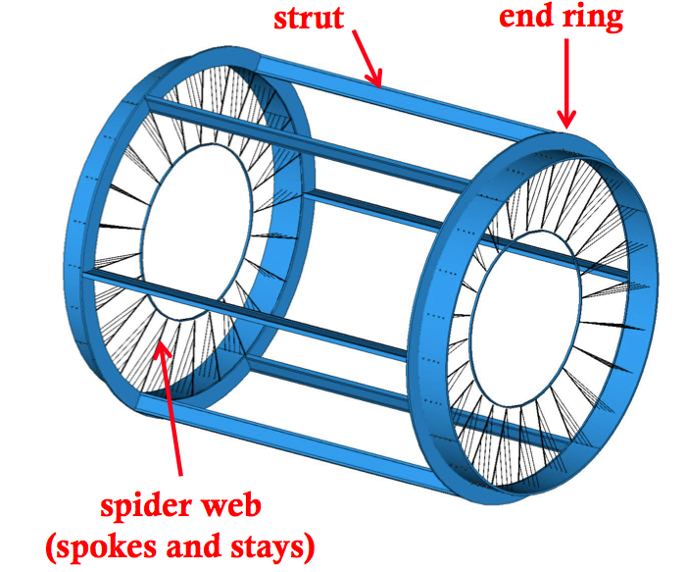
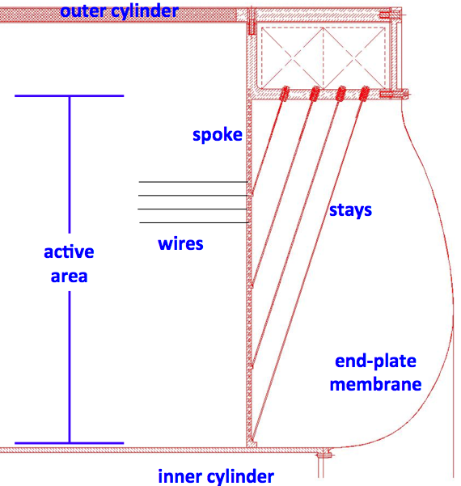
Example: The Mu2e I-Tracker proposal
Wire cage (conceptual)
strut
“L” shaped
end ring
tie-rod
screws
struts
spider web:
spokes and stays
stiffening
polygon

Slide 10
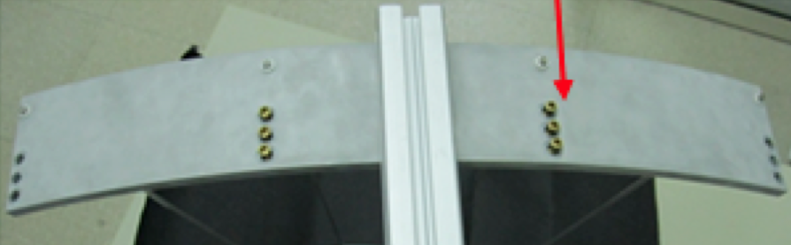
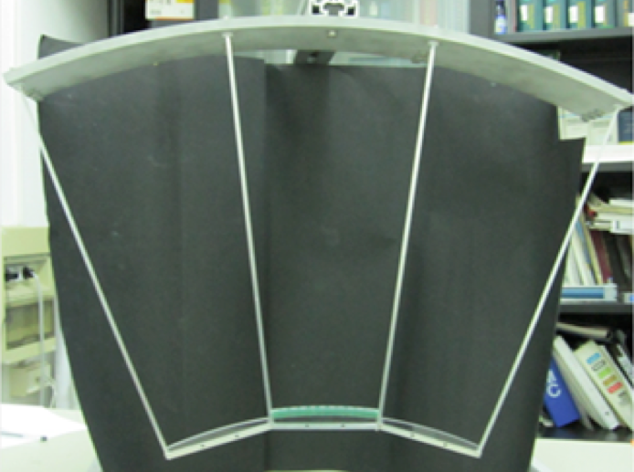
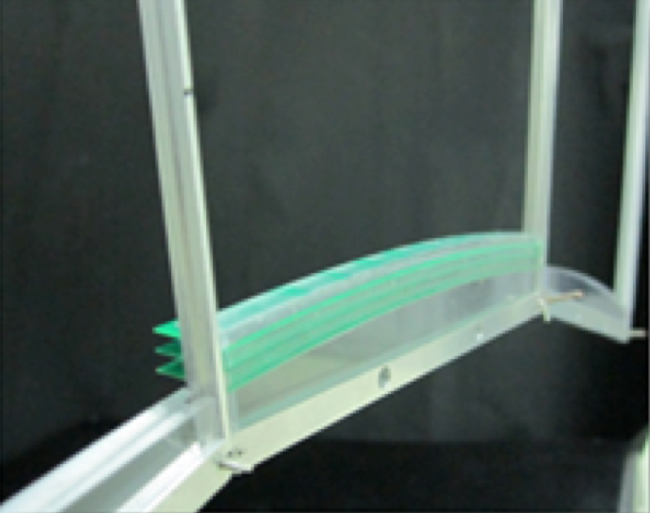
Verification of validity of principle
ANSYS
FEM
analysis
Force on the spoke
245.25 N
scale 1:1
model
to verify
validity
of principle

Slide 11
Wire Cage
This scheme does not require wire feed-through thus allowing for denser wire spacing, i.e. smaller cells (finer chamber granularity) and for larger field to sense wires ratios.
Larger field to sense wires ratio and, therefore, thinner field wires, help reducing multiple scattering contribution and total wire tension on support structure.
Large number of wires and small cells, however, require complex and cumbersome assembly procedures, which call for a novel approach to the wiring problem.

Slide 12

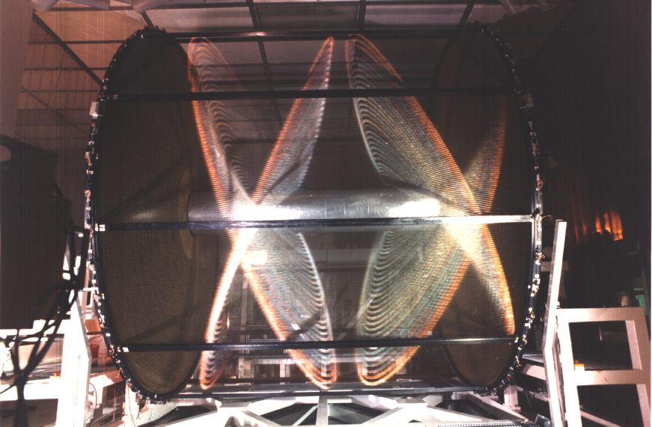
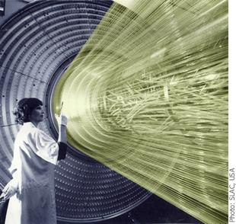
DC stringing: the old way
The Old Way
The KLOE Drift Chamber
45 m³ > 52,000 wires He/iC₄H₁₀
The Three Μοῖραι (Fates)
Κλωϑϖ
Λαχεσις
Ατροπος
Bernardo Strozzi – Le tre Parche – Venezia, circa 1620

Slide 13
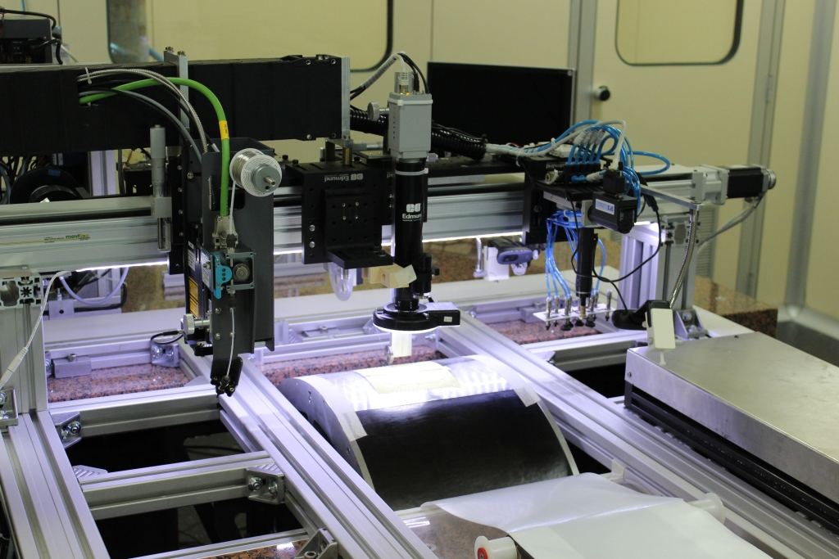
DC stringing: the novel way
KLOTHO
Spinning the thread
coil, clutch, wire spool
ATROPOS
Cutting the thread
laser solder system
LABIRINTH
The Extraction System
LACHESIS
Winding the thread
cylinder, wire PCB
THESEUS
The wire handling system

Slide 14
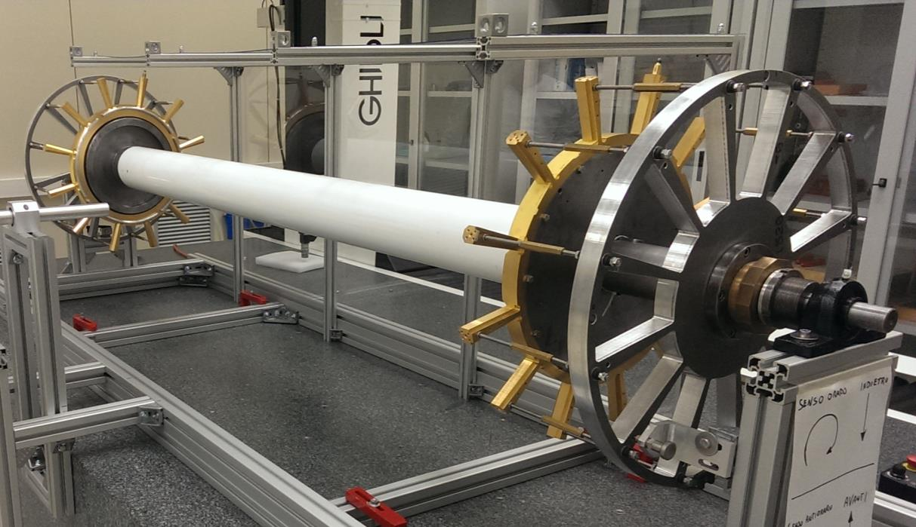
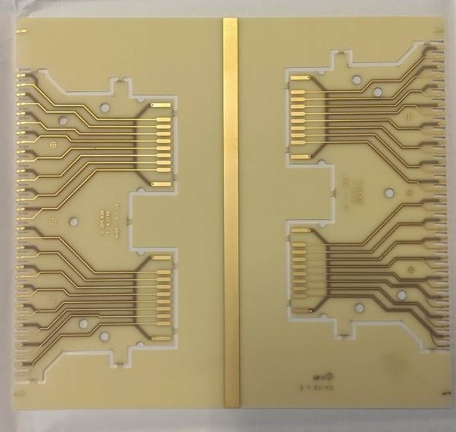
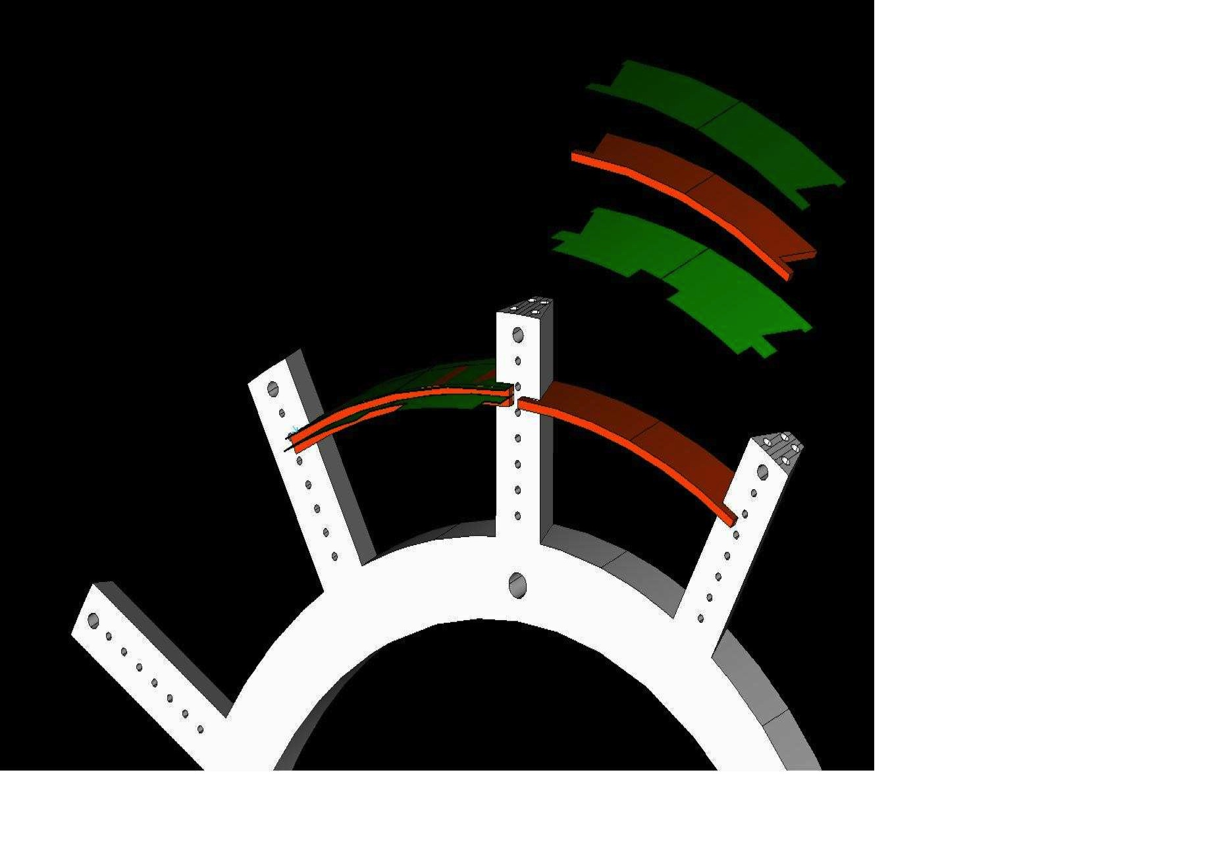
MEG2 DC EndPlates
end-plates
sense wires
PC boards
(16 cells)
400 μm
PCB
spokes
structural
removable
shaft
3D
measuring table
wire tension
compensating
wheels
peek spacer
fiducial
reference
edge
wire PC board
spoke
NC machined
peek spacer
(½ cell thick
1 sector wide)

Slide 15
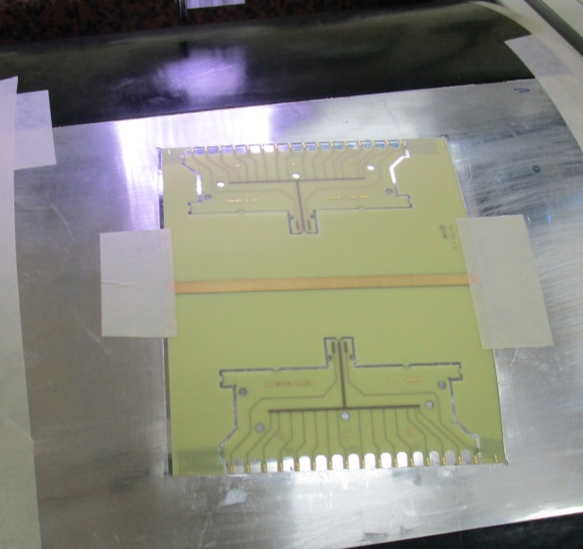
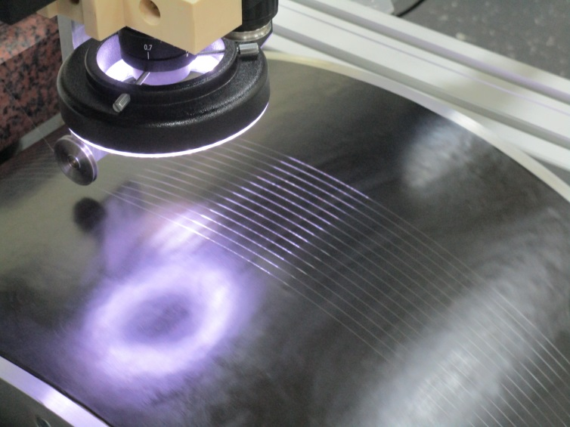
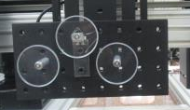
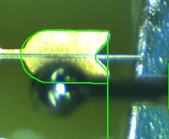
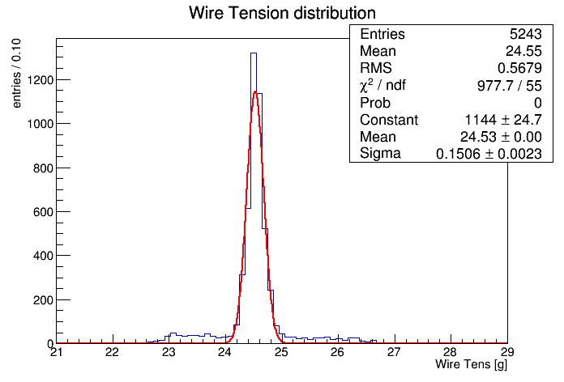
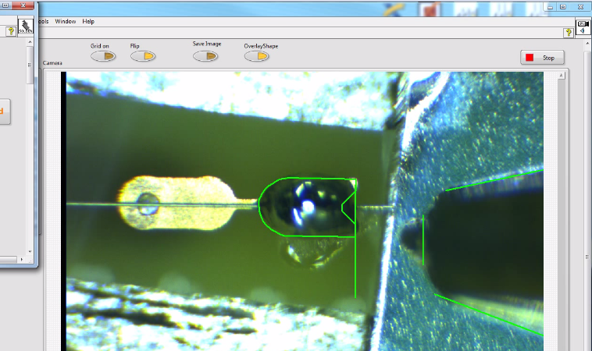
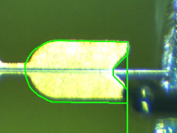
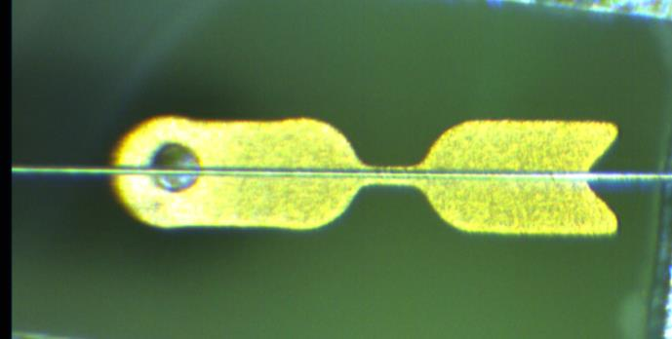
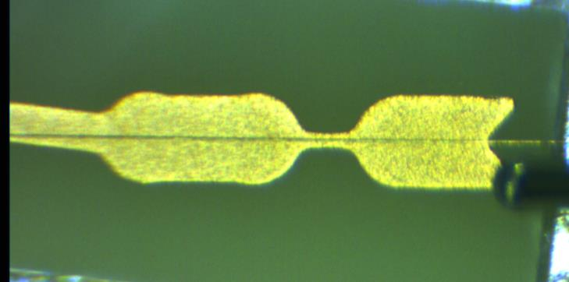
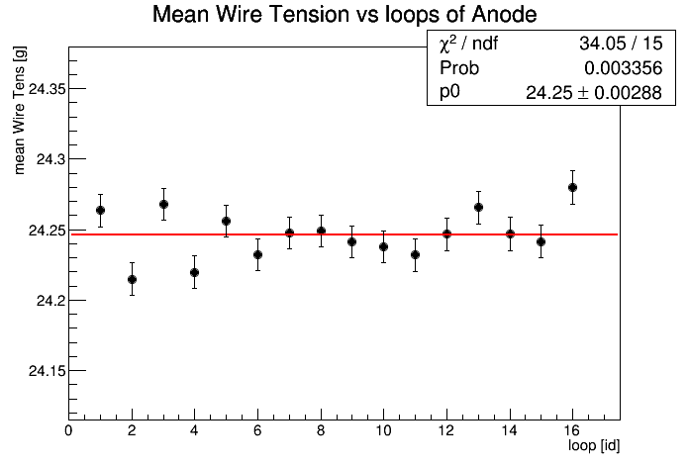
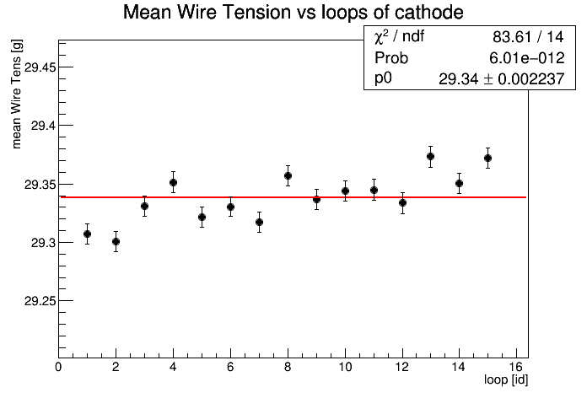
MEG2 DC Wiring
Aligning the wire
PC board on the
spinning drum
Winding the
wire on the
spinning drum
strain gauge
wire
fixed pulleys
Wire tension set up with a real time strain gauge
feedback system on the spooling el. mag. clutch
cathode
Pad image
recognition
and contactless
IR laser
soldering
constant winding speed
32 wires
deceleration phase
last 2 wires
(discarded)
acceleration phase
first 2 wires
(discarded)
anode
dual safe
soldering
solder feeder
16 sense wires
16 field wires
0.1 g
0.1 g

Slide 16
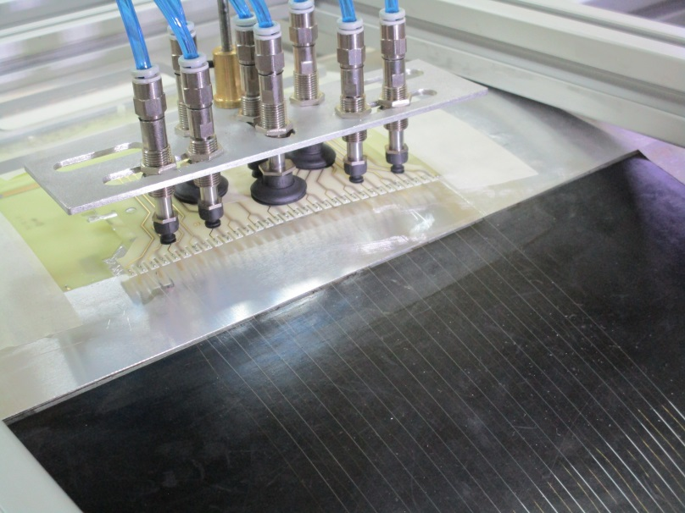
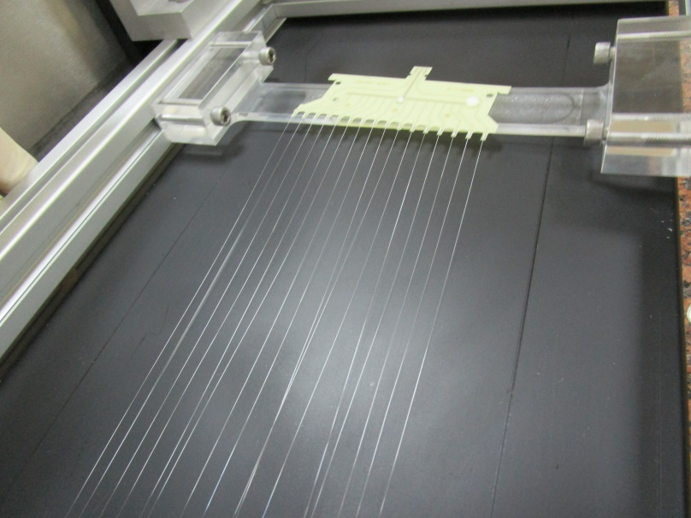
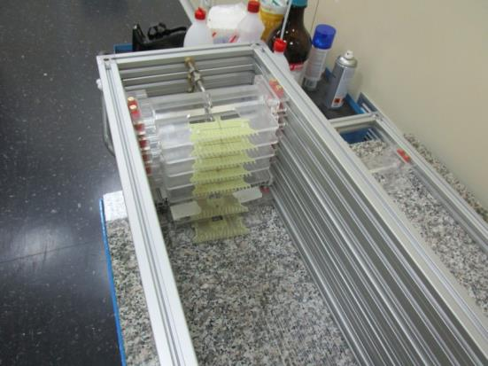
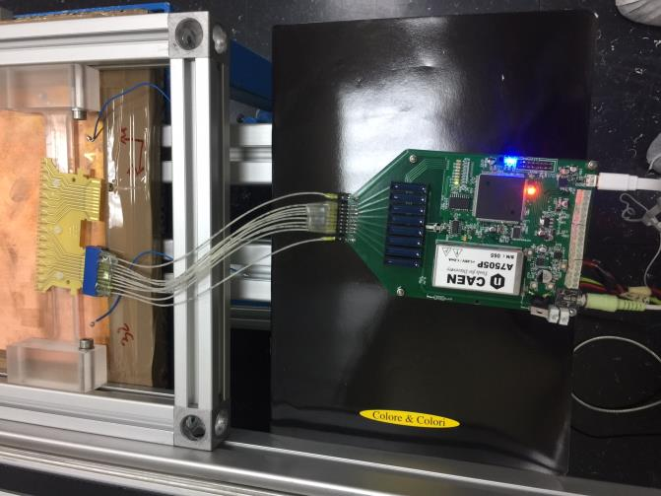
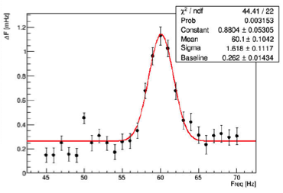
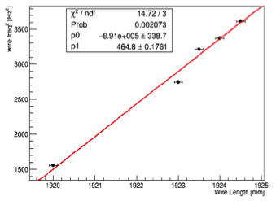
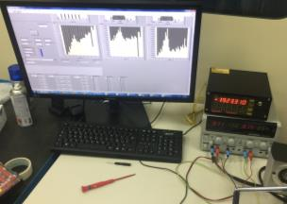
MEG2 DC Wiring
Lifting the wire
PC boards with
vacuum suction cups
Unwinding the
loose multi-wire layer
over the storage frame
Storing the multi-wire layers
for visual inspection and
wire tension measurement
Δf
[mHz]
Chamber accuracy
stereo angle < 35 μrad
wire position on PCB pad < 25 μm
cell width (wire pitch) < 1 μm
cell height (spacer) < 50 μm
wire tension < 0.1 g
PCB offset vs spoke < 50 μm
chamber length < 200 μm
f [Hz]
f²
L

Slide 17
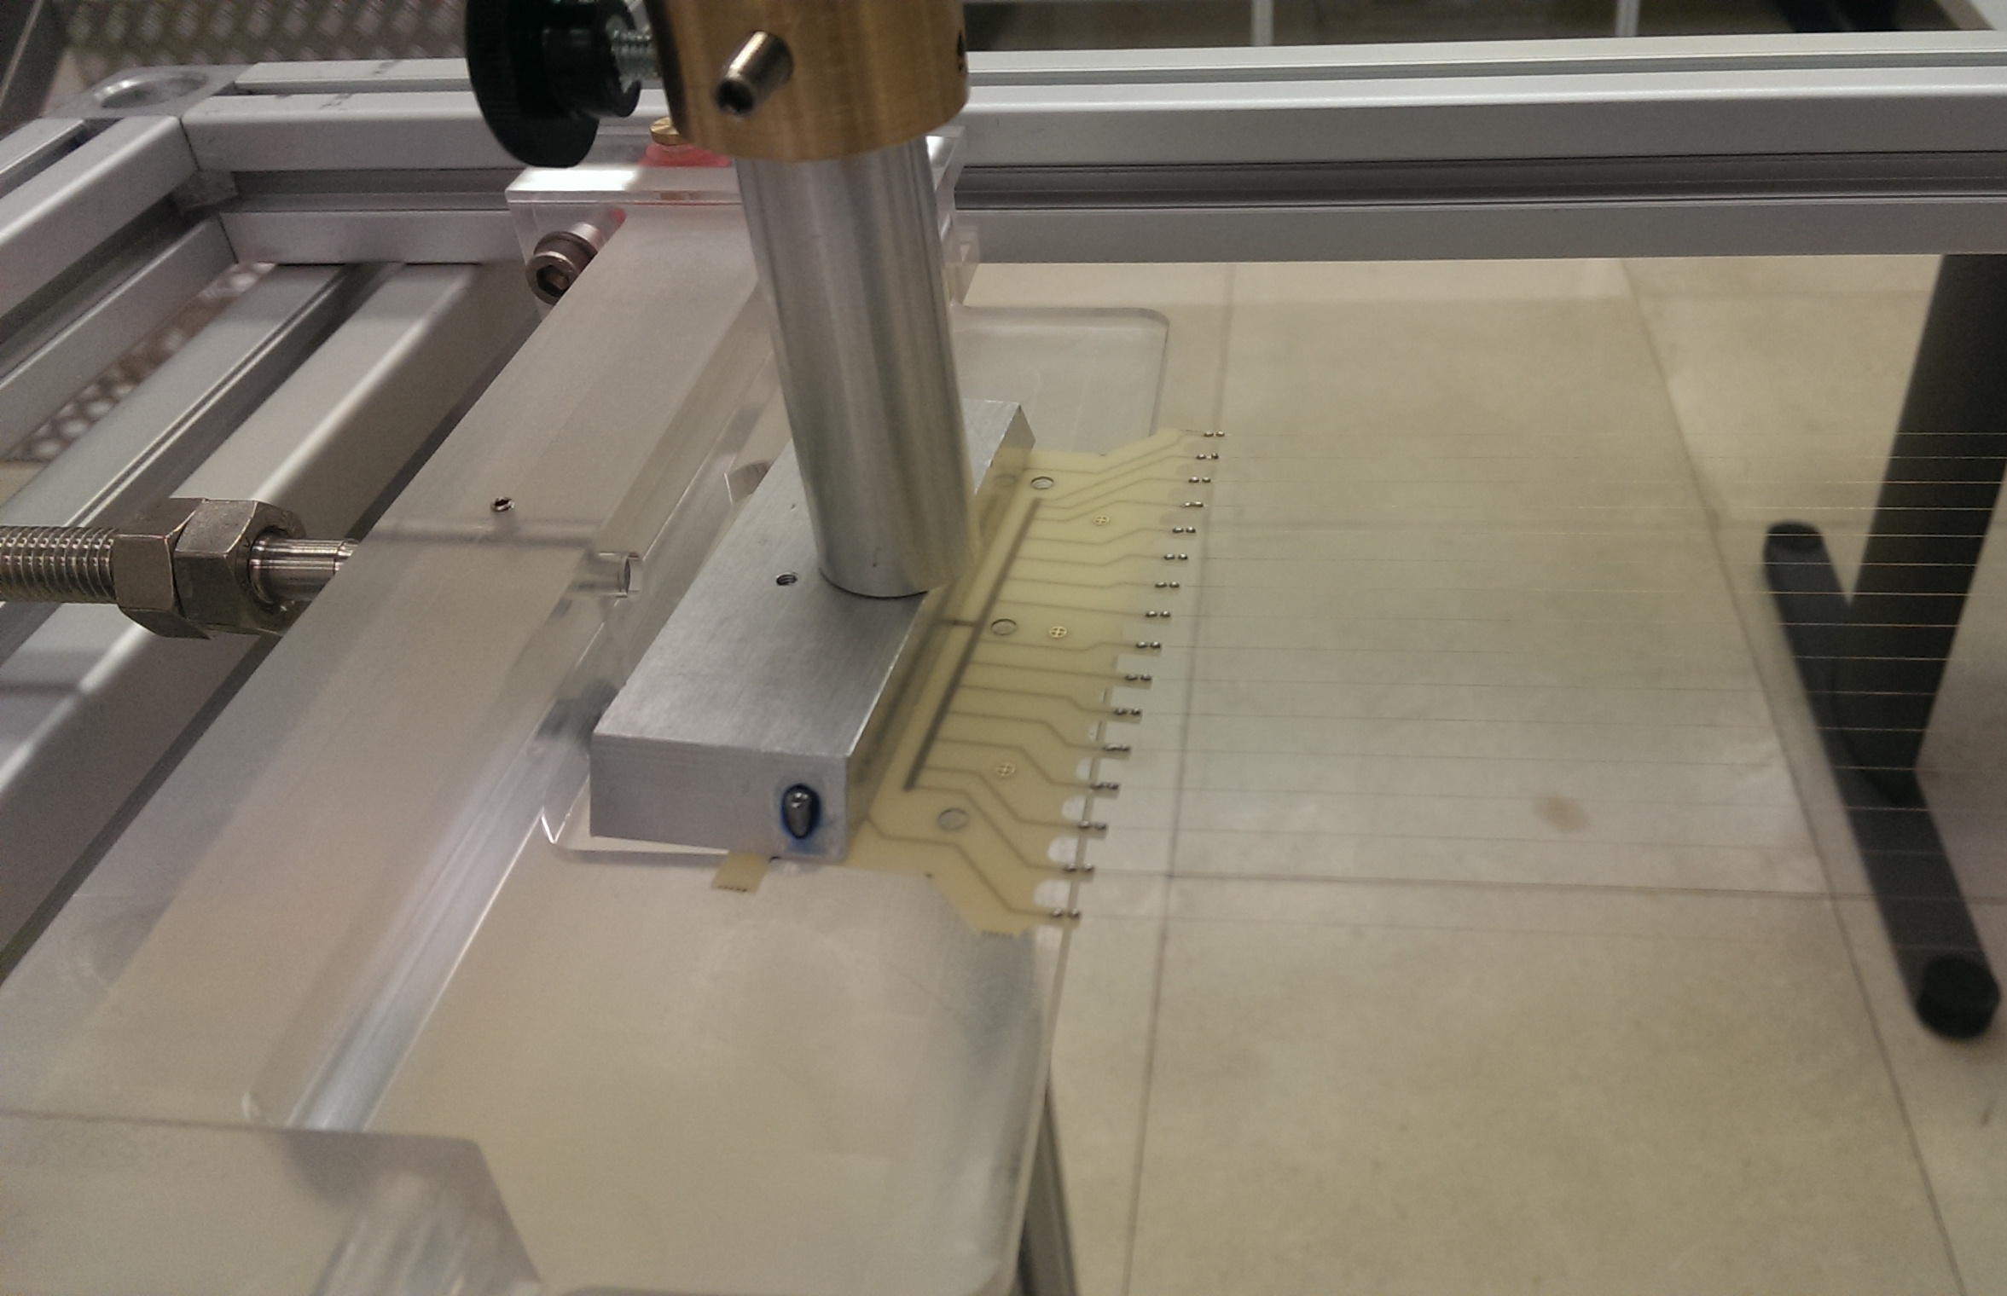
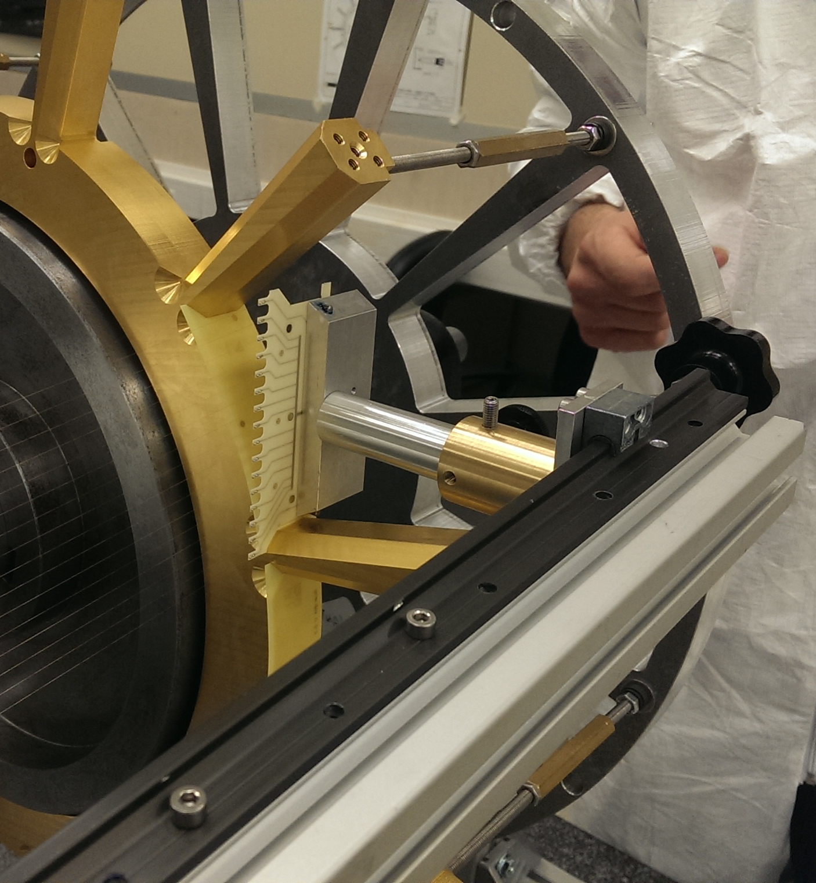
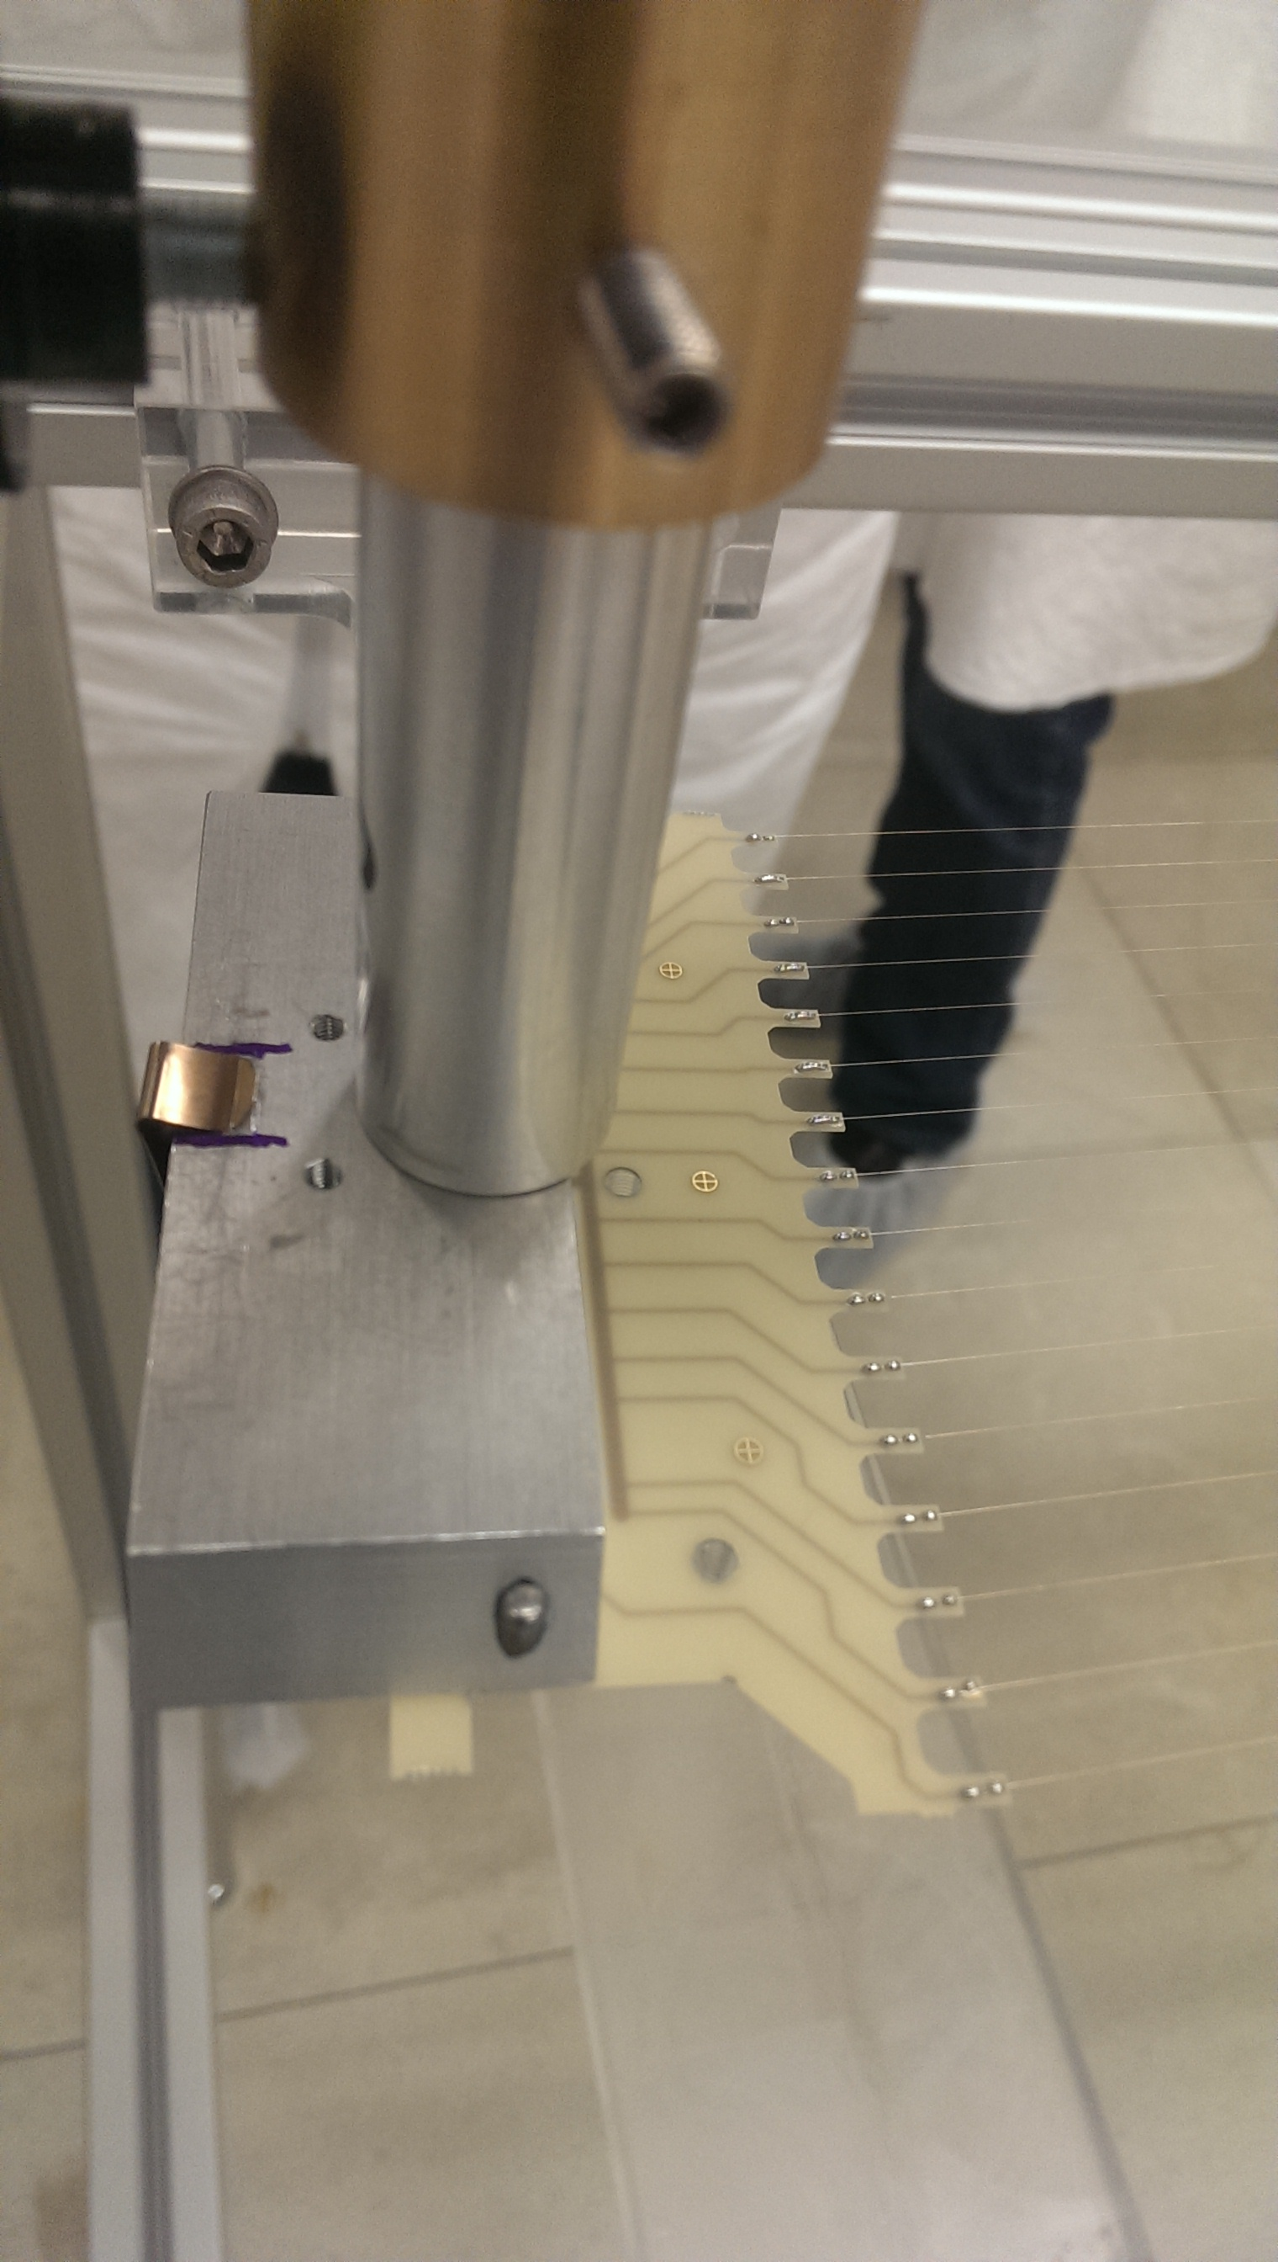
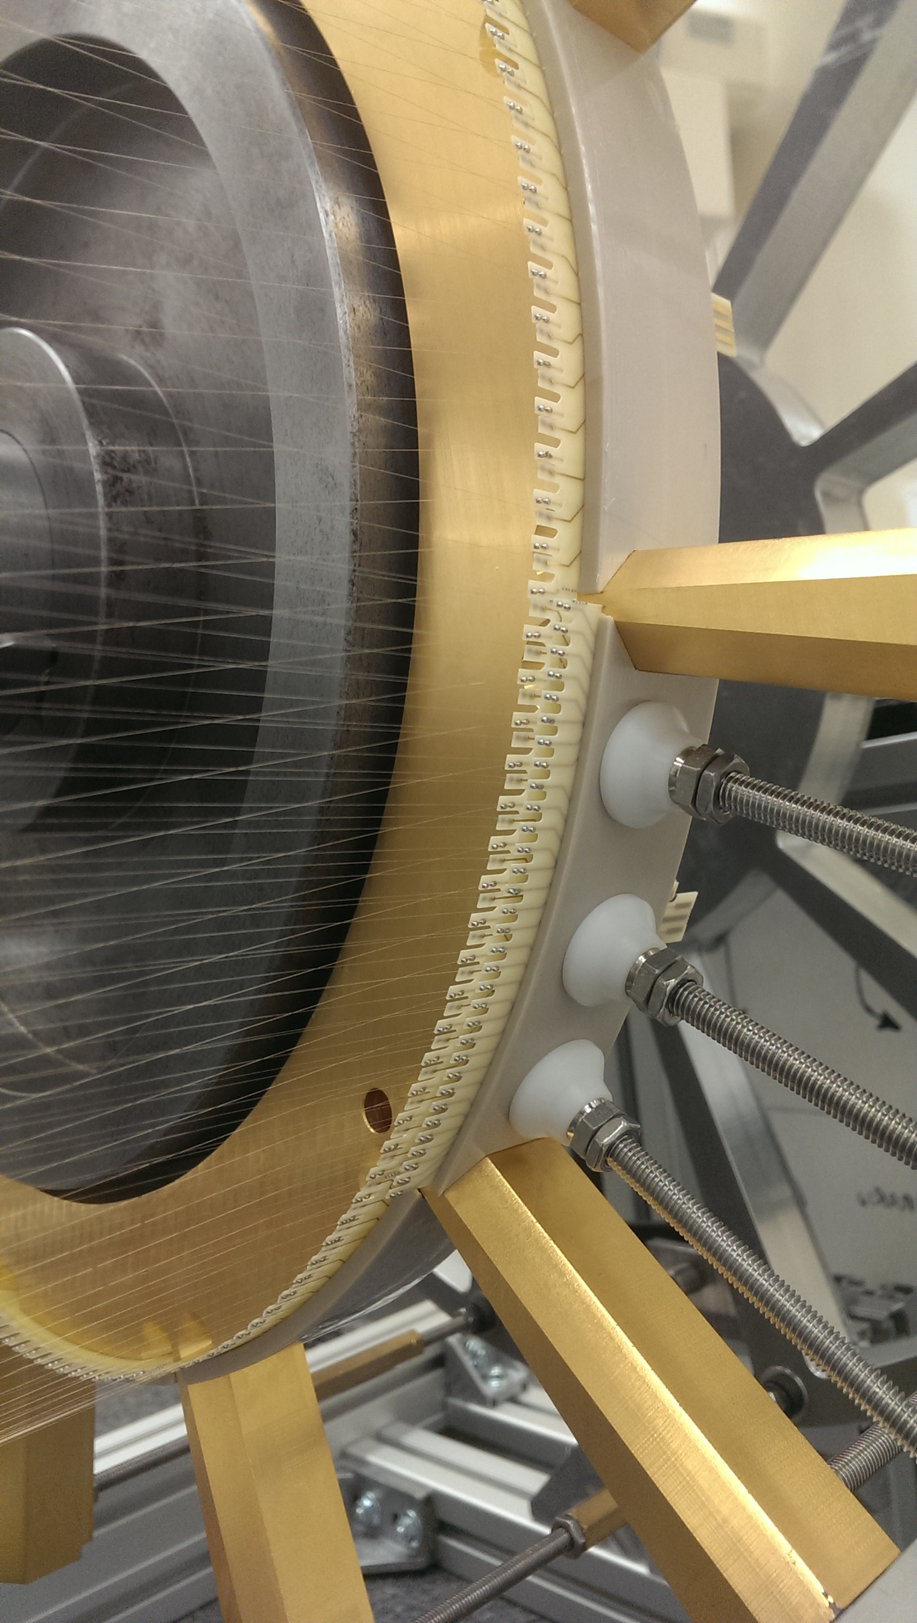
MEG2 DC Assembly
wire PC Boards
are lifted up by
adjustable arm ...
... and presented to
the end plates moved
closer by a few mm
A pressure
sensitive tape
holds them in
the correct
position above
the peek spacer.
At completion of each layer (12 sectors), the end plates are
moved away to the nominal length. The layer radial
coordinates and the tension of all wires are then measured.
After last layer has been mounted, the outer structural
carbon fiber cylindrical shell is placed and the inner shaft
is removed. The end plates are sealed, the inner mylar
cylinder is mounted, together with the extensions for the FEE

Slide 18
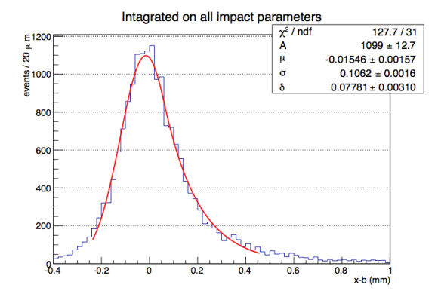
MEG2 DC Spatial resolution
Single-hit resolution measured with three different prototypes.
Results are all in agreement, yielding a resolution of about 110 μm averaged throughout the cell.
Further improvements expected thanks to the implementation of a wide bandwidth front end electronics allowing for the exploitation of the cluster timing technique.
σ = 106 μm
(He/iC₄H₁₀ = 85/15)
arXiv:1605.07970
Notes:
Several prototypes were made in order to make a reliable project for the new drift chamber. Results are in agreement, yielding a resolution of about 110 μm averaged throughout the cell.
CYLDCH will run with a low-Z counting gas mixture of Helium-Isobutane (He:iC4H10) in the fraction 85:15, which is the best compromise between track resolution and minimization
of MCS.

Slide 19
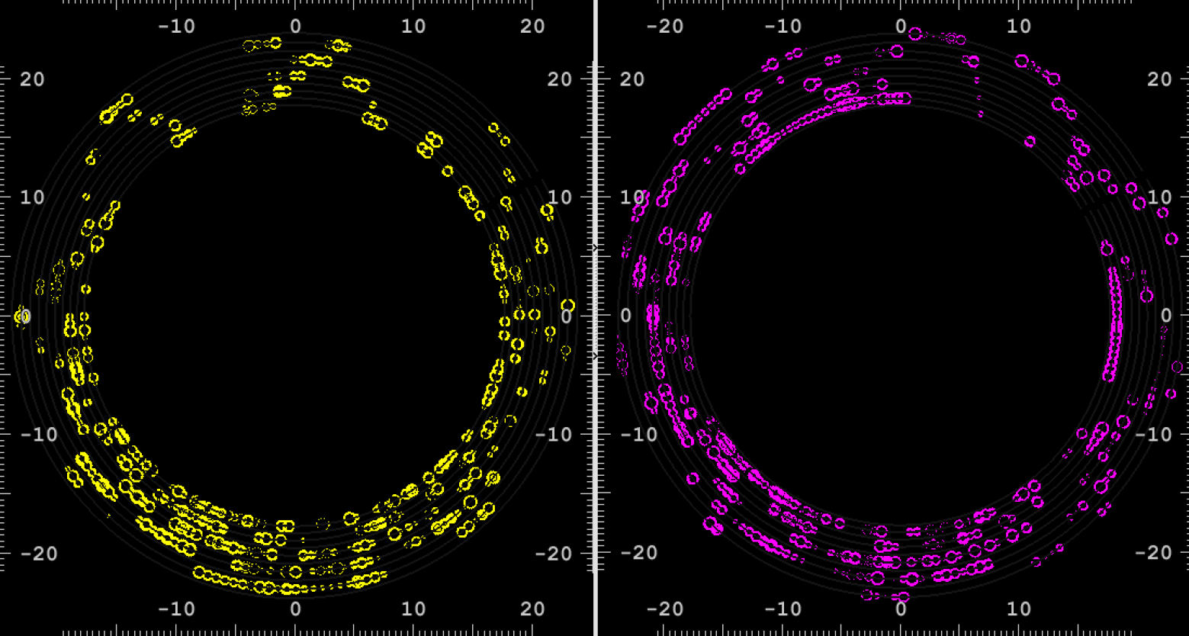
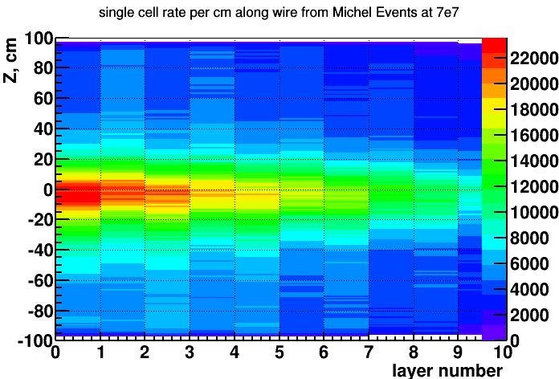
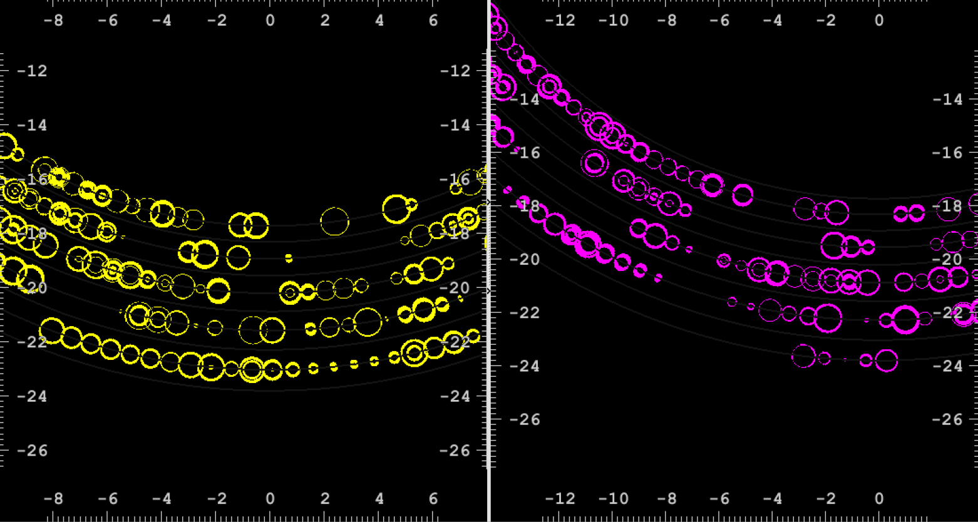
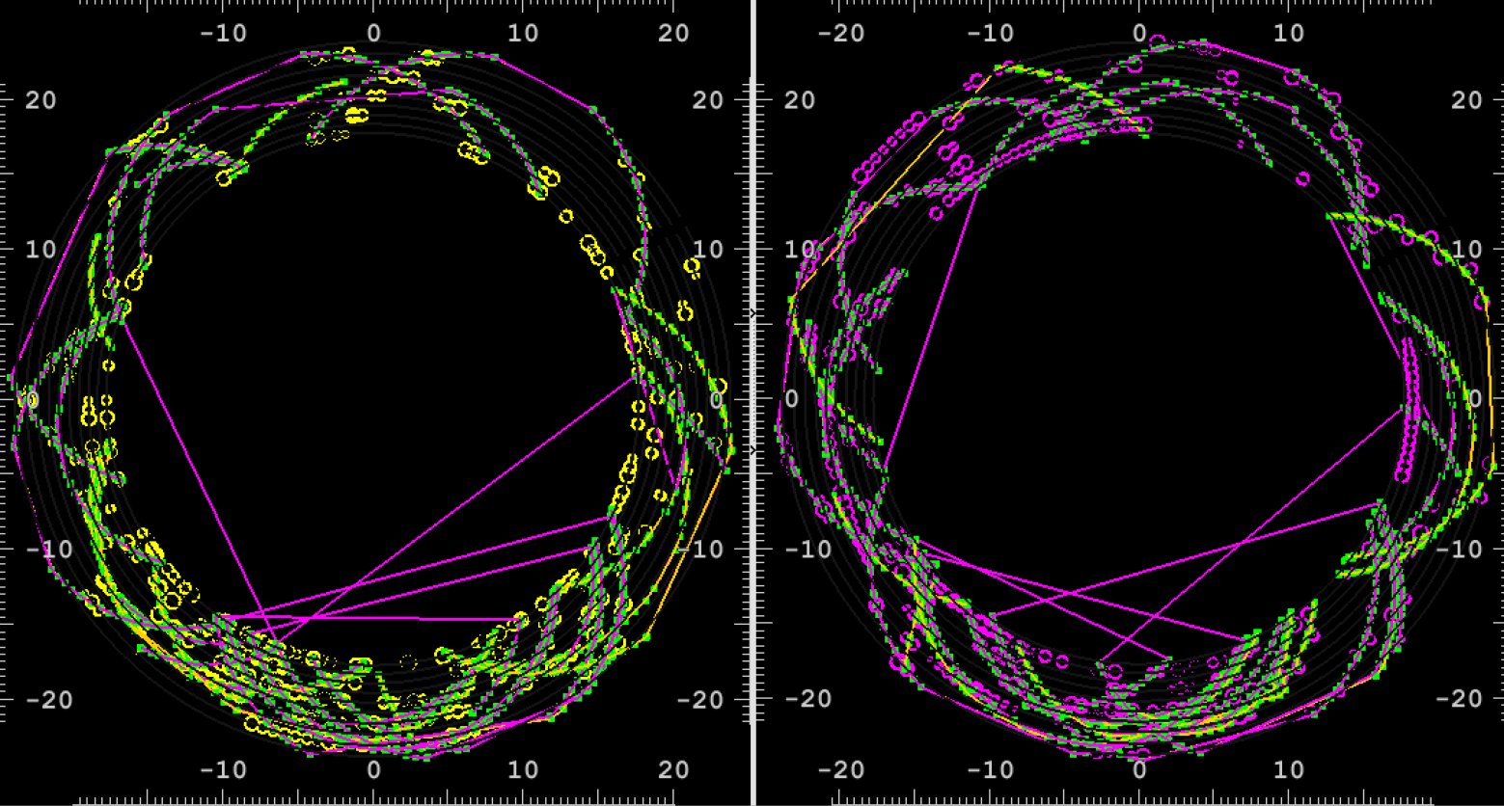



MEG2 DC Expected Perf.
hits in 250 ns window
both views
3D
track finding
and fit
segment fit + turn merging
zoom
layer
occupancy
discard short segments and isolated hits
full track fit
michel tracks
signal track

Slide 20




MEG2 DC Expected Perf.
σ_{ϕ} = 6.2 mrad
Preliminary
track finding + fit
ε ≈ 90%
σ_{ϑ} = 6.5 mrad
σ_{p} = 93.4 KeV/c

Slide 21








Cluster Timing
From the ordered sequence of the electrons arrival times, considering the average time separation between clusters and their time spread due to diffusion, reconstruct the most probable sequence of clusters drift times:
acquired
signal
reconstructed
signal
￼
For any given first cluster (FC) drift time, the cluster timing technique exploits the drift time distribution of all successive clusters to determine the most probable impact parameter, thus reducing the bias and the average drift distance resolution with respect to those obtained from with the FC method alone.
Bias
Maximum
Possible
Spacing
algorithm
First
Cluster

Slide 22



Cluster Counting
Thanks to the Poisson nature of the ionization process, by counting the total number of ionization clusters N_{cl} along the trajectory of a charged track, for all the hit cells, one can reach a relative resolution of N_{cl}^{-1/2}.
dE/dx
100 samples 3.7 cm
σ = 3.7%
≈ 2.0σ separation
(σ[%]=40.7 n^{-0.43} L[m]^{-0.32})
20% truncated mean
σ = 4.5%
≈ 1.4σ separation
μ−π 200 MeV/c
dN_{cl}/dx
Poisson distribution
σ = 1.7%
≈ 5σ separation
The data taken with a beam of μ and π at 200 MeV/c momentum at PSI, refer to a gas mixture He/iC₄H₁₀=95/5, N_{cl} = 9/cm, 100 samples, 2.6cm each at 45° (to avoid space charge effects), for a total track length of 3.7 m.
A 25 μm sense wire (gas gain 2x10⁵), readout through a high bandwidth (1.7 GHz, gain 10) preamplifier, is digitized with a 2 GSa/s 1.1 GHz, 8 bits digital scope.
  (NIM A386 (1997) 458-469 and references therein)
Experimental distribution
σ = 2.5%
≈ 3.2σ separation
μ−π 200 MeV/c

Slide 23
"Innovative DC" advantages
Gas containment – wire support separation and feed-through-less wiring
  allow to reduce material to ≈ 10⁻³ X₀ for the inner cylinder and to a few x 10⁻² X₀ for the end-plates, including FEE, HV supply and signal cables (Mu2e proposal design: 1.5x10⁻³ X₀ and 8x10⁻³ X₀, respectively).
Feed-through-less wiring
  allows to increase chamber granularity and field/sense wire ratio to reduce multiple scattering and total tension on end plates due to wires
Cluster timing
  allows to reach spatial resolution < 100 μm for 8 mm drift cells in He based gas mixtures (such a technique is going to be implemented in the MEG2 drift chamber under construction)
Cluster counting
  allows to reach dN_{cl}/dx resolution < 3% for particle identification (a factor 2 better than dE/dx as measured in a beam test)
Recipe for cluster timing/counting in He based gas mixtures:
FEE: 1 GHz BW, x10 gain (S/N ratio ≈ 8) - digitizer: 2 GSa/s sampling rate, >8 bits

Slide 24

MEG2 DC Front End El.
pre-emphasis
Current
consumption
per channel:
50 mA at ±2.5V
(500 W/end plate)
noise immunity
Op-amp ADA4927 first gain stage: low noise, ultralow distortion, high speed, current feedback differential amplifier achieving wide bandwidth, low distortion, and low noise
(1.3 nV/√Hz) and low power consumption.
THS4509 second gain stage and output driver: wideband, fully differential op- amp, very low noise (1.9 nV/√Hz), extremely low distortion, ideal for pulsed applications.

Slide 25





MEG2 DC Front End El.

Slide 26




MEG2 DC Front End El.

Slide 27

MEG2 DC Read Out
latest DRS (PSI) version
More generally, in a large DCH (60,000 channels, 30% occupancy,
1 μs drift time, 2 GSa/s - 12 bits digitization), at a 5 kHz trigger rate,
expect: > 100 GB/s!

Slide 28








Clu-Tim/Cou Read Out
AD9625-2.0EBZ
UG534 ML605

Slide 29
How long a drift chamber can be?
Gravitational sag
wire L along x-axis, f force per unit length along y, T tension of wire
f independent of x, parabolic solution
sag
wire radius r, volume density ρ, gravitational sag
Example:
L=2m; sense: 20μm W(Au), T=27g; field: 40μm Al(Ag), T=17g; guard: 50μm Al(Ag), T=26.5g

Slide 30
How long a drift chamber can be?
Electrostatic stability
Simplified model of a wire of radius R at voltage V₀, placed between two parallel grounded
planes at distance W/2 from the wire
linear charge density
assume a wire displacement Δ towards one plane
cap. per unit length
stability
condition
perfectly symmetric geometry

Slide 31
How long a drift chamber can be?
Electrostatic stability: a numerical example MEG2
20μm W sense wire, V₀= 1500V, W = 7mm, L = 2m, T = 0.25N
linear charge density
assume a wire displacement Δ = 50 μm
cap. per unit length
stability
condition
or
increase sense wire diameter to 50μm, T = 1.56N, for the same gain (same λ) need V₀=1750V
or
drawback:
multiple scattering and force on end plates increase by a factor 2.5²
(Ti(Sn) instead of W(Au)? to regain a factor 4 in mass and 10 in X₀)

Slide 32
A proposal for FCCee
  112 para-axial layers at alternating sign stereo angles, arranged in 16 equal azimuthal sectors;
  32 square, single sense wire, drift cells per sector (512 total per layer) increasing linearly as a function of layer radius;
  Cell sizes ranging from 6.3 mm to 25 mm from inner to outer radius;
  Alternating sign stereo angles in consecutive layers ranging from 40 to 160 mrad (constant azimuthal angular displacement)
  Length: 5000 mm; fully efficient up to cosϑ = 0.97 (≥16 hit)
  Inner Wall: made of 25 μm of Kapton plus 0.1μm of Au (1.2×10⁻⁴ X₀) at Radius = 500 mm;
  Outer Wall: Sandwich of 8-ply C-fiber (0° and 90°, total of 250 μm) - 2.5 mm Rohacell30 - 8-ply C-fiber (8.0×10⁻³ X₀) at Radius = 2060 mm (must support 20 Tons - check for buckling over 5 m);
  End plates:
    Wire cage (in analogy to Mu2e I-Tracker):
    0.9 g/cm² - 3×10⁻² X₀ (incl. power distr., decoupling C's, term. resistors and signal and HV cables).
    Gas envelope made of 8 ply (quasi-isotropic, 10×38 μm = 380 μm) C-fiber plus 0.3 μm Au, for a total of 0.090 g/cm² – 3.0×10⁻³ X₀;
  Gas: 90% He - 10% iC4H10 (δ = 4×10⁻⁴ g/cm³, X₀ = 1410 m), - 12.5 p.i./cm, gas gain: 4×10⁵ at V ≈ 1700 V on 50 μm wire, v_{drift} ~ 2.5 cm/μs – 0.47×10⁻³ X₀/1m track
  Wires: - 57,344 sense (50μm Sn coated Ti); 290,816 field and guard (100μm Sn coated C); for a total equivalent thickness of 1.34×10⁻³ X₀/1m track

Slide 33
Expected spatial resolution
Expected Performance: Track parameters resolutions
n = 112, B = 2.0 T, R_{out} = 2.05 m, L = 3.0 m or 5.43x10⁻³ X₀, σ_{xy} = 100 μm, σ_{z} = 1.0 mm
measurement
multiple scattering (gas + wires)

Slide 34

Expected spatial resolution

Slide 35


Expected spatial resolution

Slide 36


Expected p. id. capabilities
σ_{dE/dx}/dE/dx =
= 5.4 L[m]^{-0.37} %
(Lehraus parametrization)
3.6% for L=3m
cluster counting efficiency
ε = 80%
σ /dN_{cl}/dx =
= ε×L×12.5/cm =
1.8% for L=3m
dN_{cl}/dx
thresh.
Particle separation power as a function of cluster counting efficiency for 2m tracks.
Cluster counting outperforms dE/dx for counting efficiencies as low as 20%.

Slide 37
Conclusions
We propose for FCCee an innovative tracking system based on a
"ultra-light drift chamber with peculiar particle identification capabilities" using cluster timing/counting techniques.
It consists of a full stereo, single sense wire, square cells:
  R_{in} = 50 cm; R_{out} = 205 cm; L = 500 cm; 112 layers × (6.3 to 25.0 mm); 57,344 cells; >16 hits down to cosϑ = 0.97; stereo angles ranging from 40 mrad to 160 mrad;
  Inner cylindrical wall: 1.2×10⁻⁴ X₀
  Outer cylindrical wall: 8.0×10⁻³ X₀
  End plates (fully instrumented): 3.3×10⁻² X₀
  Gas + wires: .47×10⁻³ X₀/1m track + 1.34×10⁻³ X₀/1m track
Expected spatial resolutions: σ_{rϕ} < 100 μm, σ_{z} < 1 mm
Expected momentum resolution: Δp/p = 4.9×10⁻⁴, Δϑ = 0.9×10⁻⁴, Δϕ = 0.5×10⁻⁴ for p = 10 GeV/c and ϑ = 45°
Expected p. id.: π/κ separation > 3σ for p < 850 MeV/c and p > 1070 MeV/c
At current status of the art no need for major R&D

