Slide 1

Copper Laser-Engineered Surface Structures (LESS)
FOLLOW-UP MEETING
Elisa García-Tabarés Valdivieso
TE-VSC-SCC
19th July 2016

Slide 2
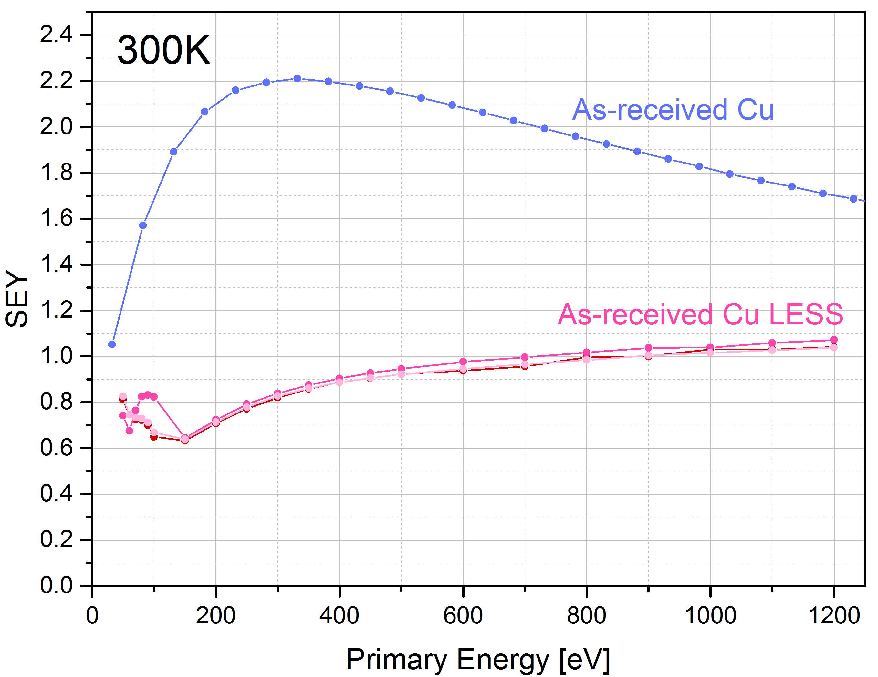
LESS Copper: University of Dundee
SEY at RT

Slide 3
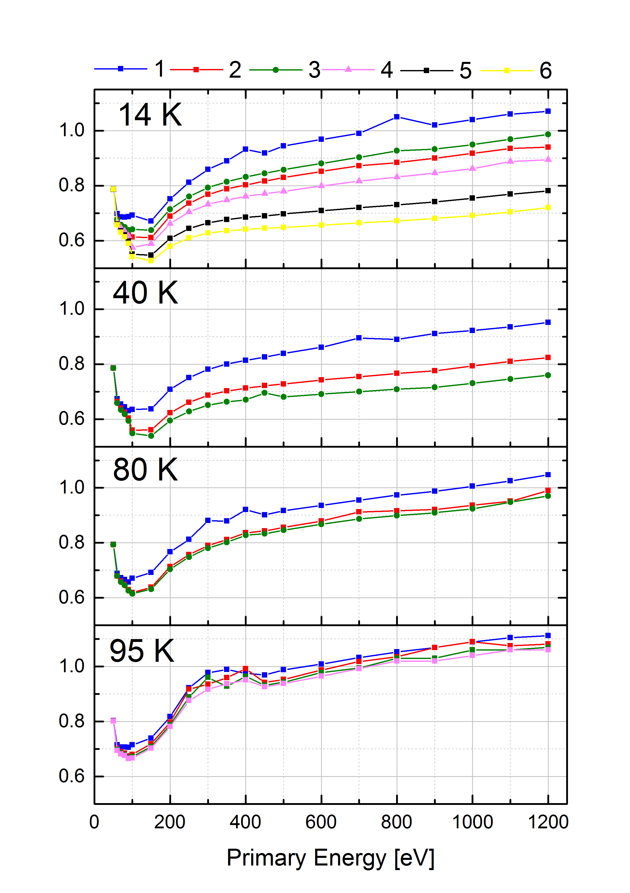
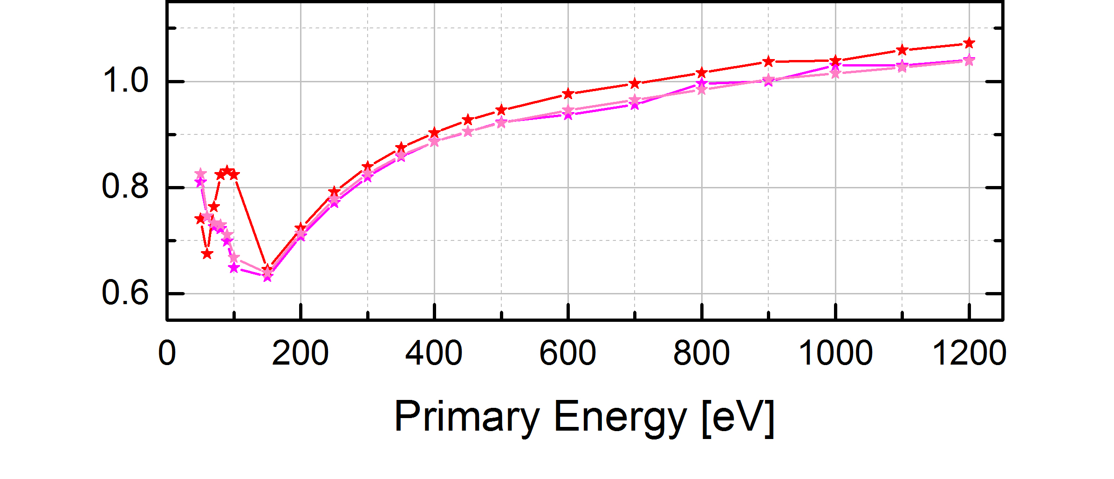
LESS Copper: University of Dundee
SEY at cold
300K
SEY goes down during SEY measurement.
It goes up immediately after the measurement.
SEY dispersion is reduced as we increase the temperature.
Conditioning of the sample?

Slide 4
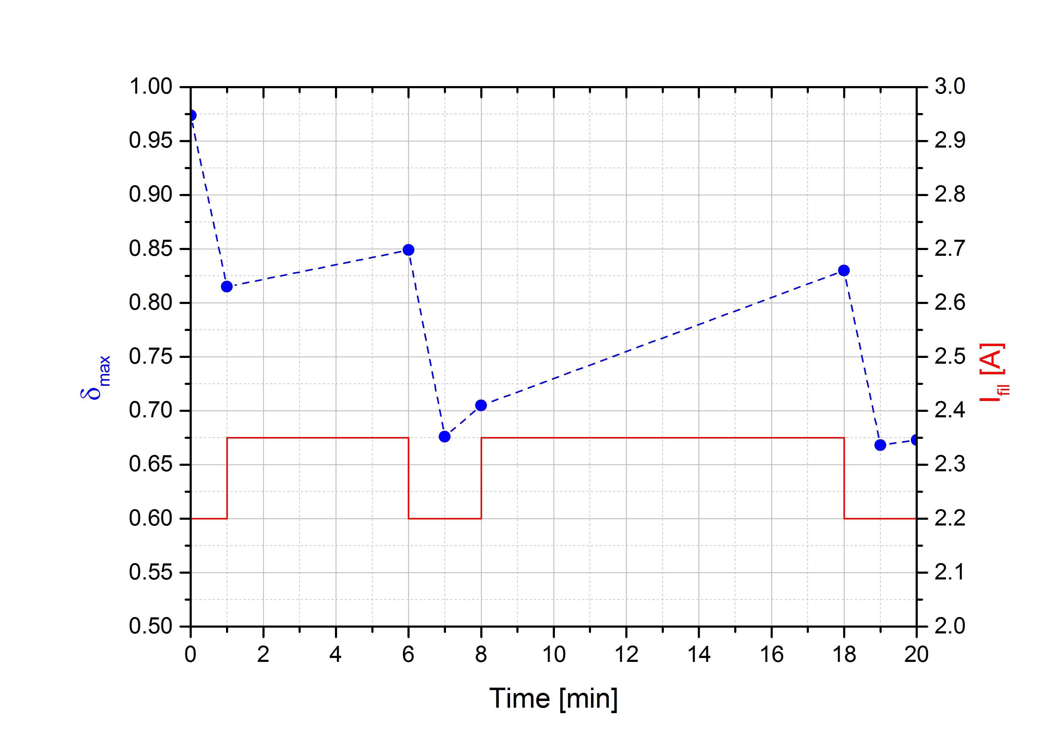
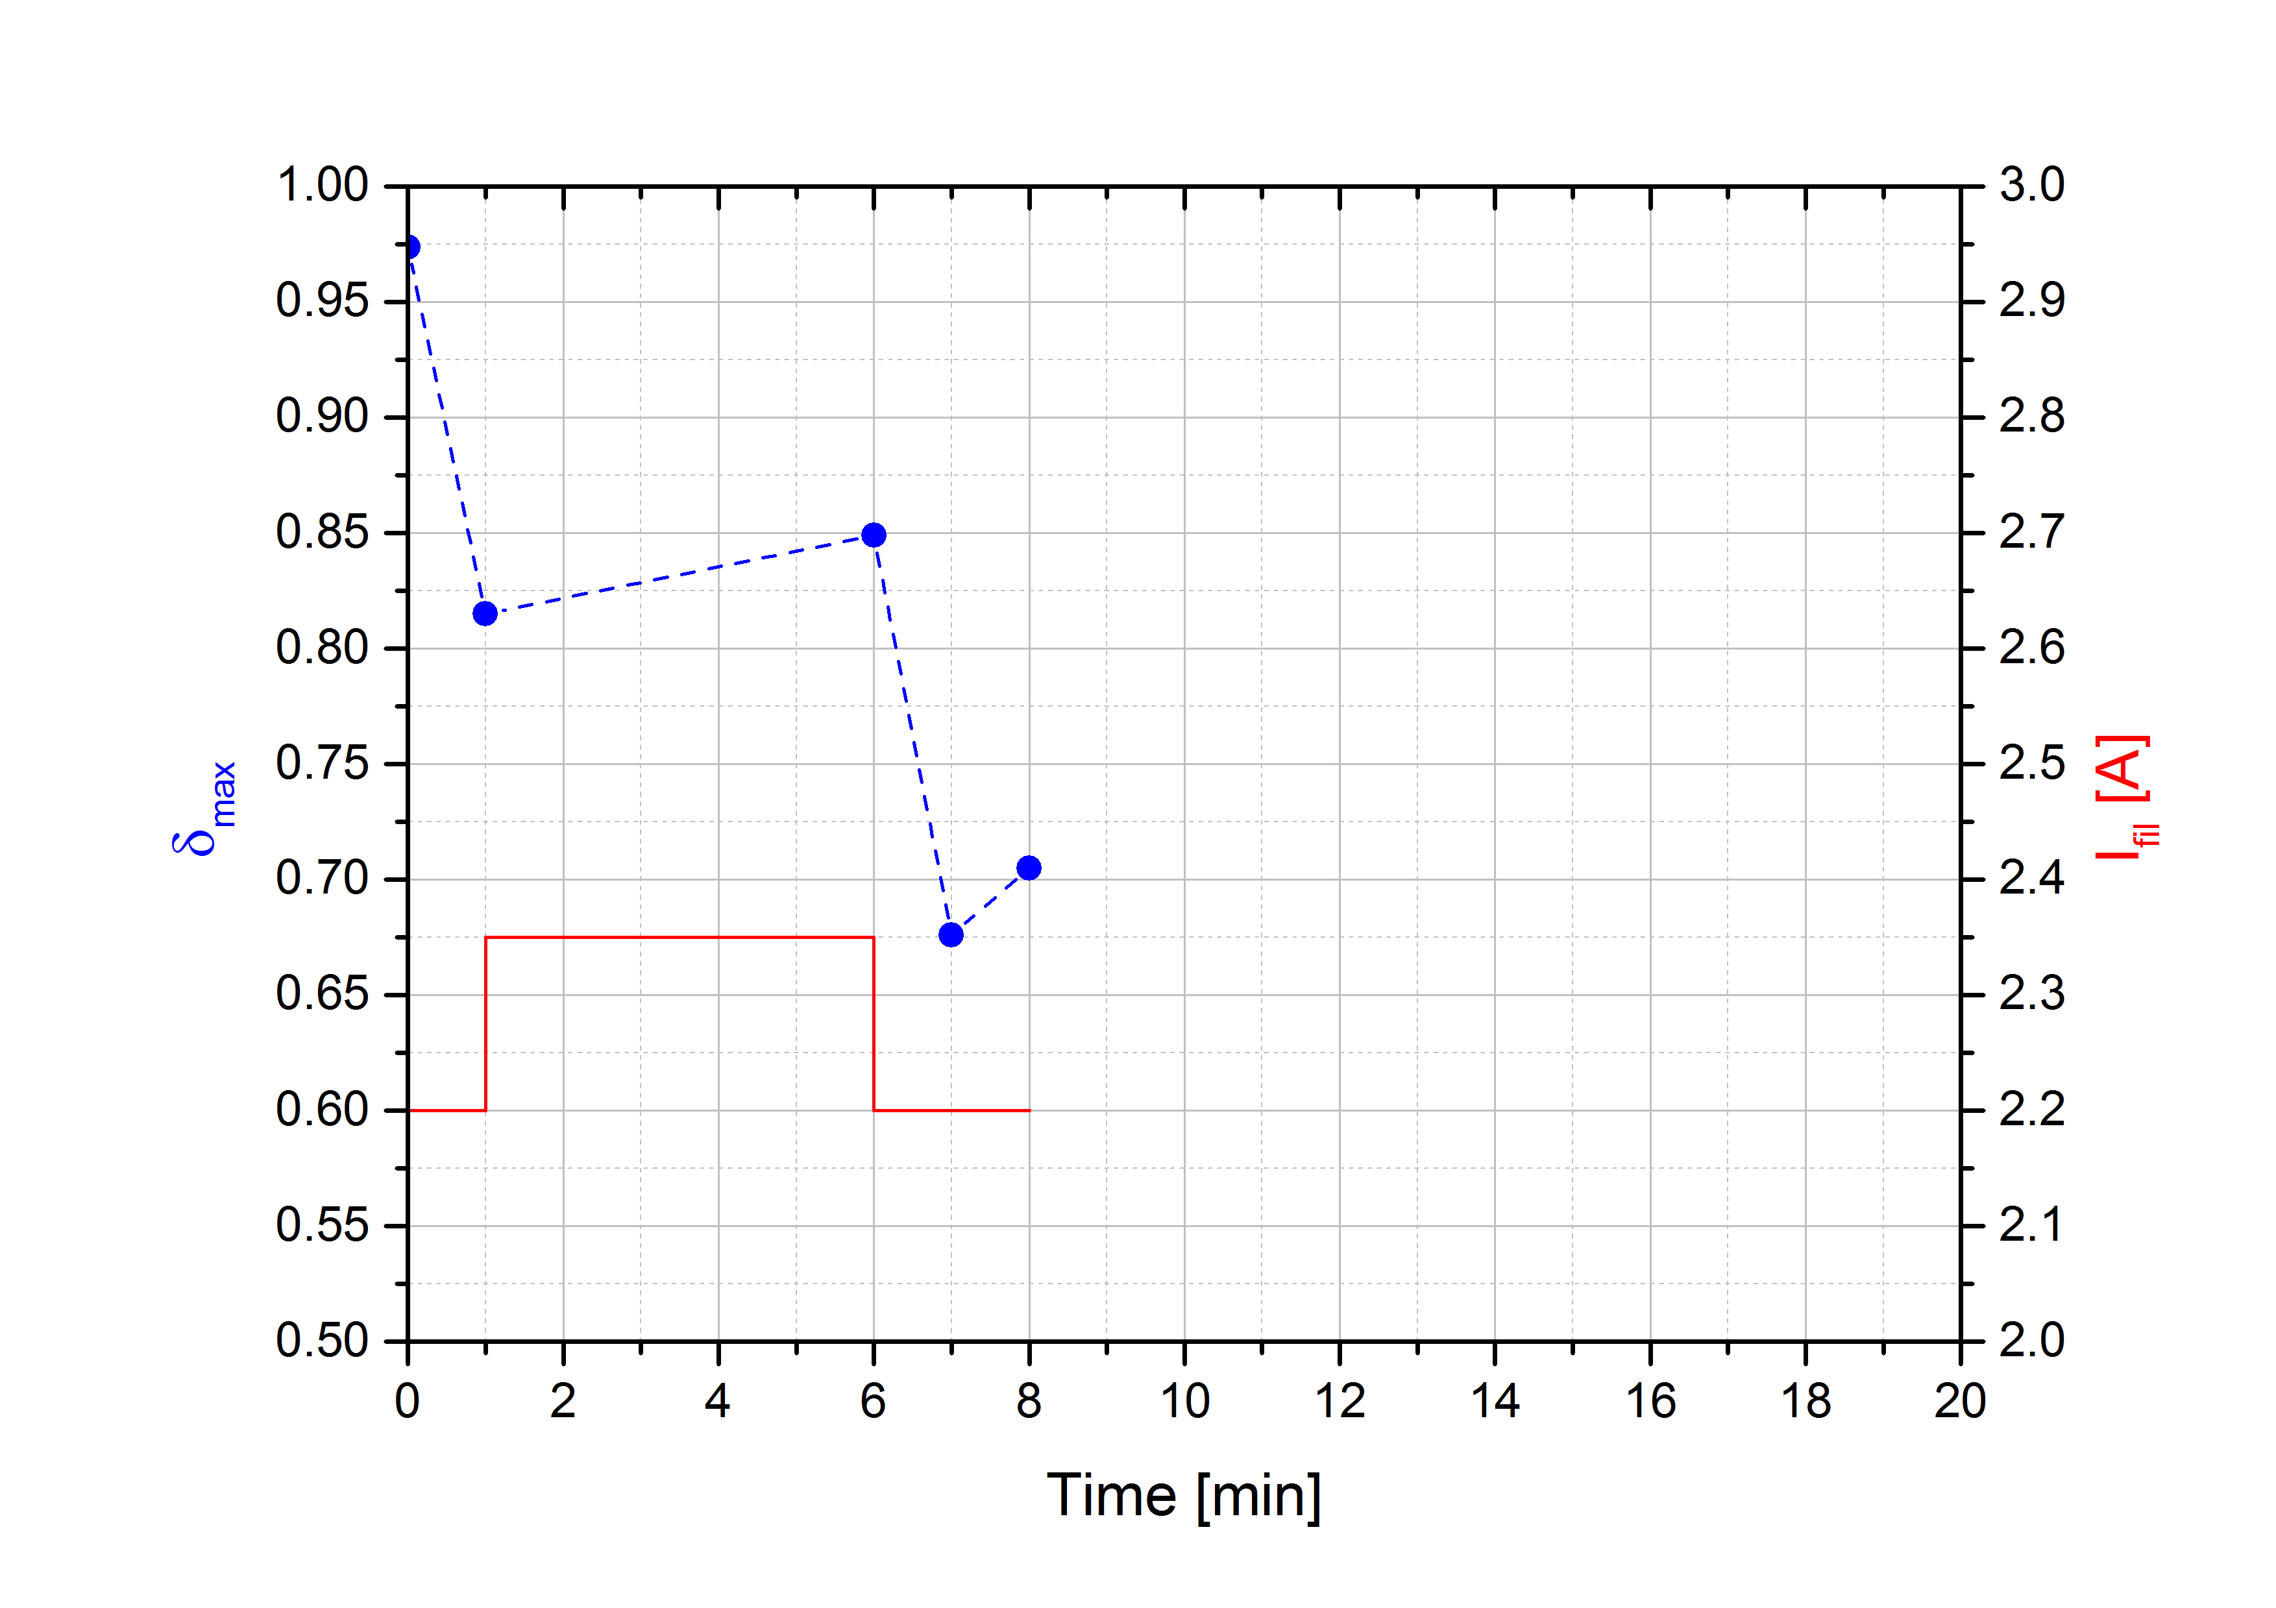
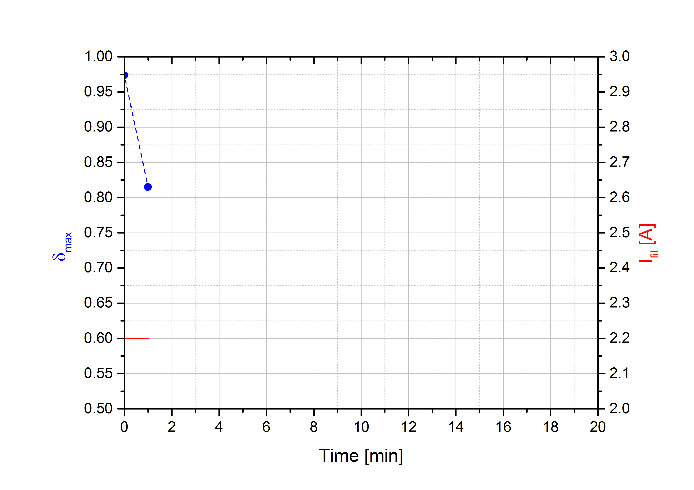
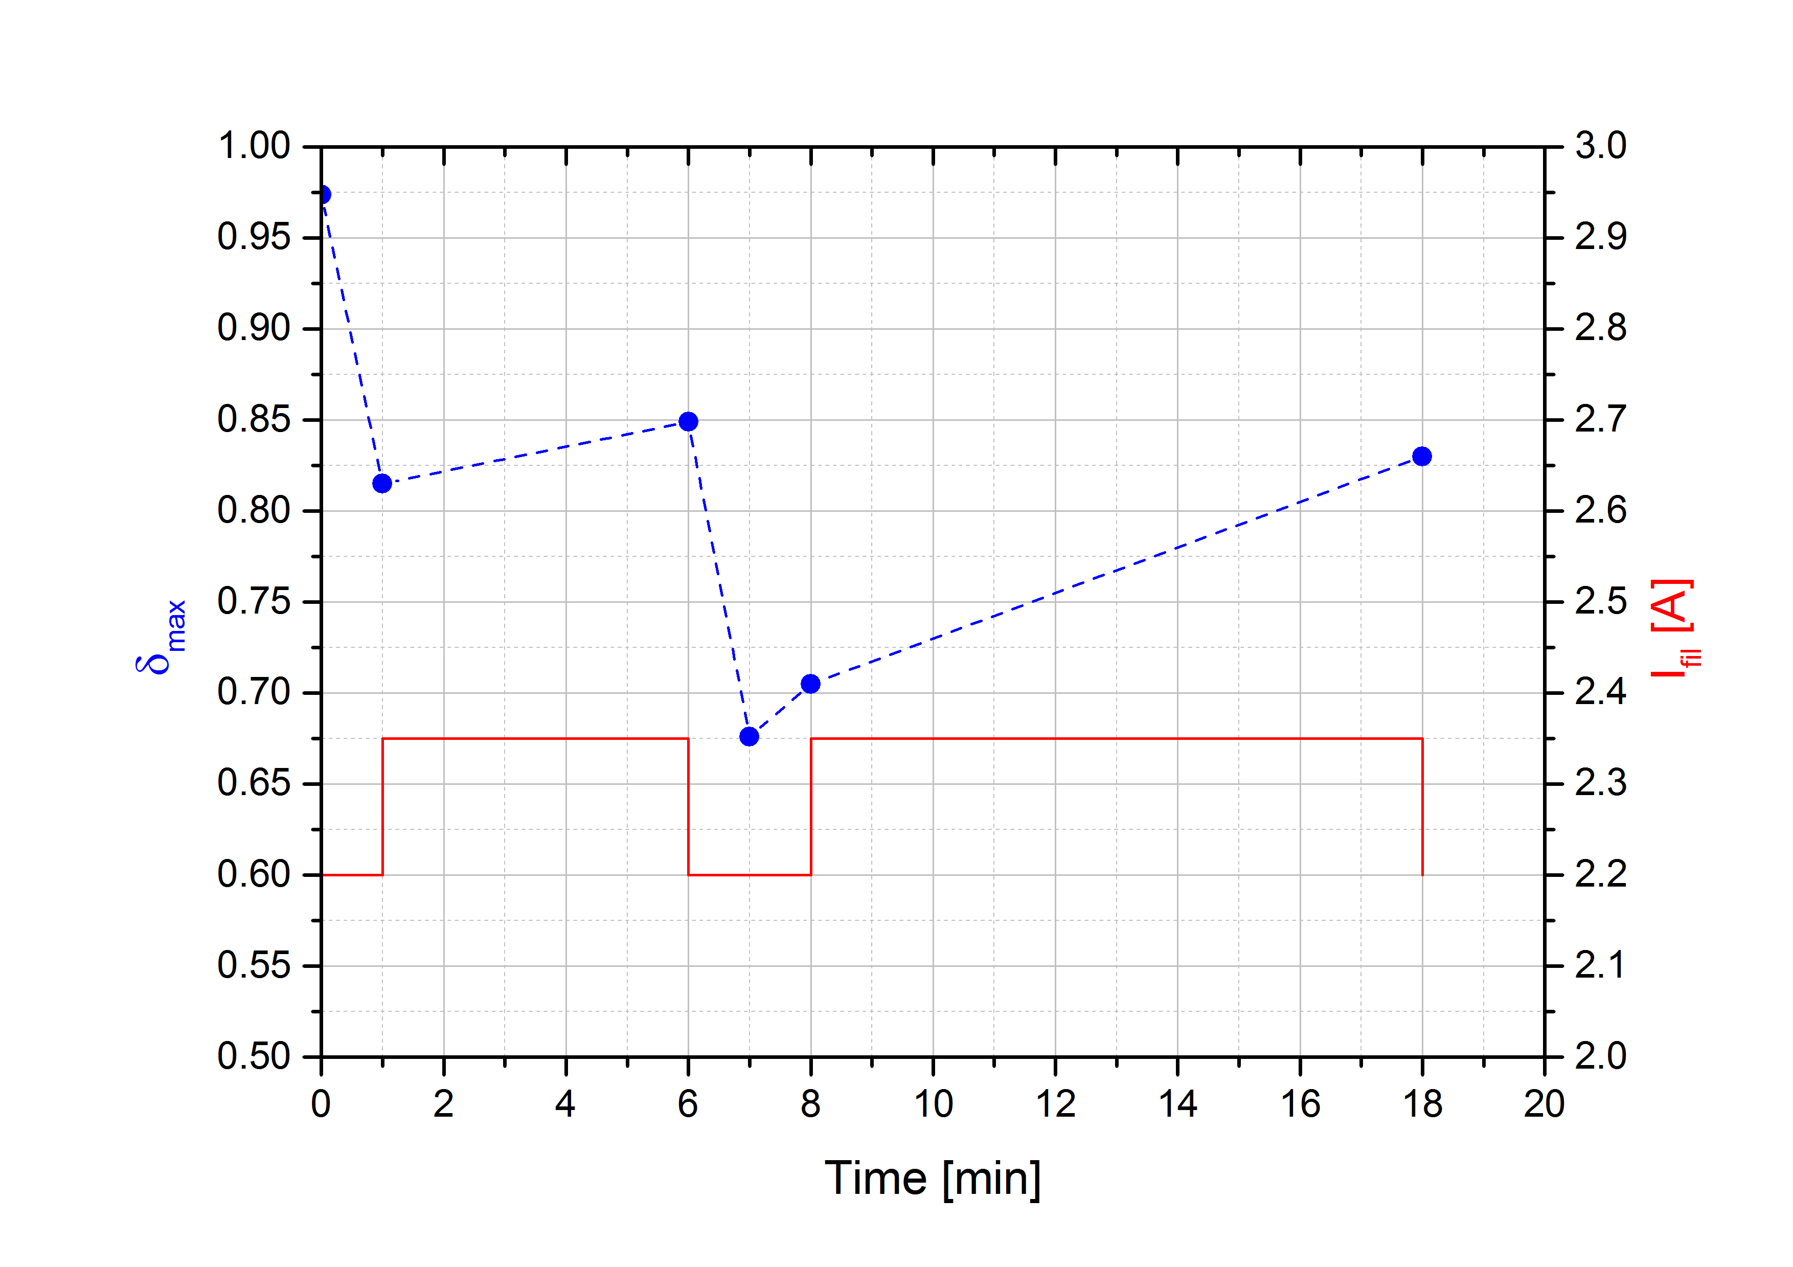
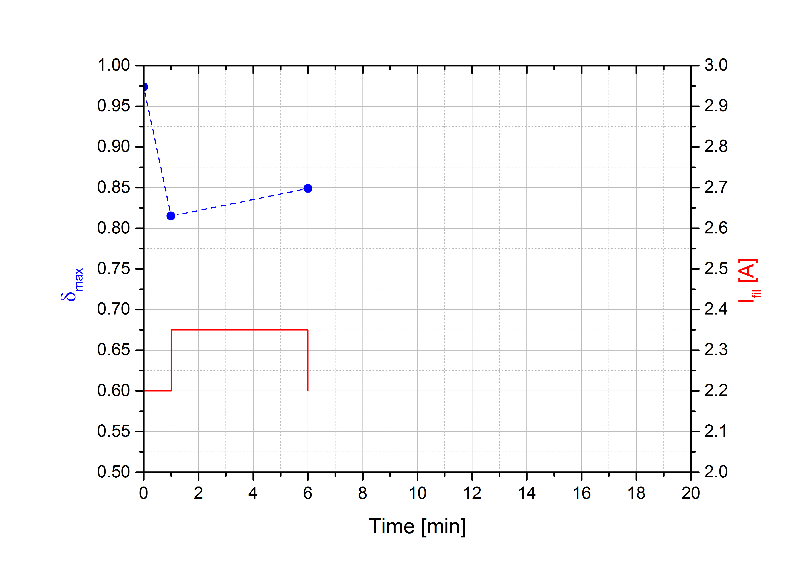
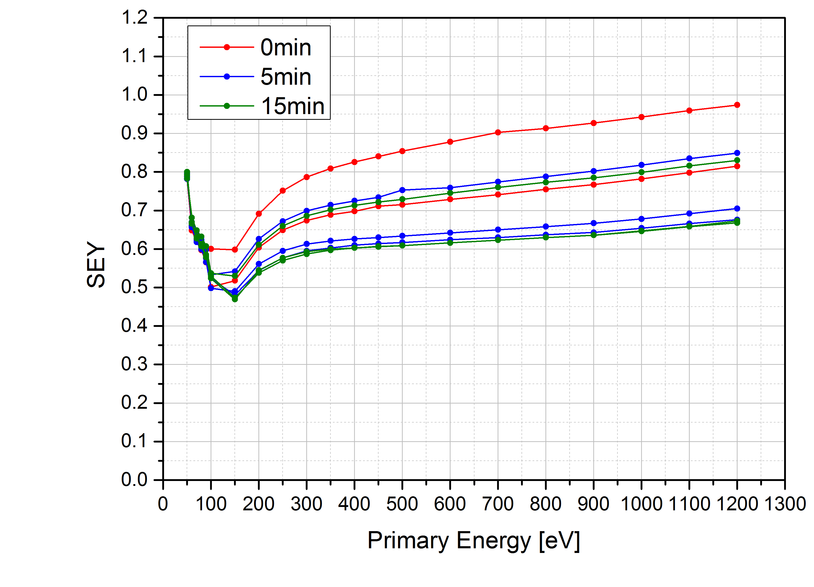
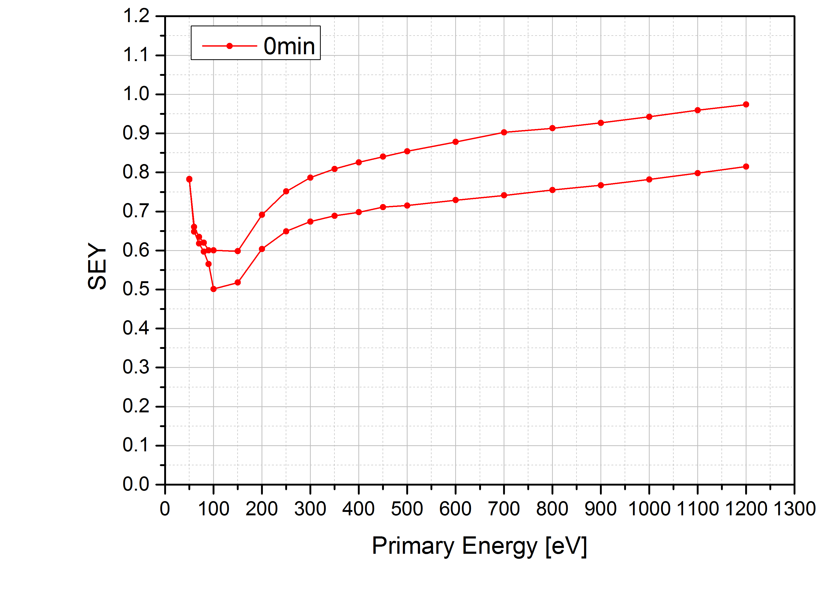
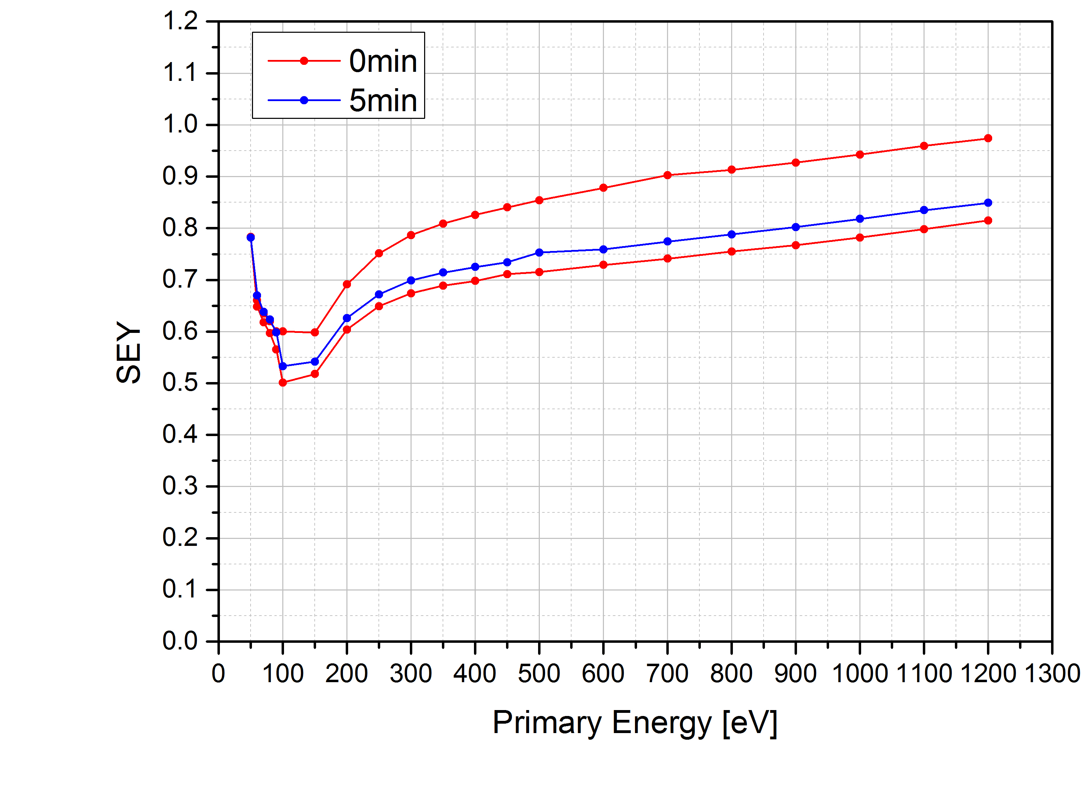
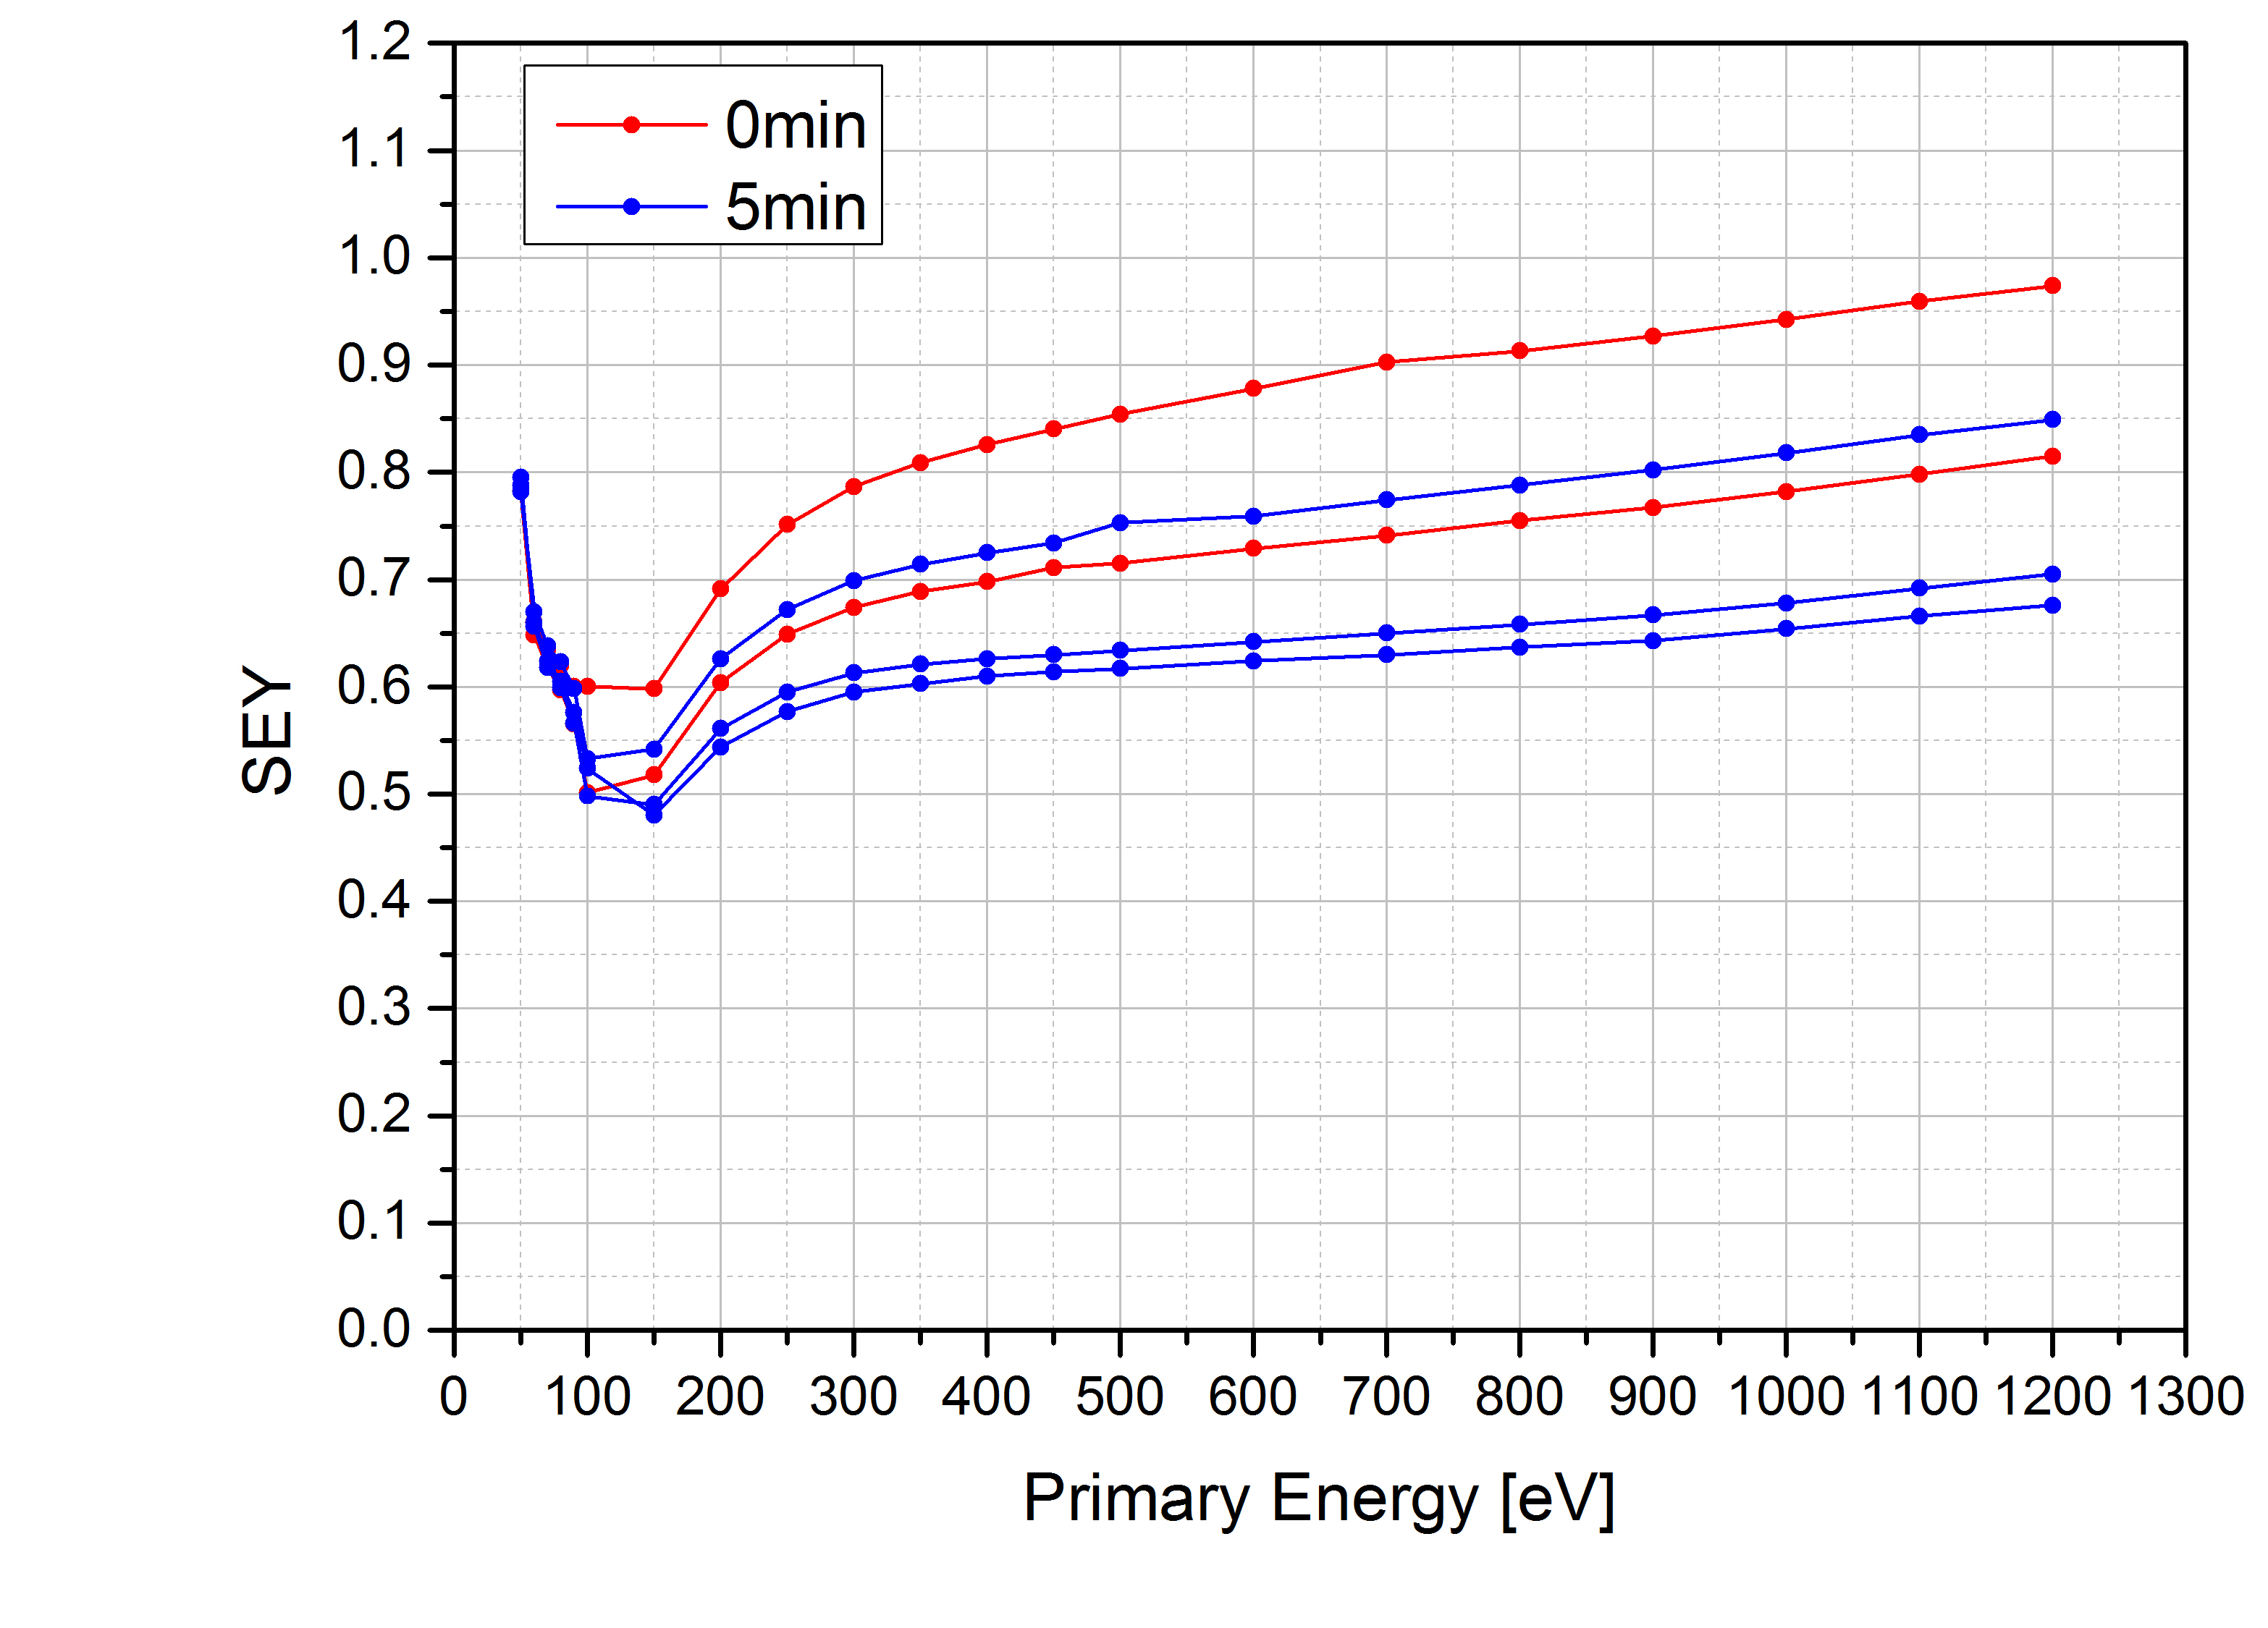
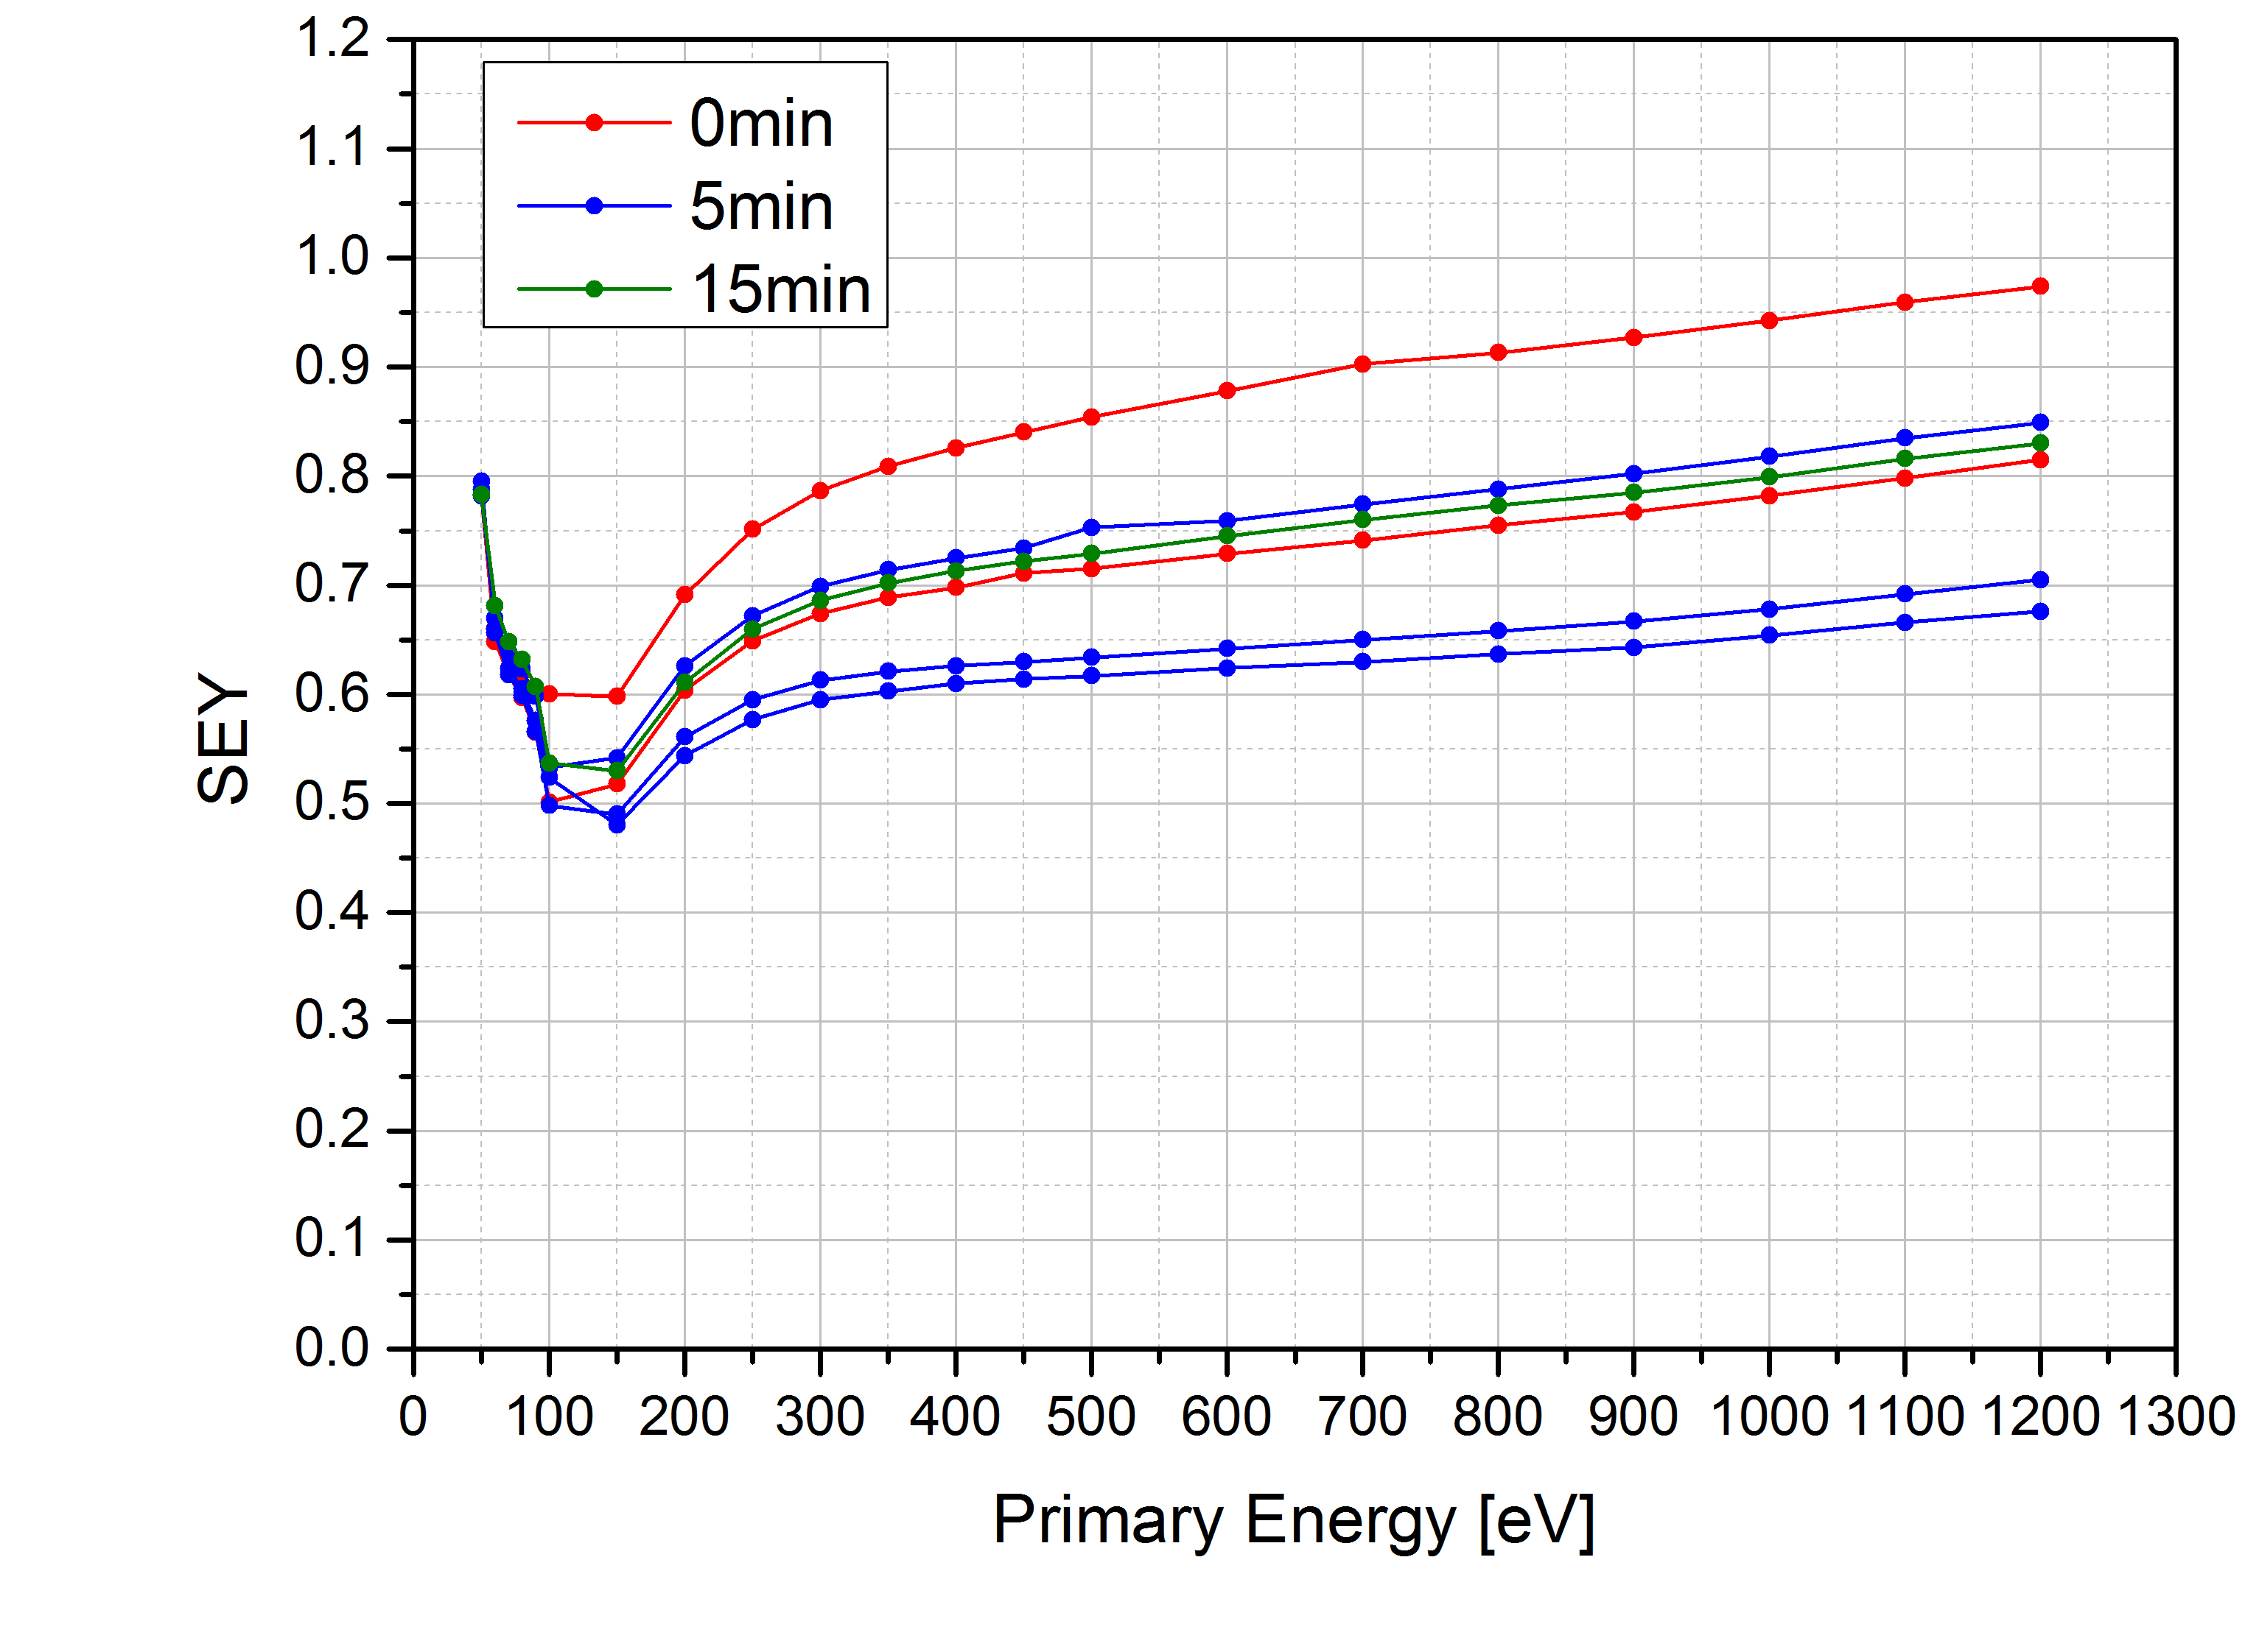
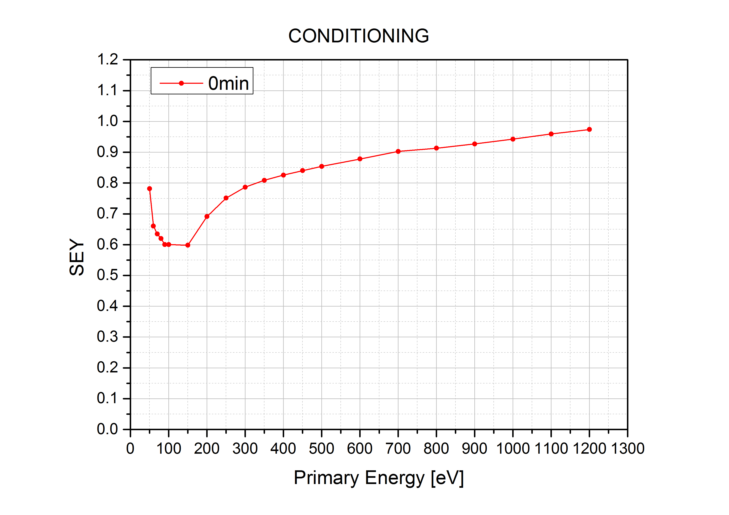
LESS Copper: University of Dundee
Conditioning?
SEY goes down during the measurement.
During conditioning, instead of going down, SEY increases.
Is the sample charging due to the presence of copper oxide?
27.06.2016

Slide 5
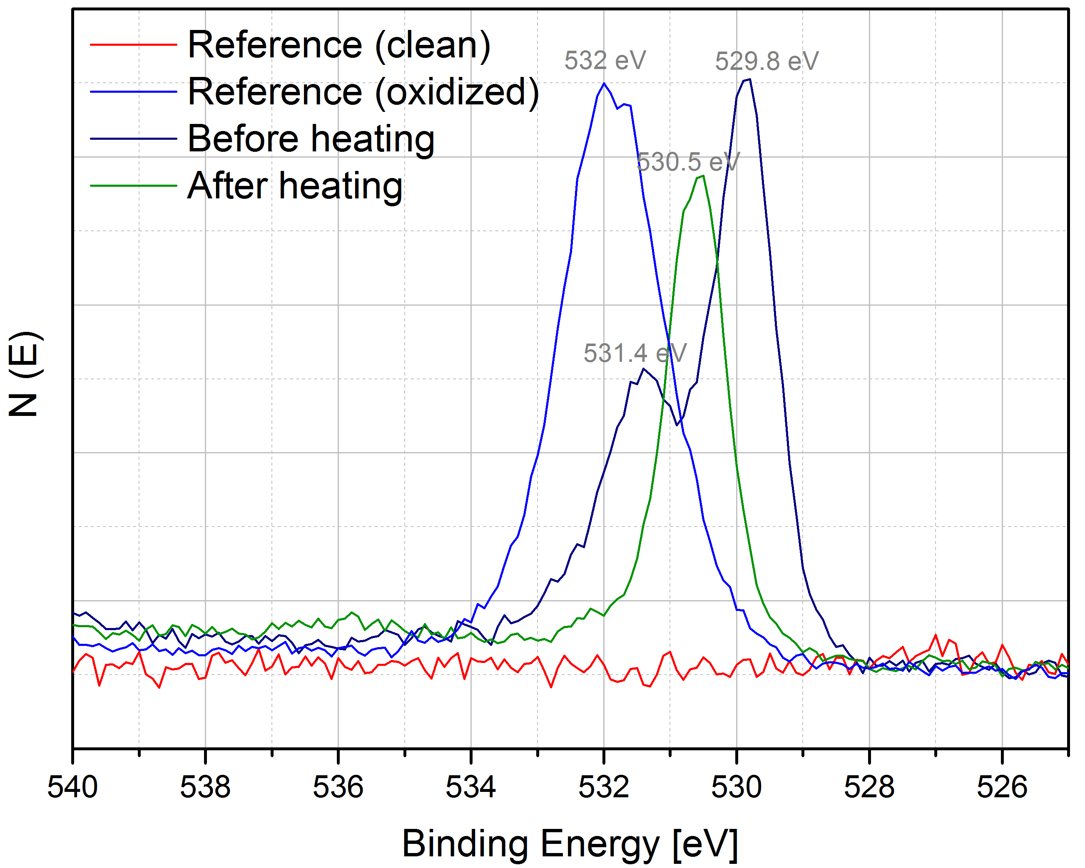
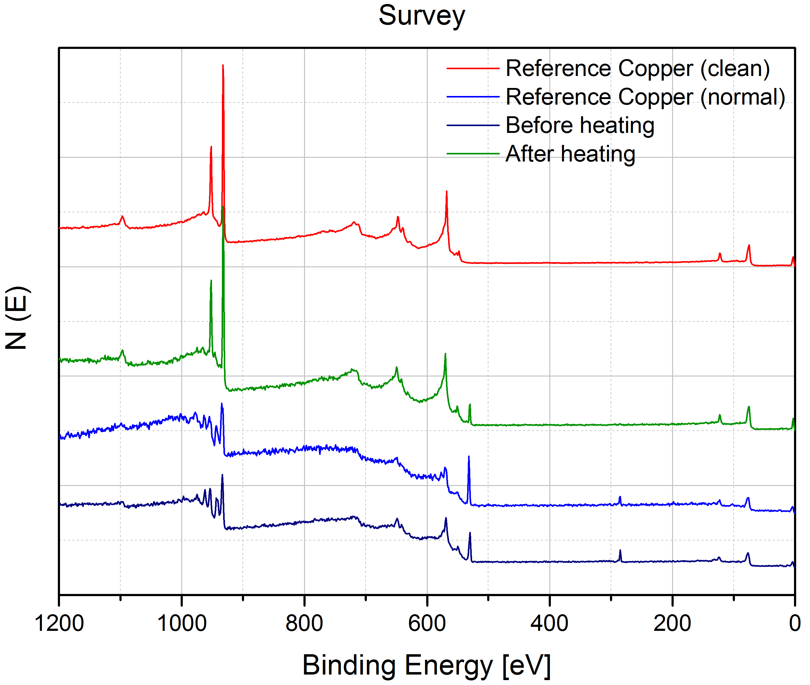
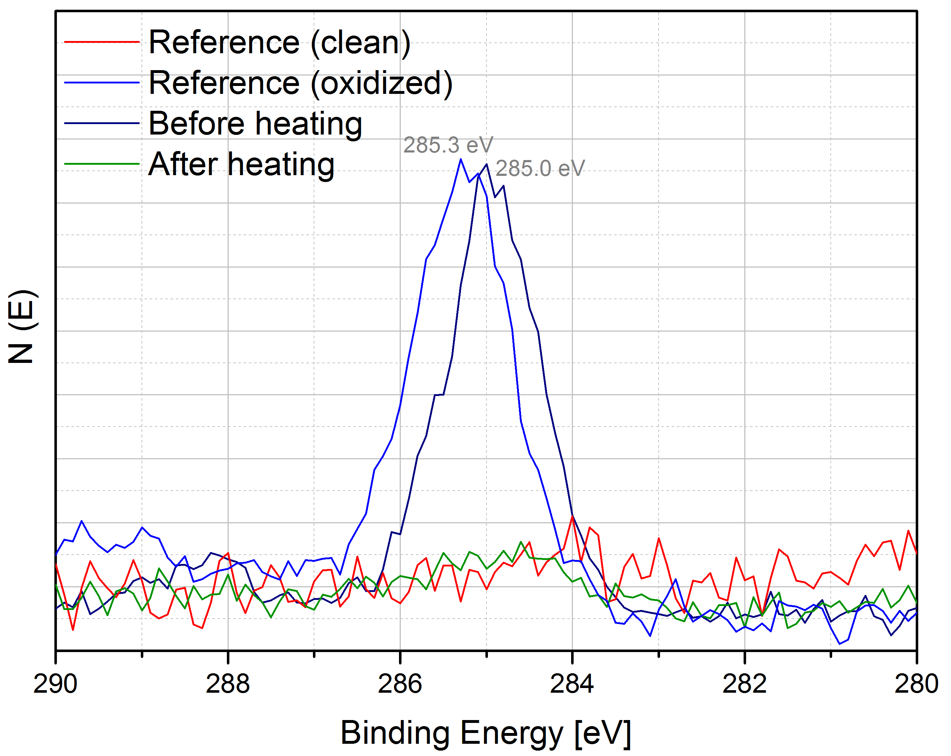
LESS Copper: University of Dundee
Oxide removal (SPECS system)
O1s
C1s

Slide 6
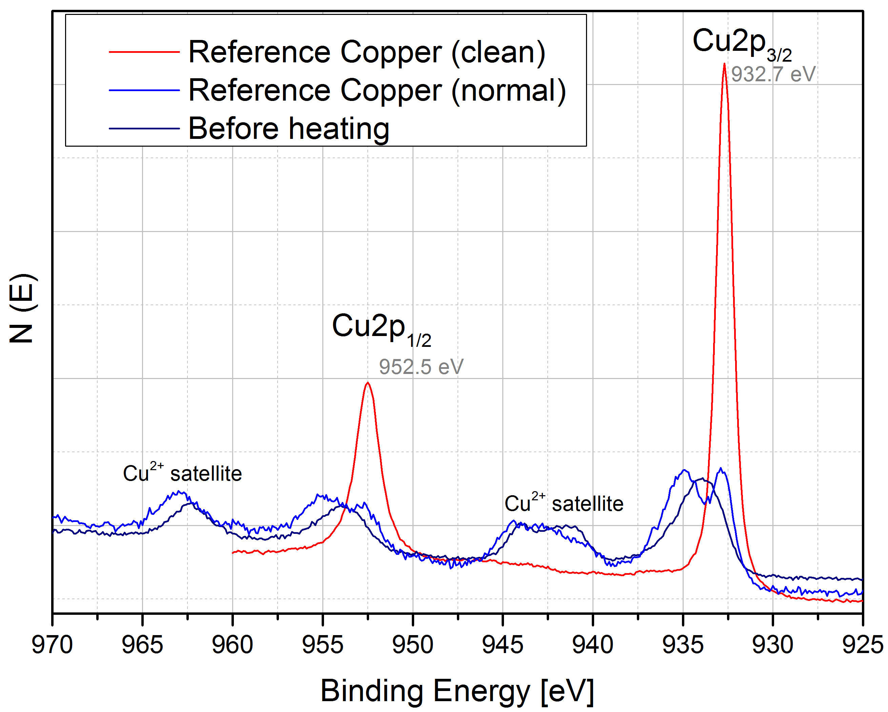
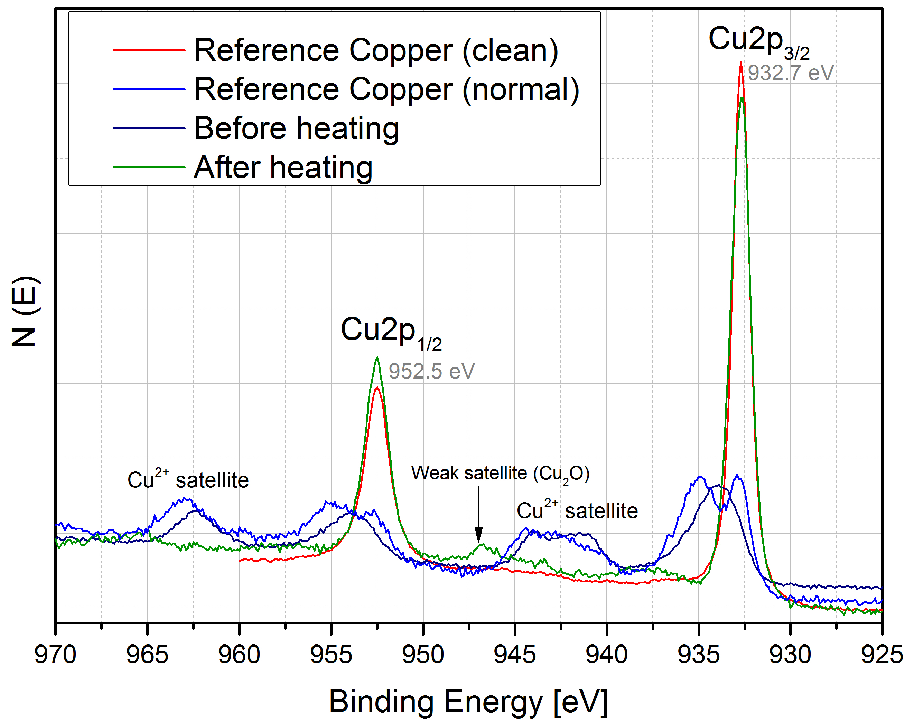
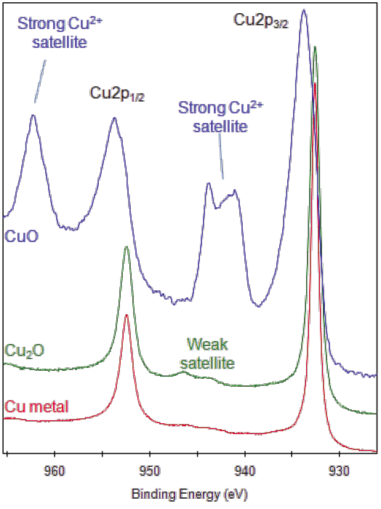
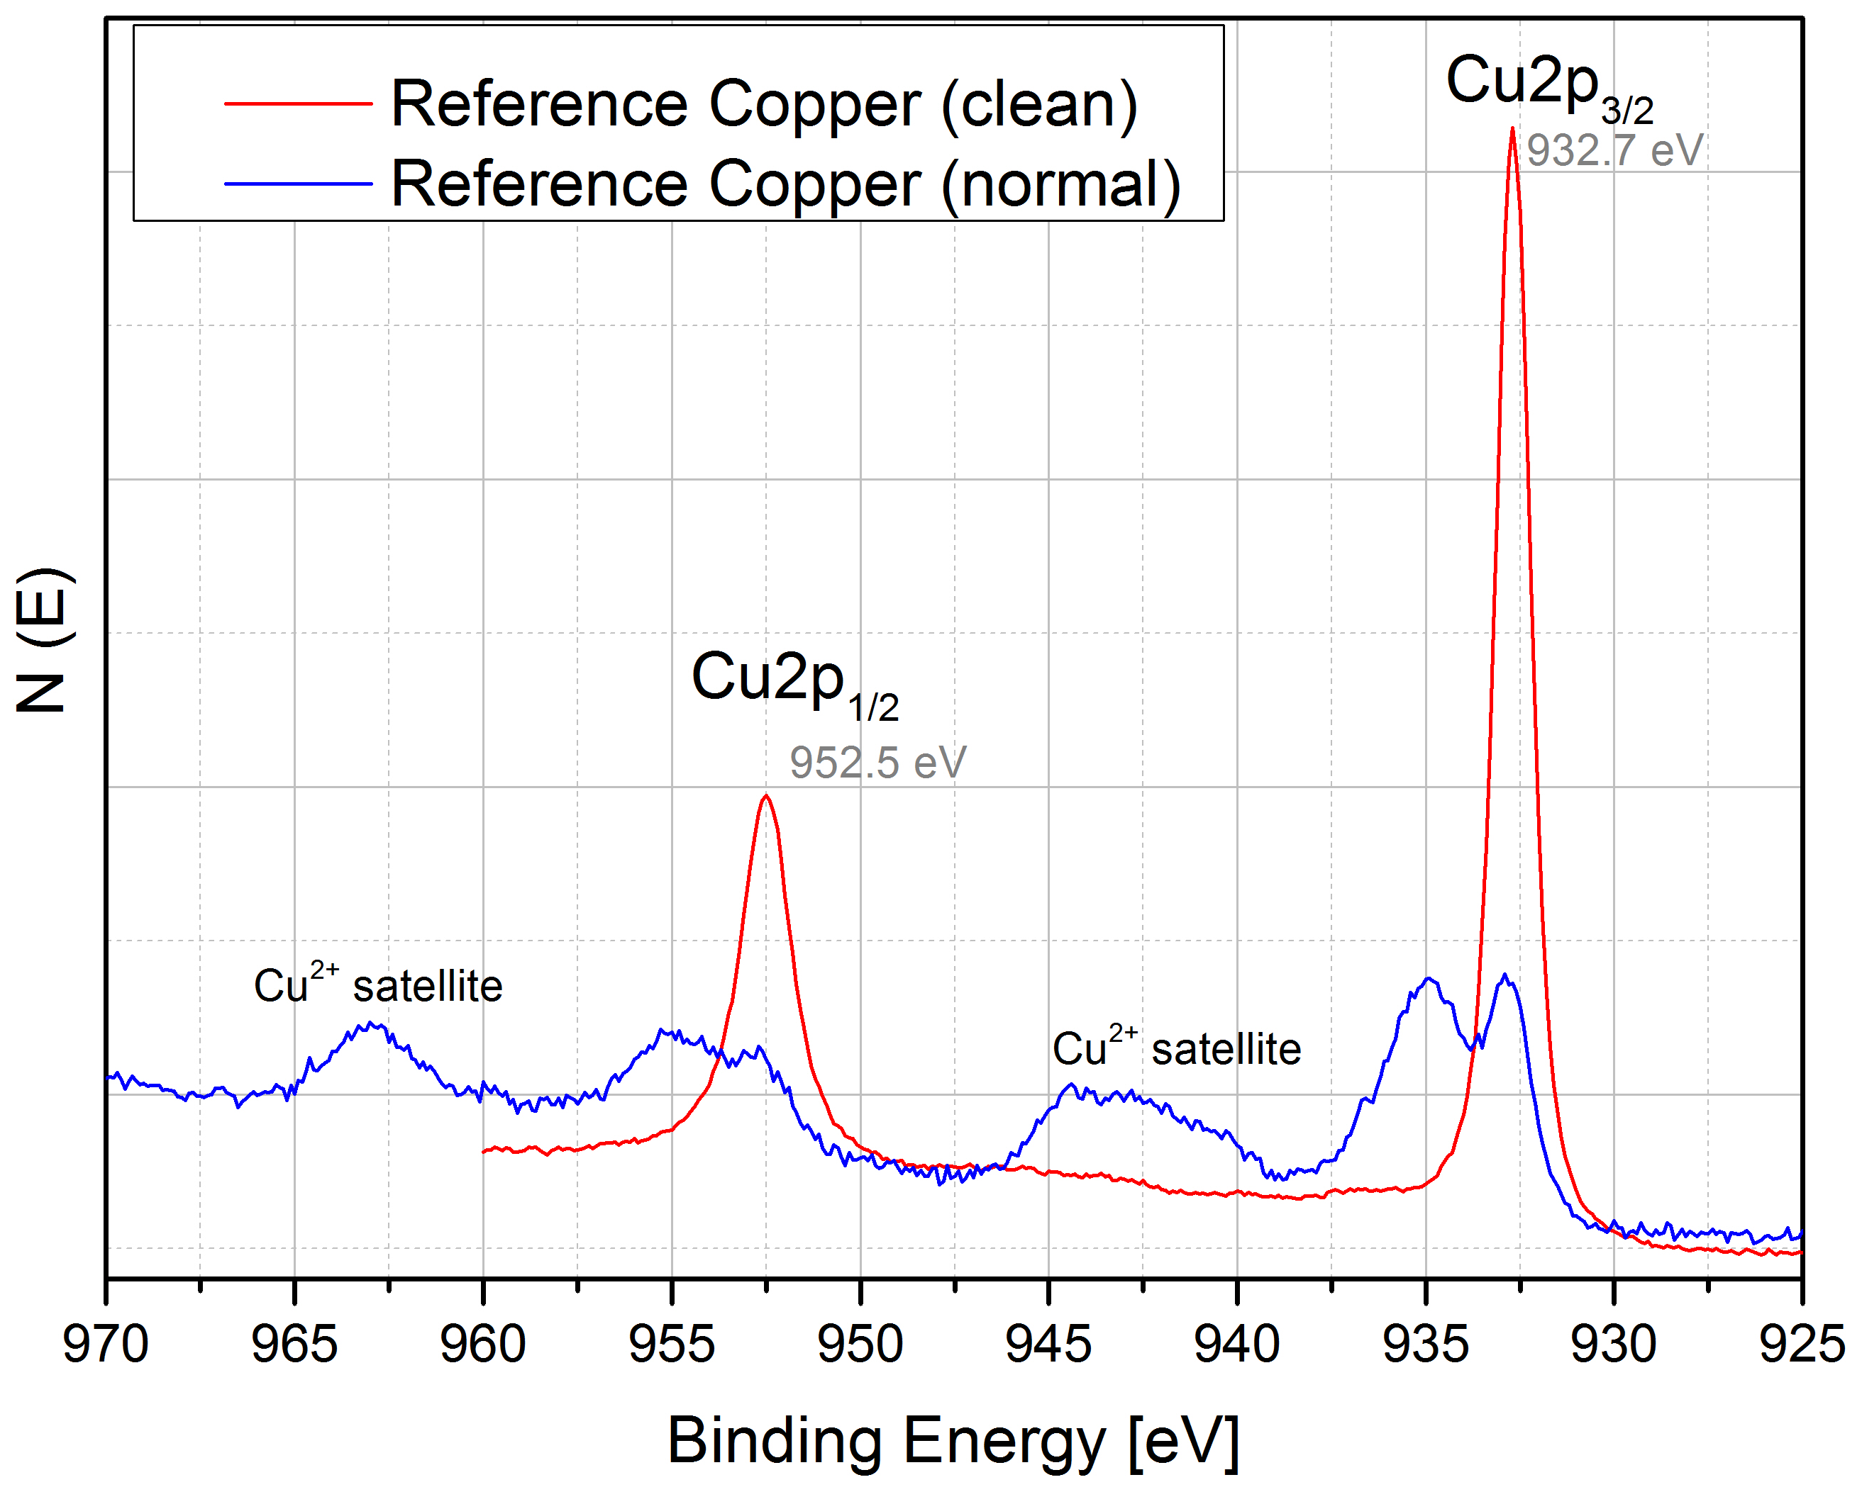
LESS Copper: University of Dundee
Oxide removal (SPECS system)
http://xpssimplified.com/elements/copper.php

Slide 7
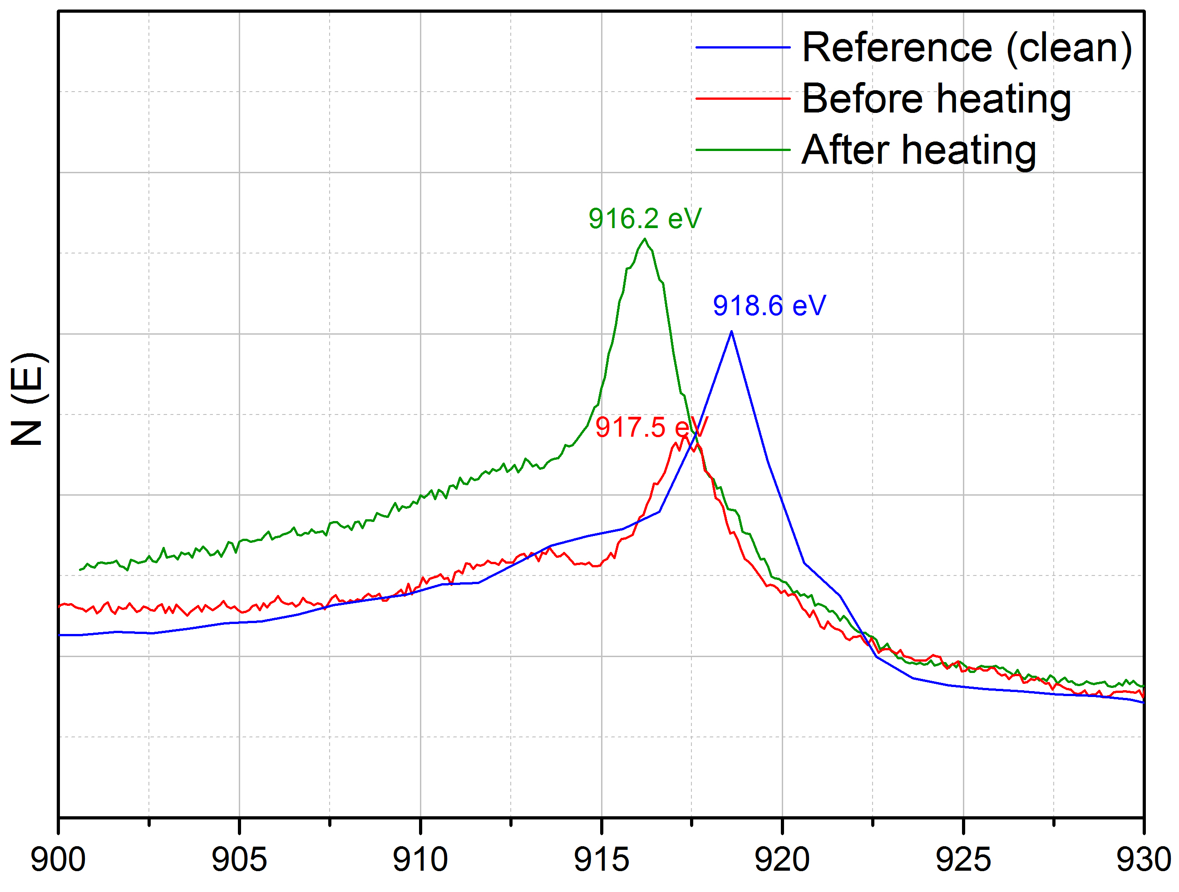
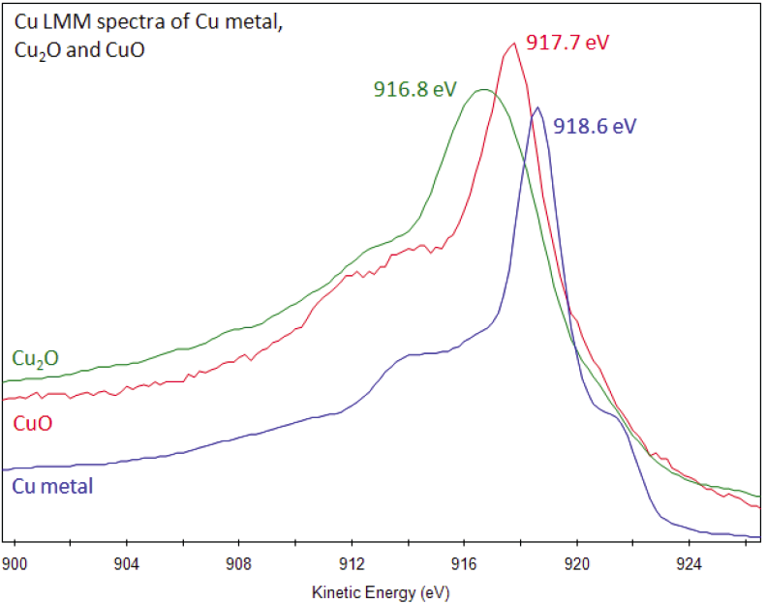
LESS Copper
Oxide removal (SPECS system)
CuLMM
http://xpssimplified.com/elements/copper.php

Slide 8
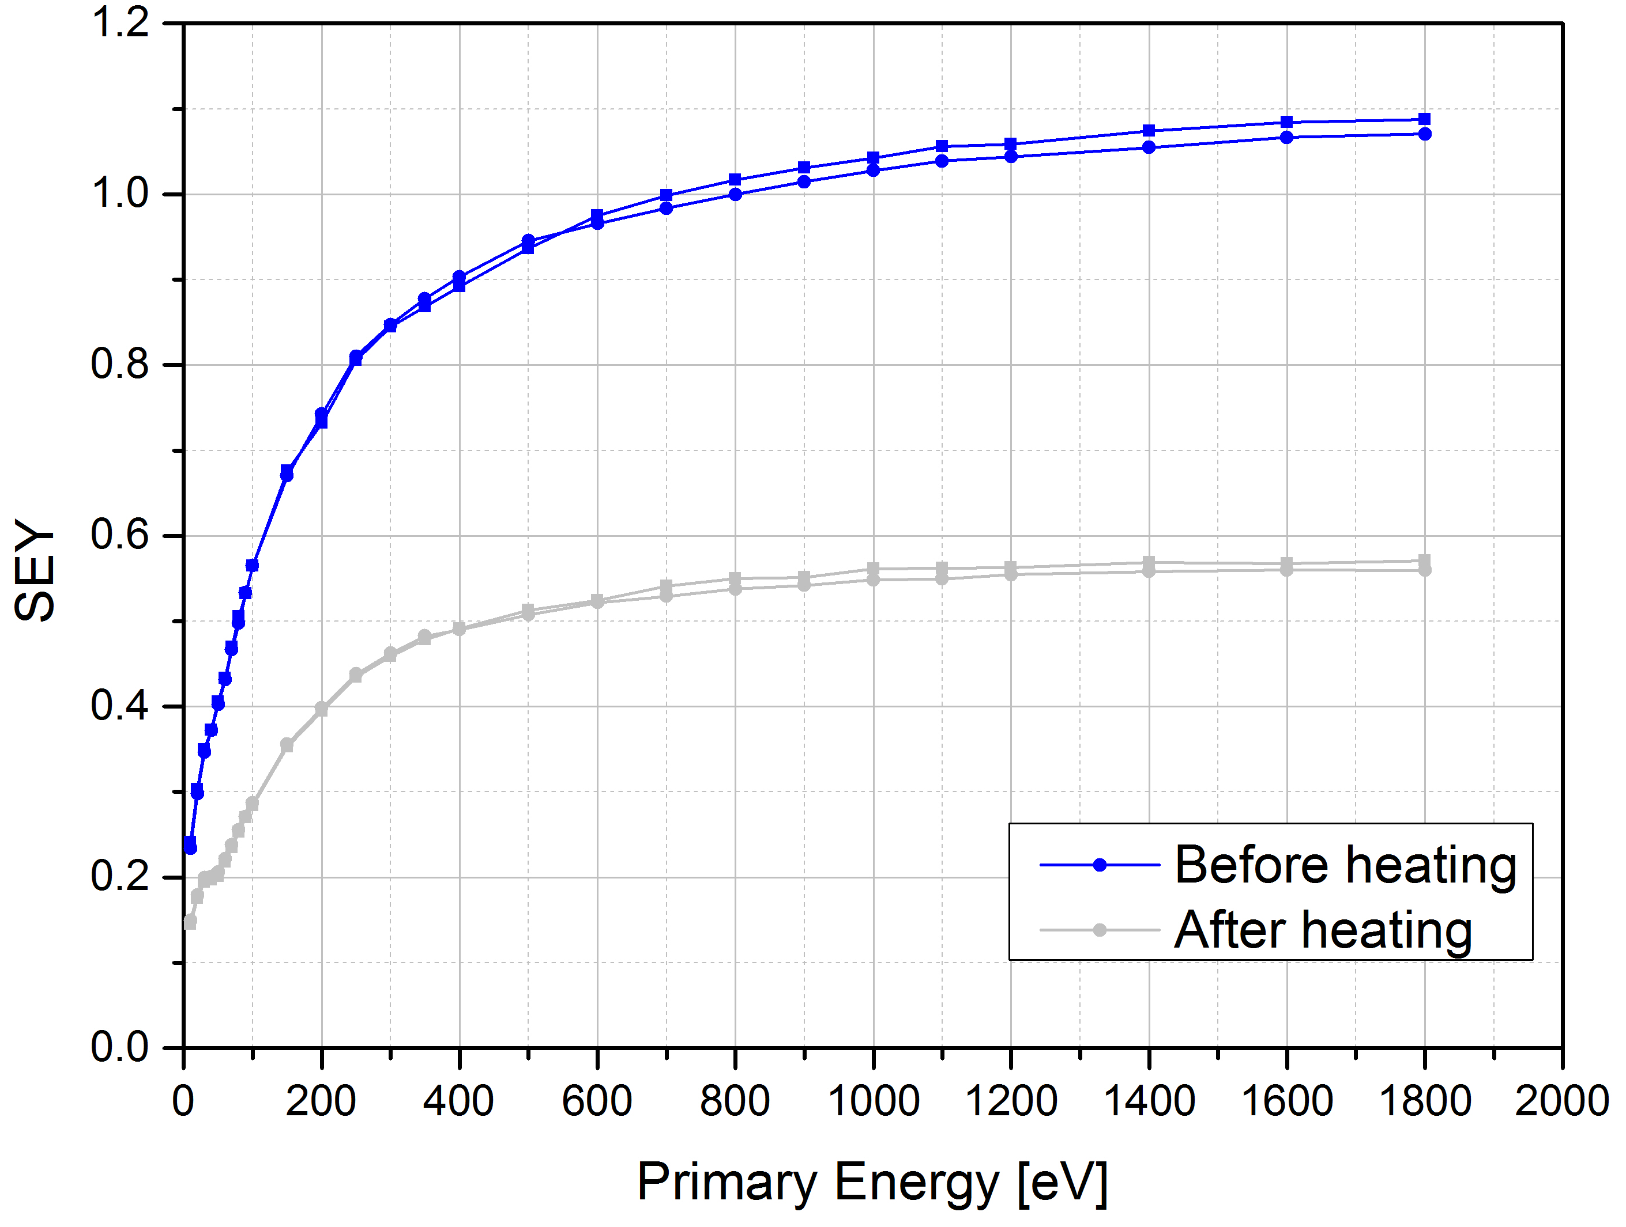
LESS Copper: University of Dundee
Oxide removal (SPECS system)

Slide 9
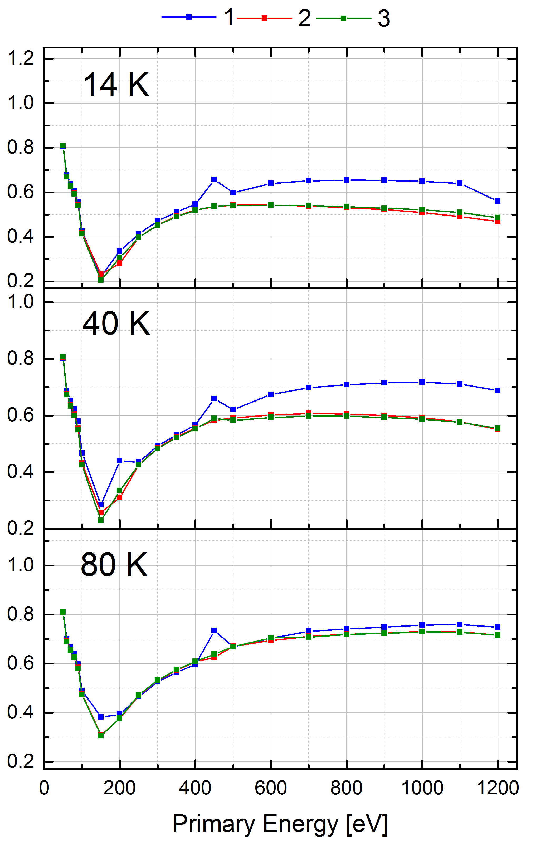
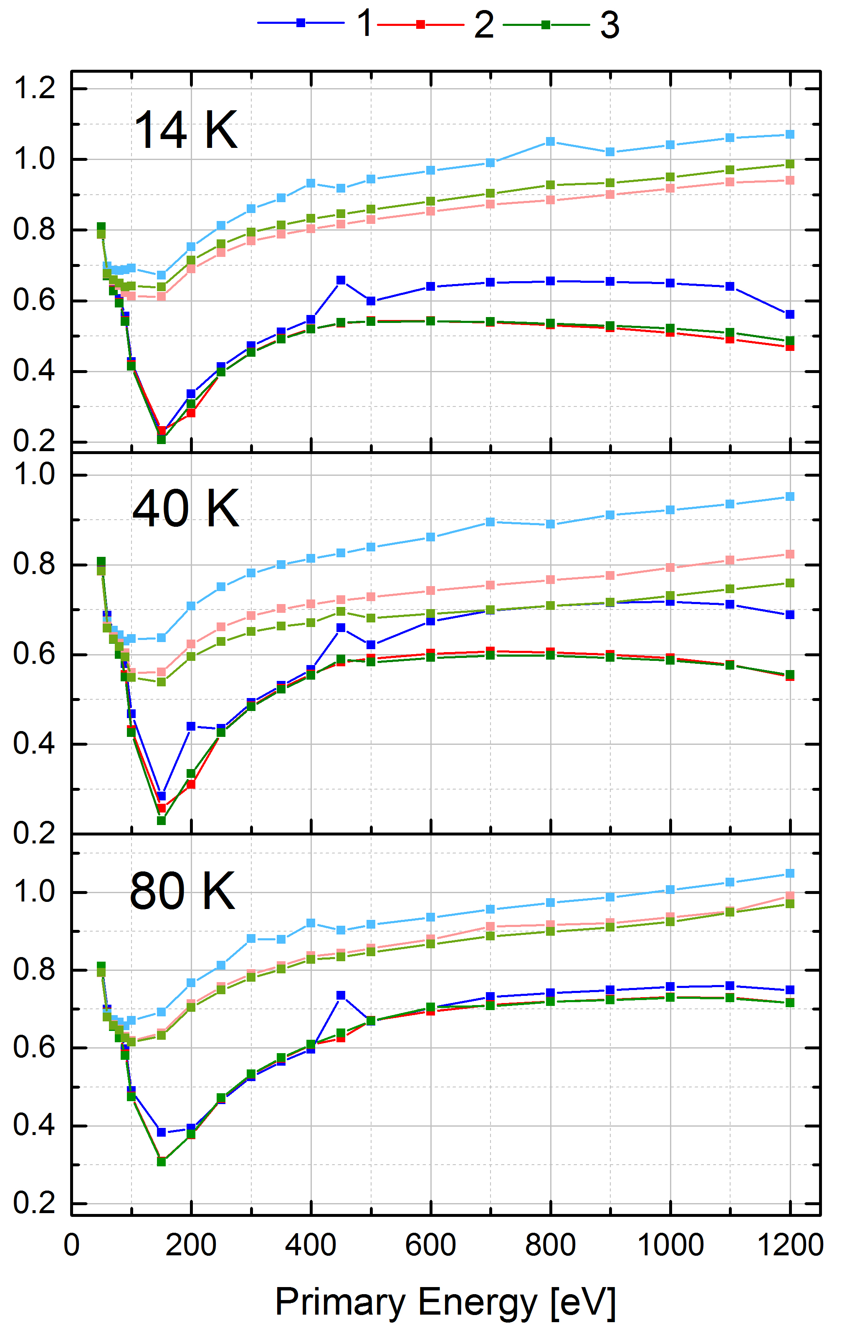
LESS Copper: University of Dundee
SEY at cold after oxide removal
SEY goes down during SEY measurement.
It goes up immediately after the measurement.
SEY dispersion is reduced as we increase the temperature.
Same behavior as before oxide “removal” but, dispersion has been reduced.

Slide 10
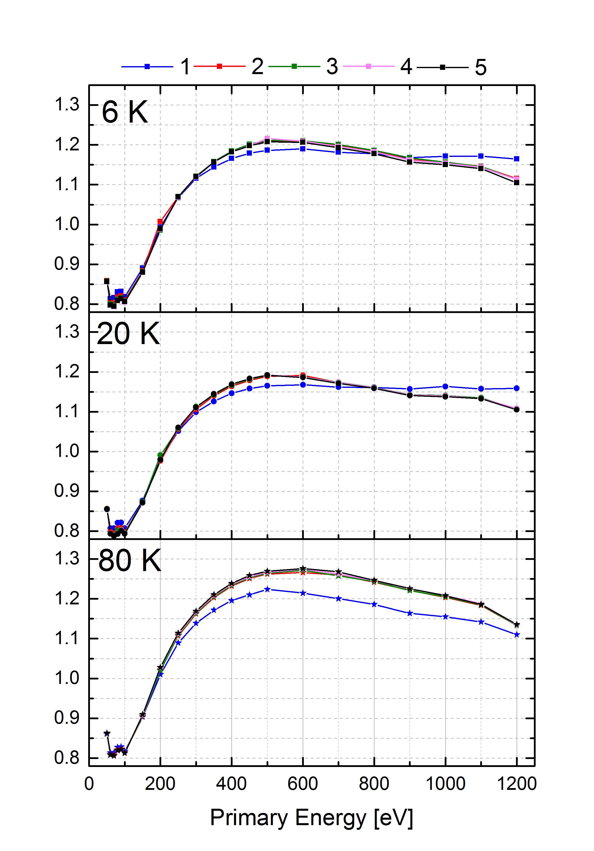
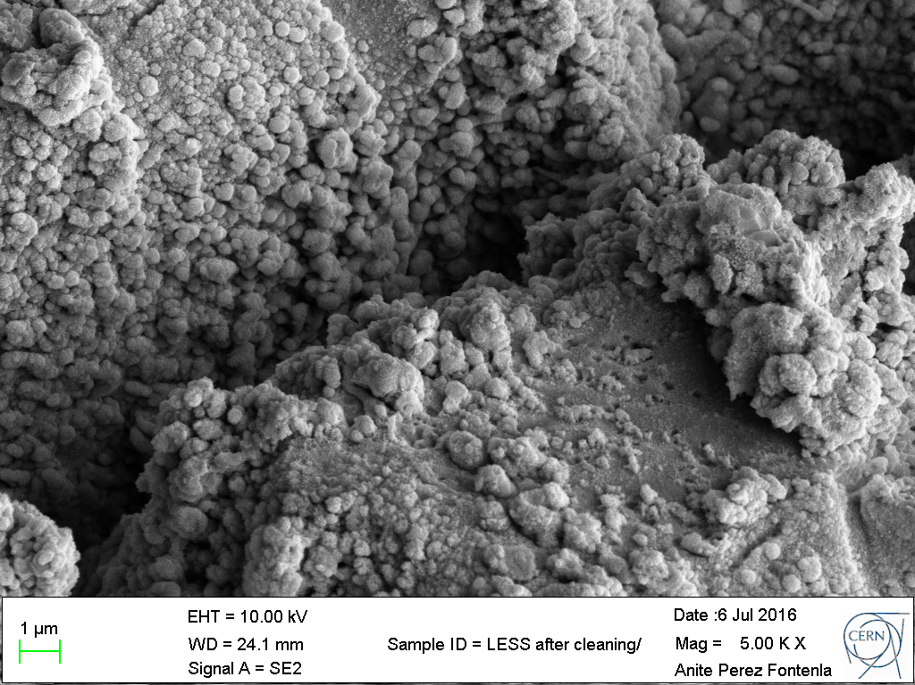
LESS Copper: University of Dundee
SEY after solvent MC20
“Type c” LESS Cu

Slide 11
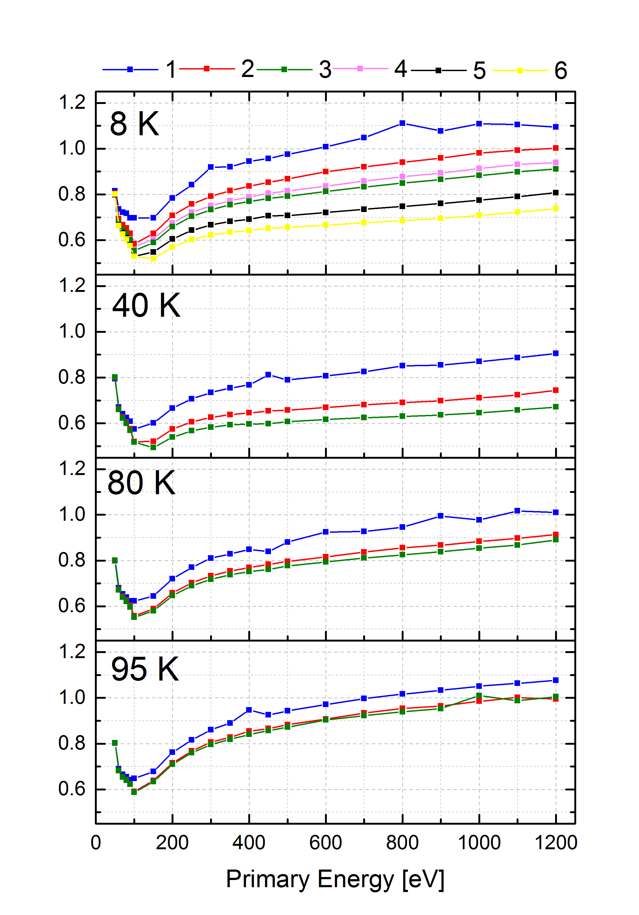
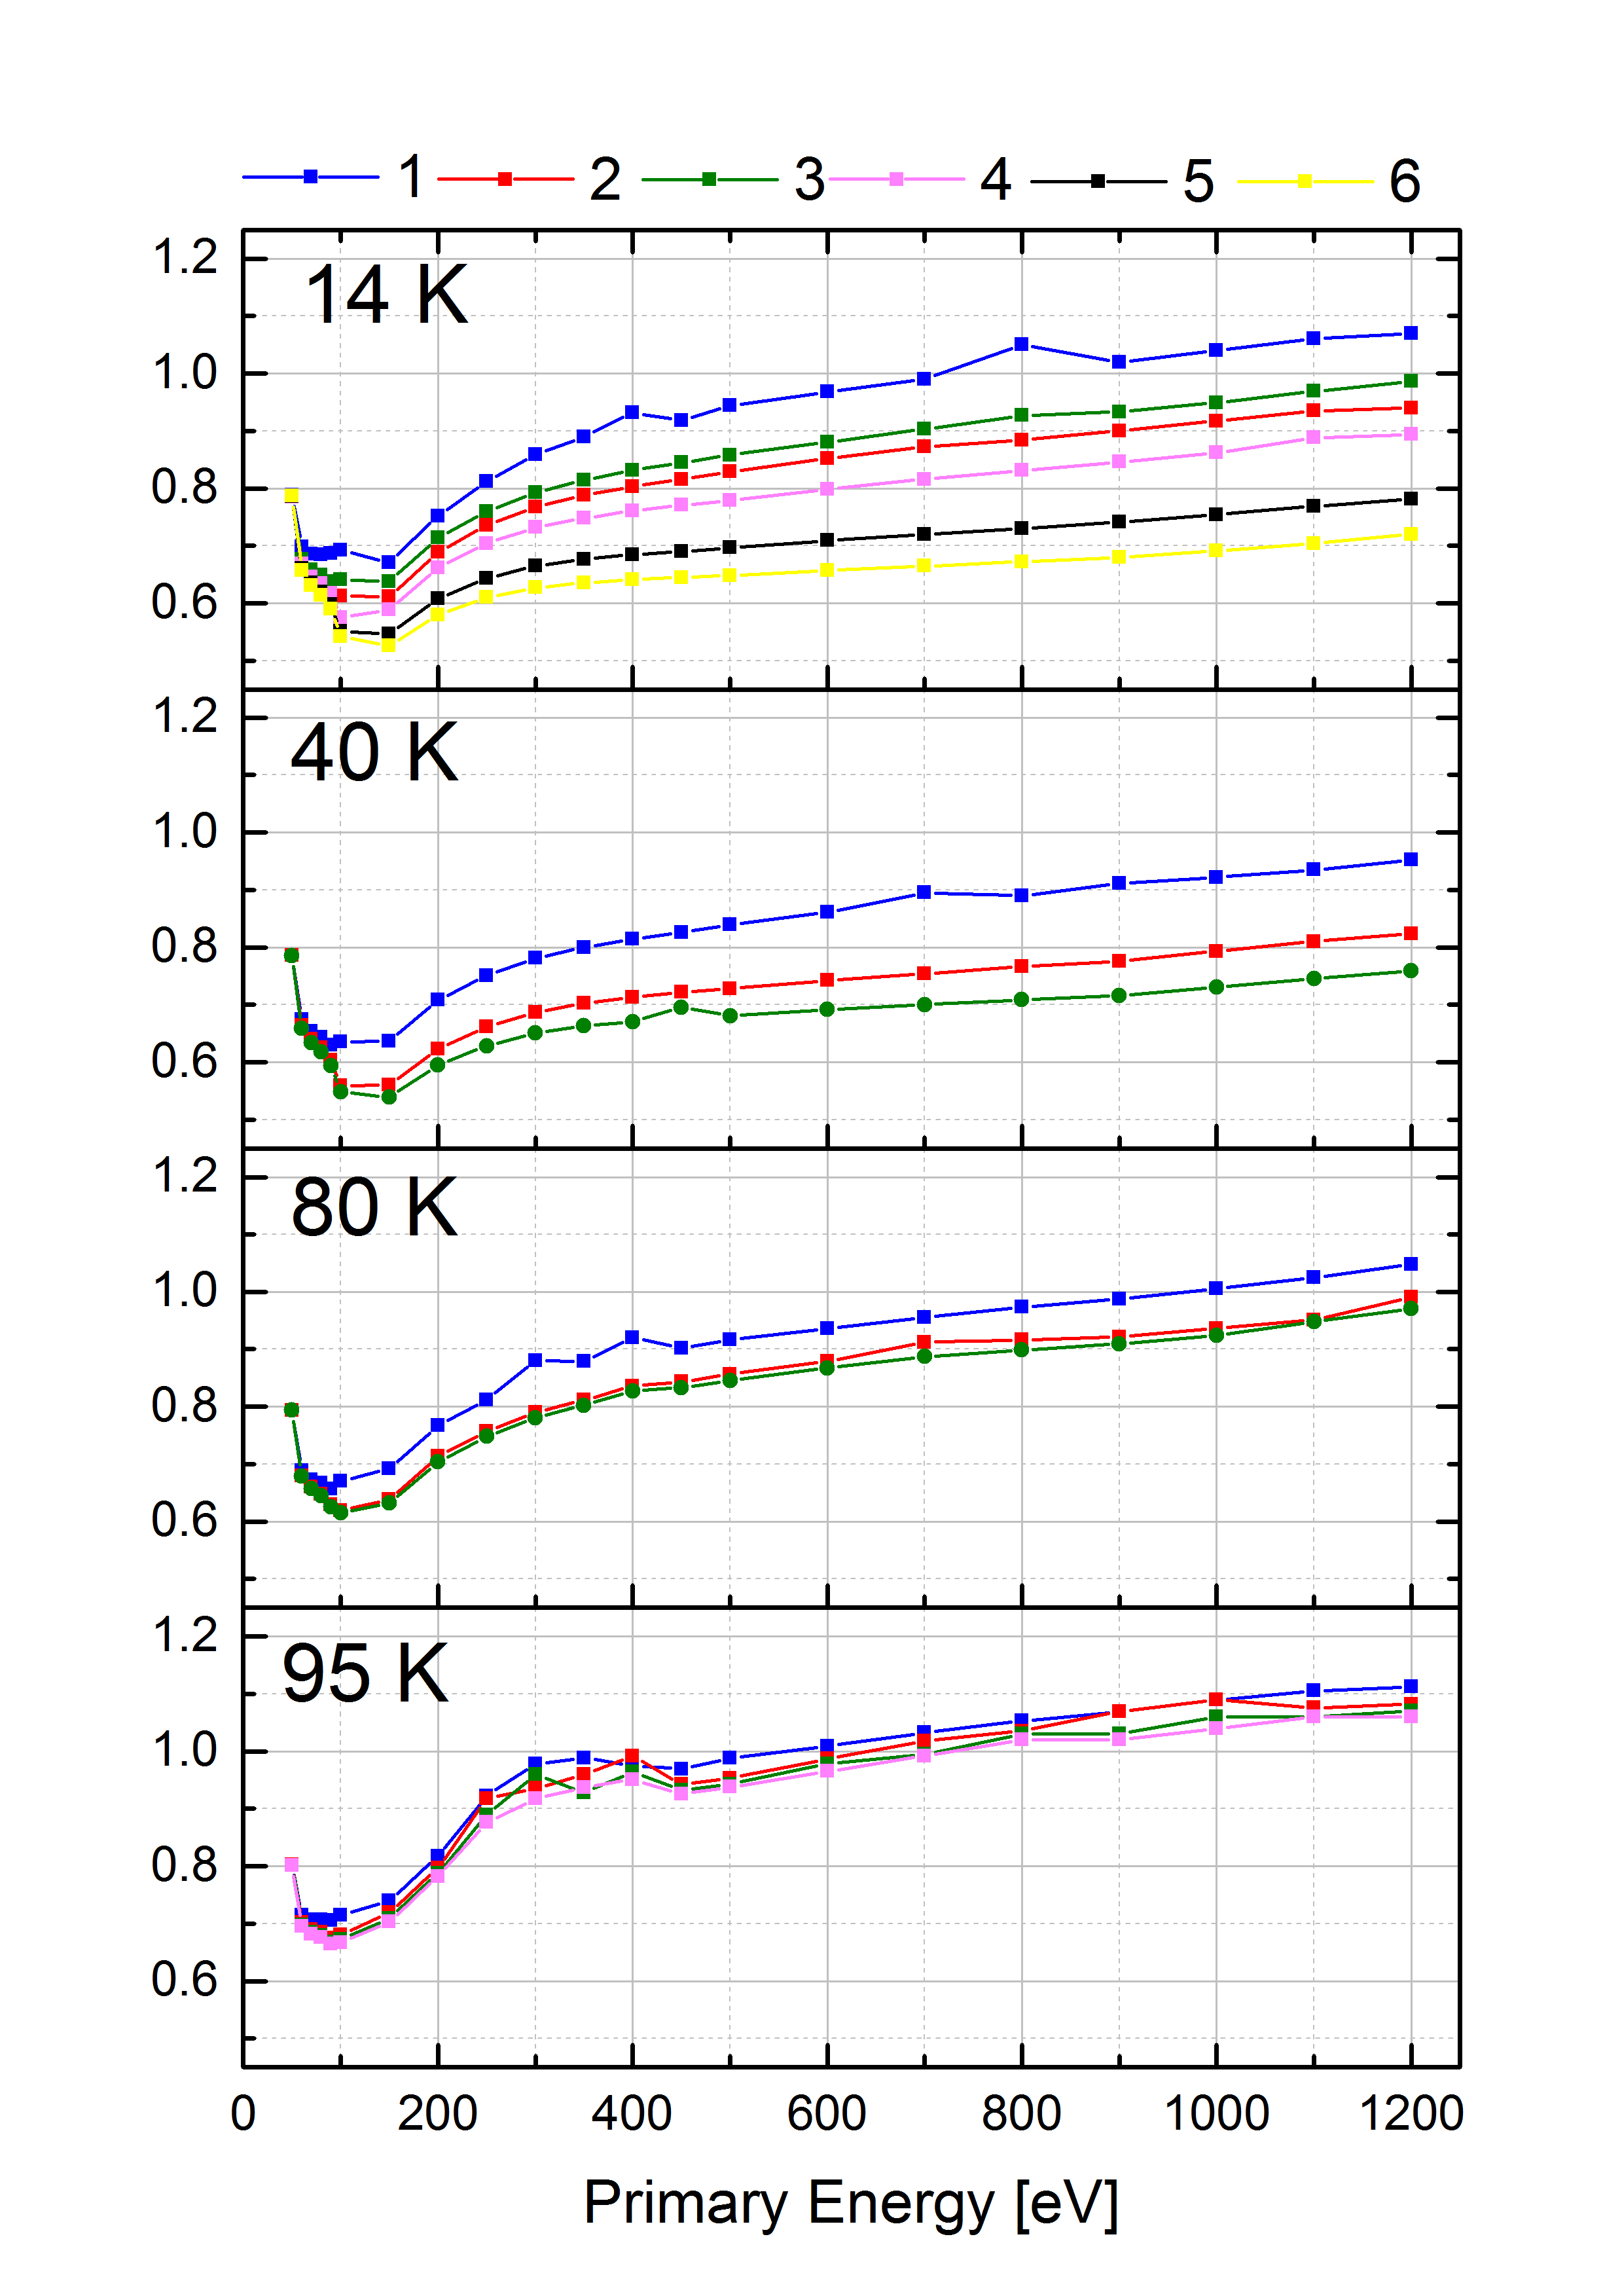
LESS Copper: University of Dundee
LESS Copper_2
LESS Copper_1

