Slide 1
Update on ECAL photon
optimisation
Matthias Weber
CERN
1
Notes:
1
1

Slide 2
Reminder: Possible Models
Values calculated from geometry xml file
 | # Layers | Absorber Thickness [mm] | Si [mm] | Other (gaps, etc) [mm] | Absorber Thickness [X0] | Si+Other Thickness [mm] | Si+Other Thickness [X0] | Total Thickness [mm] | Total Thickness [X0] | Calorimeter Thickness [mm] | Calorimeter Depth [X0]
CLIC_o2_v04 (current) | 17 | 2.4 | 0.5 | 1.5 | 0.65 | 2 | 0.06 | 74.8 | 12.01 | 129.2 | 22.85
 | 8 | 4.8 | 0.5 | 1.5 | 1.30 | 2 | 0.06 | 54.4 | 10.84
CLICdet_20_10 (original CLIC_ILD) | 20 | 2 | 0.5 | 1.5 | 0.54 | 2 | 0.06 | 80 | 11.96 | 140 | 23.35
 | 10 | 4 | 0.5 | 1.5 | 1.08 | 2 | 0.06 | 60 | 11.39
CLICdet_30_10 (possible high granularity option) | 30 | 1.5 | 0.5 | 1.5 | 0.41 | 2 | 0.06 | 105 | 13.89 | 155 | 22.58
 | 10 | 3 | 0.5 | 1.5 | 0.81 | 2 | 0.06 | 50 | 8.68
CLICdet_30 | 30 | 2.65 | 0.5 | 1.5 | 0.72 | 2 | 0.06 | 140 | 23.22 | 139.5 | 23.22
 | 0 | 0 | 0 | 0 | 0.00 | 0 | 0.00 | 0 | 0.00
CLICdet_40 (possible high granularity option) | 40 | 1.9 | 0.5 | 1.5 | 0.51 | 2 | 0.06 | 156 | 22.85 | 156 | 22.85
 | 0 | 0 | 0 | 0 | 0.00 | 0 | 0.00 | 0 | 0.00
CLICdet_40x195 | 40 | 1.95 | 0.5 | 1.5 | 0.53 | 2 | 0.06 | 158 | 23.39 | 158 | 23.39
 | 0 | 0 | 0 | 0 | 0.00 | 0 | 0.00 | 0 | 0.000
2

Slide 3
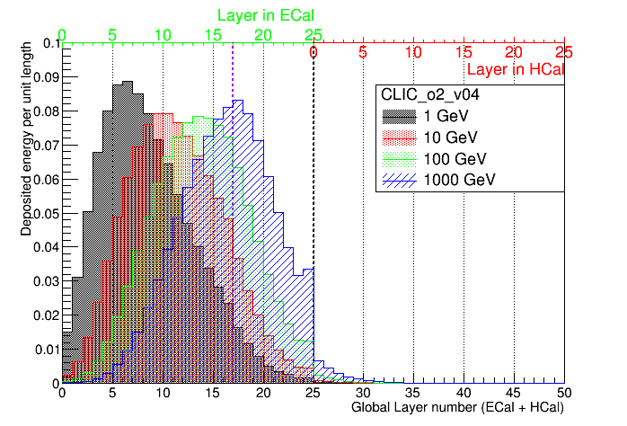
Energy deposited per unit length
CLIC_o2_v04 (CLIC_18_7)
Raw energy deposited in sensitive volume as reported by Geant4, divided by sensitive volume thickness. Normalization to 1 for high energies affected by loss of energy in ECAL-HCAL gap.
Raw energy deposited in sensitive volume as reported by Geant4, divided by sensitive volume thickness. Normalization starts to fail for high energies due to loss of energy in dead material between ECal and HCal
2.4 mm/layer
4.8 mm
22.85 X₀
Already at 100 GeV sizable
amount sampled with the larger (“bad”) layers
3

Slide 4
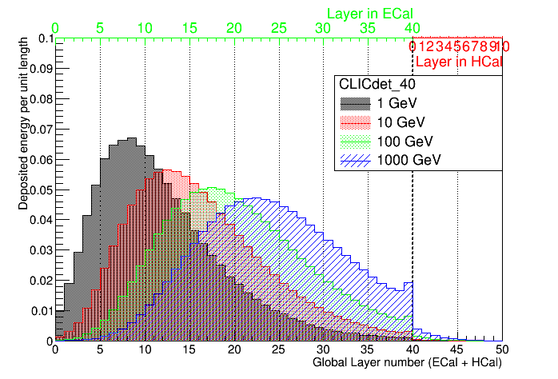

Energy deposited per unit length
CLIC_40
Raw energy deposited in sensitive volume as reported by Geant4, divided by sensitive volume thickness. Normalization to 1 for high energies affected by loss of energy in ECAL-HCAL gap.
Raw energy deposited in sensitive volume as reported by Geant4, divided by sensitive volume thickness. Normalization starts to fail for high energies due to loss of energy in dead material between ECal and HCal
1.9 mm/layer
22.85$X_{0}$
22.58 X₀
constant sampling performs good for vast energy range
4

Slide 5
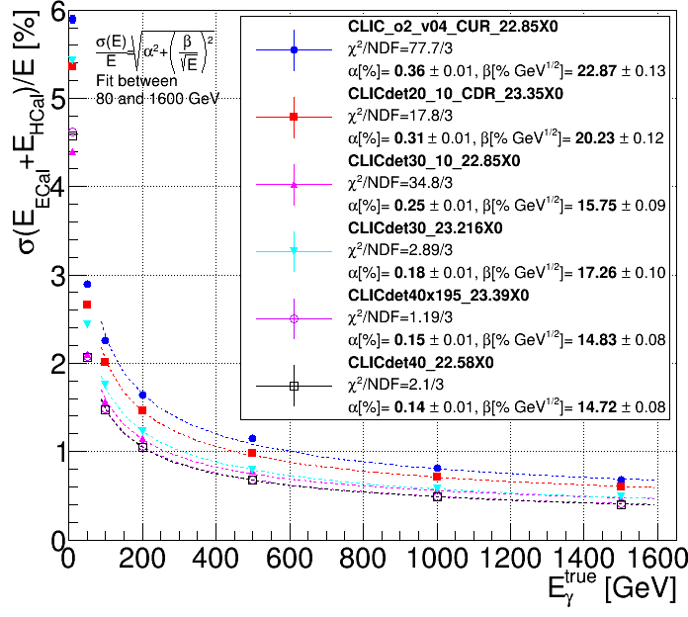
Resolution of total ECAL and HCAL Energy
Single photons in the very central part of the detector (θ ≈ 90°) and ϕ ≈ 0°
Fits agree more or less, but constant term <1%, fit agrees with the trend of the points.
Thicker back layers deteriorate
resolution of high energy γ’s
Uniform det30 option better than CDR at high energy, comparable at low energies
The uniformly thin option (det40) is best behaving at high energy since it has the thinnest layers at the back (1.9 mm and 1.95 mm comparable) )
5

Slide 6
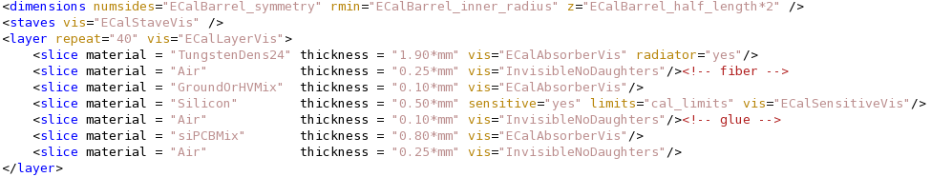
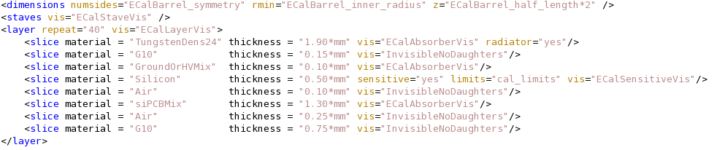
New Model CLIC_o3_v5
Uniform segmentation of ECAL
40 layers, absorber 1.9 mm, active material 0.50 mm
Model CLIC_o2_v05: other 1.5 mm: total thickness 15.6 cm cm
Model CLIC_o3_v05: other 2.65 mm: total thickness 20.2 cm
6

Slide 7
Model CLIC_o3_v05: Barrel
Compare old and new model: use point phi=0, theta=90 degrees
Determine relative resolution via distribution of E_{rel} = (E_ECAL+E_HCAL)/E_truth
measure of σ(E_{rel}): RMS and gausian fit
Old model determined through iterative gaussian fits around mean within 3 sigmas
Energy (GeV) | 10 | 50 | 200 | 500
σ(E_{rel}) | 4.72 | 2.11 | 1.12 | 0.777
RMS(E_{rel}) | 4.82 | 2.13 | 1.17 | 0.903
CLIC_o2_v05 | 4.58 | 2.07 | 1.05 | 0.673
30 layers | 5.43 | 2.44 | 1.23 | 0.790

Slide 8
Model CLIC_o3_v5: Calibration
Use particle gun samples for calibration, 10000 evts: 50 GeV K⁰_{L}, 10 GeV μ
Photons at 10, 50, 100, 200 GeV, test very high E: 500, 1000, 1500 GeV
Produced with uniform distribution in phi and theta
Two campaigns, one restricted to barrel |cos θ| <0.7, second no restriction in θ
Simulated with DD4hep, use iLCSoft package at
/cvmfs/clicdp.cern.ch/iLCSoft/builds/2016-07-04/x86_64-slc6-gcc48-dbg
Slight modification of ECAL Digitization extraction code

Slide 9
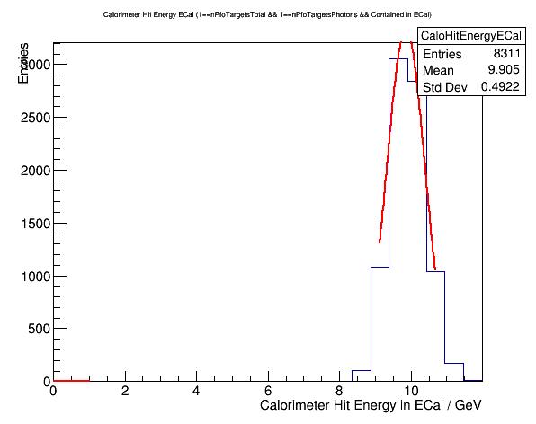
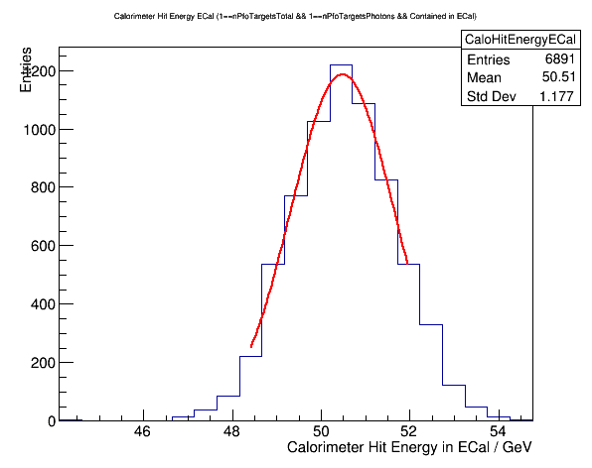
Model CLIC_o3_v5: Calibration Results
CALIBRECAL="35.652
10 GeV
50 GeV
CALIBRECAL="35.776"
CALIBRECAL="35.652”
Calibration pretty stable at different energies

Slide 10
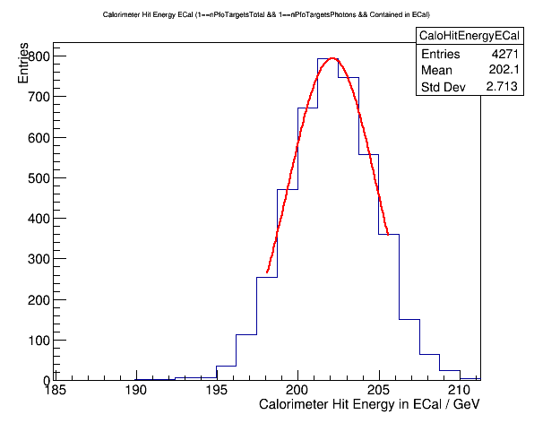
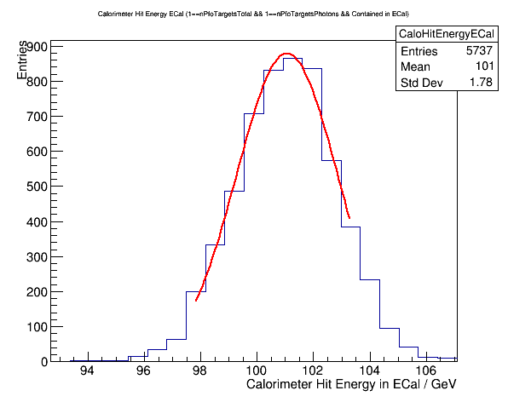
Model CLIC_o3_v5: Calibration Barrel
ECAL digitization uses photons contained in ECAL (99% of total deposited Energy)
100 GeV
5737 evts
Barrel
At 200 GeV
4271 evts
CALIBRECAL="35.619”
CALIBRECAL="35.617”
As expected requirement of 99 % is more stringent for higher energy samples
10

Slide 11
Model CLIC_o3_v5: Calibration at high Energy
Expect slight modification of EM scale in HCAL based on previous study (based on one point in phi=0):
Fit a line in 2D plot of ECAL vs HCAL Energy:
Moderate modification:
ECAL: 0.991
HCAL: 0.950

Slide 12
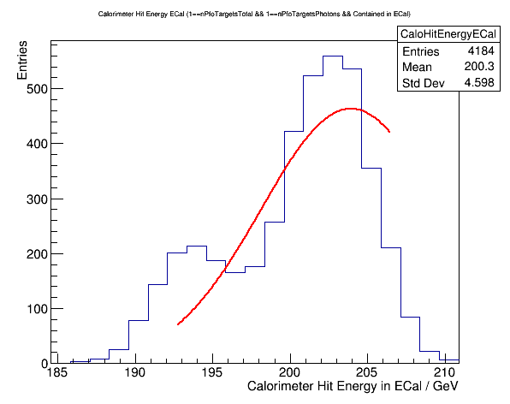
Model CLIC_o3_v5: Calibration: whole detector
ECAL digitization uses photons contained in ECAL (99% of total deposited Energy)
Barrel + Endcap
Barrel
At 200 GeV
4271 evts
Use values from samples up to 200 GeV, for Barrel and EndCap mix two peaks start to appear, seems due to different losses in cracks etc at higher energies
12

Slide 13
Model CLIC_o3_v5: Barrel Resolution
Determine relative resolution via distribution of E_{rel} = (E_ECAL+E_HCAL)/E_truth
measure of σ(E_{rel}): RMS and gausian fit
Energy (GeV) | 1 | 5 | 10 | 15 | 30 | 50
σ(E_{rel}) | 15.14 | 6.95 | 4.873 | 4.00 | 2.829 | 2.281
RMS(E_{rel}) | 22.94 | 7.175 | 4.953 | 4.056 | 2.914 | 2.355
Mean (E_{rel}) | 0.957 | 0.996 | 0.998 | 0.999 | 0.999 | 0.997
Energy (GeV) | 100 | 200 | 500 | 1000 | 1500
σ(E_{rel}) | 1.69 | 1.27 | 0.955 | 0.810 | 0.775
RMS(E_{rel}) | 1.773 | 1.366 | 1.133 | 1.065 | 0.953
Mean (E_{rel}) | 0.997 | 0.997 | 0.998 | 0.999 | 1.001
13

Slide 14
Model CLIC_o3_v5: Barrel Resolution
Determine relative resolution via distribution of E_{rel} = (E_ECAL+E_HCAL)/E_truth
measure of σ(E): RMS and gausian fit
1500 GeV: not large non gaussian tails
14

Slide 15
Model CLIC_o3_v5: Barrel Resolution
Determine relative resolution via distribution of E_{rel} = (E_ECAL+E_HCAL)/E_truth
measure of σ(E): RMS and gausian fit, now moderate energy 50 GeV, non gaussian tails smaller
15

Slide 16
Model CLIC_o3_v5: Barrel Resolution
Determine relative resolution via distribution of E_{rel} = (E_ECAL+E_HCAL)/E_truth
measure of σ(E): RMS and gausian fit, very low energy of 1 GeV start to see inefficincies in reconstruction (not the case for to 5 GeV photons)
16

Slide 17
Model CLIC_o3_v5: Barrel Overview
Summary plot of resolution in ECAL barrel
17

Slide 18
Model CLIC_o3_v5: Barrel leakage
Mean of Distribution E_HCAL/(E_ECAL+E_HCAL) in %
Energy (GeV) | 1 | 5 | 10 | 15 | 30 | 50
leakage | 0.131 | 0.343 | 0.490 | 0.576 | 0.7731 | 0.979
Energy (GeV) | 100 | 200 | 500 | 1000 | 1500
leakage | 1.30 | 1.76 | 2.58 | 3.4 | 4.19
E-HCAL, 200 GeV
E-HCAL, 1500 GeV
18

Slide 19
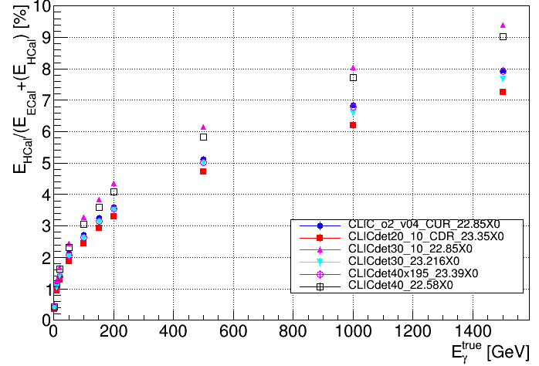
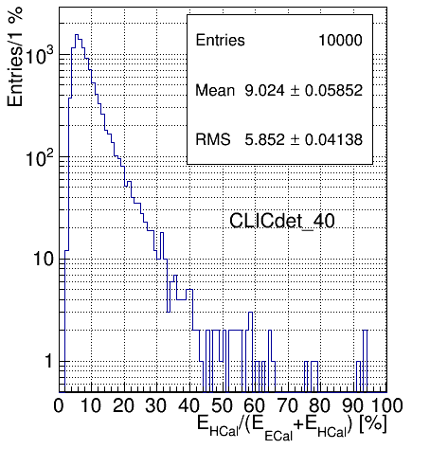
Old study: Leakage
Example at 1500 GeV
Mean
More X0’s perform generally better (as expected)
Leakage improved for high segmentation with thicker layers (1.95 vs 1.9 mm absorber thickness)
19

Slide 20
Summary
Study of new model CLIC_o3_v05: no drastic change observed in resolution of photons compared to 40 layer CLIC_o2_v05
Calibration constants stable across different energies
Resolution values drop to around 1 % at very high energies
Resolution distributions
At higher energies non gaussian tails to the lower side
at high energies non negligible contribution from HCAL
20

Slide 21
Values for X₀ calculation
Tungsten 24: 0.37 cm
Silicon: 9.36 cm
G10 (density 1.7 g/cm³): 19.4 cm
Air: 30420 cm
GroundOrHVMix: 86 % Copper
siPCBMix: 82% Copper
21

