Slide 1
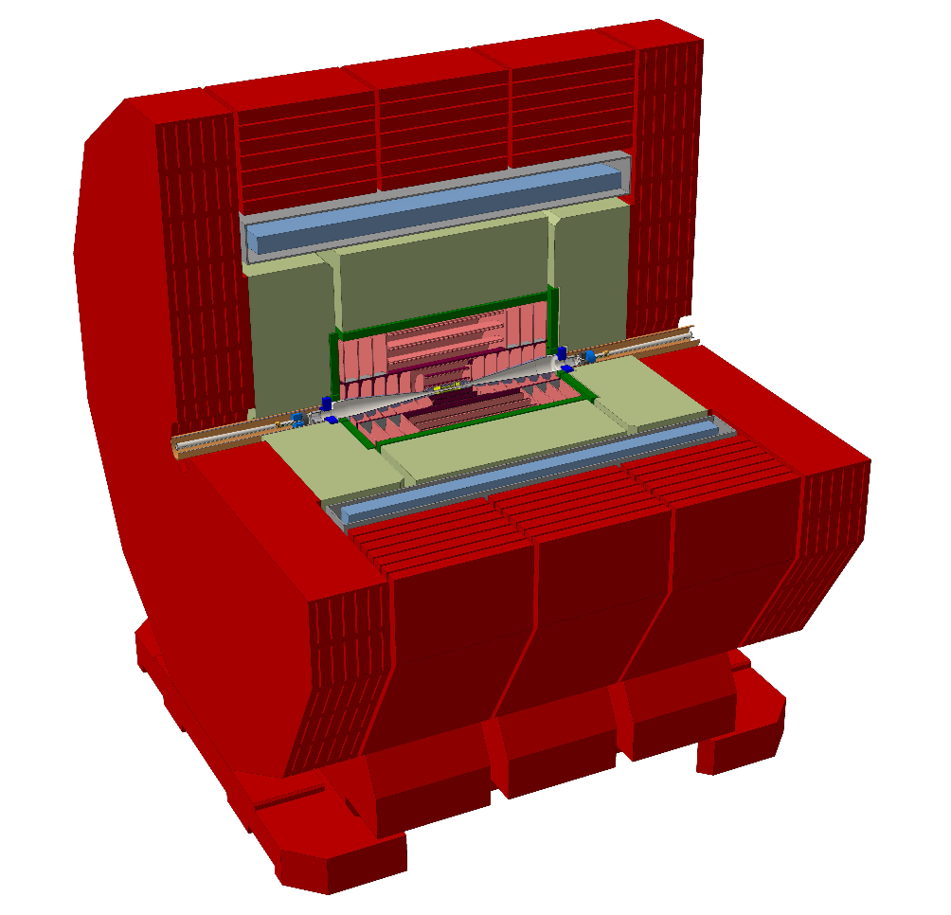
Introductory Remarks

Slide 2
ECAL in the CLIC detector model
CLIC_ILD: 30 layers (20 + 10) – taken from ILD
CLICdet_2015: 25 layers (17 + 8)
but: resolution for higher energy photons is poor (January 2016)
CLICdp detector opt. WG meeting 18 April:
N. Nikiforou presented first results (incl. 30 and 40 layers homogeneous ECAL)
CLICdp meeting in Santander (ECFA LC workshop) 31 May:
refined results, presented by M. Weber
during June: bug found in ECAL model(s):
space between tungsten plates was 2 mm (instead of 3.15 mm)
K. Elsener, CLICdp detector optimization WG 9 August 2016

Slide 3
please note:
CLICdet_2015
and the note
CLICdp-Draft-2015-019
are obsolete !
(removed from CDS, declared obsolete on Twiki and EDMS)
EDMS document: new version
latest version of the 2016 draft note always at:
https://edms.cern.ch/document/1572676/
K. Elsener, CLICdp detector optimization WG 9 August 2016

