Slide 1
SRF material R&D for FCC
W. Venturini Delsolaro
on behalf of FCC RF WP3 team

Slide 2
Outline
Recap on roadmap and lines of thought
Enabling tools, status
R/D programs, status and first results

Slide 3
Organization, manpower
Core team members: S. Aull, K. Ilyina, G. Rosaz, A. Sublet (CERN)
New fellow from January 2017
Be-weekly meeting of WP3
  Follow up of procurement lines
  Reports on coating experiments and test results
UNIGE team: M. Bonura, C. Senatore, et al.
Larger pool of “scholars” gather at the SRF R/D meeting
Technical support from RF, MME, VSC, UNIGE

Slide 4
R/D guidelines
Our focus is on SC thin films on copper substrates:
Well known advantages (see NIM-A 463, 1-8, 2001):
  Thermal stability
  Independent tailoring of SC and cooling functions
  Cost effective
  Insensitive to trapped flux
  Insensitive to microphonics
Nb/Cu
  was used in all CERN machines (LEP, LHC, HIE-ISOLDE)
  has not yet reached fundamental performance limits
  Problem: Q slope (breakeven with Nb bulk to be defined, WP1 working in this)
New materials (A15) are being investigated

Slide 5
SRF R/D: questions
Why Nb/Cu is different from bulk Nb?
More precisely: how to decompose the surface resistance?
Which components differ for the two cases?
Is R_{BCS} the only temperature dependent component?
How does R_{BCS} behave at high fields?
What other identified contributors to the surface resistance?
How the coating process parameters influence them?

Slide 6
How to decompose the surface resistance?
Usually: R_{s}(T, B, ω)= R_{BCS}(T, ω)+ R_{res}(B, ω)
R_{res}(B, ω)=Rs(T→0)= R_{fl}+R_{r0}+R_{r1} H_{rf} + O(H_{rf}²)
R_{fl}=(R_{fl0}+R_{fl1} H_{rf}) H_{ext}
(Physica C 351 (2001) 421-37)
Note: R_{BCS}(T, ω), from Matthis-Bardeen theory, is a low field approximation
Disentanglement at high field is not obvious!
Consequently, R_{res} is also only known at low field
More recently (last few years):
Calculations of R_{BCS} at finite fields becoming available (B. Xiao: arXiv:1404.2523)
R_{fl} dependence on cool down procedure
Importance of thermoelectric phenomena
Advances in Nb bulk (N doping) give new insights
Refined models of (local) thermal feedback (Palmieri and Vaglio, 2015)

Slide 7
Problem: R_{s}(T) depends on RF field and thermal gradient upon cool down…
Eacc=1.0 MV/m
ΔT=467 mK
Eacc=0.3 MV/m
Eacc=0.09 MV/m
Eacc=1.0 MV/m
ΔT=50 mK
Eacc=0.3 MV/m
ΔT→0, Eacc→0

Slide 8
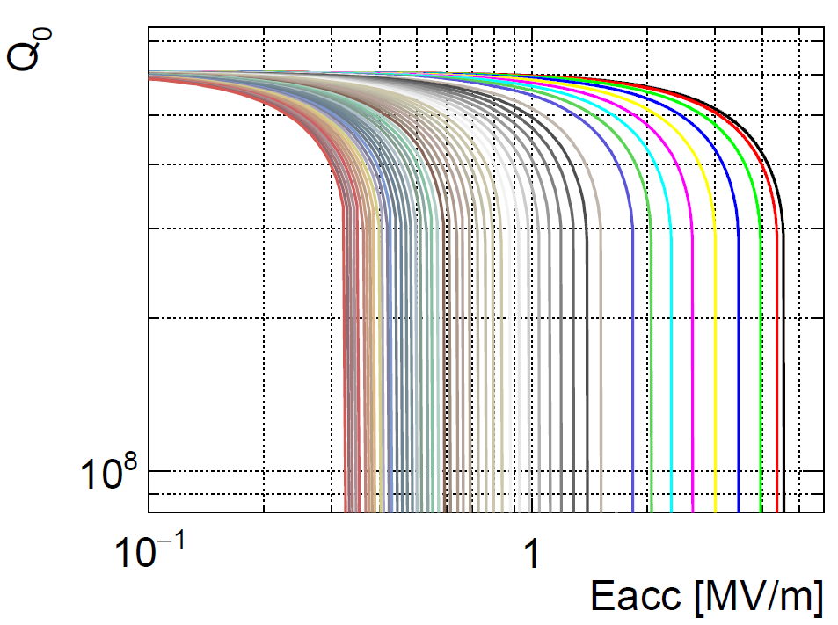
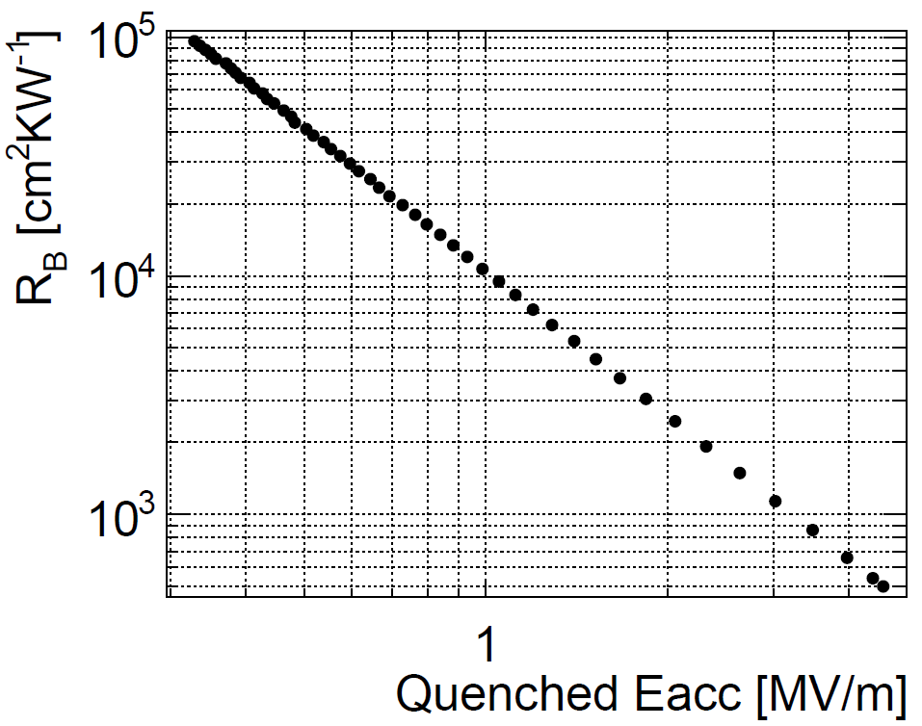
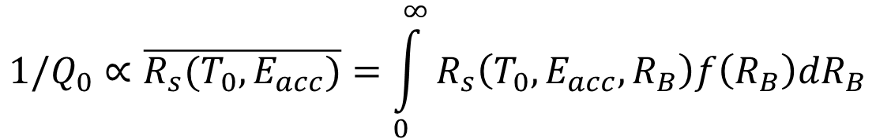
Thermal model for Q-slope
(V. Palmieri and R. Vaglio, Supercond. Sci. Technol. 29 (2016) 015004)
Higher R_{B}
Quench at this E_{acc}
The observable is an average over all thermal boundary resistances R_{B}
$${1/Q}_{0}∝\overline{R_{s}(T_{0},E_{acc})}=\int_{0}^{∞}{R_{s}\left(T_{0}, E_{acc}, R_{B}\right)f\left(R_{B}\right)dR_{B}}$$
f(R_{B}) is the (unknown) distribution function of R_{B}.

Slide 9
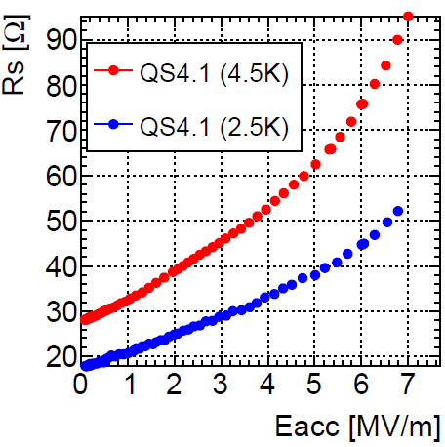
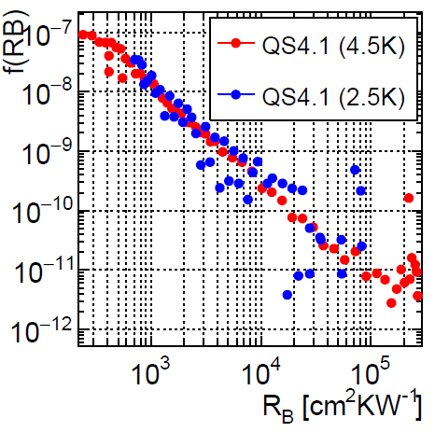
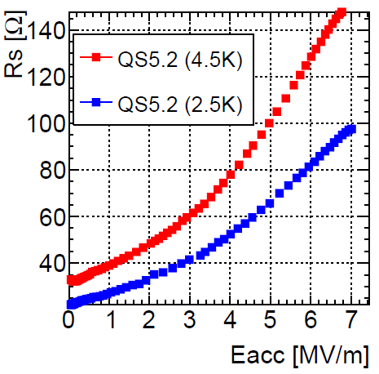
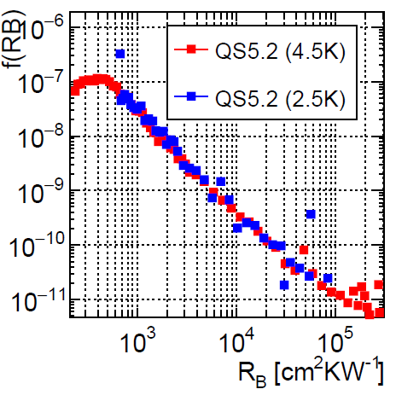
Rs(E_{acc},T₀ ) → f(R_{B}) at two temperatures
QS4.1 (2014)
QS5.2 (2015)

Slide 10
and it doesn't work for bulk Nb…

Slide 11
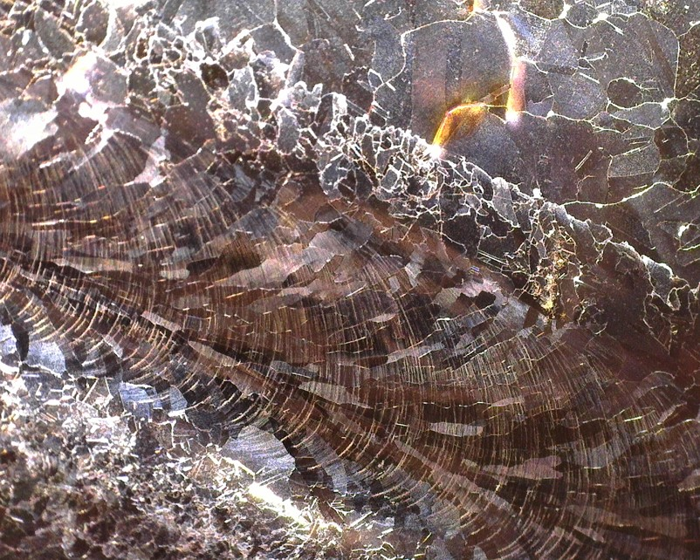
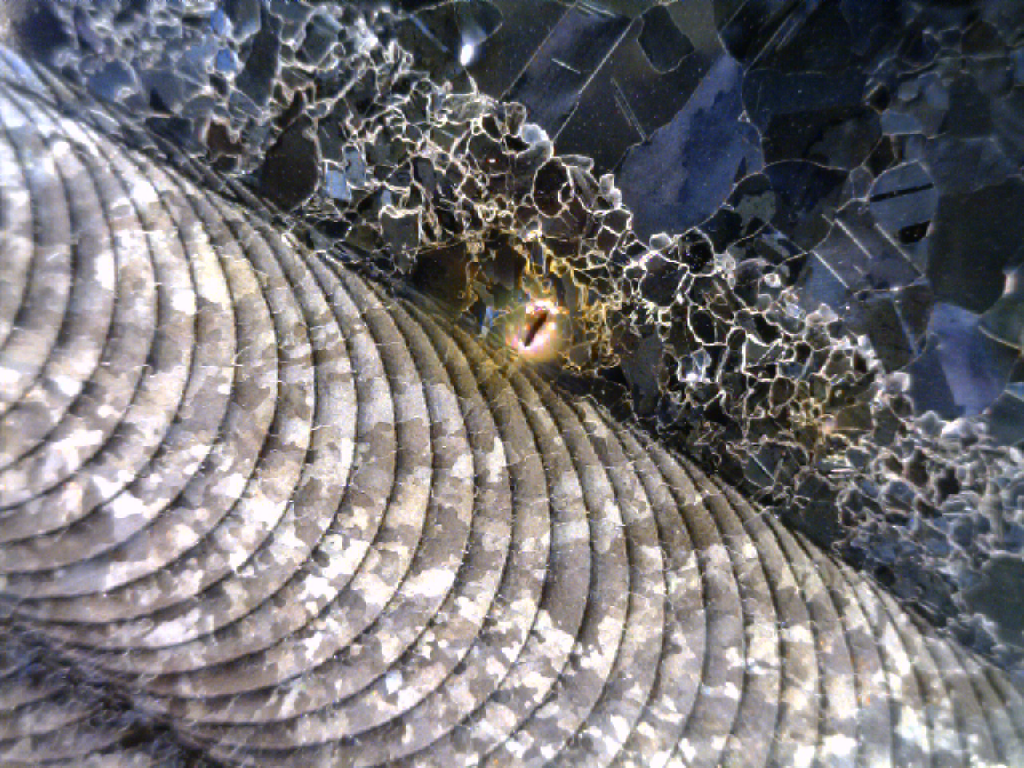
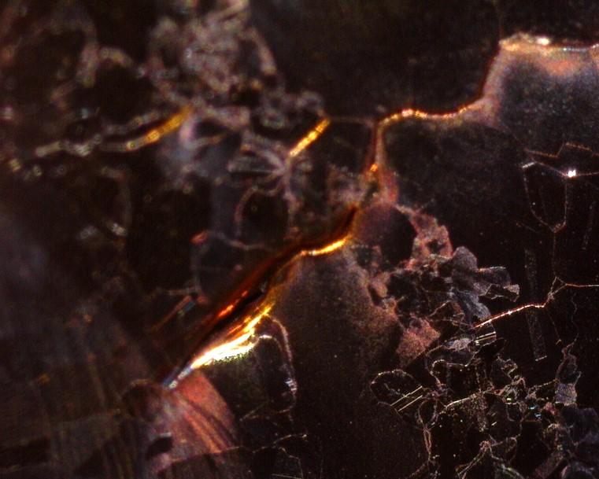
“Macroscopic” sources of RF loss: how substrates should (not) look like
Notes:
Proper BCS extraction only for best substrates.
Macroscopic (and extrinsic) problems

Slide 12
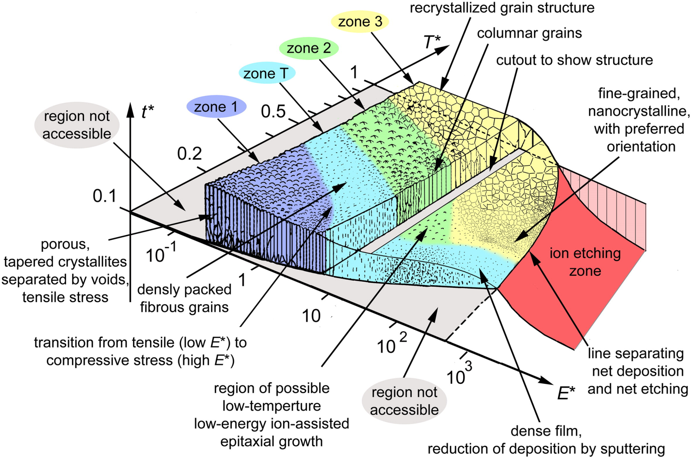
“Microscopic” sources of residual resistance
Intuitively: bad microstructure (for example voids) → extra losses
Structure Zone Diagrams: increasing the mobility of the atoms during growth→ tune microstructure
Rationale for the energetic deposition techniques, pursued in several laboratories
At CERN the chosen technique to address this is the High Power Impulse Magnetron Sputtering (HIPIMS)
A. Anders, Thin Solid Films, Volume 518, Issue 15, 31 May 2010, Pages 4087–4090
Notes:
In the simplest view…what counts is T_{(deposition)}/T_{melting} and Nb is a refractory metal…
Beware of re-sputtering effects

Slide 13
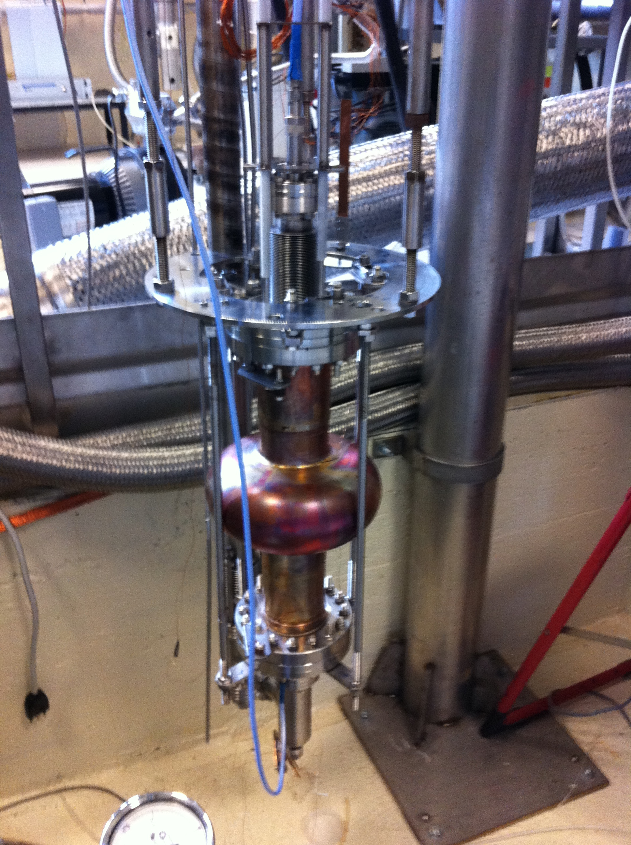
HIPIMS program
1.3 GHz mono-cells for “quick” turnaround
DCMS recipe as a reference
Varying HIPIMS parameters
So far, limited by availability of good substrates
New series of 10 test substrates under construction
Full cavity electro-polishing to be implemented
HIPIMS1 on LNL test stand

Slide 14
Results

Slide 15
Enabling tools
Good copper substrates
Full EP of cells
Superconductor DC characterisation tools
RF upgrades for high accuracy measurements
  Mobile coupler
  Digital LLRF system (SEL locking, fast acquisition)

Slide 16
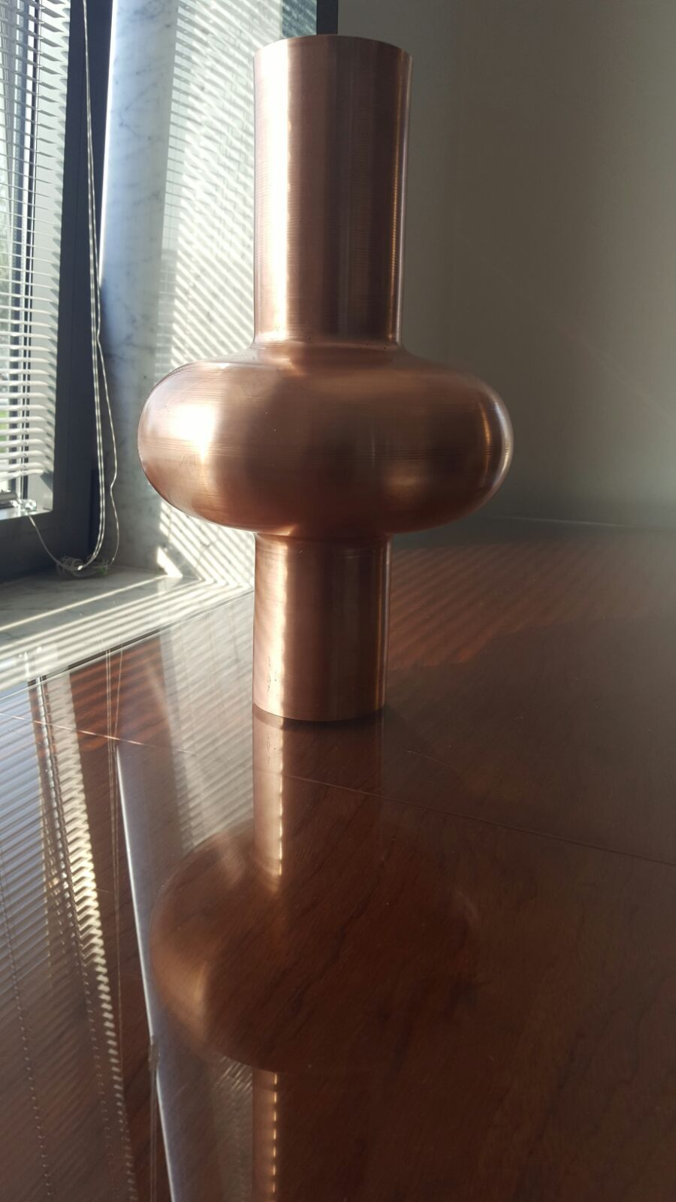
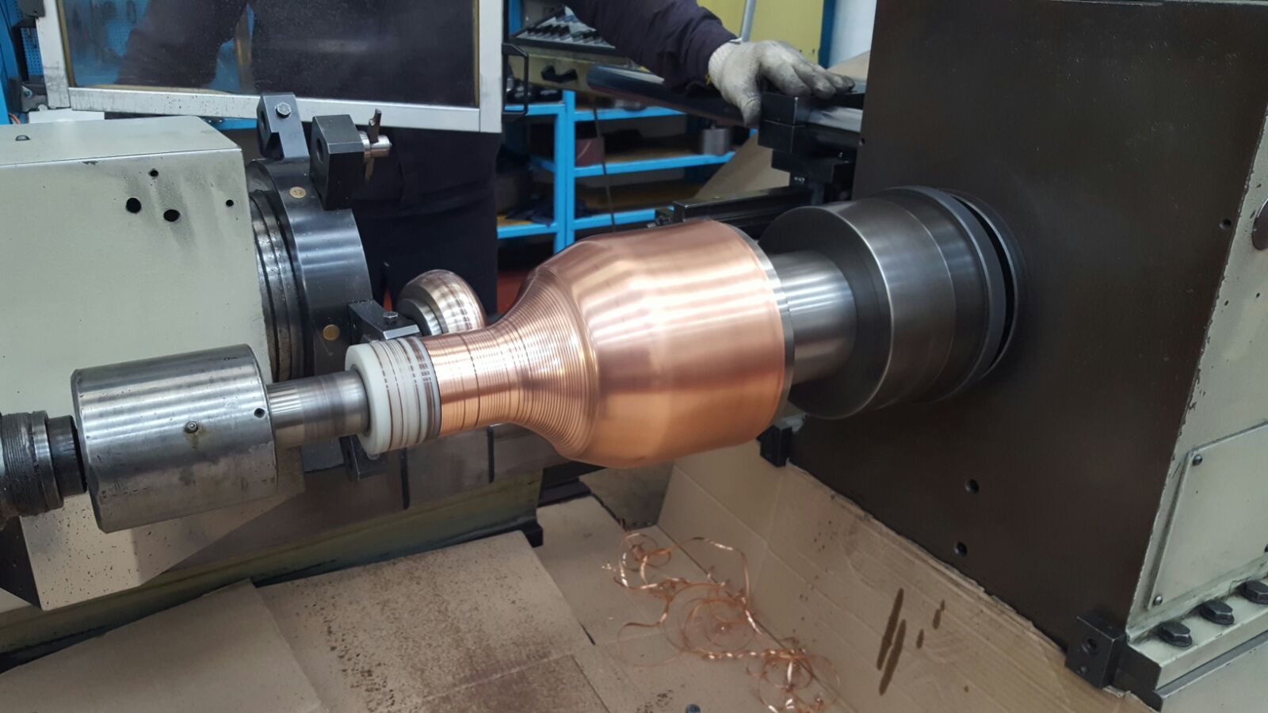
New 1.3 GHz substrates
10 cells expected from LNL w48
MME Job for cut-off welding and brazing of CF100 flanges

Slide 17
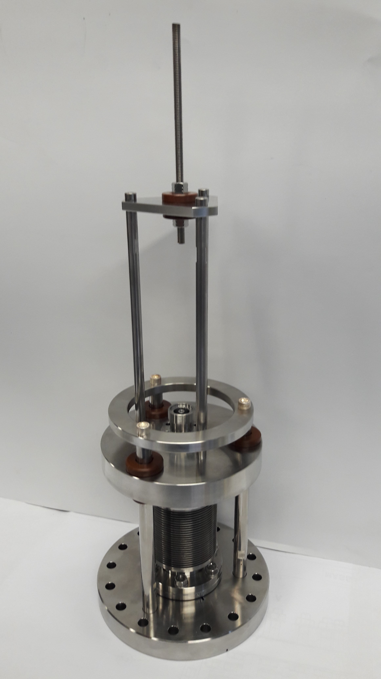
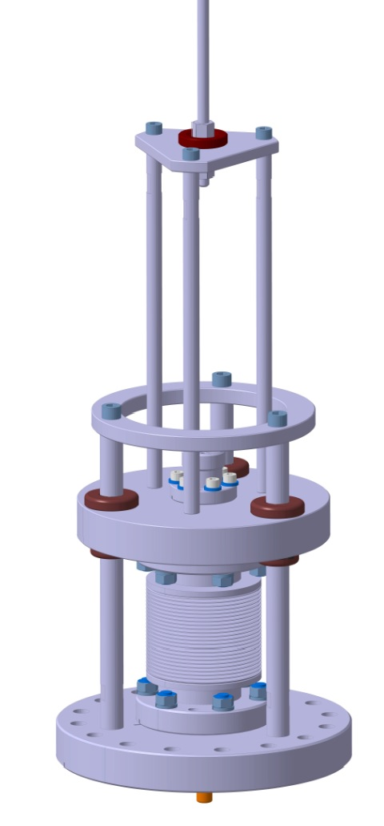
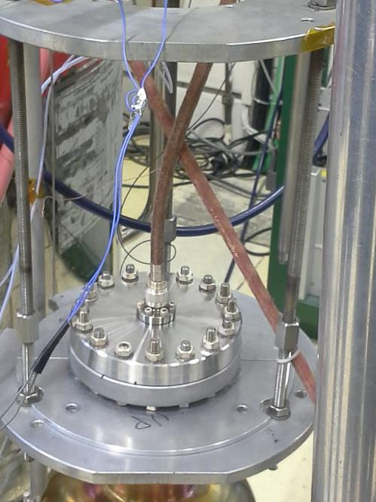
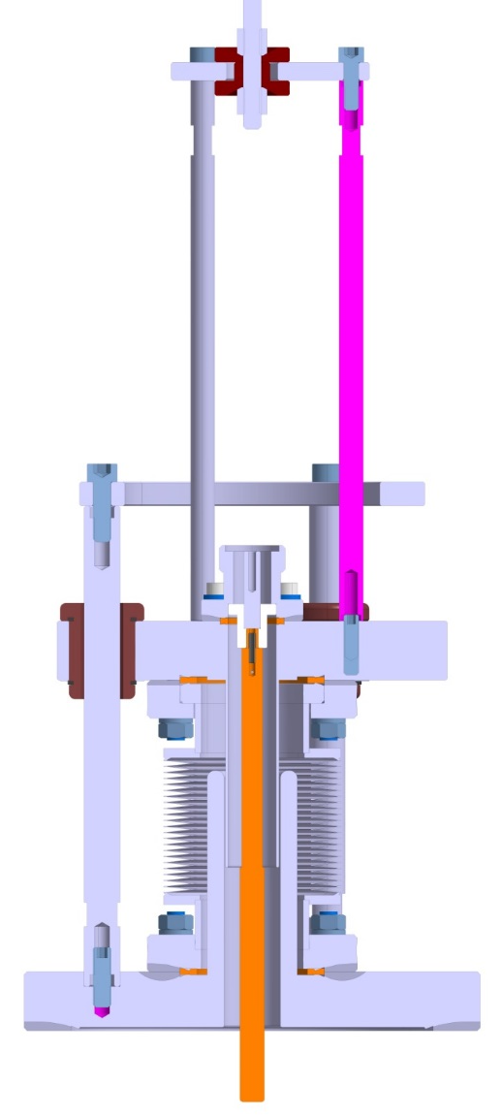
Variable coupler
3 units ready
Variable coupler design
Constant (and minimal) measurement uncertainty independent of cavity Q0
2) Easiness of MP conditioning
Old system with fixed antenna
335 mm
152 mm
Mass 7 Kg
A. Boucherie, E. Montesinos

Slide 18
UNIGE collaboration
The collaboration agreement (contract KE3170/ATS ) with UNIGE is operational since July 2016
Down-payment 25 kCHF done
Standard measurements report with was defined in details together with UNIGE
So far 16 samples sent, 7 measured, more in the pipeline

Slide 19
Magnetic measurements of witness samples
T=4K
T=4K
B_{max}=250 Oe
Small loops to identify onset of irreversibility
In case of vortex pinning m_{back} > m_{fwd}

Slide 20
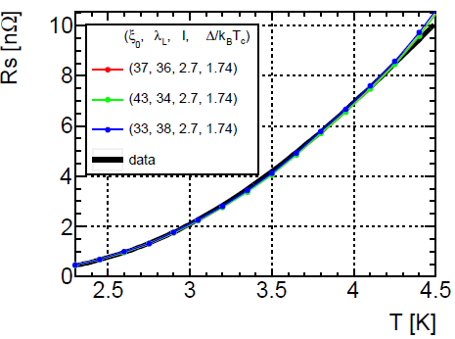
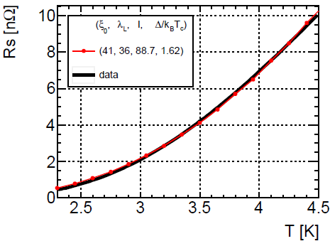
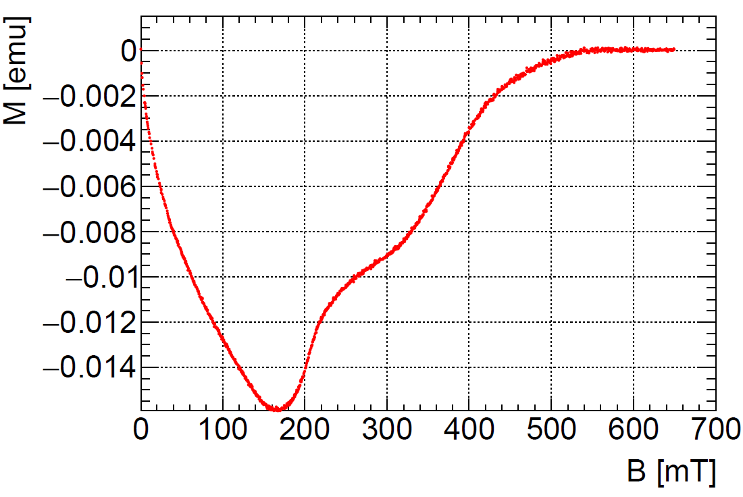

“BCS” fits of Nb films
Due to the mathematical structure of MB integrals, under-constrained fits can converge on improbable parameters
Magnetic measurements can be used to find physical constraints, yielding BCS fit with reasonable parameters
l =2.7 nm
→ RRR=1 !?
Bc₂=540 mT
Bc₂=Φ₀/2πξ(l)² → ξ(l)=25 nm
Constraint: 1/ξ(l)=1/ξ₀ + 1/l =1/25
Minimize $χ^{2}$subject to this constraint

Slide 21
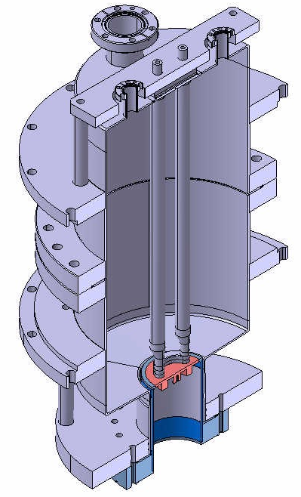
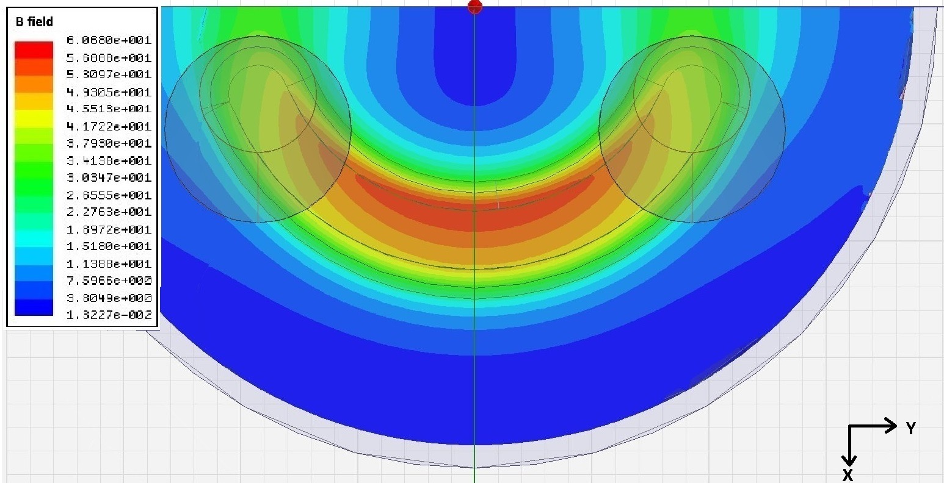

RF impedance measurements
Quadrupole Resonator (QPR)
testing of thin film samples
¹ E. Mahner et al.
Rev. Sci. Instrum., Vol. 74, No. 7, July 2003
² T. Junginger et. al
Rev. Sci. Instrum., Vol. 83, No. 6, June 2012
Testing at variable T (1.8-4.5 K), frequency (400,800, 1200 MHz) and RF magnetic field > 100 mT
The pole shoes focus magnetic field on the sample surface
1st generation developed at CERN (60 mT),
2nd generation under commissioning at HZB (120 mT)
3d generation under development at CERN, (fabrication in 2017)

Slide 22
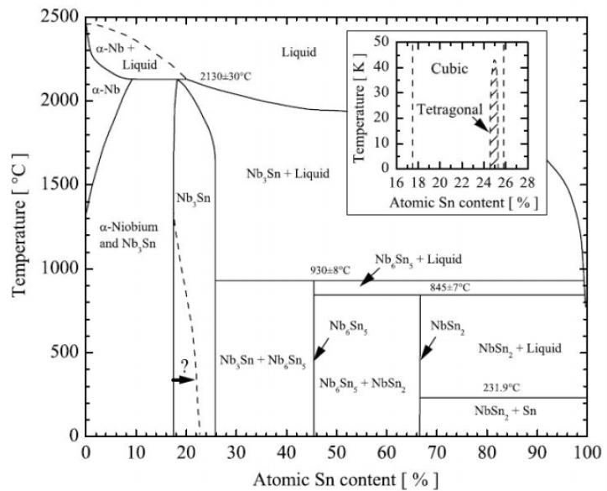
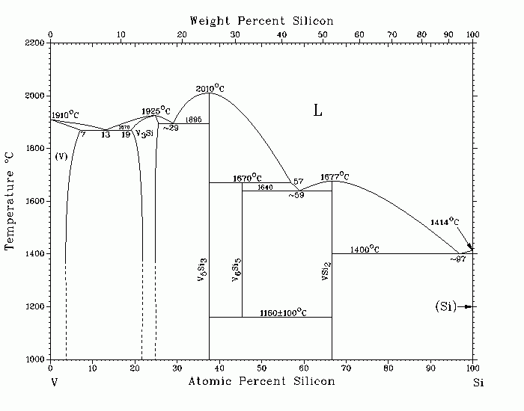
A15 (Nb₃Sn, V₃Si) coatings on copper
Binary phase diagram of the Nb-Sn system
J. Charlesworth, I. MacPhail, and P. Madsen, J. Mater. Sci. 5, 580 (1970).
High critical temperature
T_{c}^{Nb3Sn} = 18 K , T_{c}^{V3Si} = 17 K
Small BCS surface resistance
R_{s}^{Nb3Sn} ~ 0.4 nΩ (Nb₃Sn), R_{s}^{V3Si} ~ 0.3 nΩ @ 4.2K and 500MHz
Technique of choice at CERN: magnetron sputtering of an alloyed cathode (see Alban’s talk)
Stoichiometry control. A15 phase is reachable only in very narrow region of Sn % or Si%, needs high reaction temperatures
Temperature should be high enough to trigger the SC phase, but is limited by the copper substrate
Binary phase diagram of the V-Si system
J.F. Smith. Bulletin of Alloy Phase Diagrams. 6(3):266-271 (1985).

Slide 23
Diamagnetic transition of a Nb₃Sn sample
Best Tc so far: 15.9 K for Nb₃Sn

Slide 24
Summary
R/D activities on SRF cavity material and performance for FCC are defined and followed up within WP3
Main focus on Nb/Cu with energetic condensation techniques
At the moment, we are still re-establishing conditions for high quality coatings of 1.3 GHz mono-cells
10 new 1.3 GHz cavity substrates expected w48
Variable coupler designed and built, 3 units delivered w45
Collaboration agreement with UNIGE starts to produce results
Research on A15 coatings progressing

