Slide 1


FCC RF Coordination Meeting
#11
March 22, 2017

Slide 2
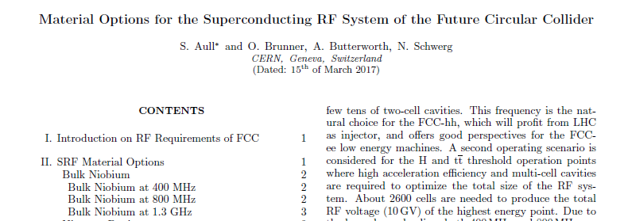
news
Status of collaborations & addendums:
- FNAL: Nb₃SN , N doping
- approved by CERN, now with FNAL
- Frankfurt University: HOM couplers for FCC_hh
- approved
- ULAN: high efficiency klystron simulations
- approved by ULAN
WP documents:
- WP1, WP2, WP3, WP5 up to date
- WP7: Igor
- new WP8 and WP9: low impedance CC (A. Grudiev)
- WP9, WP10 in preparation: RF quadrupole for Landau damping, fundamental power couplers
=> https://espace.cern.ch/FCC-SRF/_layouts/15/start.aspx#/
In preparation: Future directions for R&D: HE-LHC -> FCC_hh -> FCC_ee
Next meeting: 17 May 2017
Publication draft on SRF materials for FCC (Sarah et al.)

Slide 3
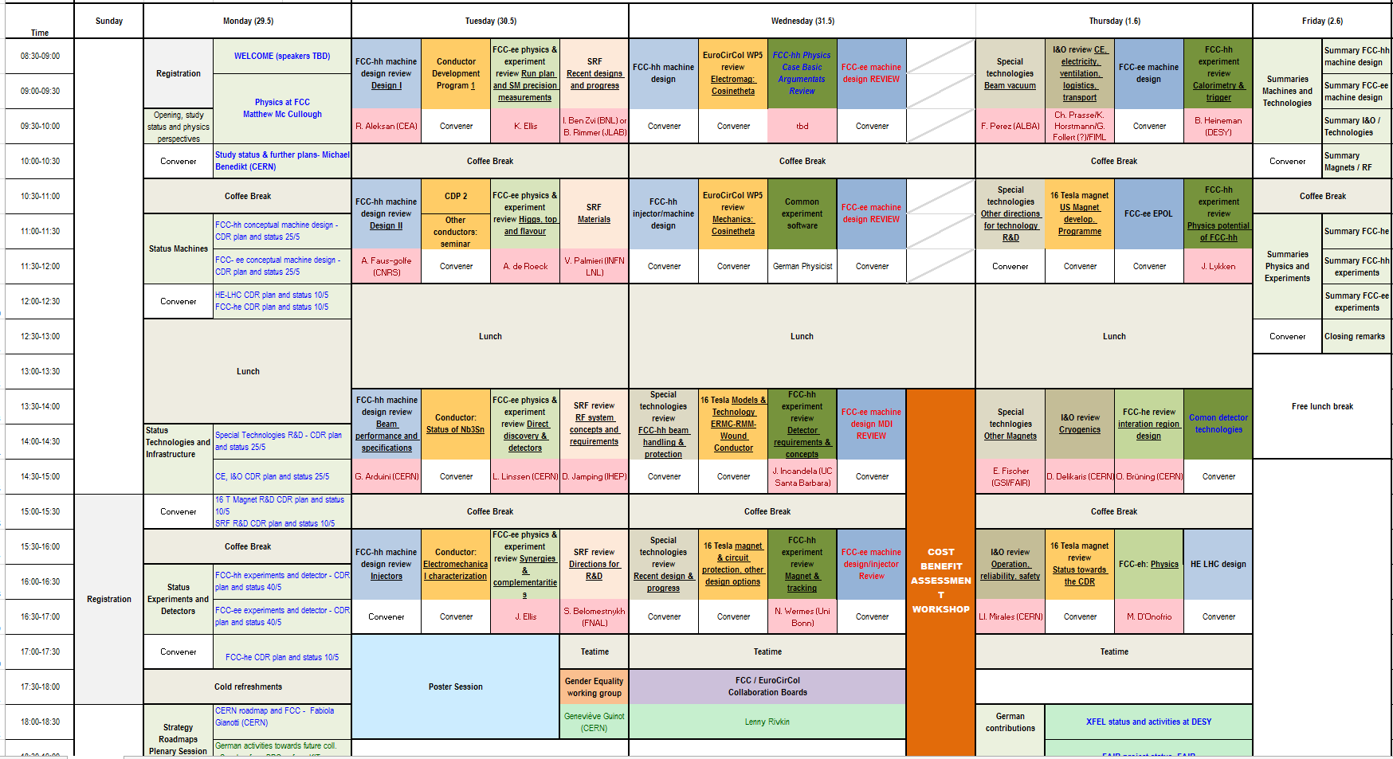
FCC week
FCC week 2017
- 29 May to 2 June 2017 in Berlin

Slide 4
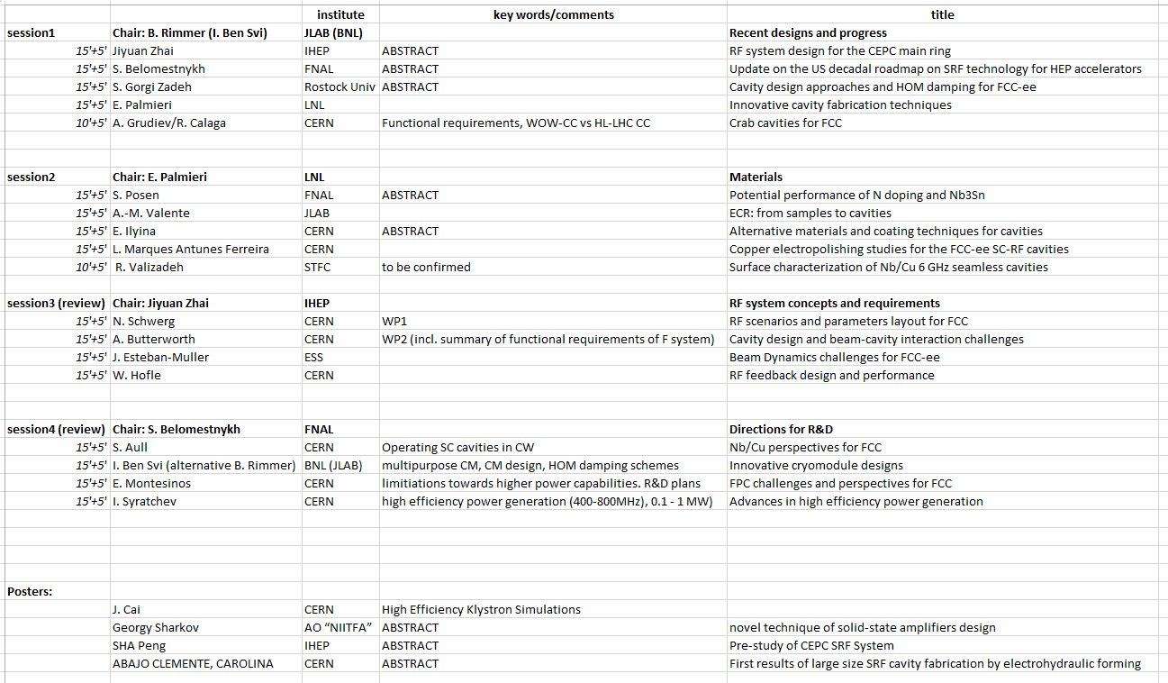
FCC week

Slide 5
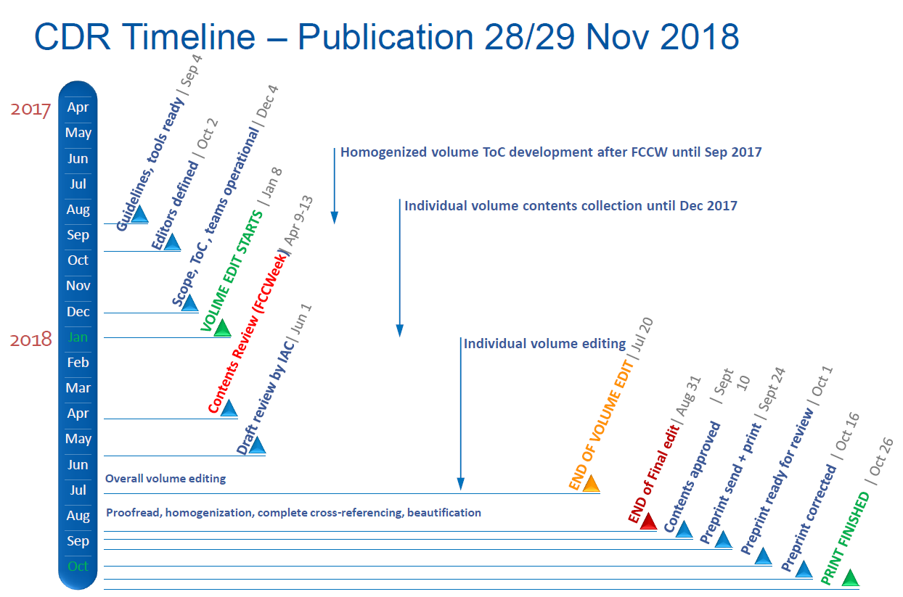
Time planning towards CDR
We have to start here!

