Slide 1


FCC RF Coordination Meeting
#13
May 17, 2017

Slide 2
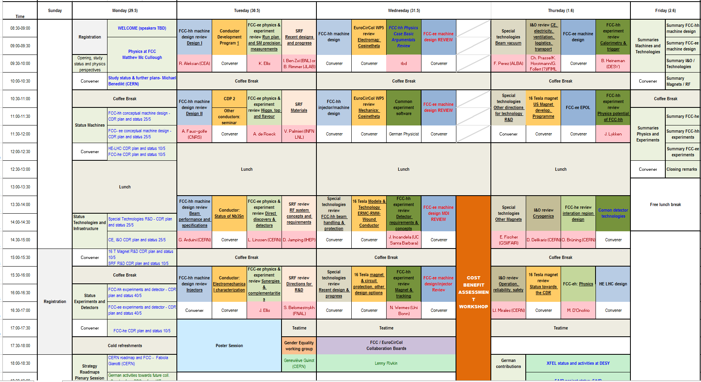
FCC week
https://indico.cern.ch/event/556692/timetable/#all.detailed

Slide 3
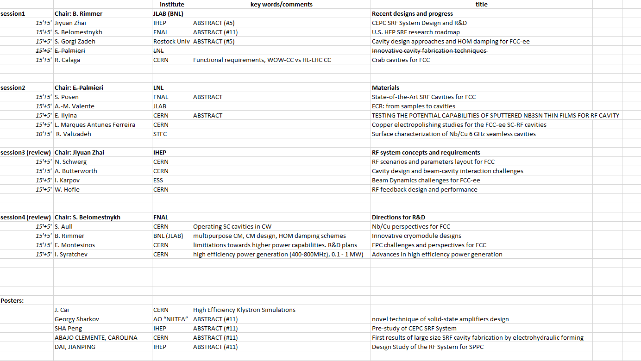
FCC week SRF R&D program

Slide 4
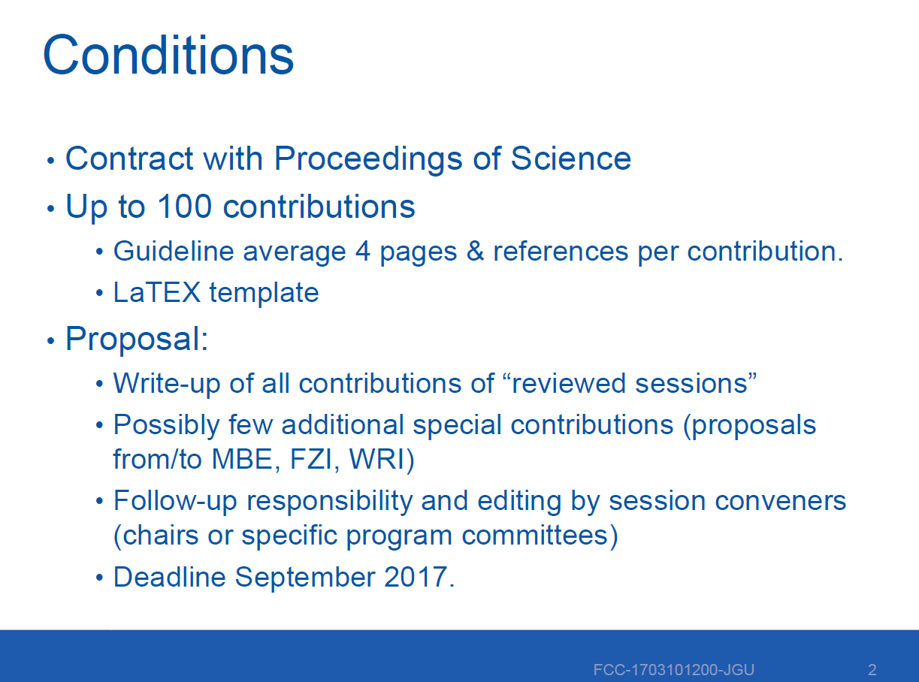
FCC week - proceedings

Slide 5
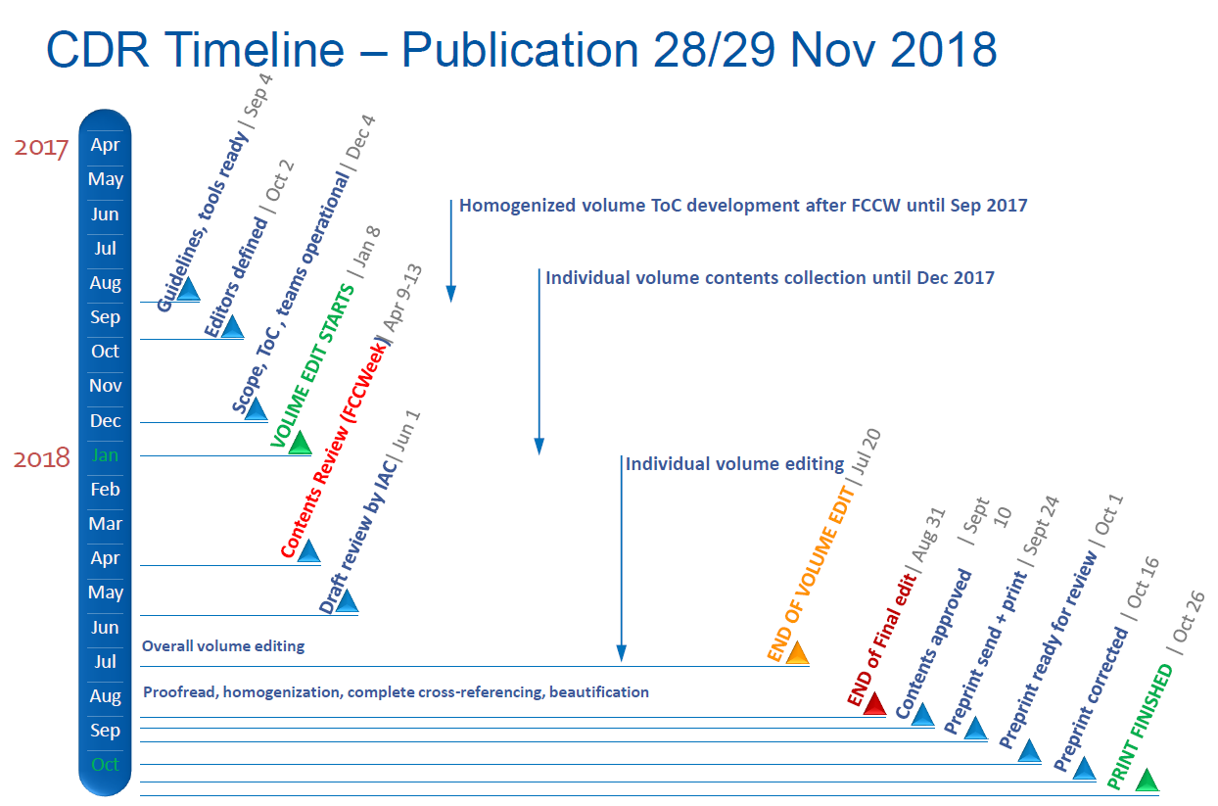
Time planning towards CDR
We have to start here!

