Slide 1
FCC SRF R&D program
CDR plan and status
xx

Slide 2
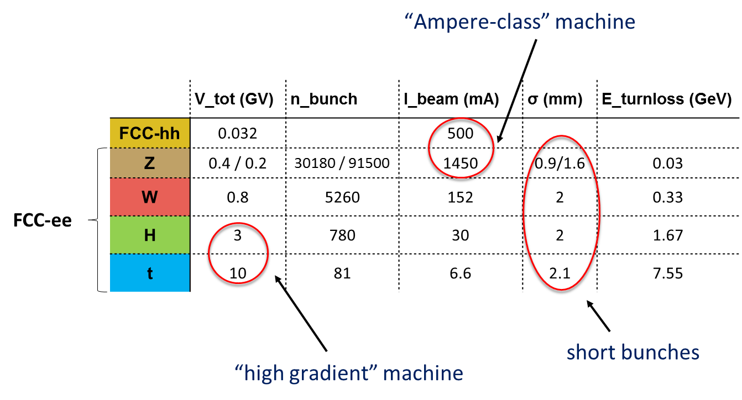
Introduction
9 work packages :
RF scenarios and parameter layout
Cavity design and beam - cavity interaction
Cavity material & performance
CERN-LNL-STFC Collaboration agreement on cavity material & fabrication
Cavity fabrication
Cryomodule challenges
High efficiency power sources
Fundamental power couplers
Low impedance deflecting cavities
Scope :
Define “ideal” RF system for each machine
Propose optimum compromise vs operation and installation timeline
Z
W
H
t
FCC-hh

Slide 3
Low impedance deflecting cavities
Introduction
Development of low impedance devices is crucial for FCC_hh
  Design and simulation ✓
  Fabrication is ongoing ✓
  Nb coating system is under development ✓
Status and Deliverables:
  Publications?
  CDR report
  Device built and test report

Slide 4
Fundamental power couplers
Introduction
  Initiative for a coordinated worldwide effort on FPC
FCC specific requirements
  Road towards high(er) CW power (1MW?) ✓
  Need for “adaptable” couplers (i.e. “fixed”, but adaptable to different Qext without breaking cavity vacuum) ✓
  Large series production: ≈ several hundreds for FCC_ee high energy and booster ✓
Status and Deliverables:
  Description of challenges, perspectives and limits (CDR report)
  R&D roadmap

Slide 5
High efficiency power sources
Introduction
  Big machine - > efficiency plot (Erk, Rome 2016)
  Each % - > xx MW -> XX MCHF
Revolution against the “textbooks”:
  HEIKA-phase1 ✓
  HEIKA-phase2 ✓
Very high efficient FCC klystron demonstrator:
  Parameters and design ✓
  Mechanical design and fabrication (Thales) ✓
External collaborators/contributors:
  ULAN (collaboration agreement)
  HEIKA
  THALES
Status and Deliverables:
  Description of challenges, perspectives and limits (CDR report)
  Roadmap towards demonstrator fabrication

Slide 6
Cryomodule challenges
Introduction
  FCC CM design will be based of existing 2 or 4.5K design (ESS, LEP, LHC, XFEL)
Specific topics of interest
  Multi-purpose cryomodules ✓
  CM cost model ✓
External collaborators/contributors:
  Preliminary discussions with JLAB and CEA Saclay
  Interesting developments at JLAB and possibly BNL and KEK
Status and Deliverables:
  Description of FCC specific requirements (CDR report)

Slide 7
Innovative cavity fabrication techniques
Introduction
  FCC_ee installation and operation timeline pushes for rapid and cost effective cavity fabrication techniques
    Ex: W -> H machines, hundred of cavities to be built assembled tested and installed
Technology developments
  High velocity hydroforming:
    Determine forming limits of high-velocity Electro-Hydraulic Forming (EHF) for Cu structures as substrate for superconducting coating (and for bulk superconducting Nb) ✓
  Spinning:
    Efforts towards seamless cavity fabrication (LNL) ✓
External collaborators/contributors:
  LNL
  STFC
  BMAX
Status and Deliverables:
  LNL 400, 800MHz cavities (on hold)
  LNL 6GHz cavities + characterisation at STFC (ongoing?)
  Bmax ?
  CDR report

Slide 8
Cavity material & performance
Introduction
  Technology choices and limits
    Sarah’s Paper (ref..) ✓
R&D and perspectives
  Bulk Nb:
    Performance and limits (reference to ESS, XFEL, …) ✓
    N_doping: (FNAL collaboration) ✓
  Nb/Cu:
    CERN developments ongoing (Uni Geneva,..) ✓
    CERN-LNL-STFC collaboration ✓
    ECR: JLAB ✓
  A15:
    Nb3Sn on Nb (FNAL) ✓
    Nb3Sn on Cu (CERN) ✓
    V3Si (CERN) ✓
External collaborators/contributors:
  LNL
  STFC
  Uni Geneva
  FNAL
  JLAB
Deliverables: insert list of publications

Slide 9
RF scenarios and parameter layout
Skeleton:
Introduction
Model description ✓
Machine layout (optimization for each machine):
  Limiting factors ✓
  Design choices and alternatives ✓
Staging scenarios:
  Timeline: installation and operation ✓
  Optimized scenario and options ✓
Cost and study model ✓
Sensitivity study ✓
Deliverables:
  FCC note in preparation (full model)
  FCC note in preparation (scenarios and layout)
Example:
  Here insert an example

Slide 10
Cavity design and beam - cavity interaction (1)
Introduction
Cavity challenges:
  High energy: aim at acceleration efficiency
    Number of cells ✓
    Material, frequency, temperature ✓
  High intensity:
    optimize cell shape with regard to HOMs ✓
    HOM damping schemes ✓
Beam dynamic challenges:
  Single bunch instabilities (Juan’s analysis, report in preparation) ✓
  Multi-bunch instabilities:
    Extension of the simulation tool for Gaussian bunch and synchrotron damping (BLOND) – done by Juan ✓
    Study of coupled bunch instabilities for all machine using the improved code – to be done, Ivan) ✓
HOM heating for all machine – in progress, Ivan ✓
Impedance budget limits (narrow and broad band)
  Resonant build-up - in progress/done, Juan/Ivan ✓
Analysis of the need for a RF harmonic system – to be done? ✓
LLRF:
  FCC_hh: 25ns - >LHC, 5ns option -> transverse emittance preservation (FCC STP) ✓
  FCC_ee: scenario for high intensity operation (see Ph. Baudrenghien, FCC week 2016) ✓
External collaborators/contributors:
  Rostock University (FCC_ee high energy)
  Frankfurt University (FCC_hh HOM damping)

