Slide 1
RF WP2: Cavity Design and Beam Interaction
Andy Butterworth 17.05.2017

Slide 2
WP2 Scope
For the moment concentrated on FCC-ee
Cavity design for FCC-ee
  Study and optimization of RF cavities for high energy operation
  Study and optimization of RF cavities and Higher Order Mode damping scheme for high intensity operation
Cavity design for FCC-hh
  Study and optimization of RF cavities for high intensity operation
Beam dynamics
  Beam dynamics and impedance studies for FCC-ee and FCC-hh
Low-Level RF
  Definition of LLRF requirements for FCC-ee and FCC-hh
  LLRF requirements for FCC-hh

Slide 3
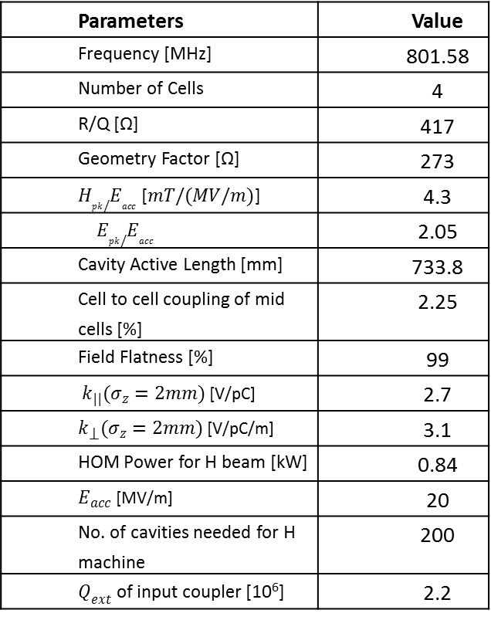
Cavity design summary (FCC-ee)
Parameters | Value
Frequency [MHz] | 801.58
Number of Cells | 4
R/Q [Ω] | 417
Geometry Factor [Ω] | 273
$H_{pk}/E_{acc}$ [$mT/(MV/m)$] | 4.3
$$E_{pk}/E_{acc}$$ | 2.05
Cavity Active Length [mm] | 733.8
Cell to cell coupling of mid cells [%] | 2.25
Field Flatness [%] | 99
$k_{||}(σ_{z}=2mm)$ [V/pC] | 2.7
$k_{⟘}(σ_{z}=2mm)$ [V/pC/m] | 3.1
HOM Power for H beam [kW] | 0.84
$E_{acc}$ [MV/m] | 20
No. of cavities needed for H machine | 200
$Q_{ext}$ of input coupler [10⁶] | 2.2
Design of cavity for high energy operation (S. Gorgi, Uni. Rostock):
4-cell 800MHz for H and tt machines
Optimized for peak fields, losses, field flatness, HOMs placement & propagation...
fixed input coupler Q_{ext}=2.2x10⁶ good for H and tt
HOMs, coupled bunch growth rates vs SR damping
LHC-style HOM damping (2xBB + 2xNB couplers)

Slide 4
Beam dynamics summary (FCC-ee)
Simulation code for lepton machines:
  SR effects added to longitudinal simulation code BLonD
Single bunch stability:
  estimations of microwave instability thresholds using BLonD in agreement with previous results
  strong SR damping keeps bunch stable even for Z machine
Coupled bunch stability for HOMs:
  analytical estimation of threshold wrt SR damping
  some modifications to BLonD to facilitate coupled-bunch simulations
HOM power
  Estimation for bare cavity (JE Mueller): 0.8 to 1.5kW for Z machine single cell 400MHz
  Calculations with different layouts (with tapers + beam pipes) ongoing (Ivan)

Slide 5
LLRF summary (FCC-ee)
Most challenging: Z machine (I_{b} = 1.45 A)
Some input & simulations from D. Teytelman (DimTel Inc.)
  “Extremely challenging, similar to high current SuperPEP2 ideas, RF system design must be driven by beam loading considerations”
  Choice of filling pattern to minimize transients
  Need aggressive RF feedback to manage longitudinal instabilities driven by large detuning at 1.45 A
    without feedback longitudinal growth time is 1.6 ms (cf SR damping time of 440 ms)
    minimum number of cavities/maximum cavity voltage to minimize detuning

