Slide 1
FCC R&D WP5 Cavity Fabrication
Status May 2017
M. Karppinen on behalf of the project team

Slide 2
Objective
Development of new cavity fabrication methods suitable for production of large series of SC cavities based on thin film and bulk Nb-technologies

Slide 3
WP 5: Scope
WU 5.1 Copper and Niobium sheet supply
C. Abajo Clemente CERN:
WU 5.2 Fabrication of seamless cavities
M. Karppinen CERN, V. Palmieri LNL
WU 5.3 High velocity forming of SC RF structures
C. Abajo Clemente CERN,TBD BMAX
WU 5.4 Fabrication of 1.3 GHz seamless cavities
W. Venturini CERN, V. Palmieri LNL
WU 5.5 Fabrication of 800 MHz 5-cell Nb-cavity
K. Schirm CERN, R. Rimmer JLAB

Slide 4
WU 5.1: Cu- and Nb-sheet Supply & Material Characterization Pre- and Post-forming
Specification, characterisation, handling, and supply of copper and niobium sheets for cavity forming development:
  Task 1: Collection of technical specifications for the sheet metal to be used for cavity forming studies;
  Task 2: Procurement of Cu- and Nb-sheets;
  Task 3: Processing of the sheets including the heat treatments, chemical processing, and cutting to required size;
  Task 4: Material characterisation at appropriate stages ranging from material reception to samples extracted from formed cavities;
  Task 5: Quality assurance related to the sheet metal supply to ensure the conformance with the technical specification and the traceability.

Slide 5
WU 5.1: Status
OFE-copper supply
  Handling of sheets to avoid scratches
  Supply of >1000 mm wide sheets challenging
Annealing:
  Annealing at CERN or in industry
  Improved tooling being manufactured
Characterisation:
  Samples from EHF half-cells analysed, additional tests underway
  Samples from spun half-cells analysed, shortly from spun and machined cells

Slide 6
WU 5.2: Fabrication of Seamless Cavities
Objective:
  Development and validation of seamless cavity forming technology by spinning for multi-cell 800 MHz and mono-cell 400 MHz Cu-cavities
Task 1: Manufacturing drawings
Task 2: Fabrication of cut-off tubes
Task 3: Fabrication of 400 MHz mono-cell cavity
Task 4: Fabrication of 800 MHz mono-cell cavity
Task 5: Fabrication of 800 MHz 2-cell cavity
Task 6: Fabrication of 800 MHz Nb cavity (Option)

Slide 7
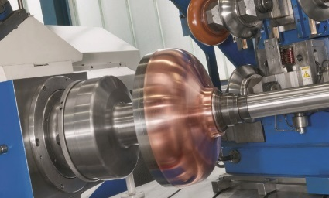
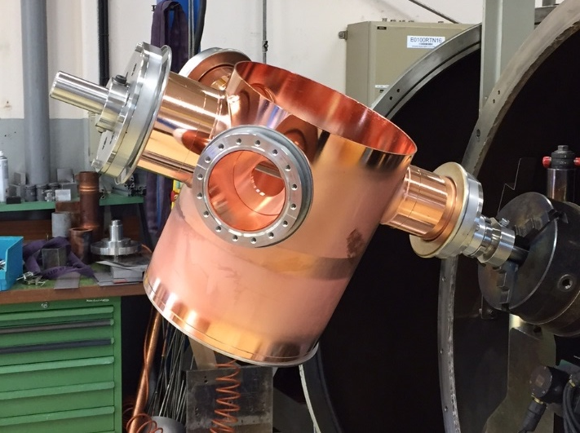
WU 5.2: Status
Task 1: Manufacturing drawings
  400 MHz complete
  800 MHz complete
Task 2: Fabrication of cut-off tubes
  Seamless tubes being investigated
Task 3: Fabrication of 400 MHz mono-cell cavity
  Material supply challenging (ø1300 mm sheets)
  Spinning tooling in fabrication
  First forming trials using Al expected in June

Slide 8
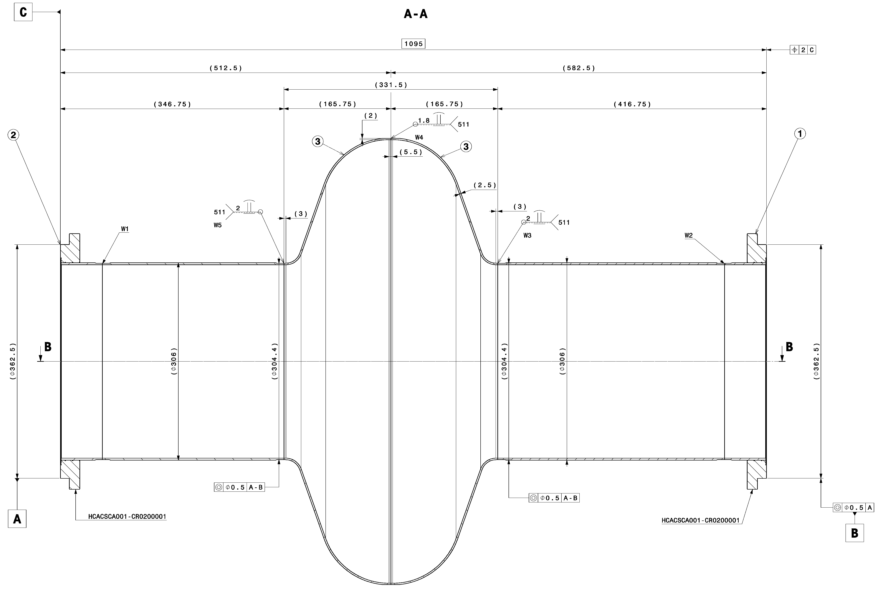
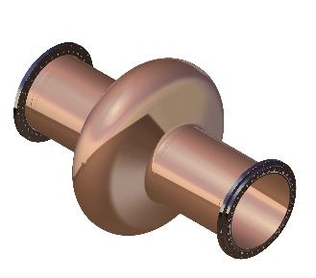
Simplified LHC 400 MHz
Practice Cavity

Slide 9
800 MHz 5-cell

Slide 10
800 MHz Mono-cell

Slide 11
800 MHz 2-cell

Slide 12
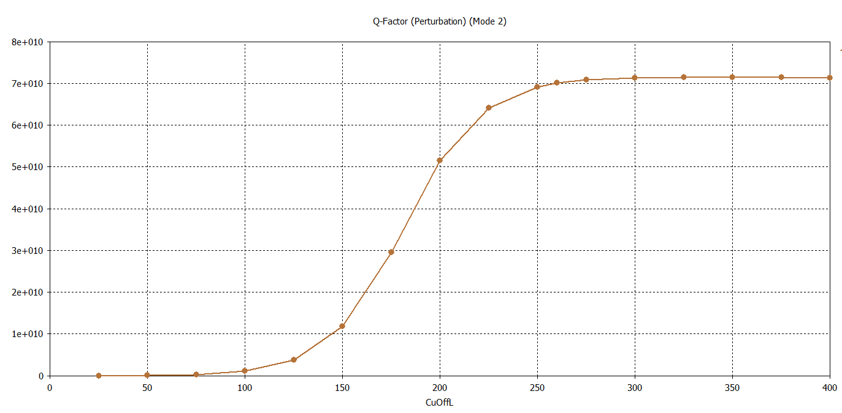
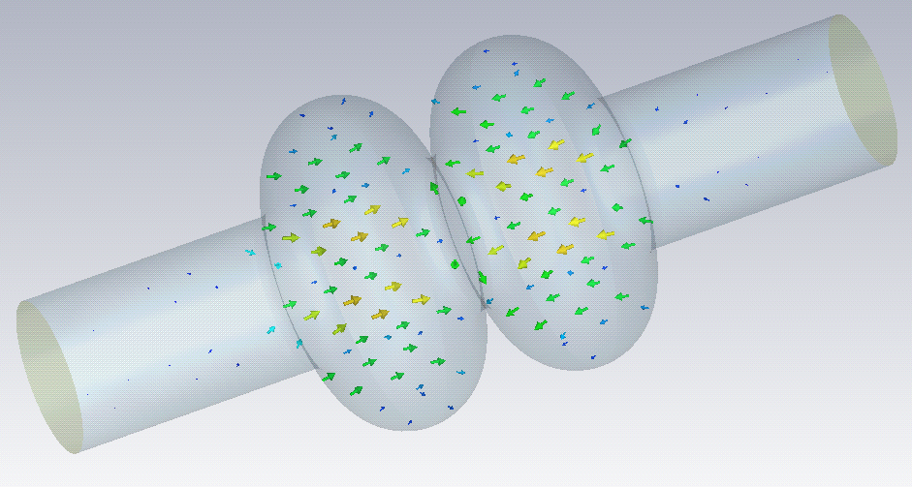
Cut-off length 260 mm
798.8 MHz

Slide 13
WU 5.3 High Velocity Forming of SC RF-Structures
Objectives:
  Thorough understanding of the EHF process applied to elliptical niobium cavities (Cu for technical development)
  Characterisation and modelling of Cu and Nb for EHF;
  Option: Production of a Nb functional structure.
Task 1: Manufacturing drawings
Task 2: Forming of 800MHz Cu half-cells
Task 3: Fabrication of cut-off tubes
Task 4: Fabrication of 800 MHz Cu-cavity from half-cells
Task 5: Feasibility study of of seamless Nb 800 MHz cells by Numerical modelling

Slide 14
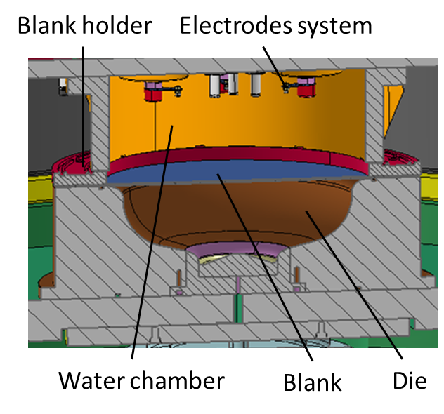
WU 5.3 Status
Task 2: Forming of 800MHz half-cells
Drawings available.
  704 MHz 3 x Cu and 2 x Nb half cells produced
    Cu dimensionally acceptable
    Nb half-cells require further development.
    Halted since Mid-2016.
  Forming tool for 800 MHz half cells launched

Slide 15
WU 5.4 Fabrication of 1.3 GHz seamless cavities
Objectives:
  New 1.3 GHz substrates for coating studies within WP3
  Clones of spun cavities used for R&D in the1990’s
Status:
  10 x seamless Cu cavity cells ordered in Feb-16 were delivered by LNL in Dec-16
  Dimensional inspection in progress
  Cut-offs for 4 cavities in stock
Plans:
  Cavity assembly, chemical processing, coatings
  RF-tests..

Slide 16
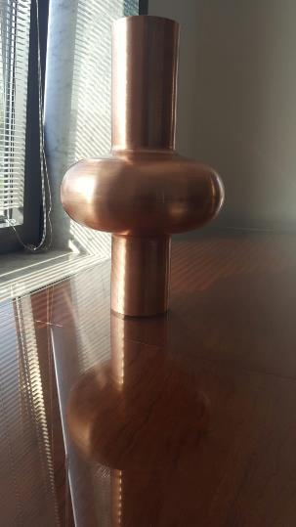
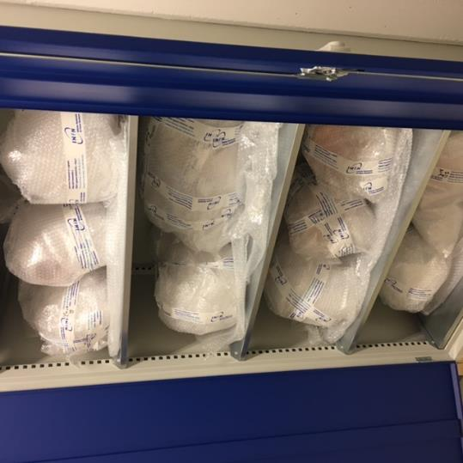
Courtesy of W. Venturini CERN BE-RF-SRF

Slide 17
First impression on metrology
Courtesy of W. Venturini CERN BE-RF-SRF

Slide 18
WU 5.4 Fabrication of 800 MHz 5-cell Nb cavity
Objectives:
  Single cell & 5-cell (simplified cut-offs)
  To use as reference cavities
Status (March-17):
  Tooling in production
  Nb in stock
Plans:
  Trial cells to validate the form
  Fabrication of Nb cavities
  Full processing and testing at JLAB
  Re-testing at CERN

