Slide 1
Nb-coated copper crab cavity alternative for FCC
Alexej Grudiev
17.05.2017

Slide 2
Outline
Crab cavity system for FCC-hh
Motivation for Nb-coated crab cavity
Cavity design and parameters
Budget and time line

Slide 3
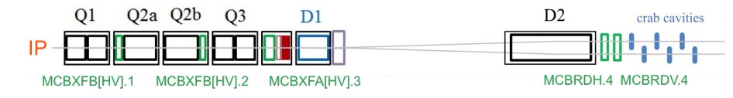
Crab cavity system for FCC-hh (april 2017)
Schematic layout:
E. Cruz-Alaniz,
Nov. 2016, Barcelona
 | FCC-hh |  | HL-LHC (R. Calaga, Chamonix 2012)
RF frequency [MHz] | 400 |  | 400
Total voltage V [MV] | 18 (uncertainty ±20%) |  | 6 ÷ 10
Available length [m] | 20
Beam separation [mm] | 250 (maybe 204 soon) |  | 194
Average beta in the ring [m] | (339+67)/2 = 203 |  | 200
Beta* [m] | 0.3 | 0.1 | 15 ÷ 25
Crossing angle [urad] | 89 | 154 | 235 ÷ 290
Beta at CC location [m] | 10100 ÷ 10900 | 30300 ÷ 32700 | 4000
Information for FCC-hh provided by FCC-hh general design WG: D. Schulte, E. Cruz-Alaniz, A. Seryi, R. Martin, R. T. Garcia

Slide 4
Comparing CC pars for FCC-hh to the HL-LHC
MORE CCs: Total voltage is 3 (2) times higher => 6 cavities per beam/side/IP
Available length: 20m/(6x2) = 1.7 m per cavity is sufficient even for longer alternatives (WOWCC)
Larger beam separation 250 vs 194 may give some advantages in case of redesign
EFFECTIVE TRANSVERSE IMPEDANCE IS MUCH (up to 3x8=24 times) HIGHER than for HL-LHC:
  Beta function at the CC location is 2.5 -> 8 times higher for the same <beta>
  Number of cavities per beam 2-3 times higher
Low impedance CC are desirable
In Conclusion: larger number of cavities, larger beam coupling impedance and different beam separation justifies looking into new alternatives for FCC-hh CC system

Slide 5
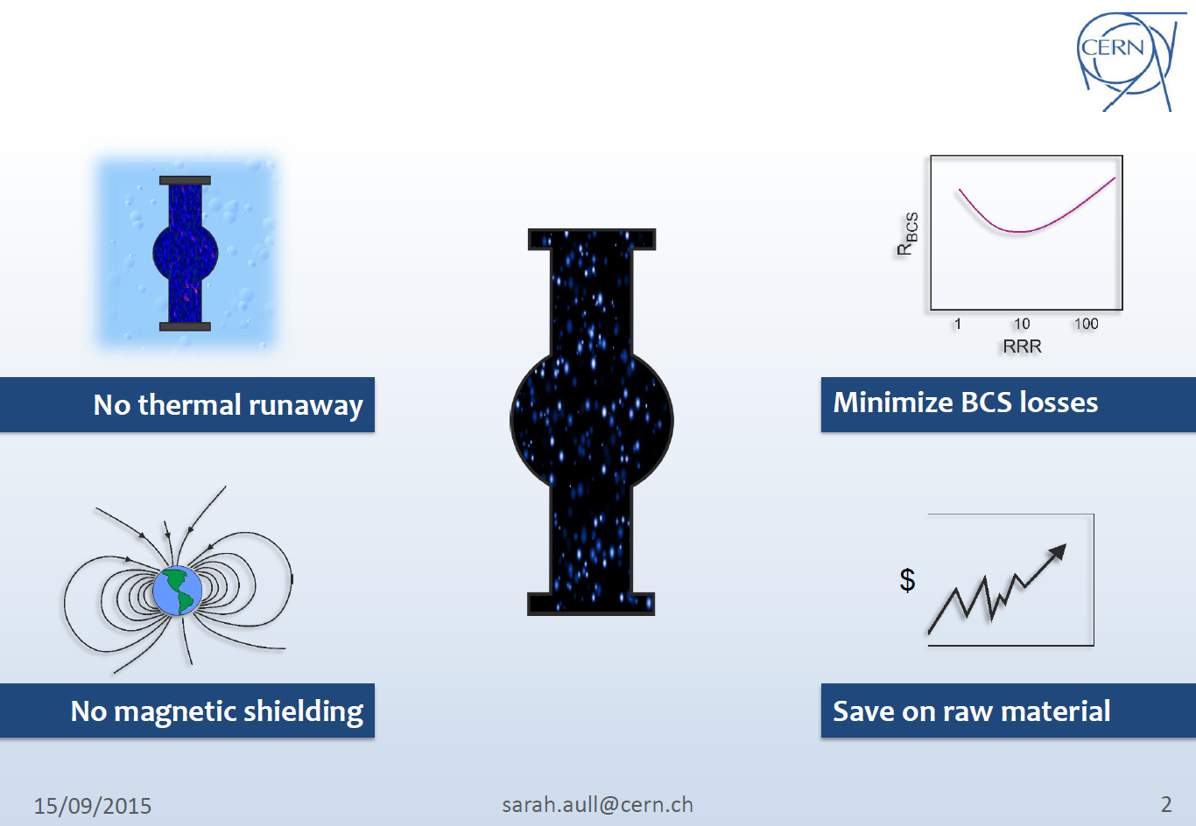
Motivation
S. Aull, SRF2015

Slide 6
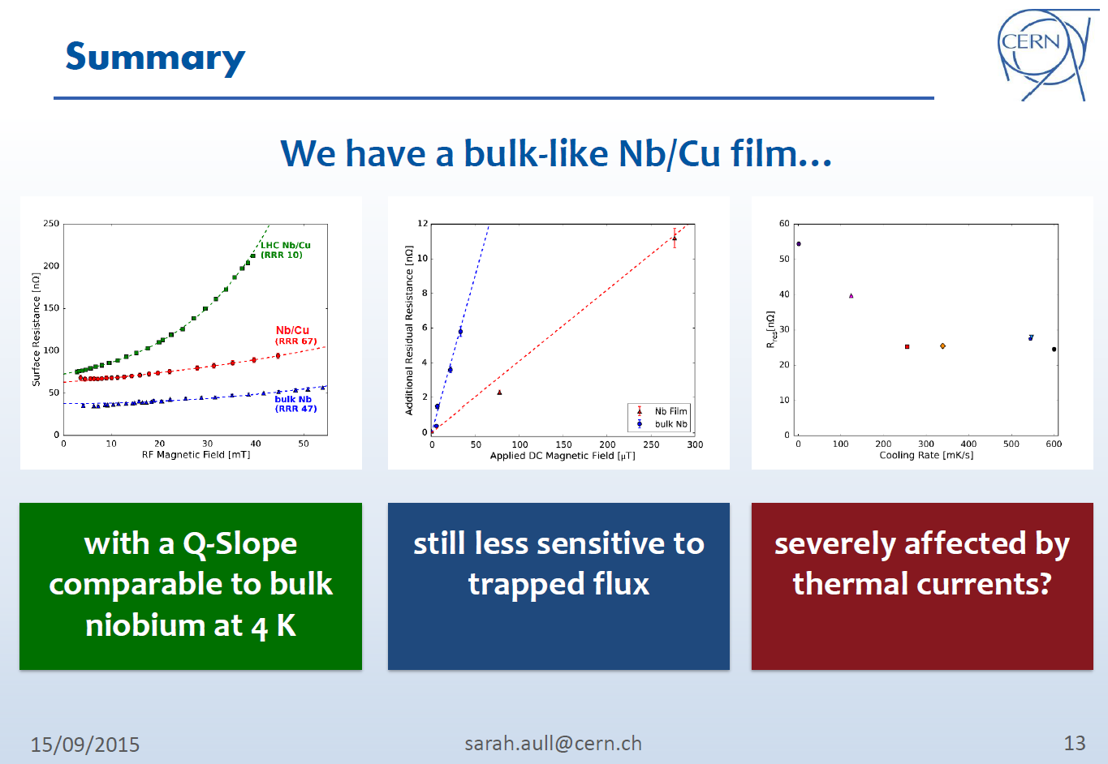
Motivation
S. Aull, SRF2015
Can we apply the state of the art coating technique to 400 MHz crab cavity?

Slide 7
Introduction
This work package covers design, construction and testing of 2 prototypes of a compact superconducting crab-cavity for LHC using Nb-on-Cu-coating technique.
The cavity shape is based on the ridged waveguide resonator with wide open apertures to provide access to the inner surface of the cavity for coating.
It also provides natural damping for HOMs and rather low longitudinal and transverse impedances.
The final goal is to validate the fabrication and coating of the cavity prototypes and to characterize its high gradient performance in a vertical test at 4K

Slide 8
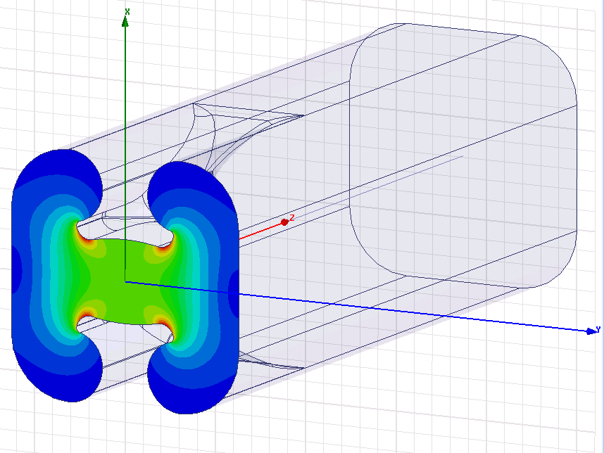
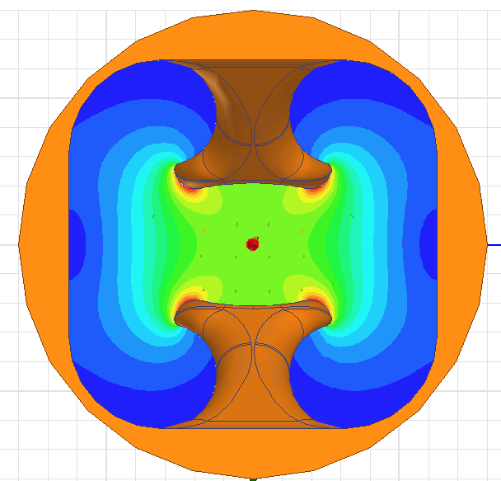
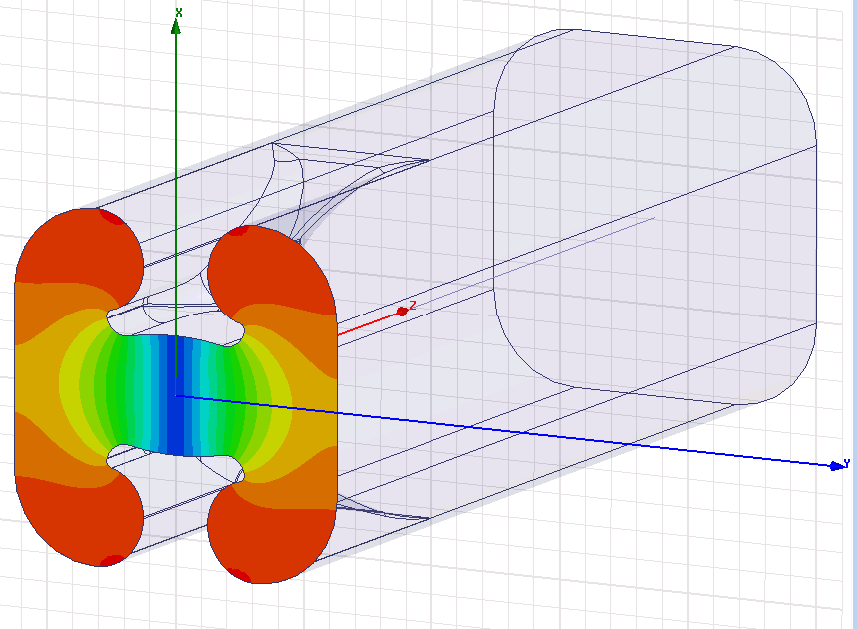
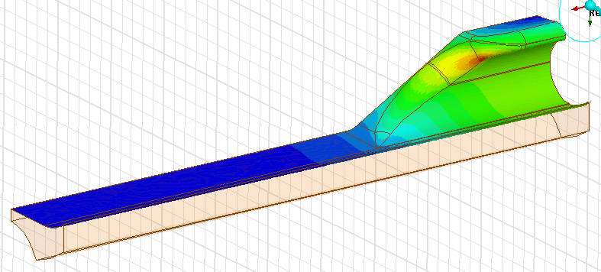
Main Parameter
L/2
d
w
w [mm] | 251.70
h [mm] | 251.70
r [mm] | 42.00
L [mm] | 1400.00
d [mm] | 192.00
d
h
r
Frequency [MHz] | 400.000
G [Ω] | 109
Vx [MV] | 3.0
Total Energy [J] | 10.4
Rx/Q [Ω] | 343.5
E_{peak} [MV] | 50
B_{peak} [mT] | 78
B_{peak} = 70 … 80 mT
Notes:
Make clear here why we are interested in the rfq. It has several advantages over the octupoles in a machine like LHC or HL-LHC.

Slide 9
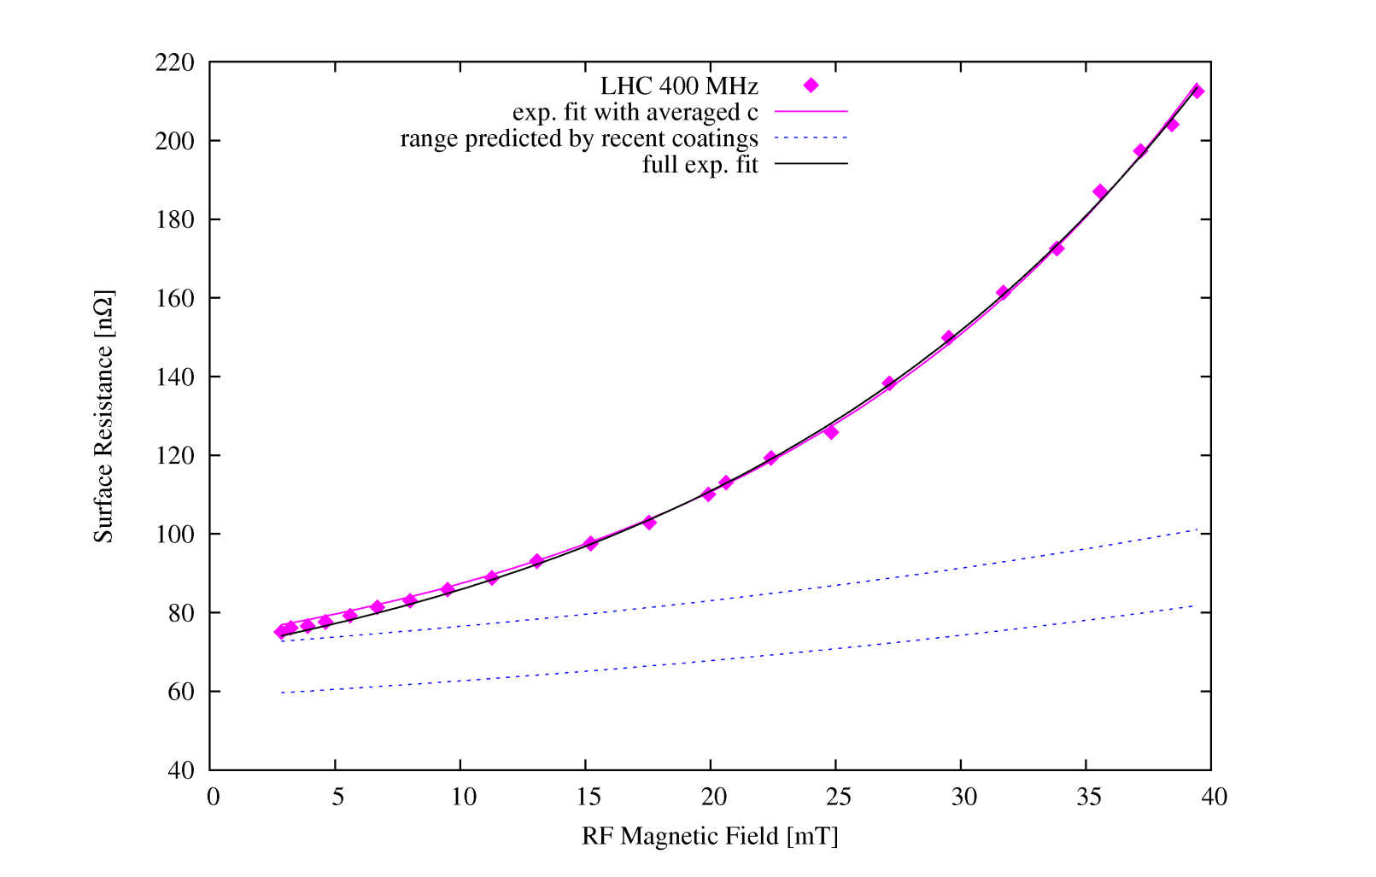
Non-linear behaviour of surface resistance (S. Calatroni, S. Aull)
LHC: Rs(Brf)[nOhm] = 54.7 + 19.0*exp(0.054*Brf[mT])
ECR: Rs(Brf)[nOhm] = 46.9 + 17.1*exp(0.023* Brf[mT])
There is a big potential in the new coatings but let’s be conservative and take LHC cavity data.

Slide 10
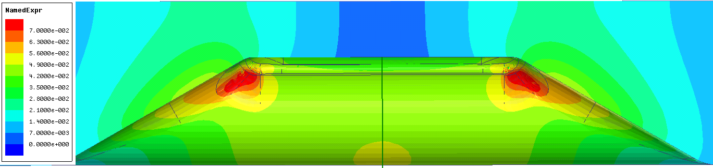
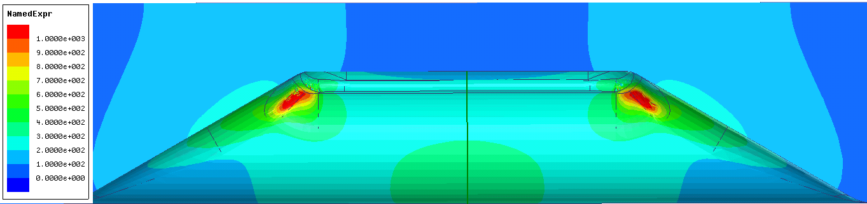
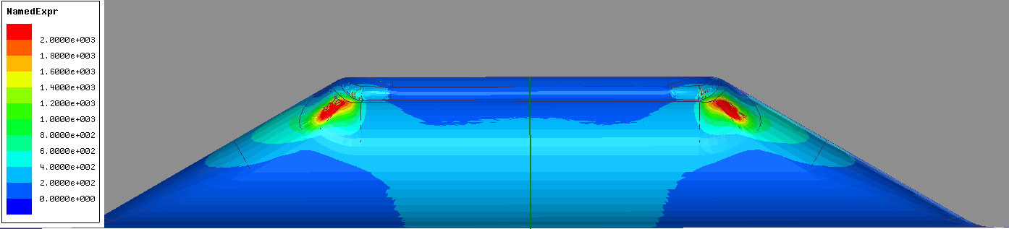
Power loss distribution on the surface for 30 degree taper at 3 MV
Brf [T]
Rs [nOhm] LHC fit
Psurf [W/m^2]
Total power loss: 67W
Q0_Nb_3MV = 3.9e8

Slide 11
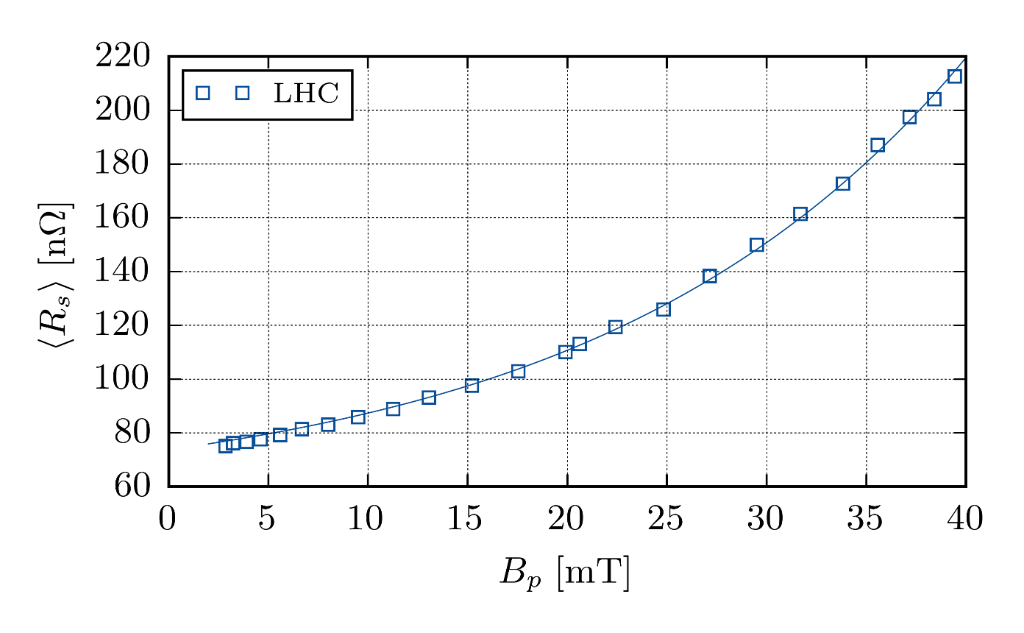
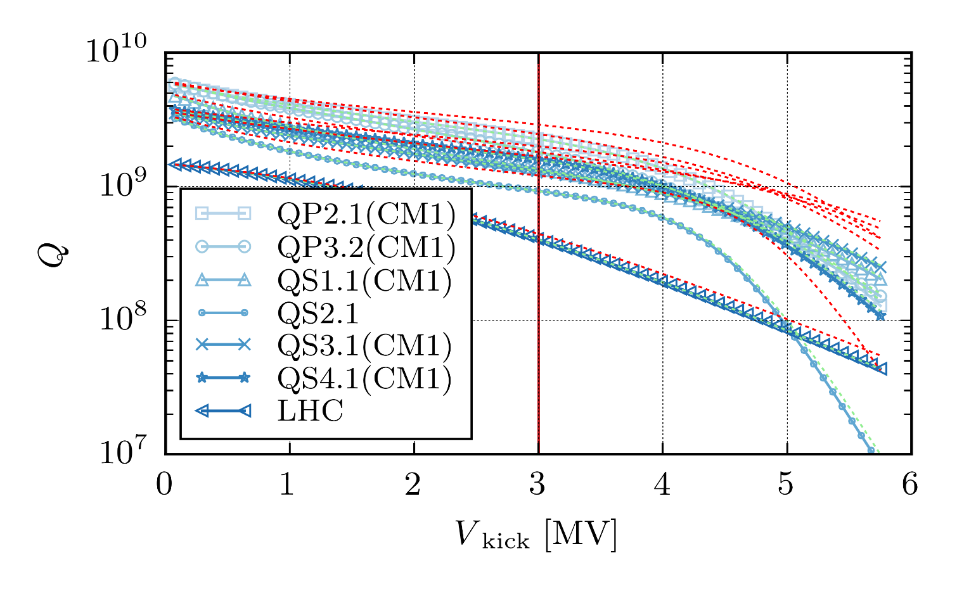
Q₀ calculation
Nominal kick voltage 3 MV → B_{peak} up to 80 mT
Results above 40mT for LHC uncertain due to lack of measurement data
Q based on extrapolation of Rs from the LHC data
Q₀ (Rs=const.) = 4.45e8
Q₀ (Rs=Rs(B)) = 4.05e8
Homogeneous Rs
Inhomogeneous Rs(B)
S. Bauer, W. Diete, B. Griep, M. Peiniger, et al., in Proc. 1999 Workshop on Superconductivity (1999) pp. 437–439.
Notes:
Make clear here why we are interested in the rfq. It has several advantages over the octupoles in a machine like LHC or HL-LHC.

Slide 12
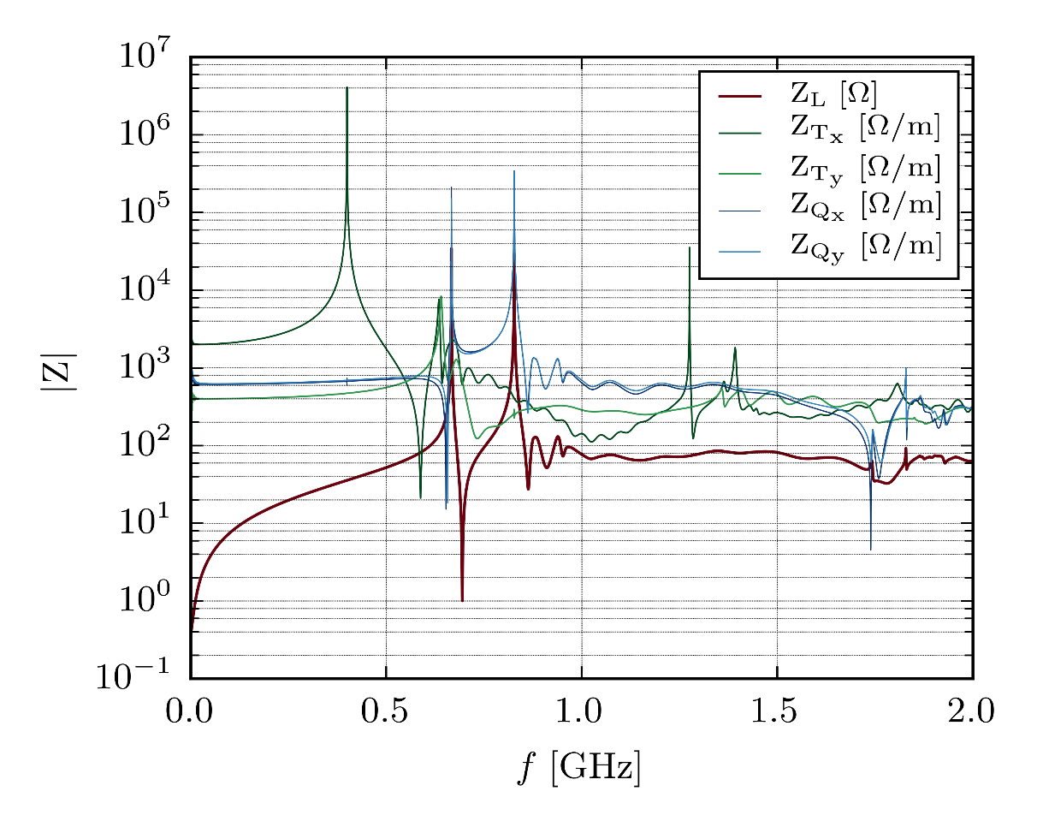
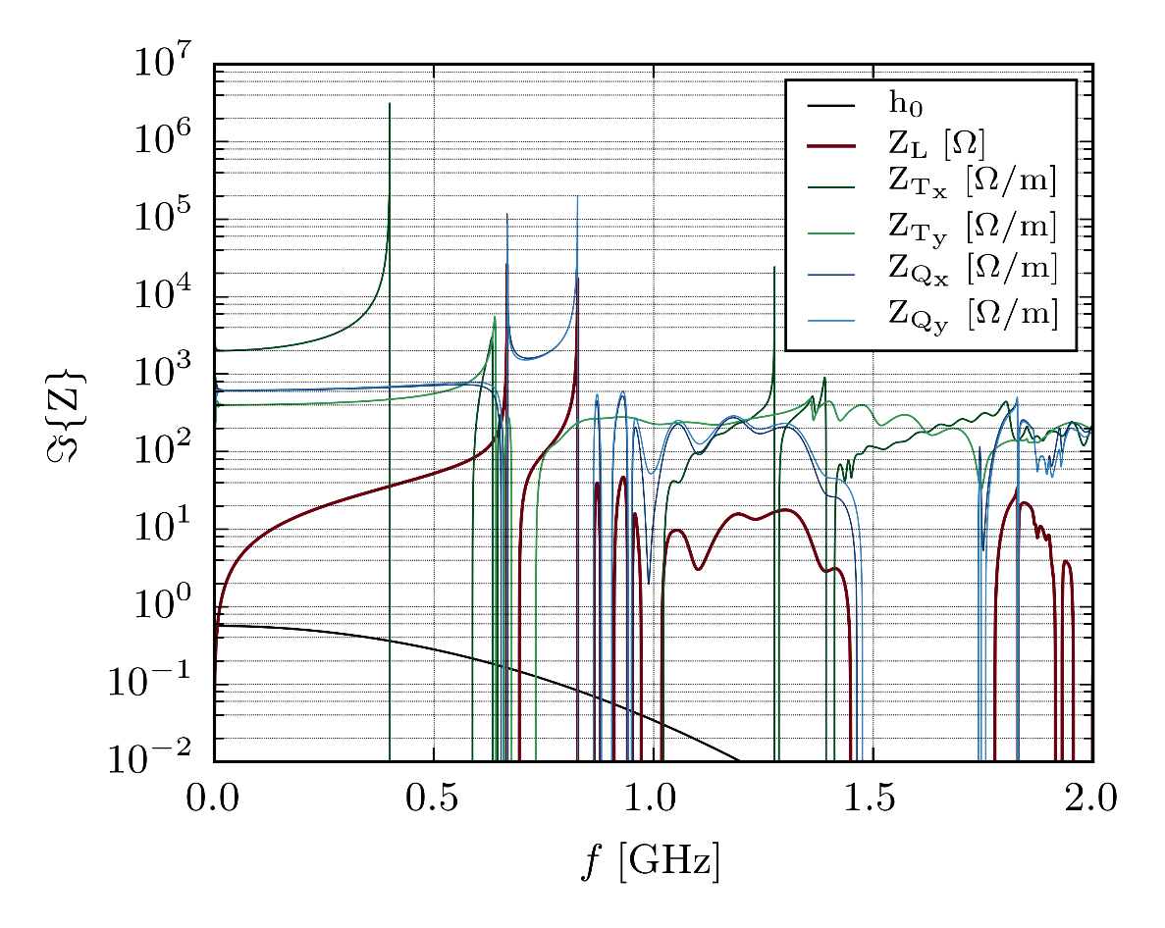
Wake Field and Impedance Calculation
Monopole
Dipole
Quadrupole
Loss factor [V/pC] | 0.012
(Z_{L}/N)_{eff} [mΩ] | 0.974
Kick factor x [V/pC/m] | 1.673
Kick factor y [V/pC/m] | 0.460
(Z_{T})_{eff} x [Ω/m] | 1562.8
(Z_{T})_{eff} y [Ω/m] | 437.6
Kick factor x [V/pC/m] | 0.733
Kick factor y [V/pC/m] | 0.769
(Z_{T})_{eff} x [Ω/m] | 631.9
(Z_{T})_{eff} y [Ω/m] | 791.9
Notes:
Make clear here why we are interested in the rfq. It has several advantages over the octupoles in a machine like LHC or HL-LHC.

Slide 13
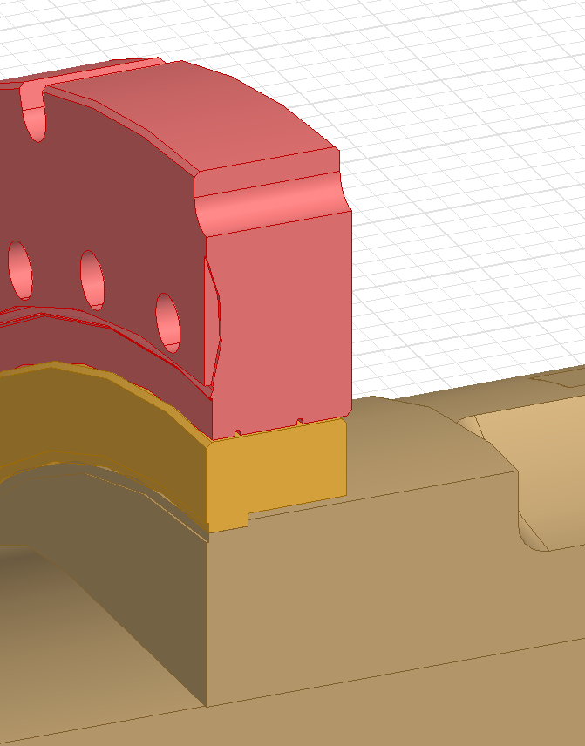
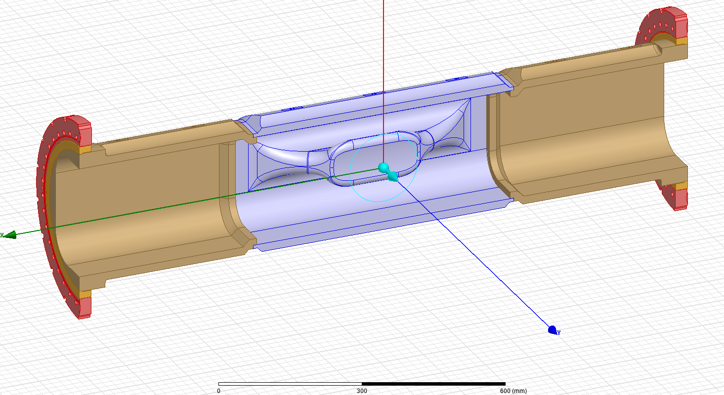
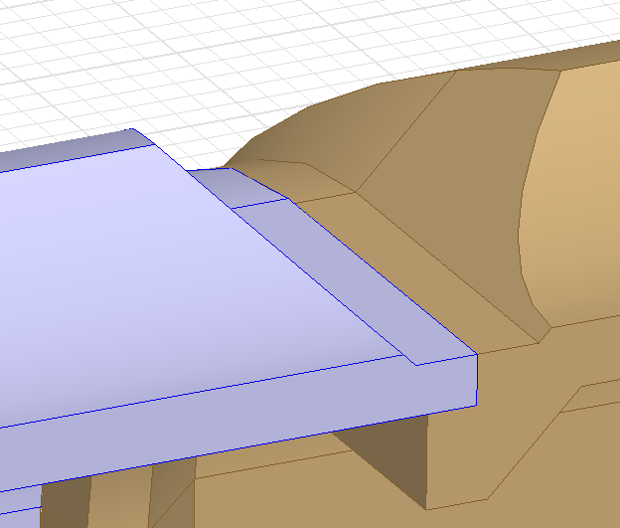
Assembly concept of the WOWCC copper substrate
brazing
welding
welding
Total weight: 290 kg

Slide 14
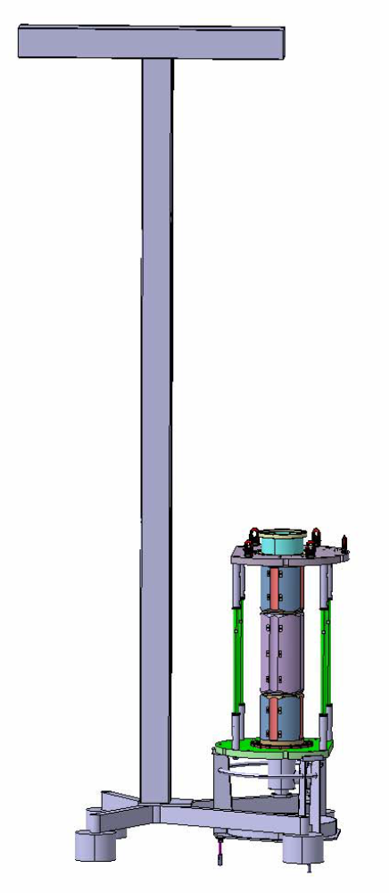
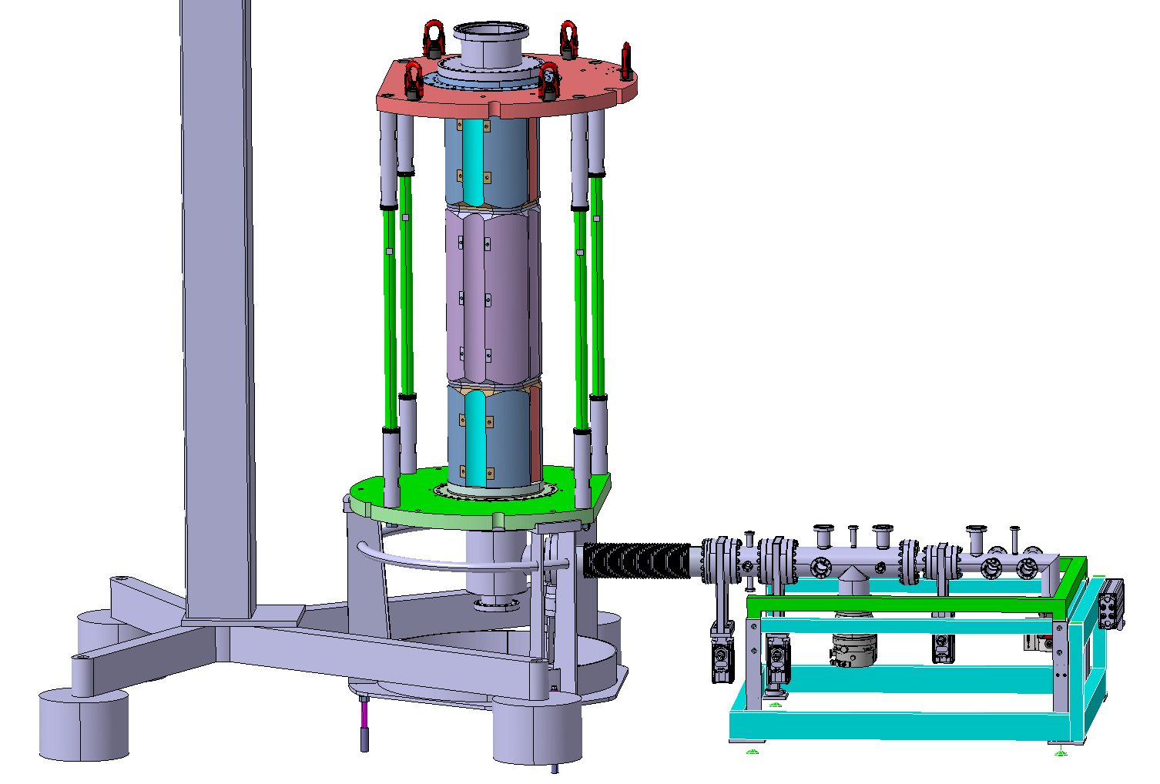
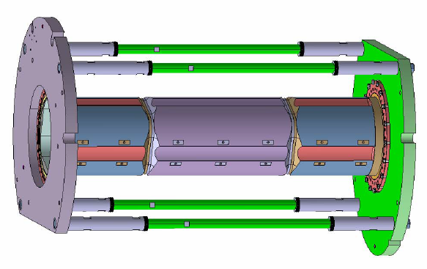
Integration of WOWCC into LHC-coating setup
Aim of the integration study:
Get overall dimensions and weight of the setup
Formulate requirements for the infrastructure in the B252
Communicate the requirements to the responsible for the infrastructure in B252
Pave the way to the future work on the design of the coating setup
WOWCC + frame weight:
517 kg
Total hight:
5.5 m
Total weight:
820 kg

Slide 15
Work package structure:
Task 1: RF design (Alexej Grudiev (RF))
Task 2: Mech. Design of the prototype and tooling (Ofelia Capatina (MME))
Task 3: Fabrication of the “substrates” (Pierre Naisson (MME))
Task 4: Surface treatment (Leonel Ferreira (VSC))
Task 5: Coating system and coating (Alban Sublet (VSC))
Task 6: Rinsing and clean room assembly of the prototypes for testing (Mikko Karppinen (RF))
Task 7: Cold Testing in cryostat (Mikko Karppinen (RF))

Slide 16
Schedule
 | 2016 |  |  |  | 2017 |  |  |  | 2018 |  |  |  | 2019 |  |  |  | 2020
 | Q1 | Q2 | Q3 | Q4 | Q1 | Q2 | Q3 | Q4 | Q1 | Q2 | Q3 | Q4 | Q1 | Q2 | Q3 | Q4 | Q1 | Q2
Material procurement
Fabrication 1st proto
Fabrication 2nd proto
Coating R&D
Coating system design
Coating system construction
(Re-)Coating 1st proto
Cold testing 1st proto
(Re-)Coating 2nd proto
Cold testing 2nd proto

Slide 17
Budget and manpower profile (end of 2016)
 |  | 2016 | 2017 | 2018 | Total
Budget [kCHF] | Design Material Fabrication Chemistry Coating RF infrastructure | 20 80 0 0 0 ? | 20 ~0 150 100 150 ? | ? ? 50 50 50 ?
 | Total | 100 | 420 | 150 | 670
Manpower [FTE]
 | Engineer (ENG) | 0.33 | 0.85 | 0.5 | 1.7
 | Technician (TEC) | 0 | 1.5 | 1.5 | 3.0
 | Fell/PJAS (FEL) | 0.45 | 0.25 | 0.25 | 1.0
20% less cost for coating system
Reduction of manpower for coating
2PM-ENG
3PM-FEL
3PM-TEC
The resources for SRF infrastructure modification in order to accommodate the WOWCC prototypes are not included

Slide 18
Summary why would we do coated crab
No thermal run-away (operation, machine protection)
Potential to reach 5 MV per cavity if coating is (2-3 times) better than for LHC 400 MHz main RF cavities (cost, impedance)
Lower impedance (x2, Z/n; x3 Z_x,y)
No magnetic shielding (cost)
Material (cost)

