Slide 2
WP12 - MAGNETS & MACHINE PROTECTION Status Report
12.1 POWERING, PROTECTION ARCHITECTURE FOR HIGH FIELD CIRCUITS
12.2 CONCEPT, ARCHITECTURE OF MACHINE PROTECTION & INTERLOCKS
12.3 HTS MAGNET PROTECTION

Slide 3
12.1 POWERING, PROTECTION ARCHITECTURE FOR HIGH FIELD CIRCUITS
Objectives: Propose architectures and technologies for the protection of high field circuits.
Quench detection/protection of the main ring (LTS) magnets.
Task 1: Analyse the LHC concept in view of removing electronics form the accelerator tunnel and centralizing them in underground infrastructures or preferably to surface infrastructures.
Energy extraction of all high current and high energy circuits.
Task 1: Extrapolate existing technologies and systems for the new requirements and propose circuit layout configurations compatible with FCC scale.
Task 2: Propose new concept for energy dump system, optimising energy recovery.
Local magnet protection system(s)
Task 1: Analyse the existing magnet protection technologies and evaluate applicability of alternative technologies like Coupling-Loss Induced Quench (CLIQ). Optimisation of the system, implementation at the design stage of the magnets. Report on feasibility based on HL-LHC experience, specify potential implications for subdivision of magnet coils,
Task 2: Evaluate the existing LHC magnet diode bypass assembly and propose required diode parameters in connection with the powering architecture of the magnets.

Slide 4

Studies of the layout of main dipole circuits
PS 1
Proposal for FCC Powering Sectors (PS)
PC 1
PS 2
HalfArc 1
8km
EE1a
EE1b
PC 2
PC 1a
EE1c
PC 1b
EE1d
SC link
PC 1c
EE1e
Study of possible circuit layouts to reduce the stored energy and limit the voltage to ground during the fast power abort
PC 1d
PC 1e
PS 1
Results presented at the FCC week 2016, Rome

Slide 5
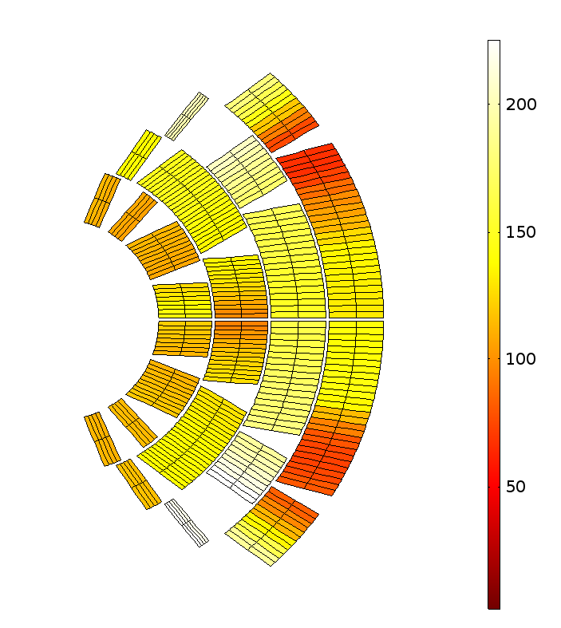
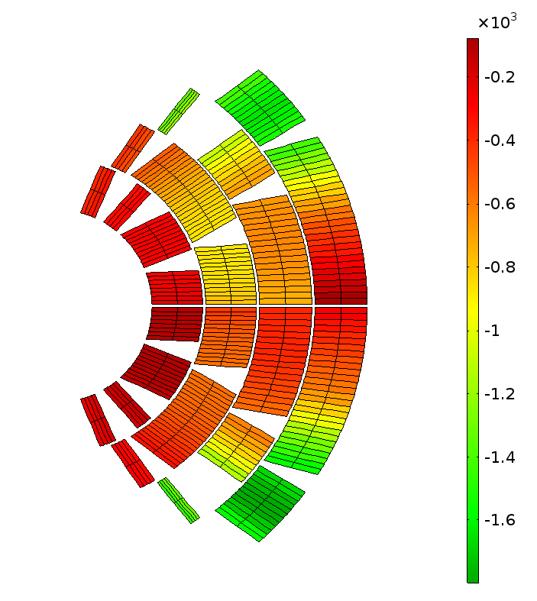
CLIQ studies for FCC cos-theta coil
Current [A] and resistance [Ω]
Temperature [K]
Peak voltage to ground [V]
Hot-spot 312 K
Outcome: temperature gradients and voltage to ground need to be mitigated possibly acting on the magnet design
Results presented at the EuroCirCol WP5 Workshop 2016, Alba

Slide 6

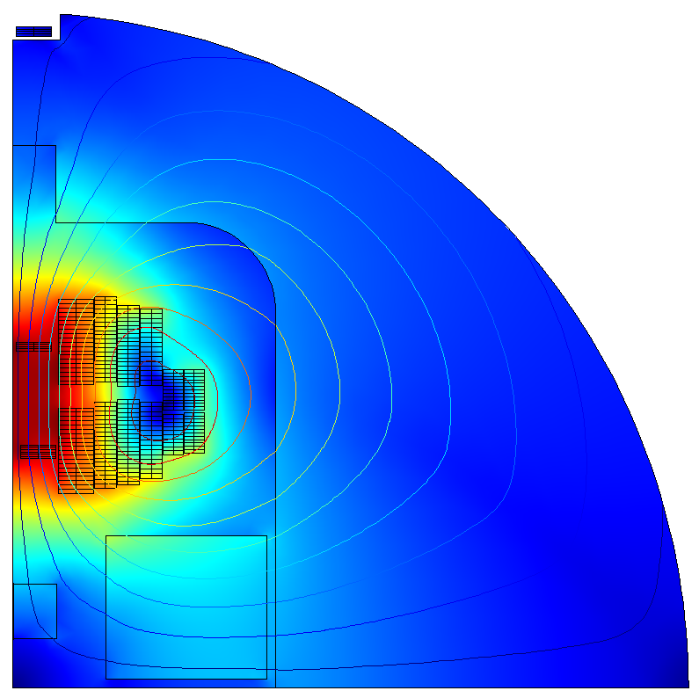

Simulation tools and the STEAM
STEAM is providing tools for coupled protection studies: protection of a chain of magnets
Circuit protection
Magnet protection
Energy extraction
Voltage to ground
CLIQ
technology
Hot-spot temperature
Voltage to ground
Common coil field model
FCC circuit model
L_{filt}
Cadence PSpice
C_{CLIQ}
C_{filt}
M₁
M₂
M_{n}
M₁₈
PC
R_{EE}
R_{filt}
M₃₆
M₃₅
M₁₉

Slide 7
12.2 CONCEPT, ARCHITECTURE OF MACHINE PROTECTION & INTERLOCKS
Objectives: Develop the architecture of the machine protection and interlock system for a larger accelerator scale as compared to LHC.
Task 1: The study of these new options of architecture must be linked to the machine availability concepts.
Task 2: Based on the outcome of the task 1, review LHC concepts and propose new architecture of protection systems to assure machine component protection and optimised availability.

Slide 8
Beam Impact & Machine Protection of the FCC-hh
Execution time for a beam dump
Fault / dangerous situation occurs
Beam interlock system informed of failures
Beam dumping system informed of failures
Beam dump begins after waiting for beam-free abort gap
Beam dump completed
DETECT
COMMUNICATE
SYNCHRONISE
DUMP
> 80 µs for BLMs < 300 µs < 326 µs 326 µs For FCC
< 100 µs < 89 µs 89 µs For LHC
User system process Beam interlock system process Beam dumping system process
Figure after [B. Todd, PhD thesis, 2006]
LHC Machine Protection System
After failure detection, about 3 turns’ time is needed to dump the full beam completely.
For FCC, the time needed is most likely similar in terms of ‘number of turns’
which is about 1 ms.
but will depend on how many abort gaps & beam dump systems we have (open point).

Slide 9
Beam Impact & Machine Protection of the FCC-hh
Top critical equipment failure modes (to be continued)
Name | Failure scenario | Magnet length | Nominal field | Nominal deflection or focusing strength | Beta-function at magnet | Required time constant of field decay | Comment
Separation dipole ‘D1’ in IRA / IRG | Powering failure of all the 4 MBXA magnets | 12.5 m | 4.27 T | 0.00032 rad | 25 km (left) 61 km (right) | > 33 s | Less critical
Separation dipole ‘D1’ in IRA / IRG | Quench of 1 magnet | 12.5 m | 4.27 T | 0.00032 rad | 61 km (right) | > 100 ms | Need to be careful
Low-β triplet quadrupoles | Quench of 1 magnet (MQXC.3RA) | 30.81 m | 86 T/m | 0.000514 m⁻² | 77 km | > 139 ms | Need to be careful
Main dipole | Quench of 1 magnet | 14.3 m | 15.92 T | 0.001366 rad | 335 m (max.) | > 55 ms | Less critical
Main quadrupole | Quench of 1 magnet | 6.29 m | 357 T/m | 0.00214 m⁻² | 350 m (max.) | > 8.6 ms | Less critical
Warm dipole in collimation insertion | Powering failure of MBW.A6R3.B1 | 9.09 m | 1.45 T | 0.000079 rad | 718 m | > 0.27 s | Less critical
Warm quadrupole in collimation insertion | Powering failure of MQWA.D4R3.B1 | 8.31 m | 29 T/m | 0.000174 m⁻² | 1068 m | > 0.023 s | Less critical
The minimum time constant of field decay is determined such that beam position is displaced less than 1.5 σ and tune change is less than 0.01, within 2 ms after magnet failure.
Other failure scenarios (RF, UFOs, etc) that could result in very fast beam losses are being studied.

Slide 10
Beam Impact & Machine Protection of the FCC-hh
Time constant of beam loss
Beam lifetime | Beam power into environment |  | Scenario | Strategy
 | LHC | FCC
100 h | 1 kW | 23 kW | Optimum operating conditions | (Possible) upgrade of the collimation system after some years of operating experience
10 h | 10 kW | 236 kW | Acceptable operating conditions (expected during early operation) | Operation acceptable, collimators must absorb large fraction of beam energy
12 min | 500 kW | 11806 KW | Particular operating conditions (during change of optics, tuning, collimator aperture setting, etc) | Operation only possible for short time (~ 10 second), collimators must be very efficient
1 s | 362 MW | 8500 MW | Fast beam loss (standard equipment failures) | Detection of failure, beam must be dumped rapidly
A few ms (multi turns) | ~100 GW | ~ TW | Very fast beam loss (fast equipment failures, e.g., magnet powering failures or quenches) | Detection of failure or beam losses, beam dump as fast as possible
1 turn | 4 TW | 26 TW | Single-passage beam loss (failures at injection or during beam dump, potential damage of equipment) | Beam dump not possible, passive protection relies on collimators, absorbers (sacrificial materials)
Table after [R. Schmidt, et al., 29th ICFA Advanced Beam Dynamics Workshop, 2003]

Slide 11
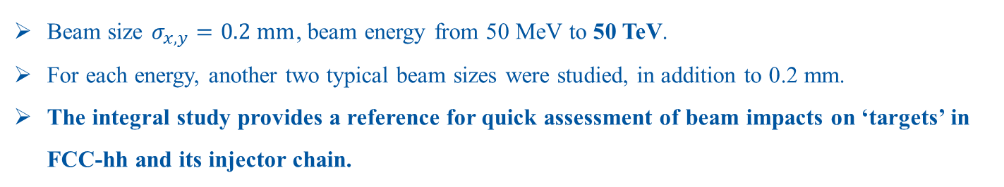
Beam Impact & Machine Protection of the FCC-hh
Energy deposition studies
Energy deposition of proton in typical materials (Left: copper, Right: graphite)
Beam size $σ_{x,y}=0.2 mm$, beam energy from 50 MeV to 50 TeV.
For each energy, another two typical beam sizes were studied, in addition to 0.2 mm.
The integral study provides a reference for quick assessment of beam impacts on ‘targets’ in FCC-hh and its injector chain.

Slide 12
Spare slides

Slide 13


Protection of FCC magnets and circuits
At the magnet level: design for protectability
CLIQ protection system
Quench-heaters protection system
Hybrid systems
At the circuit level: machine integration of magnets
Study of the possible layouts of main dipole circuits
+
As a provider of simulation tools

