Slide 1
GÉANT LHCONE Update
Mian Usman
Network Architect
2nd Asia Tier Centre Forum, Thailand

Slide 2
Topics list
Updates on the backbone
  Optical transport
  IP trunks
  NRENs access
  New functionalities
Intercontinental connectivity
  North America
  Asia-Pacific
LHCONE updates

Slide 3
What does the GÉANT Network looks like
Made of two main networks
  Infinera based DWDM
  Juniper based IP/MPLS
3 main overlays on the IP/MPLS network
  Global R&E IP
  LHCONE
  IAS – GÉANT internet service GWS+Peerings
A number of other services with much smaller data rate
  GN+
  MDVPN
  BoD
  Etc..

Slide 4
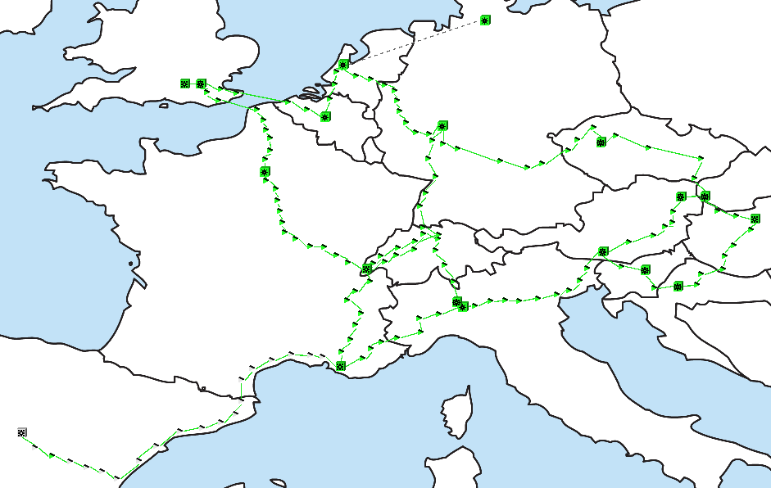
The DWDM network
Elements providing large capacity Point-to-point across defined fibre routes
10G and 100G Lambda services are provided directly on this infrastructure

Slide 5
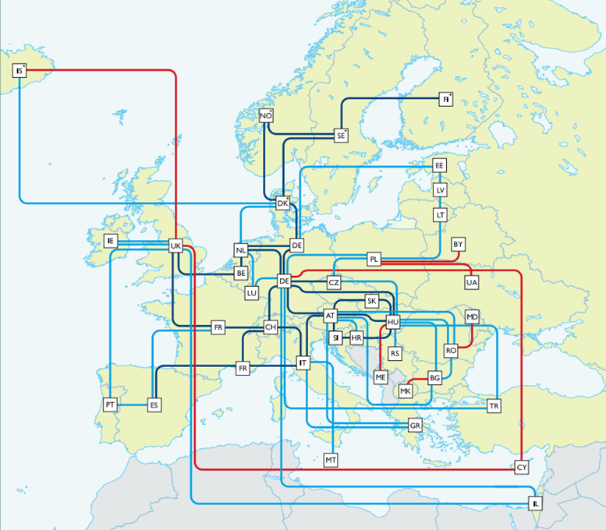
Transport network upgrades
All the dark fibre footprint was already at 500Gbps
The following paths have been upgraded to 1Tbps (2 x 500Gbps)
  London-Paris-Geneva
  London-Brussels-Amsterdam
  Amsterdam-Frankfurt
Created a new direct London-Geneva 500Gbps circuit

Slide 6
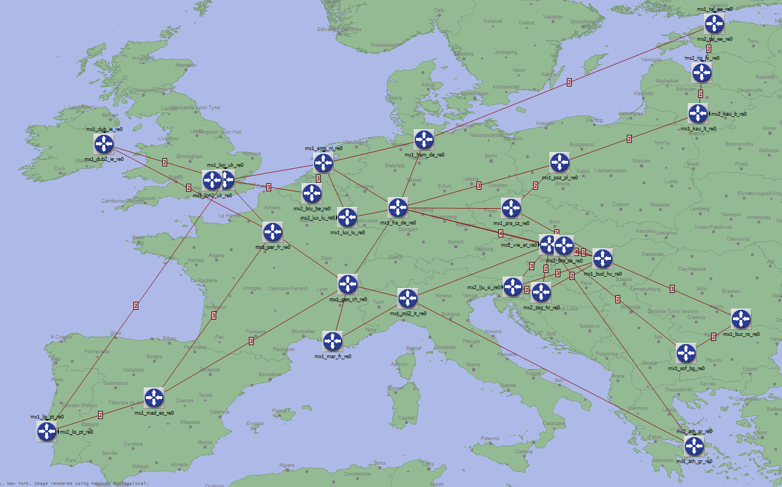
The IP/MPLS network
Juniper MX routers
IP traffic any to any .. with policy
All services expect from Lambdas are provided here
Use the DWDM network for some of its core links, leased capacity for others
Provides Overlays

Slide 7
IP trunks upgrades
Upgrade to 200 Gbps the Western Ring
  London-Paris-Geneva-Frankfurt-Amsterdam-London
Upgrade to 40 Gbps
  Budapest-Prague
Upgrade to 30 Gbps
  London-Brussels-Amsterdam
  Vienna-Ljubiana-Budapest
New IP PoP in Marseille (formerly only a transport PoP)
  Connected to Madrid and Milan to 100 Gbps

Slide 8
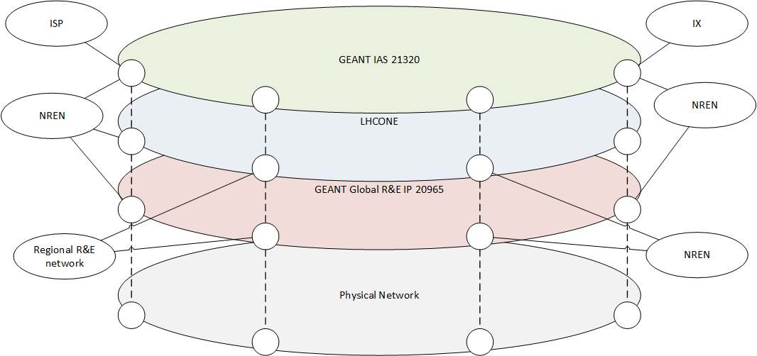
Overlays
Main overlays and type of traffic:
Global R&E IP – connects the NRENs and other regional R&E networks
LHCONE – connects NRENs and other regional networks for LHC related data exchange
IAS – connects NREN to ISP and CDN networks

Slide 9
NRENs access link upgrades
CESNET
  From 10 to 20Gbps LHCONE dedicated access
IUCC
  From 2.5 to 10Gbps

Slide 10
North America
GÉANT has joined the existing ANA-200 consortium (Internet2, Canarie, NORDUnet, SURFnet)
Now we have the ANA-300 consortium
3 x 100G links
  Paris – New York
  New York – London
  Washington – Amsterdam
Agreement with ESnet for mutual backup
  Using ESnet 340Gb capacity to Europe

Slide 11
Asia-Pacific updated
SINET5
  2 x 10G Tokyo - London
TEIN
  New 10G London - Singapore (SingaREN/TEIN shared)
  From 2.5 to 10G on the Madrid – Mumbai - Hong Kong link
NKN (India)
  2 x 5G Mumbai - Amsterdam

Slide 12
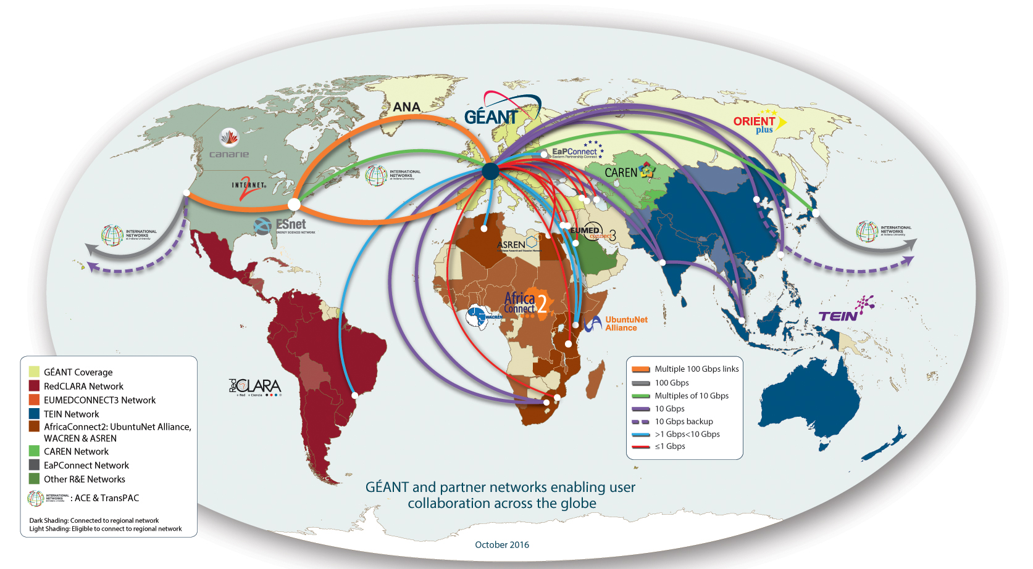
Global connectivity
Notes:
In addition to its pan-European reach, the GÉANT network has extensive links to networks in other world regions including North America, Latin America, the Caribbean, North Africa and the Middle East, Southern and Eastern Africa, the Eastern Partnership, Central Asia and the Asia-Pacific Region.
Work is also on-going to connect to Western and Central Africa.
Latin America - RedCLARA is regional R&E Network for Latin America:
connects 13 Latin American NRENs
Interconnects with GÉANT at 5Gbps (London – Brazil)
Work ongoing to procur submarine fibre between London and ??

Slide 13
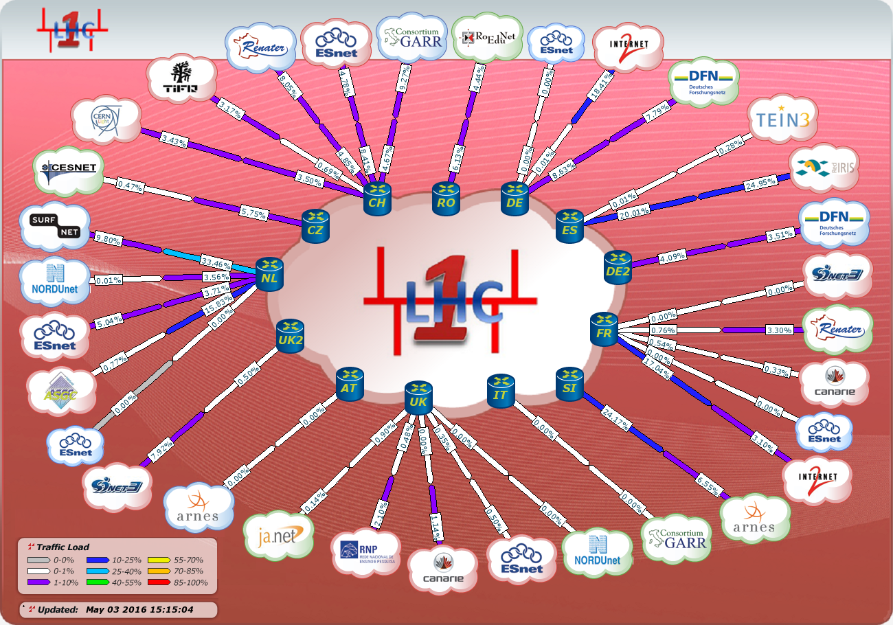
LHCONE
Serving the LHC experiments:
ATLAS
CMS
ALICE
LHCb
But also:
BELLE 2
Pierre Auger Observatory
NOVA
XENON1T (in discussion)
Currently spanning three continents
Europe
North and South America
Asia

Slide 14
New NRENs connected
BELNET (Belgium)
URAN (Ukraine)
PIONIER (Poland)
ThaiREN (Thailand)
  First TEIN-connected network to join!

Slide 15
LHCONE Asia-Pacific
SINET migrated to the new 2x10G to London
KEK (BELLE2 Tier0) connected to SINET
TIFR Peering with GÉANT LHCONE VRF
LHCONE VRF now setup in TEIN and peering with GÉANT LHCONE VRF
THAIREN and TEIN have established BGP peering
KISTI-TEIN connected to 1G (later upgrade to 10G) – LHCONE implementation expected in march
ASGC peering in AMS

Slide 16
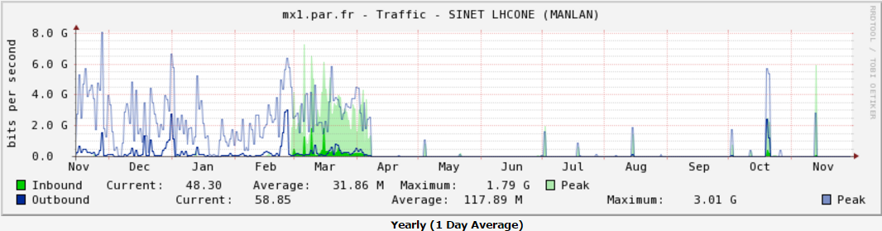
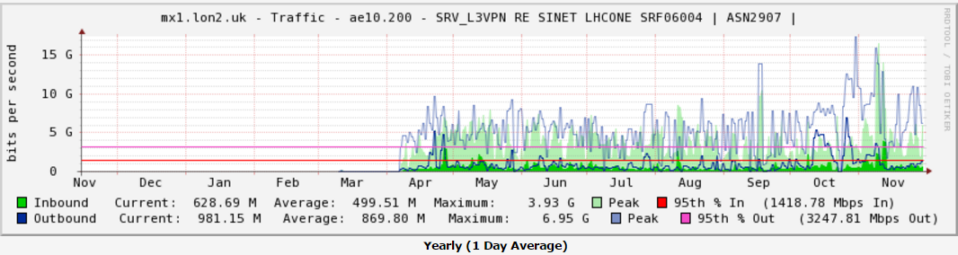
LHCONE Traffic between GÉANT and SINET

Slide 17
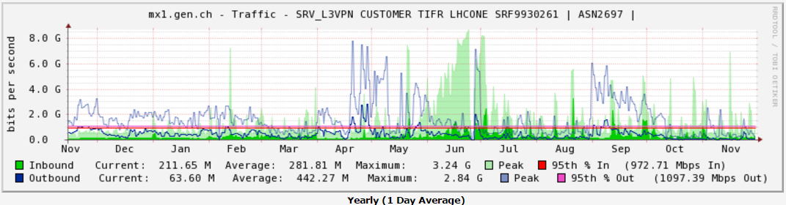
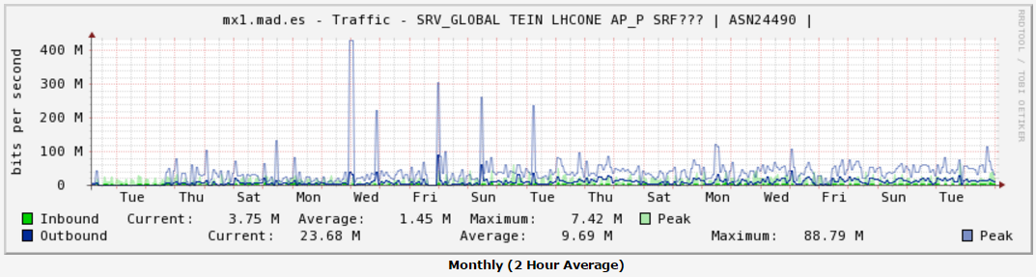
LHCONE Traffic to/from TIFR & TEIN

Slide 18
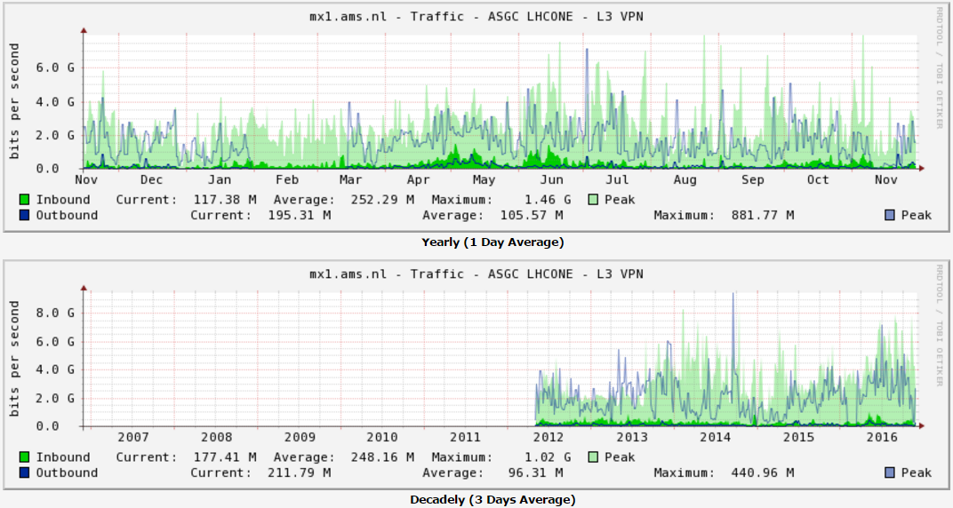
LHCONE Traffic between ASGC and GÉANT

Slide 19
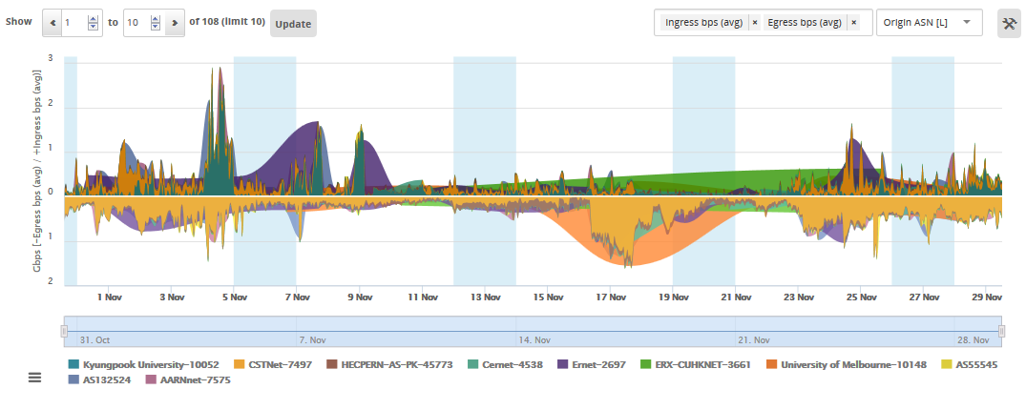
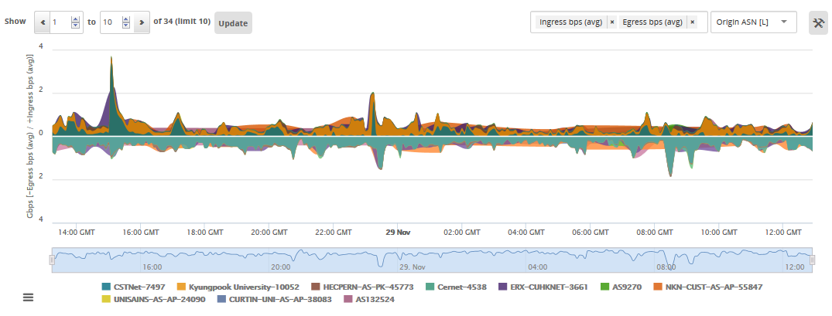
Known LHC related traffic to/from Asia

Slide 20
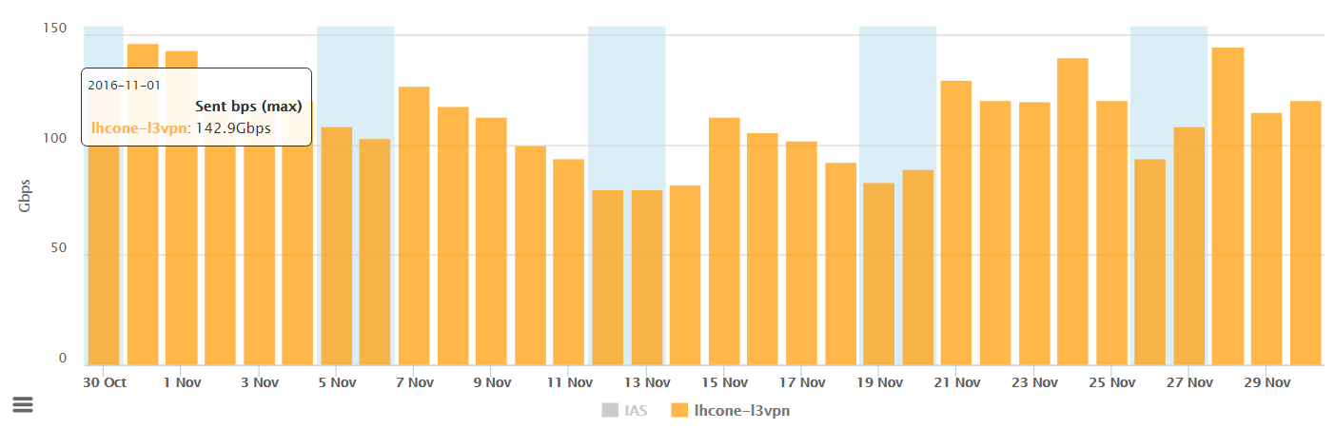
GÉANT LHCONE NetFlow Data Nov 2016

Slide 21
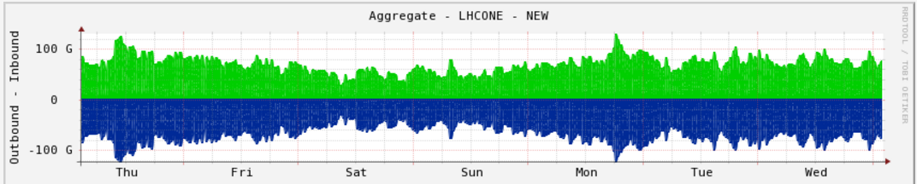
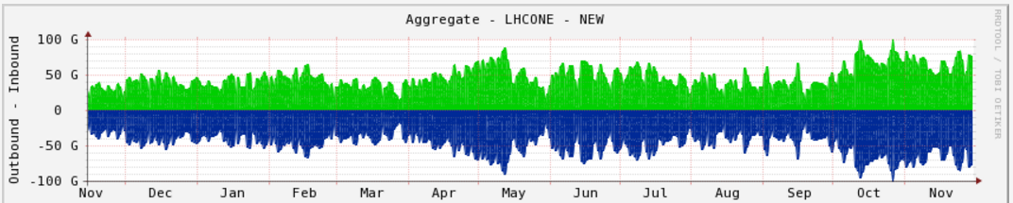
GÉANT overall
Weekly
Yearly
Notes:
Same time last year the peak traffic was around 40Gbps and average traffic closer to 30Gbps now we see regular peaks of over 60Gbps.
Overall traffic seems to be growing as you can see from GARR traffic their traffic is also growing. Some of NRENs and sites need to be upgraded as they seem to be flat-lining.
We expect to see a lot more traffic after these NRENs and sites have upgraded.

Slide 22
Questions?
Mian.usman@geant.org

