Slide 1
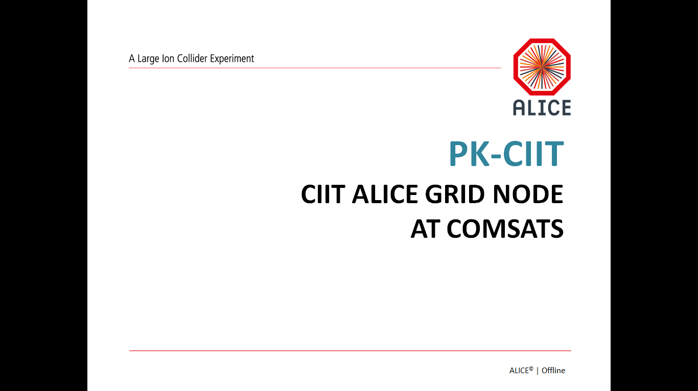
2nd Asia Tier Center Forum
30 Nov – 02 Dec, 2016
Suranaree University of Technology (SUT)
Nakhon Ratchasima, Thailand
PK-CIIT
Grid Operations in Pakistan
COMSATS
Muhammad Waqar
Fasiha Saleem
Site Admin/Faculty Member

Slide 2
Outline
Brief Overview of COMSATS Institute of IT
COMSATS Cluster Evolution
COMSATS Site Current Status
COMSATS New Site Status
IPv6 and PERN Bandwidth
Summary and Conclusion

Slide 3
COMSATS | 2016
Campuses | 8
Research Centers | 8
Student Enrolment | 37,570
Faculty Strength (Approx.) | 3000
Academic Programs | 90
Ranking | Rank No. 1 IT institute of Pakistan 3th in Pak, International Publications 4th in Overall Pak Ranking

Slide 4
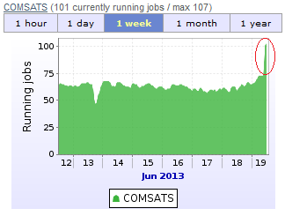
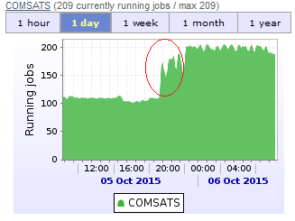
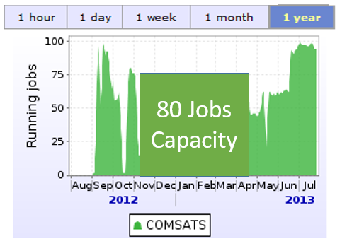
COMSATS Cluster Evolution
Year | Events
2009 | Desktop Computer as a VOBOX
2010 | Dell Server as a VOBOX
2011 | Procurement of HPC equipment (3 servers, 5 worker nodes)
2012 | Cluster building, Successfully ALICE Grid configuration
2013 | Memory upgradation
2014 | Bandwidth upgradation from 24 Mbps to 48 Mbps Two more Servers were added in existing Grid
2015 | Six Server were added in existing Grid
2016 | Development of Data Center

Slide 5
Current Status of Site
Equipment |  | RAM, Processor, HDD
Servers (SL6, EMI-3) | VOBOX | 16 GB, Dual Quad Core, 1TB
 | SBDII | 16 GB, Dual Quad Core, 1TB
 | CREAM | 16 GB, Dual Quad Core, 1TB
Worker Nodes x 13 (SL6, EMI-3 and CVMFS) |  | (42 GB, Dual Quad Core, 1TB) x 13
Storage Element |  | 100 TB (Currently, Not in production)
Bandwidth |  | 54 Mbps

Slide 6
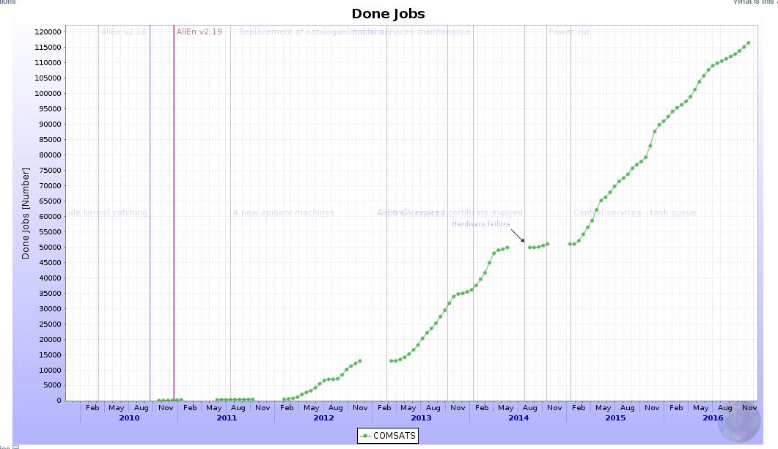

Slide 7
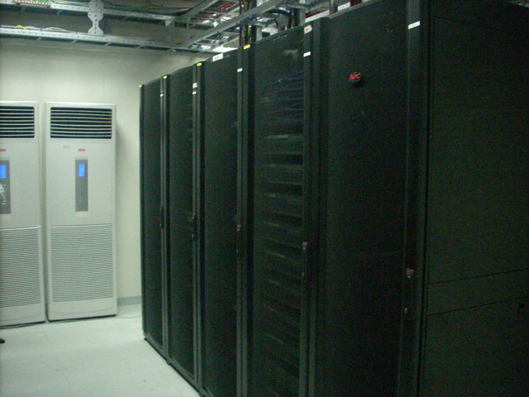
New Site Status: Tier-2 Data Center
  ALICE Jobs : 2000
    Worker Nodes: 128
      OS installation: Completed
      WN configuration : 30% Completed
    CREAMCE
    VOBOX
    SITE BDII
In progress

Slide 8
Future Site Status: Tier-2 Data Center
  Memory/RAM : 3.0 TB
  HDD: 50 TB
  Storage Element: 380 TB
  Network Bandwidth: 500 Mbps/1 Gbps
  IPv6 is configured successfully
  COMSATS is connected Via PERN to outside World

Slide 9
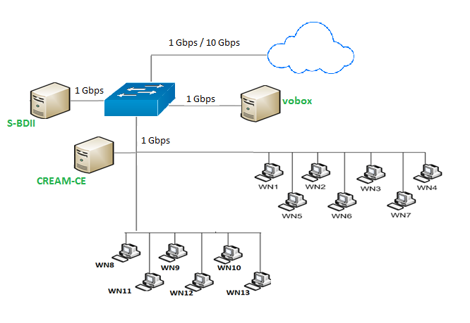
Architecture of new Site

Slide 10
Summary and conclusion
First target is to up the new site until Start of 2017.
Trying hard to ensure Availability and Reliability.

Slide 11
THANK YOU

