Slide 1
HL LHC project and requirements for the separation dipole D1
Ezio Todesco, CERN
Tatsu Nakamoto, KEK
D1 review, KEK, 30 June 2016

Slide 2
Contents
HL LHC overview
D1 requirements and design choices
Plans and Schedule

Slide 3
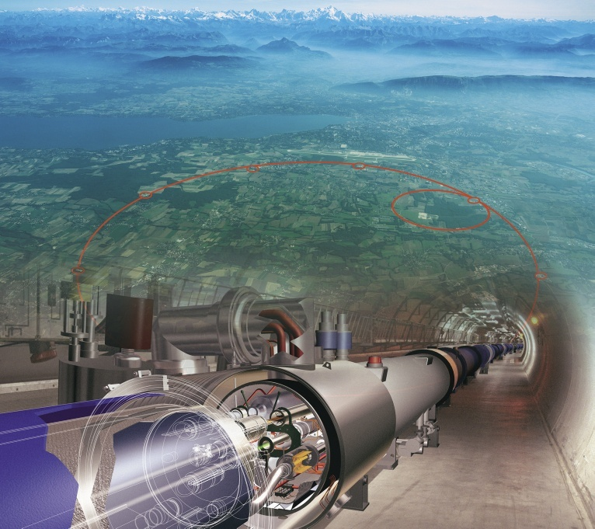
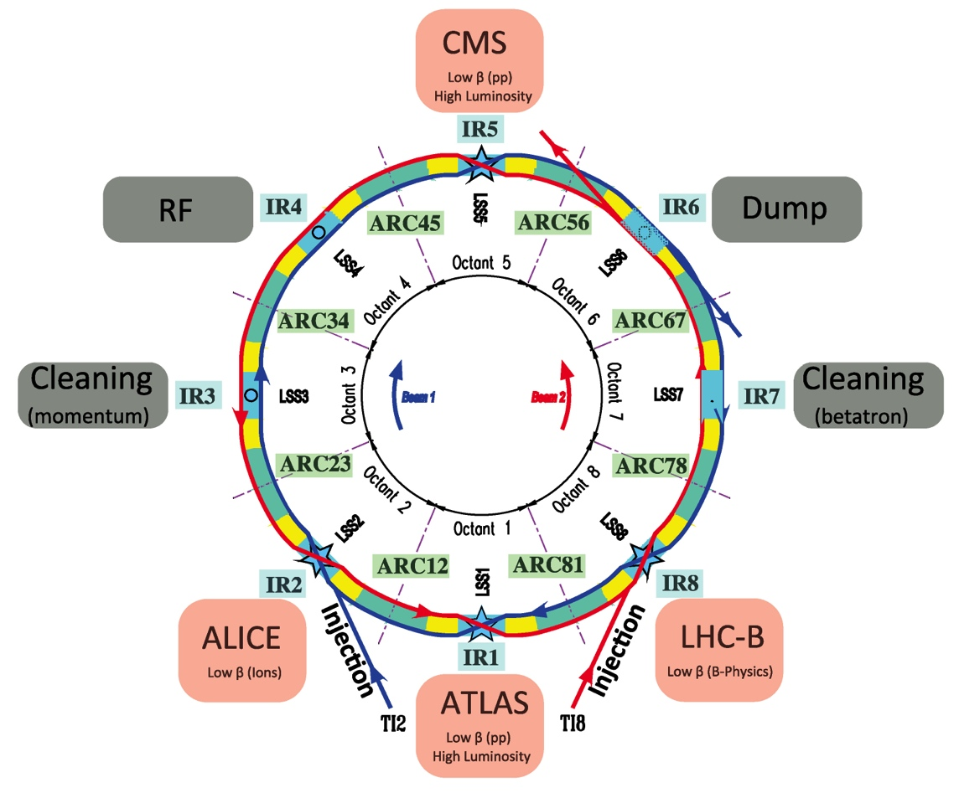
Overview: LHC
Circumference: 26.7 km
Proton Beam Injection Energy: 450 GeV
p + p Collision Energy:
  4 + 4 TeV (2012)
  Splice consolidation in LS1 (2013-4)
  6.5 + 6.5 TeV (2015)
  7 + 7 TeV (design)
Nominal Luminosity: 10 ³⁴ cm⁻² sec⁻¹
  Reached in June 2016
Superconducting Technology Nb-Ti at 1.9 K
  2 in 1 main dipole at 8.3T: 1232 magnets

Slide 4
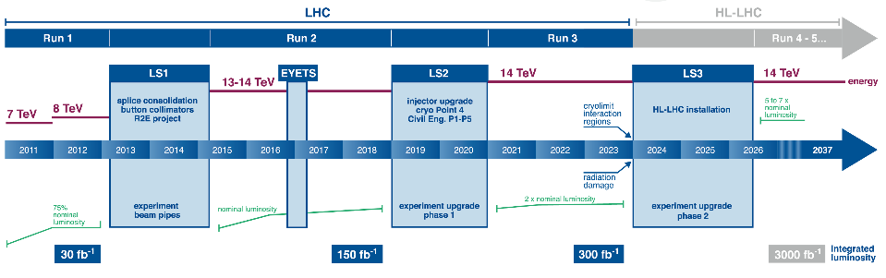
LHC and HL-LHC Schedule
<0.7 10³⁴ cm⁻²s⁻¹
50 ns bunch
pile up ∼40
Towards nominal
10³⁴ cm⁻²s⁻¹
25 ns bunch
pile up ∼40
Towards ultimate
2.2 10³⁴ cm⁻²s⁻¹
25 ns bunch
pile up ∼60
Technical limits to lumi increase
Radiation damage
50 ⇒ 25 ns

Slide 5
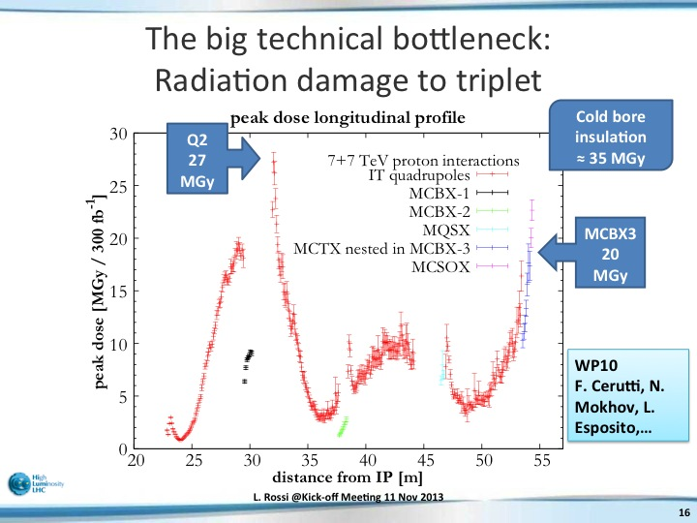
Radiation Damages in Present LHC
Prediction for nominal LHC at 300 fb⁻¹
L. Rossi @Kick-off Meeting 11 Nov 2013
IP
Q1
Q2a
Q2b
Q3

Slide 6
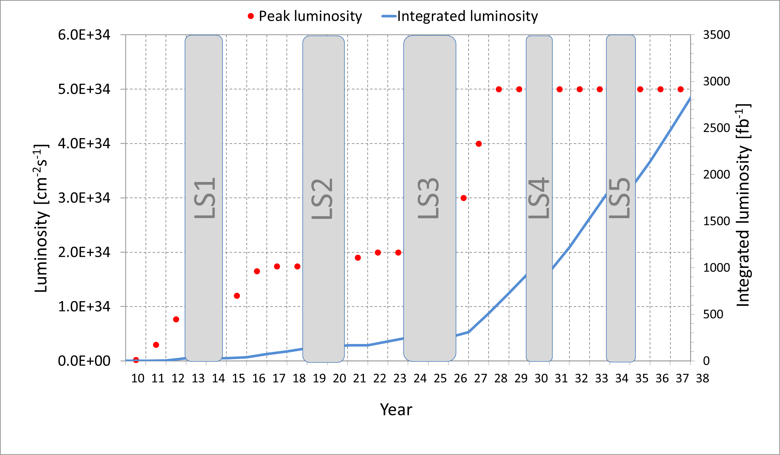
Peak and Integrated Luminosities
HL-LHC Target: 3000 fb⁻¹, 5x10³⁴ cm⁻² sec⁻¹
(Nominal LHC: 300 fb⁻¹, 1x10³⁴ cm⁻² sec⁻¹)
Nominal LHC
HL-LHC
2024 !!

Slide 7
Upgrading Scenario
20 times larger peak luminosity
Running at 5 times larger with luminosity levelling to reduce pile up
Increasing beam current (*5)
  LHC Injectors Upgrade (LIU)
    while keeping small emittance…
Reducing β* (*4)
  New IR magnets
    Increasing triplet and D1 aperture to 150 mm
    Strong correctors
Removing the geometric reduction factor
  Crab-Cavities for IR
Improving collimation efficiency
  11 T dipoles for additional dispersion suppressors collimators
Beam current
Energy
Beam Size
Geometric reduction factor
Luminosity (10³⁴ cm⁻² sec⁻¹)
Ope. Time (hour)

Slide 8
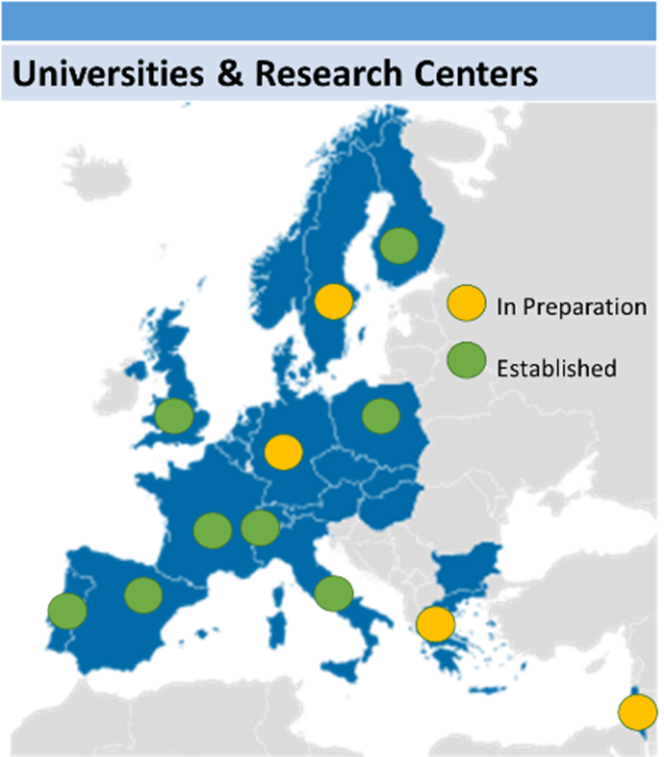
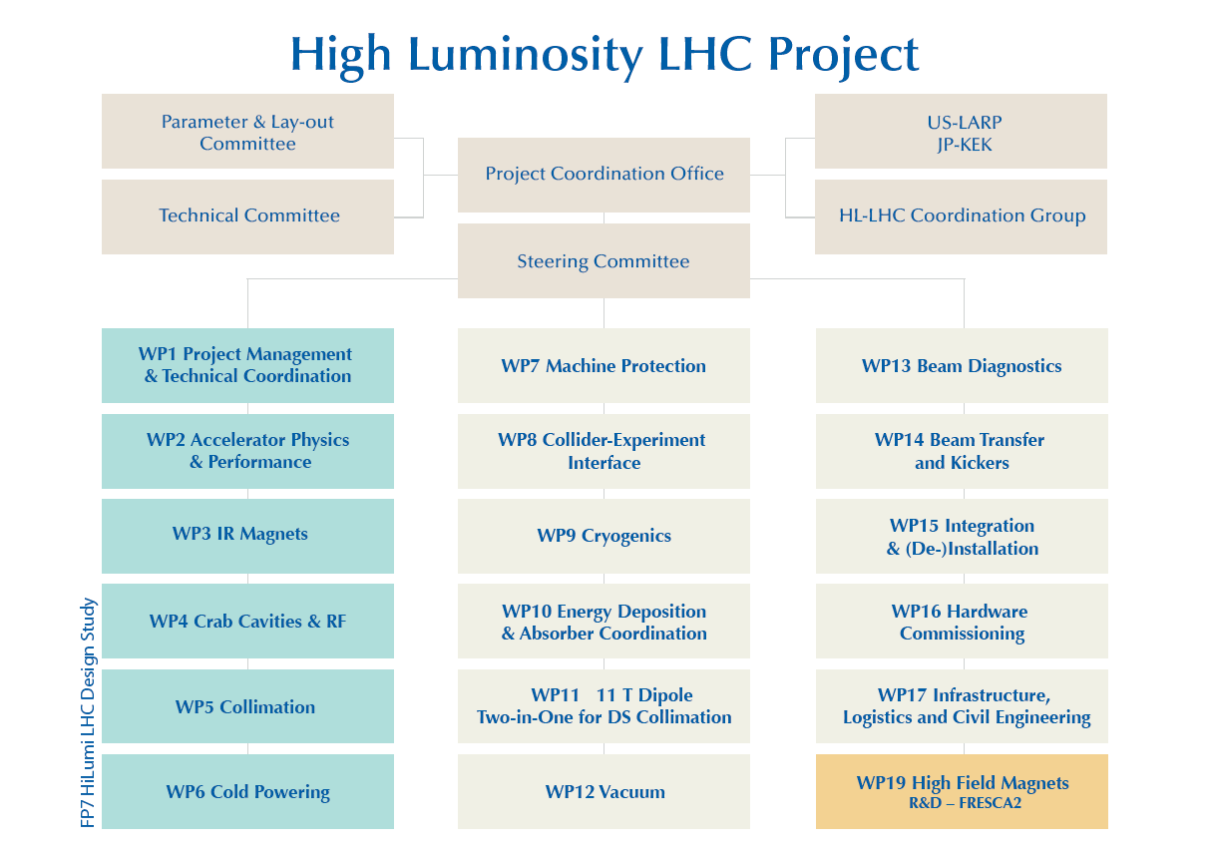


HiLumi LHC Design Study
EU-FP7 “HiLumi LHC Design Study”
Conceptual design study and model R&D started at 2011
  EU-FP7 “HiLumi LHC Design Study” hosted by CERN.
International collaboration by CERN, European institutes, US-LARP, and Japan (KEK)
  involvement of KEK: enhancing Japanese contribution to the ATLAS experiment.
  beam physics, IR magnet, crab cavity, beam diagnostics.

Slide 9
Contents
HL LHC overview
D1 requirements and design choices
Plans and Schedule

Slide 10
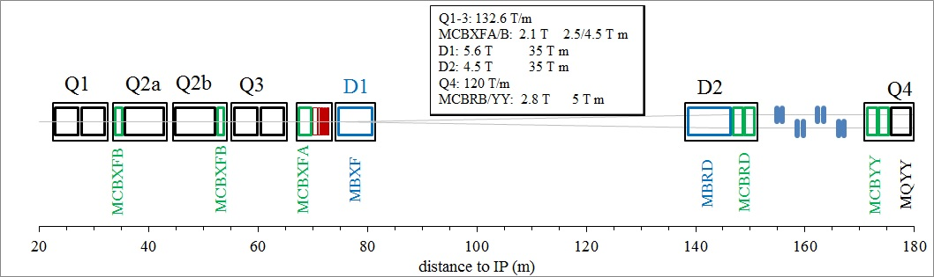
General remarks
D1 is the separation dipole in HL LHC
  It replaces the resistive D1 in LHC, with increase in the kick from 26 to 35 T m
  At the same time it reduces the magnetic length from 24 m to 6.3 m, making space available for the triplet and for the crab cavities

Slide 11
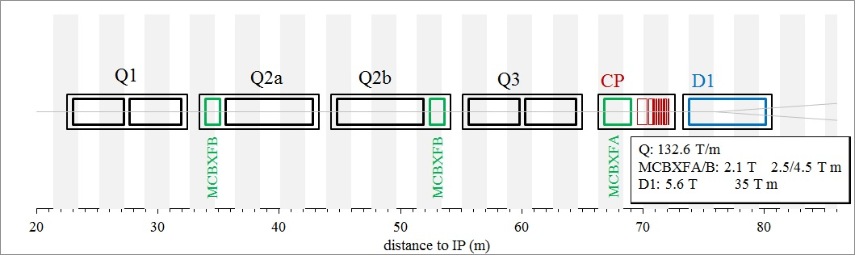
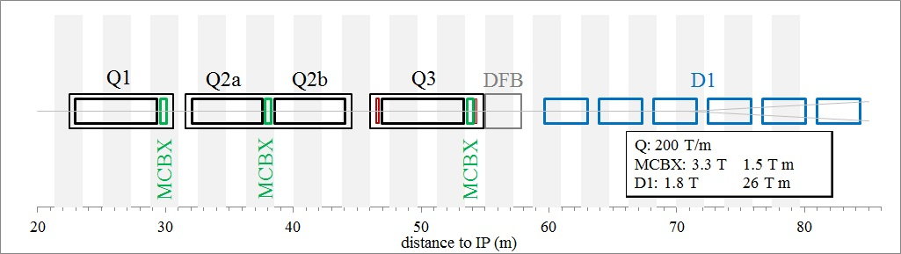
General remarks
Detail of the layout change

Slide 12
General remarks
Very large aperture of 150 mm
  Driven by the triplet requirements
We went for Nb-Ti
  Nb₃Sn would have given 2 m shorter magnet, with no performance increase and higher costs/risks
We went for a single layer layout and thin collars to leave the largest space to the iron
  For flux return, and better field quality
  Mechanical structure relying on iron

Slide 13
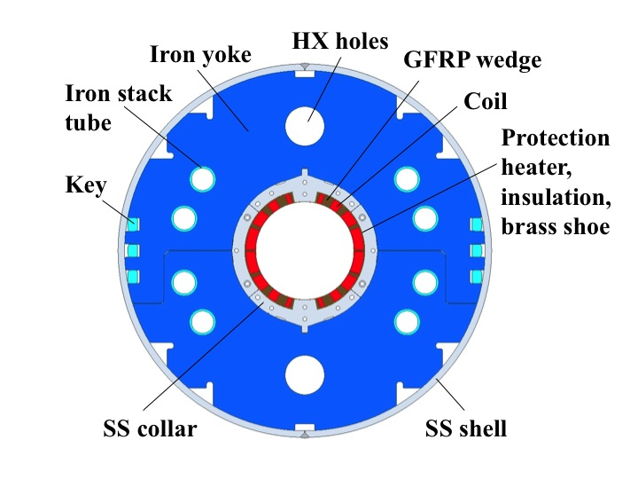
General remarks
We selected a 25% margin on the loadline
  This gives 5.6 T operational field
  We went from the initial 30% margin to 25% to be able to fit the vertical test station
D1 cross-section [T. Nakamoto, M. Sugano, Q. Xu]

Slide 14
Requirements
Performance:
  HL LHC magnets have the following guidelines
    Ability of reaching ultimate current (8% more than nominal) with limited training
    Reaching nominal current after thermal cycle with 0/1 quenches
    Operating in a stable way for more than 24 h
    Mechanics (for coil prestress) should be designed for ultimate without margin
Radiation
  Withstand 35 MGy of radiation load
    This is the level expceted at ultimate integrated luminosity so it should be taken without additional margin

Slide 15
Requirements
Cooling
  Operating at 1.9 K
  Cooling through heat exchangers
    Two heat exchangers at 90 and 270 degrees
  Max heat load of 4 mW/cm³
    Thanks to the shielding the heat load is of the same level as in the LHC

Slide 16
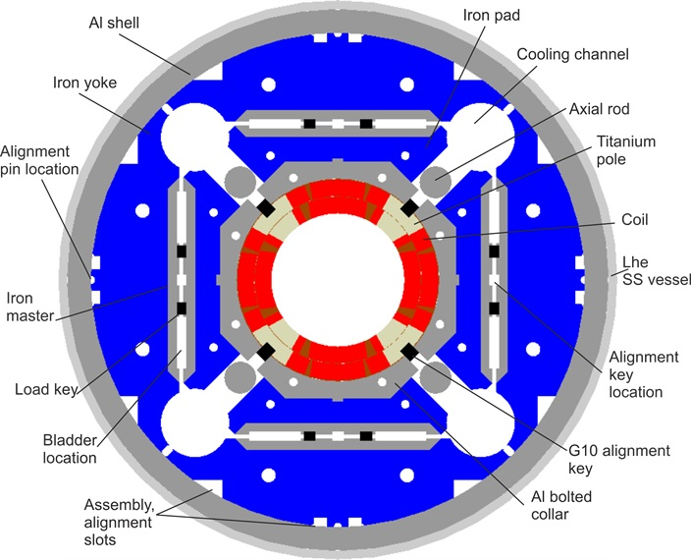
Requirements
Cooling
    In may 2016, we realized that a major design change is required: align the cooling with the quadrupole ones, which are at 45 degrees
    This is a non trivial change of design, that entails a modification of the holes and a fine tuning of the coil to recover the good field quality
QXF cross-section [G. Ambrosio, P. Ferracin]

Slide 17
Requirements
Field quality
  For HL LHC, as in LHC, there are no specifications for field quality but we have targets
    In case of out of targets a non conformity is open and it will be agreed if it can be used as it is or not
    Field quality within targets but indicating a wrong assembly can entail a magnet rejection (as happened in the LHC, for measurements indicating local anomalies due to missing shims etc …)

Slide 18
Requirements
Field quality
  The targets have been established assuming a very good control of the tolerances
    Coil positioning of the order 10-40 micron

Slide 19
Requirements
Field quality
  The systematic are optimized at high field
  Ends are included in optimization

Slide 20
Requirements
Field quality
    Most critical value is the b₃ that should stay within 3 units
    WP2 also expressed concern for b₇ and b₉

Slide 21
Requirements
Field quality
    Due to the small series, tuning shims are a must, allowing a fast correction of field quality

Slide 22
Contents
HL LHC overview
D1 requirements and design choices
Plans and Schedule

Slide 23
Plans
Two short models
  Test in mid 2016 and end 2016
    Requirement of reassembling the first model and iteration of the design will shift the second model to 2017
    Not an issue, we have time
One prototype
  Test in end 2019
Series 4+2
  In 2020-2022
  This magnet was the first to start in 2011, we have good contingency in the schedule, it is time to use it

Slide 24
