Slide 1


Overview of the D1
Development
T. Nakamoto
KEK
HL-LHC D1 Magnet Review
June 30 – July 1, 2016, KEK

Slide 2
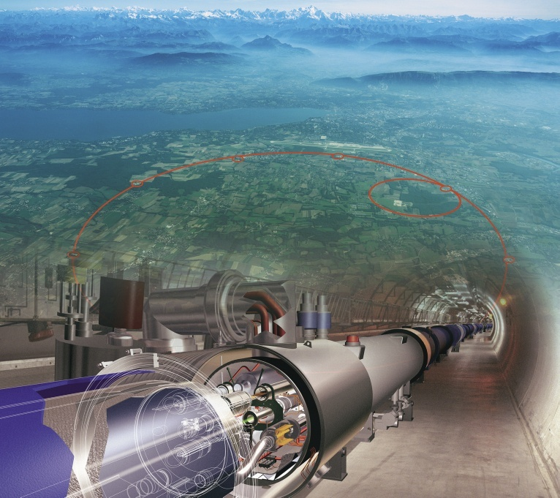
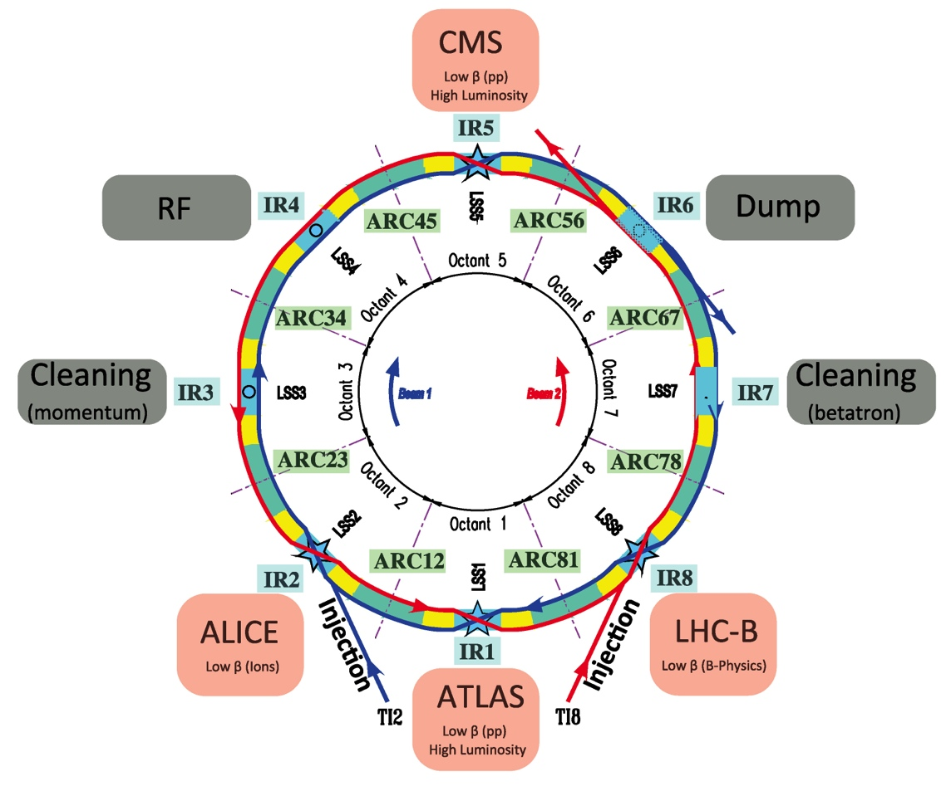
Overview: LHC
Large Hadron Collider at CERN
Circumference: 26.7 km
Proton Beam Injection Energy: 450 GeV
p + p Collision Energy:
  4 + 4 TeV (2012)
  Splice consolidation work in LS1 (2013-2014)
  6.5 + 6.5 TeV (2015)
  7 + 7 TeV (design)
Nominal Luminosity: 1 x 10 ³⁴ cm⁻² sec⁻¹
Superconducting Technology and Cryogenics
  2 in 1 main dipole at 8.3T: 1232 magnets
  Cooled at 1.9 K by 100 tons of superfluid helium
  Total weight of cold mass: 35,000 ton
  Electrical power of 40 MW for cryogenics plant
Construction budget: > 5000 MCHF

Slide 3
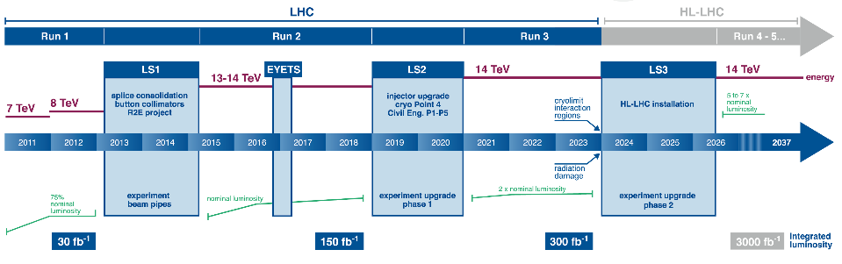
LHC and HL-LHC Schedule
0.75 10³⁴ cm⁻²s⁻¹
50 ns bunch
high pile up ∼40
1.5 10³⁴ cm⁻²s⁻¹
25 ns bunch
pile up ∼40
1.7-2.2 10³⁴ cm⁻²s⁻¹
25 ns bunch
pile up ∼60
Technical limits to lumi increase (Machine & Experiments)
50 ⇒ 25 ns

Slide 4
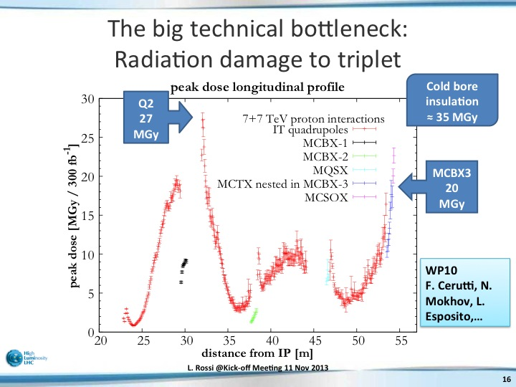
Radiation Damages in Present LHC
Prediction for nominal LHC at 300 fb⁻¹
L. Rossi @Kick-off Meeting 11 Nov 2013
IP
Q1
Q2a
Q2b
Q3

Slide 5
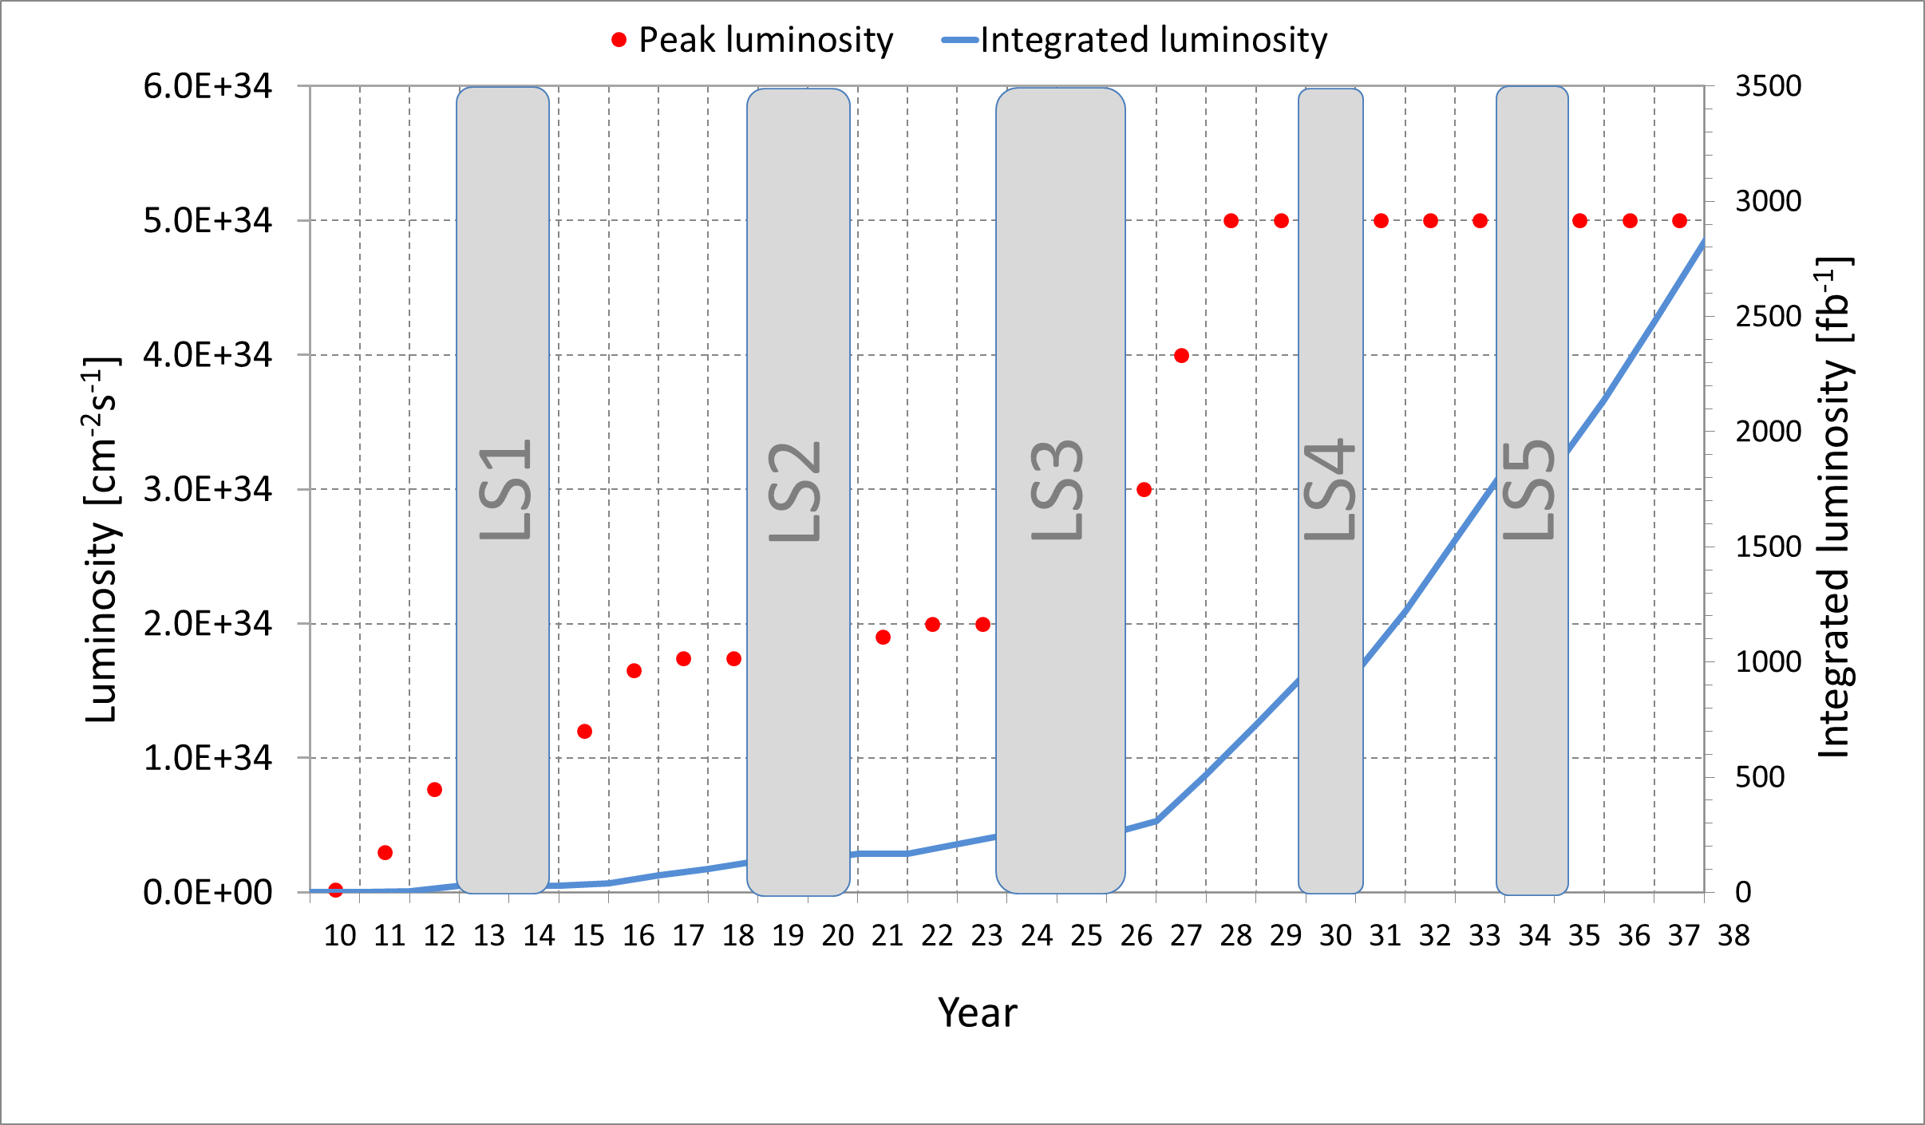
Peak and Integrated Luminosities
HL-LHC Target: 3000 fb⁻¹, 5x10³⁴ cm⁻² sec⁻¹
(Nominal LHC: 300 fb⁻¹, 1x10³⁴ cm⁻² sec⁻¹)
Nominal LHC
HL-LHC
2024 !!

Slide 6
Upgrading Scenario
For Higher Peak Luminosity
Increasing beam current
  LHC Injectors Upgrade (LIU)
    while keeping small emittance…
Small β*
  New IR magnets
    Large aperture Quads and beam separation dipole (D1)
    Matching section magnets
    Strong correctors
  New optics & Layout
    Achromatic Telescopic Squeeze
    New crossing angle
Enhancement of collision efficiency
  Crab-Cavities for IR
Suppression of Pile-Up events
  Leveled by detuning of optics
Beam current
Energy
Beam Size
Geometric reduction factor
Luminosity (10³⁴ cm⁻² sec⁻¹)
Ope. Time (hour)

Slide 7
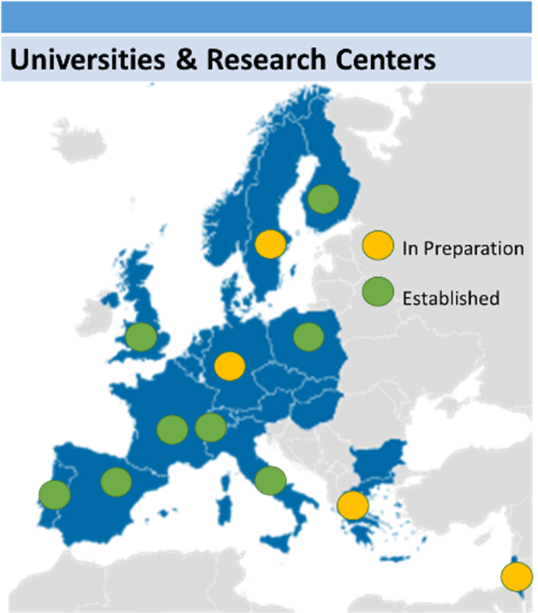
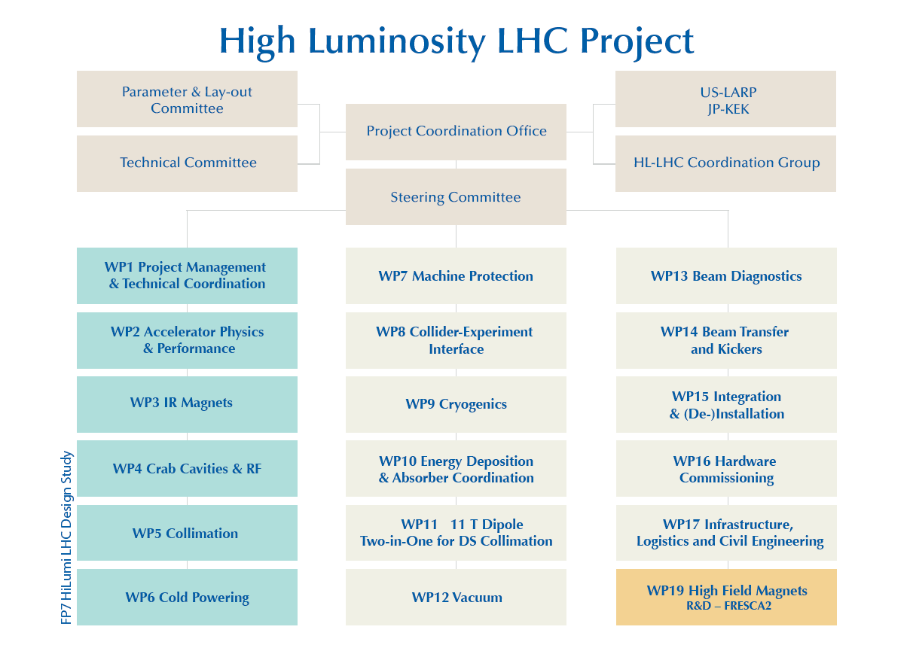
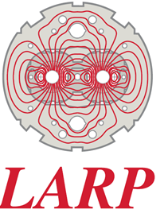

HiLumi LHC Design Study
EU-FP7 “HiLumi LHC Design Study”
Conceptual design study and model R&D started at 2011
  EU-FP7 “HiLumi LHC Design Study” hosted by CERN.
International collaboration by CERN, European institutes, US-LARP, and Japan (KEK)
  involvement of KEK: enhancing Japanese contribution to the ATLAS experiment.
  beam physics, IR magnet, crab cavity, beam diagnostics.

Slide 8
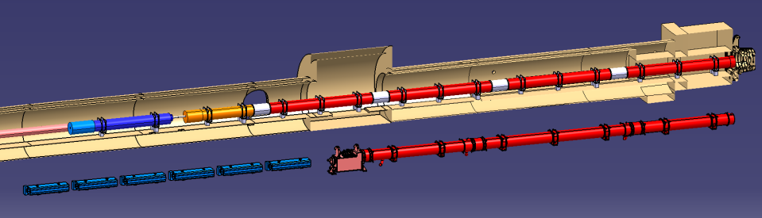





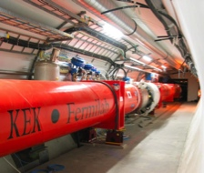

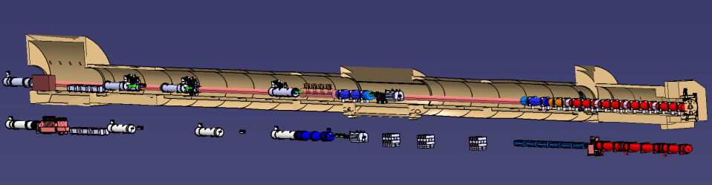

Layout of IR Magnets
Courtesy of P. Fessia
IT Quads.& D1
HL-LHC
IT Quads. w/ Nb₃Sn
Q1
Corrector
Package
Q2b
Q2a
Q3
SC D1
Nominal LHC
NC D1
Long Straight Section
HL-LHC
Crab Cavity
Q4
D2
Nominal LHC

Slide 9
Layout of IR Magnets
NC D1
SC D1
Aperture increase in IT Quads: 70mm → 150mm
  Also needed for the new beam separation dipole D1
Replacement of current NC D1 by SC D1: Shortening magnet length by 15m
  Making enough space for new crab cavities even with longer IT Quads.

Slide 10
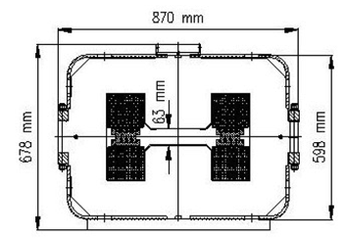
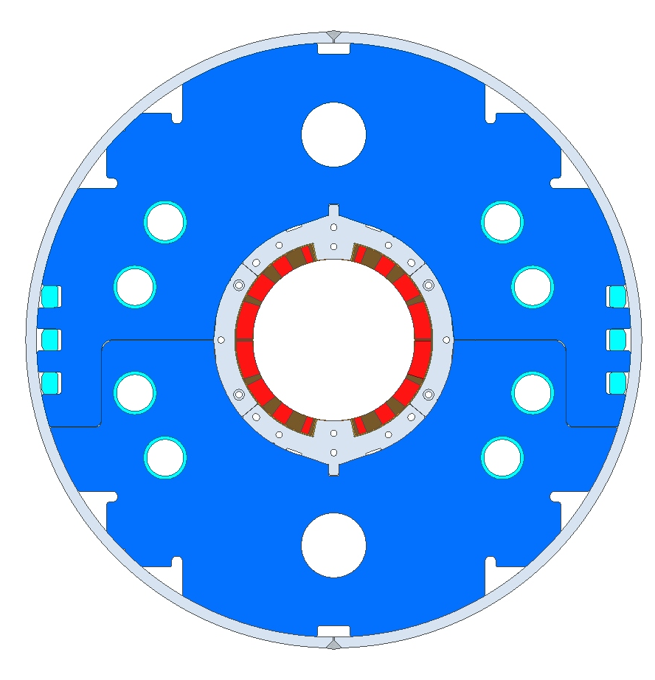
Normal-conducting vs Superconducting
 | Beam separation dipole, D1
 | LHC | HL-LHC
Aperture | 52mm gap | 150mm
Nominal Field (Peak Field) | 1.4 T | 5.6 T (6.5 T)
Magnetic Length | 3.4 m x 6 ~21m | 6.27 m
Stored Energy | 0.014 MJ/m | 0.34 MJ/m
MBXF

Slide 11
Budget, Deliverables
[Design study of the D1 and model magnet development]
Financial supports by KEK-ATLAS/Japan.
1st 2m long model magnet (MBXFS01) has been built and tested at KEK.
The second model development (MBXFS02) is also planned before the full length prototypes.
  One of the models will be shipped to CERN For mutual performance evaluation.
[7m long prototypes and production magnets]
ATLAS/Japan management has been pursuing the “ATLAS upgrade and HL-LHC” in the high priority list in the Science Council of Japan, followed by the budget request to the funding agency…
Nevertheless, the current plan is assumed the funding approval starting JFY2018.
Deliverable (plan): 6 cold masses in cryostats + 1 prototype.
General | 2m model | 7 m production magnet
Field integral | 9.8 T·m | 35 T·m
Coil aperture | 150 mm
Nominal dipole field | 5.57 T
Coil peak field | 6.44 T at center, 6.59 T at coil end
Load-line ratio | 75.4 % at center, 76.6 % at coil end
Nominal & ultimate current | 12.0 kA & 13.0 kA (~108% nominal)
Operation temperature | 1.9 K
Magnetic length | 1.73 m | 6.27 m
Mechanical coil/magnet length | 2.00 / 2.15 m | 6.57 / 6.72 m
Stored energy | 340 kJ/m
Differential Inductance | 4.0 mH/m
Number of turns in quadrant | 44 (4+8+13+19) turns in a single layer coil

Slide 12
Human Resource, Participants
KEK
Team: T. Nakamoto, M. Sugano, S. Enomoto,
Sci. Support: K. Sasaki, N. Kimura, M. Yoshida,
Eng./Tech. Support: H. Kawamata, N. Okada, R. Okada,
CERN
HL-LHC WP3(magnet) Leader: E. Todesco
D1 Link Person: A. Musso

Slide 13
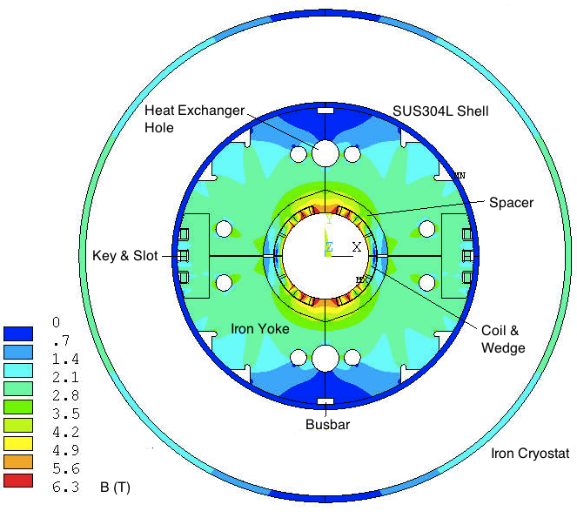
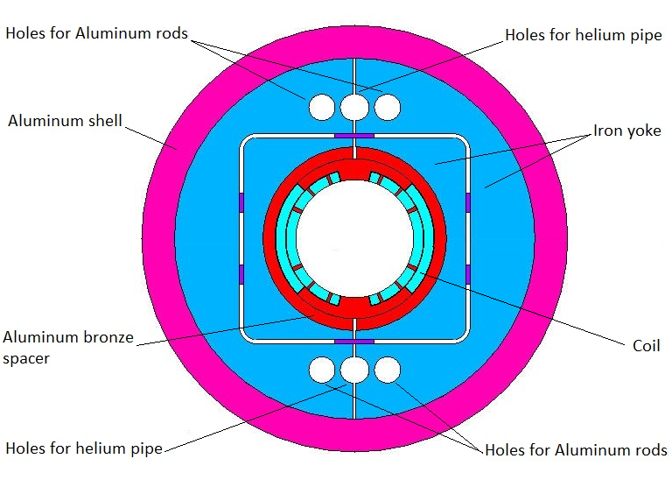
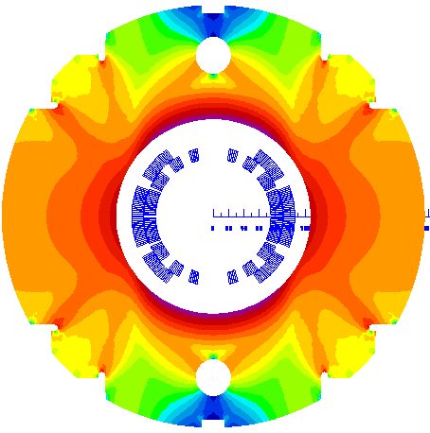
History of D1 Design Variants
Mar. 2011 – Oct. 2011
Nb₃Al (RHQT) 2 layers
Bladder Key & Shell
180 mm bore, 7.6T
Nov. 2011 – May 2012
NbTi 2-layer
150 mm bore, 6.4 T, 40 Tm.
May 2012 – Mar. 2013
NbTi 1-layer
Collared yoke, flux return cryo.
160 mm bore, 5.2 T, 35 Tm.
April. 2013 –
NbTi 1-layer
Collared yoke, flux return cryo.
150 mm bore, 5.6 T, 35 Tm.
13

Slide 14
Design Requirements, Constraints
Coil aperture: 150 mm
35 Tm w/ nominal field 5.6 T at 12 kA
  Upper limit of P/C: < 15 kA
Field quality: < 10⁻⁴ at R_{ref}=50 mm
Mechanical magnet length: < 7.0 m
  limit of the vertical cryostat at KEK.
Magnet outer diameter: 570 mm (same as LHC MB) + ?
  limited passage space in the LHC tunnel.
Radiation and energy deposition w/ Tangsten shield
  Total heat load: 135 W at ultimate
  Peak dose in lifetime: 25 MGy
  Peak energy deposition : ~2 mW/cm³ @ 5 x10³⁴ cm⁻²sec⁻¹
HeII cooling
  Free area: >100 cm² + 2 x φ60 mm HX holes
  Radial gap of 4 % to HX holes
14

Slide 15
Design Guidelines
Use of spare unit lengths of the LHC Nb-Ti superconducting cable from the main dipole (MB) outer layer, wrapped with the polyimide insulation.
Operational temperature of 1.9 K by superfluid helium cooling while operating around 75 % of short sample current (i.e. 25 % margin on the load-line).
A single layer coil for better cooling capability and to leave more space to the iron yoke for reducing the fringe field.
Enhancement of the amount of iron yoke in the cross section accomplished by “a collared yoke structure” like RHIC magnets and LHC MQXA quadrupoles.
A yoke outer diameter of 550 mm, same as J-PARC SCFM , enabling reuse of the assembly tooling and relevant facilities at KEK.
Use of radiation resistant materials for the coil parts: wedges, end spacers.
15

Slide 16
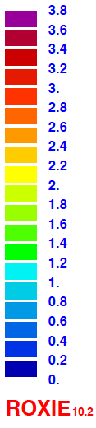
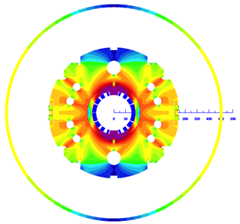
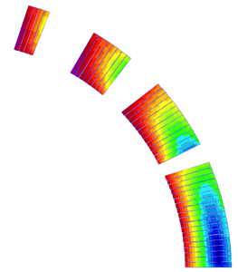
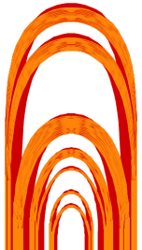
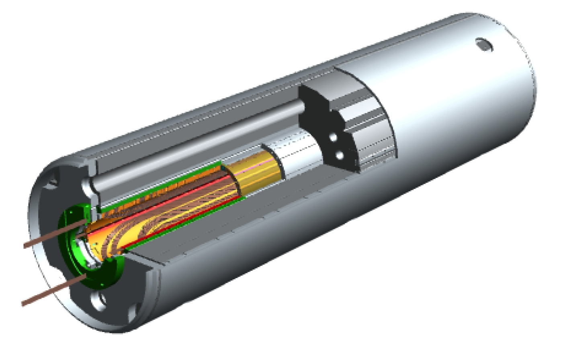
Overview of MBXF for D1
A NbTi single layer coil with 44 turns (4+8+13+19)
Nb-Ti LHC MB outer cable (15.1 mm wide)
Nominal Dipole Field: 5.59 T at 12 kA at 1.9K
  Load-line ratio: 76%
Mechanical coil length: 6.6 m
Collared yoke structure by keying
  Very small preload at collaring process
Cold mass OD: 550 +10 x 2 = 570 mm
Cryostat OD: 914 mm, same as MB cryostat
Challenges
Stress management in large aperture dipole.
Field quality under high saturation and stray field with flux return cryostat.
Radiation resistance, cooling capability.
4
8
13
44 turns
19
16

Slide 17
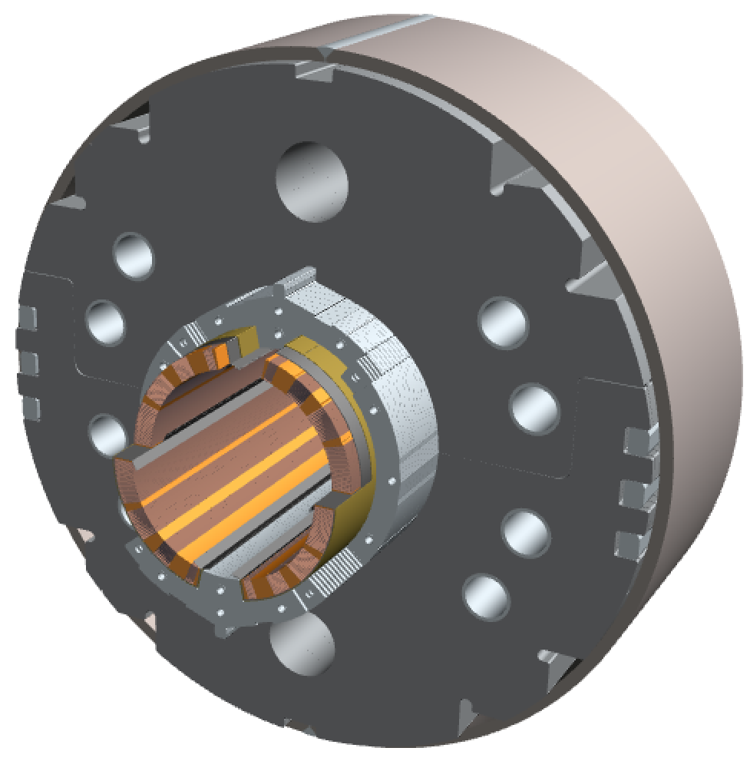
MBXF Magnet: cutaway view
Single-layer coil, 4-split spacer collars, collared yoke by keying
Notches and φ 34 mm holes for iron saturation effects
φ60 mm HX hole
HeII cooling channel
Shell: SUS304L
4 split stainless steel spacer collars: NSSC130S
Brass shoes
QPH+Insulations
Collaring keys
NbTi SC cable (LHC MB outer) + Apical insulation
Horizontal split iron yoke:
low-carbon steel (EFE by JFE steel)
Radiation resistant GFRP (S2 glass + BT resin) wedges

Slide 18
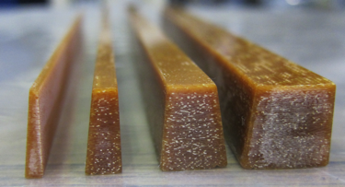
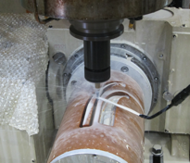
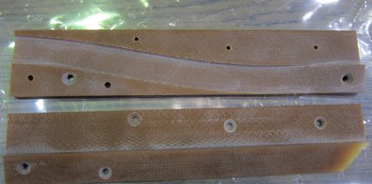
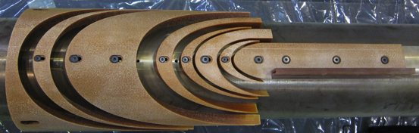
Radiation Resistant GFRP
To be published in Fusion Engineering and Design
New GFRP development with ARISAWA
  wedges, end spacers
  Bismaleimide-Triazine (BT) resin + boron-free S2 glass fibers
Flexural strength is not degraded at least up to 100 MGy of γ-ray irradiaition
Pole shim and wedges
σ_{θ} < 30 μm
Ramp box
End spacers

Slide 19
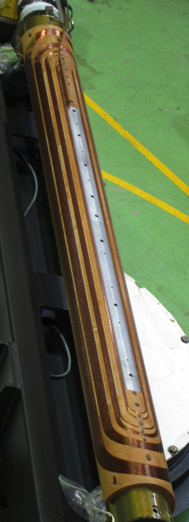
Test Coil Fabrication – Sep. 2014 –
Demonstration of coil fabrication with a first 2m (test) coil.

Slide 20


Modification of Coil End Design
Coil-end found in practice
winding
(2-m test coil)
Old version (Ver 2)
Modified design
(Ver3)
1A
1B
2
3A
4A
3B
4B
Subdivision
Points in modification of coil-end designs
Elongation of end part
To make the cable stand more uprightly
Subdivision of the outer most block
To make it easier to predict the angle of the last turn
Adjustment of distance between the blocks “1B” and “2”
To minimize integral multipole
This modified coil end was adopted for the 1st 2-m model (MBXFS01)

Slide 21
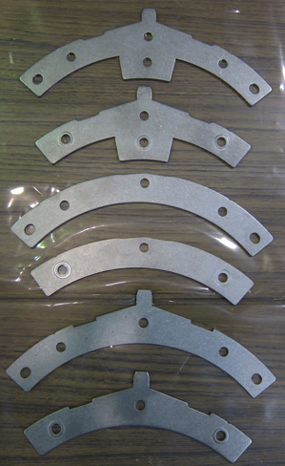
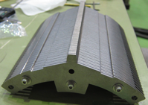
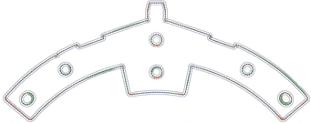
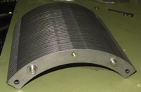
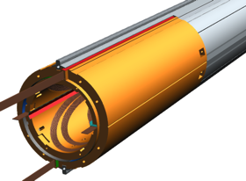
Collars
Vertical collars
Stainless steel (NSSC130S) with relative permeability of 1.002 at 4.2 K
Four split collar to avoid unwanted warp
2.3 mm-thick fixing collar and 2.6 mm-thick spacer collar
Alignment features:
  Rectangular and triangular notches of vertical collars
  Taper of side collars
Embossing to control packing factor to be 96%
Fabricated by fine-blanking technique
  High accuracy in the size for the critical parts (±10 μm)
Emboss
Side collars
Vertical collars
for coil end
Vertical collar sub-stack
±10 μm
Result of size measurement
for fine-blanked fixing collar
Horizontal collar sub-stack
SUS collar
GFRP collars will clamp the layer jump cable at the lead end similar to J-PARC SCFM
GFRP collar

Slide 22
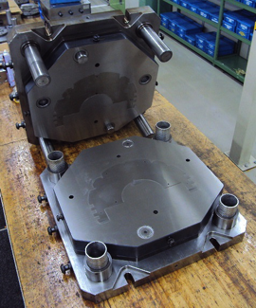
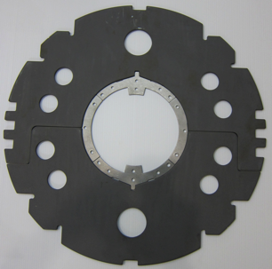
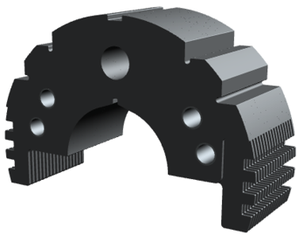
Yokes
Low carbon steel (JFE-EFE)
Fabricated by fine-blanking technique
5.6 mm-thick fixing yoke and 6 mm-thick spacer yoke
Rectangular groove as an alignment feature
Yoke sub-stack has PF of ~100%
  Embossing to control PF to be 98%
  In 2 m model, 0.6 mm-thick spacer sheets SUS316L was inserted.

Slide 23
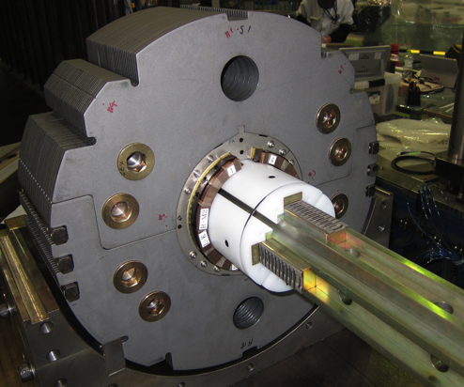
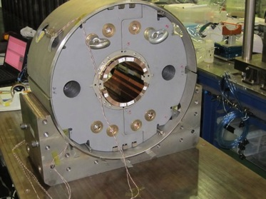
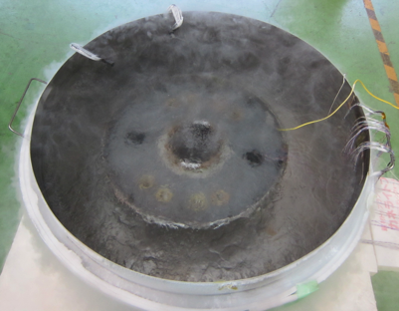
Mechanical Short Model
C1-L
C1-R
C2-L
C2-R
Compressive Coil Stress (MPa)
Collaring
Yoking
Key insertion
Shell welding
LN₂ Cooling
Validity of mechanical design of D1 was verified.
Variation of coil pole stress through the processes.
  As expected only except for stress decrease by cooling
Collaring mandrel worked as designed.
Structure of electrical insulations is OK. No unwanted wrinkles were observed.
4-way split collar concept behaved as designed.
Alignment features added to collar and yoke functioned as designed.
Shell welding will be performed again for better performance.

Slide 24
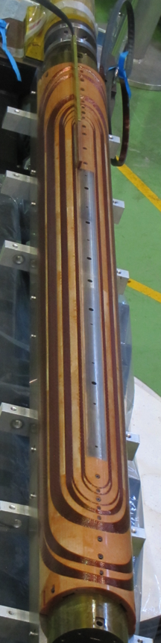
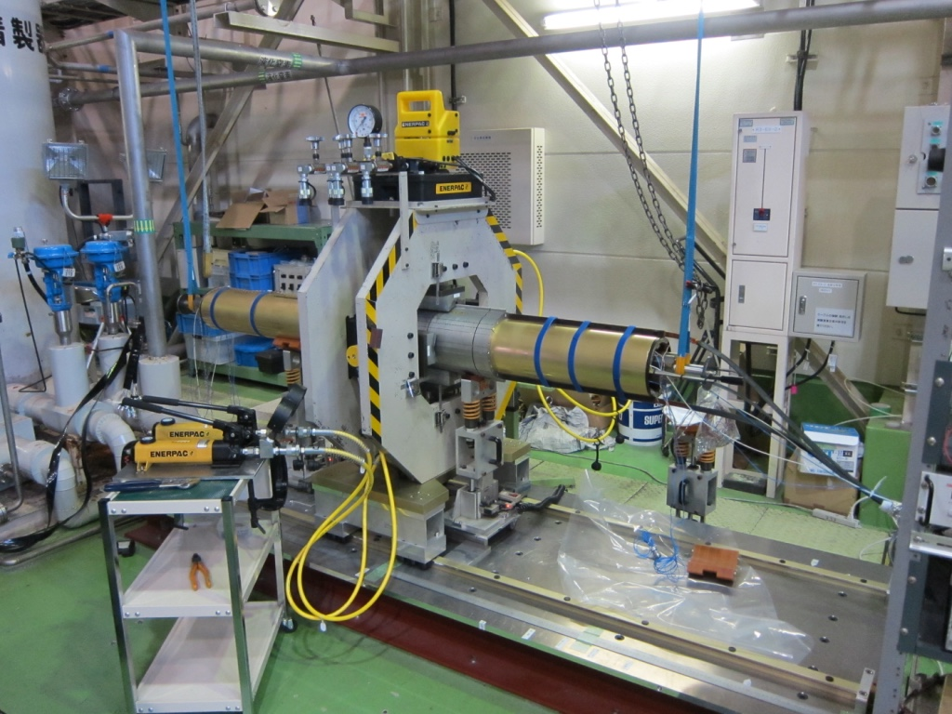
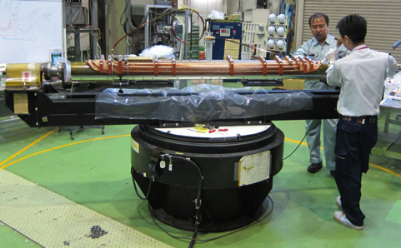
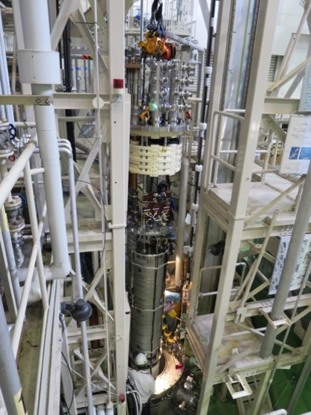
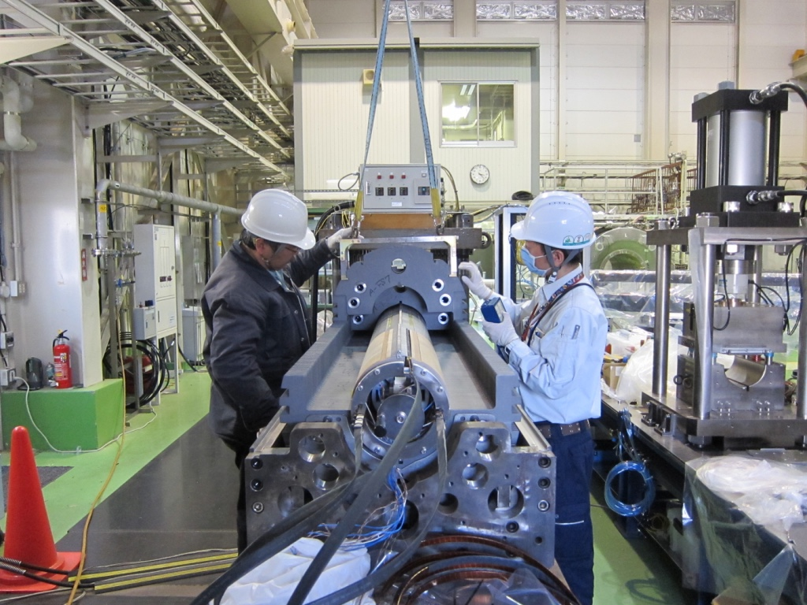
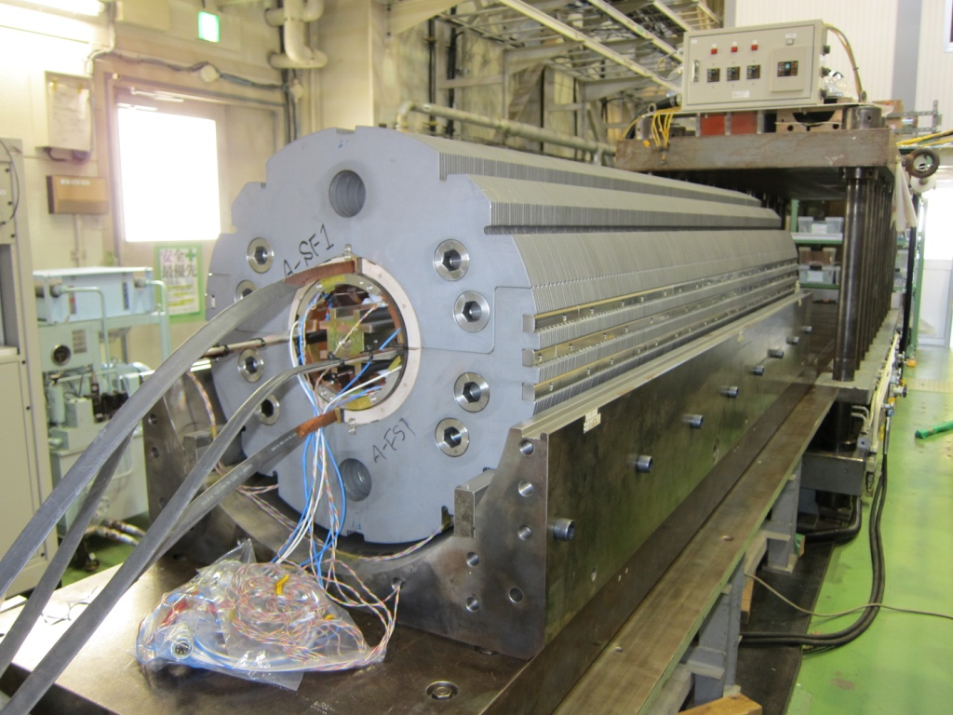
2m Model Development
Field quality has not been fully optimized for the 2m model.
  The coil-end layout was adjusted for the 7 m long production magnet. Straight section is simply shorten for the 2m model.
  2D coil cross section is not fully optimized because the yoke cross section needed a sudden change to introduce the rectangular notch after the mechanical model.
Yoke packing factor of 98% realized by inserting the SUS316L sheet in the 2m model.
  Emboss will be introduced for the production magnets.
The 1st model (MBXFS01) was completed in March 2016.

Slide 25
Test Results
[Quench Performance]
Over the nominal, but below the ultimate. Good training memory.
Unfavorable behavior: plateau, even decreasing.
[Field Measurement]
General agreement with calculation.
Large impact of ends even at the magnet center

Slide 26
New Cross section: NOT a scope of this review
Present Cross section
New Cross section
Request to change the yoke cross section in the D1 came up recently from CERN.
  As conceptual design of cryostat and interconnect proceeds, it is recognized that the HeII HXs in the D1 MUST be located at the same positions in the IT Quads.
Design study with a new cross section will be launched soon after this review. The next model magnet (MBXFS02) will implement the new design.
  Present fine-blanking dies for the yoke and the assembly tooling in the yoking process will not be usable.

Slide 27
Summary
High Luminosity LHC project is underway in CERN with international collaborations including Japan. Conceptual design study has been finished and the project is shifted to the engineering design and construction phase.
  Construction will be started around 2024, followed by physics run 2026-2037??
  5x10³⁴ cm⁻² sec⁻¹, 250-300 fb⁻¹/year, 3000 fb⁻¹
KEK has been engaged in the HLumi-LHC design study in the context of enhancing the the Japanese contribution to the physics outcome from the ATLAS experiment.
R&D of the beam separation dipole magnet, MBXF for D1, including the 2-m model has been underway at KEK.
  Mechanical short model successfully demonstrated the mechanical design and assembly procedure including tooling.
  Fabrication of the 1st 2m model magnet (MBXFS01) started with the coil winding in July 2015. The magnet was completed in Mar. 2016 followed by the cold testing at the vertical cryostat.
  MBXFS01 couldn’t reach the ultimate current (108% nominal). According to the mechanical measurement, the preload in the coil was not sufficient.
    Need to dismantle MBXFS01 for modification?

