Slide 1
Magnetic design
Michinaka Sugano
D1 magnet review, KEK, 30 June – 1 July 2016

Slide 2
Outline
Magnetic design for 7 m production magnet
  Optimization of 2 D cross-section
    Management of iron saturation
    Error analysis
    Design change of yoke (rectangular notch)
  Optimization of coil end
  3D field calculation in 7 m magnet
From 7 m to 2m magnet
  Field calculation of 2 m magnet considering KEK vertical test stand

Slide 3
Optimization of 2D cross-section

Slide 4
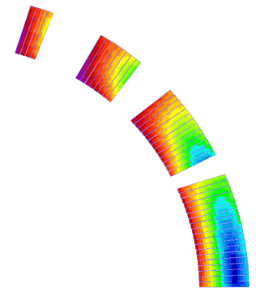
Fixed conditions for optimization
Cryostat
Coil
  φ150 mm bore
Yoke
  OD: 550 mm
  HX hole: φ60 mm at R190
Cryostat
  ID: 890 mm, 12 mmt
Based on our early design study, the following conditions were fixed in optimization.
  Single layer coil (for better cooling and maximizing the amount of iron)
  4 coil blocks, totally 44 turns (19, 13, 8, 4 turns from MP)
  Iron cryostat was taken into consideration.
HX hole
4
44 turns
8
13
Yoke
Collar
19
Coil blocks
Reference radius in ROXIE calculation: 50 mm

Slide 5
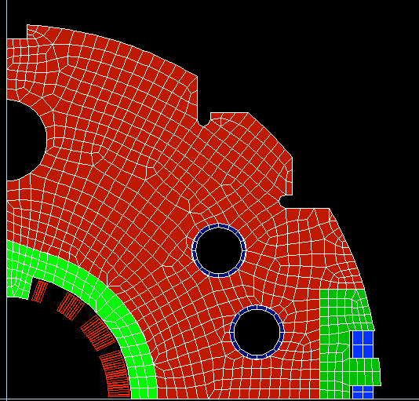
Features to minimize iron saturation effect
  Triangular notch
  Field tuning holes
Iron saturation effect on multipole coefficients can be more gentle
w and w/o field tuning holes
Field tuning hole
Triangular
notch
w and w/o
triangular notch

Slide 6
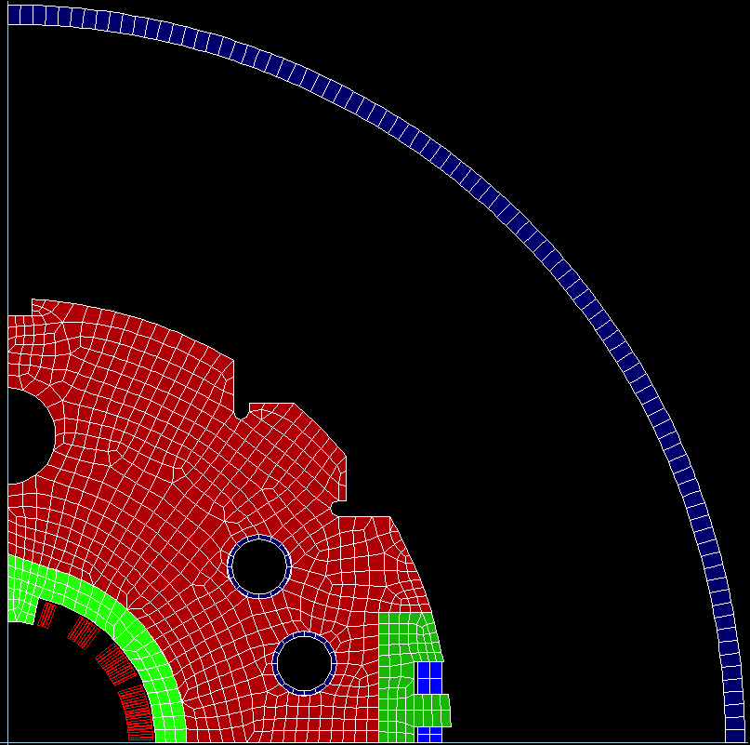
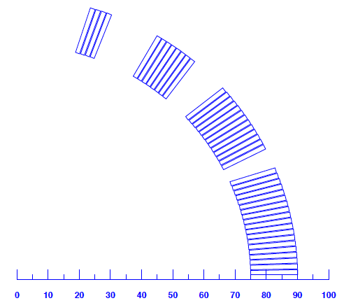
Optimization of coil block arrangement
Multipole coefficients
at I=12 kA
 | Iron yoke (Ver3.0)
Main field (T) | 5.573
b₃ (unit) | -0.059
b₅ (unit) | -0.097
b₇ (unit) | -0.111
b₉ (unit) | 0.284
b₁₁ (unit) | 0.360
b₁₃ (unit) | -0.663
b₁₅ (unit) | -1.115
b₁₇ (unit) | -0.788
b₁₉ (unit) | 0.399
All of multipoles except for b₁₅ can be controlled below 1 unit.

Slide 7
Error analysis
Change of b3 by each factor
Systematic error
  Packing factor of iron yoke: -1.2 unit
  Stainless collar (μ_{r}=1.002): -0.6 unit
  Coil mispositioning
Random error: σ_{b3}=0.5 unit for d=25 μm
Coil mispositioning
Δb3 wrt Δx=Δy=0 (unit)
CB4
CB3
 | Δx = -50 μm | Δy = 50 μm
CB1 | 1.40 | -2.20
CB2 | -1.44 | -1.20
CB3 | -0.81 | 0.68
CB4 | 0.24 | 0.51
CB2
y
CB1
x

Slide 8
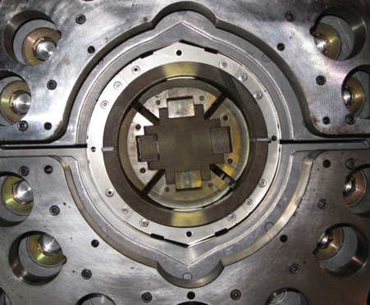
Design change of iron yoke (Rectangular notch)
Yoke
Collar
I=12 kA | Iron yoke w/o rect. notch (Ver3.0) | Iron yoke w rect. notch (Ver3.0.2)
Main field (T) | 5.573 | 5.568
b₃ (unit) | -0.059 | 5.161
b₅ (unit) | -0.097 | -1.462
b₇ (unit) | -0.111 | 0.193
b₉ (unit) | 0.284 | 0.224
b₁₁ (unit) | 0.360 | 0.371
b₁₃ (unit) | -0.663 | -0.666
b₁₅ (unit) | -1.115 | -1.116
b₁₇ (unit) | -0.788 | -0.788
b₁₉ (unit) | 0.399 | 0.399
Mechanical model
ROXIE model
(Ver3.0.2)
Rectangular notch
After 2D optimization, we needed to add a rectangular notch to yoke as a coil alignment feature. → Increase of b3 and b5 by 5.2 and -1.4 units
Further calculation confirmed that slight coil block re-arrangement can correct these field errors.→ Coil block arrangement was NOT changed in MBXFS01.

Slide 9
Transfer function
Ver3.0.2
(w Rectangular notch)
Decrease of transfer function by 10% due to iron saturation

Slide 10
Current dependence of multipole coefficients
Results of Ver3.0.2 (w Rectangular notch)
Variation of b3 is within ±20 units.

Slide 11
Optimization of coil end

Slide 12
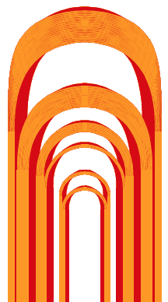
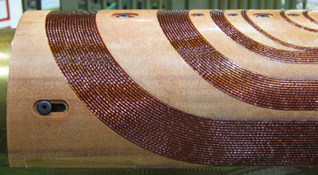
Coil end in “test coil”
Coil end shape was modified from the design of a “test coil” fabricated in 2014.
Issues in the test coil
  Average b3=8.3 unit should be reduced.
  → Further optimization of axial position of each coil end block
  Compact coil end resulted in more inclined cables at coil end
  → Cable angle, length of curved section and curvature
To reduce peak field and make the prediction of angle of the last turn in a coil block easy
→ Subdivision
Test coil (Ver2.1)
1
2
3-A
4-A
3-B
4-B

Slide 13
Approximation in 3D model
In 3D field calculation, a simplified iron model was used to reduce computational time.
Applying this simplified model to 2D calculation results in difference of b3 by 2.0 units and b5 by -0.39 units in comparison with the full iron model.
Target values of b3, b5 and b7 for 3D field optimization were set based on these differences.
Full iron model for 2D
Simplified iron model for 3D
Optimization was done for the 3D model
without rectangular notch.

Slide 14

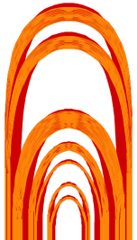
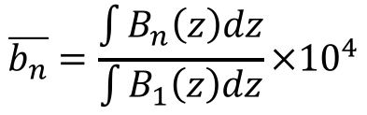
Results on optimization of coil ends
4
Definition of Average multipole coefficients
3
$$\overline{b_{n}}=\frac{\int{B_{n}\left(z\right)dz}}{\int{B_{1}\left(z\right)dz}}×{10}^{4}$$
2
1
Average multipole coefficient at I=12 kA
 | 7 m production magnet (Ver3)
(unit) | Target value | Ave. field harmonics
 | — | 10000
 | 2.020 | 2.510
 | -0.387 | -0.116
 | -0.054 | -0.698
 | — | -0.449
 | — | 0.033
 | — | -0.718
 | — | -1.085
 | — | -0.737
 | — | 0.379
 | — | -4.745
 | — | 1.666
1-A
1-B
2
3-A
4-A
3-B
4-B
Large gap between 1-B and 2
Average b3 within 0.5 unit
wrt the target value
Subdivision of the 1st block
Load line ratio at coil end:
78% → 76%
Sufficient length of curved section

Slide 15
3D field calculation in 7 m magnet

Slide 16
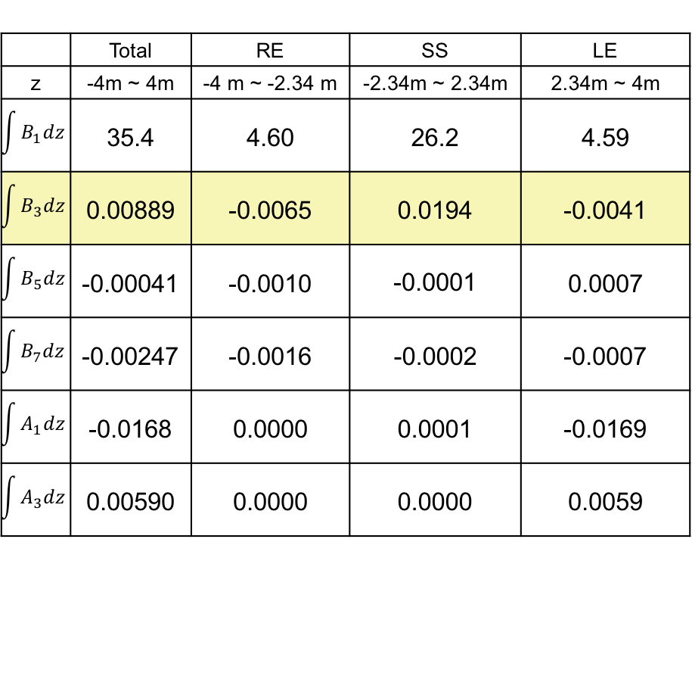
Magnetic field distribution
RE
SS
LE
Positive integrated b3 in SS is compensated with negative one in the coil ends.
Large a1 and a3 due to ramp leads
Mechanical length of 6.57 m for 35 Tm is acceptable for cold tests in the KEK cryostat.
Field integral for SS and ends at I=12 kA (Tm)
 | Total | RE | SS | LE
z | -4m ~ 4m | -4 m ~ -2.34 m | -2.34m ~ 2.34m | 2.34m ~ 4m
$$\int{B_{1}dz}$$ | 35.4 | 4.60 | 26.2 | 4.59
$$\int{B_{3}dz}$$ | 0.00889 | -0.0065 | 0.0194 | -0.0041
$$\int{B_{5}dz}$$ | -0.00041 | -0.0010 | -0.0001 | 0.0007
$$\int{B_{7}dz}$$ | -0.00247 | -0.0016 | -0.0002 | -0.0007
$$\int{A_{1}dz}$$ | -0.0168 | 0.0000 | 0.0001 | -0.0169
$$\int{A_{3}dz}$$ | 0.00590 | 0.0000 | 0.0000 | 0.0059

Slide 17
Influence of coil end on field quality
b3 in SS of 7 m magnet
RE
LE
2D calculation
b3 is not flat at the longitudinal center even in 7 m coil.
→ Influence of coil end is not negligible.
Such an effect of coil end is more remarkable in 2 m model magnet.

Slide 18
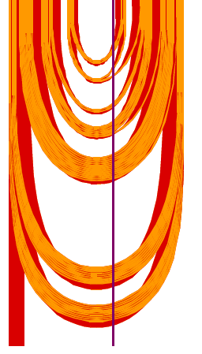
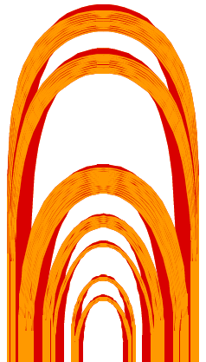
Peak field
Peak field
10
18
Peak field appears at the innermost turn in the CB3 (Block 8, 15, 22)
17
9
16
8
19
15
7
6
14
4
5
3
Block No. | Maximum field (T)
8 | 6.56
15 | 6.54
22 | 6.55
13
20
21
12
2
22
1
23
Peak field
11
24
LE
RE

Slide 19
Load line curve
Load line ratio: 75.4% in straight section
76.6% at coil end

Slide 20
From 7 m magnet to 2 m model

Slide 21
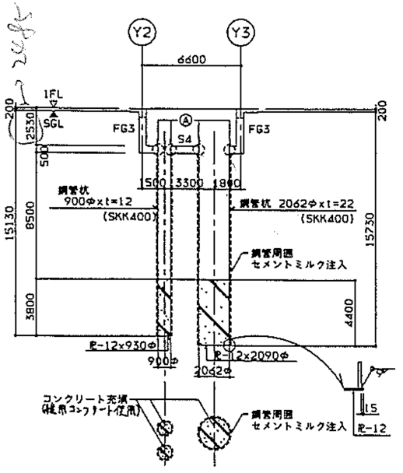
KEK vertical test stand
The model for MBXFS01 was built only by shortening the straight section of the 7 m magnet. The coil end design is the same.
Iron model with rectangular notch was adopted.
In 2 m model, we replaced the LHC cryostat by the iron pit in the underground test hole at KEK.
Iron pit in the underground test hole
(OD2062 mm, t22 mm)

Slide 22
2D calculation of 2 m model
Multipole coefficients at I=12 kA
 | Iron yoke w LHC cryostat (Ver3.0.2) | Iron yoke w iron pit (Ver3.0.2)
Main field (T) | 5.568 | 5.547
b₃ (unit) | 5.161 | -0.258
b₅ (unit) | -1.462 | -1.856
b₇ (unit) | 0.193 | 0.183
b₉ (unit) | 0.224 | 0.235
b₁₁ (unit) | 0.371 | 0.378
b₁₃ (unit) | -0.666 | -0.672
b₁₅ (unit) | -1.116 | -1.119
b₁₇ (unit) | -0.788 | -0.791
b₁₉ (unit) | 0.399 | 0.400
Additional b3 due to rectangular notch is almost cancelled by changing the cryostat condition.

Slide 23
Comparison btw 7 m magnet and 2m model
Design parameters | 2 m model | Production
Nominal current | 12.0 kA
Coil aperture | 150 mm
Field integral | 9.8 Tm | 35 Tm
Nominal dipole field | 5.57 T
Coil peak field | 6.44 T in the straight section
 | 6.56 T at coil end
Load line ratio | 75.4% in the straight section
 | 76.6% in coil end
Differential inductance | 3.95 mH/m
Stored energy | 340 kJ/m
Coil mechanical length | 2.00 m | 6.57 m
Magnet mechanical length | 2.15 m | 6.72 m
Magnetic length | 1.73 m | 6.33 m

Slide 24
Summary
Magnetic design was performed for 7 m production magnet.
As a result of optimization of 2D cross-section, multipole coefficient was able to be controlled within allowable level including variation during current ramping-up.
The results of 3D field calculation suggest that field quality at the coil center is affected by coil end even in 7 m magnet.
The 2 m model was built by shortening the straight section of the 7 m magnet with the same coil end.

