Slide 1
Mechanical design
Michinaka Sugano
D1 magnet review, KEK, 30 June – 1 July 2016

Slide 2
Outline
Mechanical calculation with ANSYS
  Calculation for each assembly step, cooling and excitation
  Estimation of required pre-stress
Assembly of 200 mm long mechanical model
  Validation of assembly procedure
  Evaluation of pre-stress of coils
Coil end support
  GFRP collar
  Longitudinal support

Slide 3
Mechanical calculation with ANSYS

Slide 4
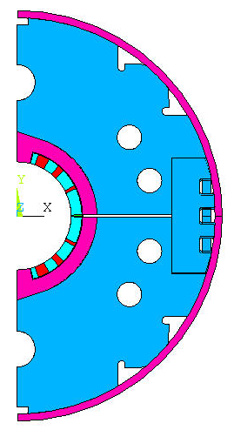
ANSYS model
1.5 MN/m
Simulation steps of the ANSYS 2D 2-layer model
Collaring
< 10 MPa pre-stress in coil by applying load on the stainless steel spacer;
Yoking (2 steps)
1. Applying load on the yoke shoulder to close the gap between top and bottom yokes;
2. Remove the load, insert the lock-keys;
Shell welding
Including stress from the stainless steel shell;
Cool-down to 2K;
Excitation.
Boundary conditions
Symmetry condition: UX = 0 in line X = 0;
Friction coefficient of 0.2 for all the internal interfaces;
Mechanical design for 110% of the nominal current;
Shear stress in lock-keys is not included
0.6 MN/m
Lorentz force
In coil at nominal current
0.5 unit thickness
for each layer
SS304L Shell

Slide 5
Mechanical properties in the ANSYS model
Same with MQXC magnet (data from M. Segreti’s ppt file: “Mechanical computation of MQXC magnet”)
Parts | Material | Young's modulus (GPa) 2K/293K | Thermal expansion coefficients (2K - 293K)
 |  |  | unit: K⁻¹ | Integrated
Coil blocks | / | 7.7 / 5.5 | 2.42E-05 | 7E-03
Wedge | Copper | 136 / 136 | 1.14E-05 | 3.3E-03
Yoke & keys | Iron | 224 / 213 | 6.82E-06 | 1.97E-03
Ground insu. | Mix Kapton-G11 (50%/50%) | 5.2 / 4.45 | 2.42E-05 | 7E-03
Collar-Spacer | SS316L | 210 / 205 | 9.97E-06 | 2.90E-03
Shell | SS316L | 210 / 205 | 9.97E-06 | 2.90E-03
GFRP wedges were used in the actual coils.

Slide 6
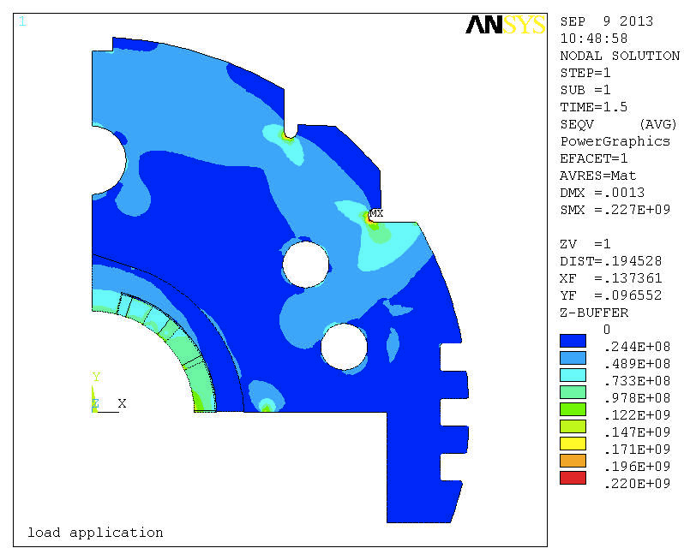
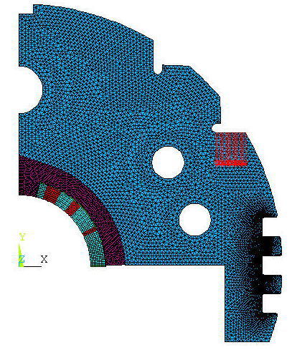
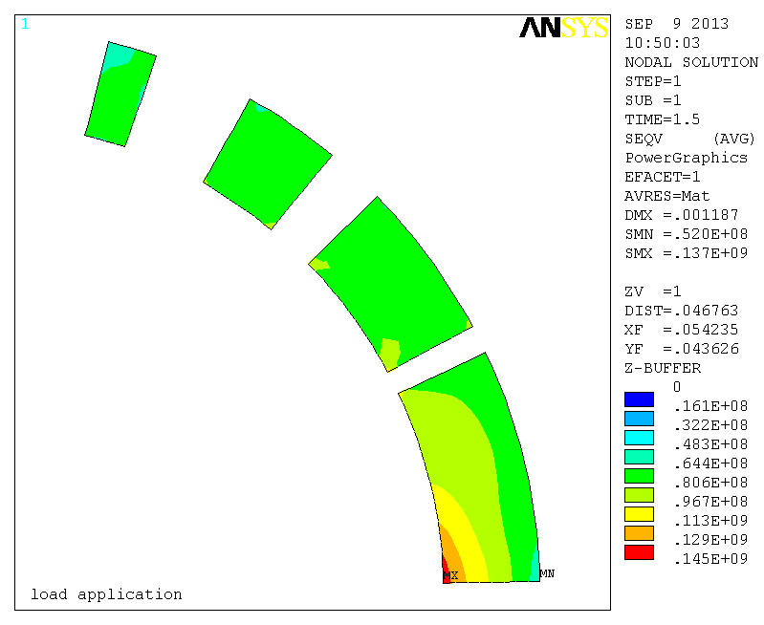
Yoking – Loading on yoke shoulder
UX = 0
Required load:
2.3 MN/m
0.5 unit
thickness
Stress in the yoke
Yoke
Collar
Coil
UY = 0
2.3 MN/m load applied on the shoulder of the iron yoke to close the initial gap between top and bottom yokes.
Stress in the coil

Slide 7
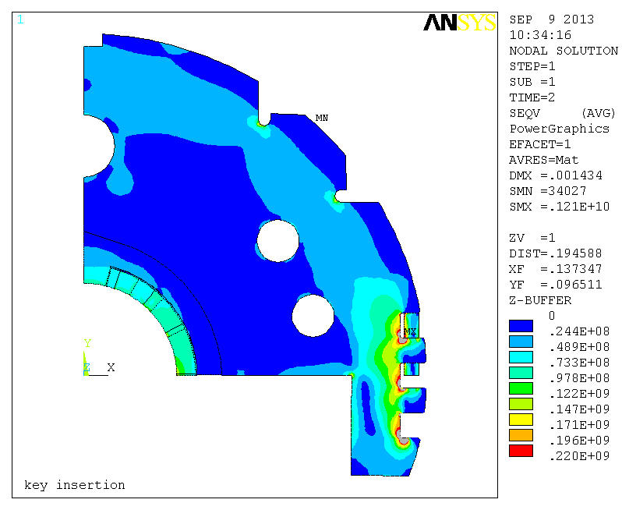
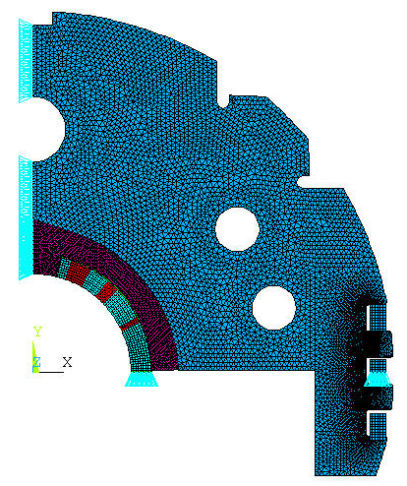
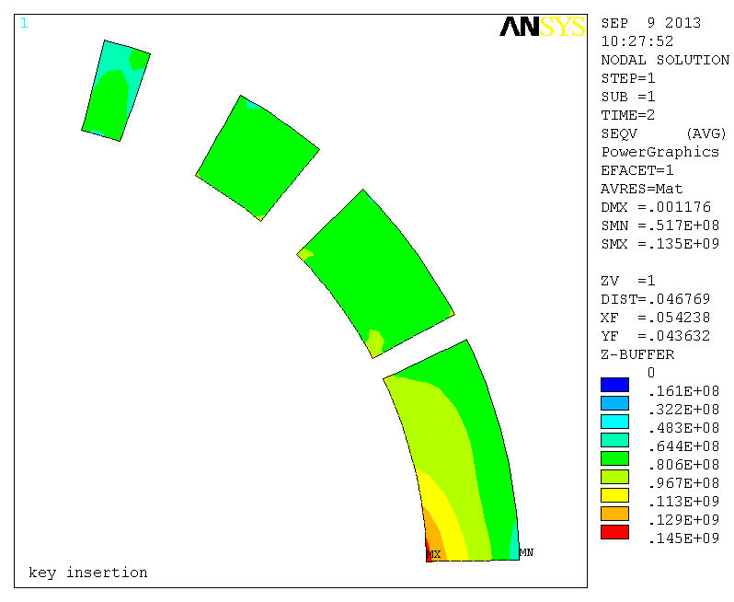
Yoking – Key insertion
Shear stress in lock-keys is not included
Highest stress at key slot
< 220 MPa would be feasible.
UX = 0
Stress in the yoke
0.5 unit
thickness
Yoke
Collar
Coil
UY = 0
Remove load from the yoke shoulder and insert the load-key; The gap between top and bottom yokes keep closed at both ends.
Stress in the coil

Slide 8
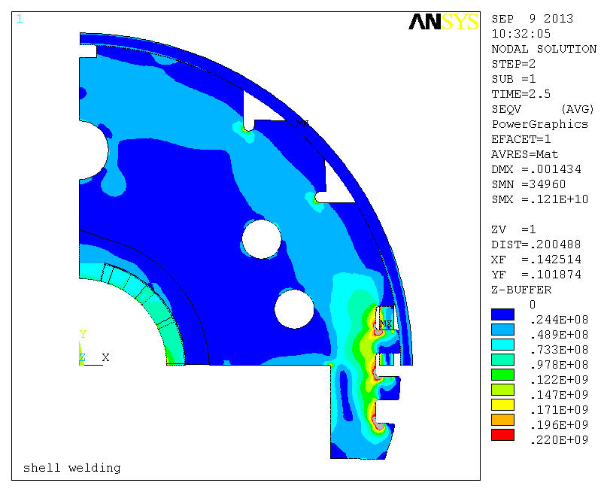
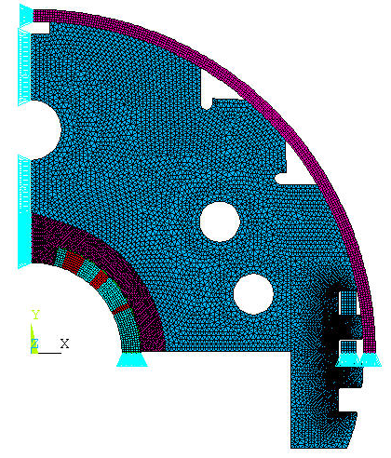

Shell welding
~1 mm displacement in x direction
UX = 0
Stress in the yoke
0.5 unit
thickness
Yoke
Collar
Coil
UY = 0
Including the shell stress by making a ~1 mm displacement at one end of the shell;
Stress in the coil

Slide 9
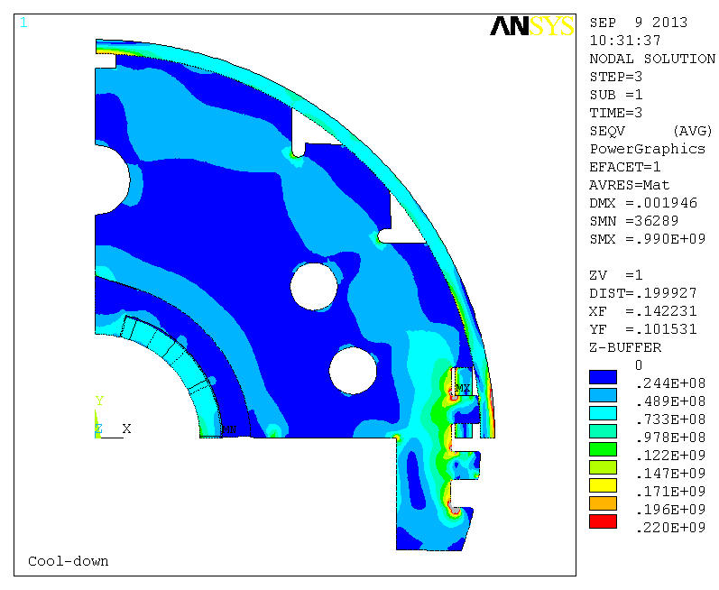
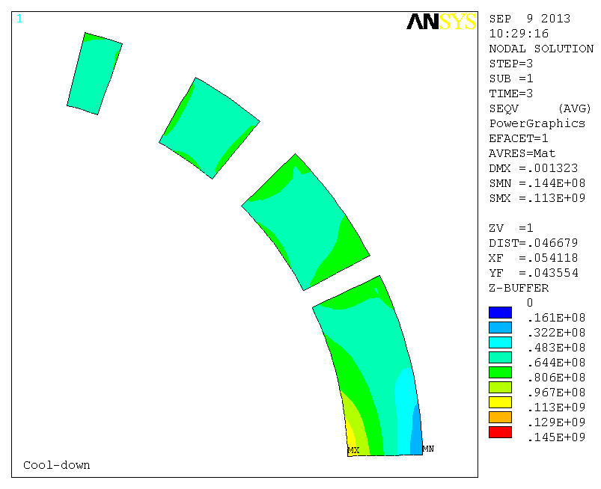
Cooling down to 2 K
~1 mm displacement in x direction
UX = 0
Stress in the yoke
0.5 unit
thickness
Yoke
Collar
Coil
UY = 0
Cool down to 2 K; The gap between top and bottom yokes keep closed at both ends.
Stress in the coil

Slide 10
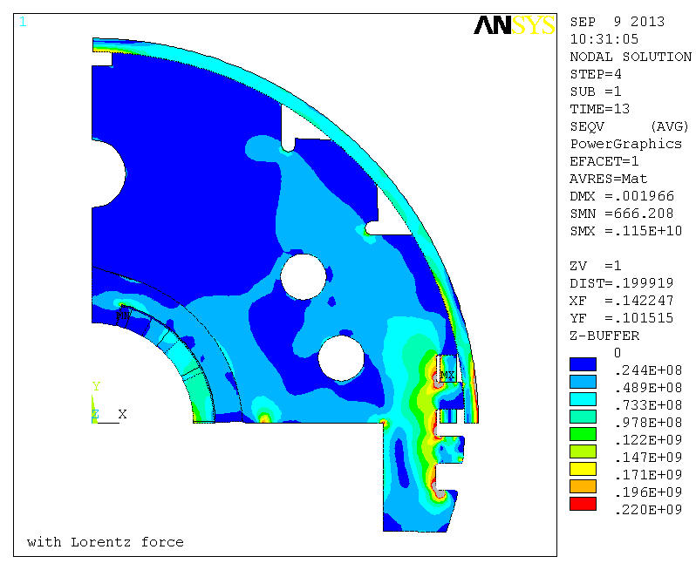
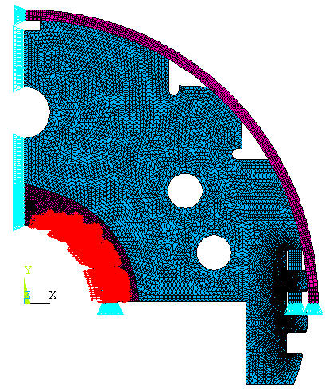
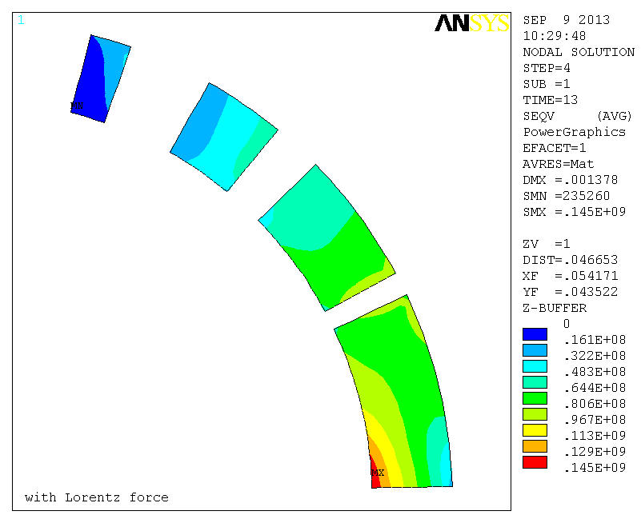
After excitation
~1 mm displacement in x direction
Simulation model
(top half)
UX = 0
Stress in the yoke
0.5 unit
thickness
Yoke
Collar
Coil
UY = 0
Applying Lorentz force transferred from the magnetic simulation results.
Stress in the coil

Slide 11
Coil stress at each step
MP
Pole
Required pre-stress to keep the coils in compression even after excitation to 110% of the nominal current:
  Pole average: 70 MPa, MP average: 94 MPa
The target value of pre-stress at pole was set to be 80 MPa including 10 MPa margin.

Slide 12
Assembly of 200 mm long mechanical model

Slide 13
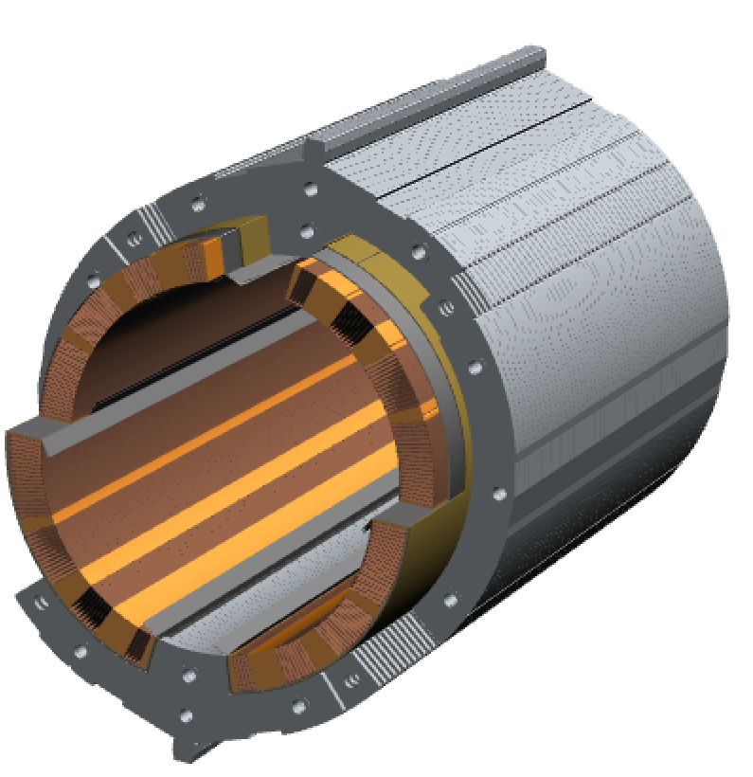
200 mm mechanical short model
Validation of mechanical structure of D1
Assembly steps and tests
1. Pre-assembly: coil, (QPH), electrical insulations, brass shoe
2. Collaring
3. Yoking
4. Shell welding
5. Cooling test
Items to be checked
Variation of coil pre-stress through the processes
Tooling and jigs: collaring mandrel, collaring press, ···
Structure of electrical insulations
4-way split collar concept
Yoking process
  Alignment of collared coil with respect to yoke
  Cantilever mechanism and lock by keys
Process of shell welding
4 way sprit collar

Slide 14
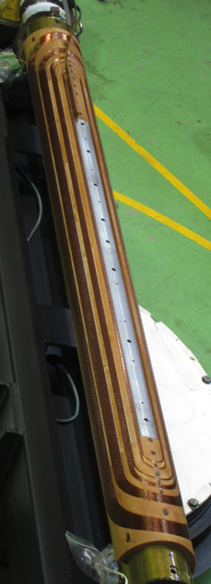
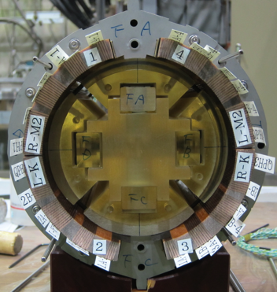
2 m test coil
2 m test coil fabricated in 2014
  Almost the same 2D cross-section as MBXFS01
  Radiation resistant GFRP wedges
Homogeneous coil size in the straight section was confirmed by coil size measurement.
200 mm long cutouts from the straight section were used for the mechanical model.

Slide 15
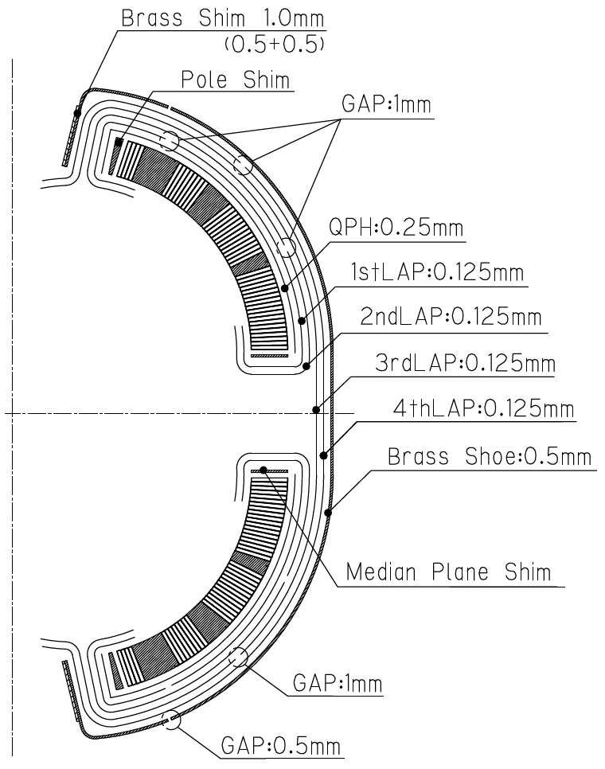
Ground insulations and brass shoes
QPH: 0.25 mm thick
Replaced by polyimide sheets with the same thickness
Ground insulations
  4 layers of 0.125 mm thick polyimide sheet
  Gap in between the insulations to accommodate large coil shrinkage
  Gap position was modified in MBXFS01 to simplify assembly work.
Brass shim and shoe
  1 mm thick brass shim at pole
  0.5 mm thick brass shoe

Slide 16
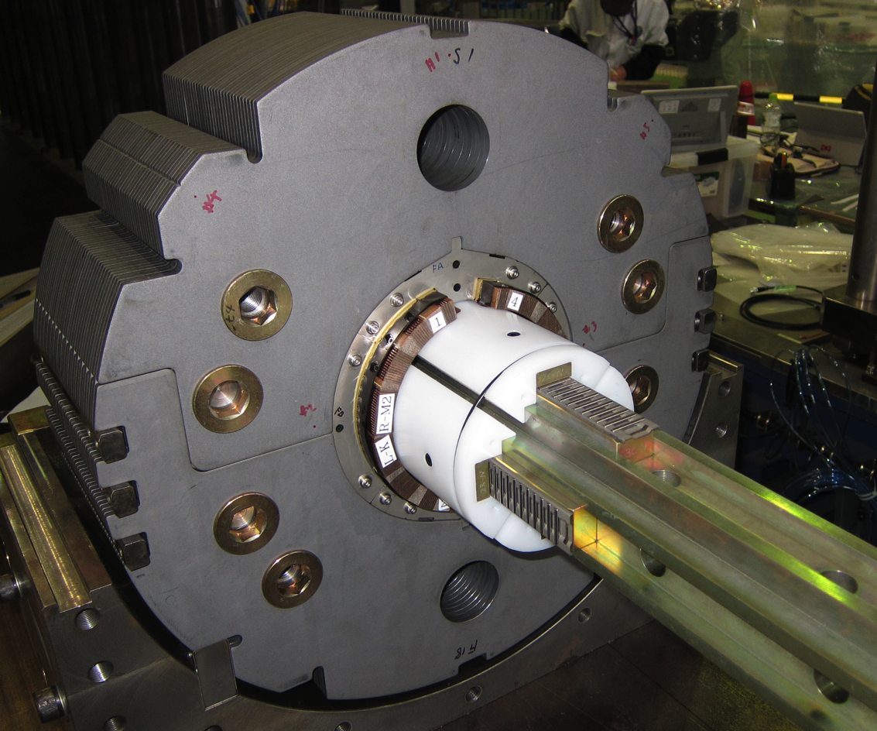
Collaring mandrel
Polyethylene
pushing bar
Flat roller
O-ring
Central core
Pushing bars can move in the radial direction by spring mechanism and support the coil inner radius.
The central core can be pulled out smoothly thanks to the flat rollers after yoking and the pushing bars can be removed.
Support and help by Glyn Kirby (CERN)

Slide 17
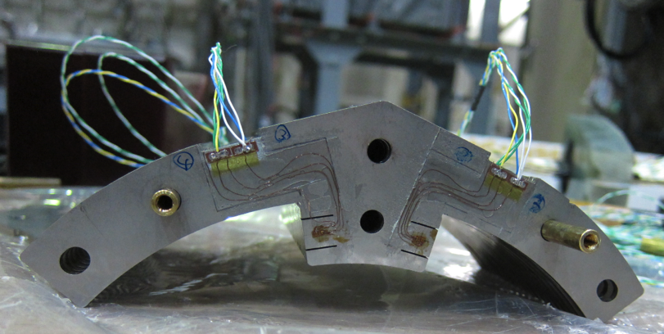
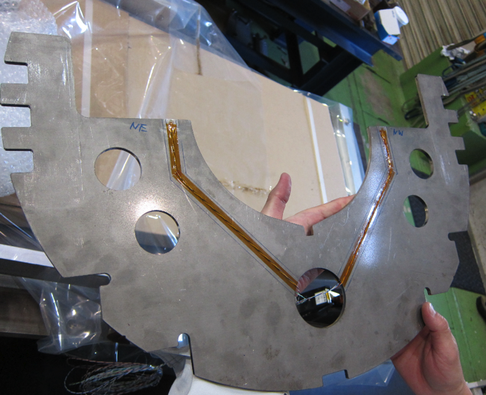
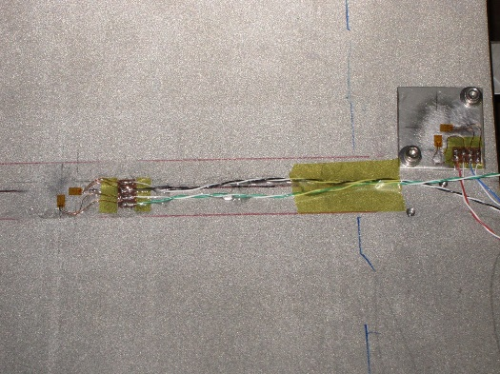
Strain gauges
Collar
  To monitor pole stress
  Strain gauges were calibrated at RT and 77 K.
  Measurement of apparent strain between RT and 77 K
Yoke
  To check contact between upper and lower yoke
  Measurement of apparent strain between RT and 77 K
Shell
  To monitor shell strain during shell welding and cooling
Collar
Yoke
Shell
17

Slide 18
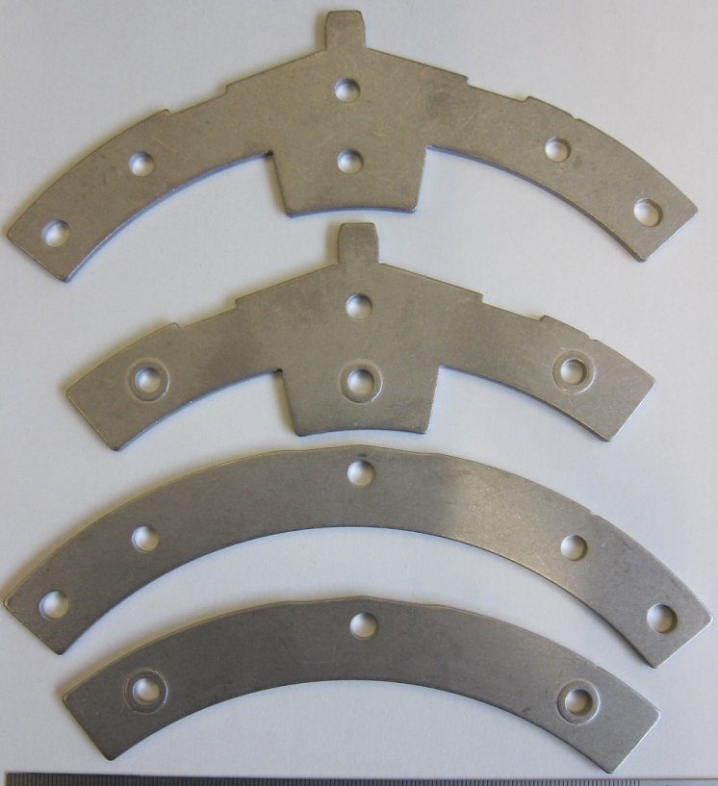
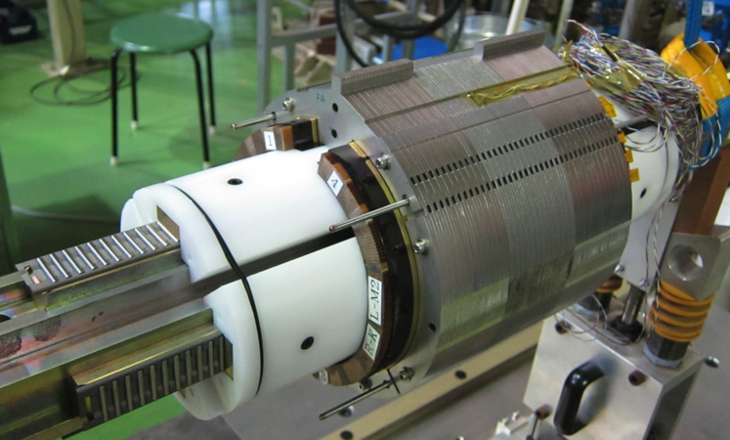
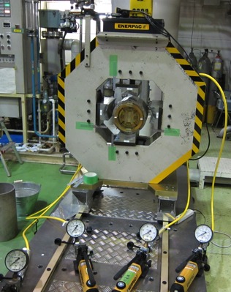
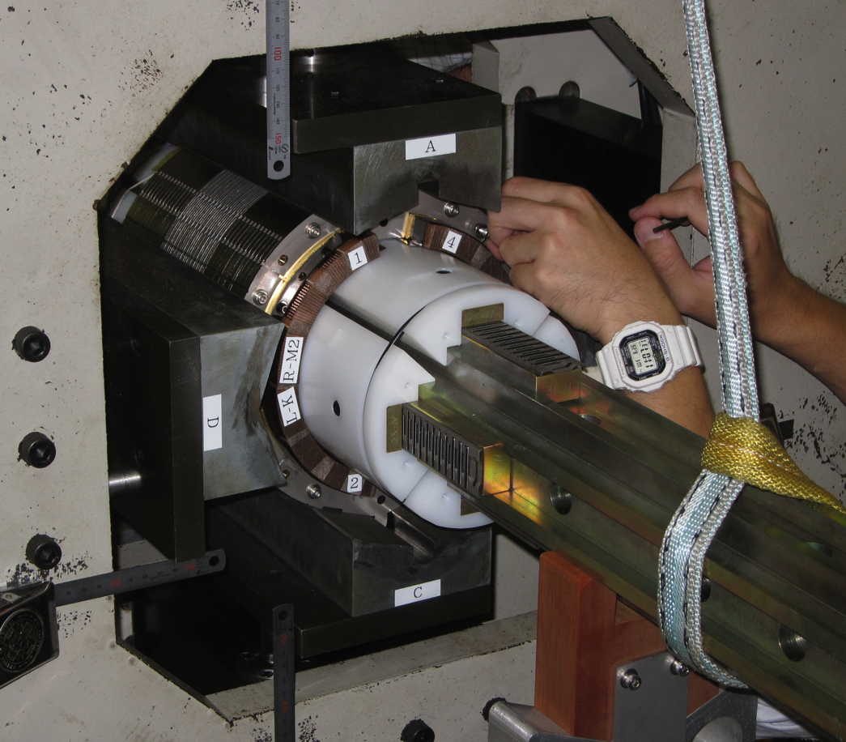
Collaring
F-vertical
Fabricated by fine-blacking
Alternate stack of S- and F- collar
0.2 mm-high emboss and rectangular groove for better cooling
Preliminary assembly
S-vertical
F-horizotal
S-horizotal
Collaring press
(Almost no coil stress)
Insertion of lock pins to link the sub-stacks

Slide 19
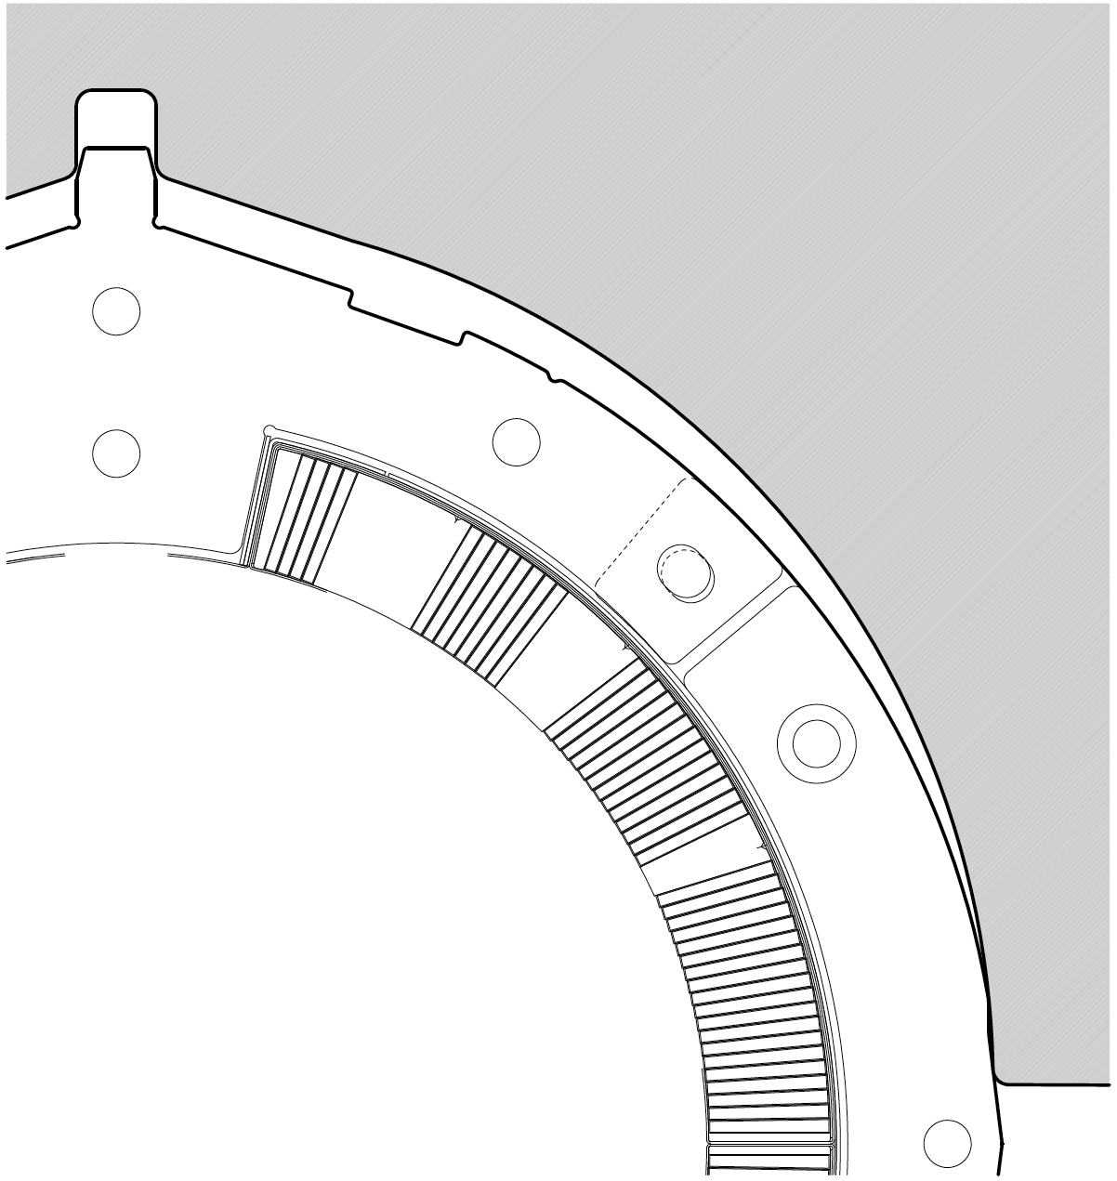
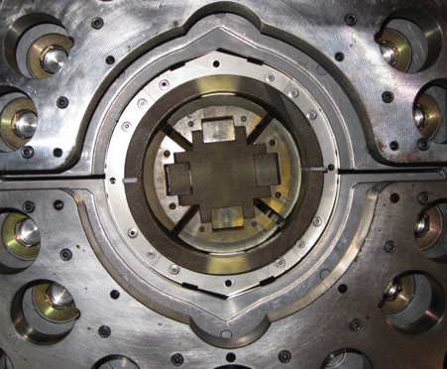
Concept of alignment of collared coil in yoking
Modified collar and yoke design
Preliminary yoking test
Collared coil was rotated wrt yoke
Iron yoke
Yoke
Collar
Rectangular
notch
Triangular notch
Side taper to prevent side collars from rotation
Rectangular notch to block rotation of vertical collars
Triangle notch for final alignment
Side taper
The concept of coil alignment was verified in a yoking trial.
Such a rectangular notch leads to additional b3 of 5 units.

Slide 20
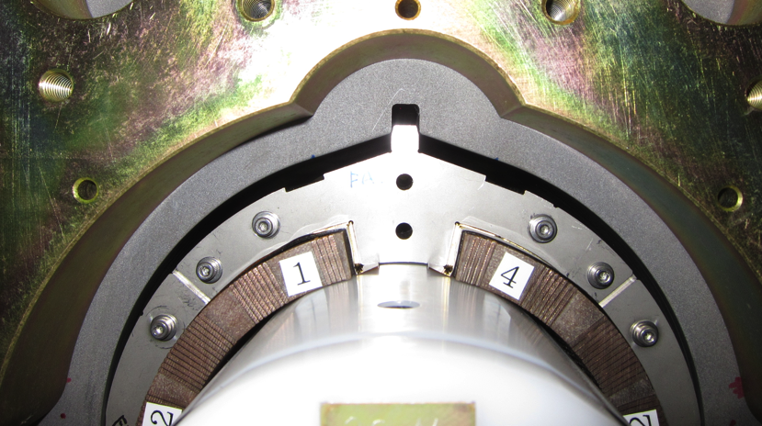
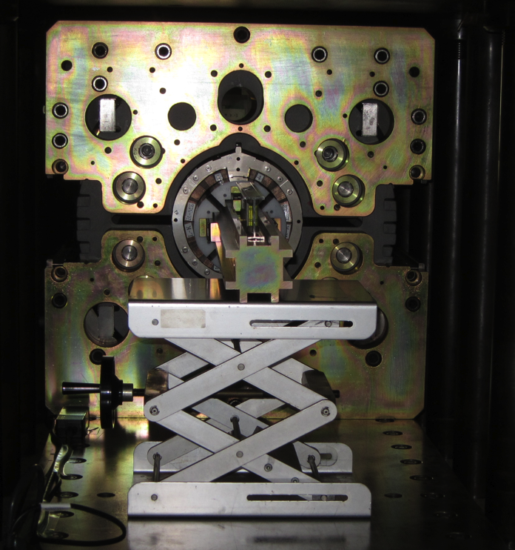
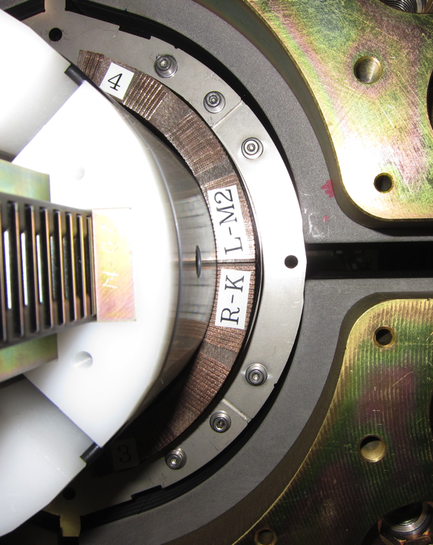
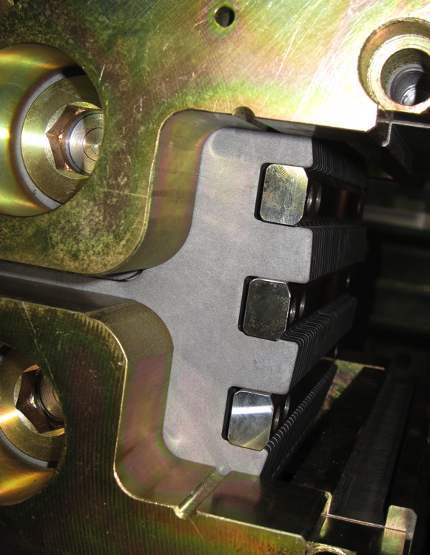
Yoking
Before yoke pressing
Loading to
yoke shoulder
Key insertion
Three keys in each side
could be inserted at
hydraulic pressure of
44 MPa (4.2 MN/m/side).
Side tapers and rectangular
notches functioned as expected.

Slide 21
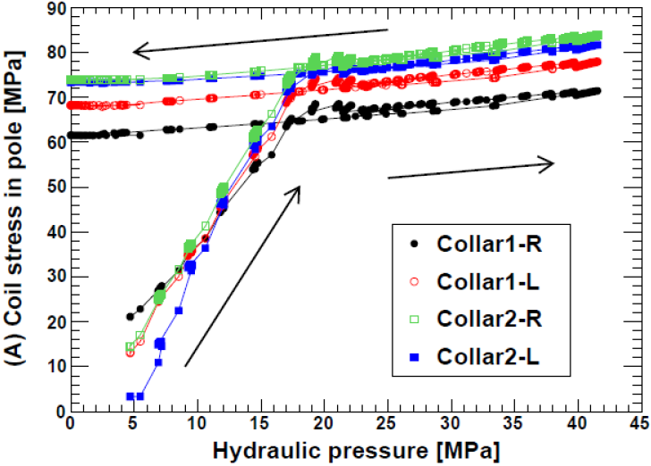
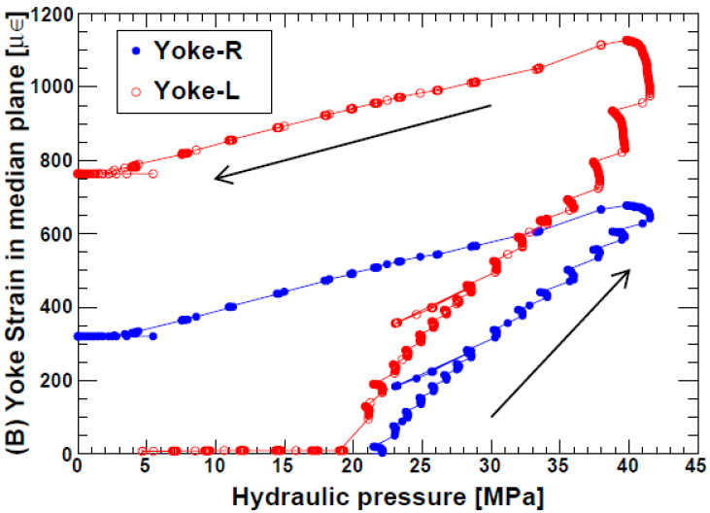

Pole stress during yoking
Collar (Pole stress)
Yoke
B
C
B
C
A
C1-L
C1-R
A
C2-L
C2-R
A: Contact of upper/ lower yoke
B: Key insertion
C: Completion of yoking
Yoke gauges
Coil pole stress after yoking: 69±5 MPa
Partial relief of coil pole stress was observed due to creep only by a few MPa over 60 hrs.

Slide 22
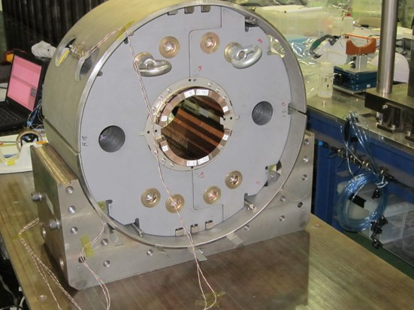
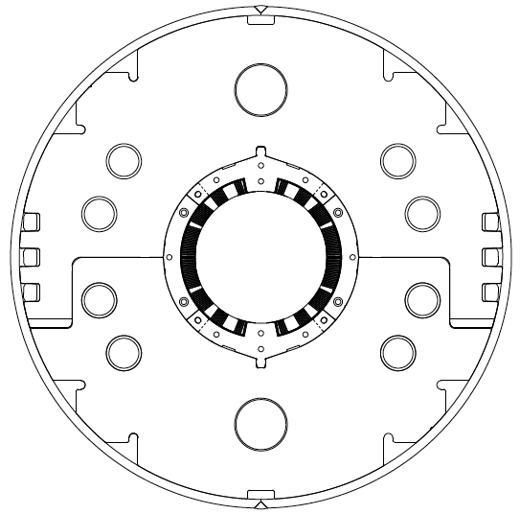
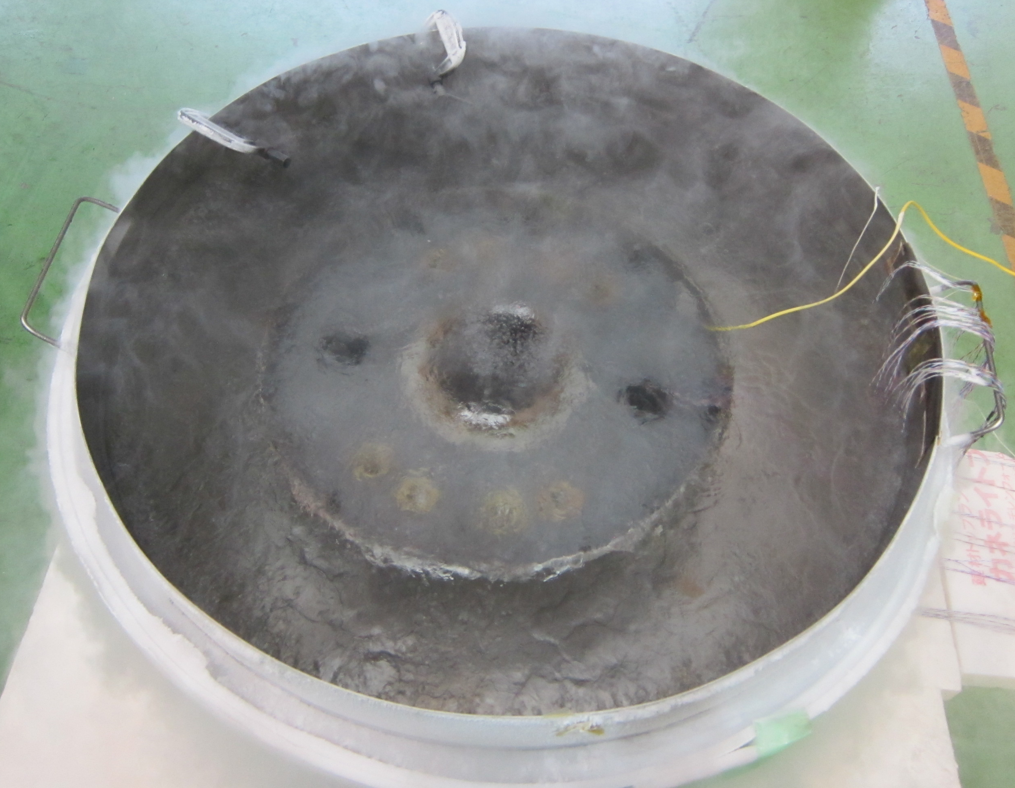
Shell welding and cooling test
Shell welding
Tensile strain
Two halves of stainless steel shells (SUS304L) were welded manually.
Tensile strain in the azimuthal direction started to develop when the gap between upper and lower halves was close.
No remarkable change of coil pole stress was observed by shell welding.
Strain gauges
Gap
Welded
Direction of thermal stress by cooling
Cooling test (77 K)

Slide 23
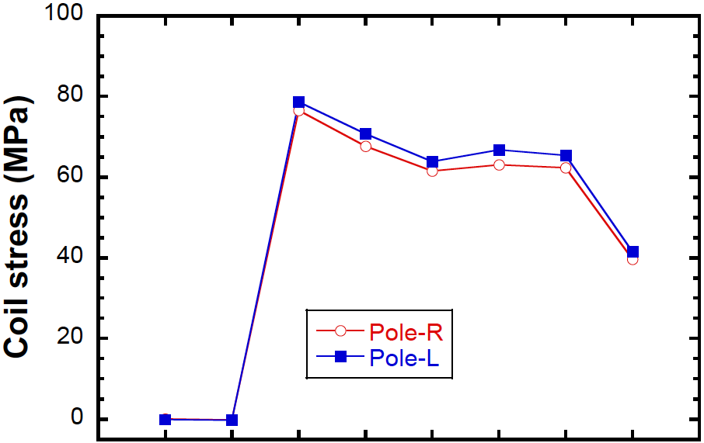
Variation of coil pole stress
Measured coil pole stress
Target pre-stress of 80 MPa at RT
ANSYS calculation
Pre-stress
after yoking
23 MPa
13 MPa
Collaring
Key
insertion
Shell
welding
Cooling
at 77 K
Applied load to
yoke shoulder
Before
shell welding
Before
cooling
Pre-stress after yoking of 69±5 MPa is lower than the target value of 80 MPa.
Stress release after cooling-down: 23 MPa in measurement
13 MPa in calculation

Slide 24
Mechanical structure at coil end

Slide 25
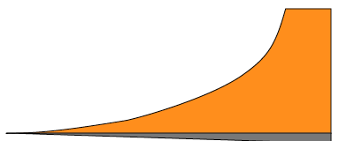
Pre-stress at coil end
Δt =
0.24 mm
Linear taper
50 MPa
GFRP end saddle was made thicker at the end so that the pre-stress can be applied during yoking.
Target value: 50 MPa

Slide 26
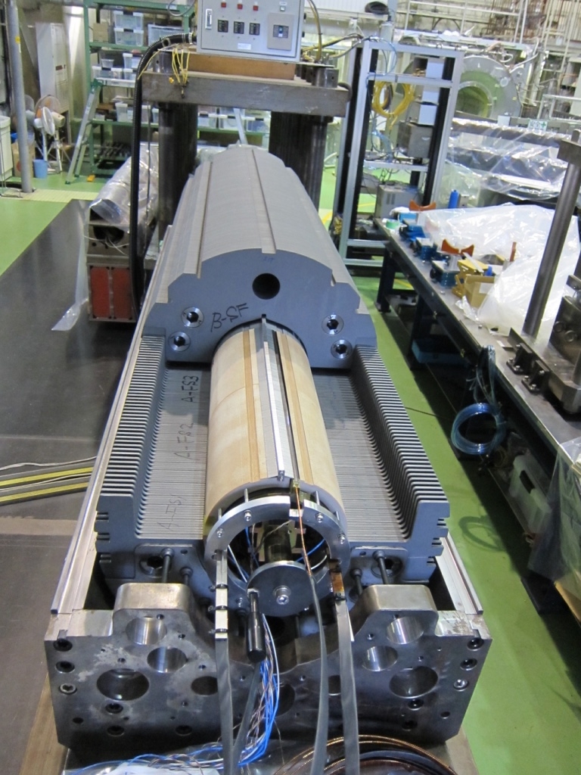
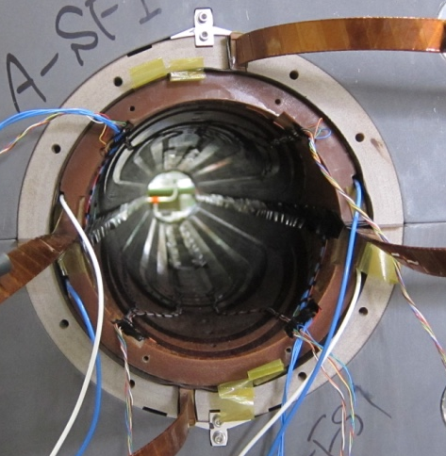
GFRP collar at lead end
Four-split GFRP collar
GFRP collar
Ramp box
Radiation resistant GFRP collars cover the lead end.
Circumference of the GFRP collars was oversized to clamp the ramp boxes with pre-stress of 40 MPa
→ Pre-stress was checked in the yoking process.

Slide 27
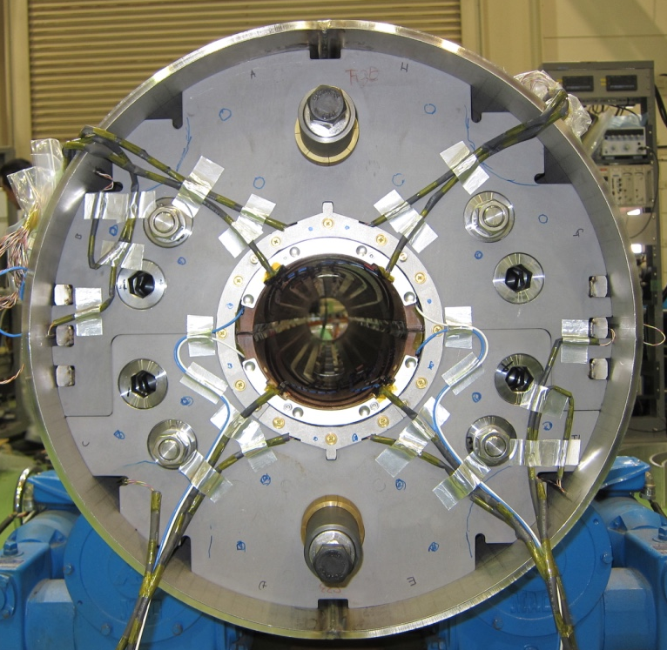
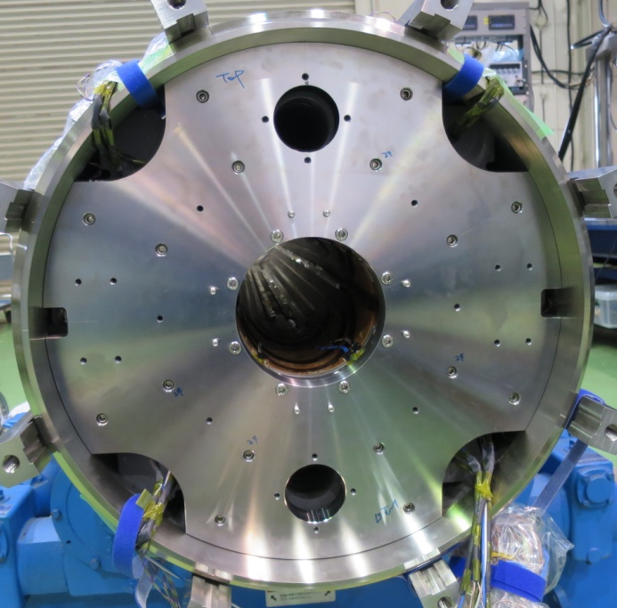
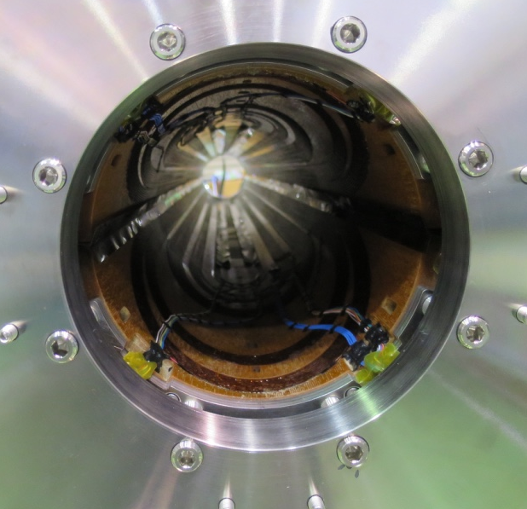
Longitudinal support
Red: Bullets for coils
Blue: Bullets for yoke
The coils and yokes were longitudinally supported from the end plates with bullets.
Preload applied to the coil was determined to be 5.2 tonf /coil (pressure of 12.3 MPa at coil end) from experience of MQXA.
In MBXFS01, strain of bullets was not monitored.

Slide 28
Summary
Based on ANSYS calculation, the target value of coil pre-stress at pole was determined to be 80 MPa.
The 200 mm mechanical short model was assembled and validity of assembly process could be confirmed.
Coil pre-stress at pole after yoking was 10 MPa lower than the target value. Stress release after cooling-down of 23 MPa was 10 MPa larger than the calculation.

