Slide 1
Quench performance
Michinaka Sugano
D1 magnet review, KEK, 30 June - 1 July 2016

Slide 2
Outline
Training plot
Quench location
Variation of pre-stress during excitation
Additional pre-stress to improve quench performance
Possible cause of quench at coil end

Slide 3
Cold test of the 1st 2m model of D1
1st test cycle
April 20 ~ 23: Cooling-down to 4.2 K
April 23: Interlock check
April 24 Current leak check (1 ~ 7 kA)
April 25 ~ 26: Training quench at 4.45 K
April 26 ~ 27: Cooling-down to 1.9 K
April 28 ~ 30: Training quench and MFM at 1.9 K
April 30~ : Warming-up
1st test cycle was suspended due to unstable behavior of the PS.
2nd test cycle
May 15 ~ 18: Cooling-down to 1.9 K
May 19 ~ 20: Training quench
May 24 ~ 26: MFM at 1.9 K
May 27: Spot heater quench at 1.9 K
May 30 : Training quench at 4.45 K
June 1 ~ 2: QPH test and MFM at 1.9 K
June 3: Spot heater quench, QPH test, Training quench
June 3 ~ : Warming-up

Slide 4
Training quench tests
Temperature: 4.45 K and 1.9 K
Energy extraction with a dump resistor of 73 mΩ
Threshold voltage: 0.1 V
Detection time: typically 10 msec
Ramp rate: 10 A/sec (5 A/sec only for the last five quenches )
Voltage taps
→ Quench start location and propagation
Quench antenna
◊ Longitudinal and azimuthal position of quench start
Strain gauge
→ Stress of coils (at collar pole), yoke and shell

Slide 5
Training plot
First quench at 4.45 K at 68% of SSL
Good training memory between the 1st and 2nd test cycles
Iq reached the nominal current of 12 kA at 1.9 K after 15 quenches.
Iq started to decrease after reaching Iq,max=12.6 kA. Quench tests at 4.45 K suggest no cable damage (Iq > 90% of I_{SSL} at 4.45 K).
Iq recovered to 12 kA at the last two quenches.
Iq did not reach the ultimate current of 13 kA.

Slide 6
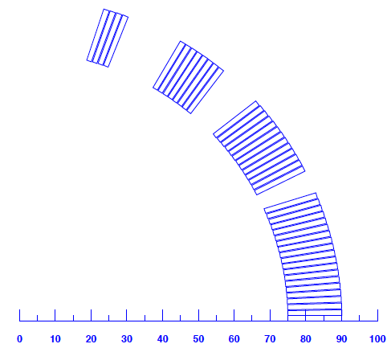
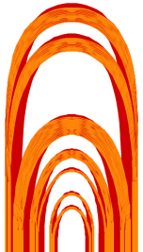
Quench start location
1.9 K
CB4
CB3
4.45 K
CB2
CB1
4.45 K
CB1
CB2
CB3
CB4
Number of quenches starting at each location
 | CB1 | CB2 | CB3 | CB4 | Splice
Top | 0 | 8 | 4 | 0 | 1
Bottom | 3 | 14 | 3 | 1 | 0
Both | 0 | 2 | 0 | 0 | 0

Slide 7
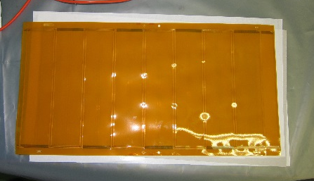
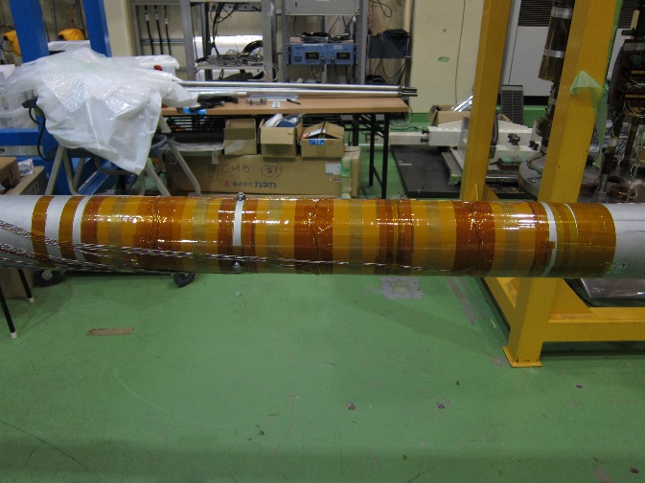
Quench antennas
Top coil
180
6S
6N
8N
8S
363
Quench antenna
for octupole
QAs wound around
the bore tube
Bottom coil
Azimuthal arrangement of QAs
wrt the coils
LE
RE
QA1
QA2
QA3
QA4
QA5
QA6
Longitudinal arrangement
One set of QAs: Normal and skew sextupole, octupole
Three sets of QAs cover each coil end.

Slide 8
Quench start location in CB2
No | Iq (kA) | Quench start coil | LE side | RE side
6 | 10.373 | Bottom | ◯
11 | 11.539 | Top |  | ◯
13 | 11.253 | Bottom |  | ◯
16 | 11.770 | Bottom(CB2, 3) | ◯
19 | 12.602 | Top (CB2, 3) |  | ◯
20 | 12.497 | Top |  | ◯
22 | 12.054 | Bottom | ◯
24 | 12.303 | Top | ◯
25 | 11.958 | Bottom | ◯
26 | 11.631 | Bottom | ◯
27 | 10.480 | Bottom | ◯
28 | (10.471) | Bottom (CB2, 3) | ◯
29 | (10.624) | Top | ◯
Detailed quench start location has not been able to be identified yet. The cases in which either LE or RE side could be clearly determined are only listed.
LE side
RE side
QA1
QA2
QA3
QA4
QA5
QA6
No. 28, 29 (4.45 K)
CB2
CB2
Top coil: Both sides
Bottom coil: Most quench in LE side

Slide 9
Quench at CB2 (Typical case)
CB4
CB3
CB2
CB1
CB1
CB2
CB3
CB4
In most of quenches, large voltage spike was first observed and then normal transition occurred.
→Quenches would be caused by wire motion.

Slide 10
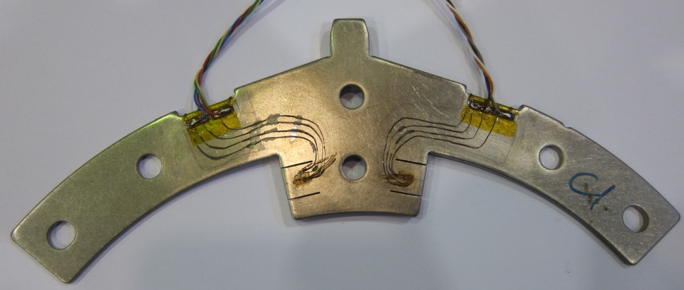
Position of collar plates with strain gauges
LE
L
M
R
RE
Collar
Collar
Collar
View from LE
CG-T-Lb
CG-T-Mb
CG-T-Rb
CG-T-La
CG-T-Ma
CG-T-Ra
CG-B-La
CG-B-Lb
CG-B-Ma
CG-B-Mb
CG-B-Ra
CG-B-Rb

Slide 11
Stress variation at collar pole during excitation
After cooling-down, absolute values of the strain gauges became unreliable. Only stress variation during excitation (Δσ) is discussed.
In the Δσ – I² curves, flattening of Δσ is clearly observed at around I = 8.5 kA.
Compressive pre-stress of the coils are completely released.

Slide 12
Correlation btw maximum Δσ and pre-stress
12
4
11
3
Stress variation, Δσ (MPa)
Maximum Δσ
Maximum Δσ(MPa)
10
5
6
2
8
1
7
Compressive pre-stress after yoking
64.6±9.6 MPa
Positive correlation
between max. Δσ and pre-stress
Compressive collar pole stress (MPa)
1 2 3 4 5 6 7 8
9
10
11
12
Pre-stress of the coils after yoking
are insufficient.
L
M
R

Slide 13
How much pre-stress should we add ?
35 MPa
Δσ (I=13 kA)
= 63 MPa
Max Δσ at present
= 26 MPa
I=13 kA
As rough estimation, pre-stress should be increased by 35 MPa.

Slide 14
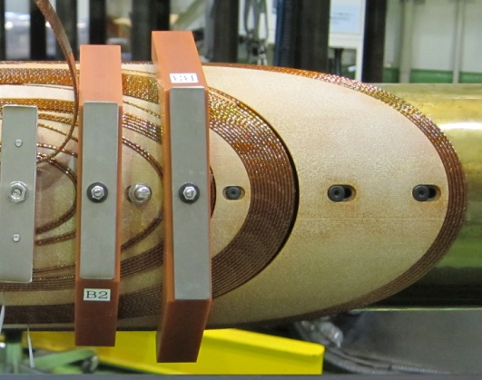
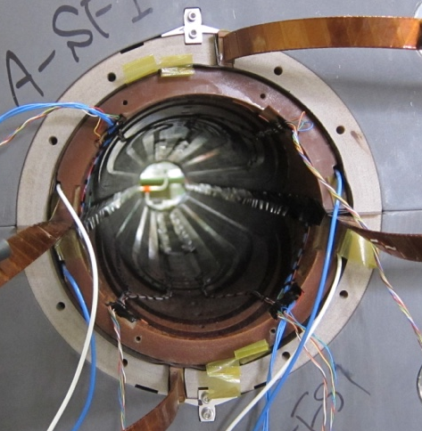
Possible causes of quench at CB2
Gap between cable and end spacers outside CB2 due to angle mismatch
→ Insufficient mechanical support ?
Radial thickness of GFRP collars was 0.1 mm thinner than the original design.
→ Lower pre-stress of coils at LE ?
LE6
C
B
2
Gap

Slide 15
Summary
The nominal current of 12 kA was achieved after 15 quenches.
Iq did not reach the ultimate current of 13 kA.
Good quench memory was confirmed between the 1st and 2nd test cycles.
Pre-stress of the coils at pole was completely released at around 8.5 kA. Increase of pre-stress would be essential to improve quench performance.
Quench started most frequently in CB2. One of the possible reasons would be insufficient cable support at coil end.

Slide 16
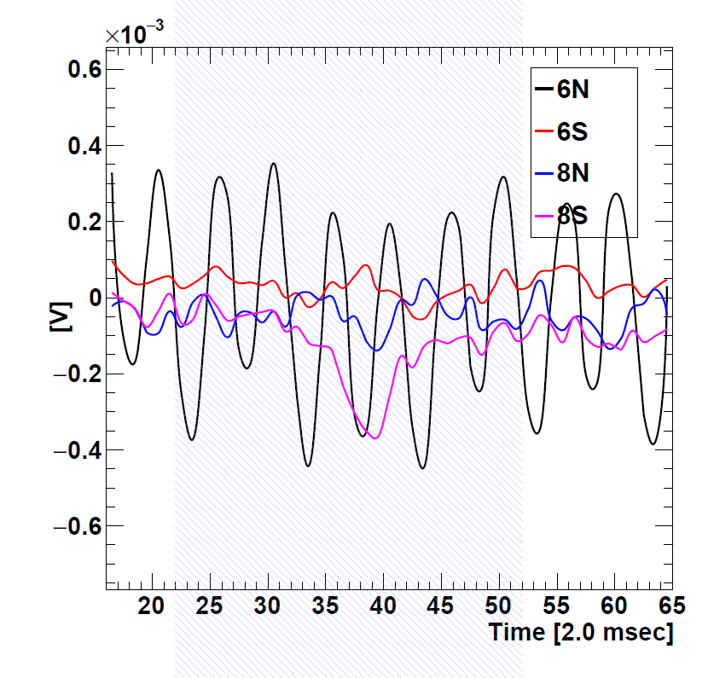
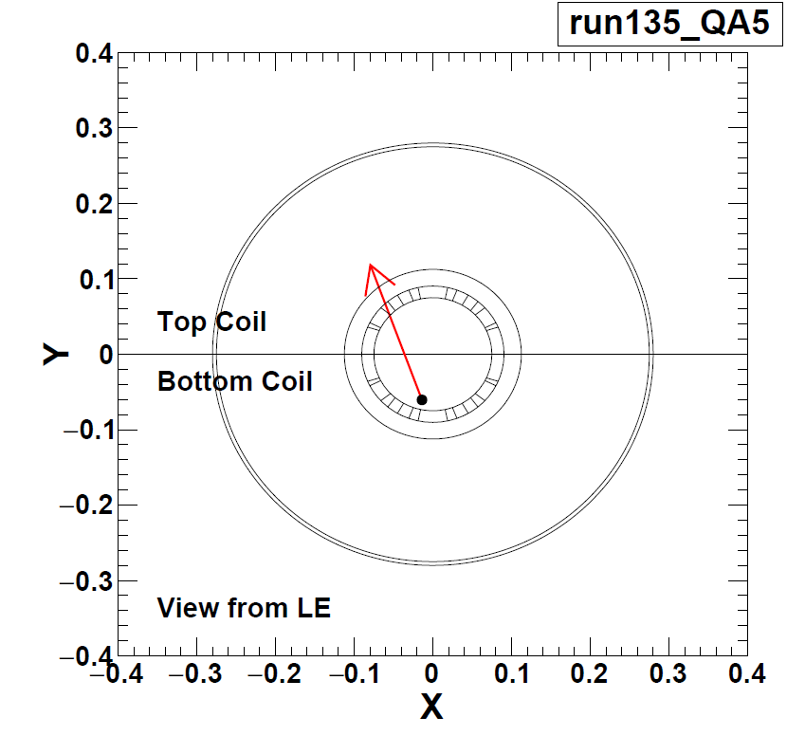
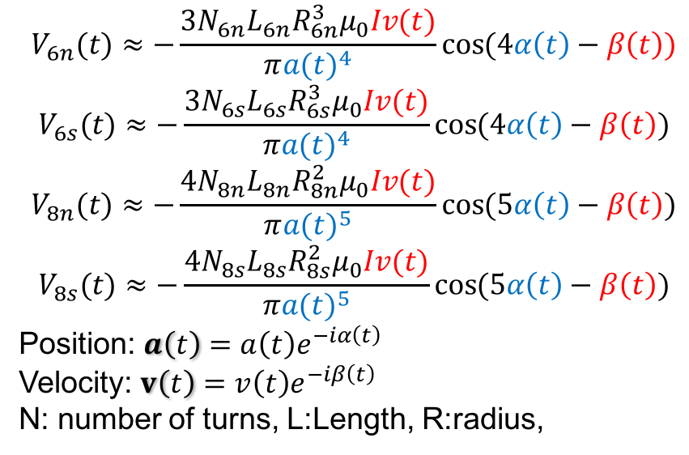
Analysis of signals from quench antennas
$$V_{6n}(t)≈−\frac{3N_{6n}L_{6n}R_{6n}^{3}μ_{0}Iv(t)}{π{a(t)}^{4}}\cos{(4α\left(t\right)−β\left(t\right))}$$
$$V_{6s}(t)≈−\frac{3N_{6s}L_{6s}R_{6s}^{3}μ_{0}Iv(t)}{π{a(t)}^{4}}\cos{(4α\left(t\right)−β\left(t\right))}$$
$$V_{8n}(t)≈−\frac{4N_{8n}L_{8n}R_{8n}^{2}μ_{0}Iv(t)}{π{a(t)}^{5}}\cos{(5α\left(t\right)−β\left(t\right))}$$
$$V_{8s}(t)≈−\frac{4N_{8s}L_{8s}R_{8s}^{2}μ_{0}Iv(t)}{π{a(t)}^{5}}\cos{(5α\left(t\right)−β\left(t\right))}$$
Position: $a\left(t\right)=a\left(t\right)e^{−iα\left(t\right)}$
Velocity: $v\left(t\right)=v\left(t\right)e^{−iβ\left(t\right)}$
N: number of turns, L:Length, R:radius,
Spot heater test (HF, 4 kA)
Quench start location identified
by quench antenna is close to
the heater position.

Slide 17
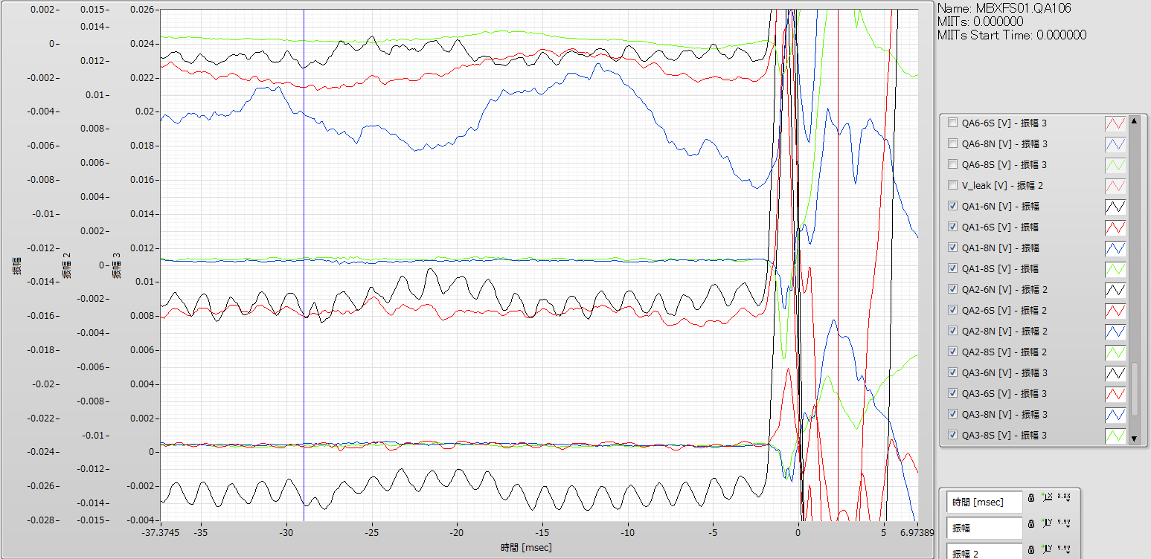
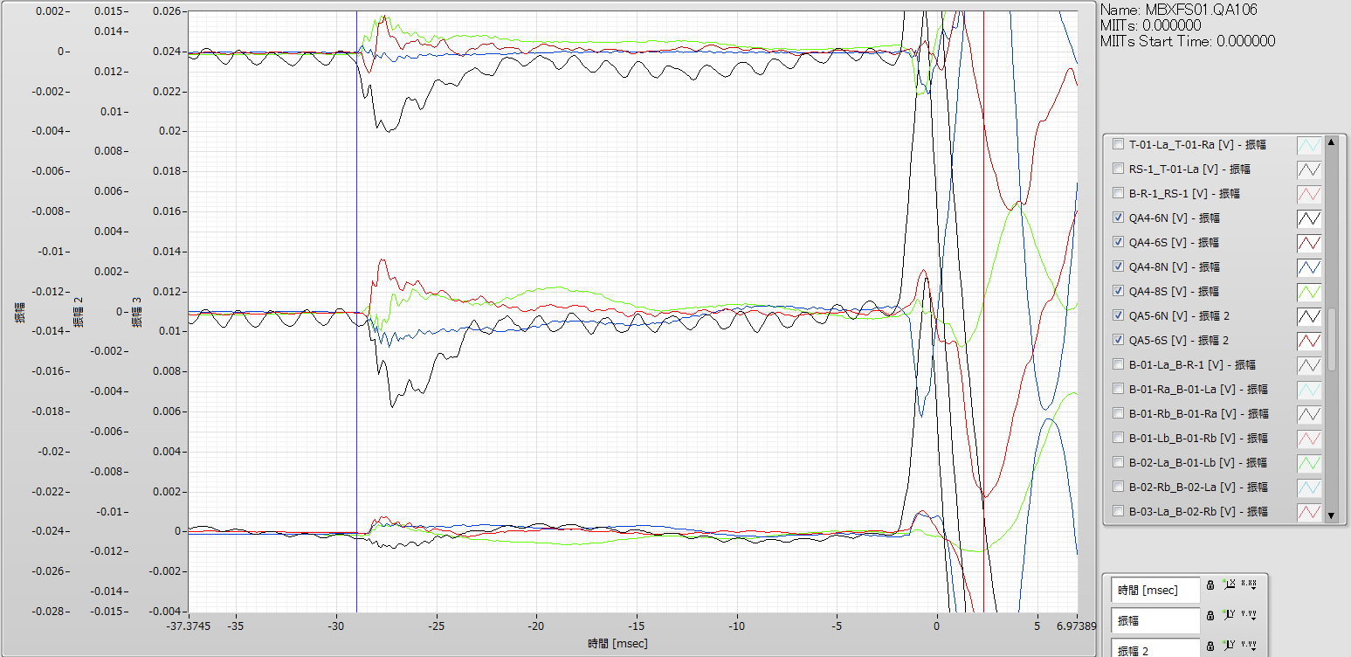
QA run106
QA1
QA2
QA3
6N
6S
8N
8S
QA4
QA5
Quench started in the region covered by QA5 (identified by voltage taps), but all QA4-6 detected the signals simultaneously.
QA6

Slide 18
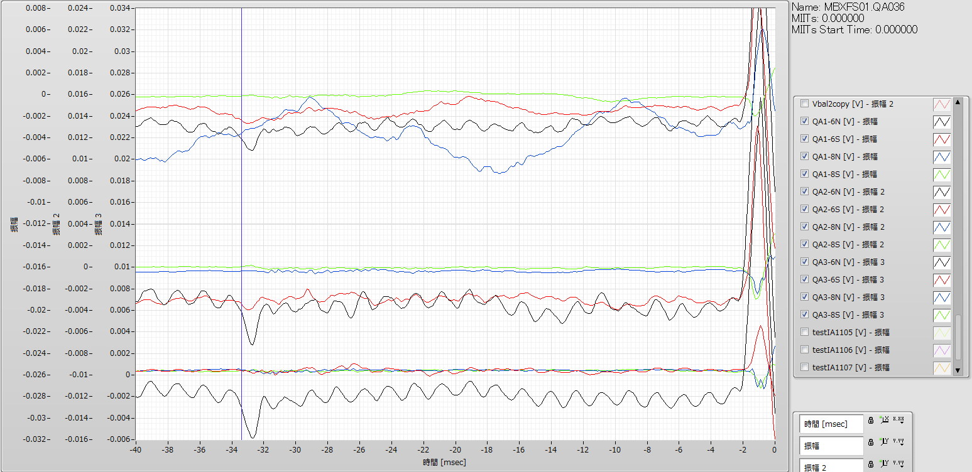
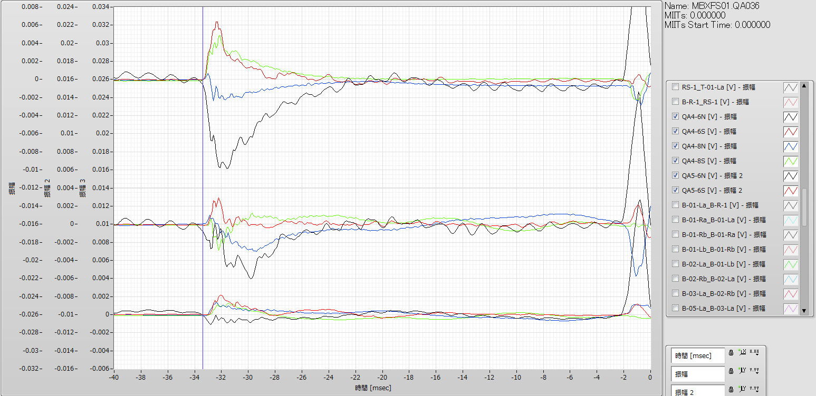
QA1
6N
6S
8N
8S
QA run 36
QA2
QA3
QA4
QA5
Quench started in CB2 (identified by voltage taps) and quench antenna signals appeared in all QA1-6.
QA6

