Slide 1
Heater quench study
Michinaka Sugano
D1 magnet review, KEK, 30 June – 1 July 2016

Slide 2
Outline
Spot heater test
  Current dependence of detection time
  Quench propagation speed
QPH test
  Current and power (energy) density dependence of delay time
  Comparison between four QPHs
All tests were carried out under energy extraction with 73 mΩ dump resistor. Current decay was not included in the test items.

Slide 3
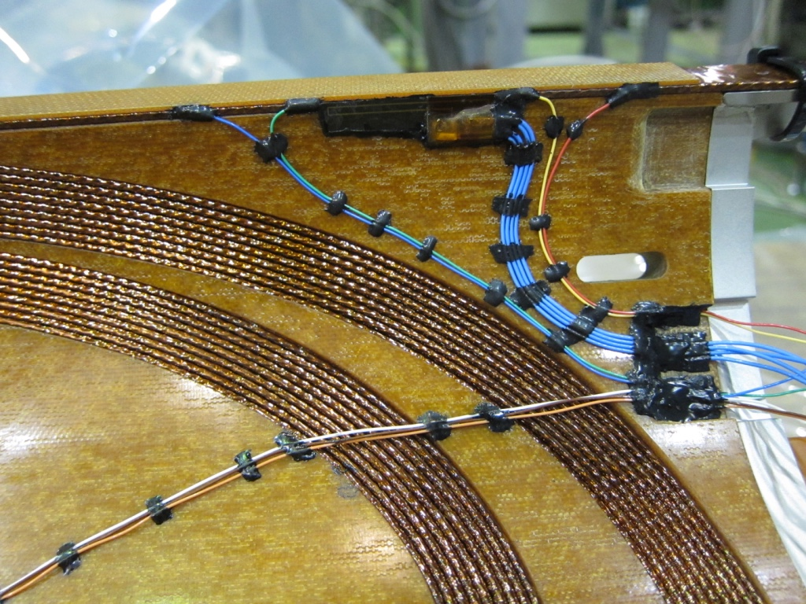
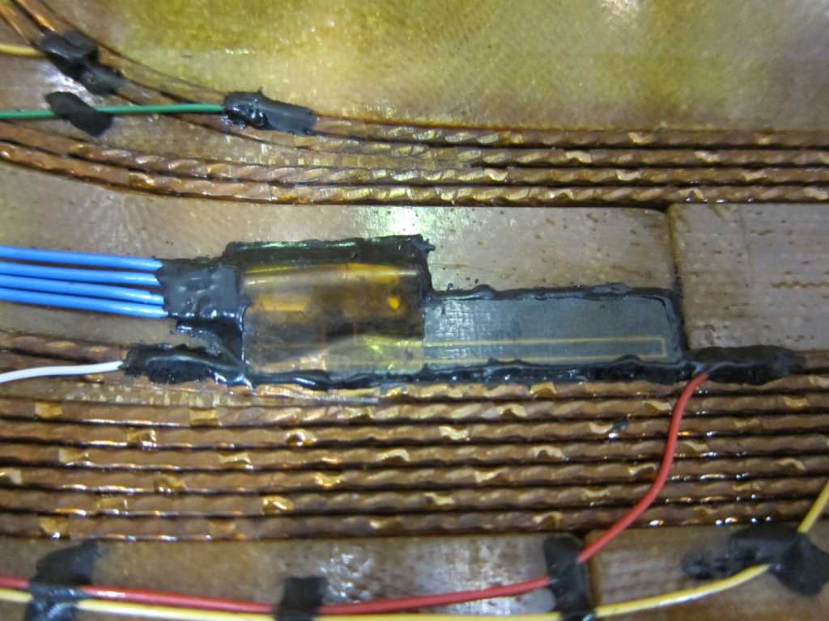
Spot heater test
Two spot heaters for each coil (high field, low field regions)
At each magnet current, amplitude and duration of pulsed current to a SPH were adjusted until quench occurred.
Maximum current to the magnet was limited to 9.5 kA.
Detection time was evaluated from balanced voltage rise.
Quench propagation speed was estimated from voltage signals using voltage taps .
Lead end
Return end
Spot heater at low field region
Spot heater at high field region

Slide 4
Evaluation of detection time
Validation time
Time to
ΔV_{bal}=0.1 V
Heater
Current
Balanced
voltage
Detection time
V_{bal}=0.1 V
Heater
voltage
Spot heater (20 V, 40W)
Current: 2 - 9.5 kA
Voltage threshold: 0.1 V
Validation time: 10 msec
Detection time =
Time to ΔV_{bal}=0.1 V + Validation time

Slide 5
Current dependence of balanced voltage rise
High field
Low field
V_{bal}=0.1V
V_{bal}=0.1V
Faster voltage rise at higher current and field
Change of slope due to transversal propagation

Slide 6
Current dependence of detection time
Longer measured detection time than calculation under adiabatic condition is reasonable.
Data of I² integral over detection time can be obtained, which will be used to discuss quench protection.

Slide 7
Quench propagation velocity
SPH3
High field
Low field
SPH1

Slide 8
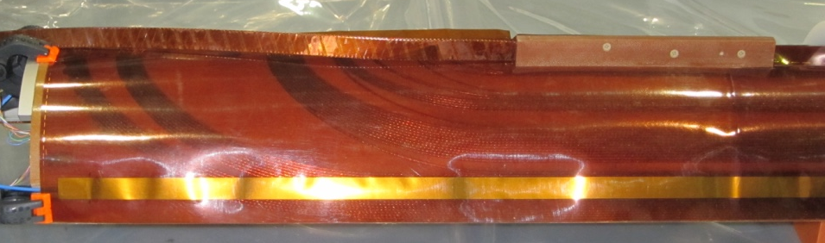
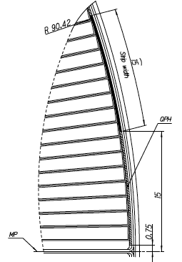
QPH test
Energy deposition test at different charged energy of a PS
PSs from CERN with C=7.05 mF and maximum charged voltage of 800 V were utilized to fire QPHs.
Only one QPH was connected with a 3 Ω dummy resistor in series for each test to evaluate delay time.
Maximum current to the magnet was limited to 9.5 kA.
A SUS strip in a QPH with t25 μm x w15 mm x l2 m without Cu ilands covers 9 turns in CB1 (low field)
Heater
strip

Slide 9
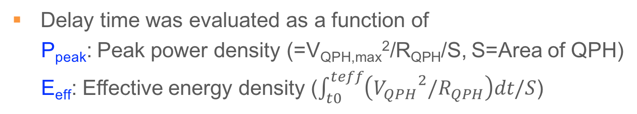
Evaluation of delay time
t₀
t_{eff}
V_{QPH}
Delay time
V
QPH1
3 Ω
dummy
resistor
QPH2
QPH
voltage
QPH3
QPH4
Balanced
voltage
7.05 mF
Current: 688 A (Injection) - 9.5 kA
QPH was fired at 100%, 50%, 25% (37.5%) of stored energy of a PS
Delay time: Time difference between QPH firing and the onset of balanced voltage
Delay time was evaluated as a function of
P_{peak}: Peak power density (=V_{QPH,max}²/R_{QPH}/S, S=Area of QPH)
E_{eff}: Effective energy density ($\int_{t0}^{teff}{\left({V_{QPH}}^{2}/R_{QPH}\right)dt/S}$)

Slide 10
Comparison of QPH1-4
Test at 9.5 kA
Very good agreement of delay time among all QPHs
Subsequent tests were performed for QPH1.
I = 9.5 kA
 | Position of QPH | Ppeak (W/mm²) | Eeff (J/mm²) | Delay time (msec)
QPH1 | Top, ramp side | 0.73 | 0.017 | 31
QPH2 | Top, non-ramp side | 0.71 | 0.016 | 31
QPH3 | Bottom, ramp side | 0.70 | 0.016 | 32
QPH4 | Bottom, non-ramp side | 0.71 | 0.016 | 31
2
1
3
4
View from LE

Slide 11
Power and energy dependence of delay time

Slide 12
Current dependence of delay time
Injection
Nominal
At injection current, quench did not occur at P_{peak}=0.25 W/mm².
Required power density to induce quench above injection current > 0.35 W/mm²

Slide 13
Summary
Spot heater and QPH tests were carried out up to 9.5 kA.
Detection time for quench starting at low and high field regions could be experimentally determined.
Homogeneous performance was confirmed for four QPHs.
From the current dependence of delay time, minimum required power density to induce quench could be evaluated.
In MBXFS02, the design of the QPH will be changed so that heater strips cover high field region as well as low field one.
We need to perform evaluation of current decay as well as the same spot heater and QPH test at higher current .

