Slide 1
Measurement during the assembly and
ELQA
Michinaka Sugano
D1 magnet review, KEK, 30 June – 1 July 2016

Slide 2
Outline
QA test results in the following fabrication steps
  Coil winding
  Curing
  Coil size measurement
  Instrumentation
  QPH, Insulations
  Collaring
  Yoking
  Shell, end ring welding and splice work

Slide 3
Coil winding
Curing
Coil size measurement
Instrumentation
QPH, Insulations
Collaring
Yoking
Shell, end ring welding and splice work

Slide 4
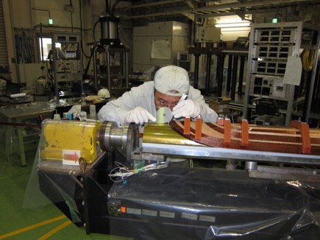
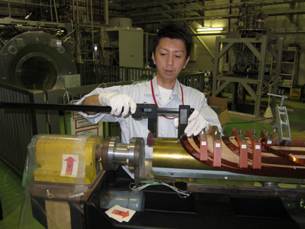
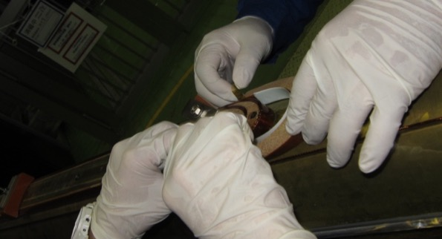

Coil winding
Visual inspection of cable surface
Following items were checked every after winding a half turn.
  Measurement of cable position and angle at the coil ends
  Check of ground fault btw the cable and the winding mandrel with a tester
Check of fitting between the cable and end spacers with Fuji paper
Fuji paper
Meas. of cable angle
with a micro-protractor
Meas. of cable position
with a caliper
Top, LE2
Top, LE6
Check of fitting between
the cable and an end spacer

Slide 5
Coil winding
Curing
Coil size measurement
Instrumentation
QPH, Insulations
Collaring
Yoking
Shell, end ring welding and splice work

Slide 6
Curing
Change of coil length and position of end spacers before and after curing → Shrinkage of total coil length < 1mm
During curing
Check of ground fault with a tester
Measurement of coil resistance
Temperatures at the mandrel and forming block
After curing
Electrical tests
  Measurement of Coil resistance → No change before and after curing
  Inductance measurement→ Same inductance between two coils
  Surge test → Normal waveform up to 3 kV
 | Coil resistance at 20ºC (Ω) |  | Coil inductance at 100 Hz (mH)
 | Before curing | After curing | After curing
Top coil | 0.234 | 0.232 | 2.17
Bottom coil | 0.234 | 0.233 | 2.15
Voltage (V)
Surge test (Top coil)
Time (μsec)

Slide 7
Coil winding
Curing
Coil size measurement
Instrumentation
QPH, Insulations
Collaring
Yoking
Shell, end ring welding and splice work

Slide 8
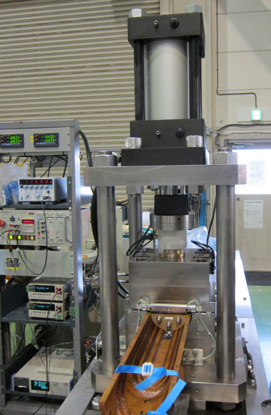
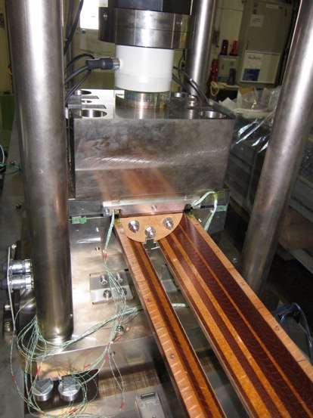
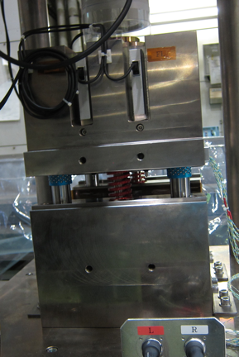
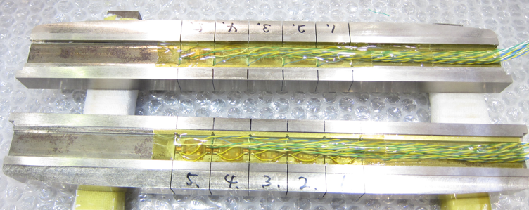
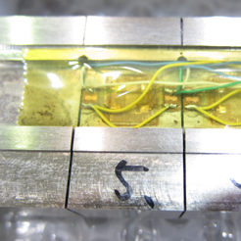
Coil size measurement
Measure the pressure to compress a coil to the final size and compare it with the target value of pre-stress
Load cell
Hydraulic cylinder
50 ton hydraulic press
Two pushing bars with strain gauges
→ Pressure applied to the coil MPs every 20 mm can be measured.
Four linear gauges
→ Coil deformation
5.4 m-long-bench
→ Longitudinal distribution
Upper block
Pushing bars
Dummy
mandrel
Lower block
Pushing bars
L5
L4
L3
L2
L1
R5
R4
R3
R2
R1
20 mm
Linear gauges
Thanks to Glyn Kirby

Slide 9
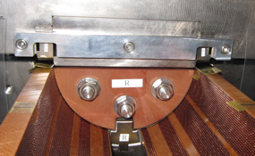
Results on coil size measurement
P_{max} in SS after correction of machine deformation (MPa)
Straight section
 | Ramp side | Non-ramp side
Top coil | 95.2±2.4 | 96.7±2.1
Bottom coil | 96.6±3.1 | 97.2±2.7
Ramp side
Non-ramp
side
Good homogeneity at the straight section
Measured values: 95 – 97 MPa
Average MP stress after yoking by ANSYS: 104 MPa (including 10 MP margin) → Measured value is 7 – 9 MPa lower
P_{max} at coil end: 15 MPa at max (Measured at 6 mm from the coil end)
Improvement of the setup to enable a measurement of the pole stress
is necessary.

Slide 10
Coil winding
Curing
Coil size measurement
Instrumentation
QPH, Insulations
Collaring
Yoking
Shell, end ring welding and splice work

Slide 11
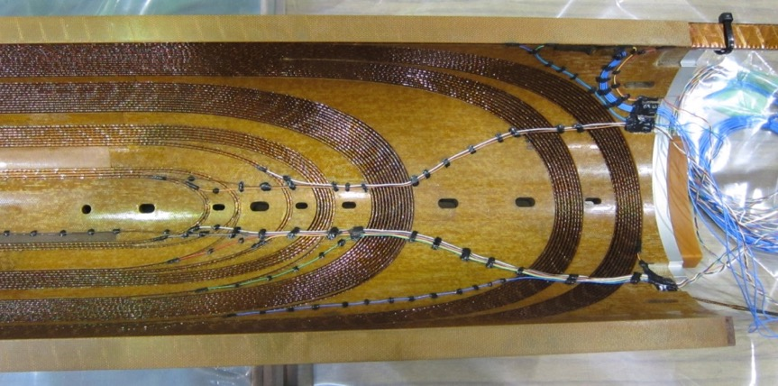
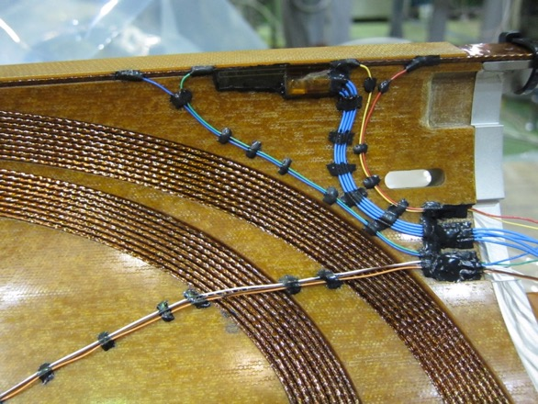
Instrumentation
Soldering the voltage taps
Attachment of spot heaters
After instrumentation work
Coil resistance → No change
Coil inductance → No change
Surge test → Normal waveform up to 3 kV
Check of insulation between a coil and spot heaters with a tester
→ OK
Voltage taps
Spot heater

Slide 12
Coil winding
Curing
Coil size measurement
Instrumentation
QPH, Insulations
Collaring
Yoking
Shell, end ring welding and splice work

Slide 13
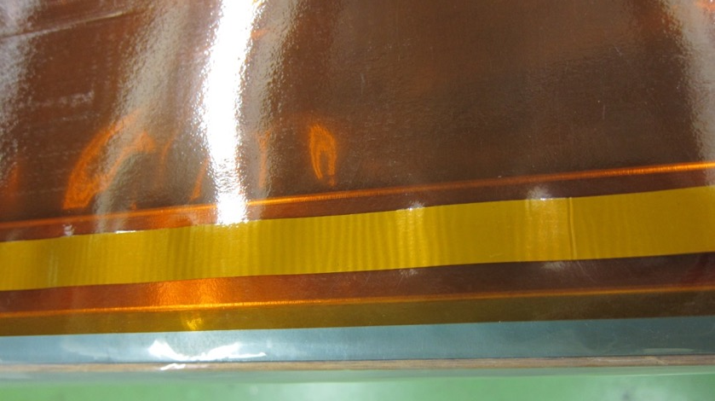
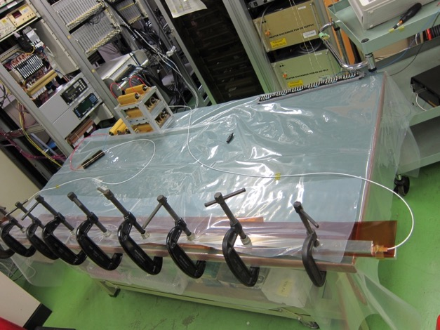
QPH test
Before starting cold mass assembly, energy deposition test was performed for the two of four QPH strips.
A SUS strip was clamped with Al bars to avoid excessive heating-up.
Almost same energy corresponding to full charging voltage of the PS (800 V) was deposited to one heater strip and a 3 Ω dummy resistor.
Reasonable decay constant of QPH voltage expected from C_{PS} = 7.05 mF and the circuit resistance was confirmed.
Wrinkles were observed after test, but we confirmed no change of the strip resistance.→ We decided to use them for the 2m model.
Additional QPH test was carried out after yoking as well.

Slide 14
Coil winding
Curing
Coil size measurement
Instrumentation
QPH, Insulations
Collaring
Yoking
Shell, end ring welding and splice work

Slide 15
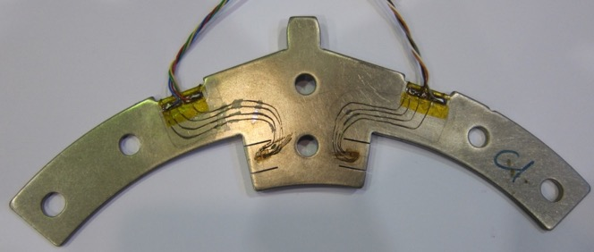
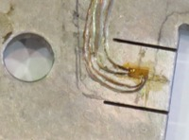
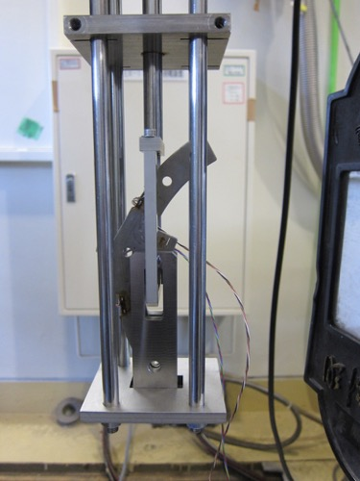
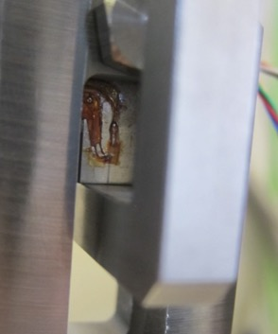
Collar strain gauges
4 strain gauges at each position (full bridge), 3 longitudinal positions in the straight section
Relationship between applied load and strain was calibrated using a tensile testing machine and the dedicated jigs at RT and 77 K.
Apparent strain was also measured between RT and 77 K.
Collar gauge
Calibration jigs
Michinaka Sugano, D1 magnet review, 30 June 2016

Slide 16
Collaring
During collaring (for each collar sub-stack assembly)
Coil resistance → No change
Check of ground fault with a tester
  Coil-to-coil, coil-to-ground, coil-to-spot heater, coil-to-QPH
  → No ground fault
After collaring
Position of each collar sub-stack
Diameter of collared coil
Monitoring of collar pole strain → No additional strain
Coil resistance → No change
Cable resistance between voltage taps → No change
QPH and spot heater resistance → No change
Coil inductance at 100 Hz
→Top (2.67 mH), Bottom (2.67 mH)
Surge test → Normal waveform
Hi-pot test to 5 kV for 1 min for coils, QPHs
→ Insulation resistance > 100 GΩ
Collar
QPH1
QPH2
Top coil
SPH1(LF)
SPH3(HF)
SPH2(LF)
SPH4(HF)
Bottom coil
QPH3
QPH4

Slide 17
Coil winding
Curing
Coil size measurement
Instrumentation
QPH, Insulations
Collaring
Yoking
Shell, end ring welding and splice work

Slide 18
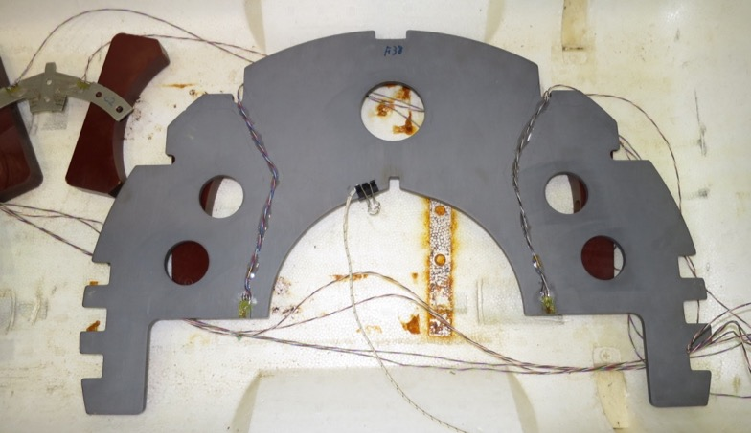
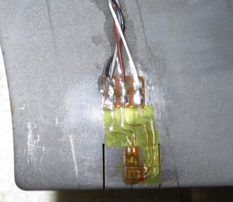
Yoke gauge
Strain gauges were attached at the tip of the tapers at the yoke MP to monitor contact between upper and lower yokes.
Apparent strain was measured between RT and 77 K.

Slide 19
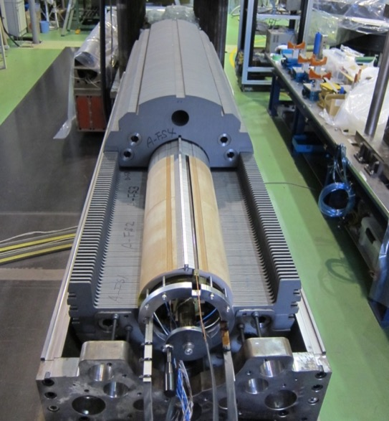
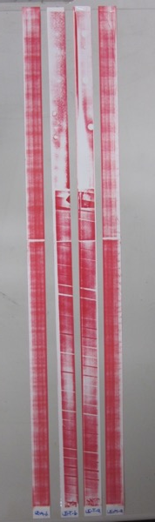
Yoking
Before yoking
All yoke plates were weighted and categorized to 6 groups.
Yoke plates were picked up evenly from each group so that total length of each yoke sub-stack can be homogenized.
Yoking trial
Check of pre-stress to the ramp boxes at the GFRP collars with Fuji paper
→ ~ 30 MPa (Target value: 40 MPa)
Polyimide shims were inserted
instead of Fuji papers.
(Total thickness of 0.4 mm
comparable to Fuji papers)
During yoking
Coil resistance → No change
Check of ground fault with a tester
→ No ground fault
Monitoring of collar pole
and yoke strain
→ Next slide
Ramp box
Fuji paper
MP

Slide 20
Strain and stress measurement during yoking
Collar pole
Yoke
B
C
C
D
D
A
A
B
A
View from LE
A: Before yoking
B: Contact between upper and lower yoke
C: Key insertion
D: After releasing load to yoke shoulder
(After yoking)
CG-T-Rb
CG-T-Ra
YG-B-Ra
YG-B-Rb
CG-B-Ra
CG-B-Rb

Slide 21
Pre-stress after yoking
View from LE
T-b
T-a
B-a
B-b
L: LE side
M: Middle
R: RE side
in the straight section
L
M
R
Measured in three longitudinal positions in SS
Average pre-stress: 64.6±9.6 MPa
Measured pre-stress is lower than the target value of 80 MPa.

Slide 22
After yoking
Outer diameter of yoked magnet → Next slide
Coil resistance → No change
Cable resistance between voltage taps → No change
QPH and spot heater resistance → No change
Coil inductance at 100 Hz
→Top (2.80 mH), Bottom (2.80 mH)
Surge test → Normal waveform
QPH test at a half energy → Similar voltage waveform for all QPHs
Hi-pot test → Insulation resistance > 100 GΩ for coils and QPHs

Slide 23
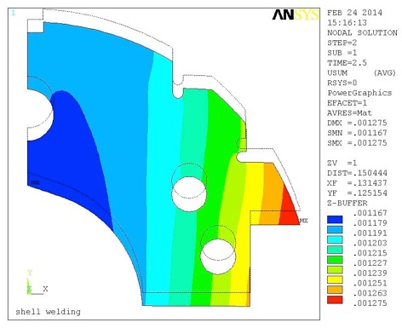
Outer diameter of yoked magnet
OD1
OD2
Long. position from LE | OD1 | OD2 | OD3 | OD4
50 | 550.079 | 550.070 | 549.909 | 549.905
700 | 550.030 | 550.040 | 549.882 | 549.860
1000 | 550.075 | 550.070 | 549.853 | 549.851
1300 | 550.030 | 550.043 | 549.858 | 549.860
1968 | 550.039 | 550.053 | 549.840 | 549.829
Ave. | 550.051 | 550.053 | 549.868 | 549.861
OD3
OD4
Yoke deformation
calc. with ANSYS
Oval deformation of yoked magnet is observed.
OD in the vertical direction is 0.19 mm larger than OD in the horizontal direction, which is comparable to ANSYS calculation.
33μm
A
12μm
55μm
B

Slide 24
Coil winding
Curing
Coil size measurement
Instrumentation
QPH, Insulations
Collaring
Yoking
Shell, end ring welding and splice work

Slide 25
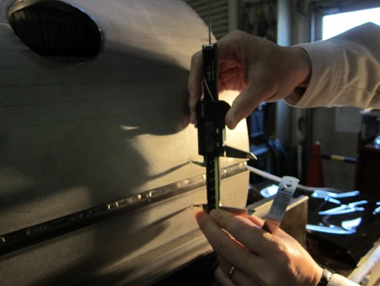
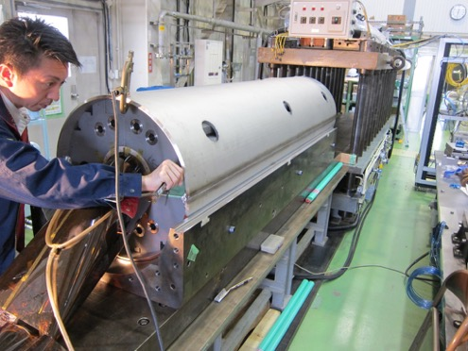
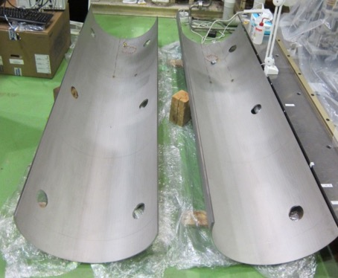
Shell welding
Temperature (Shell surface at strain gauges and a coil end)
  Strain of collar pole, yoke and shell
After each welding pass
Measurement of Shell deformation
  Gap between upper and lower shell
  Gap between shell and yoke
Dummy
Active
Active
Dummy
640 mm
RE
LE
Gap btw two halves of shells
with a caliper
Gap btw shell and yoke with
thickness gauges
Shell strain gauges
(azimuthal and axial)

Slide 26
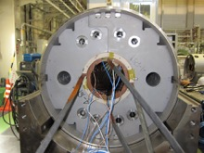
Shell deformation
Pass
number
1
2
3
4
5
6
7
8
9
10
11
Azimuthal
B
C
A
D
H
E
Axial
G
F
Deformation in the azimuthal direction
1-2 pass: Bending deformation is dominant
3-9 pass: Tensile strain developed
10-11 pass: No additional strain
Shell strain: 0.09 - 0.1% (azimuthal)
-0.05% (longitudinal)

Slide 27
After shell welding, end ring welding, ramp lead slice work
Coil resistance → No change
Cable resistance between voltage taps → No change
QPH and spot heater resistance → No change
Coil inductance at 100 Hz
→Top (2.79 mH), Bottom (2.79 mH), 2 coils (8.10 mH)
Surge test → Normal waveform
Hi-pot test: 100 GΩ between 2 coils and ground (OK)

Slide 28
Variation of pre-stress during fabrication
RT
Target value after yoking
Upper and lower limit of
the error bars correspond
to the max. and min. values
among 12 collar gauges.
Pre-stress after yoking was 15 MPa lower than the target value.
Absolute value of strain could not be measured at cold. This should be solved by the next cold test.

Slide 29
Summary
Cable angle at coil end is more inclined than the designed values even after optimization. Design of the end spacers should be modified.
In coil size measurement, we confirmed that stress to the final size in the straight section was homogeneous, but the average value was 7 – 9 MPa lower than ANSYS calculation.
Electrical soundness of the magnet and heaters was confirmed throughout the fabrication processes.
Pre-stress of the coils at pole after yoking was 15 MPa lower than the target value.

Slide 30
Buckups

Slide 31
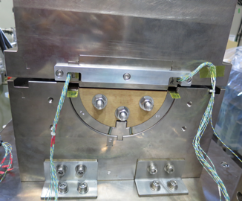
Coil size measurement procedure
Machine
displacement
Pressure – displacement curve
P_{max}
Loading
Unloading
Measure the iron dummy coil to estimate machine
deformation as a function of applied load
Compress a coil to the machine limit (Disp.=0 mm)
Correct the value of P_{max} considering machine deformation
  Ambiguity on machine deformation can influence on the result. We assumed the simplest case in which stress distribution in an iron dummy coil is neglected.
  (This assumption maximizes the Pmax. )
Iron dummy coil

Slide 32
Summary of electrical test for coils
 | Coil resistance at 20ºC (Ω) |  | Coil inductance 100 Hz (mH) |  | Surge test to 3 kV |  | Hi-pot test to 5 kV, 1 min Insulation resistance
 | Top | Bottom | Top | Bottom | Top | Bottom | Top | Bottom
Curing | 0.234 | 0.234 | 2.17 | 2.15 | OK | OK | > 100 GΩ | > 100 GΩ
Instrumentations | 0.234 | 0.233 | 2.15 | 2.15 | OK | OK | > 100 GΩ | > 100 GΩ
Collaring | 0.233 | 0.233 | 2.67 | 2.67 | OK | OK | > 100 GΩ | > 100 GΩ
Yoking | 0.233 | 0.233 | 2.80 | 2.80 | OK | OK | > 100 GΩ | > 100 GΩ
Shell, end ring welding, ramp splice work | 0.233 | 0.234 | 2.79 | 2.79 | OK | OK | 100 GΩ
Coils were electrically sound throughout the fabrication processes.

