Slide 1
Towards an
Information System
Product Team
David Horat
EGEE’09, Barcelona, Spain
24th September, 2009

Slide 2
Objectives
Where we are today
Where we might be tomorrow
Managing the transition
Software planning
Today
…
Tomorrow

Slide 3


Where we are today

Slide 4
Where we are today
JRA1
SA3
Middleware Engineering
Integration Testing

Slide 5
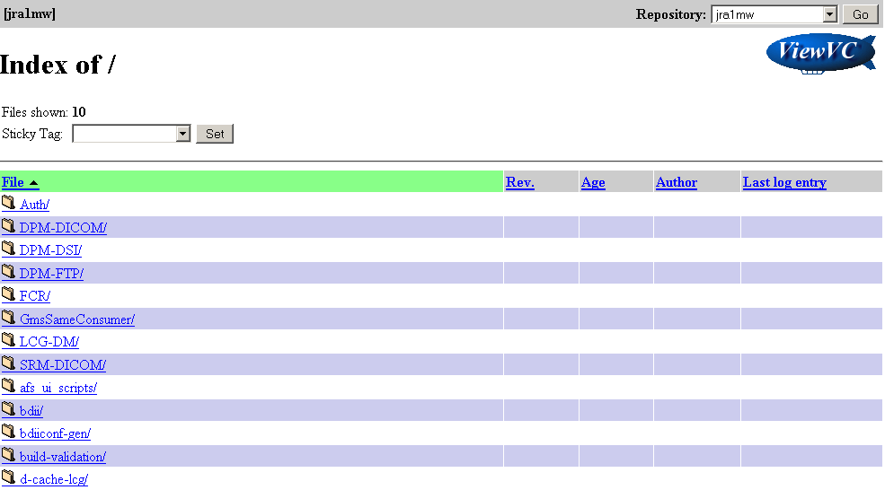
gLite CVS
Where we are today

Slide 6
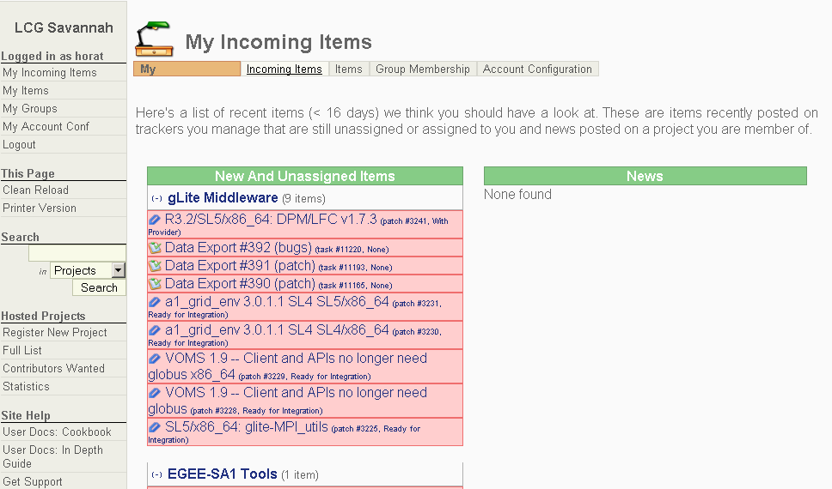
Savannah
Where we are today

Slide 7
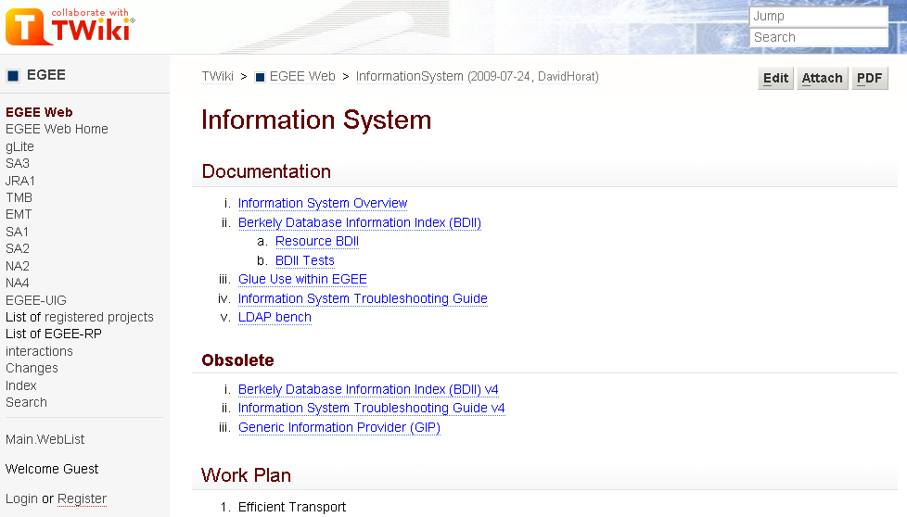
Twiki
Where we are today

Slide 8
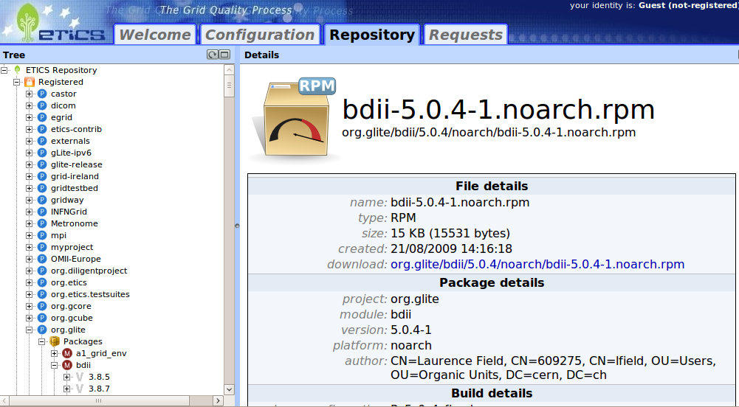
ETICS
Where we are today

Slide 9

SA3
Where we are today

Slide 10
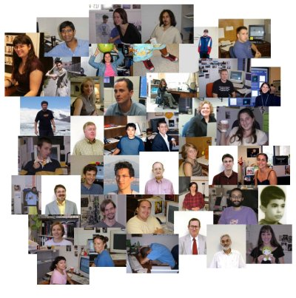


Where we are today

Slide 11

Where we might be tomorrow

Slide 12
Where we might be tomorrow
Self Contained Software Unit
  Self sufficient
  Interface (What we deliver and how?)
Same as now with minor changes
  Plus certification
  Interface (What we deliver and how?)

Slide 13

Managing the transition
Information System Product Team
Areas to consider
  Hosting options
  Building system
  Certification
  Release management
Current products
  BDII
  GLUE 2.0
  GIP
  Etc.

Slide 14
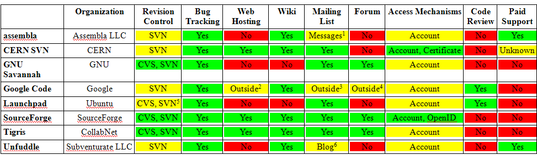
Hosting options
[1] It is really an internal messaging system rather than a standard mailing list
[2] You can use Google Sites.
[3] You can use Google Groups.
[4] You can use Google Groups.
[5] CVS and SVN are imported into Bazaar format. No native support.
[6] It is really an internal blog rather than a standard mailing list

Slide 15
Hosting options
Comments
Assembla (+60K hosted projects)
  Some interesting tools: time tracking, agile tools, etc. Biggest paid hosting platform
GNU Savannah (+3K hosted projects)
  Just for free software. If your project is GNU it goes into one server, if not into another.
Google Code
  Very easy to use IF you have a Gmail account. Easily interoperable with other Google Services.
Launchpad (+11K hosted projects)
  No native support for CVS and SVN, although they work with their Bazaar backend.
  Very good platform for software translation.
CERN SVN (+1K hosted projects)
  Used by many CERN users and partners. Hosting very big projects (ATLAS, CMS, etc.)
SourceForge (+230K hosted projects)
  The most used Open Source Software Hosting.
Tigris (+1K hosted projects)
  The company behind it, CollabNet, created Subversion and hosts it there.
  CollabNet bought SourceForge in 2007.
Unfuddle
  Time tracking. Beta web RESTful APIs with XML over HTTP using HTTP Basic Authentication.

Slide 16
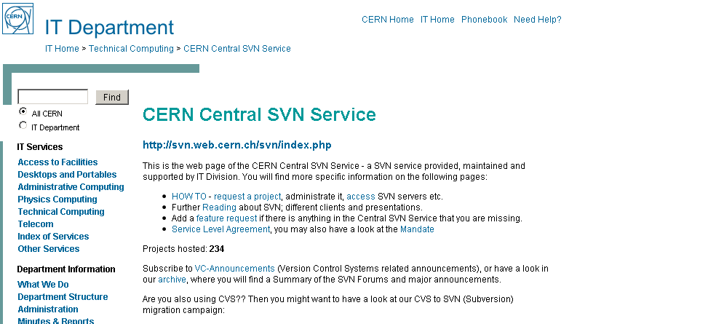
Hosting options: CERN SVN
CVS SVN
Savannah + Twiki Trac

Slide 17

Building system
Best practices in Free Software?
Get closer to the OS?
Include components in OS distributions?

Slide 18
Building system
A possibility …
The Fedora Build System
koji build <repo_tag> <source>
<repo_tag>: The repository to use for dependencies
<source>: CVS URL, SVN URL, source RPM, etc.
Dependencies resolved using the spec file
Koji

Slide 19
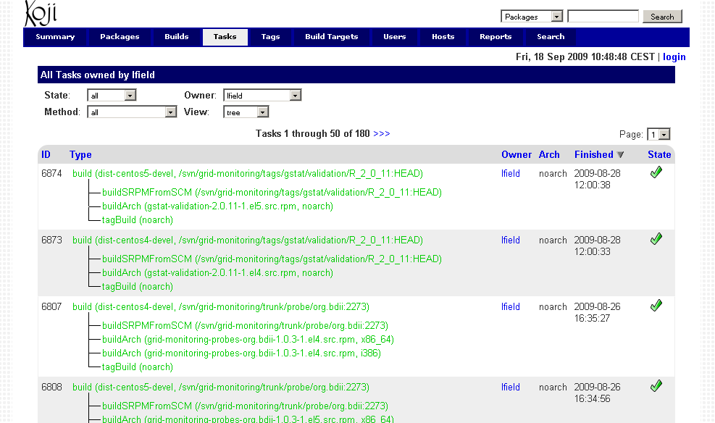
Building system

Slide 20
Building system
Pros
  Community supported
  Best practices implementation
  Multiple source types
  One command
  Process driven from the spec file
  Tag based approach
Cons
  RPM based
  Difficulty to build debs
    Already being discussed in the community
  Other possibilities?
    The Debian Build System

Slide 21
Certification
Improve automatic tests
Virtual machine images
Automatic setup
The testbed

Slide 22
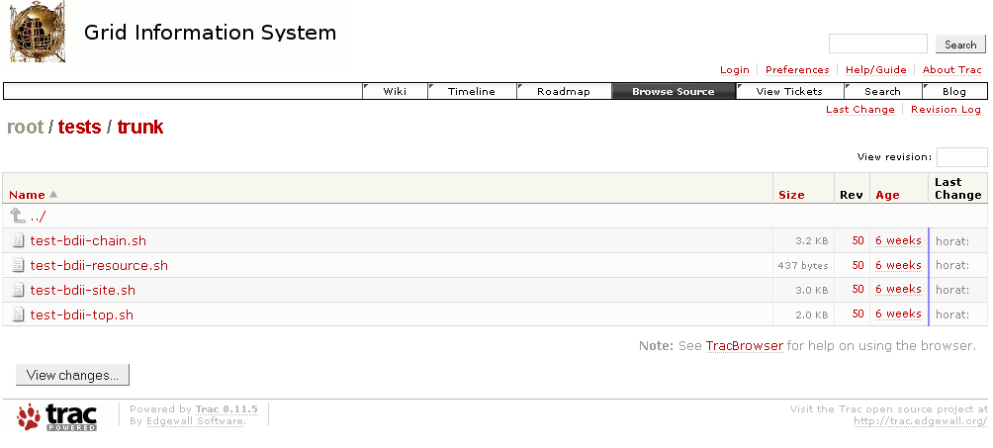
Certification: Automatic tests
Bash scripts
  Exit value 0: OK
  Exit value != 0: ERROR

Slide 23
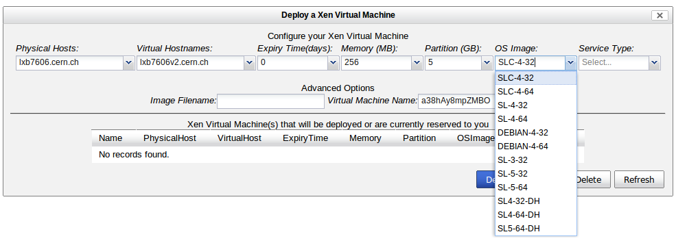
Certification: VM images
VNode: XEN virtual machines
  SL4-32-DH
  SL4-64-DH
  SL5-64-DH

Slide 24
Certification: Automatic setup
./yaimgen.sh <input file> <log file>
Update the system
Select repository
Install nodes
Install patches
Configure the system
Configure the node using YAIM
Run basic tests
And now we can start certifying …

Slide 25
Certification: The testbed
Top
BDII
Site
BDII
Site
BDII
Resource
BDII
Resource
BDII
Resource
BDII
Resource
BDII

Slide 26
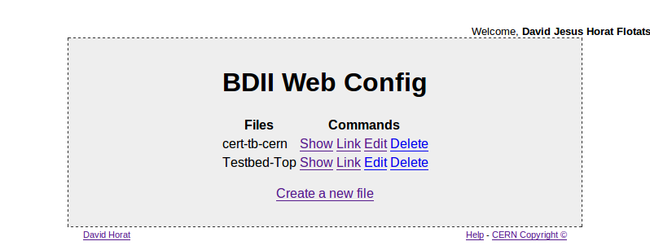
Certification: The testbed

Slide 27

Certification: The testbed
BDII
Web Config
Top
BDII
Site
BDII
Site
BDII
Resource
BDII
Resource
BDII
Resource
BDII
Resource
BDII

Slide 28
Release management
Announcements
Bug tracking
Project portal
Code browser
XML-RPC API

Slide 29
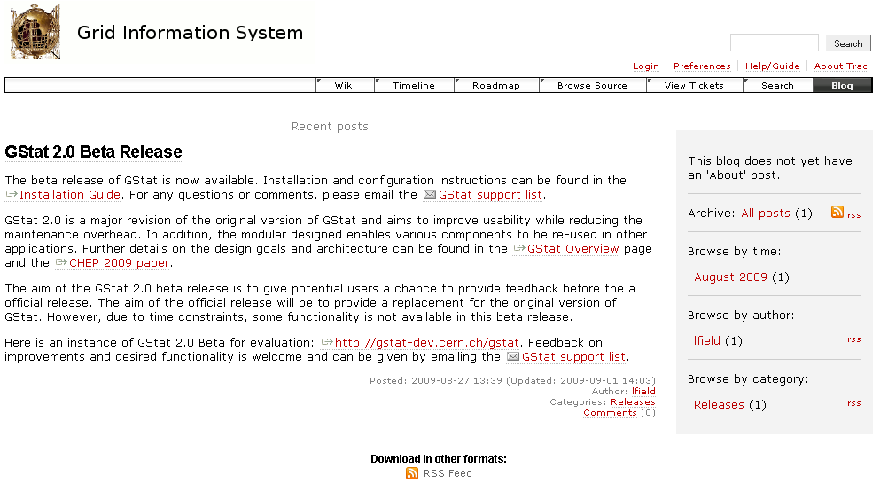
Release man.: Announcements

Slide 30
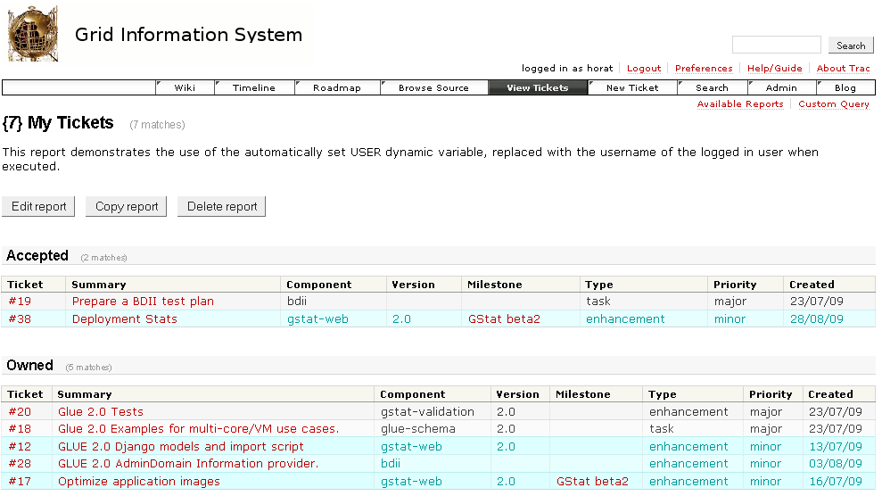
Release man.: Bug tracking

Slide 31
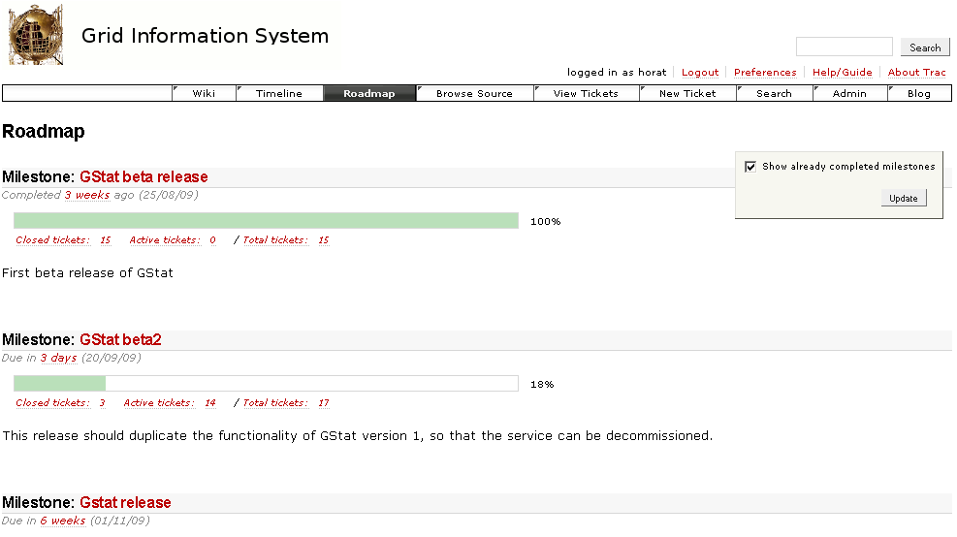
Release man.: Bug tracking

Slide 32
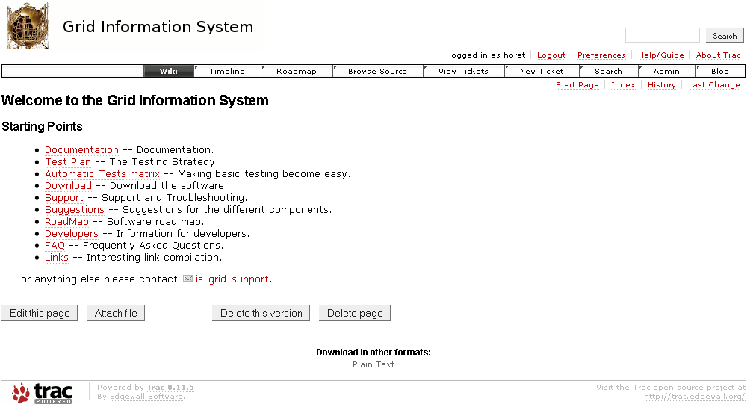
Release man.: Project portal

Slide 33
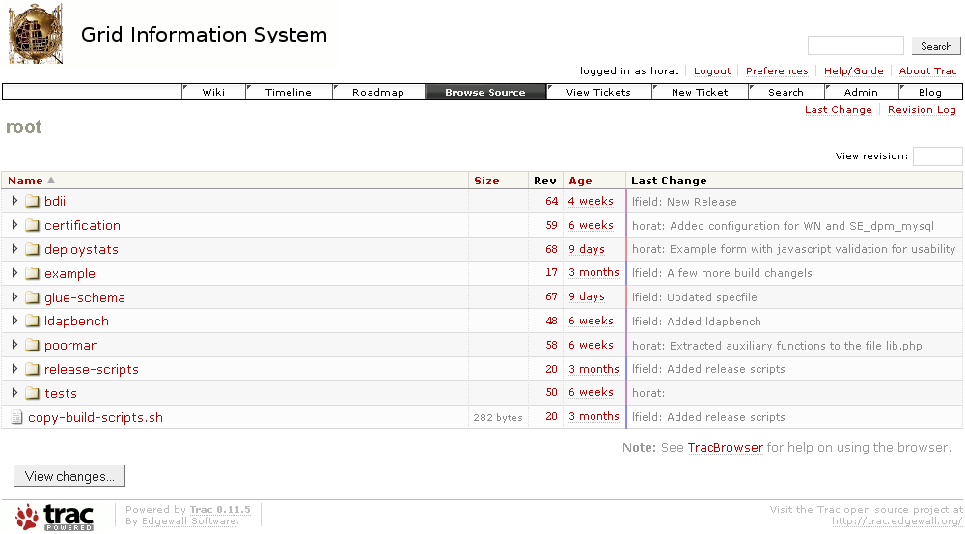
Release man.: Code browser

Slide 34
Release man.: XML-RPC API
Web Service
  XML-RPC
  Doc: http://trac-hacks.org/wiki/XmlRpcPlugin
Manage
  Tickets
  Wiki
  Search

Slide 35
Release man.: XML-RPC API
Retrieving my tickets in Python
import xmlrpclib
url = "https://user:password@svnweb.cern.ch/no_sso/trac/gridinfo/login/xmlrpc"
server = xmlrpclib.ServerProxy(url)
multicall = xmlrpclib.MultiCall(server)
for ticket in server.ticket.query("owner=horat"):
multicall.ticket.get(ticket)
print map(str, multicall())

Slide 36
Software planning
Software released
  BDII
  BDII File Editor
  GStat
  Deployment statistics
Software in which we collaborate
  GLUE Schema
  Yaimgen

Slide 37
Software planning
To come …
  GLUE 2.0 roll out
  BDII maintenance
    Performance and scalability improvement
    Investigate a more decentralized model
  GStat 2.0 release
    Validation probes
    Web application
  Yaimgen
    More and more automation

Slide 38
Thank you!
David Horat
david.horat@cern.ch
http://cern.ch/horat

