Slide 1
HL-LHC Optics Constraints for Dump Region
C. Bracco, B. Goddard, C. Wiesner, M. Fraser, A. Lechner, M. Frankl
Acknowledgment: ABP

Slide 2
Main Constraints:
Q4 gradient fixed within maximum ±1%
Horizontal phase advance MKDs➔TCDQ 90˚± 4˚
TCDS: β_{y,min} ≥ 200 m (no more than 10% smaller than present value)
TCDQ: β_{y,min} ≥ 145 m (no more than 10% smaller than present value), β_{x,min} ≥ 630m and |Dx| ≤0.2m
TDE: (β_{x} X β_{y}) ^{½} ≥ 4500 and β_{x,min} ≥ 4000 m and β_{y,min} ≥ 3200 m (no more than 20% smaller than present value)
TCDQ movement during squeeze unidirectional and towards the beam, accumulated mechanical play ➔ degraded alignment precision (required ±0.1 mm)! Need BETS redesign.
Phase advance MKD➔TCTs 0˚ or 180 ˚(± 10˚)
TCDS-MSD: β_{x,max} ≤ 175 m (aperture limitation extraction channel at injection).
Disclaimer:
Optics constraints related to machine aperture (circulating beam) are not treated in this talk (assumed as part of standard checks performed by ABP team)

Slide 3
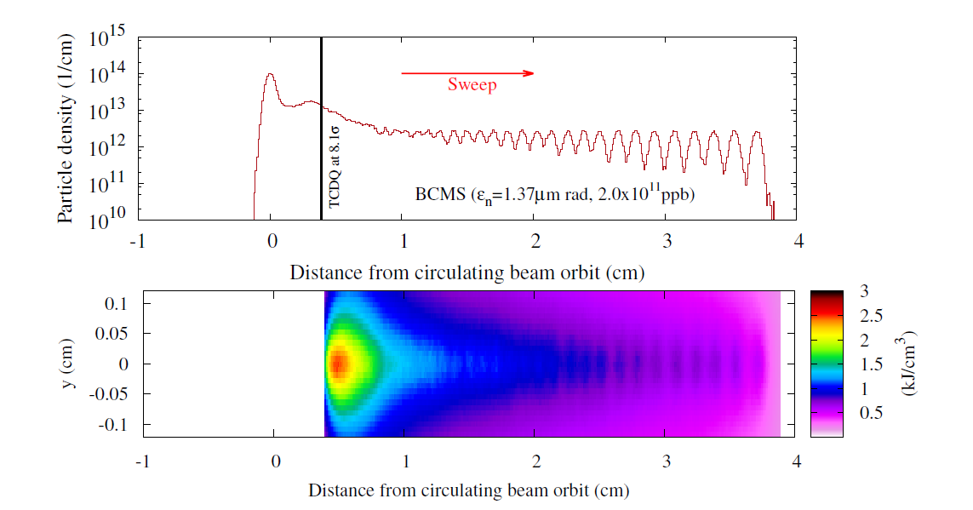
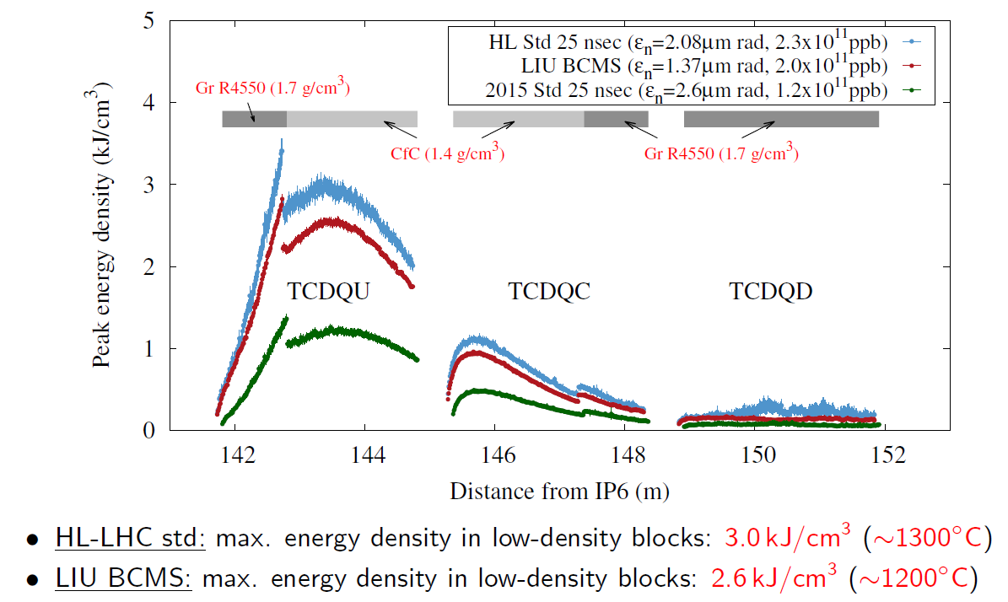
FLUKA calculations at TCDQ
7 TeV, TCDQ Half gap = 8.6 σ_{β} ➔ 0.5 σ (~250 μm) misalignment included ➔ 8.1 σ = 4 mm (present optics and 3.5 mm mrad normalised emittance)
Type 2 erratic
A. Lechner
Close to limits!

Slide 4
Present Collimator Settings @ 6.5 TeV (40 cm β*)
TCDQ
TCSG
TCP
2.8 σ = 1.4 mm (nom. β)
7.5 σ
8.3 σ
5.5 σ
Present SIS interlock on local orbit at TCDQ = +/- 1.2 mm ➔ possible moving orbit locally towards the TCDQ without losses (beam cut at 5.5 σ at TCPs)
Run 2 nominal settings at collision (40 cm β* in IP1 and IP5): TCDQ at 8.3 σ = 4.2 mm
Consider 0.5 σ setup error ➔ 7.8 σ = 3.95 mm
SIS on orbit at TCDQ = ±1.2 mm ➔ gap could go down to 2.7mm.
Scaling from FLUKA calculations and assuming a bunch population of 1.15e11 p+ this gives a maximum energy density of 2.2 kJ/cm³ and a maximum temperature of <1000˚C

Slide 5
HL-LHC Collimator Settings @ 7TeV (20 cm β*)
TCDQ
TCSG
TCP
3.3 σ = 1.7 mm (nom. β)
7.7 σ
9 σ
5.7 σ
740
Assuming a maximum allowed temperature of 1400 ˚C (“grey zone” for graphite, still ANSYS simulations needed!!) ➔ minimum gap = 3.6 mm
0.25 mm setup error ➔ minimum gap = 3.85 mm
SIS interlock 1.2 mm ➔ minimum gap = 5.05 mm ➔ Minimum allowed β_{x} = 630 m
575
630
490

Slide 6
Summarising for TCDQ Minimum β_{x}
Need to asses if Type 2 erratic (and any worse case) can be avoided
Need to confirm that SIS interlock on orbit at TCDQ can be reduced and to which level without impacting machine availability
Need to perform ANSYS calculations to assess if Graphite and CFC would withstand the beam impact in case of Type 2 erratic and limit optics conditions (e.g. 0.6 mm interlock and β_{x} = 490 m)
Once defined previous points, decide if upgrading TCDQ with more robust material (3D C-C?) ➔ impact on the cost (not in baseline)!
β_{x} change TCDQ_UP and TCDQ_DW < 5%

Slide 7
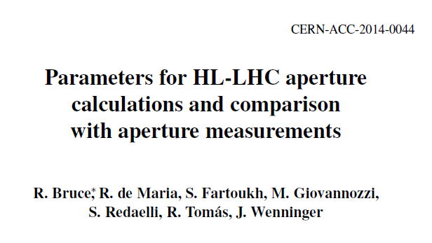
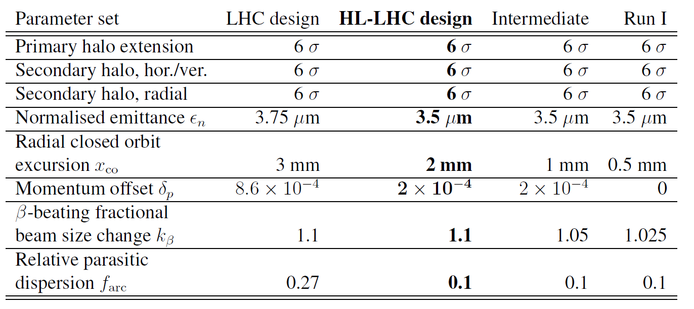
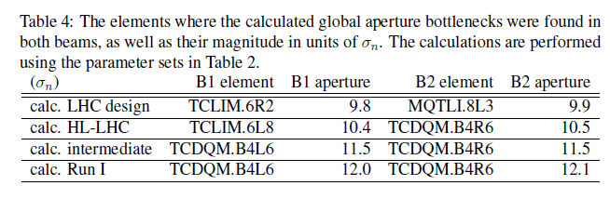
Horizontal Dispersion at TCDQ
bx
bx
Momentum spread at top energy = 1.13e-4
Total Dp/p = momentum offset + 2*momentum spread
bx
bx

Slide 8
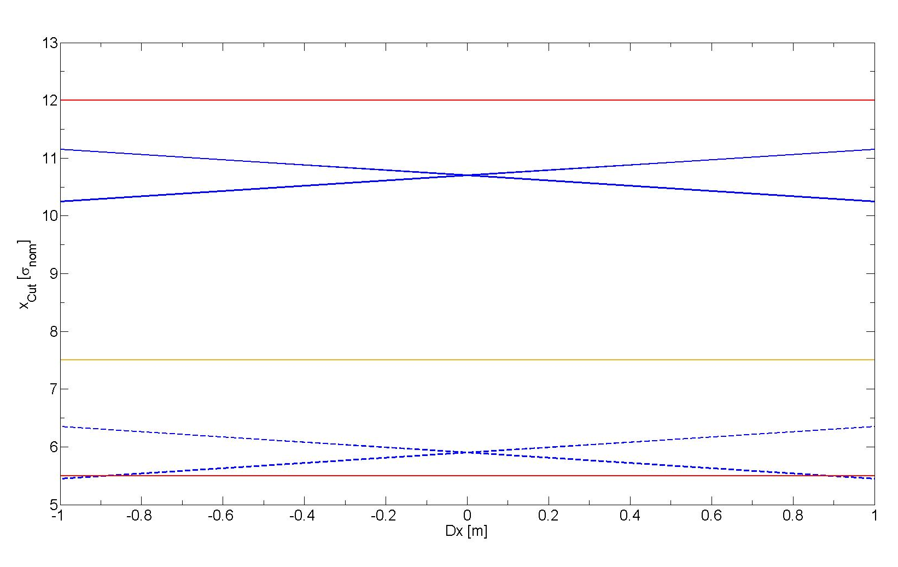
Present TCDQ Real Cut
TCDQ set at 8.3 σ_{nom} (betatron) ➔ x= 4.2 mm
Real cut x_{Cut} [σ_{nom} ] can be calculated from:
x = x_{Cut} * σ_{nom} + Dx* Dp/p + x_{dump}
x_{Cut} contains optics and alignment errors during the setup
x_{dump} is the local orbit at the moment of the asynchronous dump (at present up to ±1.2 mm)
Protection of machine aperture always granted!
Hierarchy wrt TCSG broken for x_{dump} > ± 0.120 mm independently on Dx
Hierarchy wrt TCP broken for |Dx| > 0.9 m
Global bottleneck
TCDQ
TCSG
TCDQ
TCP

Slide 9
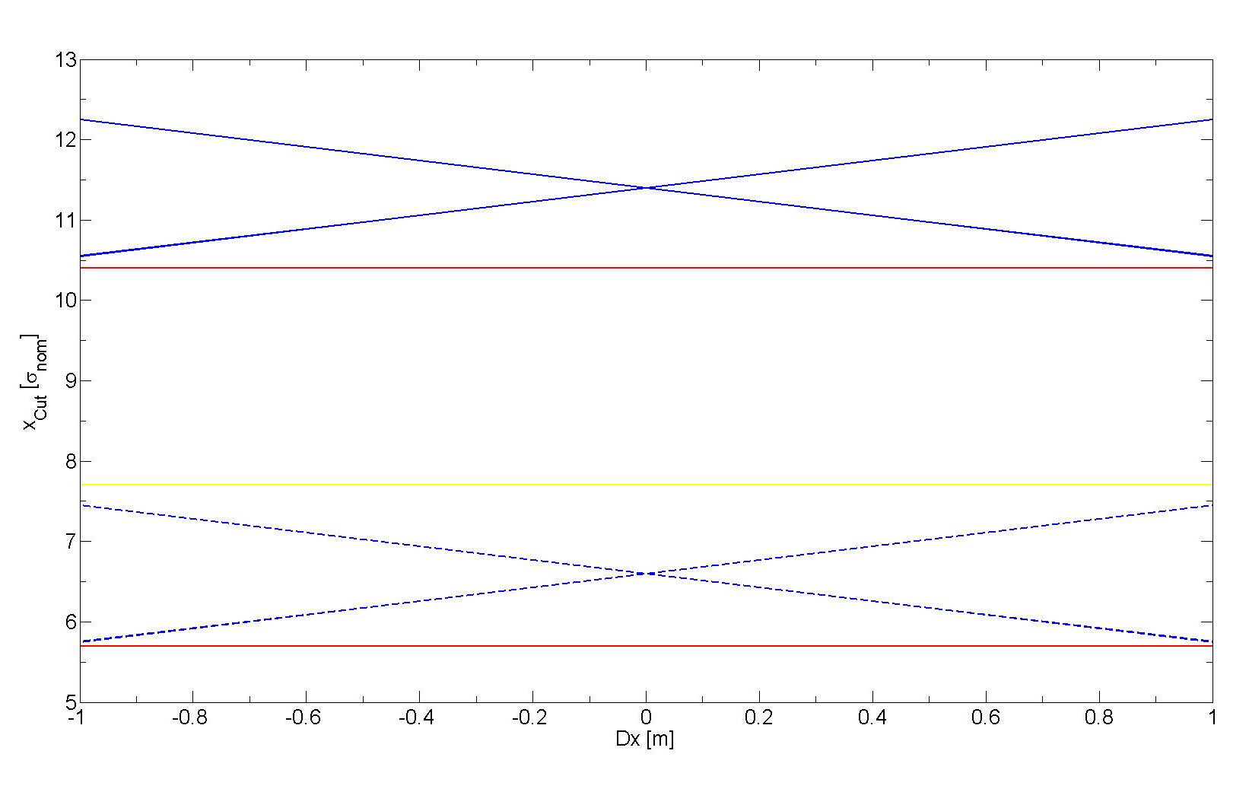
HL-LHC TCDQ Real Cut
TCDQ set at 9 σ_{nom} (betatron) ➔ x= 4.5 mm
Real cut x_{Cut} [σ_{nom} ] can be calculated from:
x = x_{Cut} * σ_{nom} + Dx* Dp/p + x_{dump}
x_{Cut} contains optics and alignment errors during the setup
x_{dump} is the local orbit at the moment of the asynchronous dump (at present up to ±1.2 mm)
Protection of machine not provided! Either reduce SIS interlock or larger machine aperture (phase advance of global bottleneck wrt MKD not taken into account) or closer TCDQ (possible damage in case of type 2 erratic)
Hierarchy wrt TCSG broken for x_{dump} > ± 0.200 mm independently on Dx
Hierarchy wrt TCP ok
TCDQ
Global bottleneck
TCSG
TCDQ
TCP

Slide 10
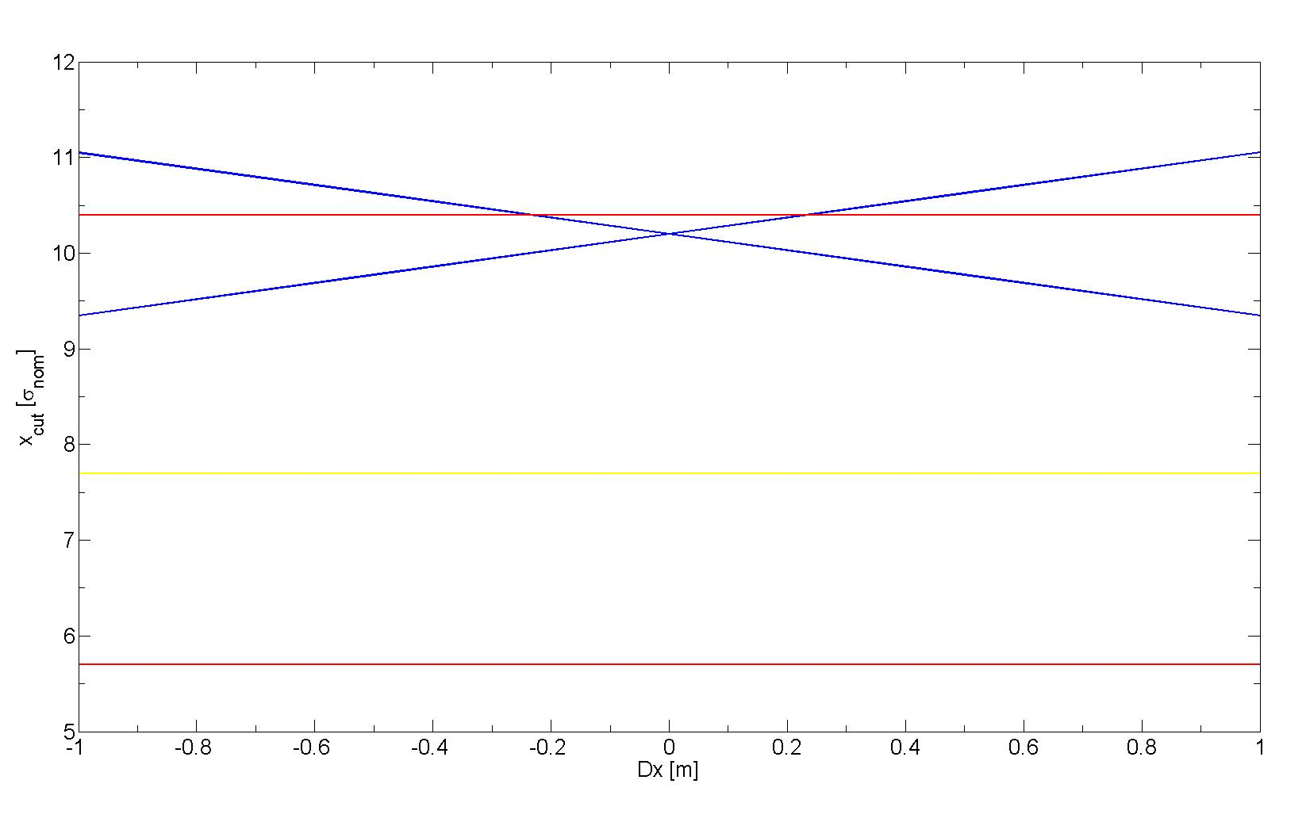
HL-LHC TCDQ Real Cut
10.4 σ aperture
SIS interlock 0.6 mm ➔ |Dx|≤ 0.2 m
Global bottleneck
TCDQ
TCSG
±1.2mm x_{dump}
TCP

Slide 11
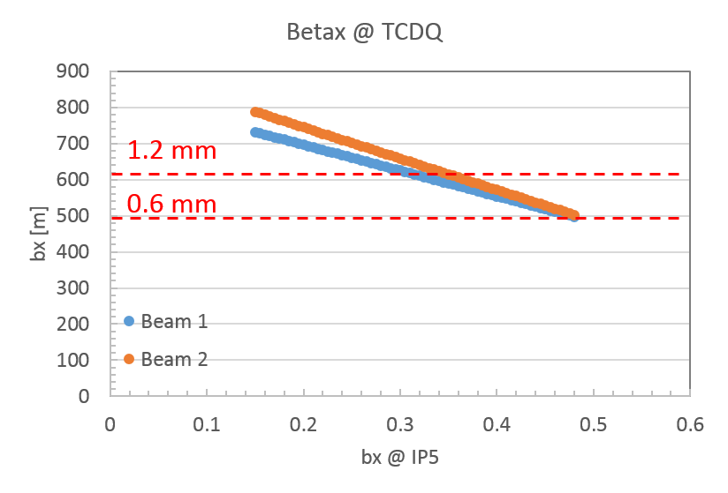
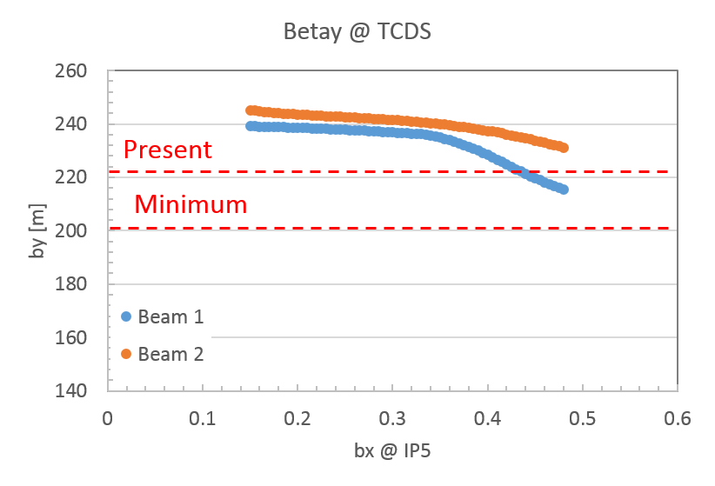
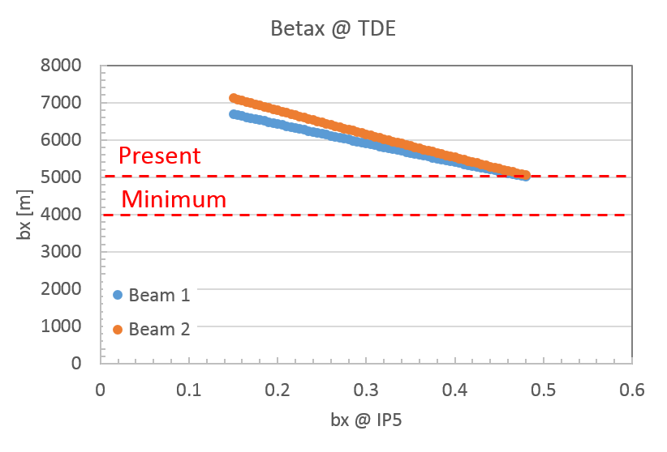
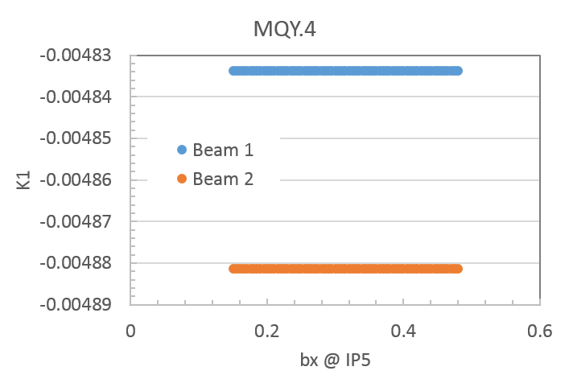
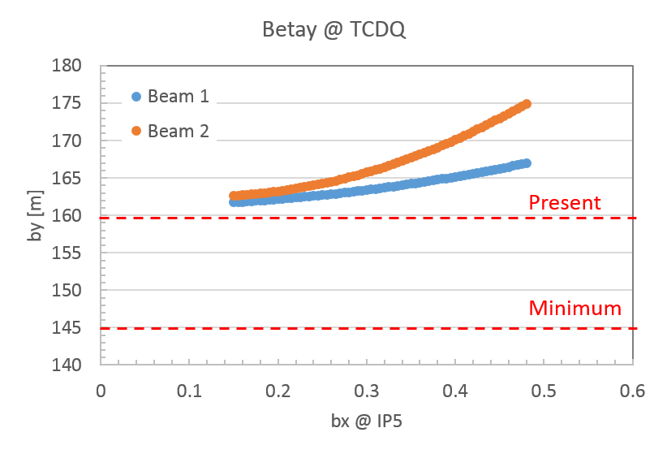
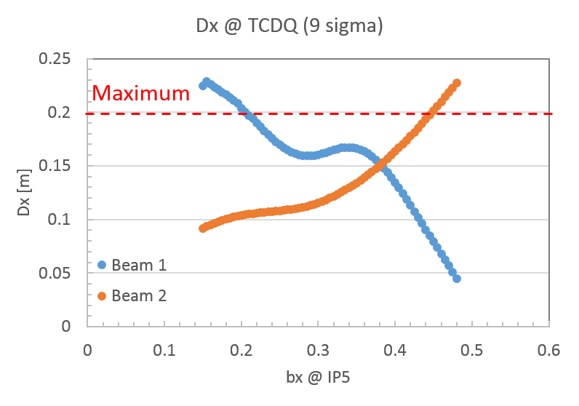
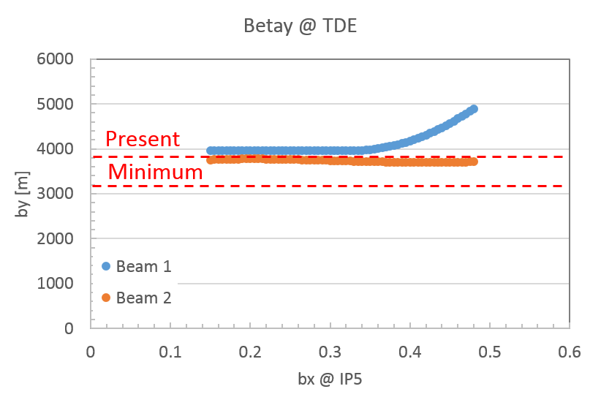
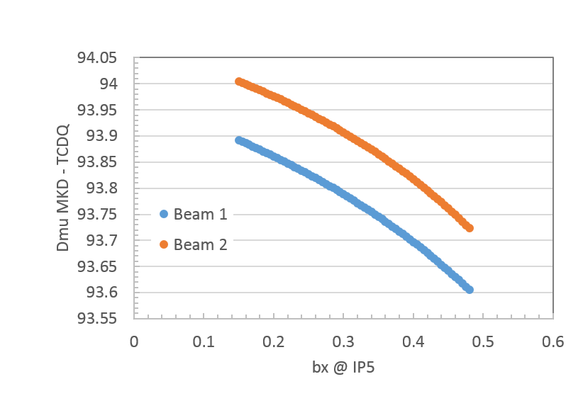
HL-LHV1.2 Squeeze Round
http://lhc-optics.web.cern.ch/lhc-optics/HLLHCV1.2/squeeze/
Squeeze
Maximum
Dx @ TCDQ calculated from Dx and DxP @ IP6
Almost all conditions fulfilled but:
  Dispersion @ TCDQ (to be reminded that this constraint depends on the SIS interlock for local orbit @ TCDQ and TCDQ half-gap)
  β_{x} @ TCDQ only for SIS interlock of 0.6 mm and 9 σ half-gap
  TCDQ moving away from the beam during the squeeze (4.5 mm ➔ 5.5 mm, ~2σ movement)

Slide 12
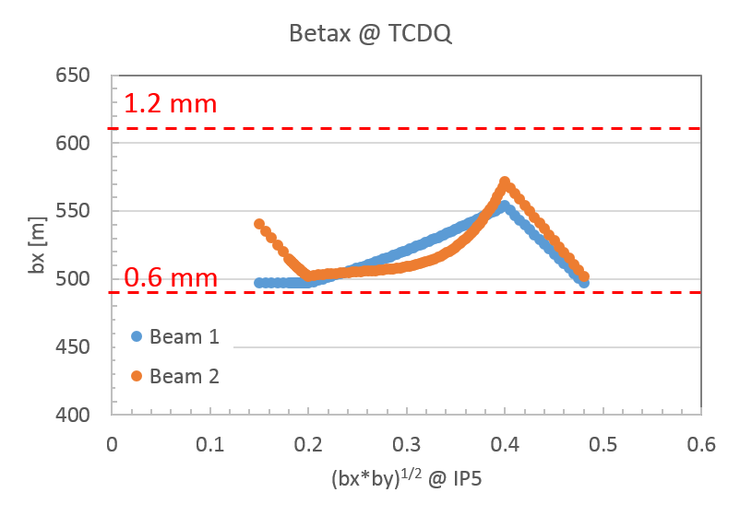
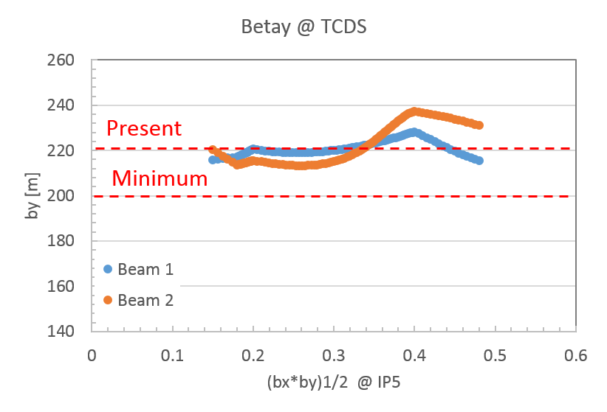
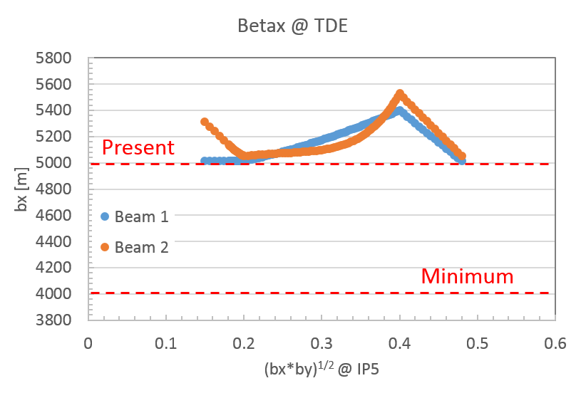
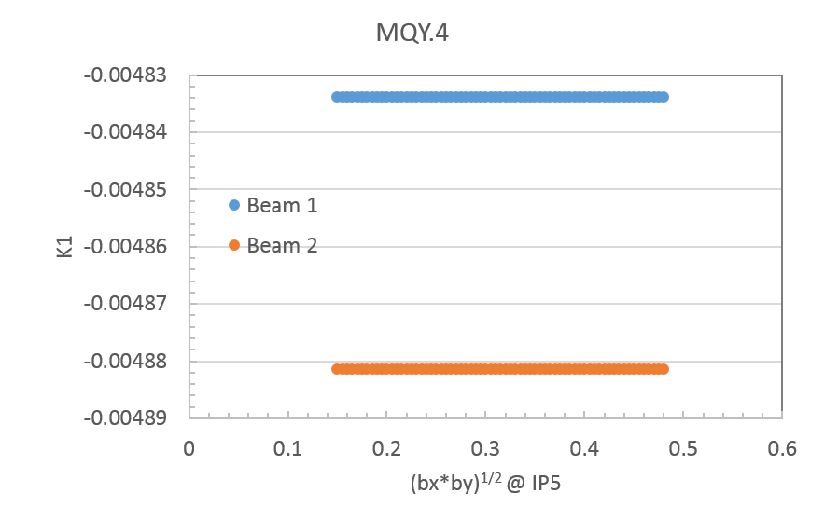
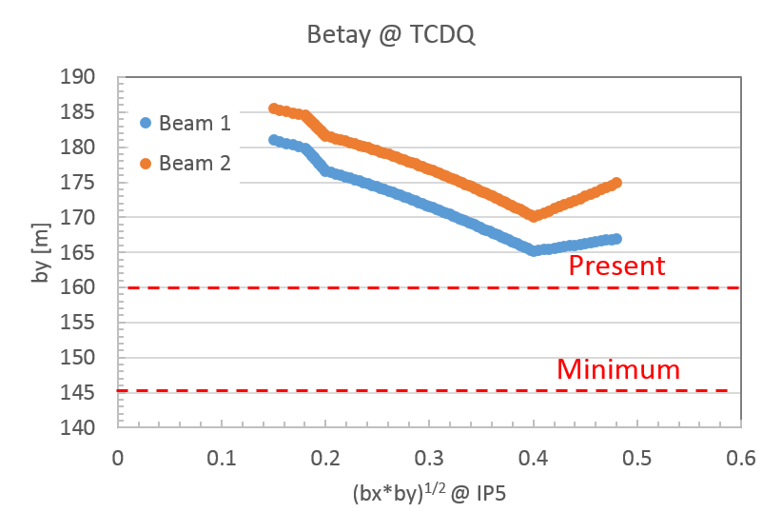
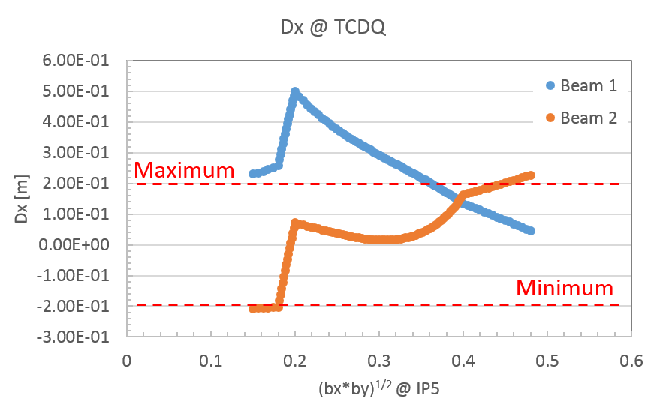
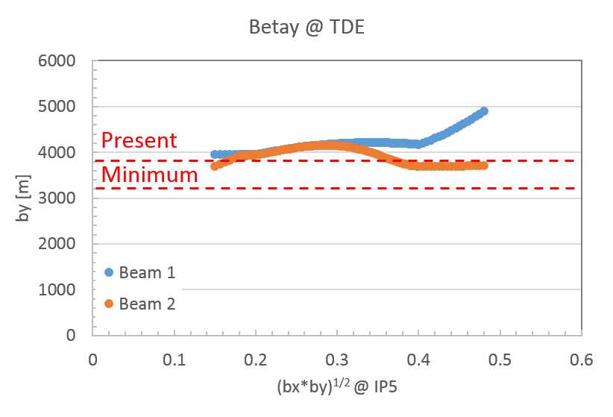
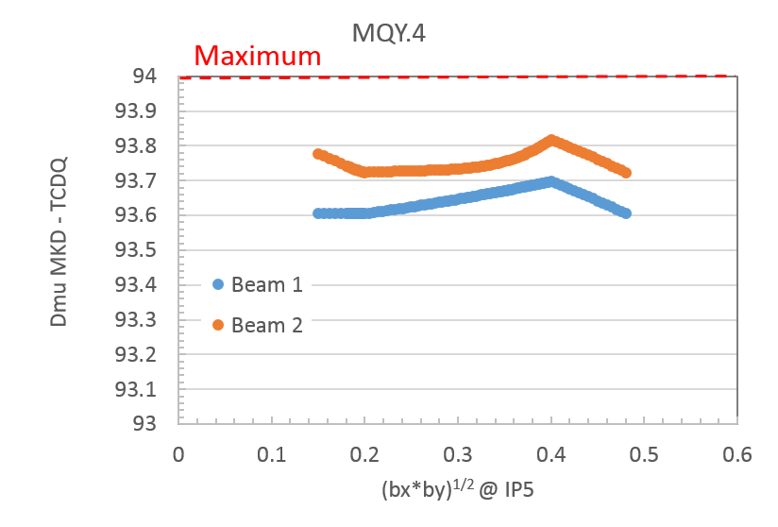
HL-LHV1.2 Squeeze Flat
http://lhc-optics.web.cern.ch/lhc-optics/HLLHCV1.2/squeeze/
Squeeze
Dx @ TCDQ calculated from Dx and DxP @ IP6
Almost all conditions fulfilled but:
  Dispersion @ TCDQ (to be reminded that this constraint depends on the SIS interlock for local orbit @ TCDQ and TCDQ half-gap)
  β_{x} @ TCDQ only for SIS interlock of 0.6 mm and 9 σ half-gap
  TCDQ moving away and towards the beam (maximum movement 5.00 mm ➔ 5.4 mm, ~0.8 σ). If maximum variation < 1 σ (< 0.5 mm) TCDQ could be set to the closest position already before the squeeze (possible coll. hierarchy violation)

Slide 13
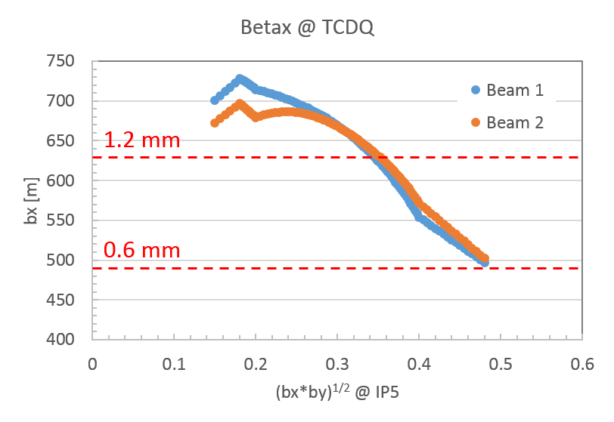
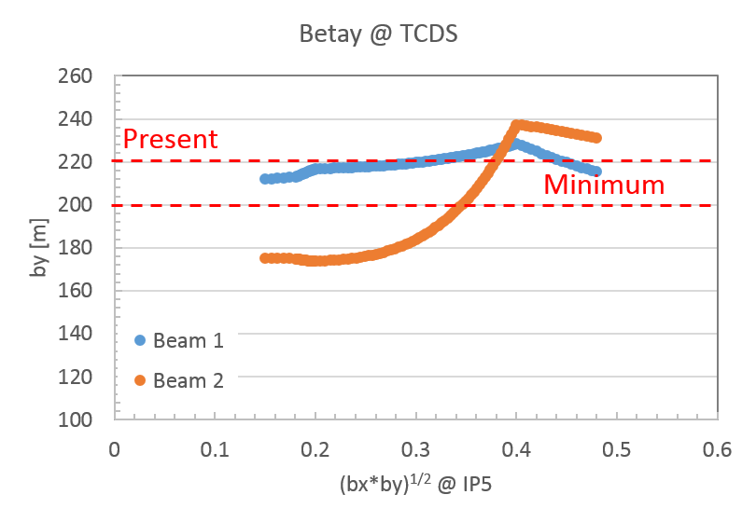
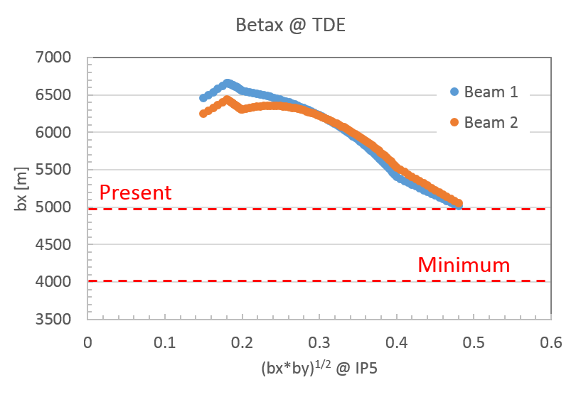
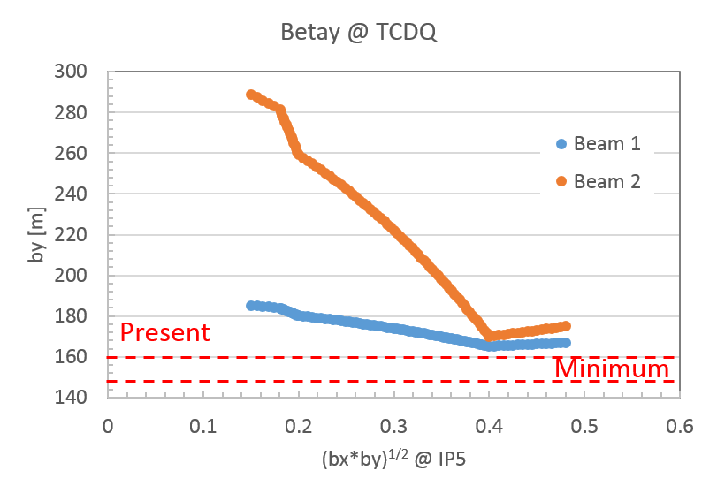
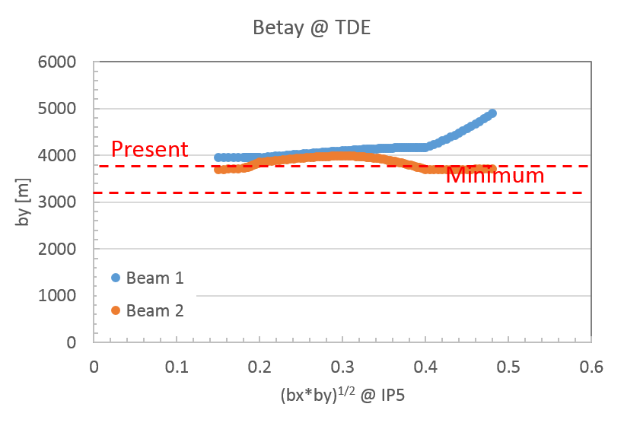
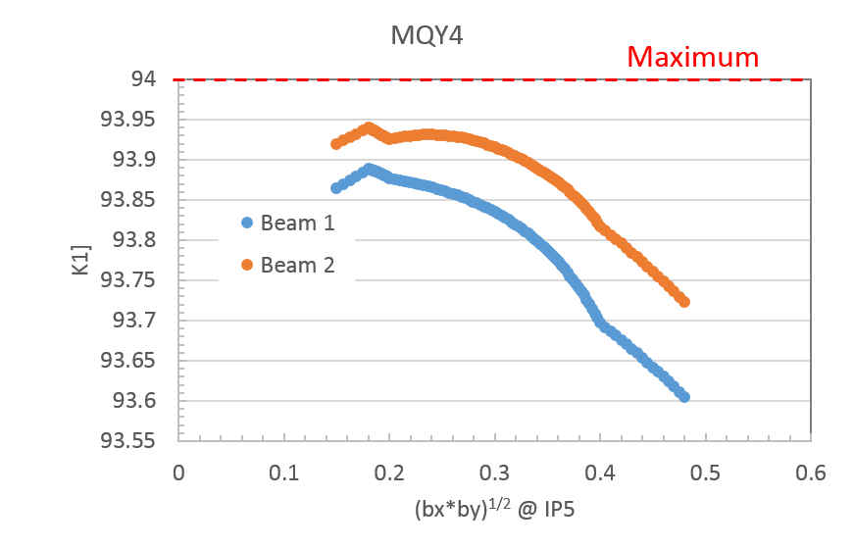
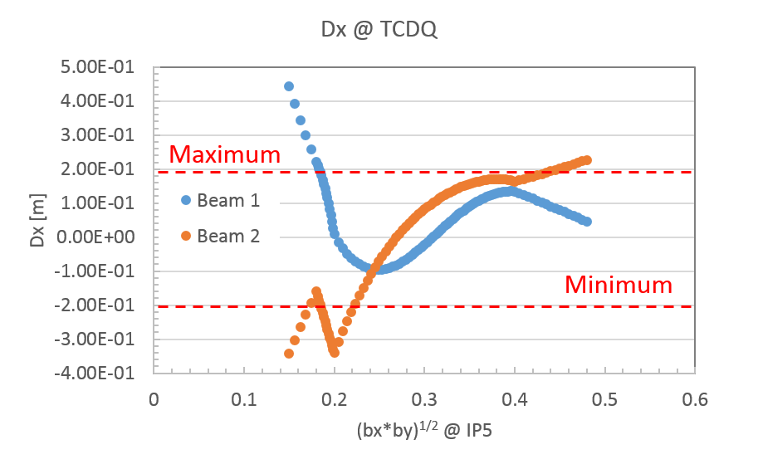
HL-LHV1.2 Squeeze FlatHV
http://lhc-optics.web.cern.ch/lhc-optics/HLLHCV1.2/squeeze/
Squeeze
Dx @ TCDQ calculated from Dx and DxP @ IP6
Almost all conditions fulfilled but:
  Dispersion @ TCDQ (to be reminded that this constraint depends on the SIS interlock for local orbit @ TCDQ and TCDQ half-gap)
  β_{y} @ TCDS
  β_{x} @ TCDQ only for SIS interlock of 0.6 mm and 9 σ half-gap
  TCDQ moving away and towards the beam (4.5 mm ➔ 5.5 mm, ~2σ movement)

Slide 14
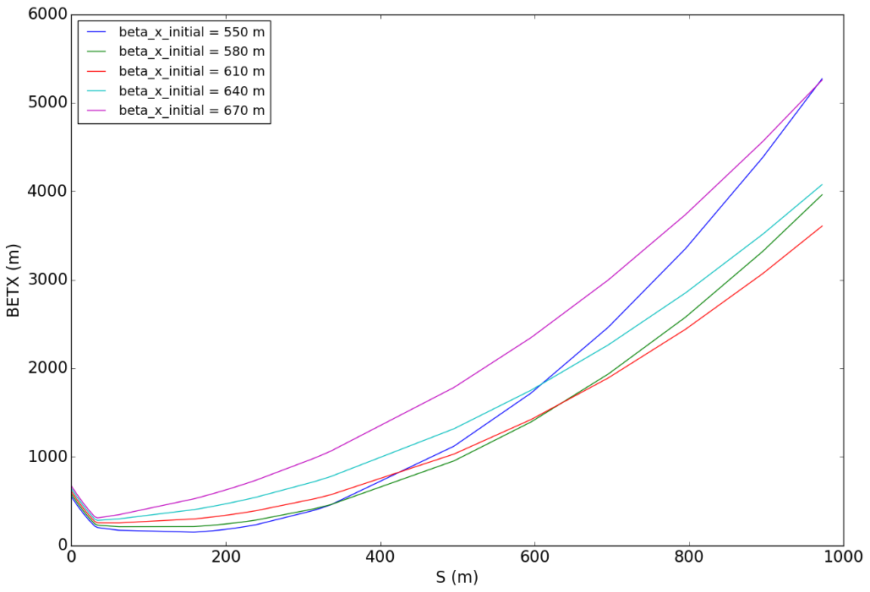
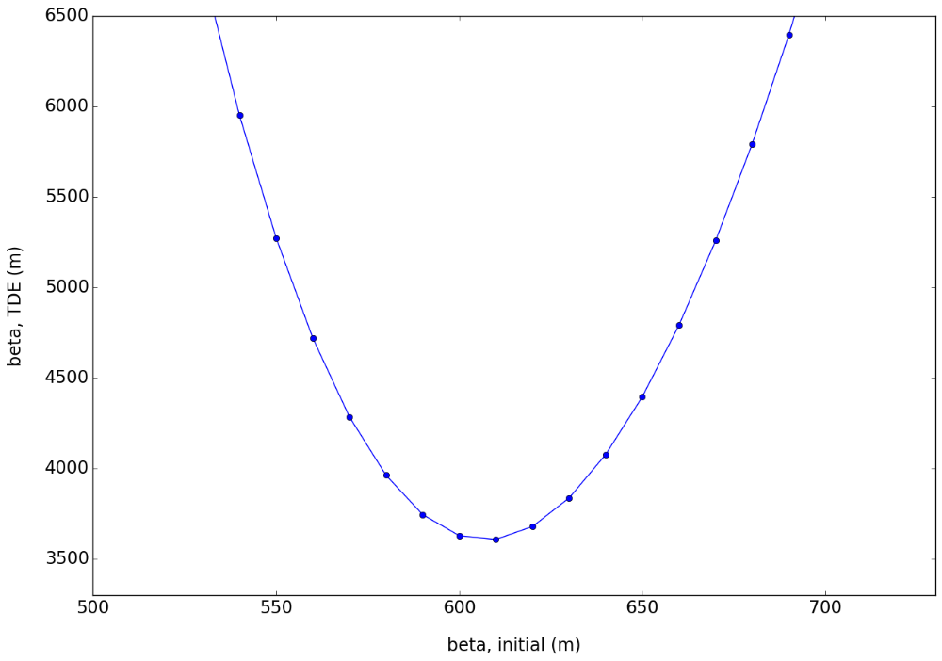
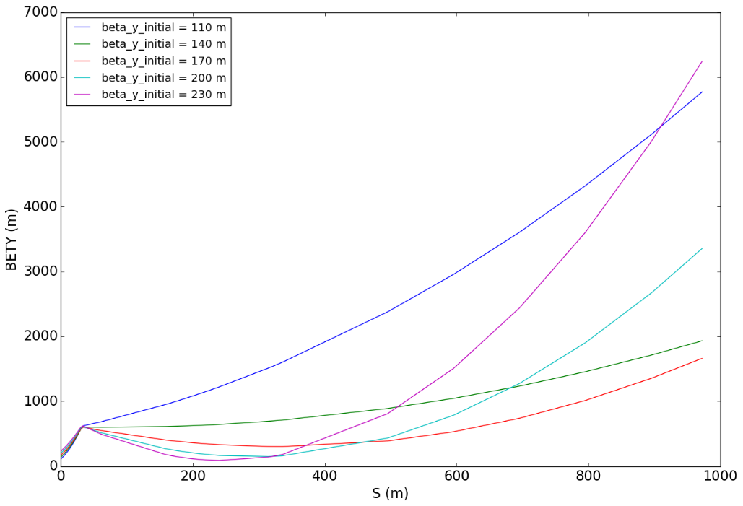
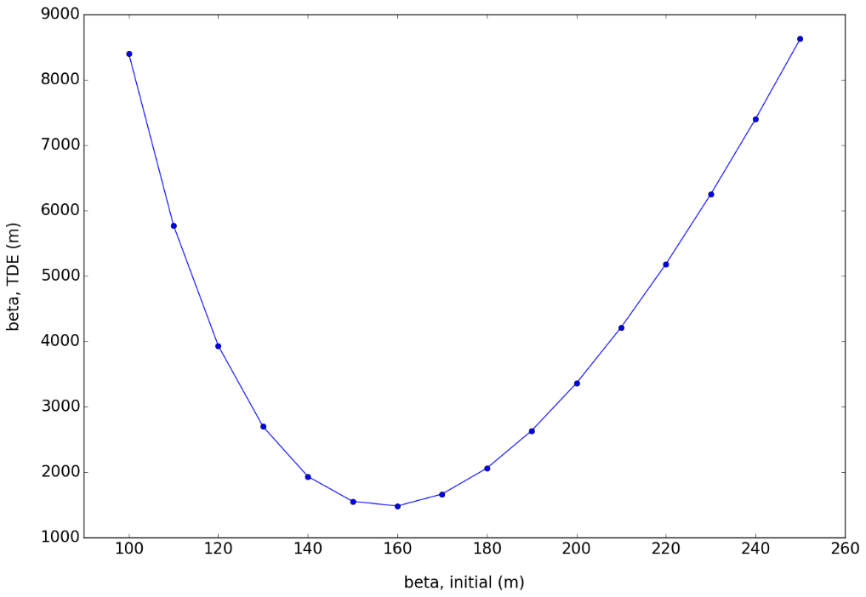
Beta @ MKD
580 m
640 m
TDE
Maximum βx,y (now 540 m and 216 m respectively) defined by available aperture for circulating beam at injection (ABP checks)
Present
Minimum
Minimum
125 m
200 m
TDE
Present
Minimum
Minimum
C. Wiesner

Slide 15
Conclusions 1/2
Present HL-LHCV1.2 optics:
Q4 gradient fixed within maximum ±1%: OK
Horizontal phase advance MKDs➔TCDQ 90˚± 4˚: OK
TCDS: β_{y,min} ≥ 200 m: OK (not OK for FlatHV but probably not critical) (ANSYS calculations needed for final confirmation)
TDE: (β_{x} X β_{y}) ^{½} ≥ 4500 and β_{x,min} ≥ 4000 m and β_{y,min} ≥ 3200 m: OK (ANSYS calculations needed for final confirmation).
TCDS-MSD: β_{x,max} ≤ 175 m at injection (aperture limitation): OK
Phase advance MKD➔TCTs 0˚ or 180 ˚(± 10˚) (not yet checked)

Slide 16
Conclusions 2/2
Present HL-LHCV1.2 optics:
TCDQ:
  β_{y,min} ≥ 145 m: OK (ANSYS calculations needed for final confirmation)
  β_{x,min} ≥ 630 m for present ±1.2 mm SIS interlock on local orbit and 9 σ half-gap (to avoid TCDQ damage in case of Type2 erratic): not OK. Need to assess if:
    Type 2 erratic (or worse) can be avoided
    Possible to reduce SIS limit without impacting machine availability: if ≤0.6 mm ➔ β_{x,min} ≥ 490 m: OK (ANSYS calculations needed for final confirmation)
    TCDQ material upgrade ➔ impact on cost (not in baseline)
    TCDQ movement during squeeze unidirectional and towards the beam: not OK. Try to keep total needed displacement <1σ ➔ move TCDQ to closest position before squeeze (possible hierarchy violation) ➔ no BETS upgrade needed!
  |D_{x}| ≤ 0.2 m (TCDQ hg = 9σ) provided that either global aperture bottleneck ≥ 11.6σ or SIS interlock can be reduced to ≤0.6 mm (aperture 10.4σ ): not OK

Slide 18
Present Optics Parameters
Beam 1 | MKD | MQ4 | TCDS | MSD | TCDQ | MQ4 | MQ5
Bx_min [m] | 250.9 | 203.1 | 153.3 | 157.2 | 483.5 | 549.9 | 147.1
Bx_max [m] | 542.8 | 219.3 | 156.7 | 235.9 | 505.5 | 570.5 | 162.2
By_min [m] | 215.6 | 588.8 | 224.6 | 134.7 | 161.4 | 197.3 | 602
By_max [m] | 533.1 | 609.5 | 236.9 | 222.9 | 169.8 | 214.4 | 604.6
Dx_max (abs) [m] | -0.143 | -0.093 | -0.063 | -0.061 | -0.023 | -0.017 | +0.002
Dmux_MKD_centre [deg] | 0 | 3 | 51 | 65 | 94 | 96 | 103
Beam 4 | MKD | MQ4 | TCDS | MSD | TCDQ | MQ4 | MQ5
Bx_min [m] | 248.0 | 217 | 152.2 | 156.1 | 479.2 | 576.0 | 164.2
Bx_max [m] | 568.9 | 218.6 | 154.4 | 230.6 | 510.9 | 576.7 | 165.8
By_min [m] | 192.4 | 583.4 | 240.0 | 147.2 | 158.9 | 193.4 | 578.7
By_max [m] | 531.1 | 586.5 | 247.9 | 234.5 | 169.2 | 193.7 | 581.5
Dx_max (abs) [m] | -0.053 | -0.051 | -0.150 | -0.205 | -0.294 | -0.308 | -0.157
Dmux_MKD_centre [deg] | 0 | 3 | 51 | 64 | 94 | 97 | 103

Slide 19
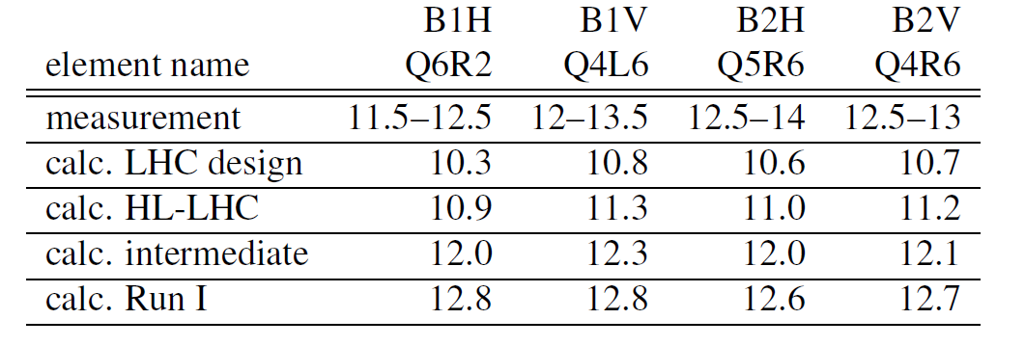
±1.2mm x_{dump}
bx
bx
SIS interlock 0.6 mm ➔ |Dx|≤ 0.2 m
Q4
Global bottleneck
TCDQ
10.4 sigma aperture
TCSG
TCP

