Slide 1
Connection Cryostat for Collimators in IR2 Dispersion Suppressors: Concept Overview
Massimiliano Moretti, TE-MSC-CMI
Arnaud Vande Craen, TE-MSC-CMI
Cedric Francois Eymin, EN-MME-EDM
Delio Duarte Ramos, TE-MSC-CMI
HL-LHC TCC Meeting
01/09/2016

Slide 2
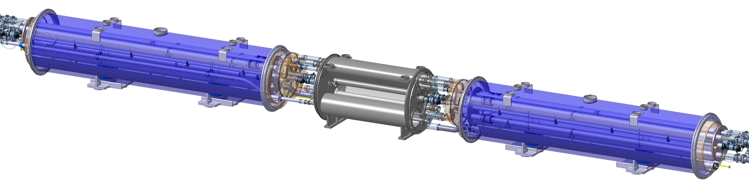
Introduction
  Connection Cryostat for the Cryo-bypass (CCC)
  During LS2, the current LHC connection cryostat has to be replaced to install the collimator in left and right sides of IR2
  The new CCC is designed to work in combination with the standard QEN bypass cryostat
  The continuity of the cryogenic and electric lines has to be guaranteed

Slide 3
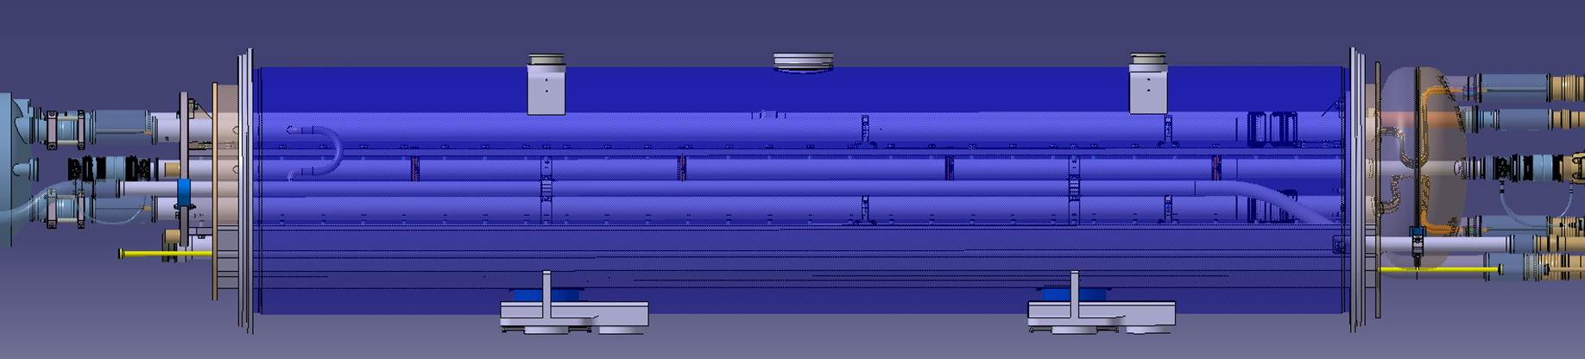
Conceptual Design
  The concept of the current LHC connection cryostat can be re-adapted
  Exploitation of vacuum vessel concept and cold supports
  Cold mass traversed by the cryogenic circuits, the bus-bars lines, the beam pipes and the related supporting and alignment systems
  Mechanical strength and assembly stability to be preserved
  Shuffling module for the bus-bars lyras and the feeding of LHe cooling
  Use of standard concept of bottom tray and thermal shield

Slide 4
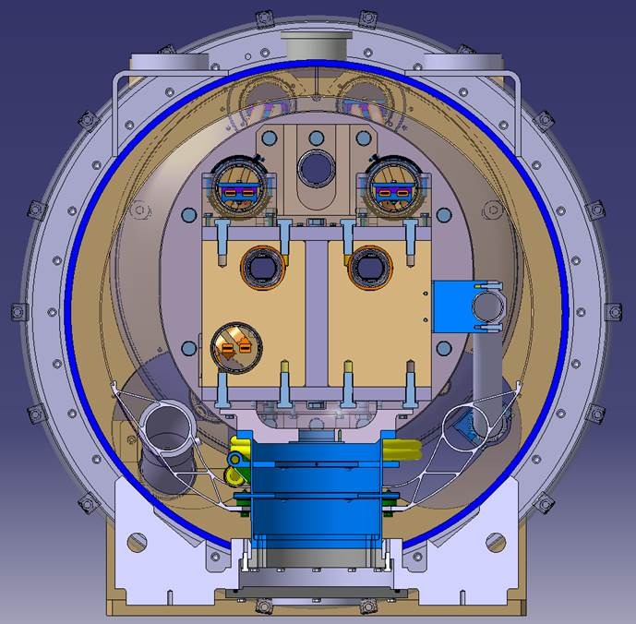
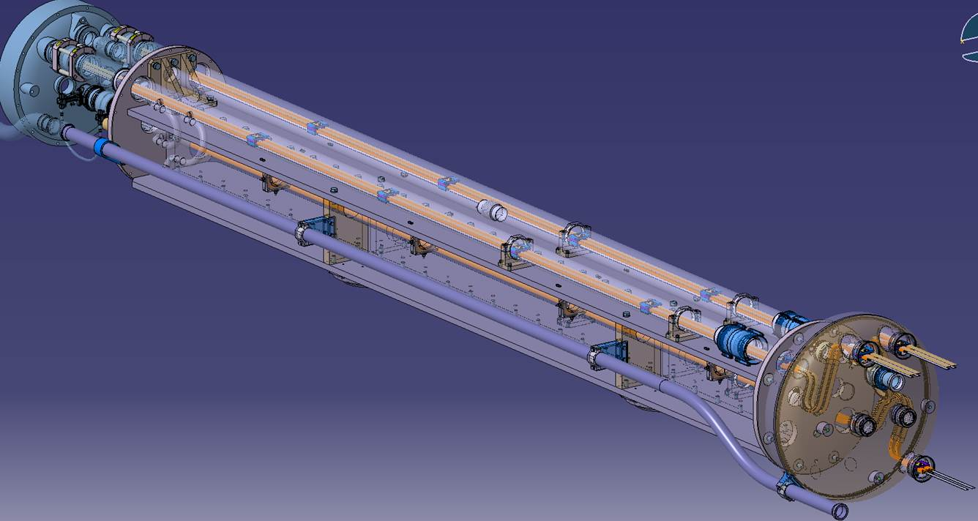
Cold Mass Overview
  The structural stiffness is ensured by an H-beam in the middle:
  Bolted plates in stainless steel
  Limitation of the displacements under load
  Standard LHC dipole support posts
  Cooldown performed through Cu braids connected to the M lines

Slide 5
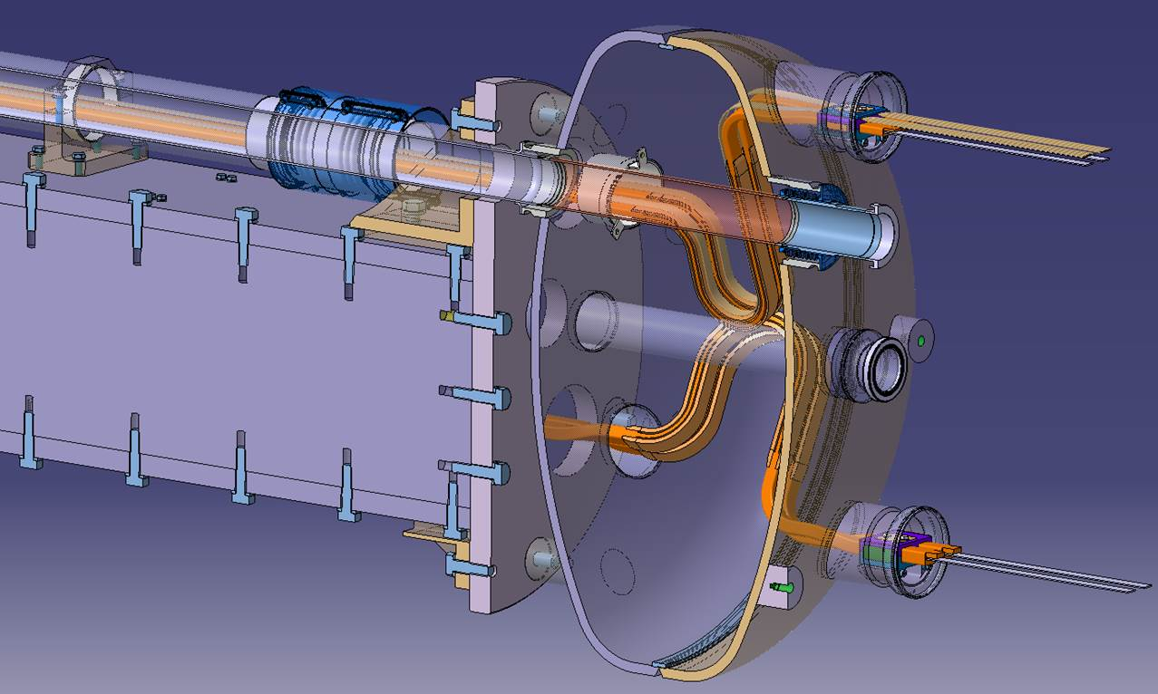
Cryogenic and Electric Lines
  Bayonet heat exchanger (X line) and auxiliary bus-bars line (N line)
  The layout of the M lines is designed to reduce the radial forces at the interconnects
  Shuffling module:
  Cooling of the X line
  Fitting of bus-bar lyras
  Transfer of the bus-bars to QEN bypass cryostat by matching the different radial positions

Slide 6
Radiation Shield Issue
  The radiation shielding requirement has to be verified
  An eventual radiation shield could represent an integration problem:
  Interference with the cold mass circuits and supports
  Complicated implementation of its connection to the H beam
  In case of a Pb shield, it should be thermalized to avoid the superconducting transition of Pb under 7.2 K
  Heavy loading of the cold mass resulting higher cold bore displacements and alignment difficulties

