Slide 1
Changes to underground HL-LHC CE engineering infrastructures
P. Fessia, S. Maridor, B. Vazquez De Prada

Slide 2
Time plan
Presently finalizing Point 1
After finalise Point 5 (different direction of lift exit underground leading to different US integration)
Production of “implantation” drawings
Target all models (CATIA+2D drawings) to SMB for the 15-16/09
Recall what shown here will be integration minimum envelope that will differ from SMB final model because of construction tolerances and construction solutions adopted

Slide 3
Main modifications
Technical change | Corresponding CE change
Splitting valves and cold box in 2 elements | Reduction of the shaft diameter from 10.2 to 9.7 m
 | Introduction of enlargement on the UL to house the valve box
 | Reduction of the US-UW diameter (from 16.9m to 16 m) and US length (US – 4.5 m)
PC of Q4,Q5,Q6 moved to RR | Reduction UR diameter from 7 m to 5.8 m
CLIQ reduction and moved in the bypass
Reduction of cooling capability linked to reduce requirement from crab also in case of full installation and elimination of the Q4,Q5,Q6 PC and associated cables | Reduction of the UW length and diameter (UW – 4.5m )
Possibility to keep the full crab installation without SR building | Increase UA diameter from 6 to 6.2 m
Re-optimization UL | We can reduce from 3m width to 2.5 m width. Pending on cost savings assessment from CE. If we save money we reduce if not wee keep
As promised, as soon as finished we will try to bring back CLIQ racks if space available, but we will not have margin on cable length

Slide 4
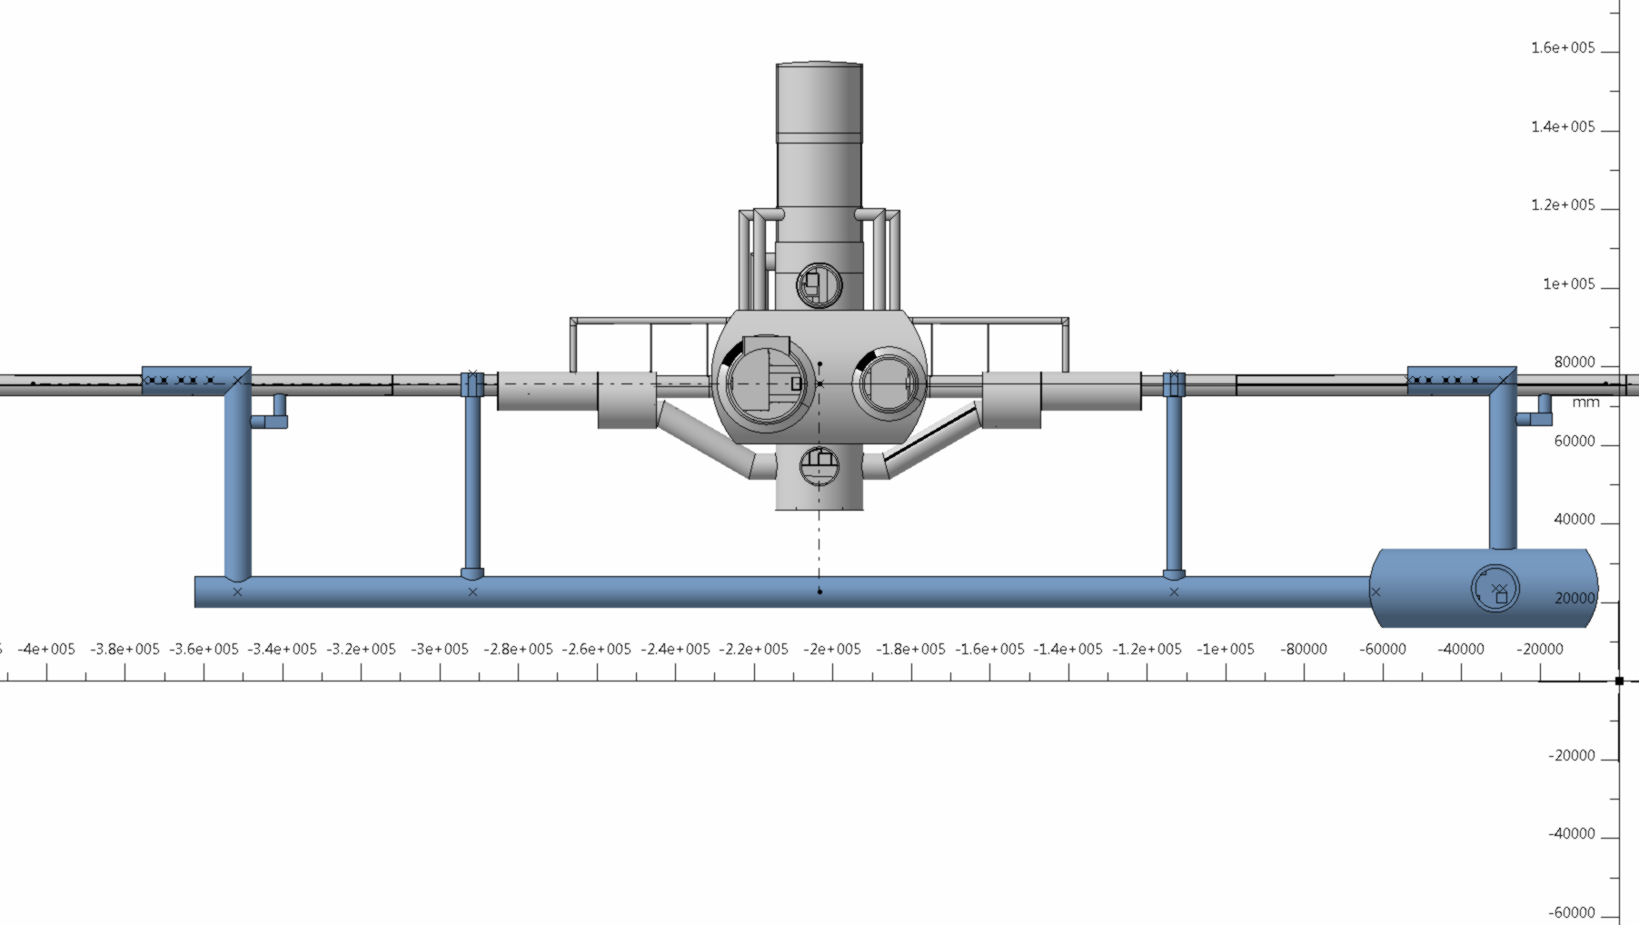
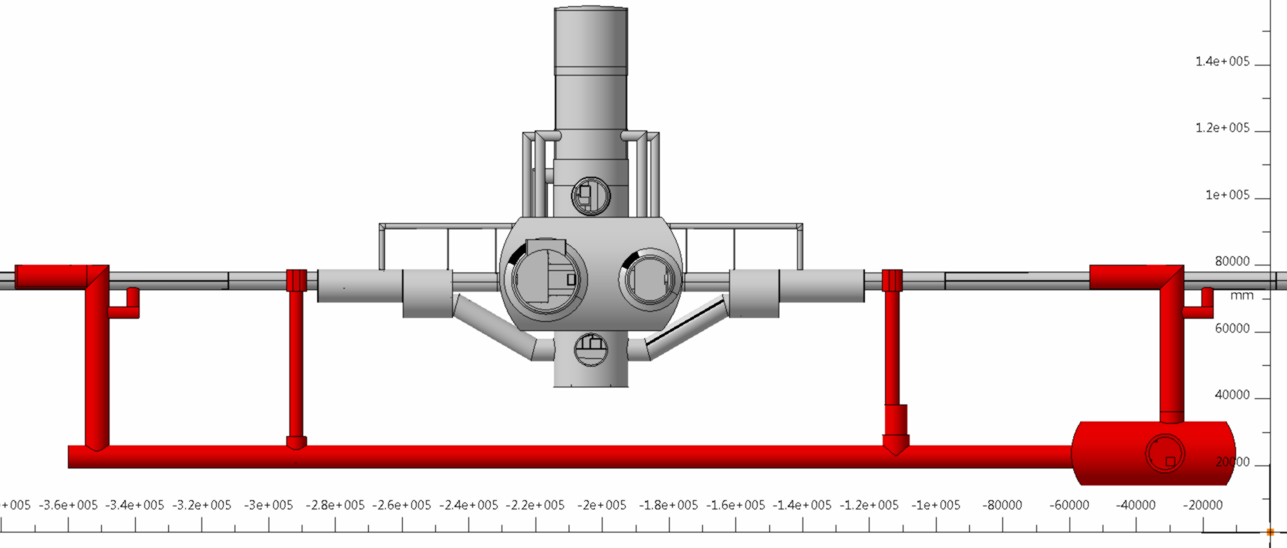

Slide 5
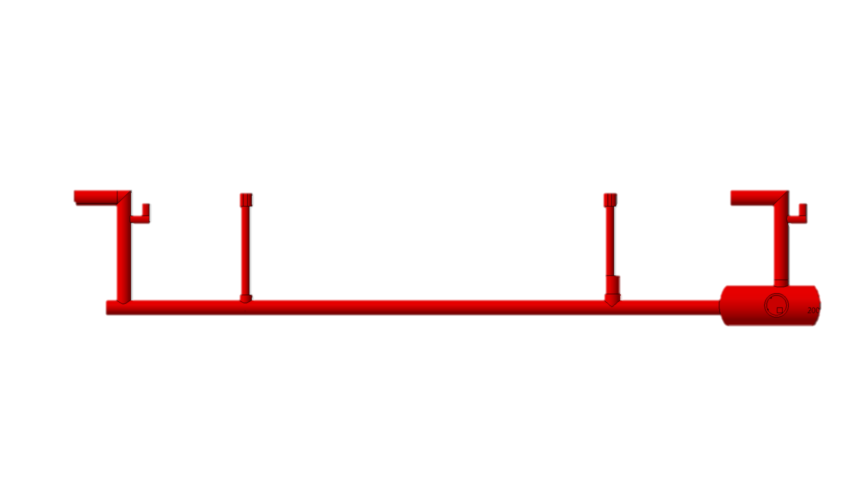

Slide 6

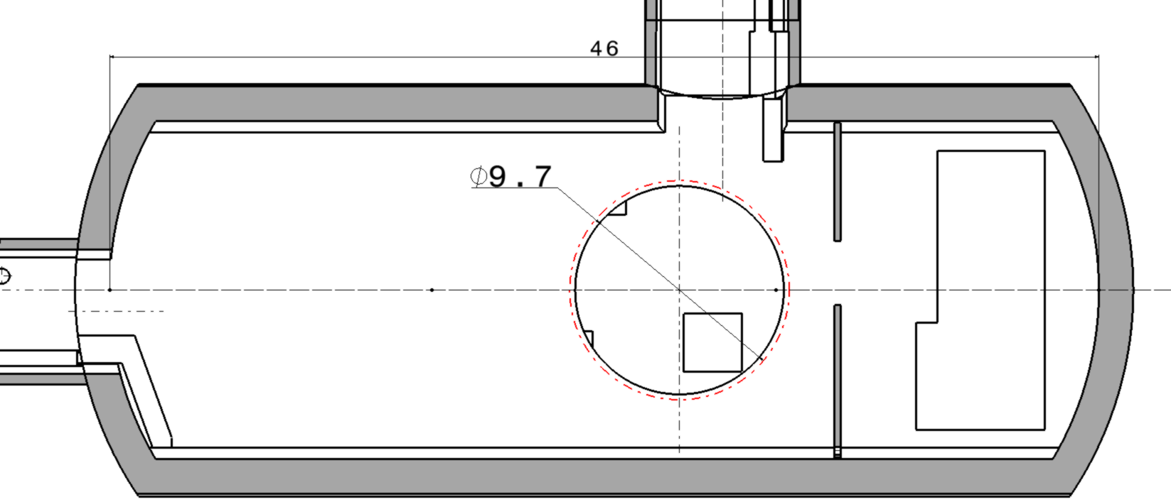
PM : from 10.2m to 9.7 m (≈ -8%) :
PM

Slide 7
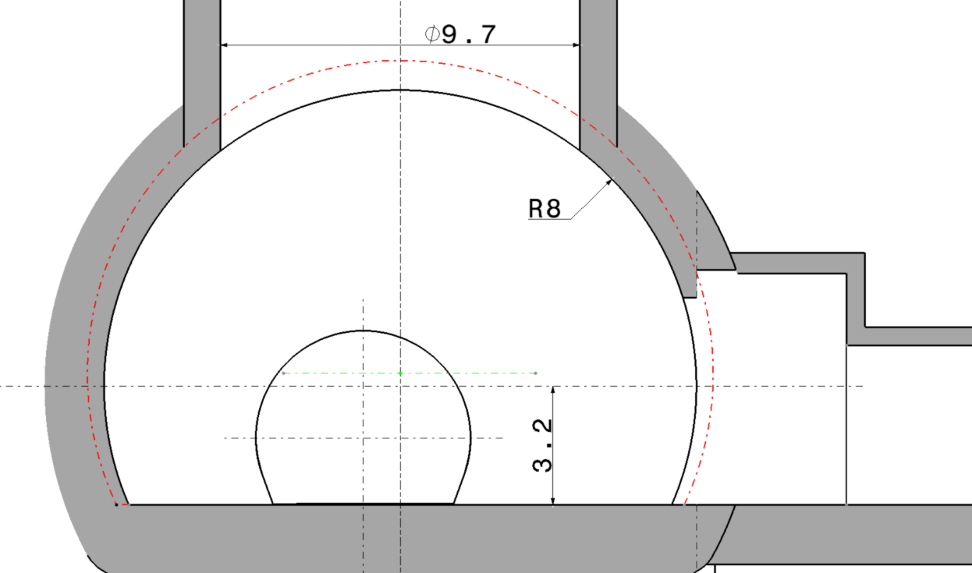
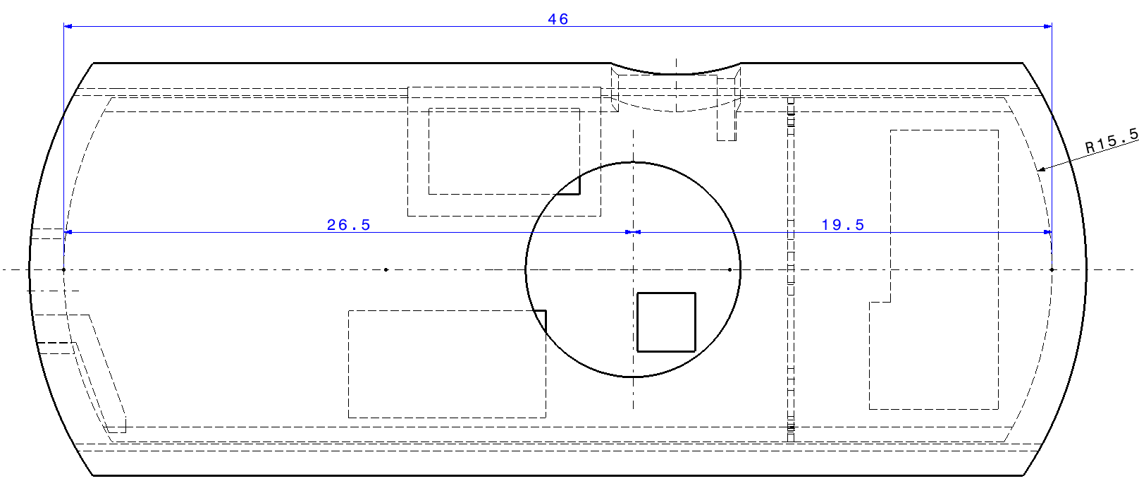
US/UW
US reduction (-25% volume)
Diameter 16 m (16.9 baseline)
Length 46 m ( 55 m baseline)

Slide 8
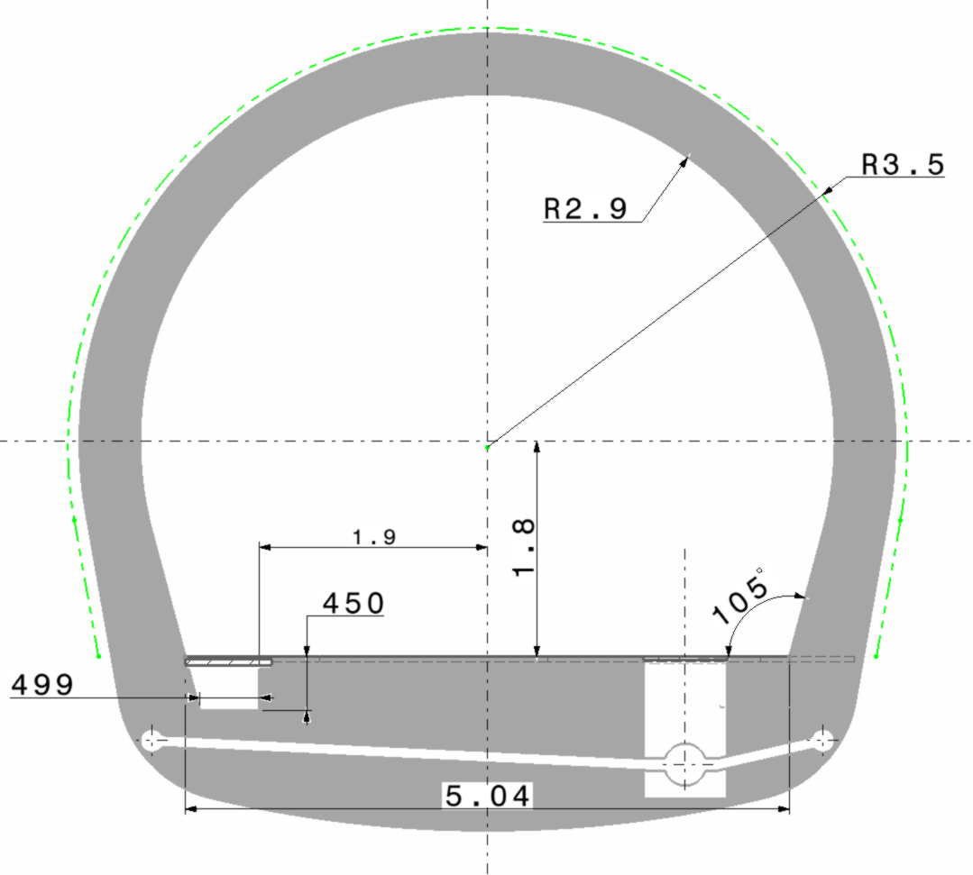
UR
UR : from 3.5 m to 2.9 m (≈ -20% of volume)
UR15

Slide 9
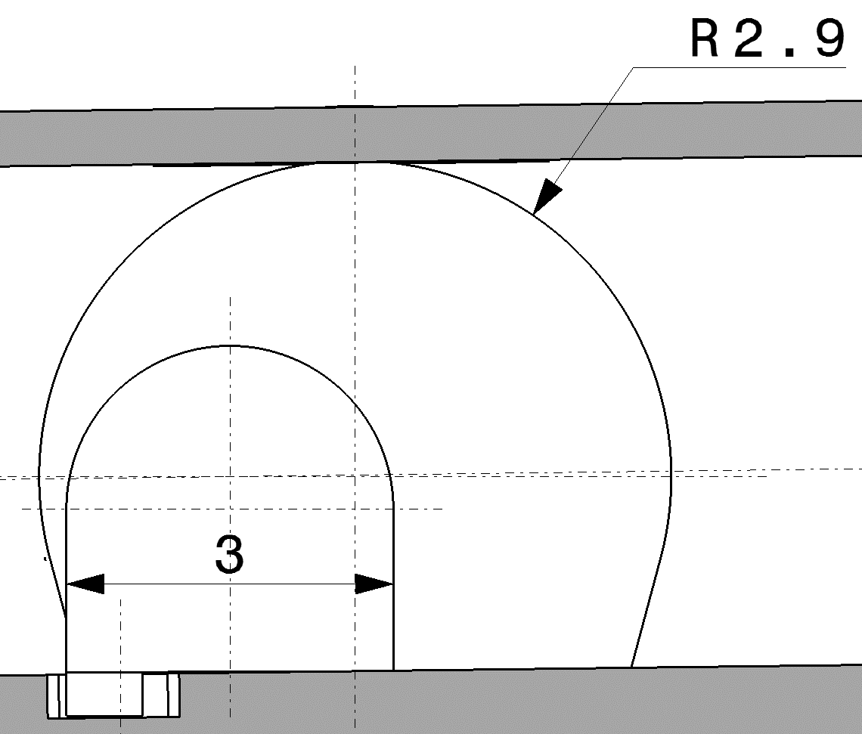
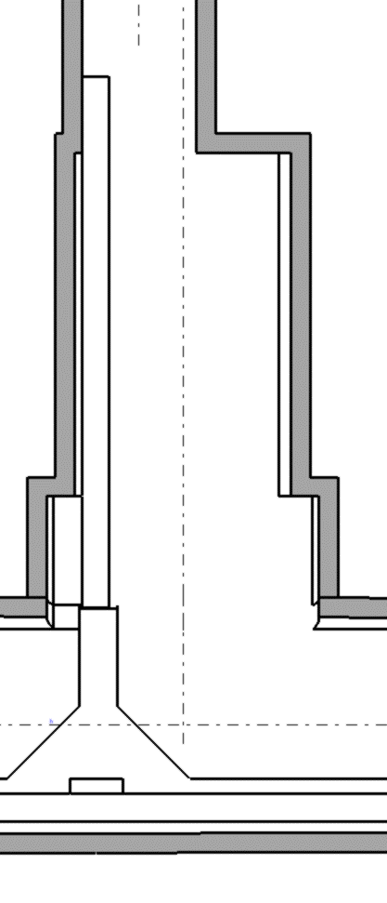
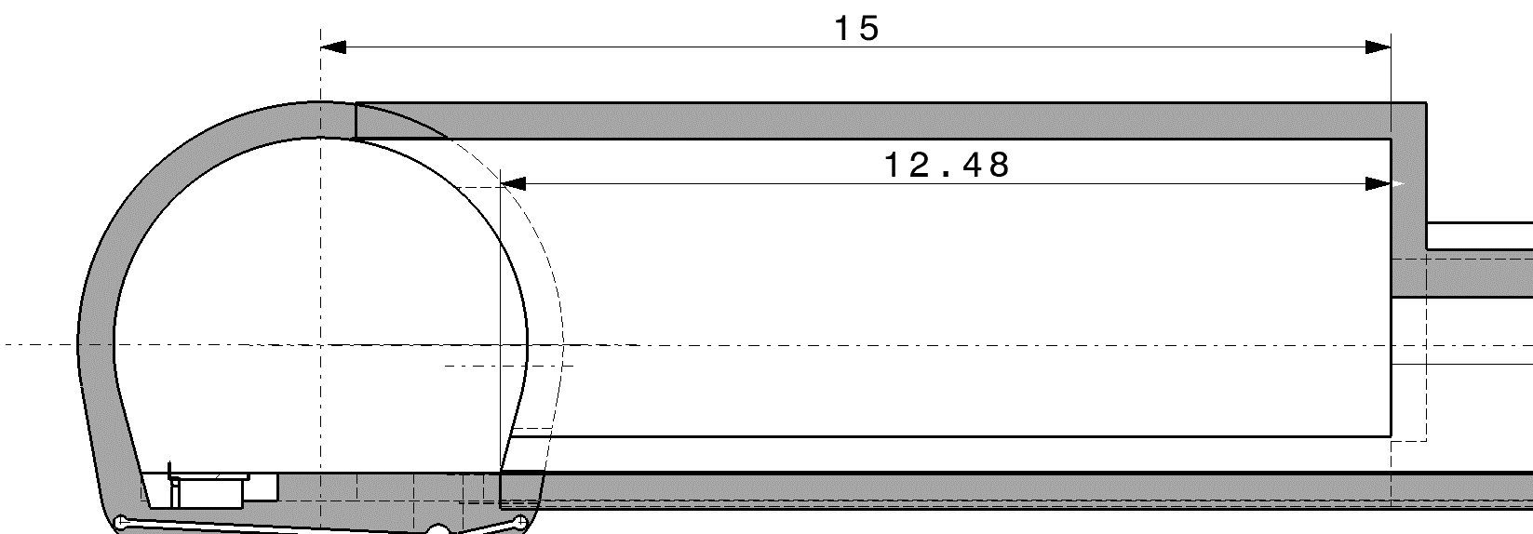
UA : R 3.1
ULx3
ULx7
UL x3 : STAY AS BASELINE
BUT UL x7 : Need alcove for cryo.-box

Slide 10
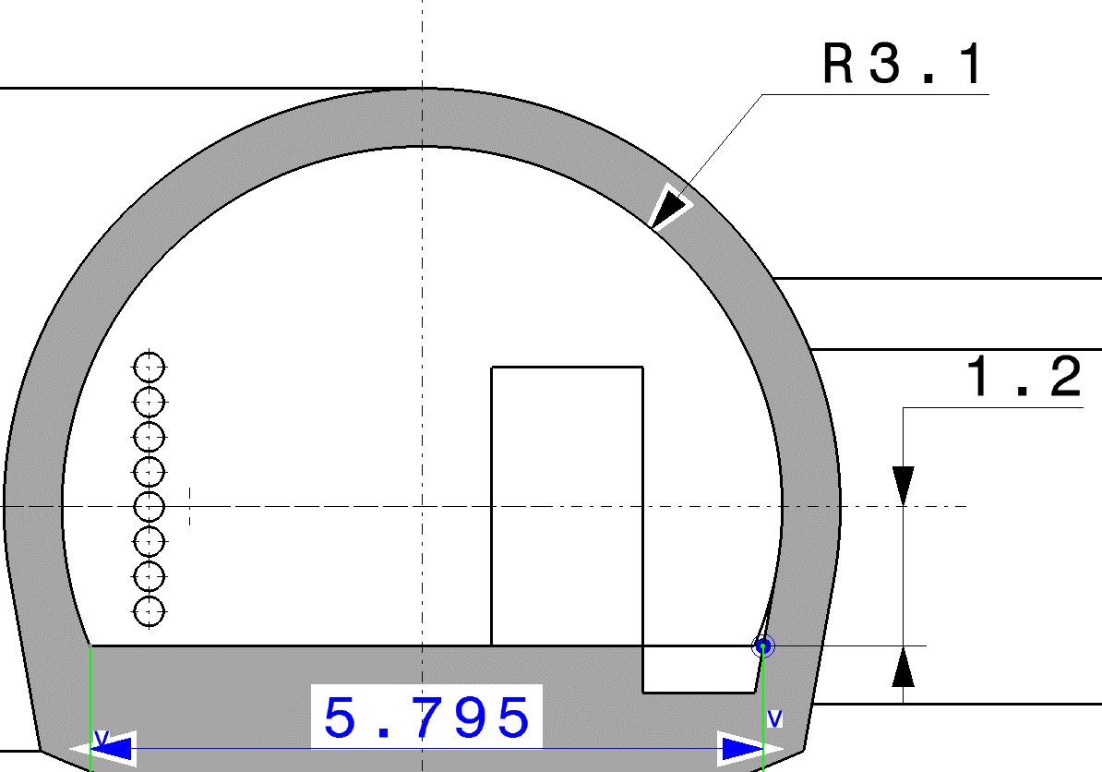
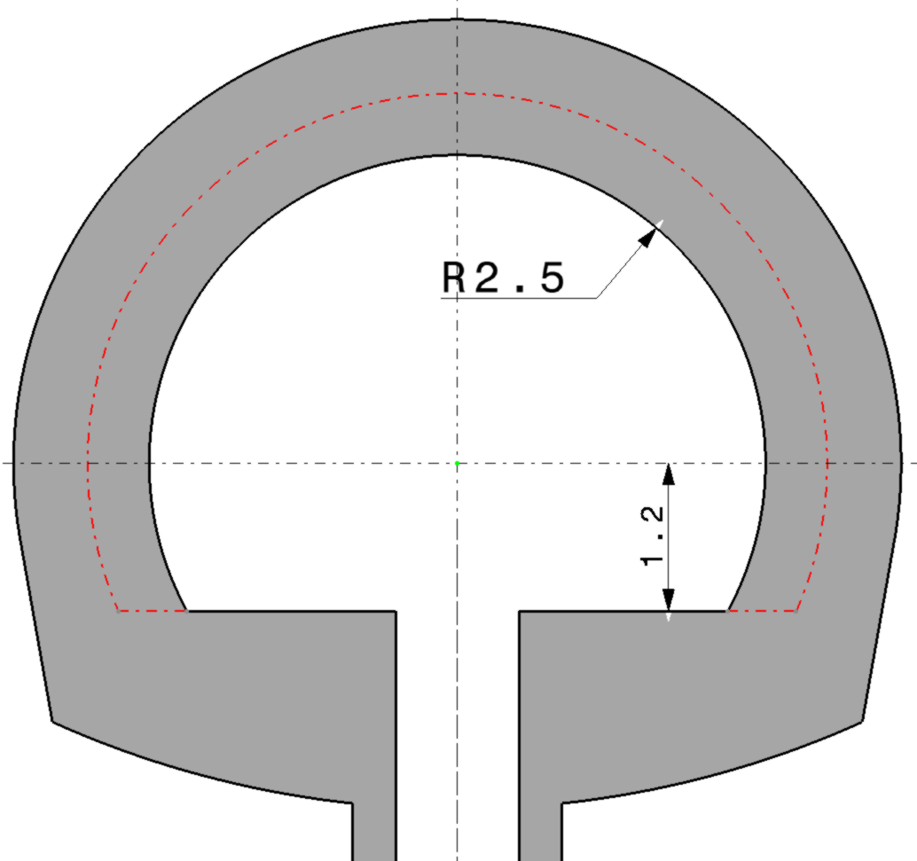
2
UA : R 3.1
1
1
UA
UA
2

Slide 11
How we can move Crab Cavity to the arc for 1 meter

Slide 12
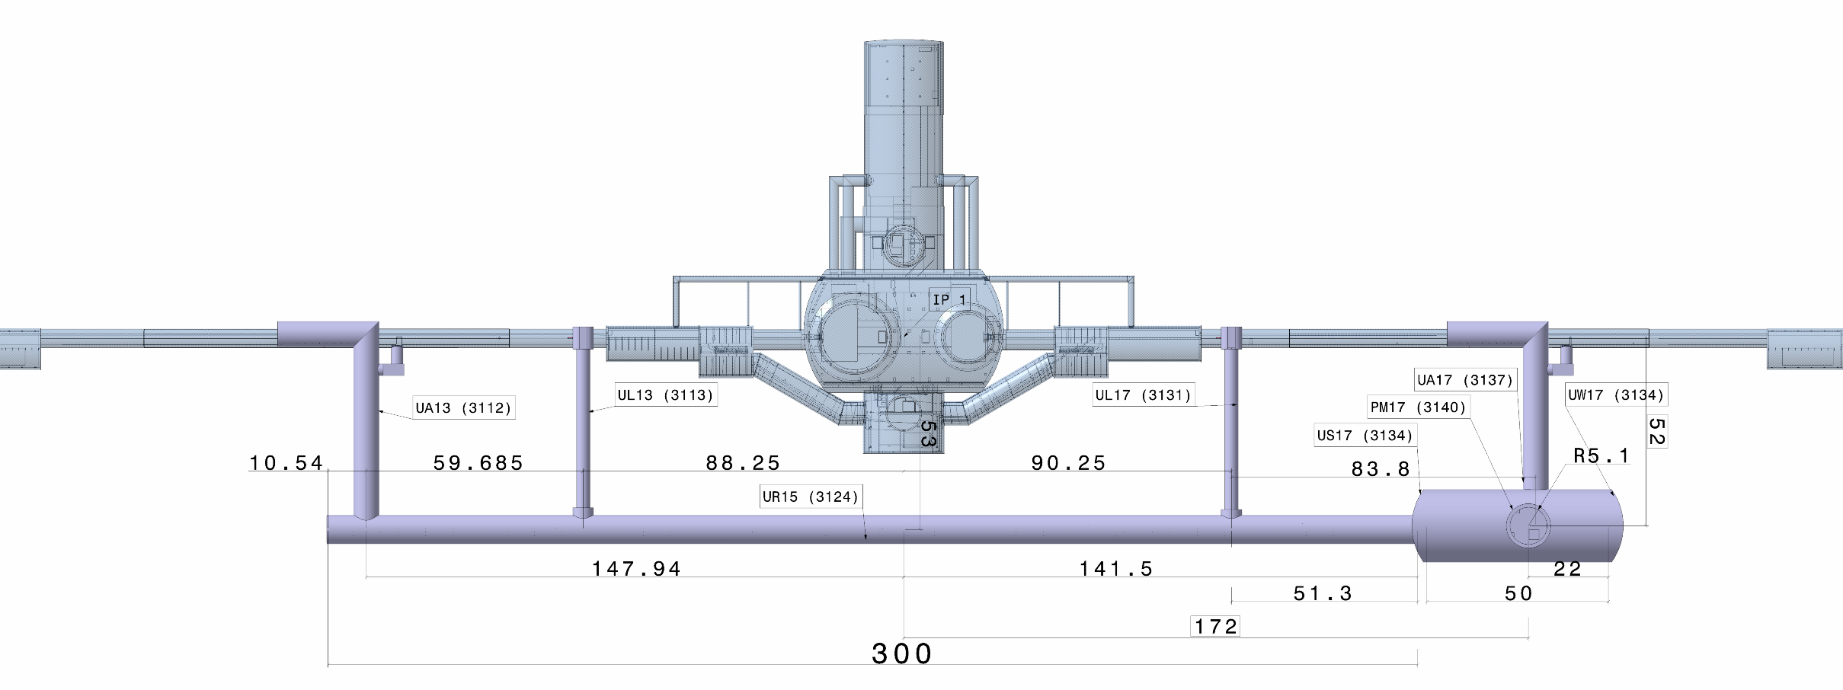
UA17

Slide 13
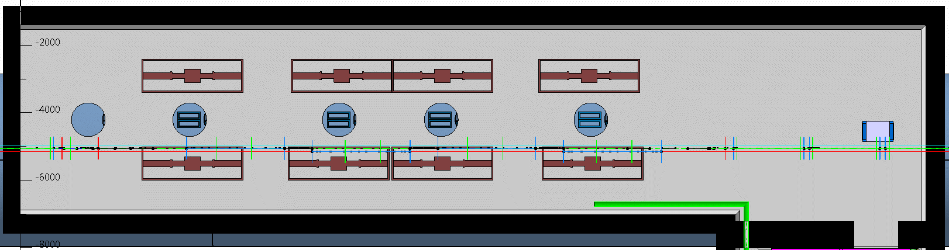
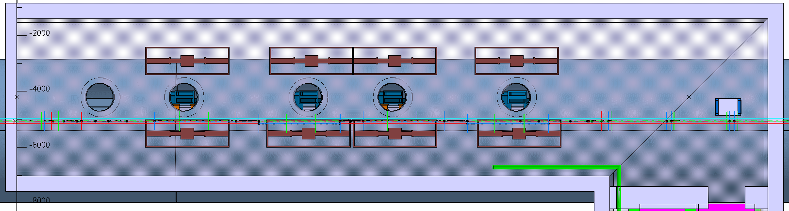
IP
Arc
UA17
4.4 m
CORES + 1m
3.4 m

Slide 14
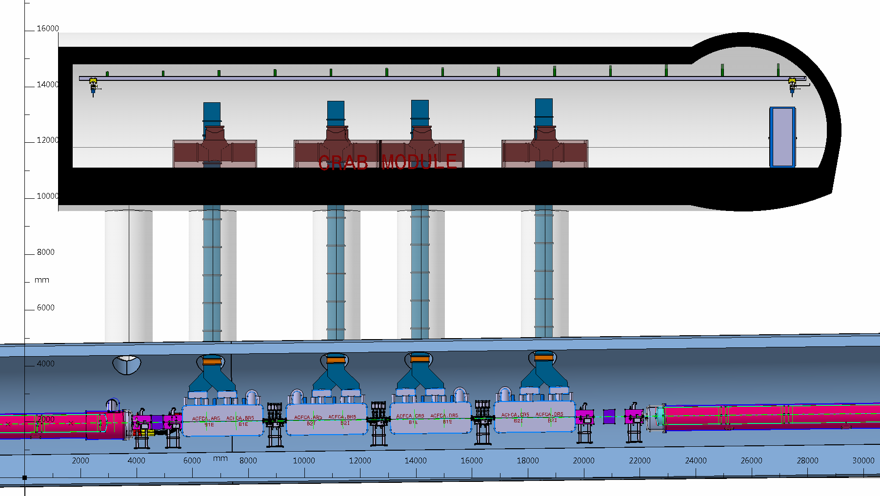
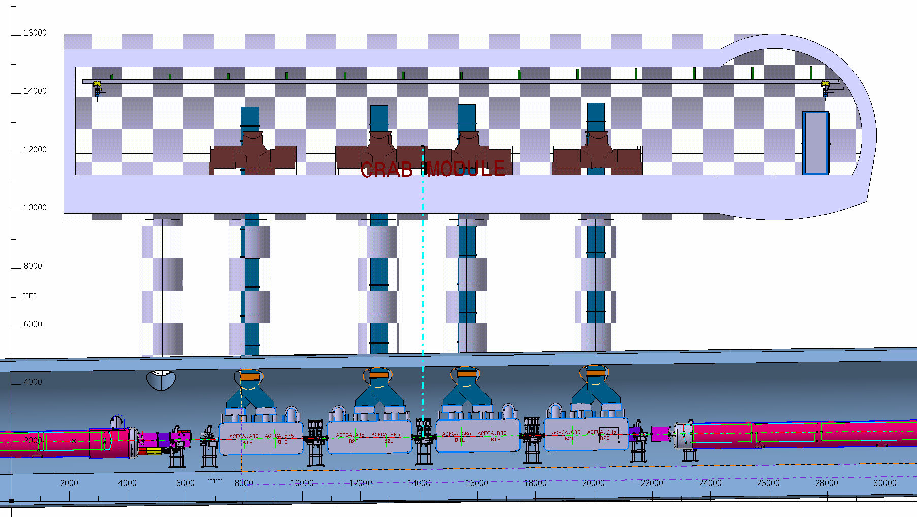
UA17
4.4 m
UA17
CORES + 1m
3.4 m

Slide 15
UA13

Slide 16
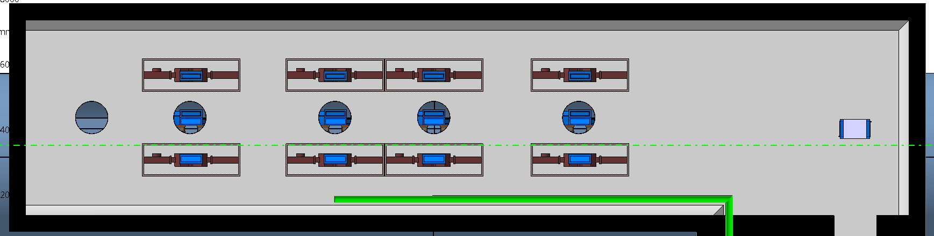
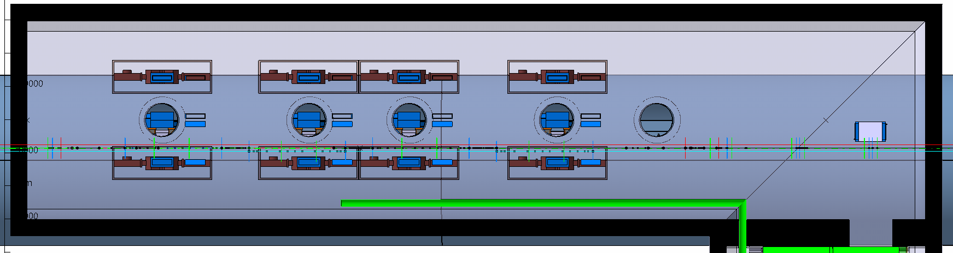
ARC
IP
UA13
4.4 m
4 CORES + 1m ; cables core switched
5.4 m
2.4 m

Slide 17
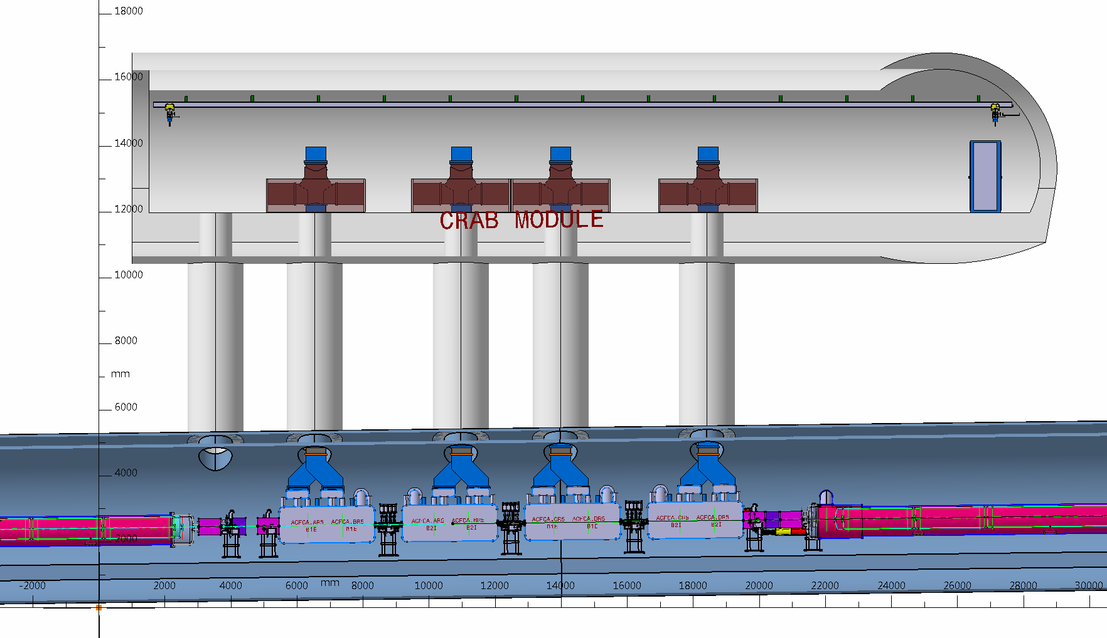
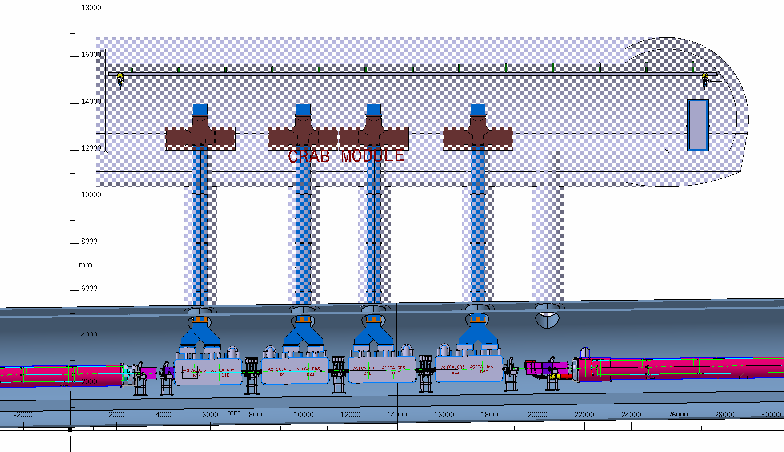
UA13
4.4 m
UA13
4 CORES + 1m ; cables core switched
5.4 m
2.4 m

Slide 18
conclusions
1 meter displacement toward the arc is feasible and can be absorbed in the present CE design including RP constraints and it was validated in the last months following a request by WP2 that after was not implemented
.

