Slide 1



BPM and interconnect shielding in the Inner Triplet region
A. Tsinganis, F. Cerutti (EN/STI/FDA)
with T. Lefevre, R. Jones, D. Draskovic (BE/BI)
C. Garion, R. Kersevan, R. Fernandez-Gomez (TE/VSC)
14th HL-LHC TCC Meeting – September 1, 2016

Slide 2
Introduction
Peak dose values in the IT using the first FLUKA implementation of IT interconnects with incorporated BPM were presented at last annual meeting (October 2015)
  https://indico.cern.ch/event/400665/contributions/1843468/
A peak value of 48MGy at the IP face of Q2B was predicted for 4000fb⁻¹ (36MGy after re-baselining to 3000fb⁻¹) for horizontal crossing
The interruption of the Inermet BS shielding in the interconnect (exceeding 70cm) was indicated as the primary cause of this localised problem
Improvements to the interconnect design in the direction of increasing the shielding have since been investigated and the results are presented here

Slide 3
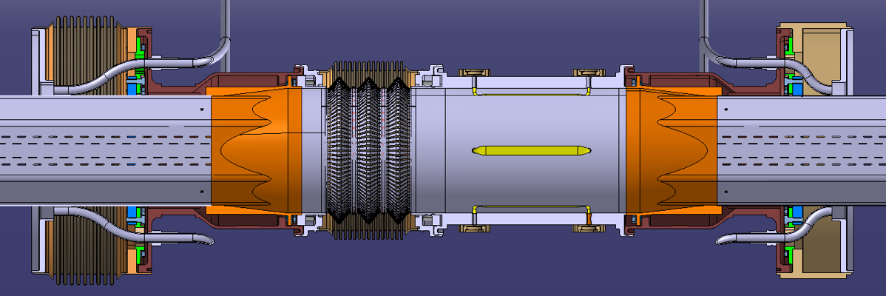
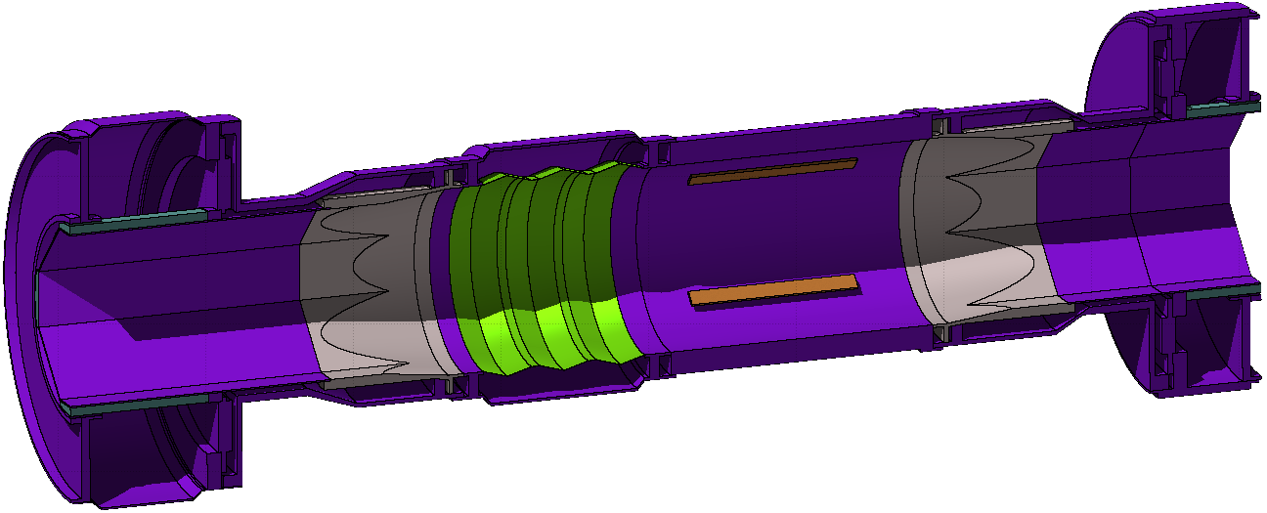
First interconnect implementation (#1)
“Circular” BPM
No additional shielding
71cm gap in the Inermet beam screen shielding
BS shielding gap 70.8cm
Outgoing
beam
BS shielding (Inermet)

Slide 4
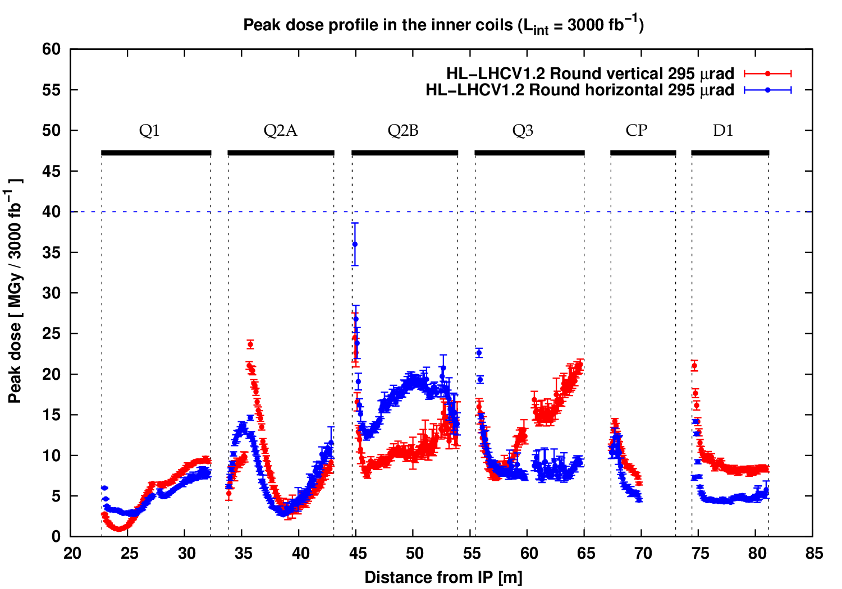
First interconnect implementation (#1)
Very high dose peak at non-IP face of Q2B, especially for horizontal crossing (previously shown at 48MGy for 4000fb⁻¹)

Slide 5
Proposed cure
It was shown that alternative optics and crossing scenarios could significantly reduce the peak value
  HOWEVER, some of these solutions are dependent on specific hardware availability (e.g. wire compensation)
It was proposed to investigate local design improvements with the view of reducing the shielding interruption
Constraint: any additional shielding element would only be effective if its radial position matches that of the BS shielding

Slide 6
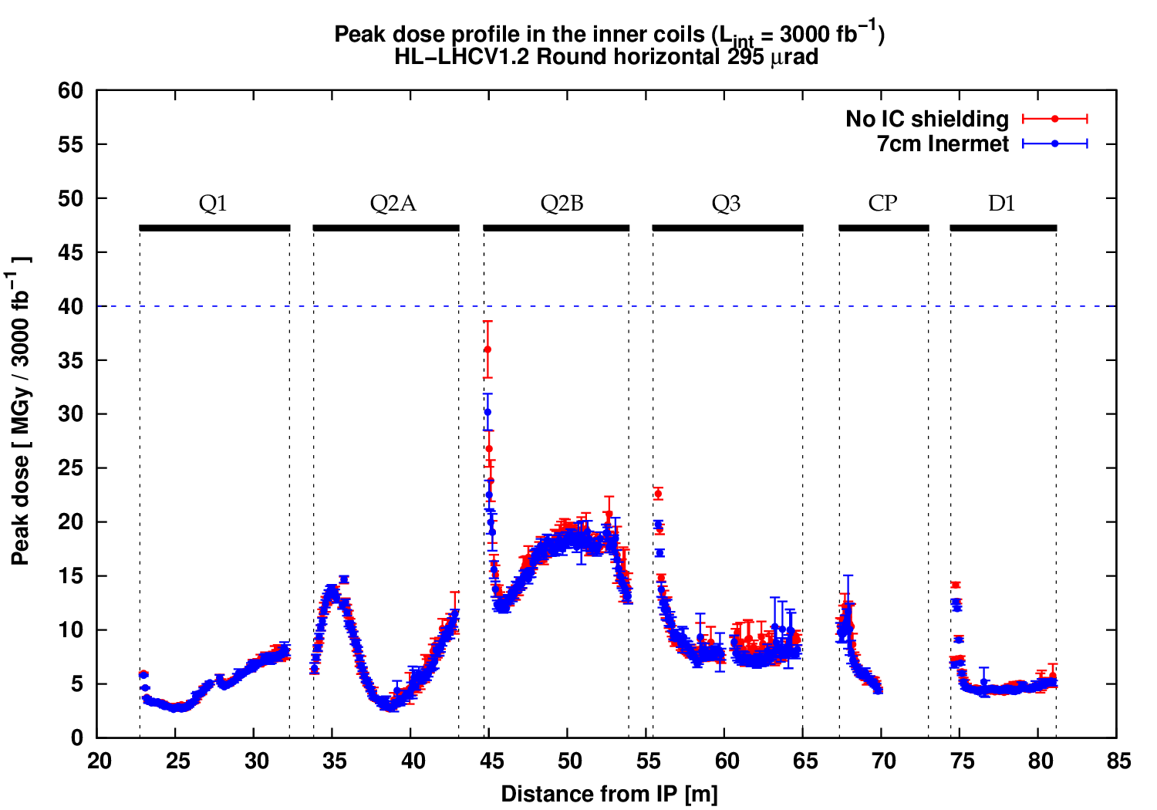
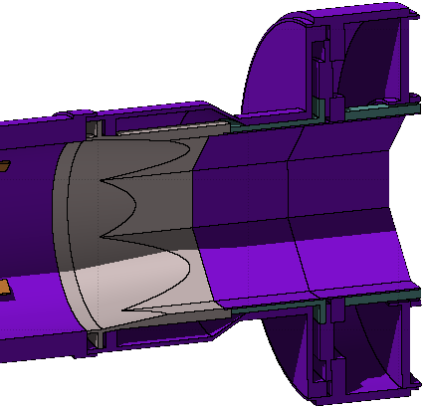
Second interconnect implementation (#2)
“Circular” BPM
Addition of 7cm Inermet insert on non-IP side
Peak value reduction by ~15%
Additional shielding (Inermet, 7cm)

Slide 7
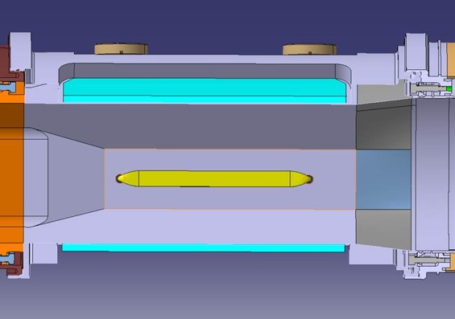
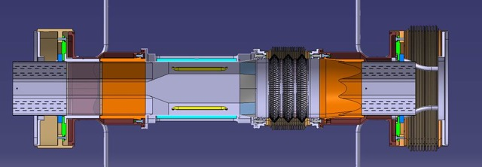
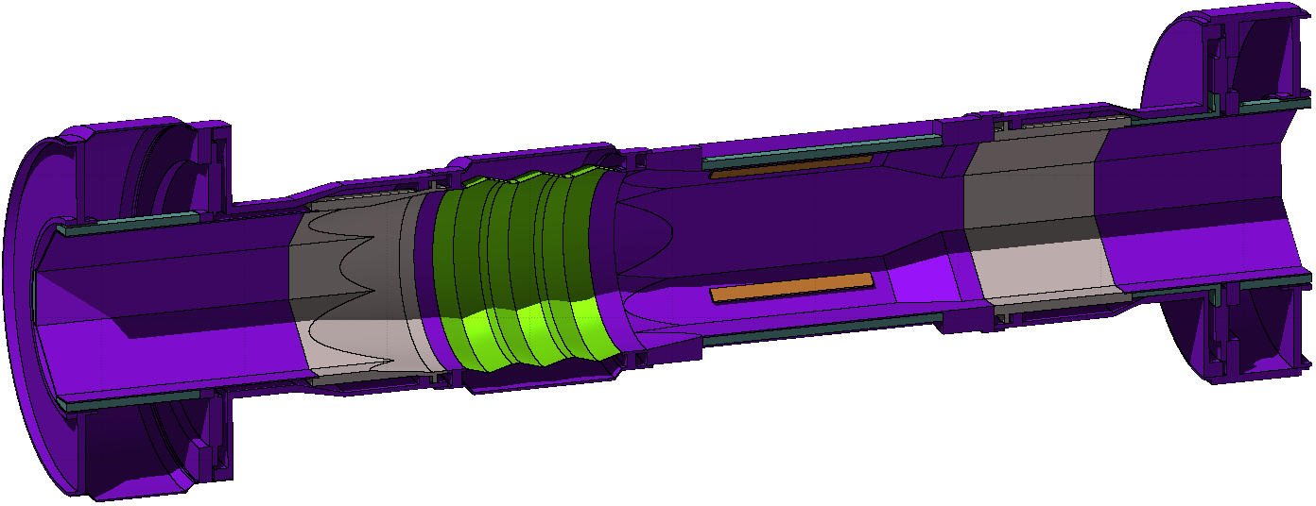
Third interconnect implementation (#3)
“Octagonal” BPM with incorporated 18cm Inermet pieces on the mid-planes (retaining previously included 7cm insert)
Further ~15% reduction with respect to case #2
BPM shielding (Inermet, 18cm)

Slide 8
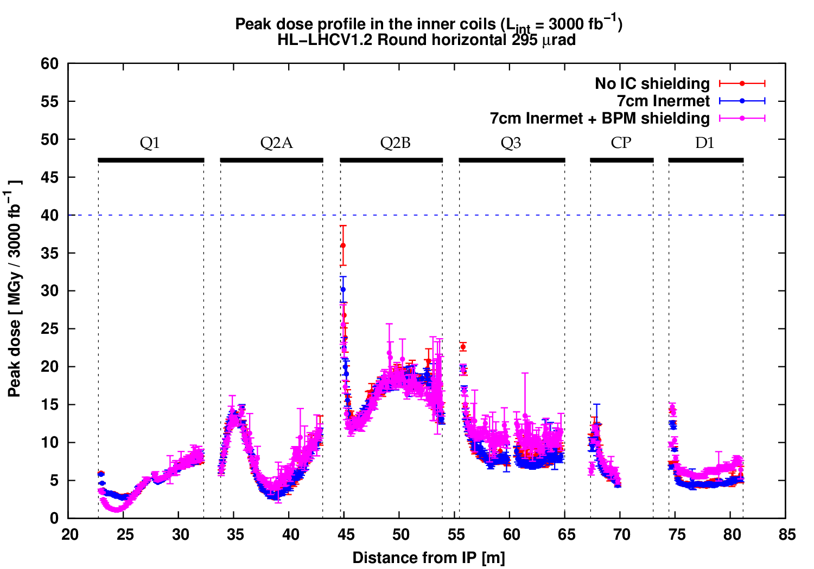
Summary of results
36MGy
30MGy
26MGy
15% reduction of the peak with 7cm insert
Further 15% reduction with octagonal shielded BPM
Total reduction of ~30%

Slide 9
Conclusions
Both the inclusion of the 7cm insert and the octagonal shielded BPM design lead to an appreciable (~15% each) reduction of the peak dose value in the IP-face of Q2B
By combining the two solutions, a total reduction of almost one third (~30%) is achieved
This reduction would come in addition to other gains obtained by different optics and crossing combinations (crossing plane switch etc.), as presented at last annual meeting
Based on these results we recommend the adoption of this design

