Slide 1

HL-LHC IT STRING
M. Bajko CERN
for TCC 15th September 2016

Slide 2
Outline of the presentation
WP16 in the HL-LHC Structure and IT STRING Scope
Brief return to the past
Experience with LHC Triplet
Relevance of HL-LHC IT String
ID Card
Main facilities of the IT String
Organization of the work
Limitations and solutions in space
Limitations and solutions in time
Status of the work

Slide 3
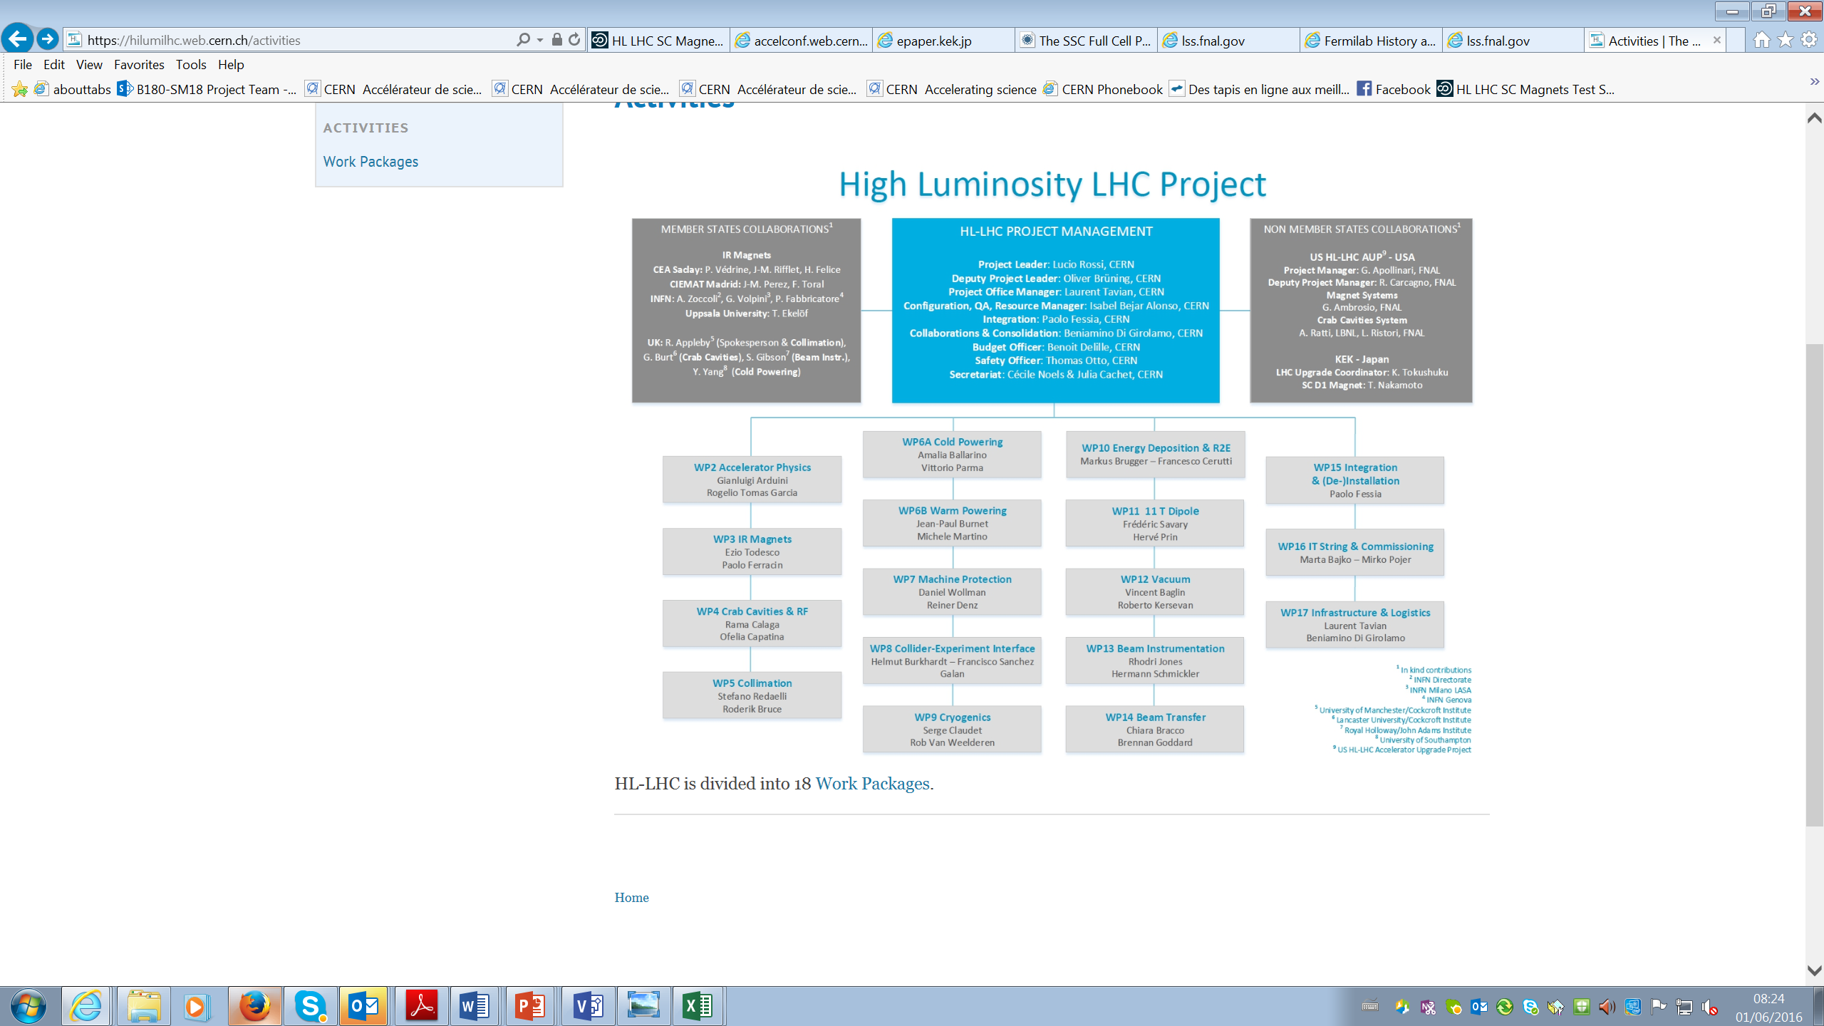
The HL-LHC IT STRING in the organigram
[…] THE WP16 covers the coordination of the commissioning of the HL-LHC equipment as part of the accelerator system. […] The first important system test will be the Inner Triplet (IT) STRING test.
The IT STRING should comprises all magnets with their cold and warm powering and associated cryogenics systems from Q1 to D1 magnets including DFX. […] The IT STRING will have conditions as similar as possible to the operational ones and will constitute an integration and system test of the most critical part of the upgrade.
Ref. HL_WP16 Conceptual specification : https://edms.cern.ch/document/1586706/1
Ref. HL_WP16 IT STRING Mandate: https://edms.cern.ch/document/1513780/1

Slide 4
The HL-LHC IT STRING SCOPE
INTRODUCTION
In the HL-LHC configuration, the Inner Triplet (IT) region of IR1 and IR5 of the present LHC will be heavily modified. In particular the Q1-Q2-Q3-D1 magnets will be completely different from the present LHC magnets, mainly due to the new technology they are based. In particular the
D1 magnet will be superconductor instead of normal conductors as is today in the LHC. The IT quadrupoles (Q1-Q3) will use Nb₃Sn superconductors instead of the Nb-Ti used by the present ones.
The powering of the magnets will be with higher current than the present LHC IR magnets and will be made via a superconducting link. The protection of the magnets based on Nb₃Sn superconductor technology will be different from the present ones (ex. Cliq and new QH) due to its particulate characteristics at low and medium field and the high magnetic energy stored in the magnets in operational conditions.
In addition, the aperture will be much larger, the cold mass configuration will be completely different and the corrector package will be substantially modified as configuration and technology, too.
[…]
MAIN GOAL
The HL LHC IT STRING will be a test stand to STUDY and VALIDATE the COLLECTIVE BEHAVIOURE of the different systems: magnets, magnet protection, cryogenics for magnets and superconducting link, magnet powering, vacuum, and interconnections between magnets and superconducting link, alignment.
Ref. HL-LHC IT STRING Scope https://edms.cern.ch/document/1693312/1

Slide 5
System architecture WP16
IT STRING
Magnets Cryostats and Connections (MSC)
Cold Powering System (MSC)
Warm powering system (EPC)
Magnet Protection System (MPE)
DAQ
Vacuum (VAC)
Utilities
Design and Integration
Cryogenic System (CRG)
Cryogenic Cooling
Cryogenic Distribution
Controls Instrumentation and Software
Magnets (Q1,Q2A,Q2B,Q3,CP,D1)
DFH
Magnet Interconnects
Controls Instrumentation and Software
Measuring Systems
SC Link
Current leads (DFX)
Control Instrumentation and Software
Power Converters (EPC)
Warm Power Distribution (EL)
Control Instrumentation and Software
Protection Heater Supplies
Cliq System
Energy Extraction
PIC
Control Instrumentation and Software
Hardware
Control, Instrumentation and Software
Civil Engineering ( GS)
Network (Including Wfip)
Demineralized Water ( EN CV)
Water Cooled Cables (EN EL)
Survey System (EN ACE)
Transport and Handling EN-E)
Control Room( TE-MSC)
Safety (HSE,HL LHC)
https://edms.cern.ch/document/1690890/1.0

Slide 6
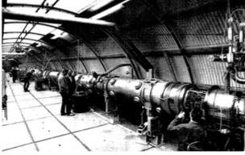
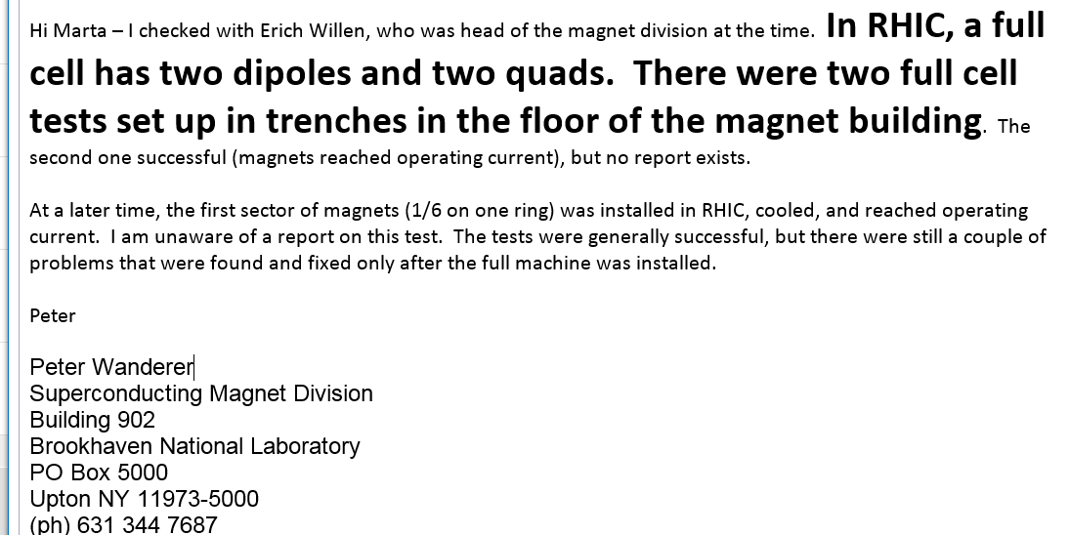
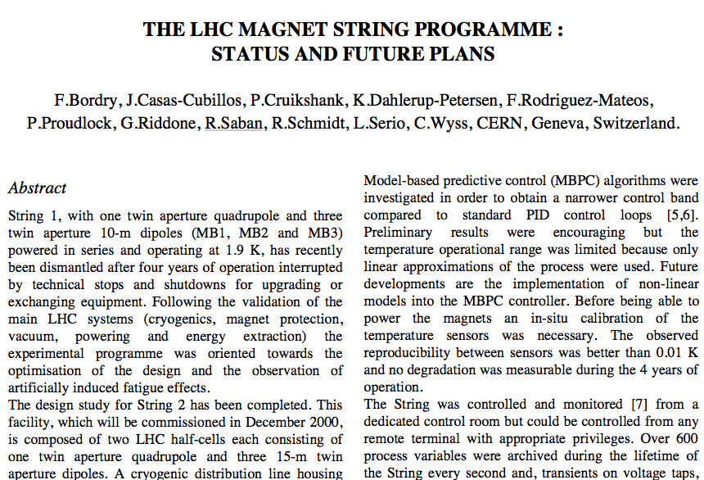
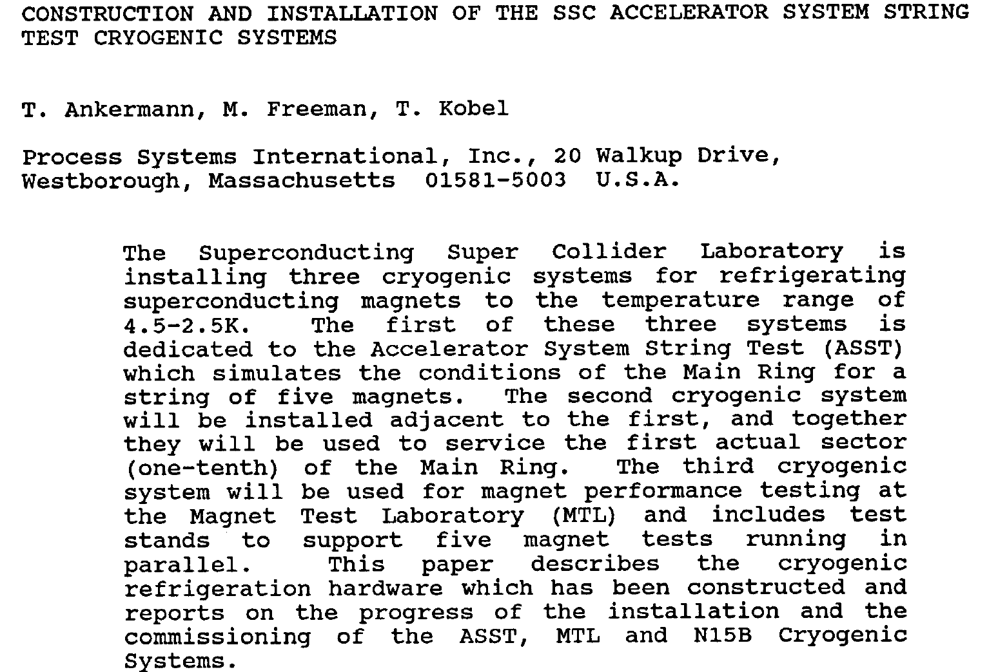
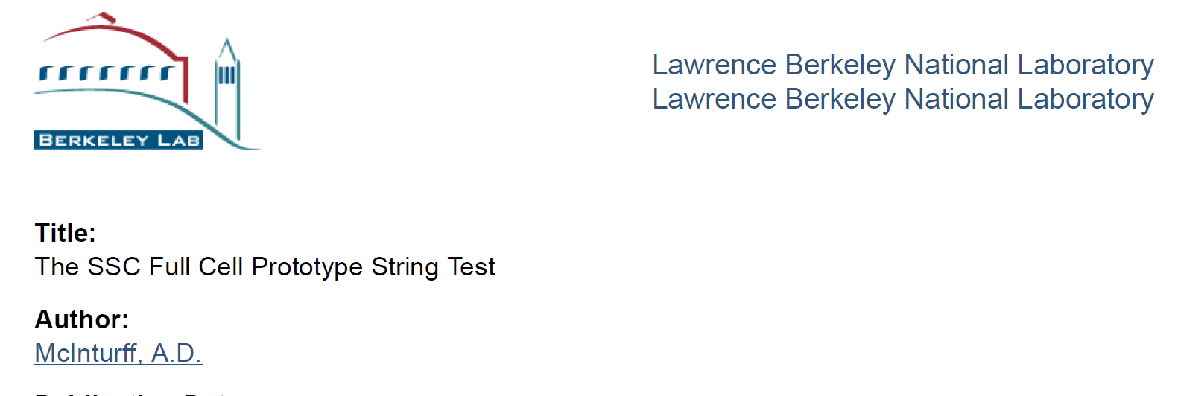
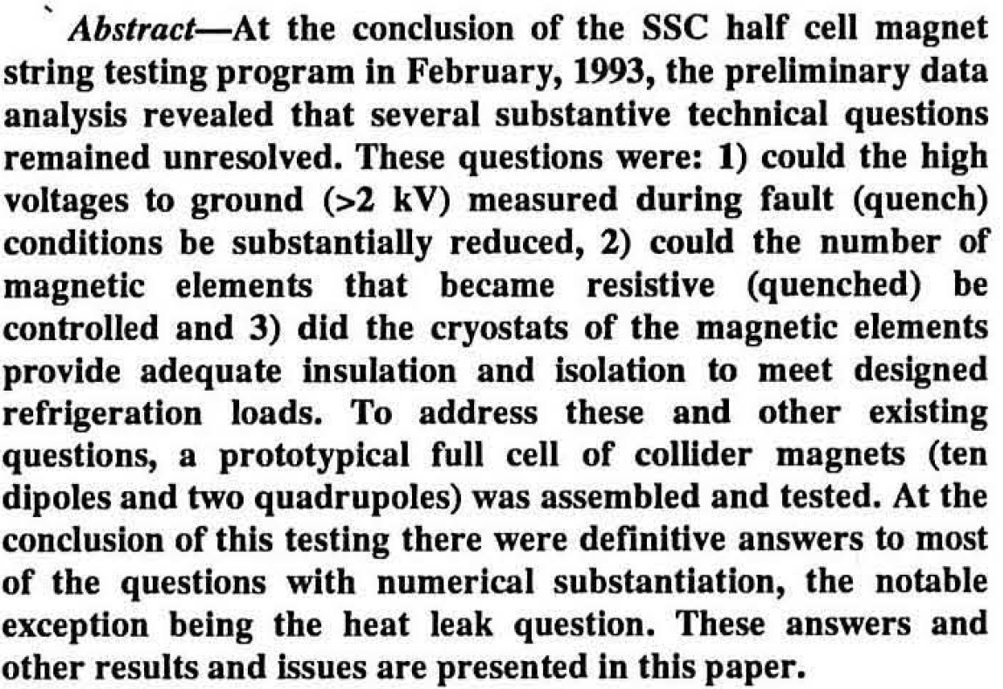
Previous experience - past
In the past STRINGs tests were run for
SSC
Hera
Tevatron,
RHIC and
LHC
DESY
Magnet string tests
A 36 metre chain of superconductive­ magnets built for the HERA electron-proton collider has been under test since April at DESY in Hamburg. The magnet string is composed of three full-sized prototype dipole magnets (with coils made at DESY and mounted in cryostats at BBC-Mannheim) and two quadrupoles
(made at Saclay).
[..] It has been quenched more than 20 times at magnetic fields between 1.8 and 5.8 tesla, the latter corre­sponding to a proton beam energy of 1010 GeV
CERN Courier, December 1987

Slide 7
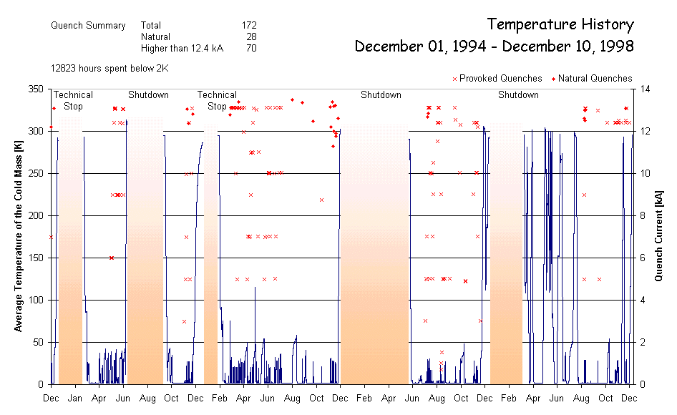
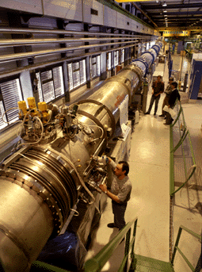
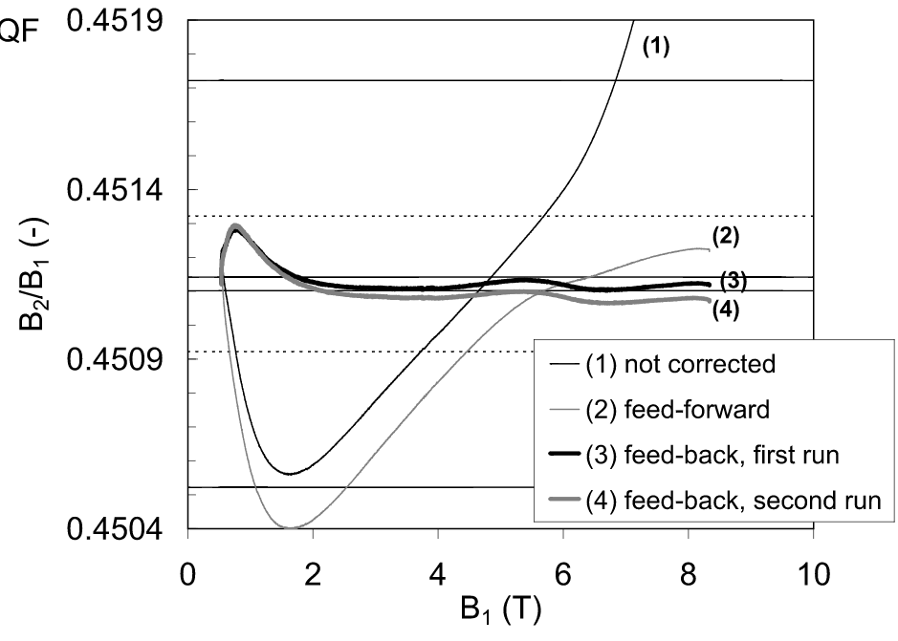
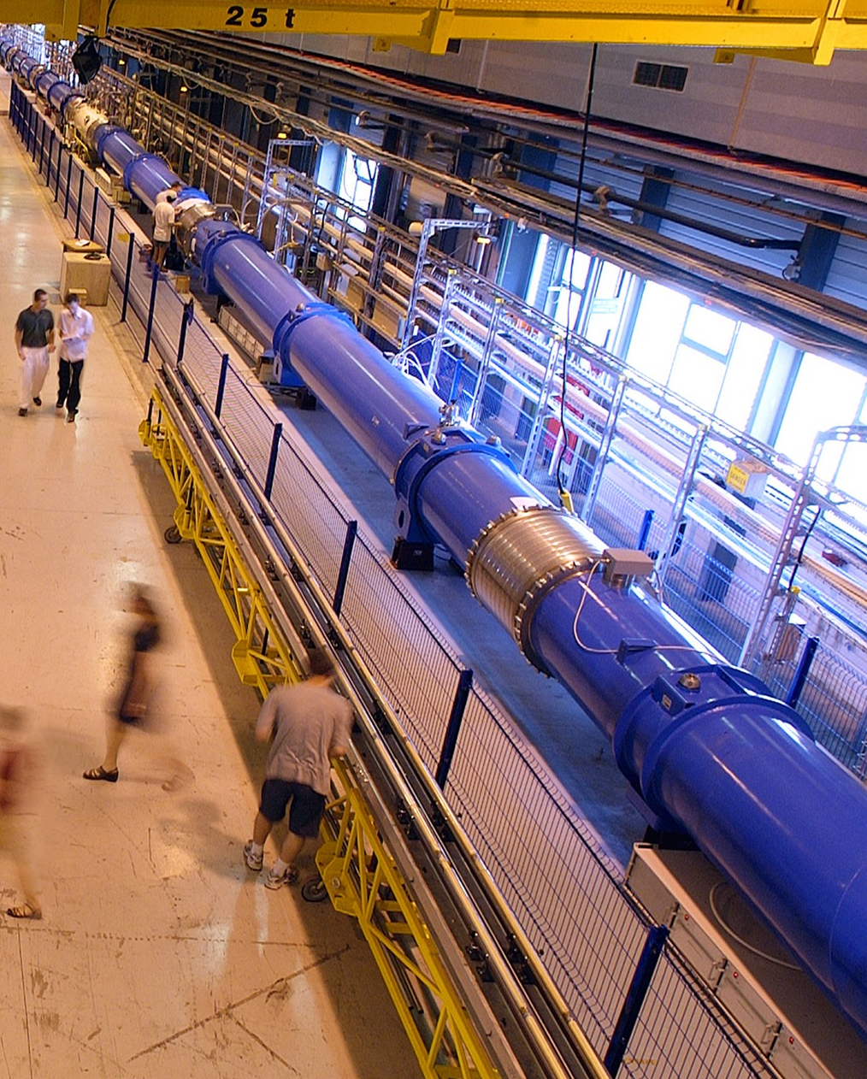
Previous experience @ CERN
STRING-1 (1994-1998)
One half LHC cell:
  3 MB (10 m) + 1 MQ
Validation of:
  Cryogenics (6 CD’s)
  Vacuum
  Quench (172) and protection
  Powering and energy extraction
STRING-2 (2000-2004)
One full LHC cell
  6 MB (15 m) + 2 MQ + correctors
Validation of:
  Cryogenics,
  Vacuum
  Quench and protection
  Powering
  Accelerator relevant operation (e.g.tracking of MQ and MB)
String-1 in SM-18
String-2 in SM-18
Courtesy of L. Bottura

Slide 8
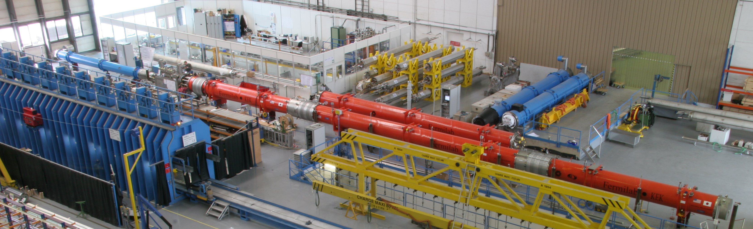
Previous experience : LHC triplets
What we have learned from it?
STRING of Q1 Q2 Q3 (2005)
  Validation of:
  Cryogenics,
  (Insulation) vacuum
  Quench and protection
  Powering
  Accelerator relevant operation
When pumping the vacuum magnets moved
Inner triplet linked via the “W” bellows ( not interconnected) in B. 181
Info from H. Prin

Slide 9
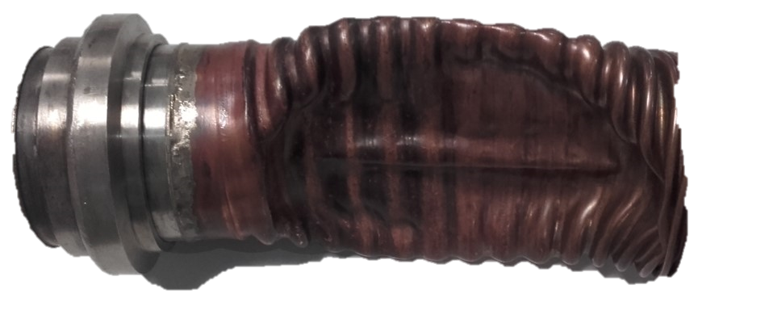
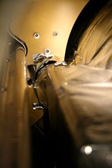
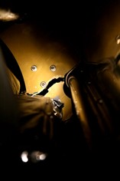
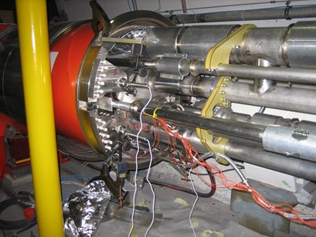
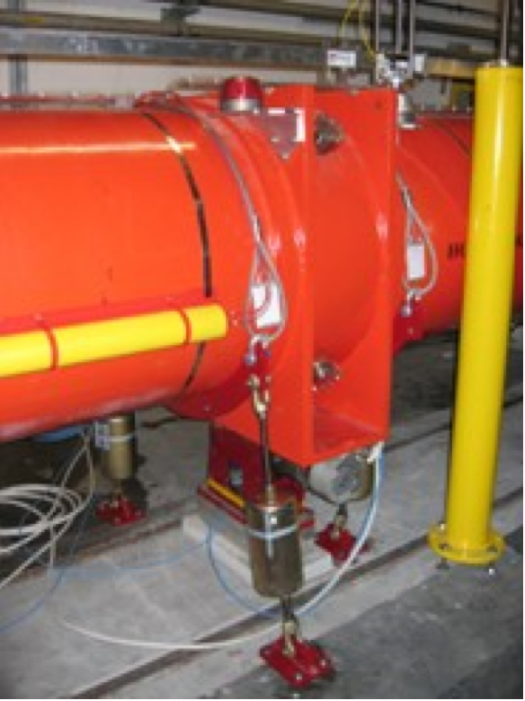
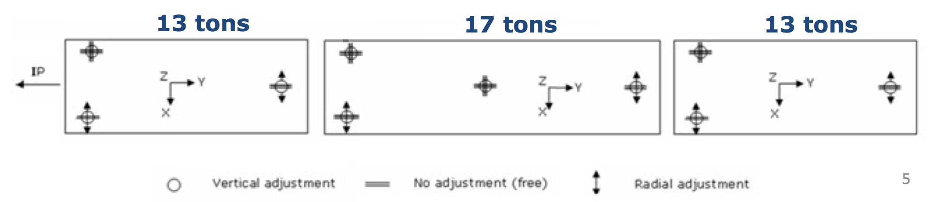
Previouse “InExperience”: LHC triplets
What we could have learned from a more complete IT STRING :
STRING of Q1 Q2 Q3 (2005)
  Validation of:
  Cryogenics,
  Vacuum
  Quench and protection
  Powering
  Accelerator relevant operation
The default of the heat X tube that collapsed during the pressure and leak test in the tunnel at < 10 bar. The NCR was due to a bad procedure of welding . Discovered in the tunnel and implied a serious intervention and so delay!
This NC hided the next one (see below)
The default of the spiders: a design problem in the supporting system of the cold mass, only being seen once interconnected and ready for cooling.
The spider (supporting system very good radially but not longitudinally) broke and an other serious intervention on this implied once again a delay !
The supporting of the present triplet is largely hyperstatic and loads are not distributed as foreseen in the chain of the triplets. Some of the supports takes higher loads ( load on Q2 central jack up to 17 t). The straps been installed to overcome the problem.
The alignment is also laborious.
Info from H. Prin and L. Bottura

Slide 10
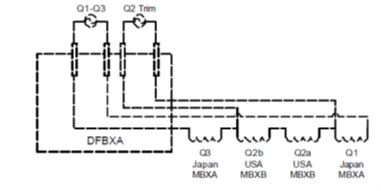
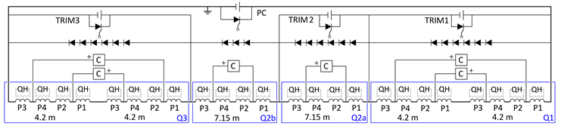
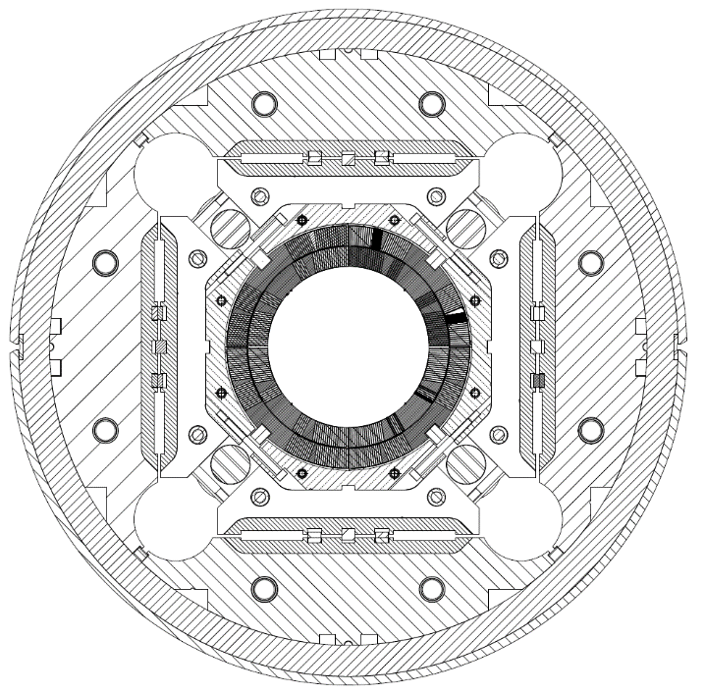
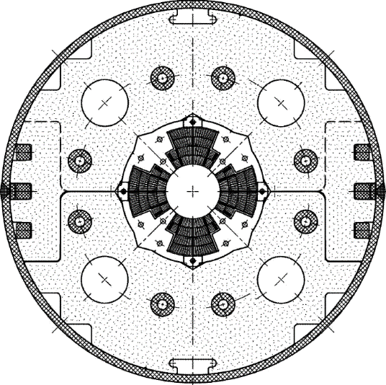
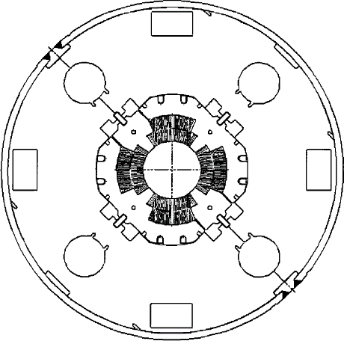
LHC vs HL-LHC triplet
Is one of the most complex electrical circuit in the tunnel
Quench analysis
LHC
HL-LHC
MQXA
MQXB
MQXF
Comparison of main magnet characteristics
NbTi against Nb₃Sn technology
1.3-1.5 times the cold ass OD (to 630 mm)
2.14 times the aperture: (to 150 mm)
~ 4 times the e.m. forces in straight section
~ 6 times the e.m. forces in the ends
2- 4.8 times the stored energy (to 1.2 MJ/m)
Courtesy of P. Ferracin and G. Willering and E. Ravaioli

Slide 11
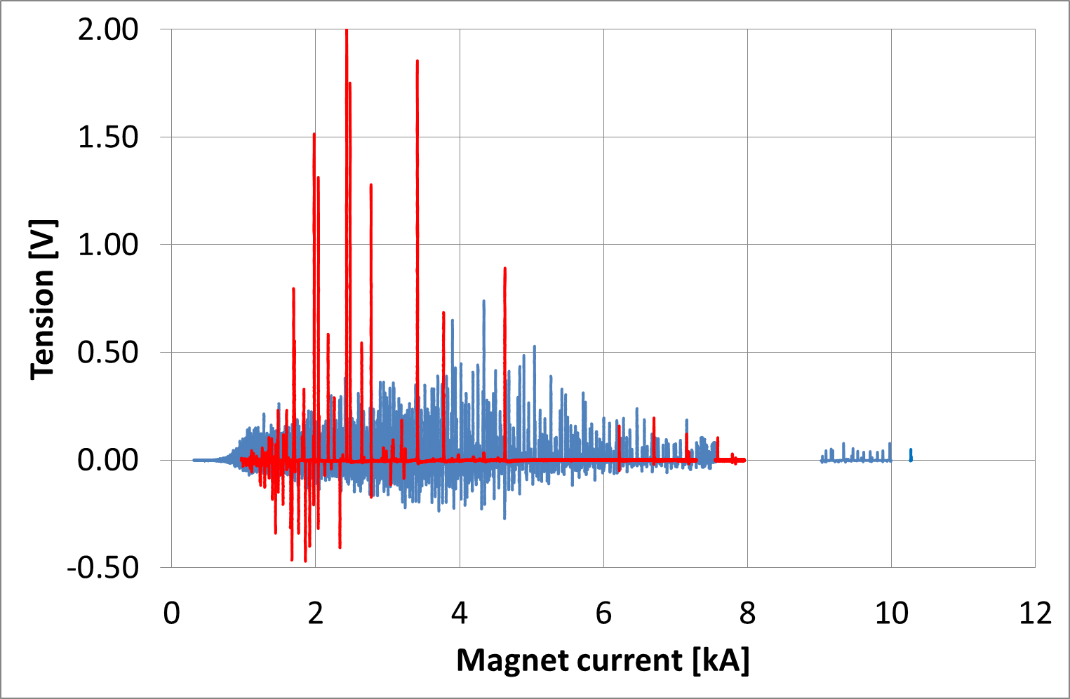
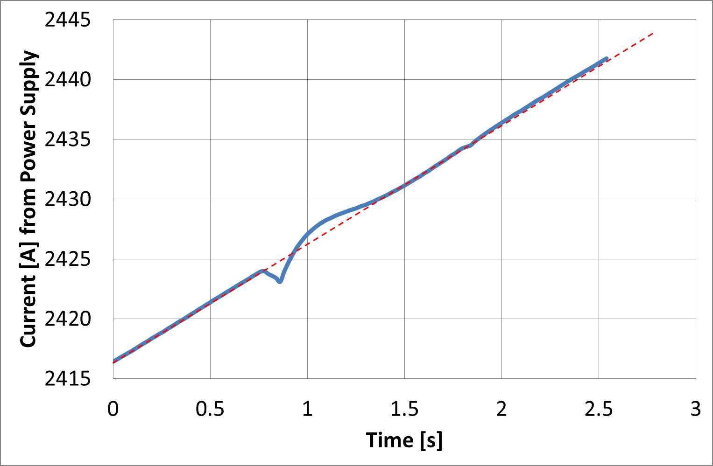
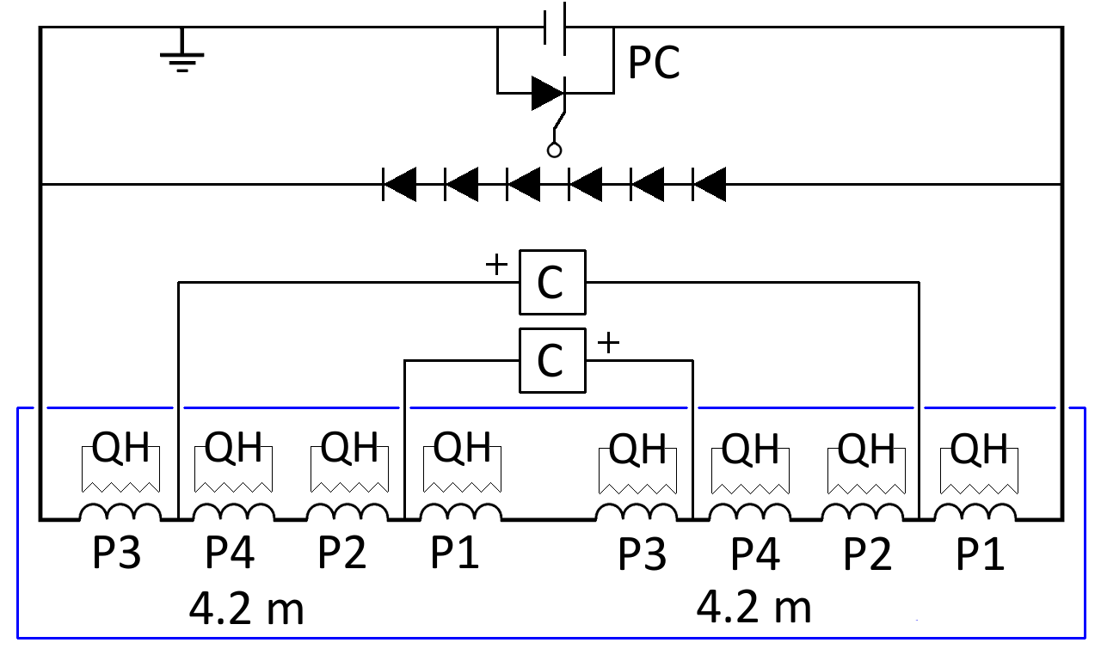
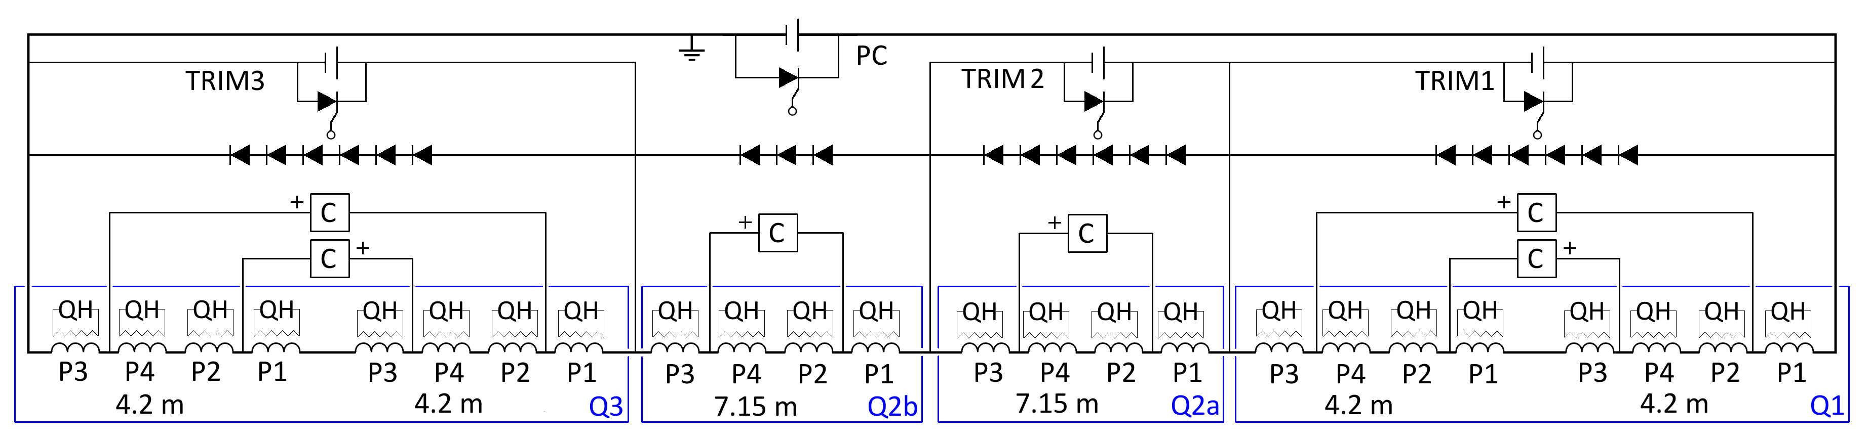
Ex. of future experience to gain with IT String
Features related to Nb₃Sn :
Flux jumps show up in Nb₃Sn magnets as a “noise”, both in the terminal and compensated voltage
  The effect propagates from one spot along the cable length
  Poles are coupled magnetically, attempting to reduce flux changes
Flux jumps are random in location, amplitude and occurrence
They can influence powering (1 ppm control) as well as the detect-ability of normal transitions
HQ01 flux jumps
HQ01 current control
Courtesy of H. Bajas
Features related to the HL-LHC IT Circuit:
Cold masses powered and protected individually by cliq and quench heaters but once in a circuit the effect can propagate : the ringing, the HV. Return currents in the trim bus bars and main bus bars aswell as in the Sc link
Cold mass test
All these aspects can be simulated but test needs to validate the simulations
Courtesy of E. Ravaioli
Circuit test
Q1
Q2a
Q2b
Q3

Slide 12
Relevance for the HL-LHC IT STRING
The HL-LHC IT-String can provide relevant experience (same object as in the LHC), validation (“first time” test) and advanced operation information on:
Magnet positioning, alignment, interconnection procedures (do not under-estimate)
Mechanical behavior of the IT continuous cryostat (Q1 to DFX) and other components (DSH, DFH) under pressure, vacuum, cool-down, operation and warm-up
Cryogenic behavior and operation under static (and dynamic) conditions
Insulation and beam vacuum static (and dynamic) behavior
Powering behavior of the system with Sc links, dynamic response (and associated field quality), interaction of circuits
Cross talk between magnets in operation and during a quench, detection, propagation and protection of the complete superconducting circuit
These aspects, especially the collective behavior, can only be tested in a representative test, a so-called STRING
GOALS in parallel:
Develop methods, techniques
Develop tooling
Develop procedures
Installations
Test
Operation
for
definition of
to
support
HWC and OP of HL-LHC

Slide 13
ID Card of HL-LHC IT-String
[…] a FULL INTEGRAL TEST of the equipment from Q1 till D1 including the DFX is foreseen in the HL-LHC project, in CONDITION AS SIMILAR AS POSSIBLE to the operational one.
The IT STRING of the HL-LHC will be composed by systems previously tested individually at least in nominal operational conditions.
HL_WP16 Conceptual specification : https://edms.cern.ch/document/1586706/1
Test Facility name: HL-LHC IT STRING
Test Facility location: SM18 (b. 2173)
Test date: 2021-2023
Operational temperature: 1.9 K
Operational current: 108% I_{nominal} = 18 kA?
Magnets: Q1, Q2a, Q2b, Q3, CP, D1
Cold powering: SC link (60 m or 110 m) HTS leads DFH and DFX,
Warm powering: 1 x PC 18 kA , 3 Trim Q1-Q3, 6 x 2 kA , 1 x 12 kA, 9 x 0.1 kA Water cooled cables
Protection: CLIQ , QH and EE

Slide 14
Main Facilities needed for the HL-LHC IT STRING
Remarks
UPGRADE DRIVEN BY the recommendation enabling to carry out the full test programme with no contraints
  CRYOGENIC COOLING PRODUCTION: + 35 g/s LHe to 60 g/s
  NEEDS essentially for the running of the HL LHC IR STRING in parallel with magnet testing
  DEMINERALISED WATER PRODUCTION: + 150 m³/h
  NEEDS FOR DEMINERALISED WATER ENTIRELLY COMING FROM MAGNET operation
  POWERING FROM THE NETWORK: 3 MVA
  NEEDS FOR NEW OR MODIFIED PC COMING FORM MAGNETS and IR STRING
SM18-UPG project of the TE department under the responsibility of V. Mertens:
the upgrade of all necessary services to cover the needs for the test stands operation ( this includes the HL-LHC STRING as a test stand of a complete system).

Slide 15
Test stands : cryogenics upgrade
An additional 35 g/s liquefier (thus bringing the total production capacity for LHe at 4.2 K to 60 g/s)
The existing total pumping capacity in SM18 at 1.8 K is 12 g/s, combining the capacity of WPU1 and 2.
If need for IR STRING a dedicated 3rd WPU shall be installed.
Ref. L. Serio
Foreseen for 2019

Slide 16
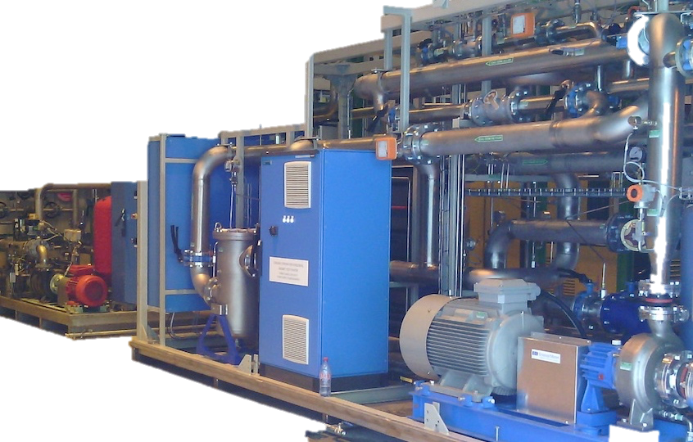
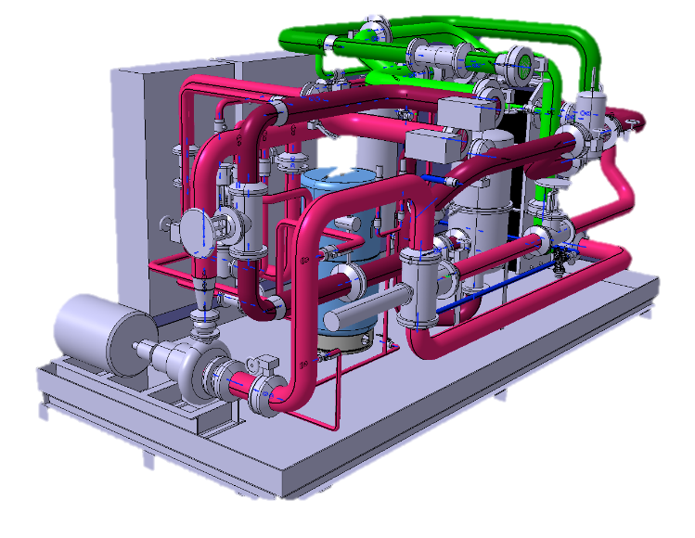
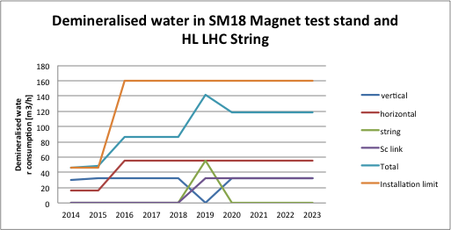
Test stands : demineralized water production
The demands for the magnet test stations, including the IT String, will rise to a peak need to 1.7 MW (142 m³/h).
In the past SM18 had a demineralised water station with a thermal capacity of 800 kW limiting the operation to two test stands
Operational from April 2016
Ref. A. J. Broche

Slide 17
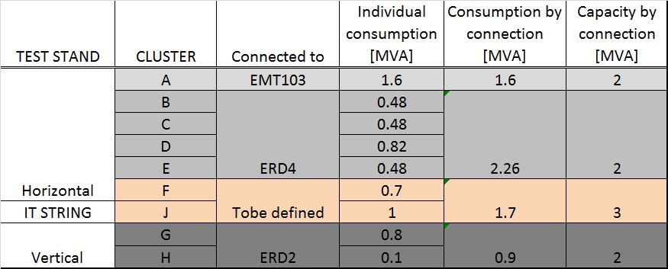
Test stand : electrical powering
Foreseen for 2019
To allow some flexibility and margin with new requests that are not formulated yet, the proposal is to INSTALL a TRANSFORMER OF a 3 MVA CAPACITY
The new transformer will feed HL-LHC IT STRING (Cluster J ) and the new Cluster F with the 20 kA power converter.
Ref. C. Giloux, F. Formenti, N. Dos Santos

Slide 18
How we are organised for the work?
Integration and Construction
Test plan and results
Regular meetings every 3 weeks: Friday afternoon in SM18
The team is made of persons appointed by the GLs.
Meetings to define the test plan to be reported to the HL-LHC TCC . ….later regular reports on the results .
The team is made of the concerned WP leaders and HL-LHC and TE management.
Antoine Kosmicki EN ACE integration
Estrella Vergara EN ACE planning
Hugues Thiesen, Samer Yamine TE-EPC
Jean-Claude Guillaume EN-EL
Amalia Ballarino, Andre Jacquemod TE MSC
Vittorio Parma TE MSC
Ezio Todesco TE MSC
Herve Prin TE MSC
Luigi Serio, Serge Claudet +… tbd during summer 2016 TE CRG
Markus Zerlauth TE MPE
Felix Rodriguez Mateos TE MPE (Mr. Circuit)
Patrick Viret TE MSC ( TSO B. 2173)
Paul Cruikshank, Cedric Garion TE VAC
Carlos Arregui Rementeria HSE
Dominique Missiaen EN ACE
Helene Mainaud Dourand EN ACE
Serge Pelletier EN-HE
Adriaan Rijllart EN STI
M. Pojer is deputy of HL-LHC STRING

Slide 19
Main components and schematics
Power Converters (PC)
Water Cooled Cables (WCC)
Current Leads (CL and DFH)
Superconducting Link (DSH)
Connection Module (DFX)
Magnets (D1,CP,Q3,Q2a,Q2b,Q1)
EE and Protection
Interlock and DAQ systems

Slide 20
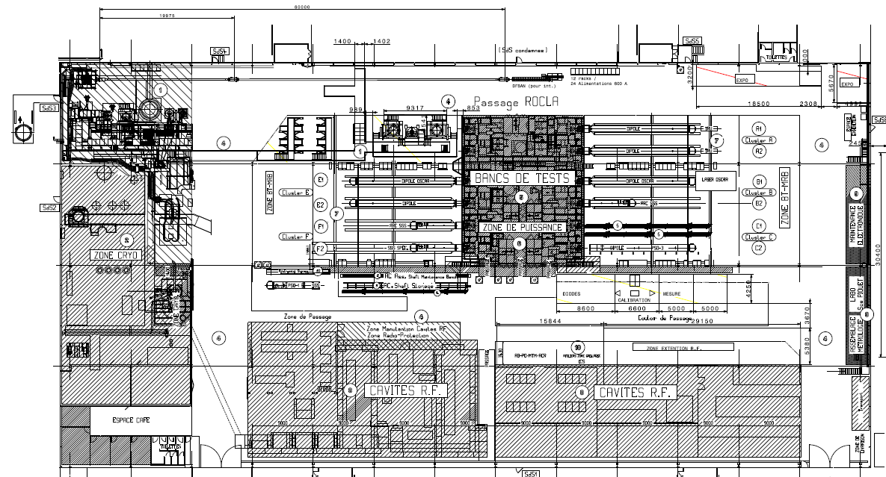
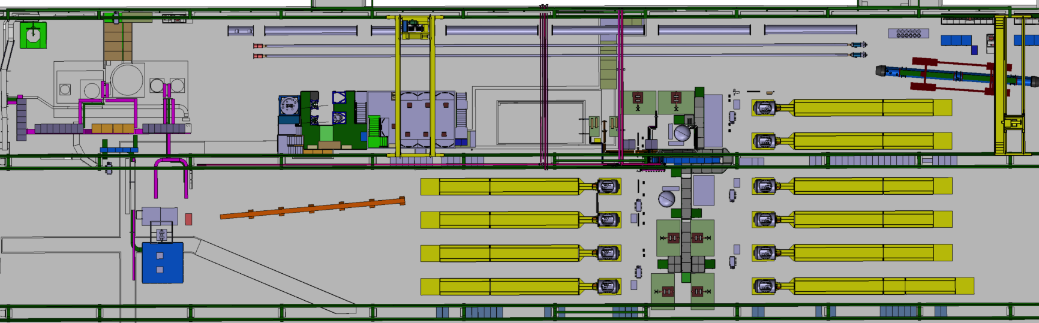
Limitations in space in SM18
THE SUPERCONDUCTING MAGNET TEST STAND AT CERN in SM18
EXIT
EXIT
What boundary conditions we considered?
VISITORS
EXIT
STRING and SC LINK
VERTICAL BENCHES
EXIT
CLUSTERS
F E D
HORIZONTAL BENCHES
CLUSTERS
C B A
Is in a building of 7200 m² over which the test stands for magnets occupies about 50%.
CRYOGENIC ZONE
Superconducting RF CAVITY TEST ZONE
LN₂ TEST ZONE
Marta Bajko for the TCC 15th September 2016

Slide 21
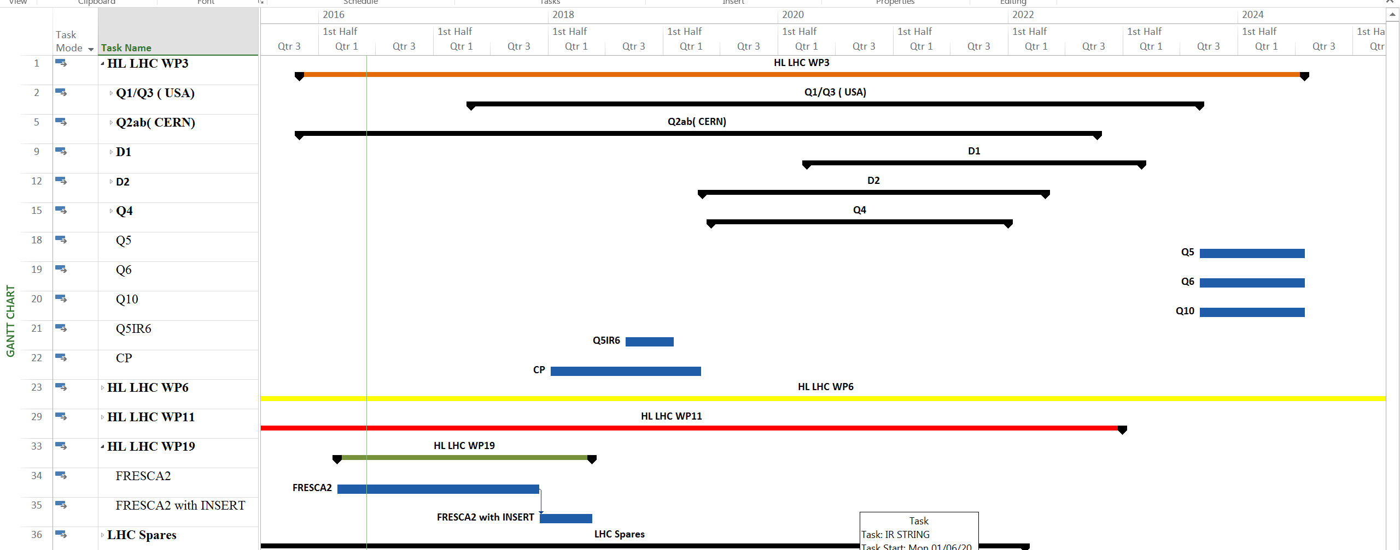
Conflict or synergy between test stands
Vertical test cryostat
SC link test stand (110m)
IT String (80 m)
Horizontal benches
Overlap with Vertical cryostats
Overlap Sc link test stand and STRING
The integration is driven by a possible synergy as following:
Share time, cryogenic cooling and electrical powering systems between Sc link test stand and IT String

Slide 22
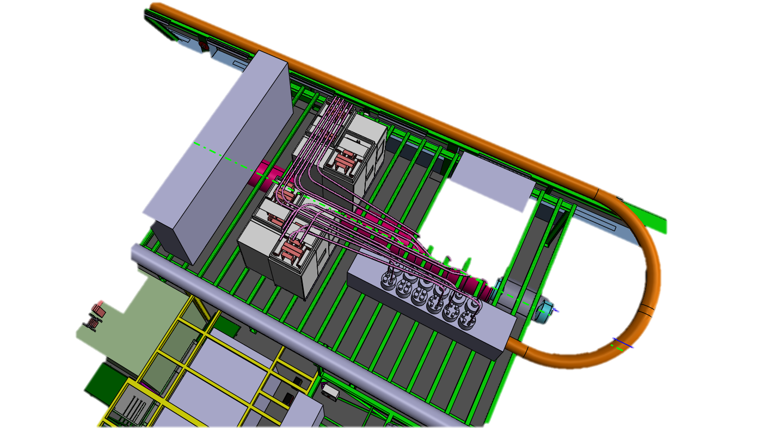
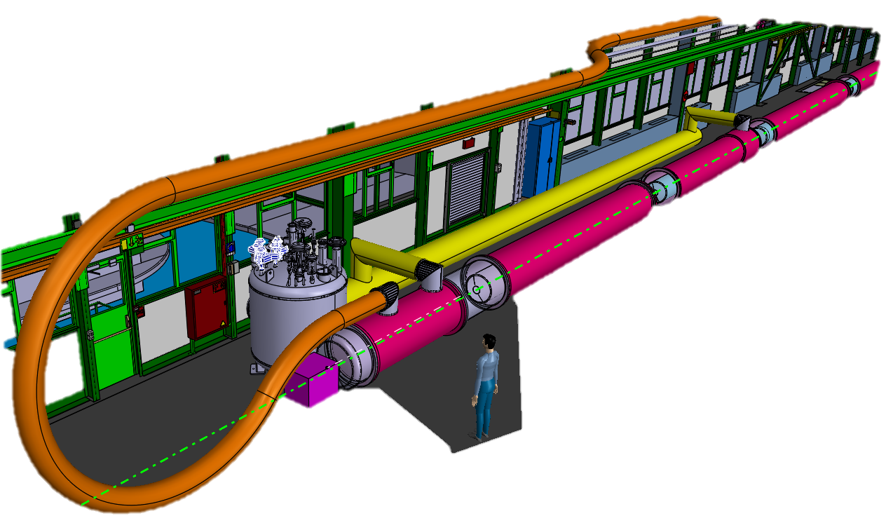
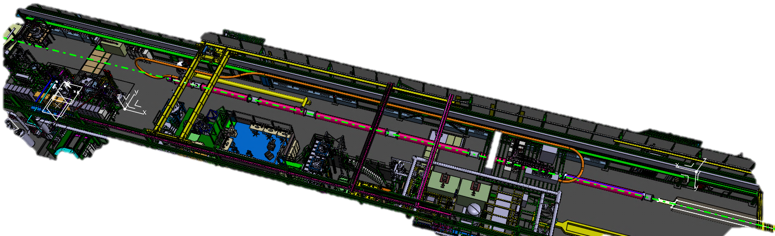
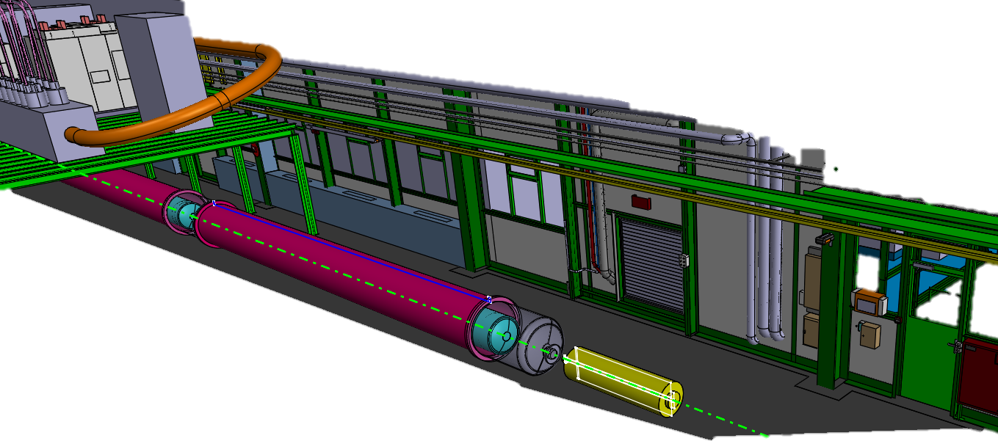
Options in space: where we are today
Cooling side
Powering side
Extremity

Slide 23
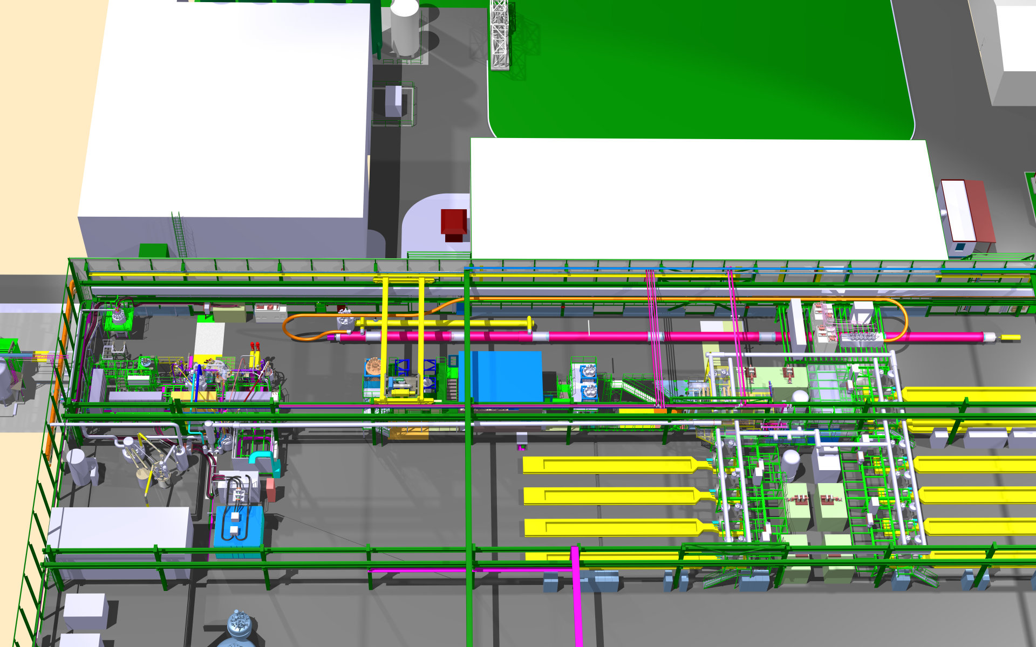
The latest proposal for integartion

Slide 24
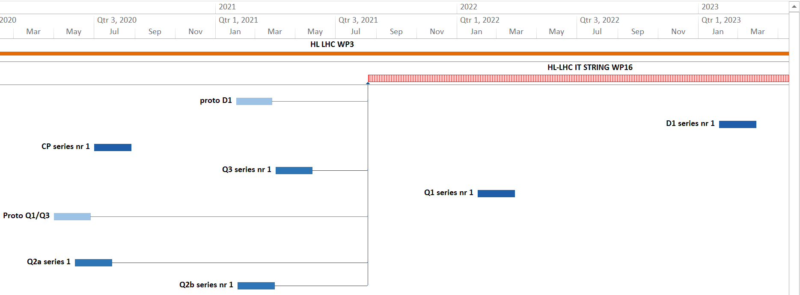
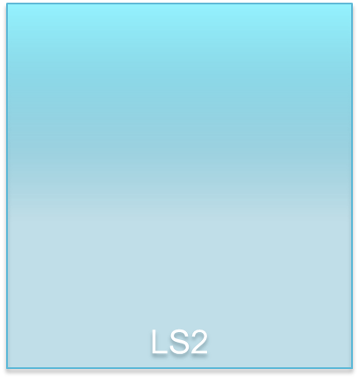
IT STRING the earliest possible?
2020
2021
2022
2023
INSTALLATIONS
OPERATION

Slide 25
Current status of the work
Integration ongoing with all elements that we know today
Estimate of budget ( 4.5 MCHF) have been done and now is under verification by the members of the integration team. The strategy is that
  All main components usable in the HL-LHC are part of the WP ( prototypes or series)
  All components that are not usable in the HL-LHC are to be payed by the WP16 budget
  All services are assured within the SM18 UPG project ( financed by both TE dep and HL-LHC project)
Estimate of manpower has been done and now is under verification by the members of the integration team
In case of missing man power management support will be required
Few WPs gave already a wish list for the complete test plan

Slide 26
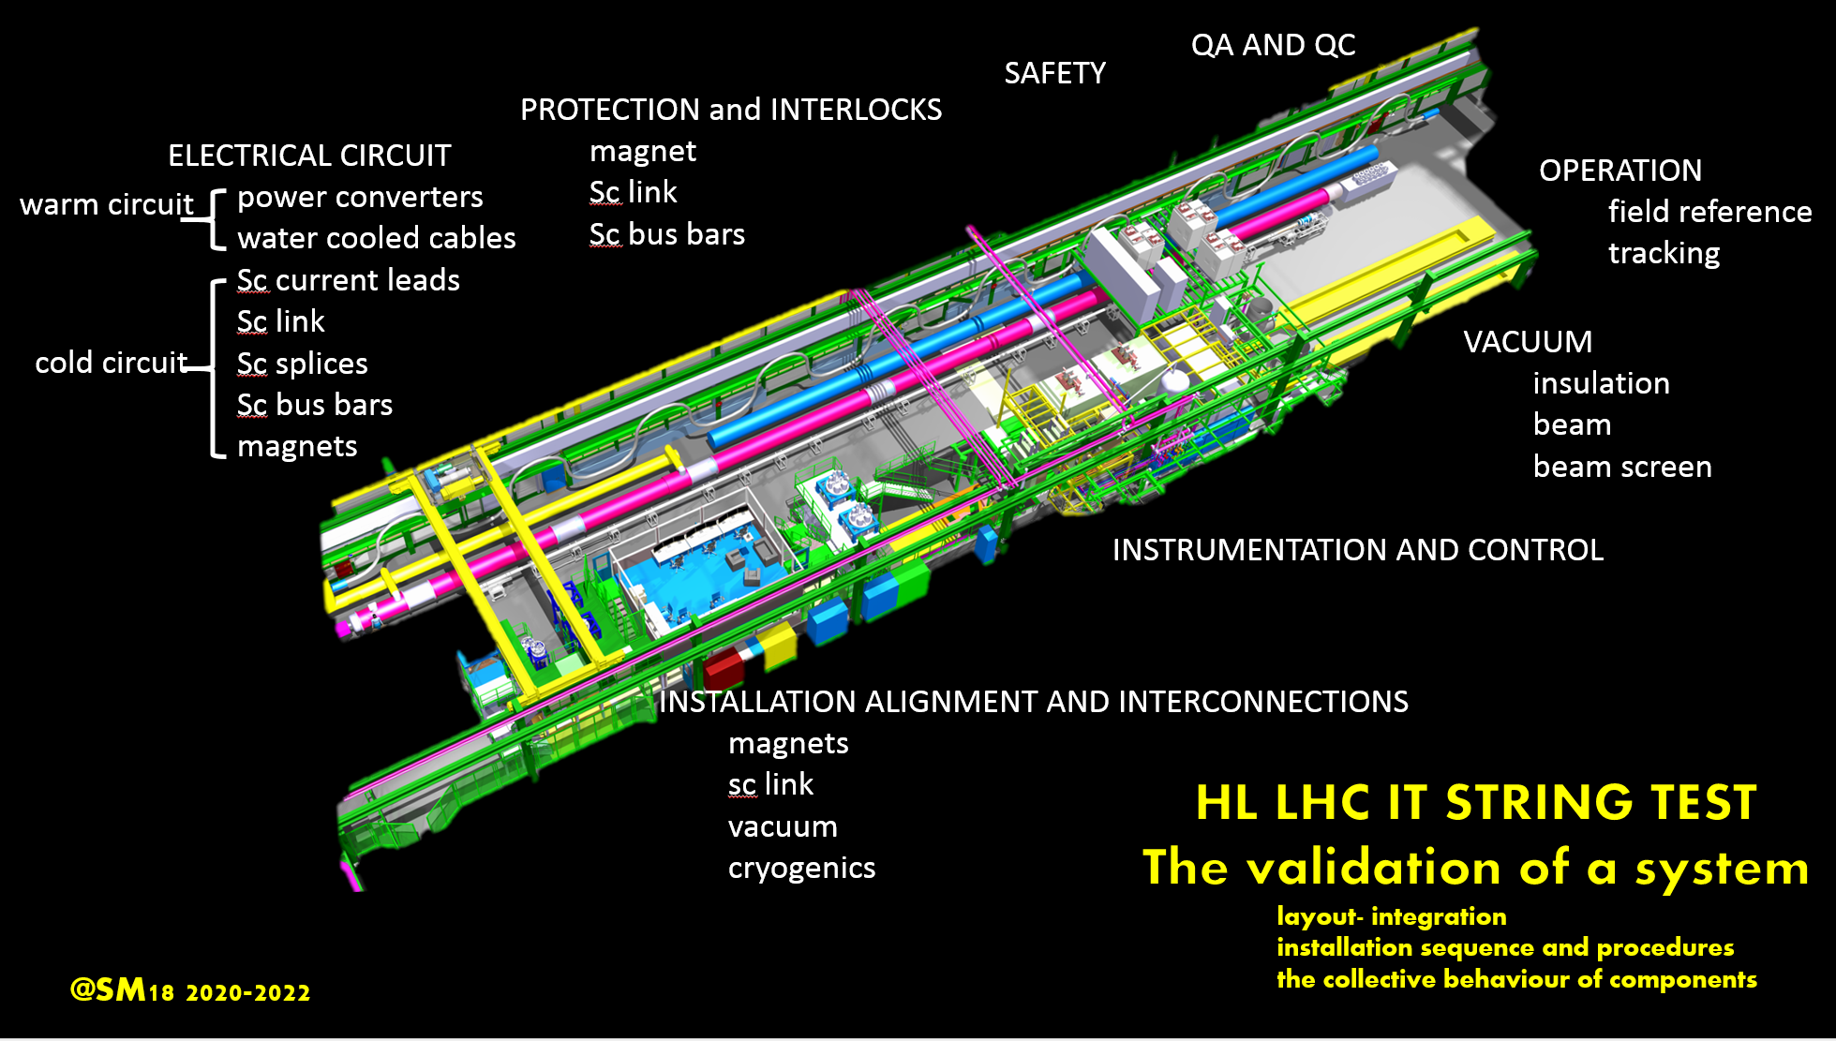

Slide 27
Thanks for your attention

Slide 28
HL LHC STRING preliminary TEST PLAN
Validation of a layout- integration
Validation of installation sequence and procedures
Validation of a system (of components)
Validation of their collective behaviour
Quench: provoked, natural, holding current, propagation, detection, protection, clic, dump, switch
Cryogenics: cooling- warming speed ( Nb₃Sn), heat load, recovery after quench, pressure, temperature, shielding
Integration: layout, interconnections, systems around ( racks, cables trays, control cables et), total weight
Powering: bus bar, connections, current leads, power distribution at warm and at cold, converters, water cooled cables
Electrical integrity: splice resistance, electrical insulation
Interlock
Vacuum: leak detection, beam screen
Instrumentation , DAQ systems, DB , QA, QC: specific or not to string
Alignment
GOALS in parallel:
Develop methods, techniques
Develop tooling
Develop procedures
Installations
Test
Operation
X
definition of
2
support
HWC
OP

Slide 29
MPE goals of HL-String test
Validation of interlock loops and quench loops (for potential improvement of topology/diagnostics)
Validation of final versions of the interlocks, quench detection system (QDS) and controls interfaces (including new phenomena as flux jumps,…)
Validation of CLIQ layout and magnet protection for full magnet string
Validation of transient effects and electromagnetic coupling in full magnet string + sc link during normal operation and during protective actions (CLIQ/heater firing). Verification of simulation models with obtained measurements.
Validation of EE systems for IT corrector magnets (600A, 2kA)
Validation of IST procedures for protection equipment
ELQA procedures for full string
Validate fully automated analysis of faults + automated/remote fault recovery (QDS, MP3 and Software)
Transient heat load test (studies of beam/UFO induced quenches)
Note:
  Validation of the 11T topology should follow the same approach, using already on the test beds configurations as close as reasonably possible to the final LHC installation
  String test and LS2 have a significant overlap, which might cause manpower issues for the hard- and software sections of MPE

Slide 30
VAC goals of HL-String test
String (2019 - ):
Beam screen:
  Quench
  Thermal contraction
  Heat loads to the cold mass (supporting system)
  Flow induced vibrations
Interconnections:
  Assembly procedure and tooling for the PIM installation and beam screen cooling circuit
  Measurements of the displacements at cold, during cool down and warm-up
  Behaviour of the RF fingers
Insulation vacuum:
  Leak tests
  New O’ring or seals
Beam vacuum:
  Pump down time before cool down
  Static vacuum gas analysis
  He, H₂, CO, CO₂ propagation tests with a-C coating at different beam screen operating temperature in the range 40 – 70 K
  Study impact of quench and beam screen temperature on vacuum levels along the line and at cold warm transitions (with possibly dedicated vacuum gauges located at interconnects)

