Slide 1
HL-LHC layout update and ongoing optics work
R. De Maria
Thanks to G. Arduini, R. Bruce, F. Cerrutti, P. Diaz, D. Duarte, S. Fartoukh, M. Fitterer, D. Gamba, M. Giovannozzi, P. Fessia, H. Prin, S. Redaelli, A. Tzinganis, B. Vasquez, I. Zurbano.
16th HiLumi TCC Meeting 22/09/2016

Slide 2
Layout Changes 1.2 → 1.3
Triplet layout revised for BPM position
2 crab cavities per IR/side/beam with compatibility for 4
TAXN-TCTs-TCLX-D2 layout
2xMCBYY+MQYY assembly replaced by Mask+4xMCBY+MQY
MQY at 1.9K for Q5 in IR6
HL-LHC layout based on LHC-LS2 layout
  DS collimators, 11T dipole (MBH)

Slide 3
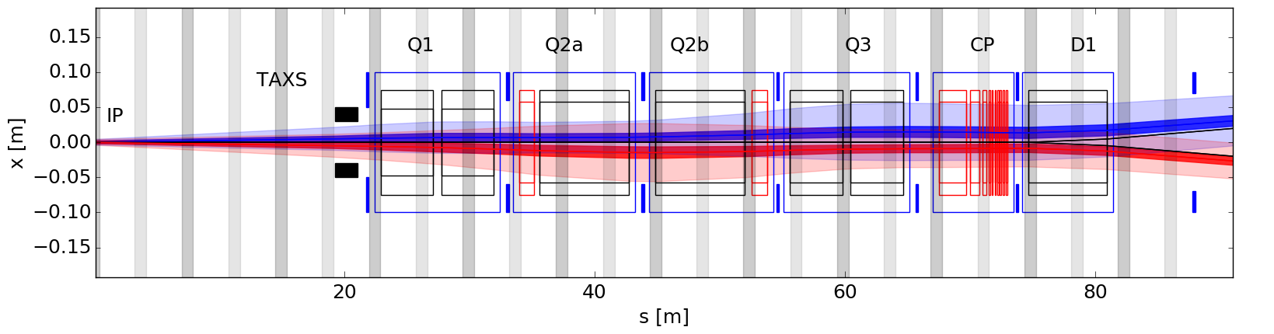
Updated triplet layout and BPM
All layout moved by 8 cm towards the IP. L*=22.92 m
Q1a-Q1b and Q3a-Q3b distance reduced by 4 cm.
All the BPMs are at positions compatible with operation with bunch lengths of 1.1-1.2 ns (center of BPMs >57 cm further away from LR encounters WP2 meeting 27/9/2015).
P. Fessia, B. Vasquez, C. Garion, F. Galan, H. Durand, M. Sitko, S. Evrard, T. Lefevre, V. Baglin, V. Parma, P. Ferracin, E. Todesco, H. Prin.

Slide 4
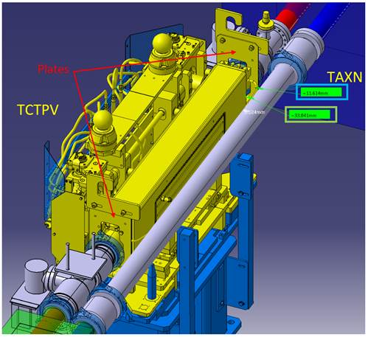
TAXN-TCTs-TCLX-D2
Integration vacuum elements.
No fifth axis in 2-in-1 TCLX, TCTPXH.
New tanks to be designed.
P. Diaz, V. Baglin, 23/8/2016

Slide 5
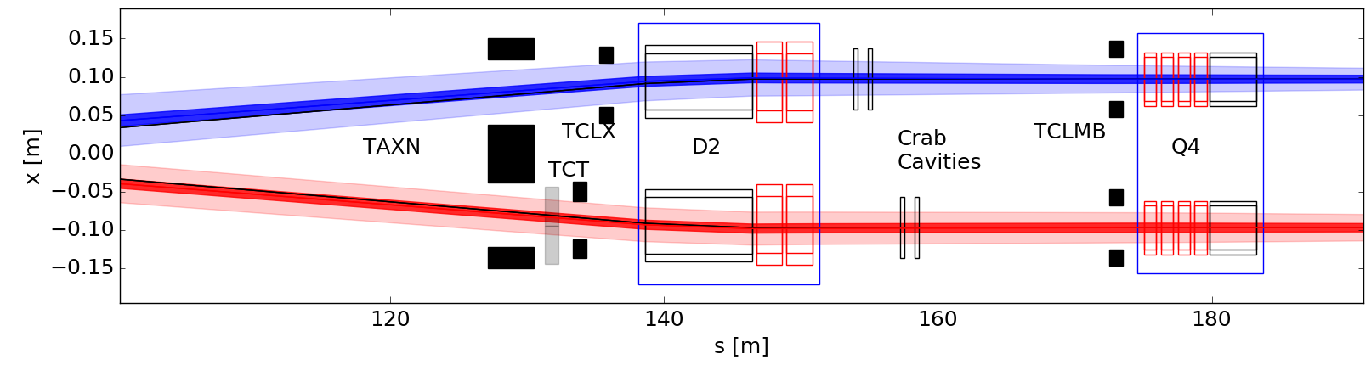
4 → 2 crab cavities
Only 2 cavities per side per beam per IR.
Civil engineering and tunnel space reserved for 4.
Used at max voltage 3.4 MV (it was at 2.9 MV in the last baseline)
Easier to align (→ additional margin in the corrector budget if only 2 cavities)

Slide 6
Q4: MQYY -> MQY
2xMCBYY+MQYY replaced by Mask+4xMCBY+MQY.
Mask: same of Q5 (1.5 m length, 1 m active material as first guess F. Cerutti)
Q4 becomes bottleneck for flat optics.
Work ongoing to reassess requirements of orbit correctors.
H. Prin, 8/8/2016

Slide 7
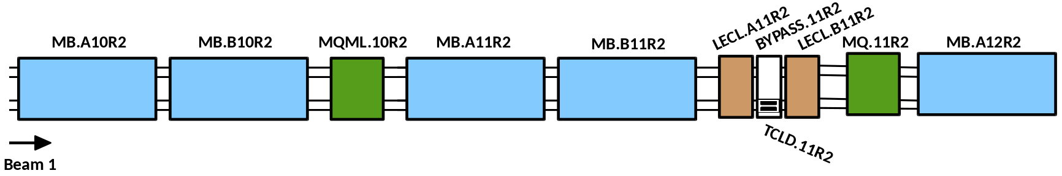
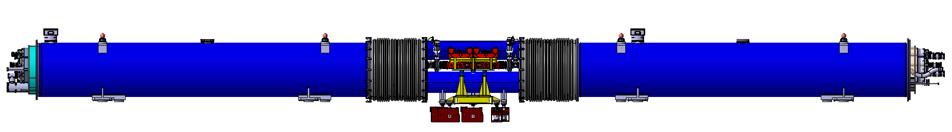
Dispersion Suppressor collimators - MBH
Implemented in LS2:
Collimator in empty cryostat in Point 2 (Q11 IP side).
Collimator with MBH replacing MB.B8R7.B1 and MB.B8L7.B2 in Point 7.
S. Redaelli et all. TDR Chapter 5.
J. Jowett et al., Presentation at the 14th Meeting of the HL-TCC, Sept 2016, https://indico.cern.ch/event/559125/

Slide 8
Optics On-going Studies 1.2 → 1.3
Detailed verification of the optics limits taking into account the apertures and latest information concerning the tolerances for the round and flat optics (tentatively 20/20 cm and 40/15 cm)
Definition of two versions for possible scenarios to push performance: 15/15 – 30/7.5 cm as described in the TDR
IR6 with improved phase advance [1] for flat optics and iteration on new dump constraints [2]
  [1] S. Fartoukh, WP2 meeting, 27/11/2015
  [2] C. Bracco, TCC meeting, 4/8/2016

Slide 9
Conclusion
Layout and optics updated with the latest input from integration and re-baselining.
Focusing now on the optics work (ongoing) for the present layout aim for a complete optics version for the beginning of October.
Integration team to cross check optics files and prepare drawings.
Optimizations are possible but they do require first the finalization of the optics for the present layout and, if deemed feasible will be proposed for the next layout/optics version.

