Slide 1
Quadrupolar mode RF system for enhanced transverse Landau damping in HL-LHC: design proposal and R&D needs
Alexej Grudiev, Kevin Li, Kai Papke, Michael Schenk
16th HL-LHC TCC,
22 Sept. 2016
Acknowledgements:
G. Arduini, H. Bartosik, O. Brunner, X. Buffat, O. Capatina, R. De Maria, A. Maillard, E. Métral, E. Montesinos, Y. Papaphilippou, G. Rumolo, E. Shaposhnikova, C. Zannini,

Slide 2
RF quad for LD in LHC. Short history
Idea (2013):
  A. Grudiev, RF quadrupole for Landau damping, Talk at ICE meeting (23.10.2013), Radio frequency quadrupole for Landau damping in accelerators, PRSTAB 17, 011001, (2014)
Numerical verification for the case of LHC (2014):
  A. Grudiev, K. Li, and M. Schenk, Radio Frequency Quadrupole for Landau Damping in Accelerators: Analytical and Numerical Study, Proceedings, HB2014.
Proposal for proof-of-principle experiment in SPS (2015):
  M. Schenk, Talk at HSC meeting (16.11.2015), https://espace.cern.ch/be-dep/ABP/HSC/Meetings/rfq_in_sps_hsc_161115_final.pptx
Proposal for HL-LHC (2016):
  M. Schenk et al., Use of RF Quadrupole Structures to Enhance Stability in Accelerator Rings, HB2016
  Presentation of the proposal at 72nd HiLumi WP2 meeting: https://indico.cern.ch/event/544547/contributions/2243207/attachments/1318988/1977372/RFQuad_LD_WP2_020816_final.pptx
  RF design of the cavity, K. Papke (to be presented at B252 seminar 7.10.2016), https://indico.cern.ch/event/570104/

Slide 3
Outline
Introduction
Beam dynamics studies for HL-LHC
RF design of the cavity
Design of the RF system
Potential location in LHC tunnel
Cost estimate
R&D timeline
Summary

Slide 4
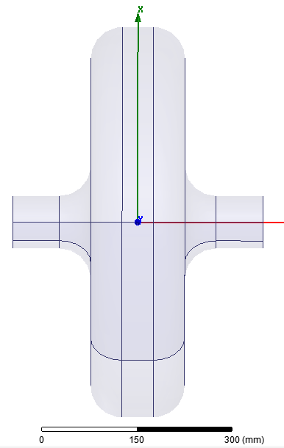
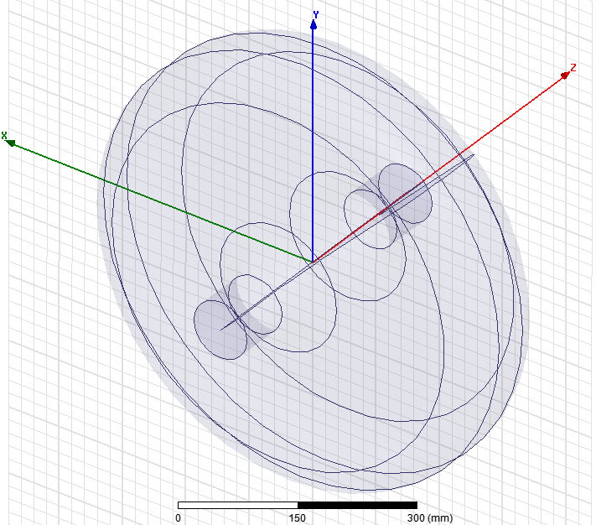

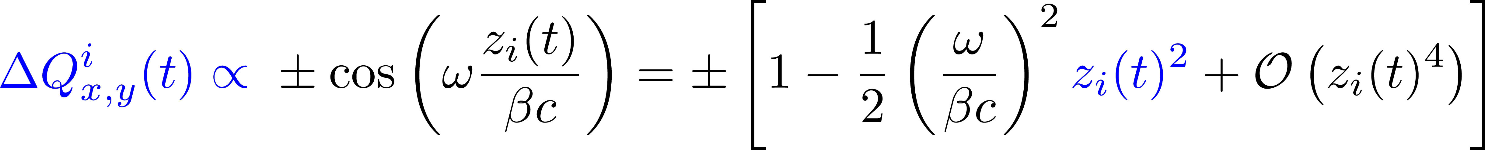
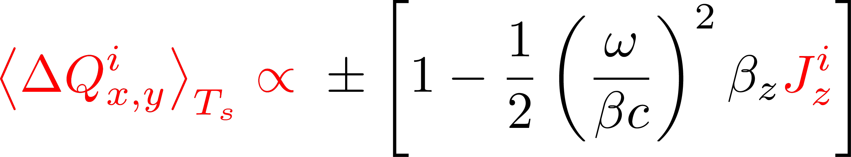
Introduction
Basic working principle of an RF quadrupole
Proposal by Alexej Grudiev^{[2,3]}
An RF quadrupole introduces a betatron tune spread to ‘damp’ transverse collective instabilities via Landau damping.
Example: Pillbox cavity with TM₂₁₀ mode.
Working principle
RF-modulated quadrupole kick
translates into a betatron detuning (assume ϕ₀ = 0)
At second order: Detuning with longitudinal amplitude (action).

Slide 5
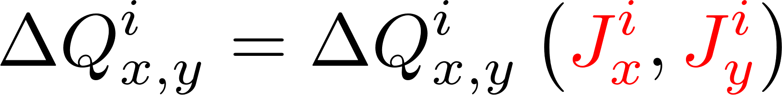
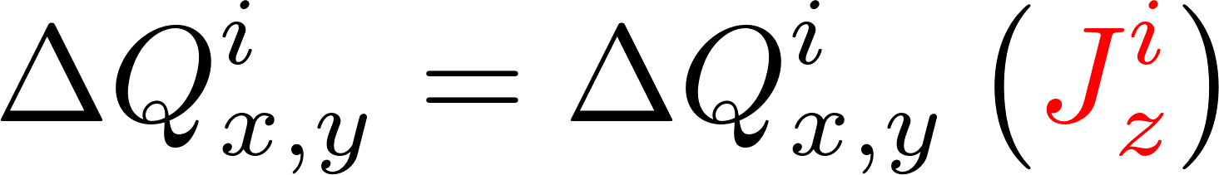




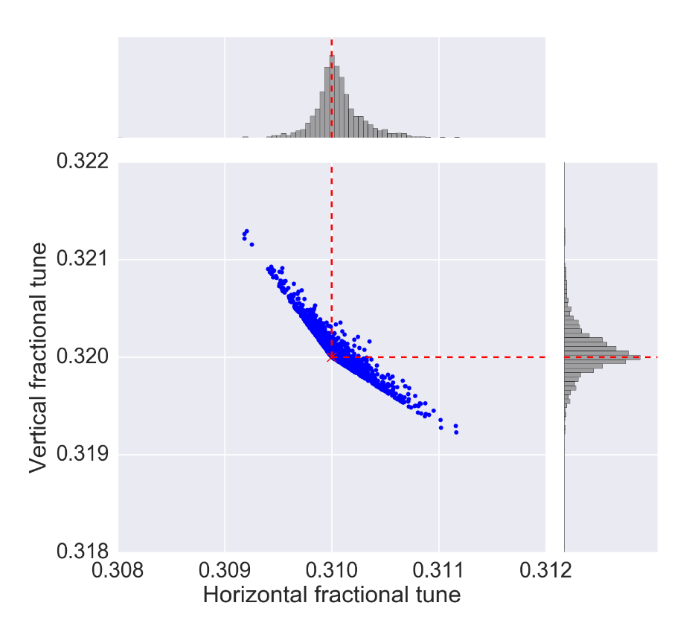
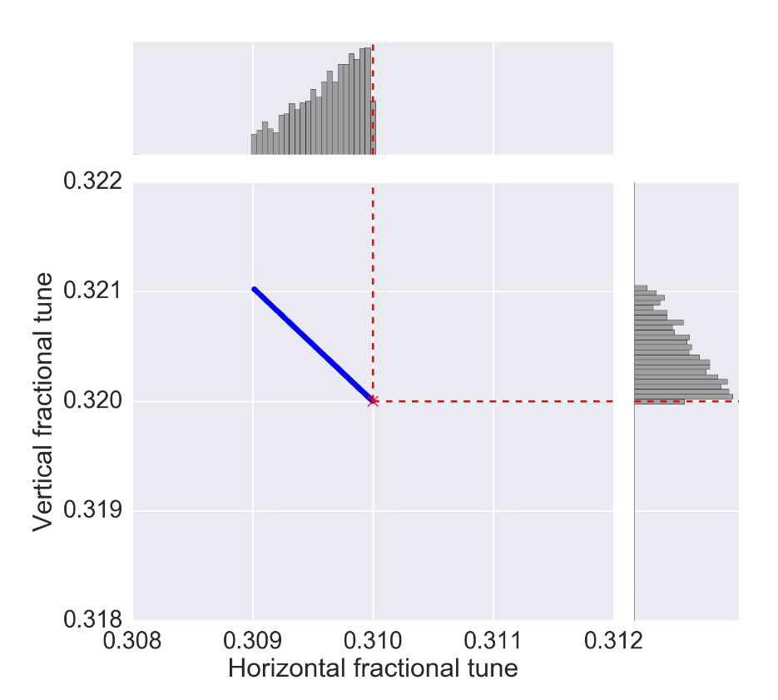
Introduction
Betatron detuning with amplitude
Detuning w. transverse amplitude
Detuning w. longitudinal amplitude
Example: Landau octupoles (LO)
Examples: RF quadrupole, Q’’

Slide 6
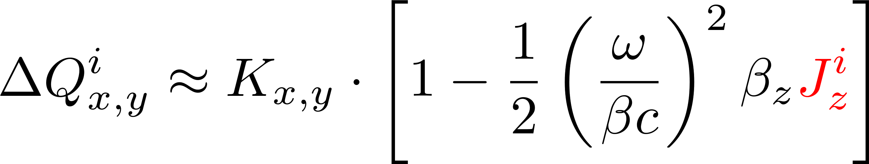
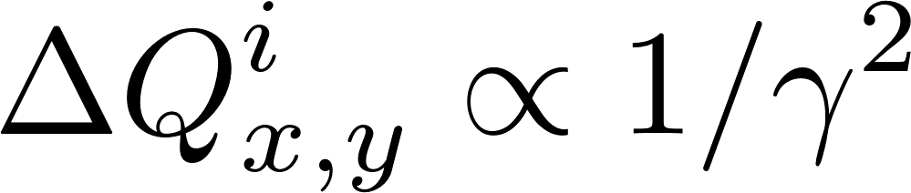
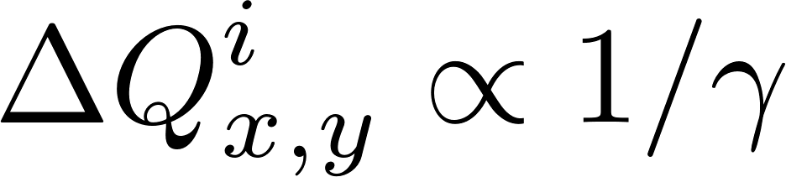
Introduction
Motivation for an RF quadrupole
LO
LHC operation shows^{[16,17]}
  Landau damping is successfully used against instabilities.
  LO are often operated close to their limit.
RF quad
HL-LHC will have to handle beams of higher intensities and higher brightnesses^{[7]}
  Potentially leads to more violent instabilities.
  LO less effective due to lower transverse beam size.
  At 7 TeV, spread in J_{z} is 10⁴ - 10⁵ times larger than that in J_{x,y}.
  Even compact RF quadrupole can produce a large incoherent betatron tune spread.
RF quadrupole could be an ideal device to increase the margin for stable HL-LHC operation.
Additional advantage for potential future high energy accelerators
  On the energy ramp, the detuning from LO is affected by both adiabatic damping and increased beam rigidity, i.e.
  An RF quadrupole is only affected by the increased beam rigidity, i.e.
  (given that the longitudinal emittance is blown up along the ramp – as done in (HL-)LHC)

Slide 7
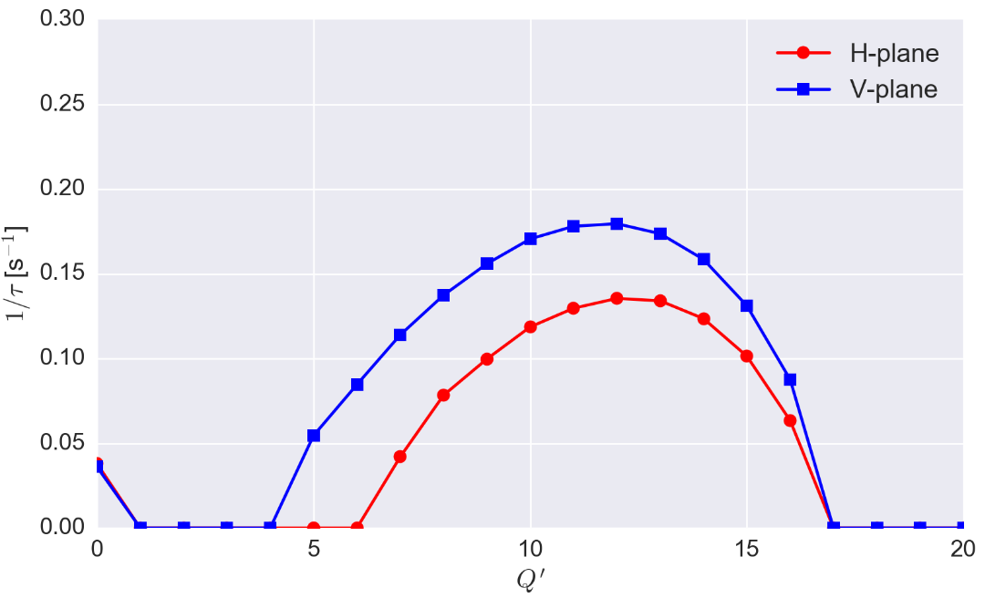
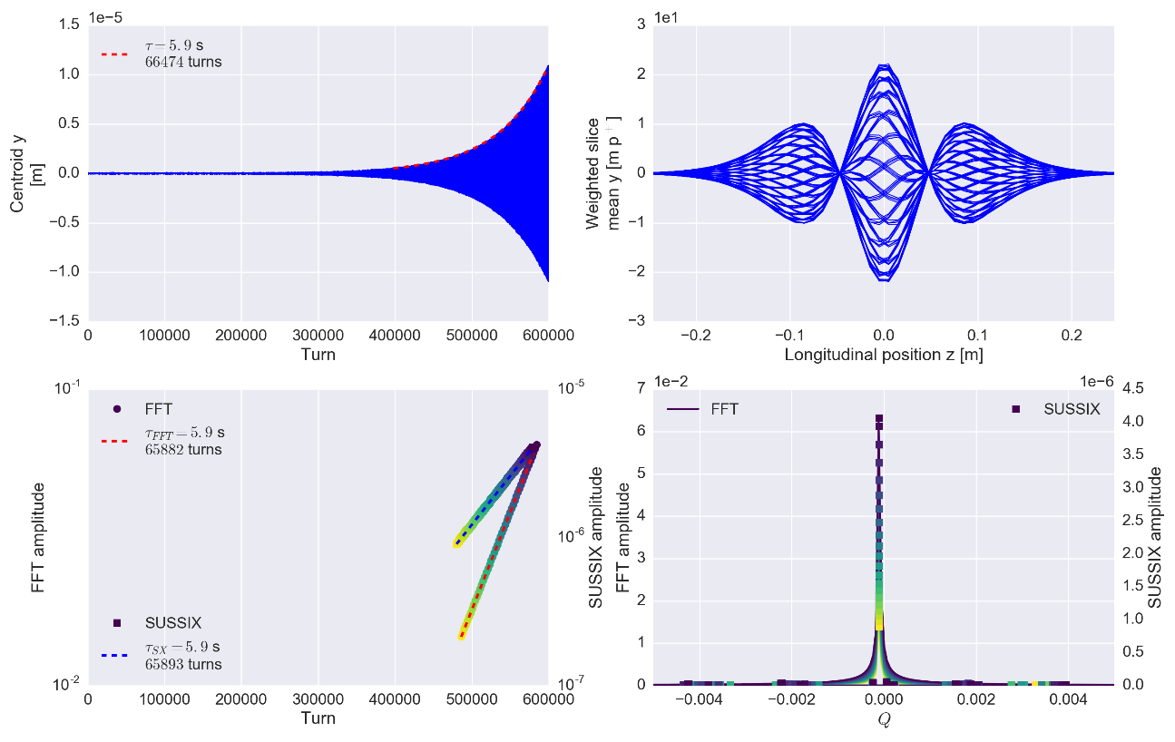
RF quadrupole for HL-LHC
Simulation setup and chromaticity scan
  Single bunch at 7 TeV with HL-LHC design parameters^{[7]}.
  Stabilising systems
    LHC transverse damper, idealised.
    LHC magnetic octupoles.
    Superconducting RF quadrupole at β_{x,y} = 200 m (conservative)^{[1-3]}.
  LHC operation shows that Q’ = 10 can be a potential working point.
  With transverse feedback system, we observe a head-tail mode (0, 2).
  Similar instability experimentally observed in LHC^{[16]}.
  Without RF quadrupole, an LO current of I_{f} = (170 ± 10) A is required for stabilisation.
  (only accounting for impedance)
PyHEADTAIL
Q’ = 10
Sensitivity too low (# turns)
Head-tail mode
(0, 2)
azimuthal
radial

Slide 8
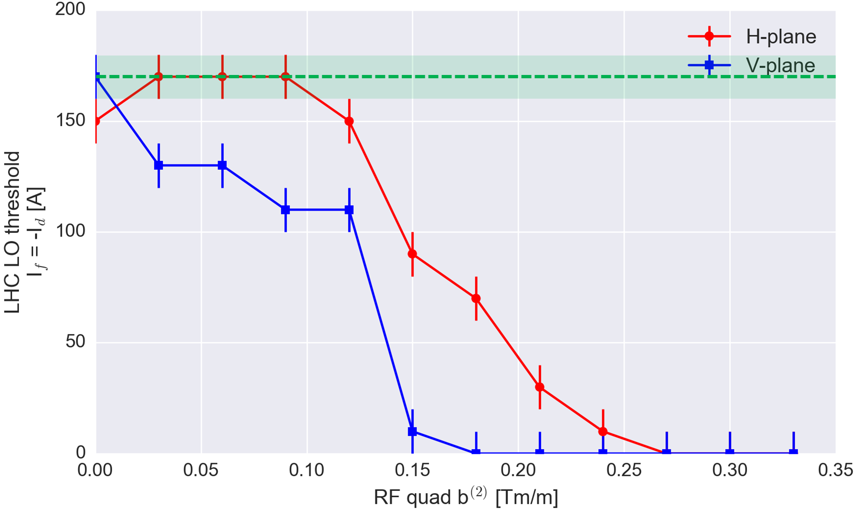
RF quadrupole for HL-LHC
800 MHz cavity
I_{f, thr} w/o RF
quadrupole
Tunespreads for stabilisation with RF quadrupole and LO alone
RFQuad(ΔQ_{x})_{RMS} ≈ (6.9 ± 0.4)∙10⁻⁵
RFQuad(ΔQ_{y})_{RMS} ≈ (4.5 ± 0.4)∙10⁻⁵
LO(ΔQ_{x,y})_{RMS} ≈ (3.6 ± 0.2)∙10⁻⁵
In this case:
LO at I = 500 A ~
RFQ at b⁽²⁾ = 0.8 Tm/m

Slide 9
RF quadrupole for HL-LHC
Additional arguments supporting the RF quadrupole
Mitigation of electron cloud instabilities
  Electron cloud instabilities are an important potential performance limitation in the LHC.
  Recent simulations of electron cloud instabilities in the LHC with Landau octupoles show a beneficial effect of Landau damping against this type of instabilities.
  (https://espace.cern.ch/be-dep/ABP/HSC/Meetings/hsc_lhc_elcoud_12-09-16.pptx
  Kevin Li, HSC meeting, 12.09.2016)
  A similar study is ongoing to evaluate the effect of an RF quadrupole against this type of instabilities.
Behaviour of dynamic aperture is different compared to Landau octupoles. This could be a potential benefit (the RF quadrupole is linear in the transverse plane).
Additional degrees of freedom
  Possibility to adjust the phase ϕ₀ to operate the RF quadrupole in different modes (e.g. let bunch enter the cavity off-crest to mimic a first order chromaticity effect).
  Possibility to change the betatron tune and the tune spread along the bunch train(s), e.g. by means of a mismatch of frequency of RF quad wrt. main RF.

Slide 10
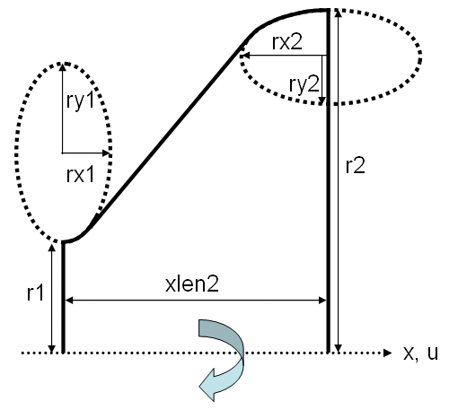
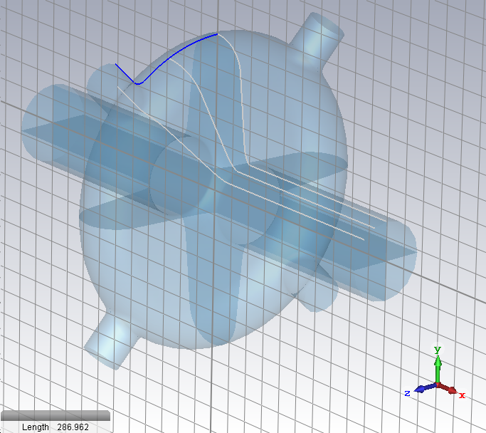
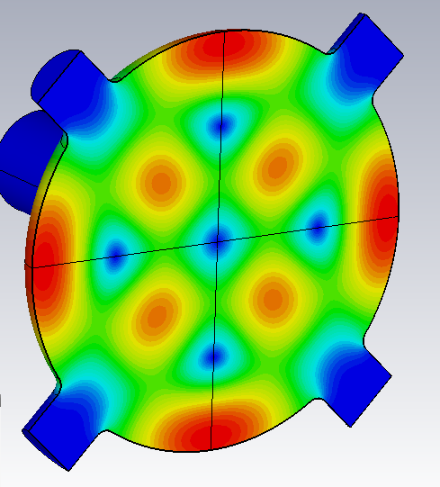
Elliptical cavity RF design
Parameter of the 800MHz with beam pipe radius: Rbp = 80 mm
r1 [mm] | 80.000
r2 [mm] | 318.933
xlen2 [mm] | 103.719
rx1 [mm] | 19.665
rx2 [mm] | 69.909
ry1 [mm] | 53.845
ry2 [mm] | 66.858
G [Ω] | 338.807
B_{max}[mT] (W=1J) | 118
b₂ [mTm/m] (W=1J) | 12.3
Loss factor [V/pC] | 53.1e-3
Kick factor [V/pC/m] | 0.914
(Z_{L}/N)_{eff} [mΩ] | 1.542
(Z_{T})_{eff} [Ω/m] | 866.75
B_{max}/b₂ [T/(Tm/m) | 0.955
W/b₂ [J/(Tm/m)] | 80.931
(Z_{L}/N)_{eff} /b₂ [Ω/(Tm/m)] | 0.125
(Z_{T})_{eff} /b₂ [(Ω/m)/(Tm/m)] | 70147.232
Notes:
Make clear here why we are interested in the rfq. It has several advantages over the octupoles in a machine like LHC or HL-LHC.

Slide 11
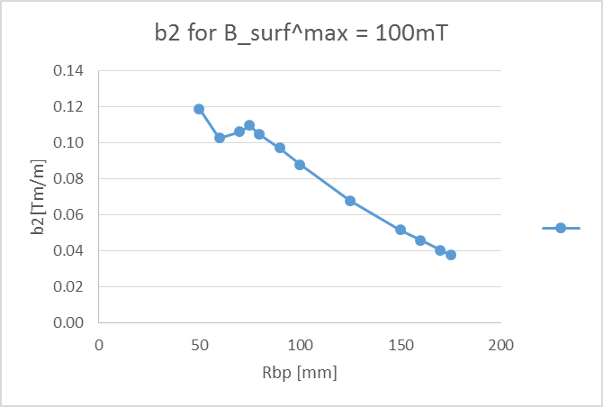
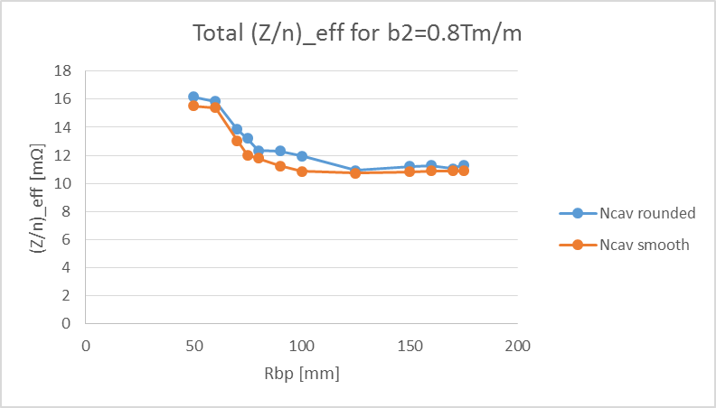
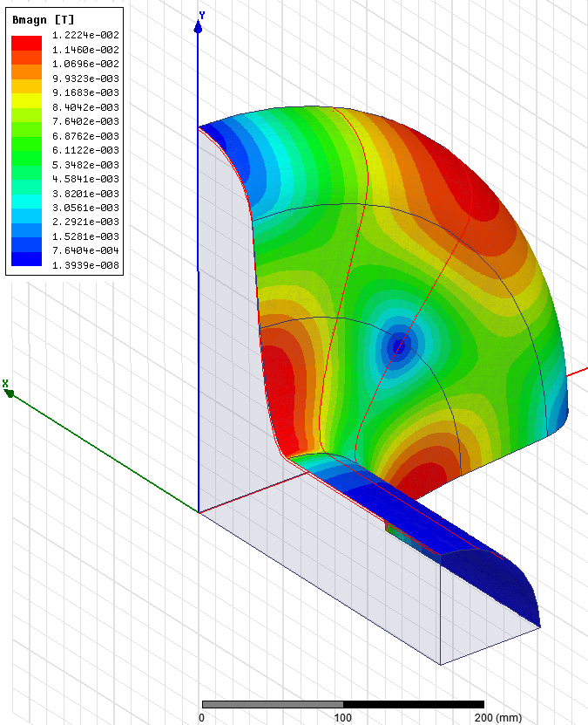
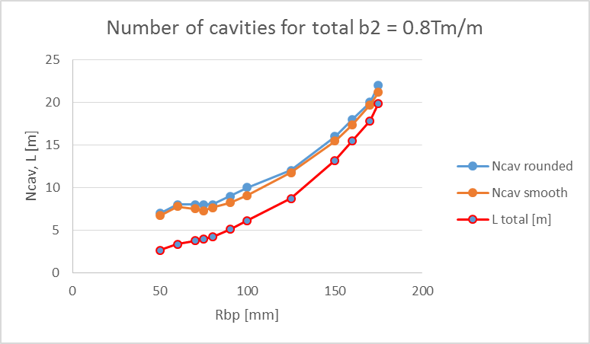
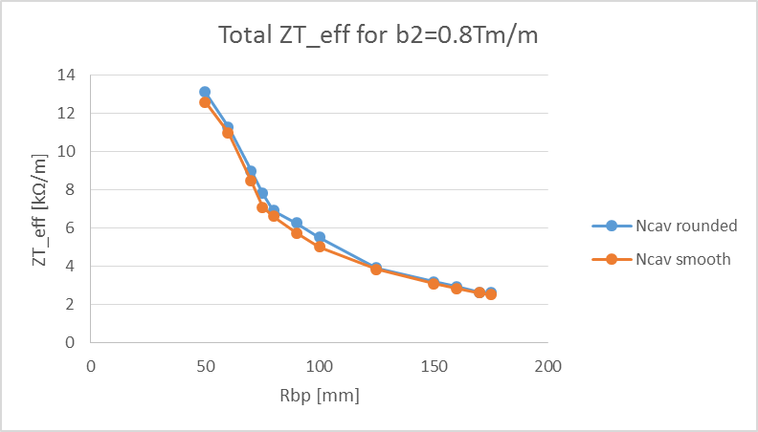
Elliptical cavity: RF design and Impedance
HL-LHC
Budget
93 mΩ
LHC 400 MHz: 10 mΩ (installed)
LHC 200 MHz: 15 mΩ (not installed)
Rbp
HL-LHC
Budget
~20 MΩ/m
Constraints:
Max Bsurf = 100mT
Total b2 = 0.8 Tm/m
L < 10 m

Slide 12
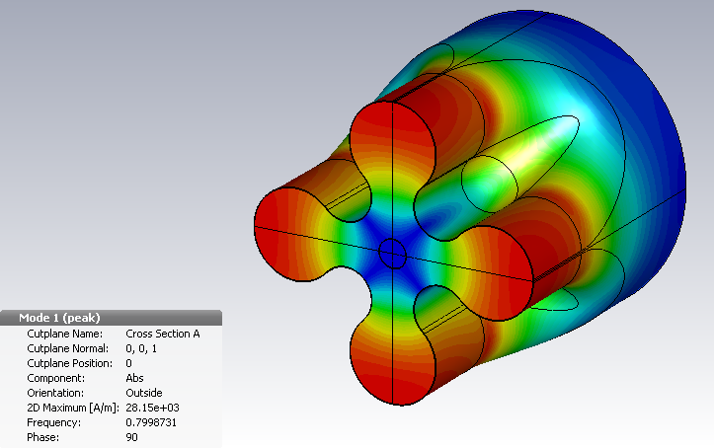
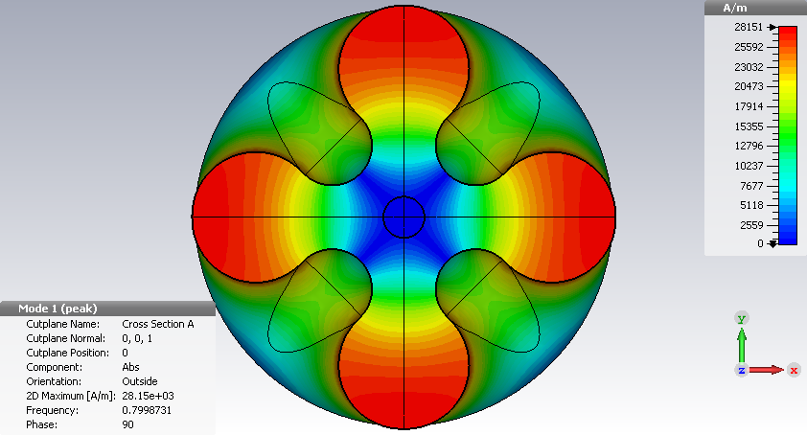
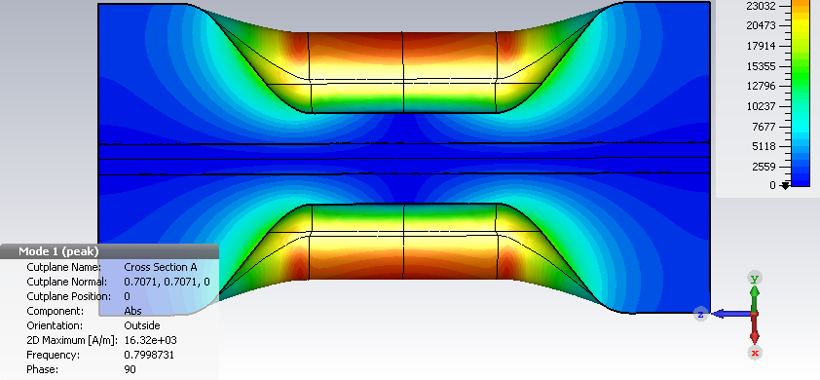
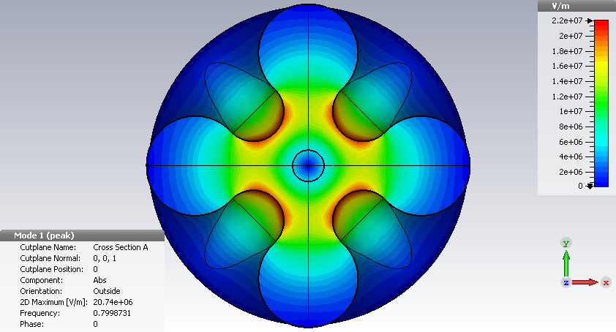
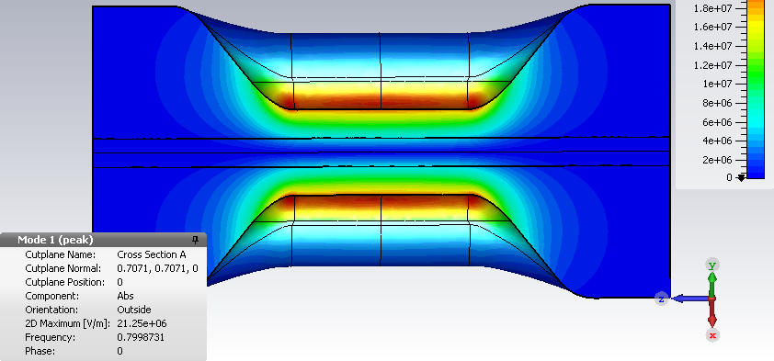
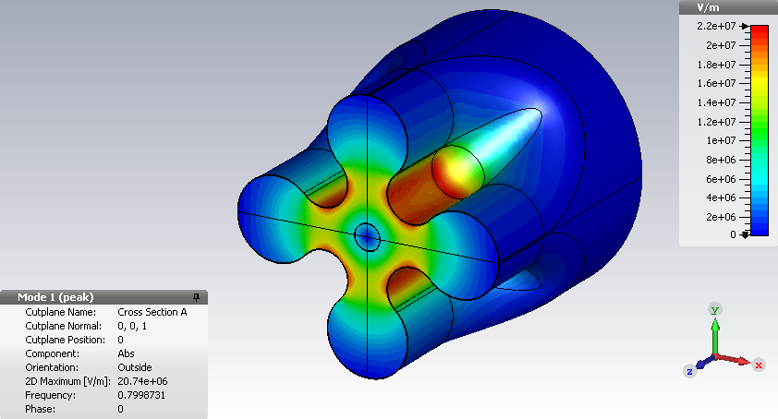
RF design of the 4-vane cavity
B-field
Taper
angle
2a
E-field

Slide 13
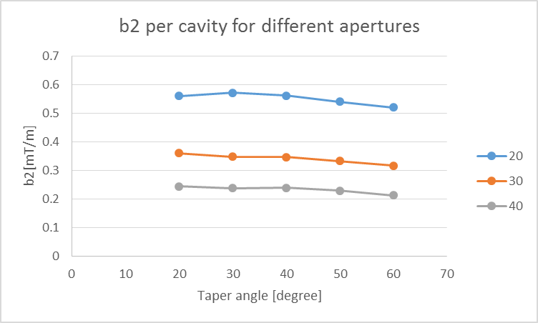
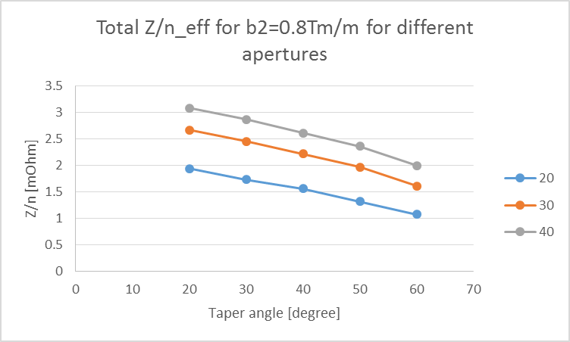
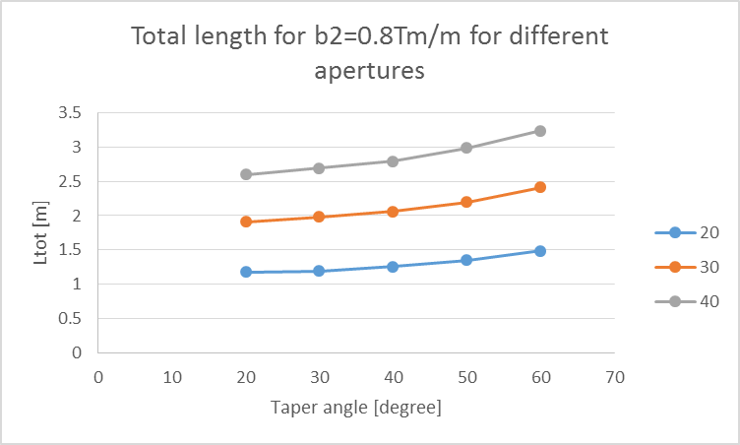
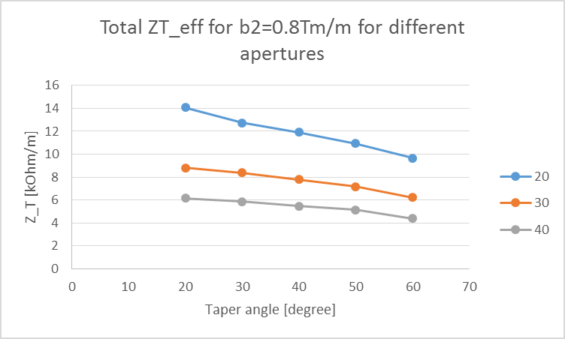
4-vane cavity design: RF design and impedance
E-field distribution in
One half of the cavity
HL-LHC
Budget
93 mΩ
HL-LHC
Budget
20 MΩ/m
Constraints:
Max Esurf = 50 MV/m
Total b2 = 0.8 Tm/m

Slide 14
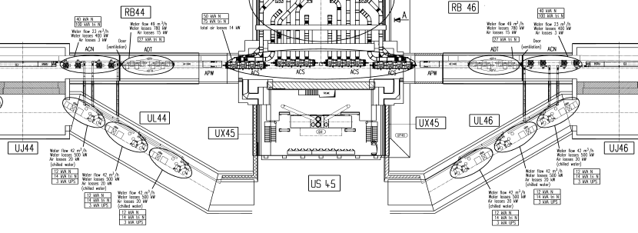
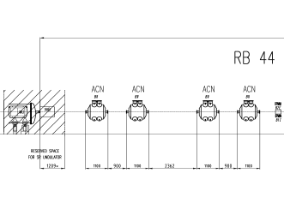
RF system potential location and Cost estimate
Cost estimate is based on:
  RF sources and network:
    400 MHz LHC main RF cost data (Olivier Brunner)
    800 MHz SPS RF system (Eric Montesinos)
  Cryo-module and cavities:
    “Cost estimate for the HP-SPL” (sLHC-project-note-0037 (2012))
    Discussion with Ofelia Capatina concerning cost break down and scaling taking into account experience of SPL prototype cryo-module construction
It is assumed that it is installed in IR4 in the space reserved for 200 MHz RF cavities.
~10m

Slide 15
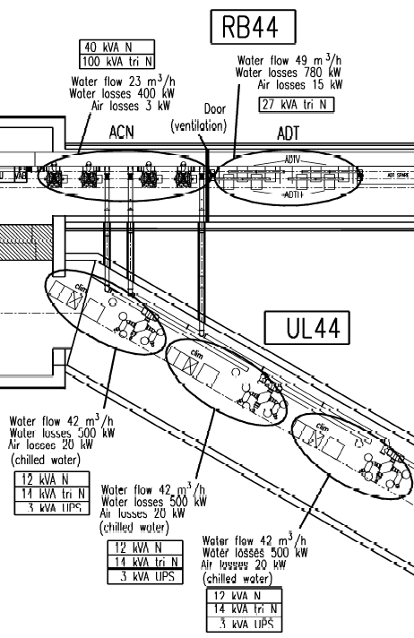
Cost of RF power per quadrupolar cavity
60kW CW 800 MHz RF station (IOT) | Tech. parameters | Cost [kCHF]
RF power station (power converters, IOT, control) | 40-60 kW RF power | 300
RF load, circulator | 60 kW | 75
Waveguide system (1kCHF/m) | WR1150, ~25m | 25
Total |  | 400
10m
Increasing Qext from 1e6 to 1e7 results in lower cost of RF power system by factor 6.6
5kW CW 800 MHz RF station (SSPA) | Tech. parameters | Cost [kCHF]
RF power station (Solid State Power Amplifier, control) | 5 kW RF power | 40
RF load, circulator | 5 kW | 7
Transmission line (0.5kCHF/m) | Coax3-1/8”, ~25m | 13
Total |  | 60
10m

Slide 16
Elliptical Cavity cost model:
TM210 cavity: f=800MHz
HOM
HOM
SPL beta=1 cavity: f=704MHz
HOM
D400
Dbp
D650
FPC
tuner
FPC
L = 5 x 214 + 2*Lbp
Lcav = Lc + 2*Lbp = 200 + 2*Dbp
1 cavity:
1 FPC
1 Tuner
2 HOMs
-------
210kCHF
Material cost:
Material Surface:
S ~ 5 x Scell + 2 x Sbp
~ 5 x π(Dc+Lc)²/2 + 0
~ 5 x π(0.4+0.214)²/2 ~ 3 m²
Cost: 80k / 3m² ~ 27k/m²
Material Surface: ~1/f²
S ~ 1 x Scell + 2 x Sbp
~ π(Dc+Lc)²/2 + 2 x πDbp²
~ π(0.65+0.2)²/2 + 8πRbp²
~ 1.1 + 8πRbp² m²
Cost: 30 + 670Rbp² kCHF (Rbp[m]); 800 MHz
Fabrication cost: Assumed to be close to that one of SPL: 300+150k for the first cavity, 100k for each next one

Slide 17
Cryostat cost model
Parametrization is based on SPL series (design report):
Cryostat beta=1, 8 cavities, 12 m 450+36 kCHF
Cryostat beta=0.65, 3 cavities, 4.5 m 300+36 kCHF
C1 = 150k / 7.5m / 0.4m
= 50 kCHF/m/m - material dominated
C0 = 210k + 36k ~250 kCHF - fabrication dominated
BUT
Absolut value is based on the SPL 6m short proto cost, which is factor 4 higher than the SPL DR prediction :
C0+C1*L*Dc = 250k + 6m*20k/m = 370 kCHF < 1500 kCHF
For RF quad system there will be only 2 cryo-modules. :
Factor 4 will be used for fabrication + material cost with respect to the model
Design + tolling cost is devided by number of cryomodules (2): (500+700)/2=600kCHF per cryostat
Cost = C0 + C1*L*Dc
Cost = 1600k + 200k/m/m * L * 0.65m
= 1600k + 130k/m * L
= 1600k + 130k/m * Lcav * Ncav
Limit:
L < 10 m , see layout in IR4 =>
Cost < 2300 kCHF

Slide 18
Total cost estimate per beam
Total cost of RF system:
  Ctot = Ccry + [Ccav0 + Ccav1*Ncav] + CRF*Ncav;
  Ncav = f(Rbp) due to RF design
Cryostat cost:
  Ccry = 1600k + 130k/m * Lcav * Ncav;
  Lcav = Lc + 2Lbp = Lc + 4Rbp = 0.2m + 4Rbp
Cost of the cavities
  Ccav0 = 300k + 50k (design + tooling cost)
  Ccav1 = 100k + 30k + 670Rbp² k/m² + 210k;
Cost of RF power:
  CRF = 400k (IOT based)
Cost includes:
design,
tooling,
material,
fabrication
It does not include:
infrastructure
  electricity,
  controls,
  vacuum,
  cryogenics,
installation,
Testing
comissioning,
….

Slide 19
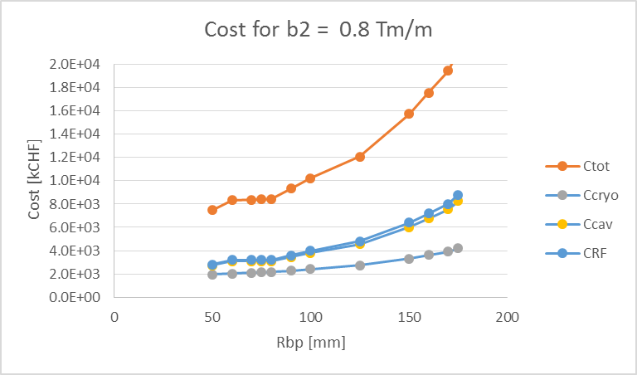
Cost versus Impedance per beam for Elliptical cavity
Most critical parameter is Z/n_eff = 12 mΩ, which is about 13% of the HL-LHC longitudinal impedance budget.
Impedance versus cost indicated that Rbp = 80 mm is about right
In this case, total cost is about 8.5 MCHF. Total cryo-module length is about 5 m.
Increasing Qext from 1e6 to 1e7 reduces the Cost by 8*(400-60)=2700 kCHF
Increasing beta-function in the RF quad location helps to reduce the number of cavities for the same betatron frequency detuning (~1/beta)
Zt_eff is not critical < 0.1% of HL-LHC transverse impedance budget
Rbp=80mm

Slide 20
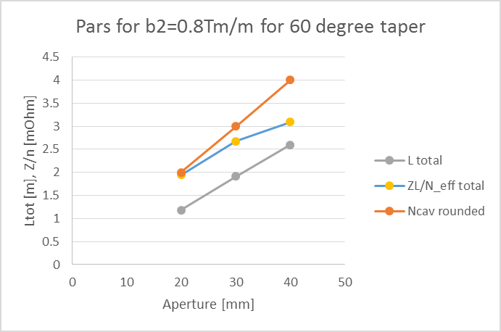
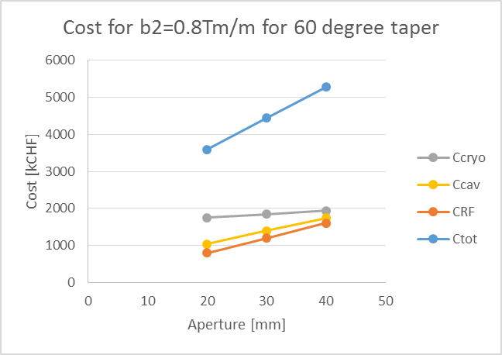
Cost versus Impedance per beam for 4-vane cavity
Most critical parameter is Z/n_eff = 2 - 3 mΩ, which is about 3% of the HL-LHC longitudinal impedance budget.
The smaller the aperture the better both for the cost and impedance. It has to be decided based on allowed aperture restriction in this location.
Number of cavities is 2 – 4 is lower than for elliptical cavities 8. So is the cost: 3.6 – 5.4 MCHF and the cryo-module length: 1.5 – 3 m.
Increasing Qext from 1e6 to 1e7 reduces the Cost by about 1000 kCHF
Increasing beta-function in the RF quad location helps to reduce the number of cavities for the same betatron frequency detuning (~1/beta)
Zt_eff is not critical < 0.1% of HL-LHC transverse impedance budget
Definitely 4-vane cavity is a better choice:
  Lower impedance
  More compact and less expensive system

Slide 21
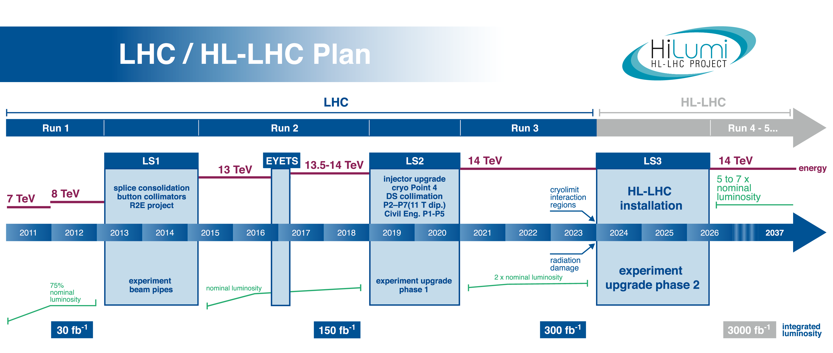
RF quad R&D timeline (optimistic scenario)
RF quad cavity: design, fabrication and vertical test
RF quad cryo-module prototype: design, fabrication and proof of principle test in SPS
Fabrication of 2 RF quad cryo-modules for HL-LHC
Decision about installation in HL-LHC to be taken based on Run4 experience

Slide 22
R&D objectives
Single cell vertical tests (Could be done outside of CERN with minimum load on CERN manpower)
  Achievable field level? Possible limitations:
    Surface RF fields: Is 100 mT and 50 MV/m achievable ?
    Multipactor
    Field emission
    …
  Frequency stability to microphonics (to some extent)
Single cavity cryo-module for test in SPS (Would require CERN manpower. May come after and profit from Crab cavity prototyping and testing in SPS)
  Frequency stability to microphonics
  Alignment
  Operating with the beam
  Proof-of-principle experiment of stabilizing the beam in SPS

Slide 23
Summary
RF quadrupole system for enhancement of the Landau damping in HL-LHC equivalent to LO system has been proposed
Impedance and cost optimized design of the RF system for HL-LHC has been presented
Possible R&D roadmap in line with the HL-LHC schedule has been presented

Slide 24
References I
[1] A. W. Chao, Physics of collective beam instabilities in high energy accelerators, Wiley, 1993.
[2] A. Grudiev, Radio frequency quadrupole for Landau damping in accelerators, Phys. Rev. ST Accelerators and Beams 17, 011001, 2014.
[3] A. Grudiev, RF quadrupole for Landau damping, Talk at ICE meeting, 23.10.2013.
[4] A. Grudiev, K. Li, and M. Schenk, Radio Frequency Quadrupole for Landau Damping in Accelerators: Analytical and Numerical Study, Proceedings, HB2014 (USA), 2014.
[5] J. Scott Berg and F. Ruggiero, Stability Diagrams for Landau Damping, LHC Project Report 121, 1997.
[6] K. Papke, A. Grudiev, Design of RF quadrupole resonator, Slides, 31.05.2016.
[7] O. Brüning and L. Rossi (Edts.), The High Luminosity Large Hadron Collider, Advanced Series on Directions in High Energy Physics Vol. 24, 2015.
[8] C. Zannini et al., Benchmarking the SPS transverse impedance model: headtail growth rates, Talk at SPSU meeting, 09.10.2014.
[9] H. Bartosik, Beam dynamics and optics studies for the LHC injectors upgrade, PhD thesis, 2013.

Slide 25
References II
[10] M. Schenk et al., Use of RF Quadrupole Structures to Enhance Stability in Accelerator Rings, Proceedings of HB2016 (Sweden), 2016.
[11] A. Piwinski, Synchro-Betatron Resonances in Circular Accelerators, DESY, 1995.
[12] H. Bartosik et al., Improved methods for the measurement and simulation of the CERN SPS non-linear optics, Proceedings of IPAC16 (Korea), 2016.
[13] C. Vaccarezza et al., Preliminary results on Daphne operation with octupoles, Proceedings, EPAC2002 (France), 2002.
[14] V. V. Danilov, Increasing the transverse mode coupling instability threshold by RF quadrupole, Phys. Rev. ST Accel. Beams 1, 041301, 1998.
[15] E. A. Perevedentsev and A. A. Valishev, Synchrobetatron dynamics with a radio-frequency quadrupole, Proceedings of EPAC2002, Paris (France), 2002.
[16] L. R. Carver et al., Current status of instability threshold measurements in the LHC at 6.5 TeV, Proceedings of IPAC16, Busan (Korea), 2016.
[17] E. Métral et al., Measurement and interpretation of transverse beam instabilities in the CERN Large Hadron Collider (LHC) and extrapolations to HL-LHC, Proceedings of HB2016 (Sweden), 2016.
[18] E. Métral et al., Status of the LHC Instabilities, 1st ICE Meeting, 14.07.2010.
[19] E. Métral, B. Salvant, N. Mounet, Stabilization of the LHC single-bunch transverse instability at high-energy by Landau octupoles, 13.09.2011.

Slide 26
Back up

Slide 27
RF system for a quadrupolar cavity
No beam loading : Input RF power per cavity: P_{in} = ωU_{cav}/Q_{ext}.
  Assuming Q_{ext} ~ 1e6; frequency stability must be better than df ~ f/2Q_{ext}~ 8e8/2e6 ~ 400Hz
  U_{cav} – stored energy per cavity
Number of cavities is defined: N_{cav} = b⁽²⁾/b⁽²⁾_{cav}
  Specified total RFquad kick: b⁽²⁾ = 0.4 Tm/m;
  b⁽²⁾_{cav} – RFquad kick per cavity which is limited by max. Bsurf = 100 mT:
Example: Rbp = 0.08m
  b⁽²⁾_{cav}= 0.105 Tm/m;
  U_{cav}= 81*0.105 = 8.5 J ~1/f^2
  P_{in} = 2π*8e8*8.5/1e6 = 43 kW ~1/f
  N_{cav} = 0.4/0.105 = 3.8 => 4
SPS 800 MHz RF system is more relevant both from frequency and RF power point of view.
If we assume higher Q_{ext} -> 1e7, P_{in} -> 4 kW and a Solid State Amplifier becomes a very attractive solution with lower cost. But the frequency stability must be < 40 Hz for a cavity as big as an LHC main RF cavity is it feasible?

