Slide 1
ICE-DIP project
14 September 2016
Introduction
Bob Jones (CERN)

Slide 2
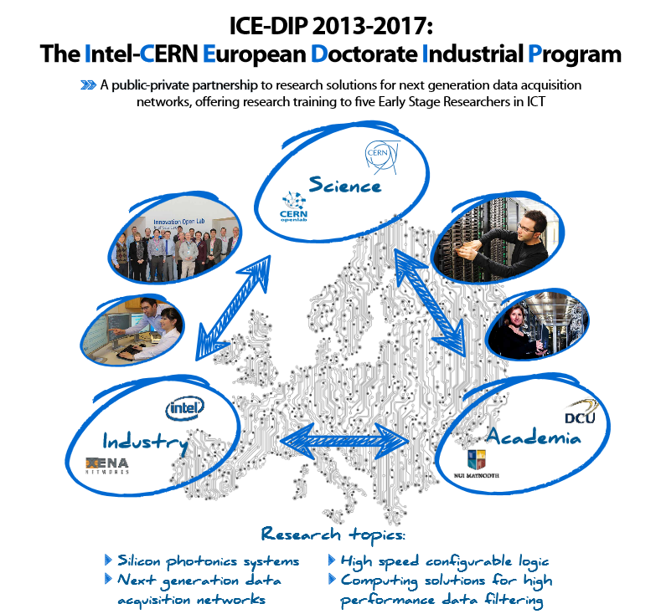
The ICE-DIP Project

Slide 3
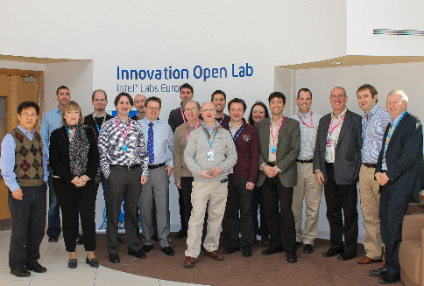
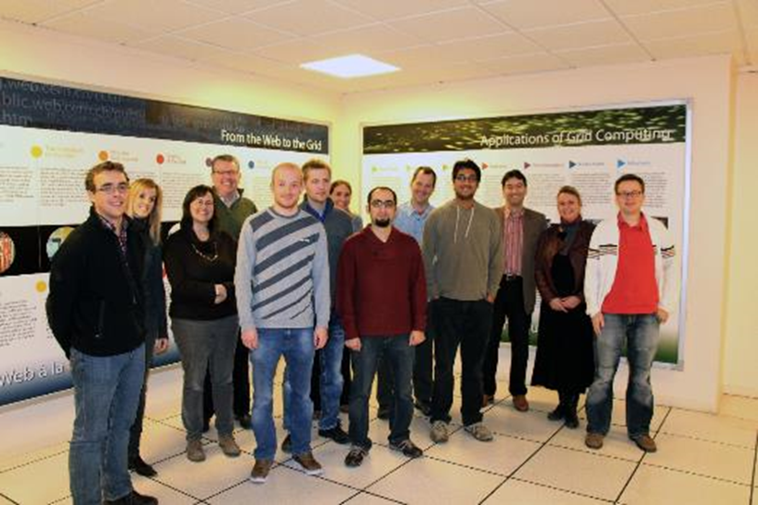
ICE-DIP timeline
Kick-off meeting Feb’13
Students recruited Nov’13
Secondments / Training
End of fellowships Nov’16 & project Jan’17
Final workshop Sept’16

Slide 4




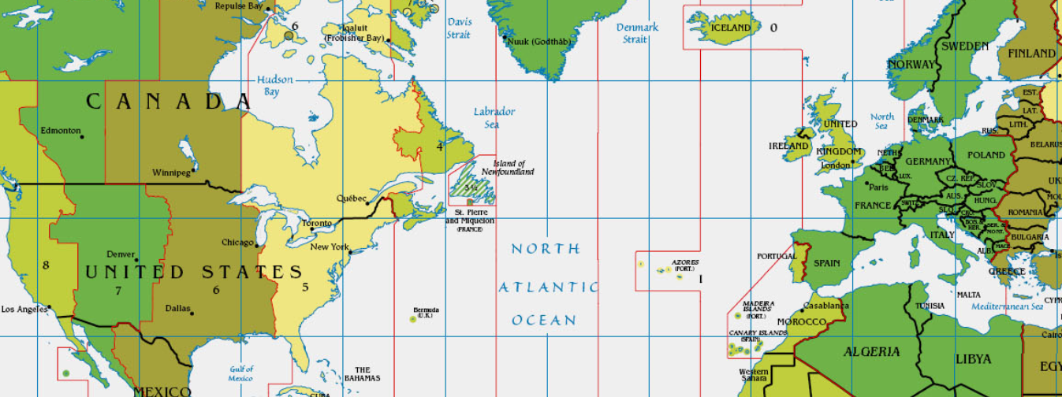

ICE-DIP network
Dublin, Ireland
Maynooth, Ireland
Copenhagen, Denmark
Leixlip, Ireland
Gdańsk, Poland
Santa Clara, USA
Paris, France
Munich, Germany
Geneva, Switzerland

