Slide 1
Data transfer on manycore processors for high throughput applications
14/09/2016
ICE-DIP WP4a - ESR4
Aram Santogidis
Notes:
Leader slide change the footnotes

Slide 2
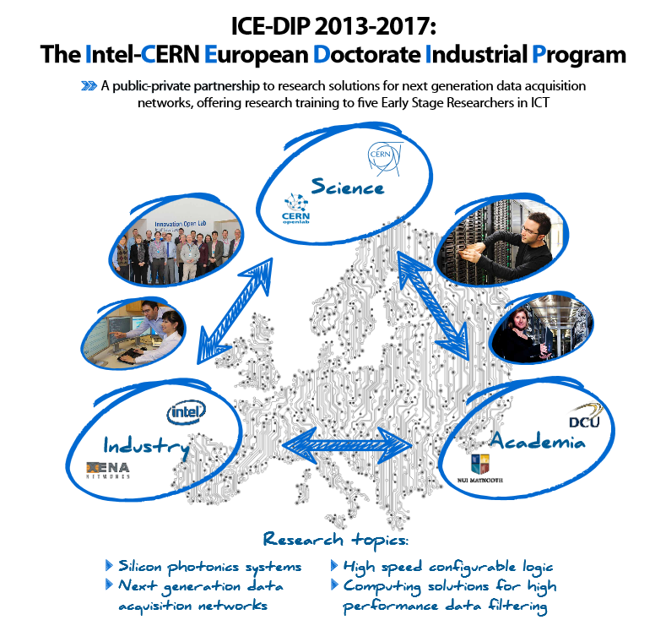
The ICE-DIP Project
Notes:
In this talk I will concentrate how the work done these 3 years connects to:
Maynooth University
CERN
Intel

Slide 3
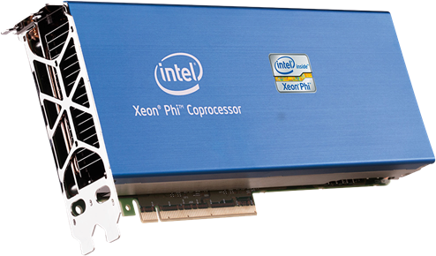
Intel Xeon Phi Coprocessor
Up to 61 Cores
PCIe gen2 Peripheral
Different computation modes
  Offloading
  Symmetric
Notes:
I focused my studies on Intel Xeon Phi Coprocessor codenamed: Knights Corner.
I find the symmetric mode particularly attractive since it is quite unique compared to say GPUs where you can use them as offloading engines. The fact that the coprocessor runs a

Slide 4
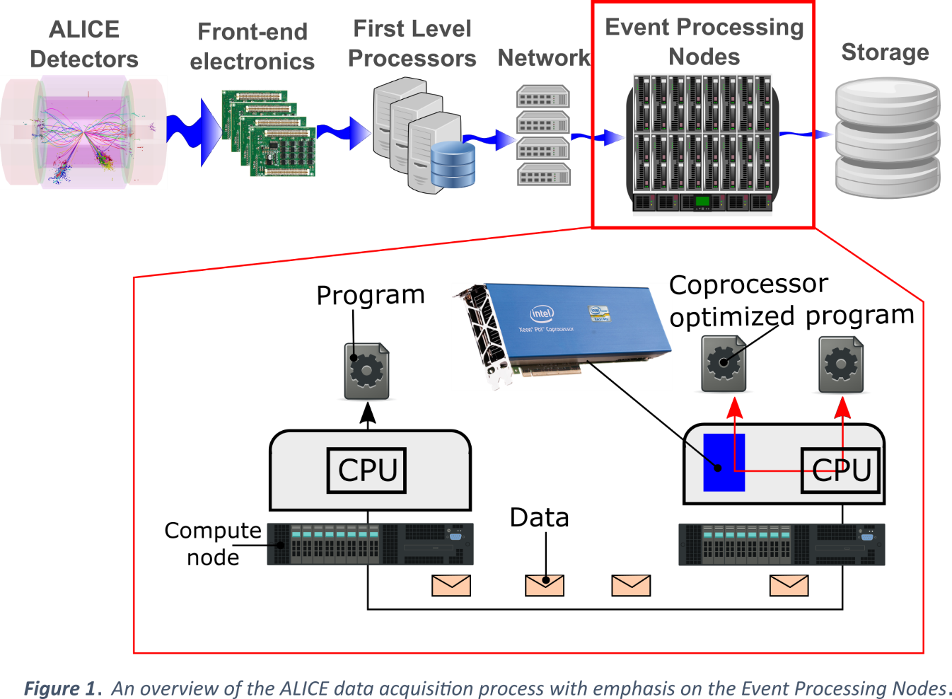
Online processing overview and my focus

Slide 5
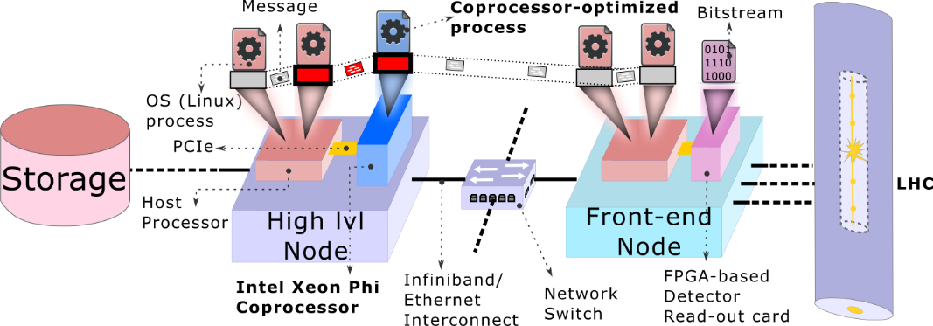
Coprocessor-Host communication in the online processing system

Slide 6


Data transfer libraries for the data acquisition system of the ALICE experiment
Instant messaging for computers
Helps to create distributed systems
Provides good performance
Easy to program from non-expert programmers

Slide 7
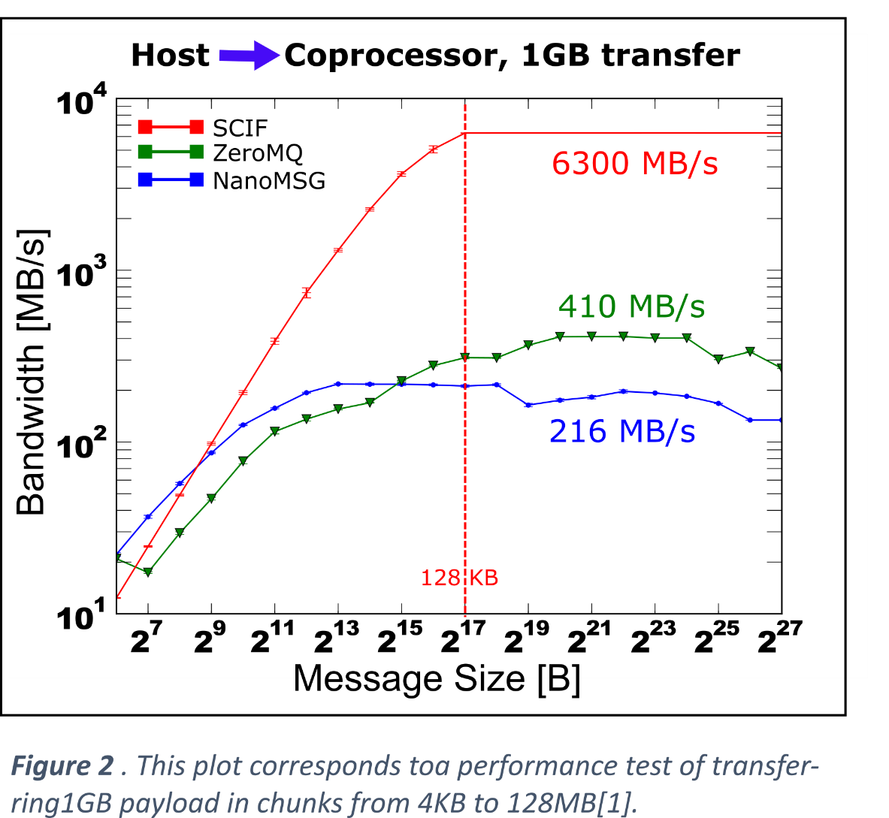
An opportunity for improvement

Slide 8
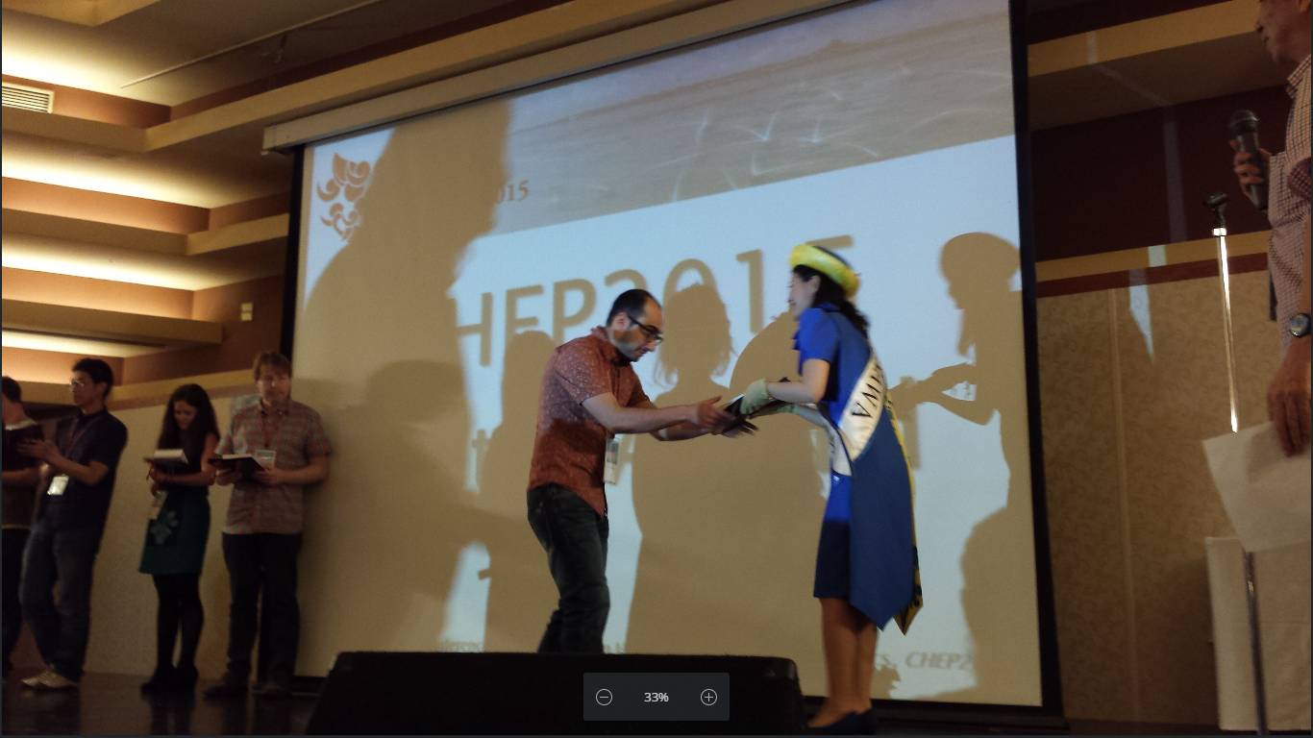
CHEP’15 poster contest award

Slide 9
The Trans4SCIF library the Intel Xeon Phi Coprocessor
Easy-to-use socket-like interface
  Send/Recv
E.g. up to 3 GB/s data throughput (4x imporovementwith the cost of 32 MB of memory space
Exploits cache-aligned RDMA transfers over PCIe
ZeroMQ extension for SCIF
In principle can be re-used by other RDMA based transports (e.g OmniPath)

Slide 10
Outreach and dissemination
Publication
  A. Santogidis, A. Hirstius, and S. Lalis. “Optimizing the transport layer of the ALFA framework for the Intel Xeon Phi Coprocessor” Proceedings of the 21st International Conference on Computing in High Energy and Nuclear Physics, April 2015, Okinawa, Japan, 2015.
Many talks were given to diverse audiences and places
  CHEP’15, Okinawa, Japan
  Augmented reality lab, Hong Kong
  inverted CERN School of Computing, Geneva
  thematic CERN School of Computing, Split
Some more are planned for the immediate future
  Huawei Labs, Paris
  Undergraduate students of University of Thessaly, Volos, Greece

Slide 11



Acknowledgements
Many thanks to ICE-DIP and openlab colleagues for their support. Also thanks and regard to my 6! supervisors. Andrzej Nowak, Andreas Hirstius, Olof Barring, Fons Rademakers, Spyros Lalis, Bryan Hennelly.
This research project has been supported by a Marie Curie Early European Industrial Doctorates Fellowship of the European Community's Seventh Framework Programme under contract number (PITN-GA-2012-316596-ICE-DIP).

