Slide 2
Porting CernVM to AArch64
CERN Summer Student Programme 2016, Dept.: EP-SFT
Talk by | Felix Scheffler | felix.scheffler@in.tum.de
Main Supervisor | Jakob Blomer | jakob.blomer@cern.ch
2nd Supervisor | Gerardo Ganis | gerardo.ganis@cern.ch
Special thanks to TechLab for providing access to ARM64 infrastructure. Further information @ https://twiki.cern.ch/twiki/bin/viewauth/IT/TechLab

Slide 3
Agenda
Background
  µCernVM – Virtualisation in HEP
  Why ARM?
  ARM & Virtualisation
Project
  Development environment
  Modified µCernVM image
  Benchmarking
  Conclusions
Further Material

Slide 4
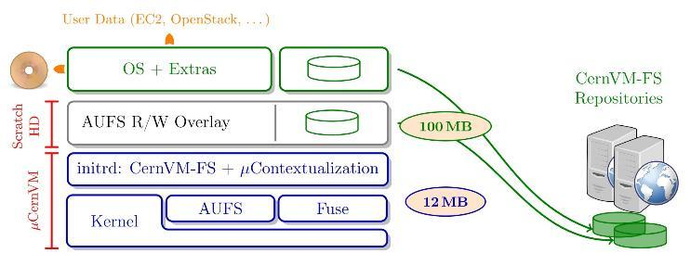
µCernVM – Virtualisation in HEP
Background
Typical shortcomings of VM images:
large size → difficult and not efficiently to distribute, slow start
difficult to keep up to date
J. Blomer, D. Berzano, P. Buncic, I. Charalampidis, G. Ganis, G. Lestaris, R. Meusel and V. Nicolaou, “Micro-CernVM: slashing the cost of building and deploying virtual machines,” Journal of Physics: Conference Series, vol. 513, no. 032009, pp. 1-7, 2014
A custom Linux kernel/initrd pair connects to a CVMFS repository that resides on a dedicated web server. In contrast to “usual” VMs, anything that is needed from this repository is only downloaded on demand, aggressively cached and eventually released again.

Slide 5
µCernVM – Virtualisation in HEP
Background
Typical shortcomings of VM images:
large size → difficult and not efficiently to distribute, slow start
difficult to keep up to date
J. Blomer, D. Berzano, P. Buncic, I. Charalampidis, G. Ganis, G. Lestaris, R. Meusel and V. Nicolaou, “Micro-CernVM: slashing the cost of building and deploying virtual machines,” Journal of Physics: Conference Series, vol. 513, no. 032009, pp. 1-7, 2014
A custom Linux kernel/initrd pair connects to a CVMFS repository that resides on a dedicated web server. In contrast to “usual” VMs, anything that is needed from this repository is only downloaded on demand, aggressively cached and eventually released again.

Slide 6
Why ARM?
Background
Energy efficiency
Huge workload
Architectural considerations
[…] continue to increase in performance such that they are now within the range of x86 CPUs […]
[…] development of new ARM-based microservers and an upward push of ARM CPUs into traditional server, PC, and network systems.
C. Dall and J. Nieh, “KVM/ARM: The Design and Implementation of the Linux ARM Hypervisor,” March 2014.
By early 2013 CERN had increased the power capacity of the centre from 2.9 MW to 3.5 MW […] The Grid runs more than two million jobs per day. At peak rates, 10 gigabytes […] every second.
https://home.cern/about/computing
Data centers can waste 90 percent or more of the electricity they pull off the grid.
The New York Times, SEPT. 22, 2012
[…] comparable core counts and clock frequencies at a fraction of the energy cost of traditional multicore systems
[However], resource imbalances […] may result in significantly longer execution time and higher energy cost …
Tudor, B.M., Teo, Y.M. On understanding the energy consumption of ARM-based multicore servers (2013) Performance Evaluation Review, 41 (1 SPEC. ISS.), pp. 267-278.
more than 95% market share in smart phone processors
https://www.arm.com/markets/mobile
Notes:
strong standing in mobile devices and computing (particularly driven by energy considerations). The HEP community is confronted with computations carried out on millions of cores 24/7. Thus, computing is not only a technical, but also an economic problem
The global chip market is primarily shared between Intel, AMD and ARM. Thus, porting µCernVM to ARM also potentially opens up a new market to serve. Once ARM is more mature in the server market as well, it is desirable to have an HEP virtualisation solution to serve this architecture.

Slide 7
ARM & Virtualisation
Background
Year | Event | Benefit
2011 | Introduction of hardware virtualisation to ARMv7-A
2013 | Merge KVM/ARM (Linux ARM hypervisor) into Linux 3.9 kernel C. Dall and J. Nieh, “KVM/ARM: The Design and Implementation of the Linux ARM Hypervisor,” March 2014. [Online]. Available: http://systems.cs.columbia.edu/files/wpid-asplos2014-kvm.pdf | - No need for 3rd party hypervisors - platform-wide standard
2014 | Using UEFI in QEMU/KVM (AArch64 + AArch32) https://wiki.linaro.org/LEG/UEFIforQEMU | - No industry standard for booting on ARM (like BIOS on x86-64), UBOOT is no standard either
2016 planned | Linaro Openstack development cloud on AArch64 https://www.linaro.cloud/ Video conference with Linaro | - real-world test case, mutual feedback on Openstack and µCernVM

Slide 8
Development environment
Project
 | HPE ProLiant m400 (Moonshot) [1] | Geekbox
Architecture | AArch64
OS | CentOS7 | Android/Ubuntu Dual Boot OS
Software | Linux 4.2.0, gcc 4.8.5 | Linux 3.10.0, gcc 4.8.4
Cores | 8 cores 2.4GHz | 8 cores 1.5GHz (RK3368 SoC)
Memory | 64GB | 2GB
Further Information | http://www8.hp.com/us/en/products/proliant-servers/product-detail.html?oid=7398907 | http://www.geekbox.tv
[1]
Special thanks to TechLab for providing access to ARM64 infrastructure. Further information @ https://twiki.cern.ch/twiki/bin/viewauth/IT/TechLab

Slide 9
Modified µCernVM image
Project
BIOS/
MBR
EFI system partition
GPT-partitioned
Modified FAT32
make oldconfig based on x86-64 µCernVM kernel & CONFIG_EFI_STUB=y
startup.nsh
<path-to-kernel-image> initrd=<path-to-initrd>
other-kernel-command-line-parameters
preliminary (limited set of packages ported to AArch64)
/usr/share/AAVMF/AAVMF_CODE.fd
UEFI Application/Image 1 → … → UEFI Application/Image n → UEFI Shell
/usr/share/AAVMF/AAVMF_VARS.fd
virt-install -n <name> -- boot uefi --memory <MB> --vcpus <#> --cpu host --disk path=<hdd>,format=raw(,cache=none,bus=virtio) --cdrom <context> -v --virt-type kvm --accelerate

Slide 10
Benchmarking - Framework
Project
What?
Compare AArch64 host vs. VM performance
How?
Real-world benchmarks (ROOT6 stress and CMS GEN-SIM)
Low-level I/O benchmarks (disk and network throughput)
time dd bs=1M count=4000 if=/dev/zero of=<of> conv=fsync
iperf3

Slide 11
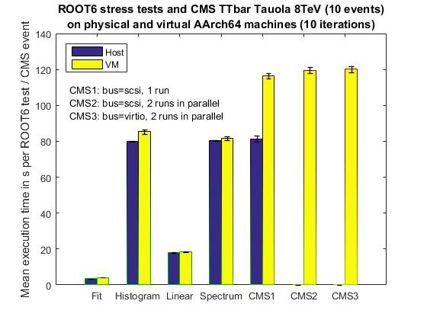
Benchmarking – ROOT6 and CMS
Project

Slide 12
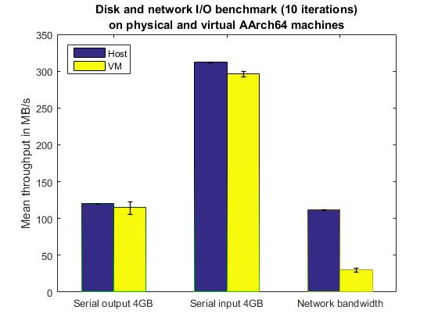
Benchmarking – Low-level I/O
Project

Slide 13
Conclusion
Project
Status quo
  Successfully ported µCernVM to AArch64
  As a side project, ported µCernVM to Intel 32bit (move BOINC-CernVM to new µCernVM framework)
  Proved that µCernVM code base is portable with relatively little effort
  Measured runtime performance via real-world (ROOT6 and CMS) and low-level I/O and network benchmarks
To Do
  Test µCernVM image in Linaro Openstack cloud (mutual feedback)
  Further benchmarks/tests under varying conditions (VM or host configurations, load configurations, parallel threads etc.) to gain more insight into current bottlenecks

Slide 14
Questions?

Slide 15
Modified µCernVM image - Details
Further Material
virt-install -n <name> --memory <MB> --vcpus <#> --cpu host --disk path=<hdd>,format=raw(,cache=none,bus=virtio) --cdrom <context> -v --virt-type kvm --accelerate --boot uefi
/usr/share/AAVMF/AAVMF_CODE.fd
UEFI Shell ← UEFI Application/Image n ← … ← UEFI Application/Image 1
/usr/share/AAVMF/AAVMF_VARS.fd
startup.nsh [“<path-to-kernel-image> initrd=<path-to-initrd> other-kernel-command-line-parameters”]
Read-only cache (local copy of preliminary CVMFS repository with a limited set of packages ported to AArch64)
custom Linux kernel make oldconfig based on x86-64 µCernVM kernel & CONFIG_EFI_STUB=y
Initrd 00setup 01modules 02network 03time 04devices 06context 07extracontext 11resize 12kexec 13context_epilog 14cvmfs 15rebase 20aufs 25inject 30cvmfs-save-pids 80drtini 95pinfiles 96save-logs 97hotfixes 98cleanup 99boot
10root
if started up for the 1st time
if empty disk exists
partition empty disk in MBR scheme && update devices
fi
if no second partition on existing boot disk
either partition remaining space using MBR or GPT scheme depending on primary partition
format in ext4
fi
fi
mount root fs
.ucernvm_boot_loader
Read/Write scratch area
ucernvm-devel.$(UCERNVM_VERSION)-$(UCERNVM_RELEASE).cernvm.aarch64.hdd
EFI System Partition (modified FAT32)
Size:
~15 … 50 MB
Full disk (e.g. provided through Openstack after dd‘ing ESP)
Size: O(GB)

