Slide 1
Fundamental mechanism of the quantum computational speedup
Giuseppe Castagnoli

Slide 2
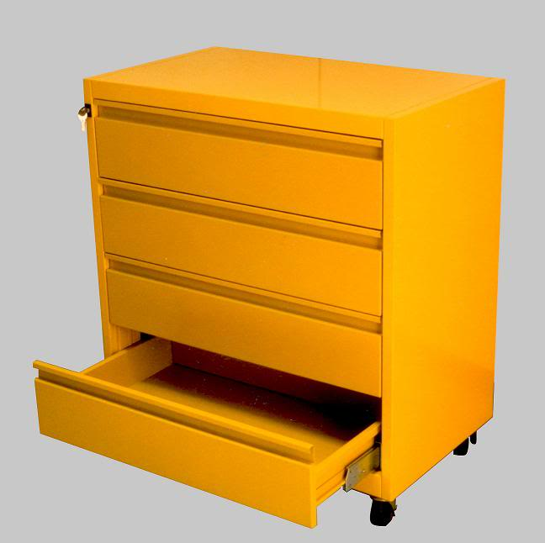
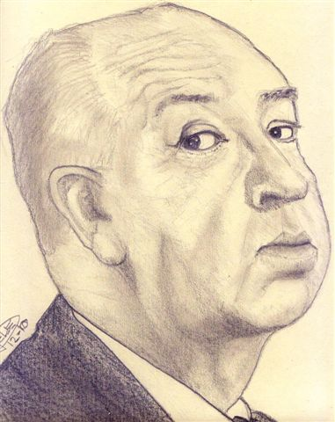

Example of quantum speedup
Bob, the problem setter, hides a ball in one of four drawers
Alice, the problem solver, is to locate it by opening drawers
In the classical case she may need to open up to three drawers, in the quantum case it always takes one
There is a quantum speed-up
BOB ALICE
00
01
10
11

Slide 3

Some jargon
Drawer and ball problem: oracle problem
Checking whether the ball is in a drawer: function evaluation (oracle query)
b = number of the drawer with the ball; checking whether the ball is in drawer a: computing (evaluating) the Kronecker function
Quantum speedup: number of function evaluations required by the quantum algorithm vs number required by the best known classical algorithm

Slide 4
Speedup is poorly understood
Dozens of speedups discovered
All by means of ingenuity
No fundamental explanation of the speedup
No unified explanation of the amount of speedup
A lacuna of quantum computer science
Quantum cryptography, the other pillar of quantum information, directly relies on the foundations of quantum mechanics

Slide 5
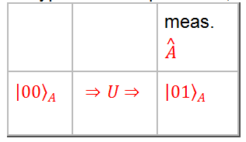
Representation incompleteness
Poor understanding of the speedup: the usual representation of quantum algorithms, limited to the process of solving the problem, is physically incomplete
Drawer number: 01
Quantum register A: contains drawer number a.
Alice unitarily changes input state it into an output state that encodes the solution, then acquired by a final measurement
Initial measurement: missing
Number of the drawer with the ball: not represented physically
Completing the physical representation explains the speedup

Slide 6
Three steps
1) extending the usual representation, limited to the process of solving the problem, to that of setting it
2) relativizing the extended representation to Alice, who cannot see the problem setting selected by Bob (should be hidden inside the black box)
3) symmetrizing the relativized representation for time-reversal – to represent the reversibility of the computation process
Step 3) provides a quantitative explanation of the speedup

Slide 7
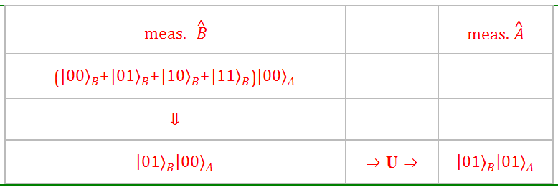

1) extending the representation
Adding a quantum register B that contains the number of the drawer with the ball
Unitary transformation between initial and final measurement outcomes
Extended representation works for Bob (and any external observer)
Not for Alice
Input state would tell her the number of the drawer with the ball before she begins her problem solving action

Slide 8
Relational quantum mechanics
Quantum state has meaning to an observer
Rejects the notion of absolute, or observer independent, state of a system
E. g. a quantum state could be sharp to an observer and a superposition to another

Slide 9
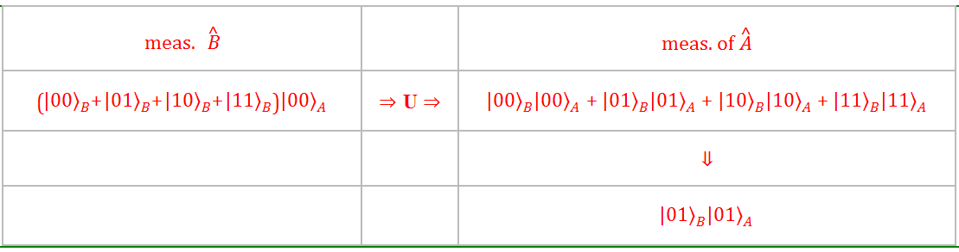
2) relativizing the representation to Alice
postponing the projection of the quantum state due to the initial measurement at the end of the unitary part of Alice’s action
Throughout it, Alice remains completely ignorant of number of the drawer with the ball selected by Bob
Legitimate: degree of freedom of quantum description

Slide 10
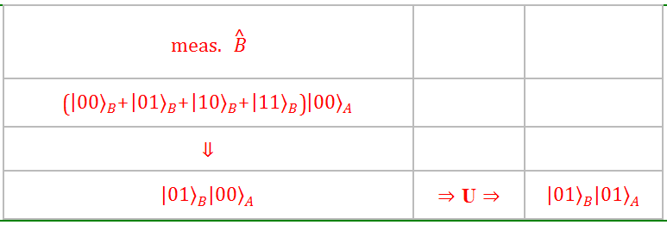
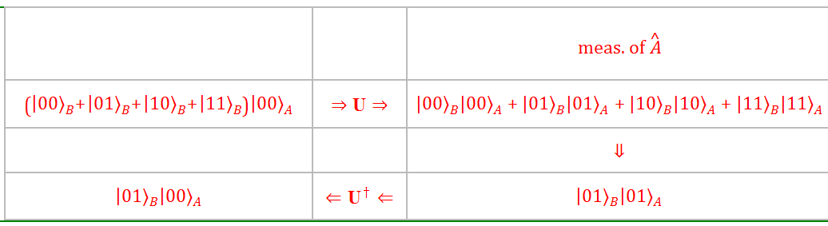
3) symmetrizing for time-reversal
1) outcome of initial measurement random, 2) unitary transformation between initial and final measurement outcomes
Selection of the number of the drawer with the ball by:
1) initial measurement
2) final measurement
Which measurement?
Neither one alone: would introduce preferred direction of time, unjustified in a reversible context
Share selection evenly between initial and final measurements

Slide 11
3) symmetrizing for time-reversal
Initial and final measurements reduce to partial measurements that evenly and without redundancy contribute to the selection, e. g.:
initial measurement of , reduced to that of , selects 0 of 01; outcome propagated forward in time
final measurement of , reduced to that of , selects 1 of 01; outcome propagated backward in time
Performing the two propagations in a sequence time-symmetrizes the representation
Superposition of all the possible ways of sharing

Slide 12
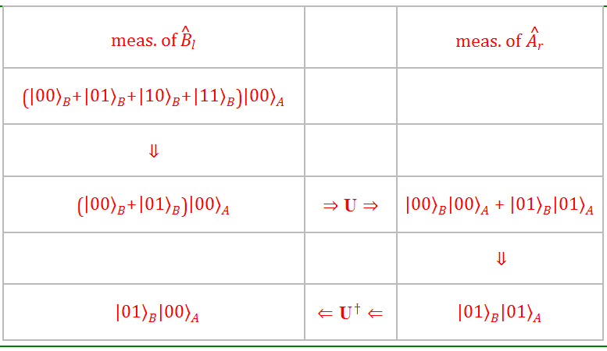
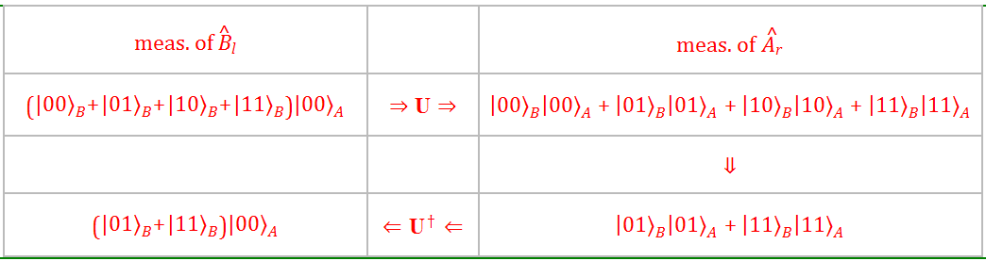

Slide 13
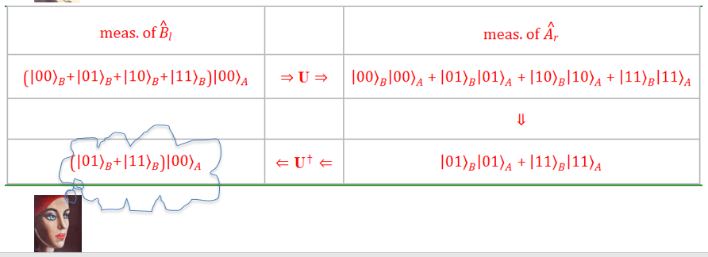
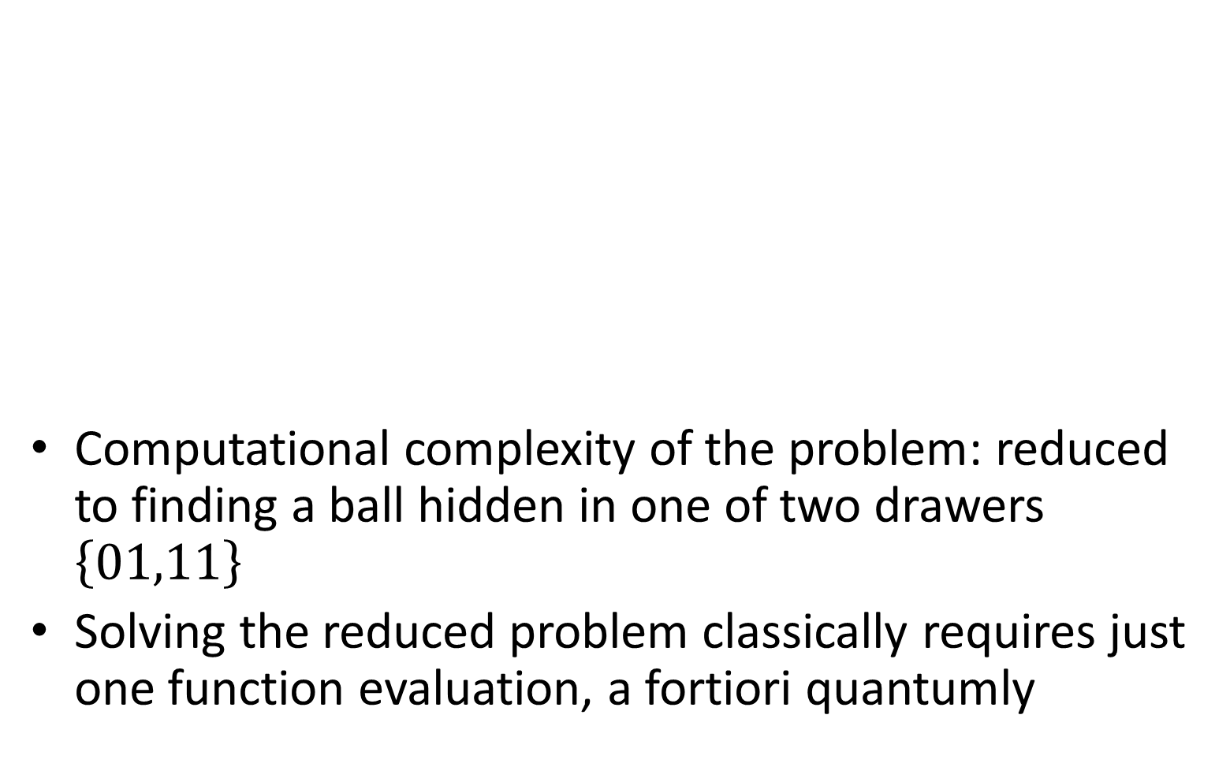
Advanced knowledge
Computational complexity of the problem: reduced to finding a ball hidden in one of two drawers $\left\{01,11\right\}$
Solving the reduced problem classically requires just one function evaluation, a fortiori quantumly

Slide 14
Reduced problem
Oracle problem can always be solved quantumly with the number of function evaluations required to solve its reduced problem classically
Reduced problem: original one but for the fact that the problem solver knows in advance a part of the problem setting that corresponds to half solution
Found an upper bound to the quantum computational complexity of oracle problem
It holds for any oracle problem and can be computed on the basis of the problem alone

Slide 15
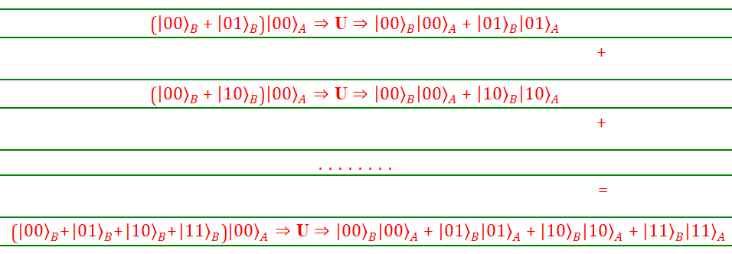
Quantum superposition
Taking the superposition of all the time-symmetric transformations rebuilds the original transformation with respect to Alice
Symmetrization for time-reversal partitions the transformation with respect to Alice into a superposition of time-symmetric transformations each solving an instance of the reduced problem

Slide 16
Upper bound checked on the major quantum algorithms
Deutsch, Deutsch&Jozsa, Simon, Shor, Grover, Abelian hidden subgroup (12 algorithms)
All optimal in character
Upper bound always coincides with the number of function evaluations required to solve the problem in an optimal quantum way
Conjecture: this holds in general, for any oracle problem

Slide 17
Conjecture
requires just one function evaluation
By an optimal quantum algorithm, a non-optimal one would require a higher number
The symbolic description of a quantum process speaks to us in classical logic

Slide 18
Summarizing
In all cases, half of the random outcome of the initial measurement (half of the problem setting) selected back in time by final measurement
This tells nothing to Bob, who knows the outcome of the initial measurement to start with
To Alice, who is shielded from the outcome of the initial measurement, it tells half of it and thus a corresponding half of the solution
Time-symmetrization by reducing initial and final measurements to complementary partial measurements: inspired by the work of Dolev and Elitzur on the non sequential behavior of the wave function highlighted by partial measurement

Slide 19
Positioning
Two main approaches to the quantum speedup:
Quantum computer science (quantum complexity classes and their relations to the classical ones)
Relation between speedup and fundamental quantum features (entanglement/discord)

Slide 20
Positioning – quantum computer science
Quantum computer science is analytic in character
The present explanation of the speedup is synthetic, derived from the foundations
Like in analytic geometry (mathematics on coordinates) and the synthetic one (derivation of theorems from postulates)
Analytic counterpart of the upper bound
Difficulty of deriving it?
Upper bound vs today’s quantum complexity classes
If the conjecture that the upper bound is the number of function evaluations required by an optimal quantum algorithm were true, it would solve the well known open problem of quantum query complexity

Slide 21
Positioning – relation between speedup and the foundations
The speedup appears to always depend on the exact nature of the problem while the reason for it varies from problem to problem (Vedral, Henderson)
Present fundamental explanation applies to all oracle problems and is quantitative in character

Slide 22
Conclusion
Found an upper bound to the computational complexity of any oracle problem, always coinciding with the number of function evaluations required by the optimal quantum algorithm
Derived in a synthetic way from the foundations of quantum mechanics

Slide 23
Future work
Checking whether the upper bound always coincides with the number of function evaluations required by the optimal quantum algorithm
Finding oracle problems liable of interesting speedups, classifying quantum complexity of oracle problems (compare with existing quantum complexity classes)
Further studying the fundamental implications of an explanation of the speedup that merges time-symmetric quantum mechanics and quantum information

Slide 24
References
Aharonov, Y., Cohen, E., Elitzur, A. C.: Can a future choice affect a past measurement’s outcome? Ann. Phys. 355, 258-268 (2015).
Dolev, S. and Elitzur, A. C.: Non-Sequential Behavior of the Wave Function. arXiv:quant-ph/0102109 (2001)
Castagnoli, G. and Finkelstein, D. R.: Theory of the quantum speedup. Proc. Roy. Soc. A 1799, 457, 1799-1807 (2001)
Castagnoli, G.: The quantum correlation between the selection of the problem and that of the solution sheds light on the mechanism of the quantum speed up. Phys. Rev. A 82, 052334-052342 (2010)
Castagnoli, G.: Highlighting the mechanism of the quantum speedup by time-symmetric and relational quantum mechanics. Found. Phys. Vol. 46, Issue 3. 360--381 (2016)
Castagnoli, G.: On the relation between quantum computational speedup and retrocausality. Quanta Vol. 5, No 1, 34-52 (2016)
Castagnoli, G.: Completing the physical representation of quantum algorithms explains their computational speedup. arXiv:quant-ph1705.02657 (2017)

