Slide 1
Directional dark matter search with nuclear emulsion
Takashi Asada
University of Naples/LNGS/JSPS
On behalf of NEWSdm collaboration

Slide 2
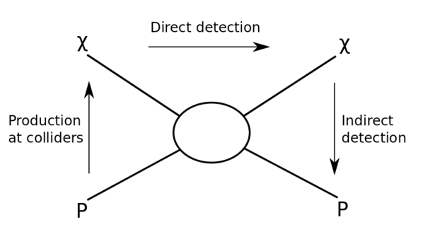
Direct Dark Matter Search
The aim is the detection of nuclear recoil
come from WIMP interaction
WIMP wind is good feature to proof
the detection and the galactic origin
WIMP
WIMP wind
WIMP
240 km/sec
WIMP
Target
nuclei
WIMP wind
< 540 km/sec
0.3 GeV/cm³
30km/sec
Nuclear recoil
Low energy, few events
Notes:
There is several talks of dark matter search in the conference.
One is …
Our target is the direct detection of nuclear recoil…
WIMP is thought that

Slide 3
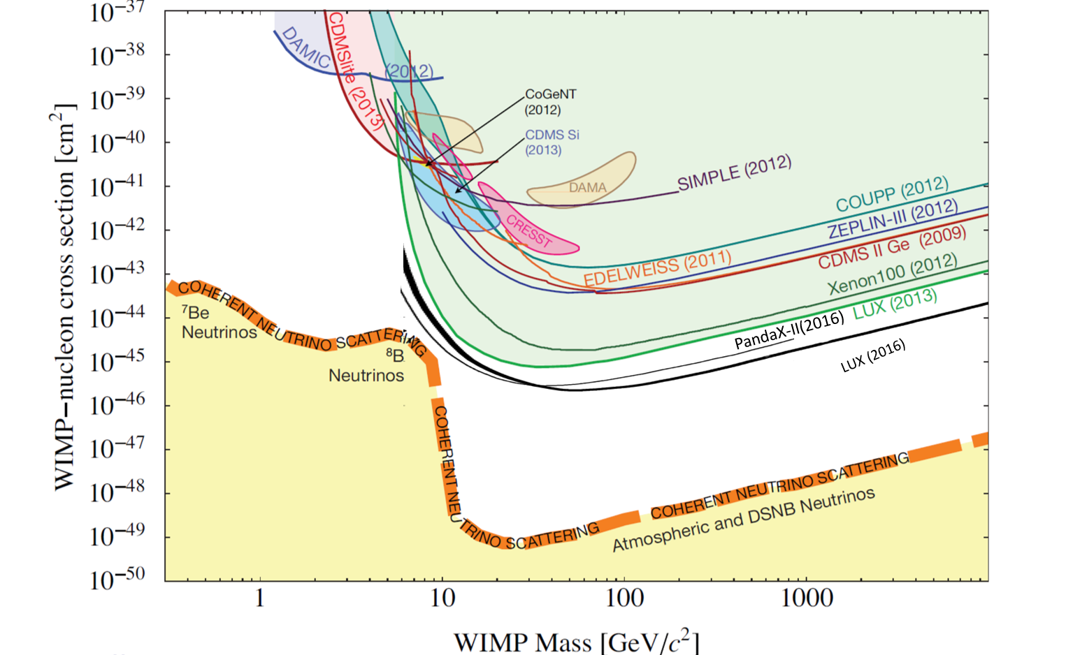
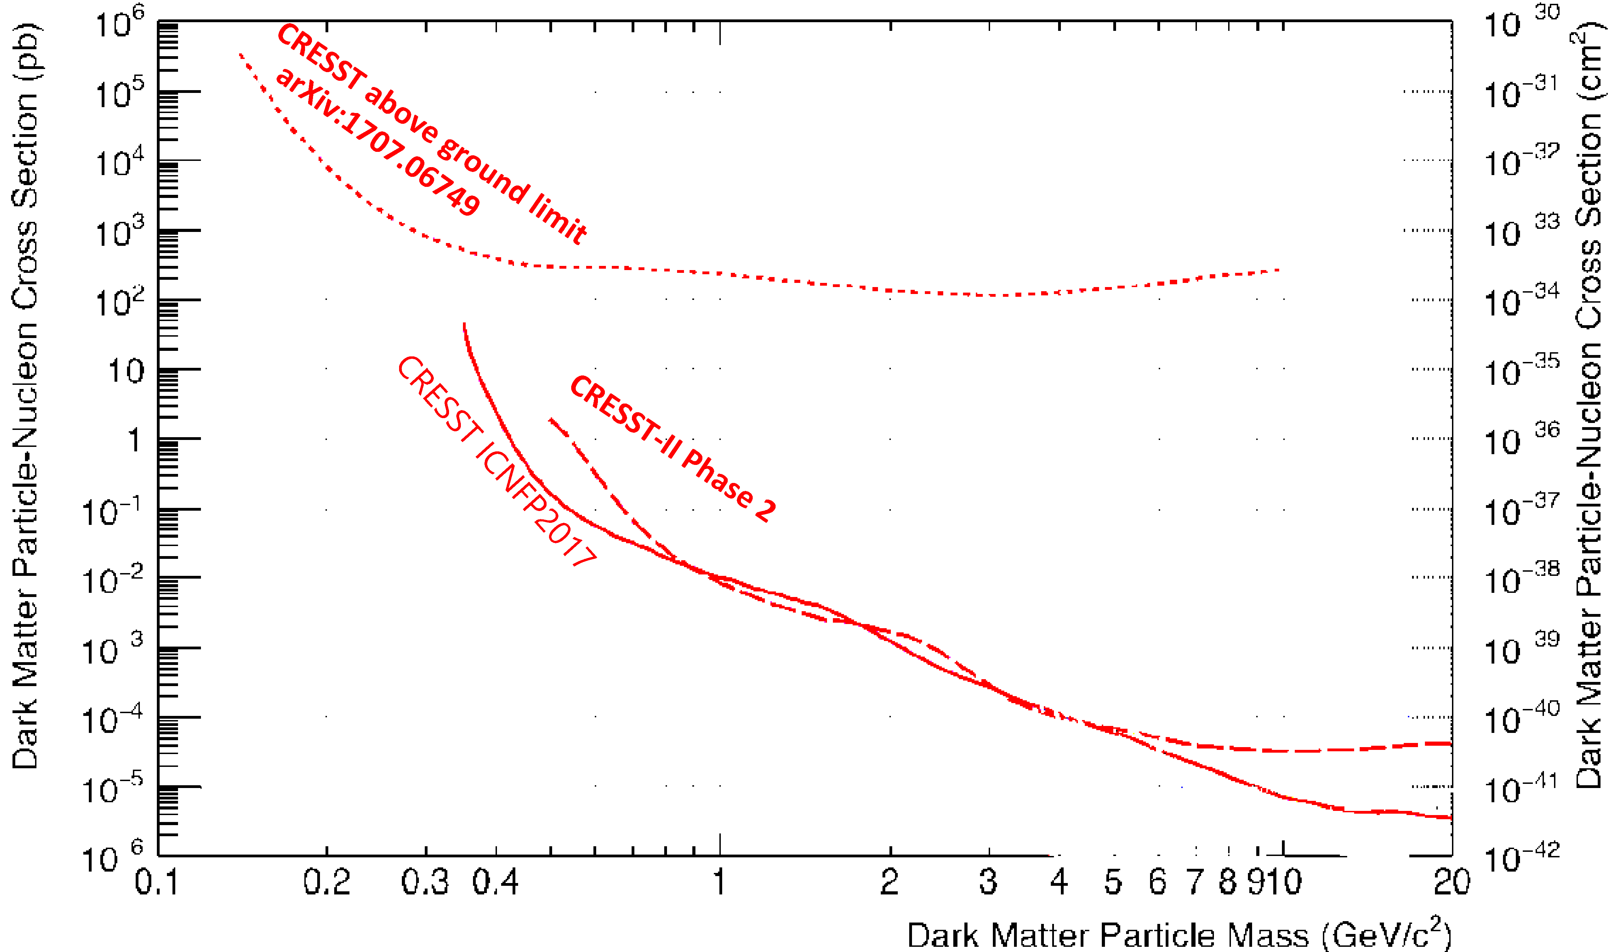
Recent Direct Dark Matter Searches
DAMA
CRESST (2017)
arXiv:1307.5458
+ IDM2016 reports
+ ICNFP2017
The direct detection is approaching to neutrino floor
Notes:
CRESST

Slide 4
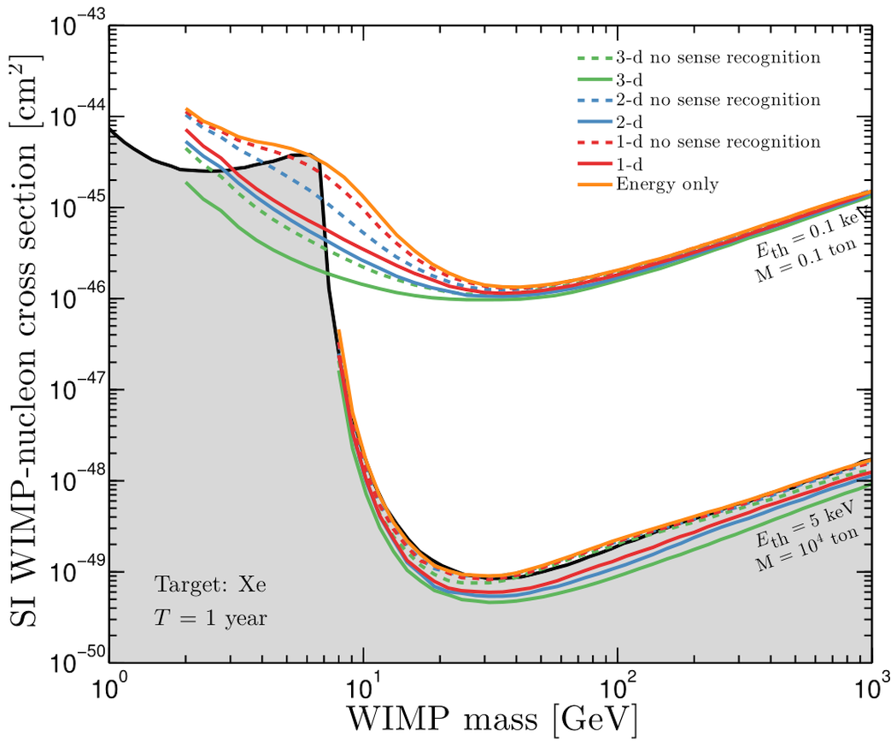
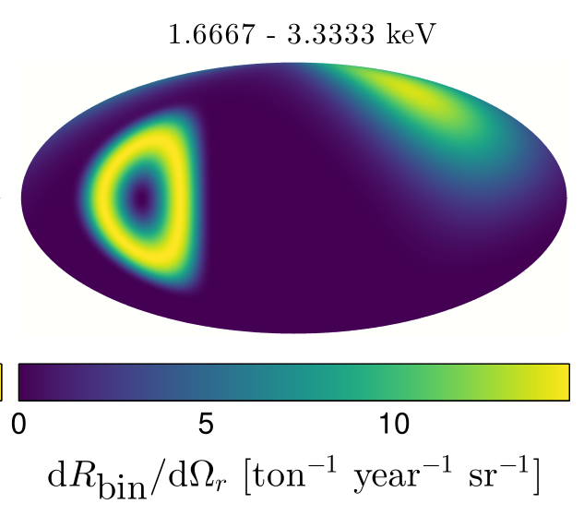
The Advantage of Directionality
DAMA
⁸B
WIMP
⁸B
Lab Coord Sys at September 6th
arXiv:1307.5458
+ IDM2016 reports
F. Mayet et al., Physics Reports 627 (2016) 1
Directional detection will overcome the neutrino floor

Slide 5
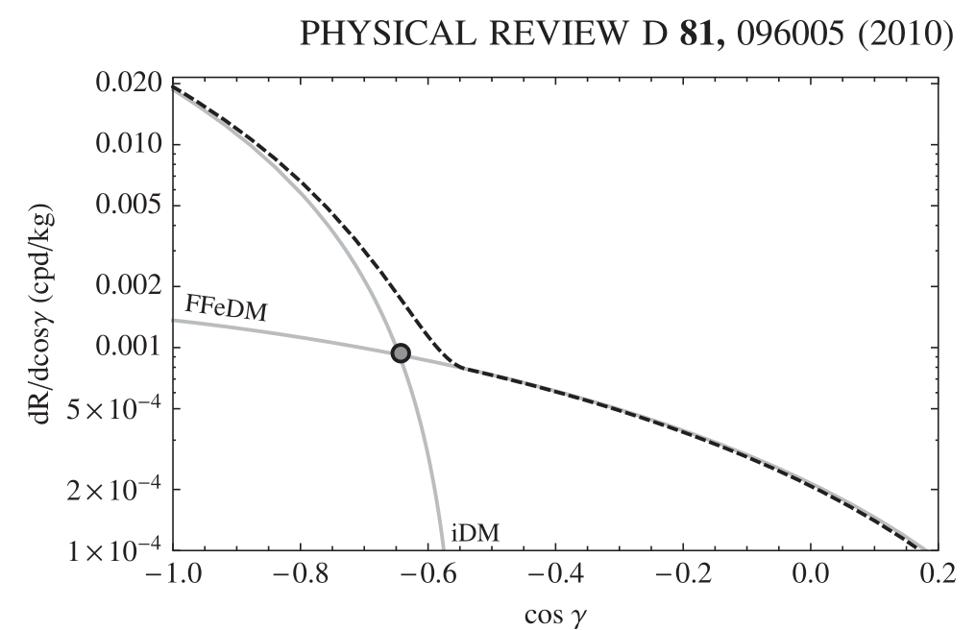
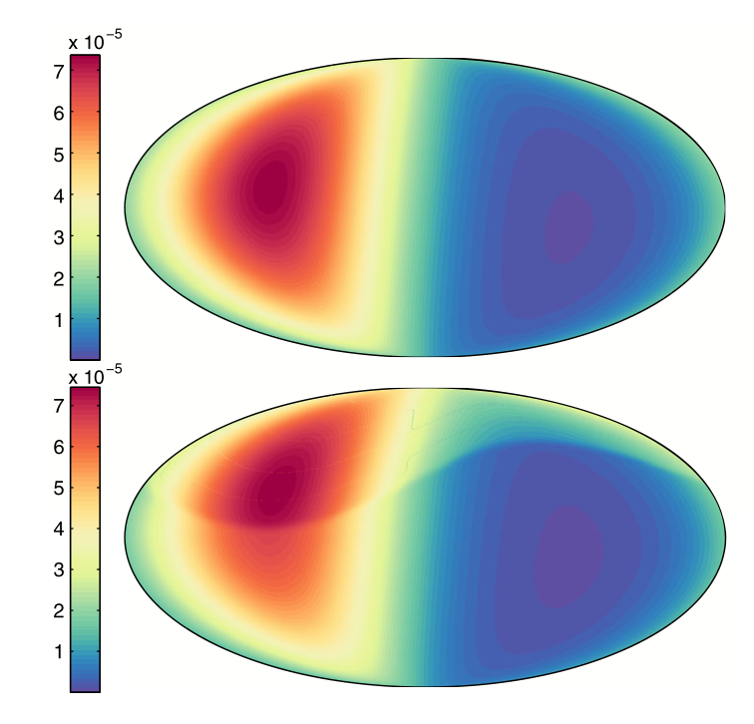
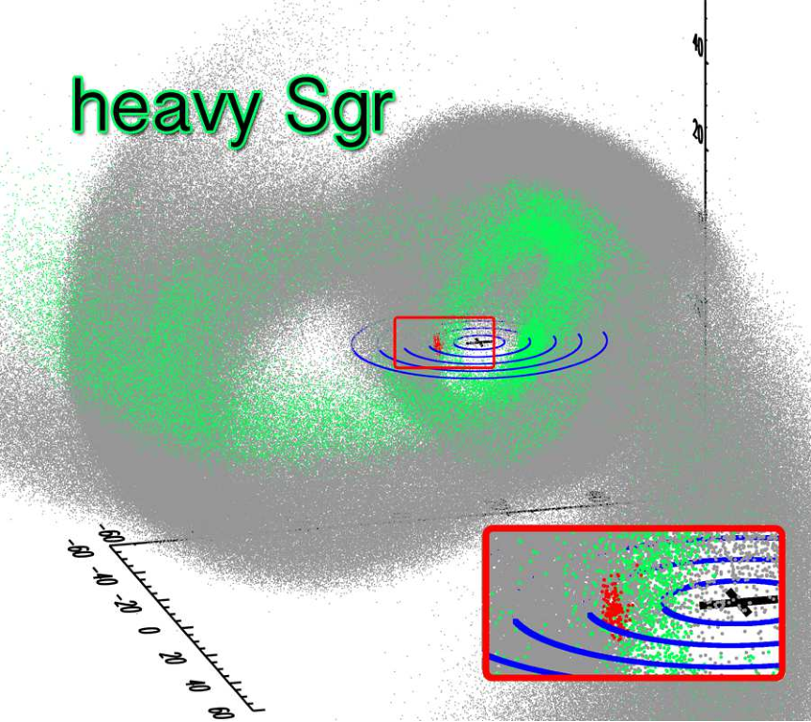
The Advantage of Directionality
inelastic dark matter
dark matter streams
PHYSICAL REVIEW D 90, 123511 (2014)
halo only
FFeDM: form factor elastic dark matter
iDM: inelastic dark matter
Sagittarius stream
+halo
this effect is emphasized with heavier target!
Sgr stars
Sgr DM
And other anisotropic DM velocity models…
(cf. Nagao’s talk, 22 Aug)
Directionality will contribute
for the physics of WIMP
DM near the sun
C. W. Purcell et al., JCAP 08, 027 (2012)

Slide 6






NEWSdm collaboration
Nuclear Emulsions for WIMP Search
+ directional measurement
http://news-dm.lngs.infn.it
LoI under review by
the LNGS Scientific Committee
https://arxiv.org/abs/1604.04199
NEWSdm Collaboration
70 physicists, 14 institutes
ITALY
INFN e Univ. Bari,
LNGS, INFN e Univ. Napoli,
INFN e Univ. Roma
GSSI Institute
JAPAN
Chiba, Nagoya
RUSSIA
LPI RAS Moscow, JINR Dubna
SINP MSU Moscow, INR Moscow
Yandex School of Data Analysis
SOUTH KOREA
Gyeongsang
TURKEY
METU Ankara

Slide 7
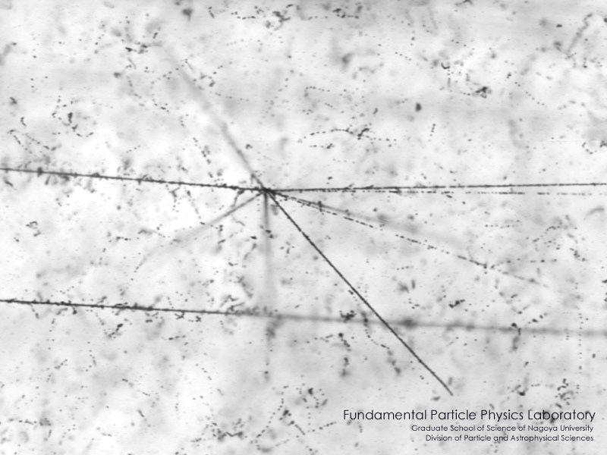
Nuclear Emulsion
AgBr crystal
300 μm
particle
Development treatment
3 dimensional tracking with high spatial resolution

Slide 8
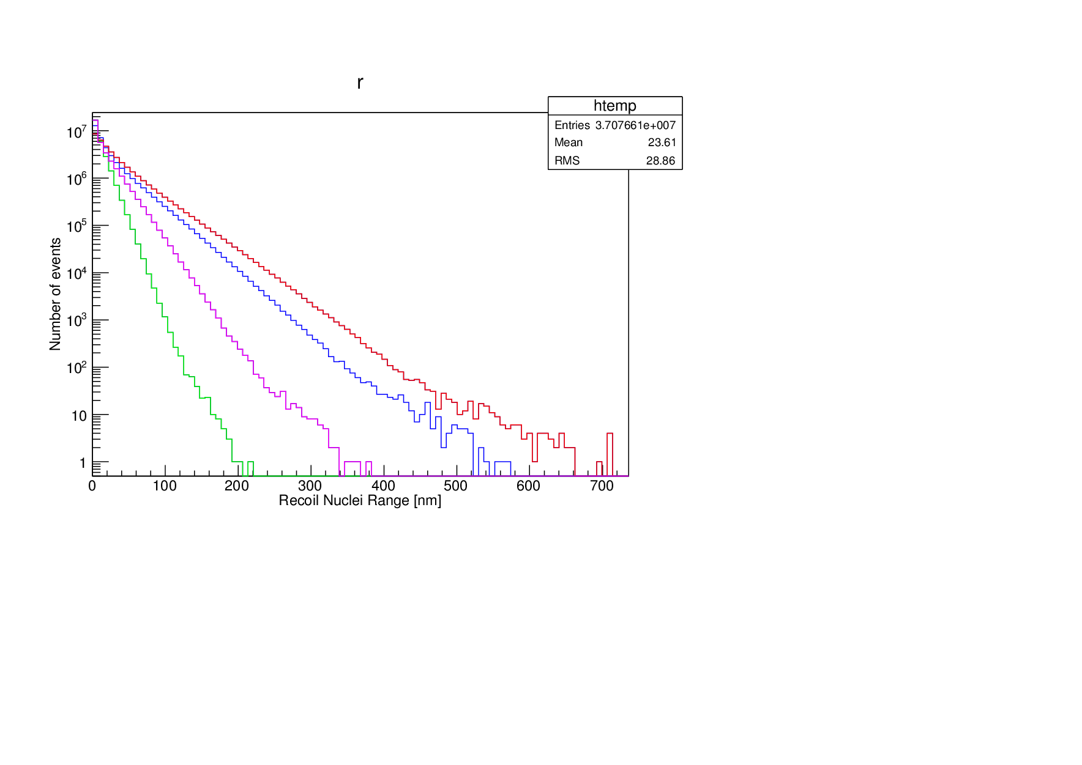
The challenge of NEWSdm
expected recoil length in the nuclear emulsion
WIMP mass
― : 100 GeV/c²
― : 50 GeV/c²
― : 20 GeV/c²
― : 10 GeV/c²
3.2 g/cm³
target : C,N,O, Ag, Br
100 GeV/c²
10 GeV/c²
20 GeV/c²
50 GeV/c²
Track length [nm]
recoil length < 1 um
Angular dispersion due to straggling ~ 25 deg
low background
scalability
→ new technologies both detector and analysis

Slide 9
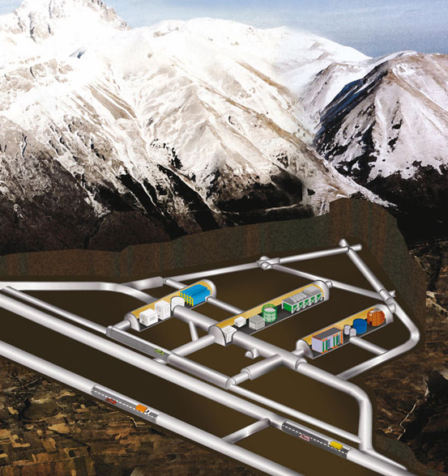
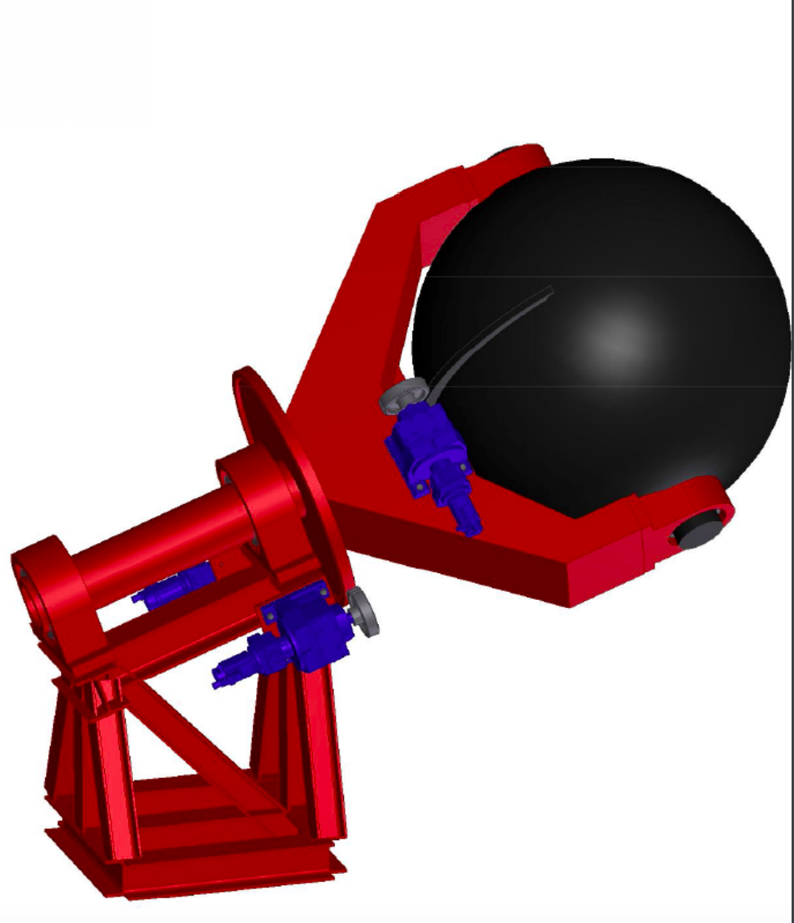
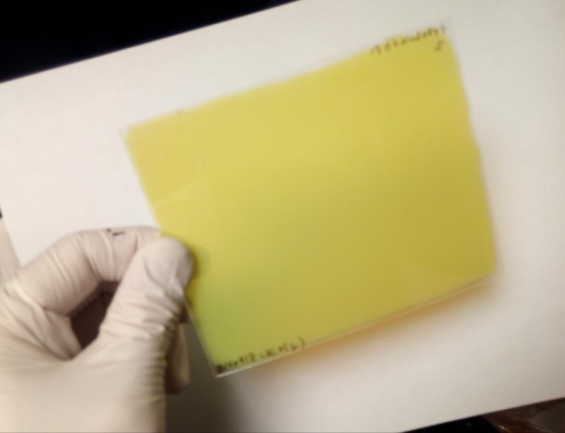
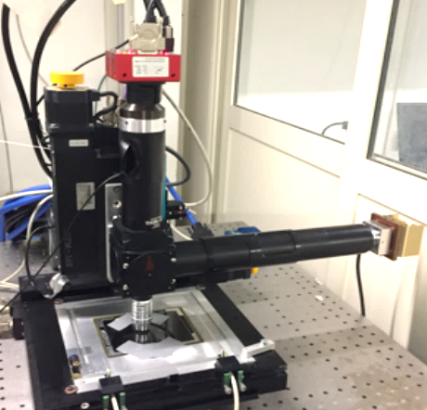
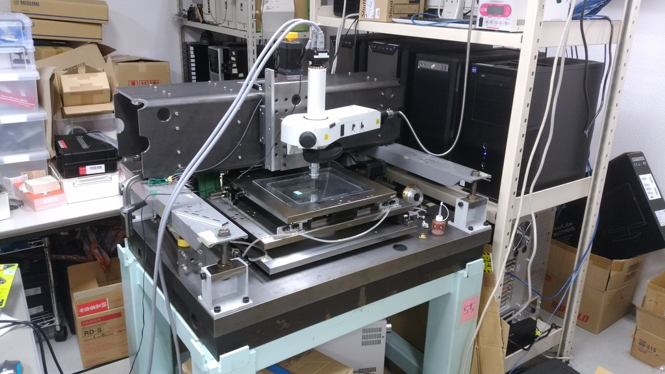
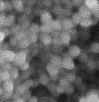
NEWSdm Experiment
Gran Sasso
underground laboratory
Emulsion film
Equatorial Telescope
Super-high resolution device
multiple analysis(high-speed/high-precision)
WIMP
100 nm
AgBr
Crystal

Slide 10
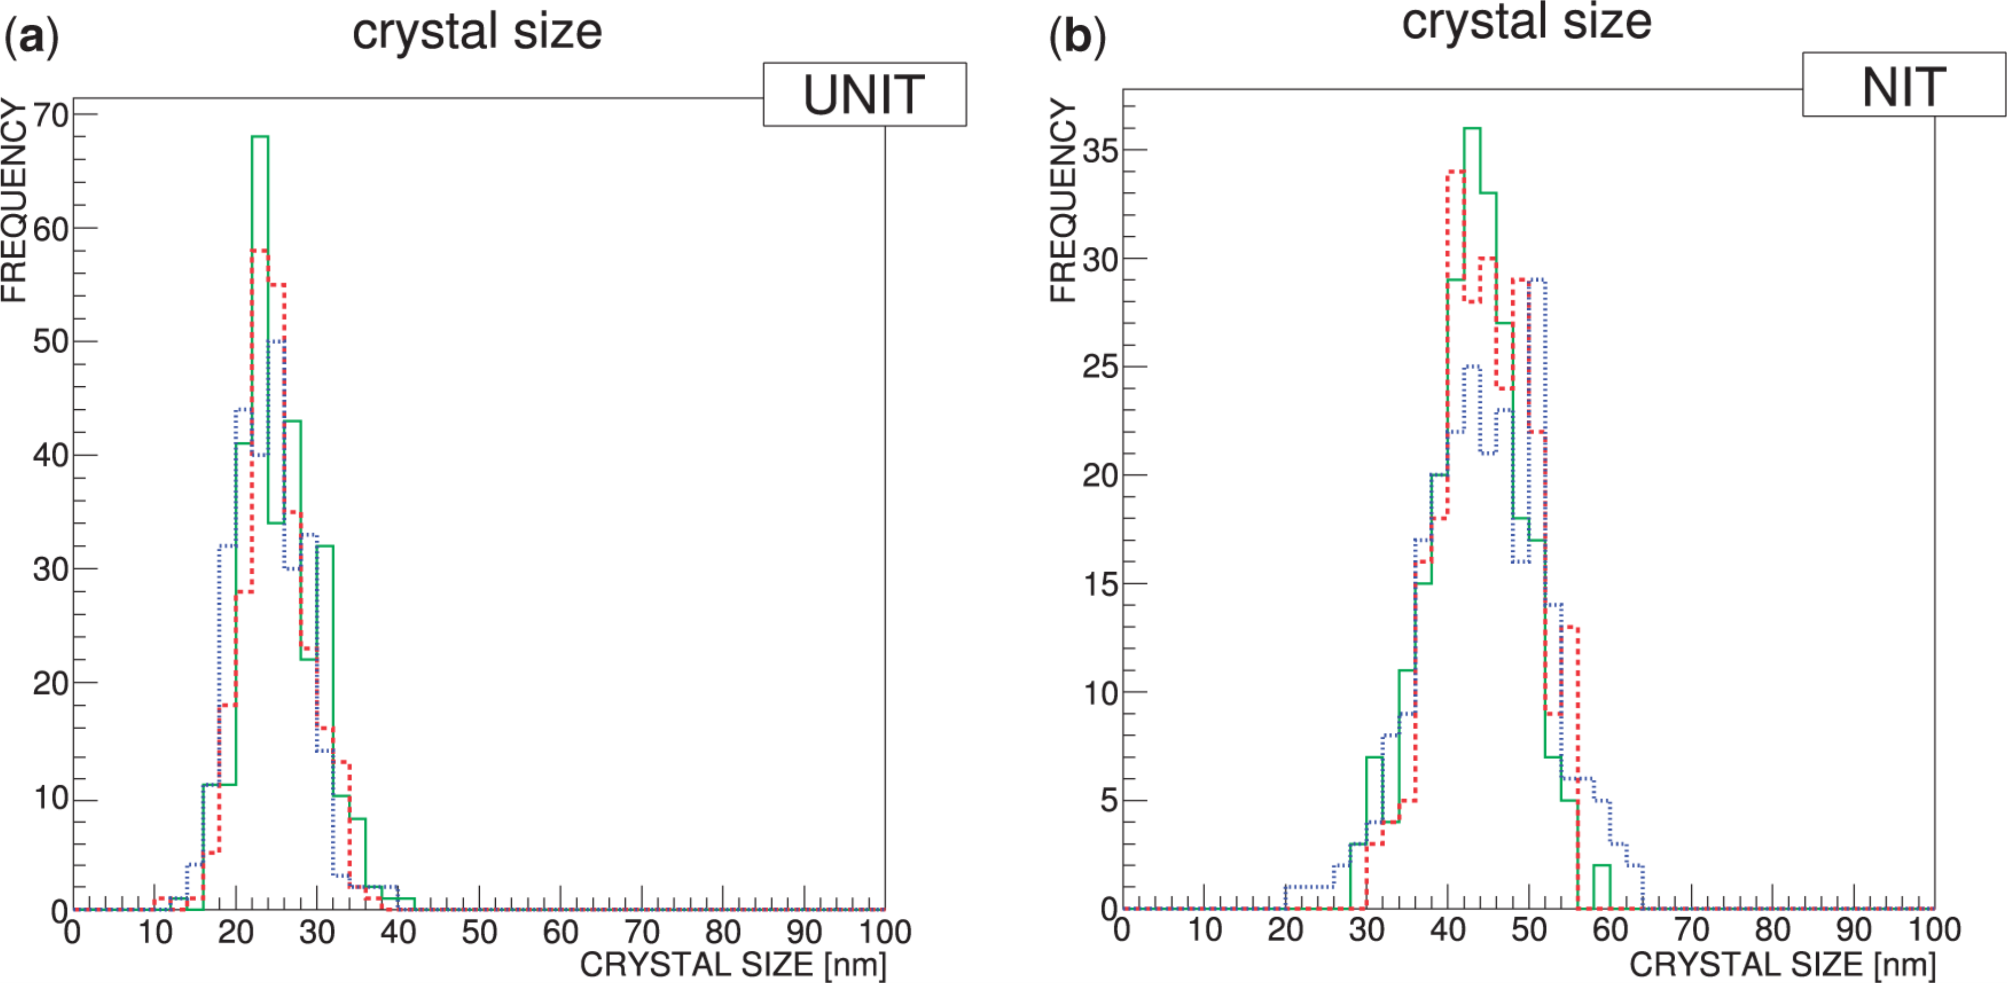
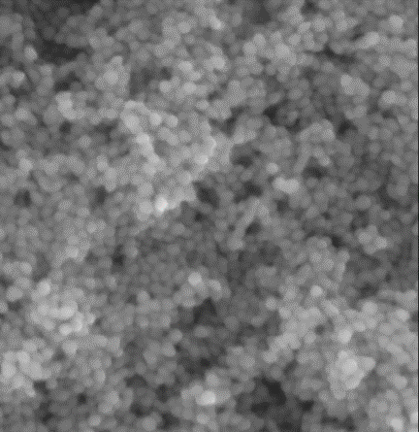
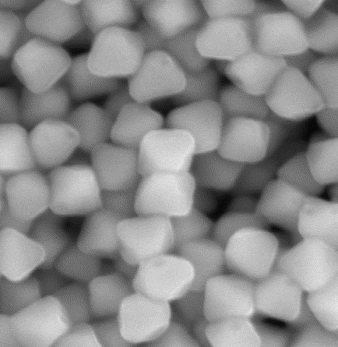
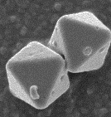
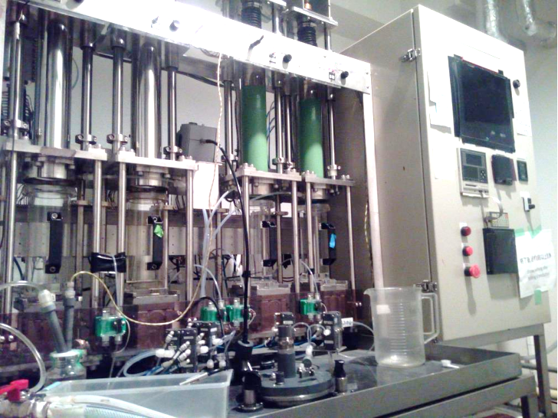
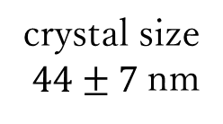
Super Fine-grained Nuclear Emulsion : NIT
PTEP (2017) 063H01
NIT(Nano Imaging Tracker)
crystal size
$44±7$nm
NIT
Super Fine-grained
0.2 um
0.8 um
500nm
500nm
500nm
Smaller crystals give higher resolution
theoretical resolution
(average crystal distance)
→ 71 nm !
Self production facility in Japan
Production time : 4–5 hours /batch
Production amount : ~ 100 g (+ 300 g)
(2nd machine)
​large mass easily achievable!

Slide 11
Potential of NIT
MC of scattering (SRIM) and crystal size of NIT
*case of ¹²C
in emulsion
－ Scattering limit
－ Tracking
46 deg
*
－ Tracking
23 deg
average range of SRIM
100 nm
200 nm
tracking : at least 2 crystal
high angular resolution for low energy track
Notes:
SRIM and crystal size

Slide 12
Readout strategy
overall scan : 1st selection
trigger of signal candidates
high speed scanning
minimum selection for next analysis
Higher level selection 1
multiple scanning for higher precision
complex software analysis
repeat scanning
analysis by other imaging system
  plasmon effect
  3 dimensional readout
Higher level selection 2
Higher level selection 3
・
・
・
signal confirmation

Slide 13

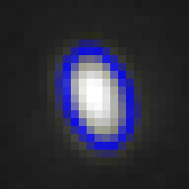
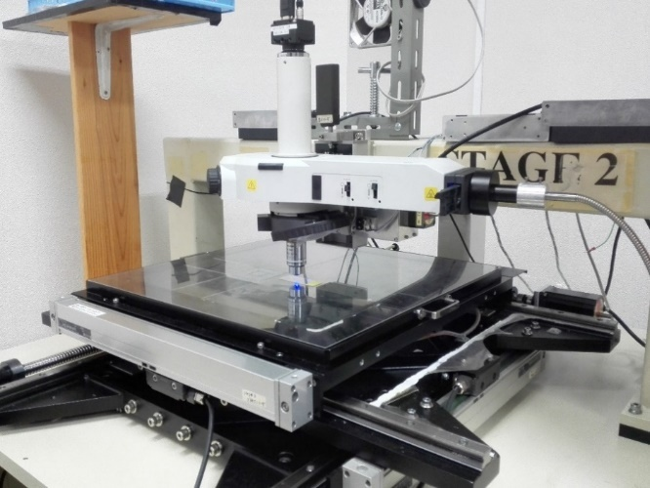
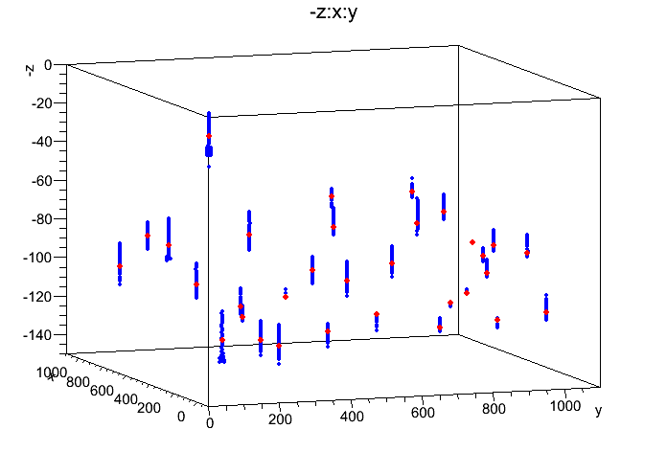
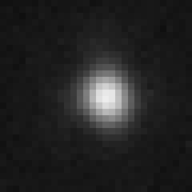
1st selection : shape analysis
Optical Microscope PTS-2
grain (image)
raw image
Elliptical fitting
1.7µm
ellipticity = major / minor
JINST 12 (2017) T04002
20 um
50 um
high speed scanning
3D positioning for each events
minimum amount selection for next analysis
dominant noise (spherical shape)
unexpected developing crystal
tiny dust from material

Slide 14
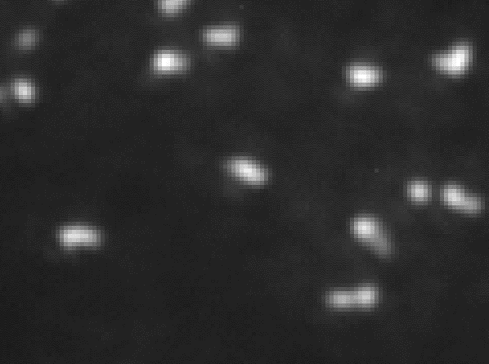
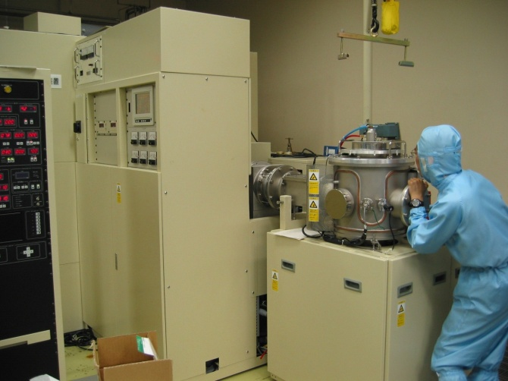
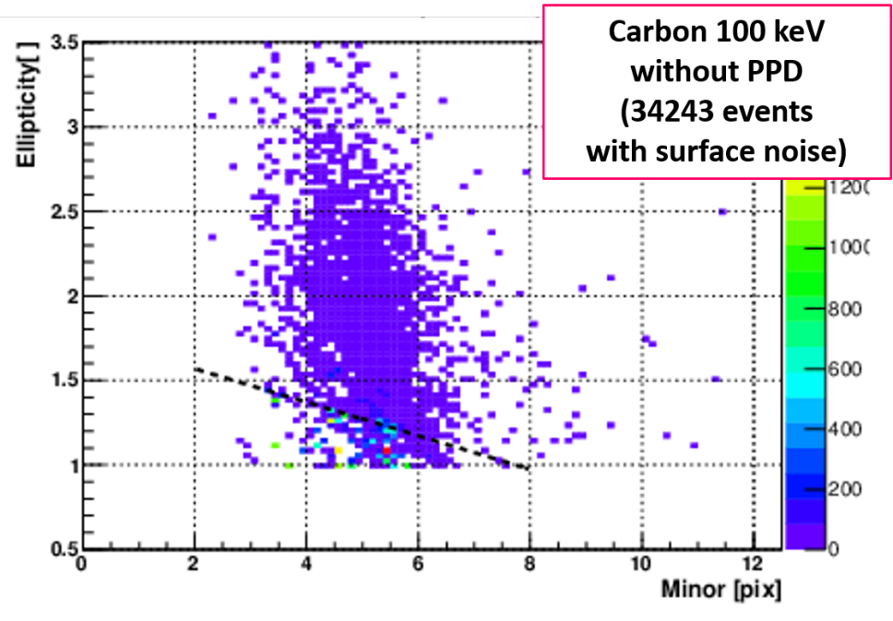
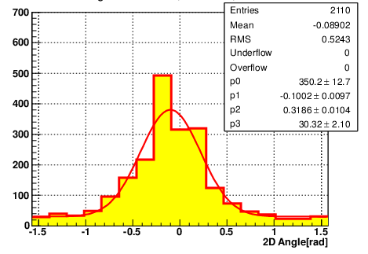
Detection of low energy tracks
Ion implantation system @Nagoya Univ.
5–200 keV
C, N, O, Kr etc.
1 µm
Carbon 100 keV
mean length :
255 nm
Carbon 100 keV
Angular distribution
distribution
~350 mrad
est. scattering
300 mrad
(SRIM)
→ ~scattering limit
Ellipticity
signal
spherical noise
Minor [pix]
(1pix = 55 nm)

Slide 15
Roadmap of 1st selection system
[ PTS2 ] 40 g/y (current system)
[PTS3a] 120 g/y expected (x 3 higher than PTS2])
  Wider FOV due to higher vision camera
[PTS3b] 500 g/y expected
  PTS3a + large DOF system
[PTS3b’, PTS4] 1000 - 3000 g/y expected
  PTS3b + custom special lens, high framerate
PTS-4
PTS-3b’
PTS-3b
PTS-3a
PTS-2
scan-sharing with multi-laboratory/multi-systems

Slide 16
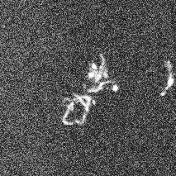
Higher Level Analysis
Silver grain
Electron microscopic image
Ag core
electron⁻
dissolved
Development
1 μm
Purpose :
signal confirmation and BG separation
accurate measurement of track details (angle, length…)
characteristic nano-structure of silver grain is not negligible → super-resolution

Slide 17
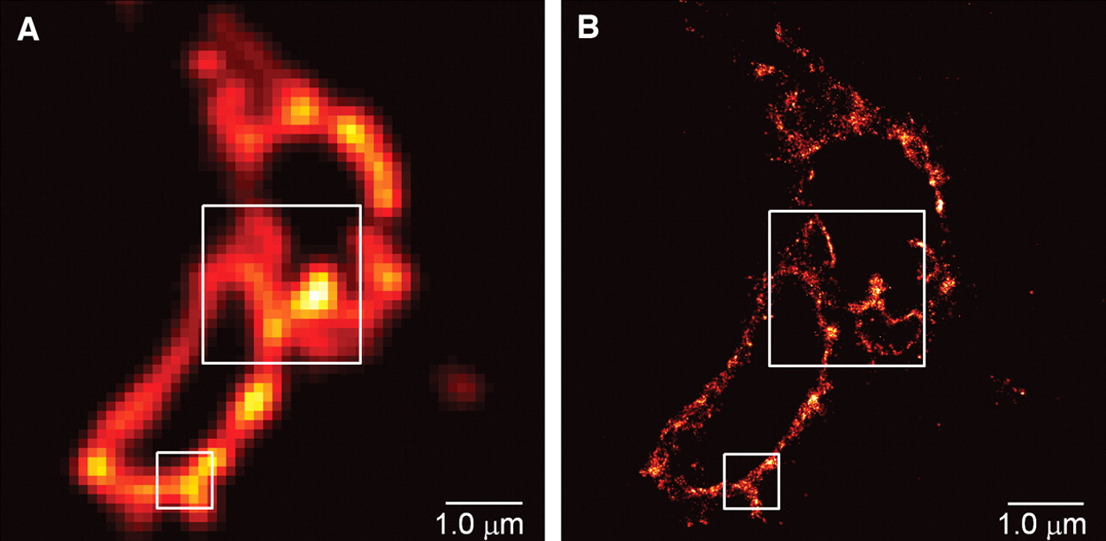
Imaging beyond the optical resolution
The position accuracy is superior than the optical resolution
each fluorescence molecular can be observed
→ super resolution
How our case is?
Silver (metal) structure
→ Local Surface Plasmon
COS-7 cell optical images
Eric Betzig et al., Science 313, 1642 (2006)
2014 Nobel Prize in Chemistry
100nm

Slide 18
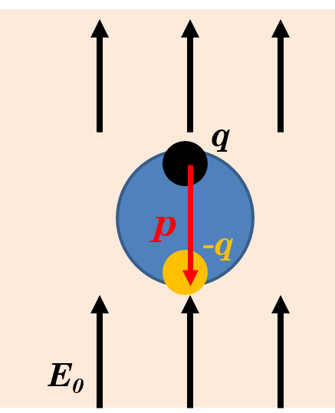
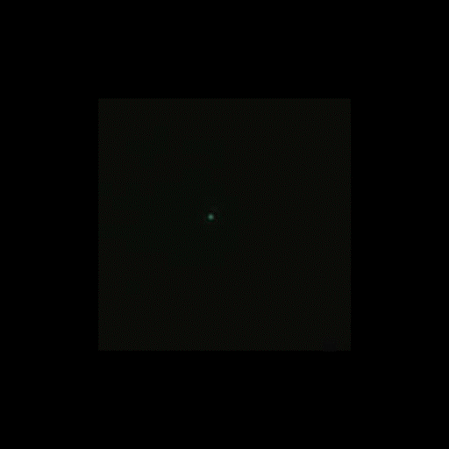
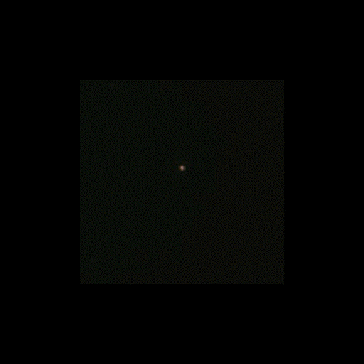
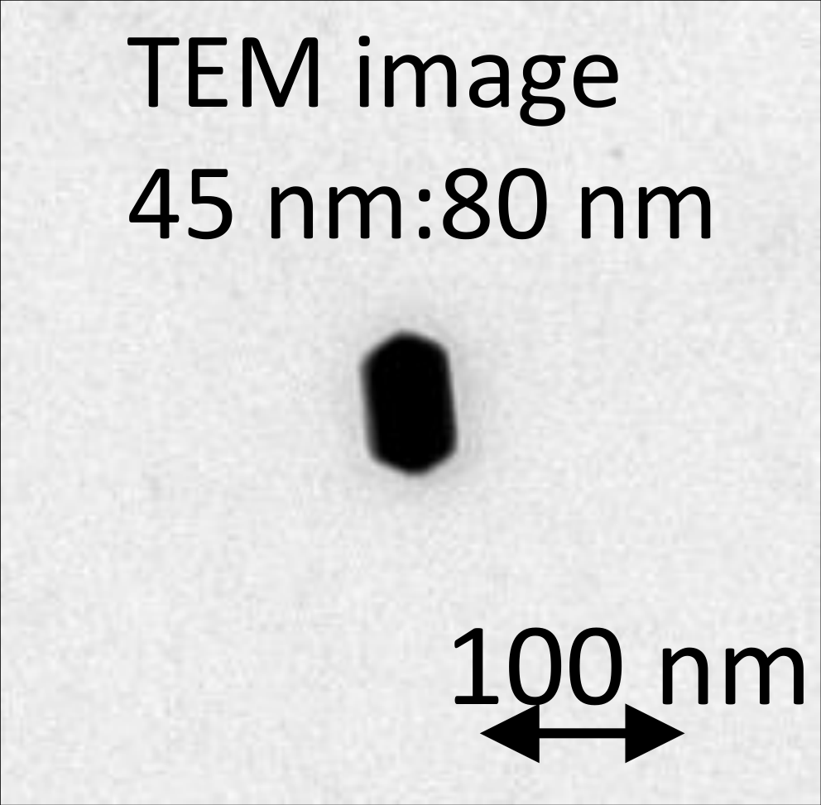
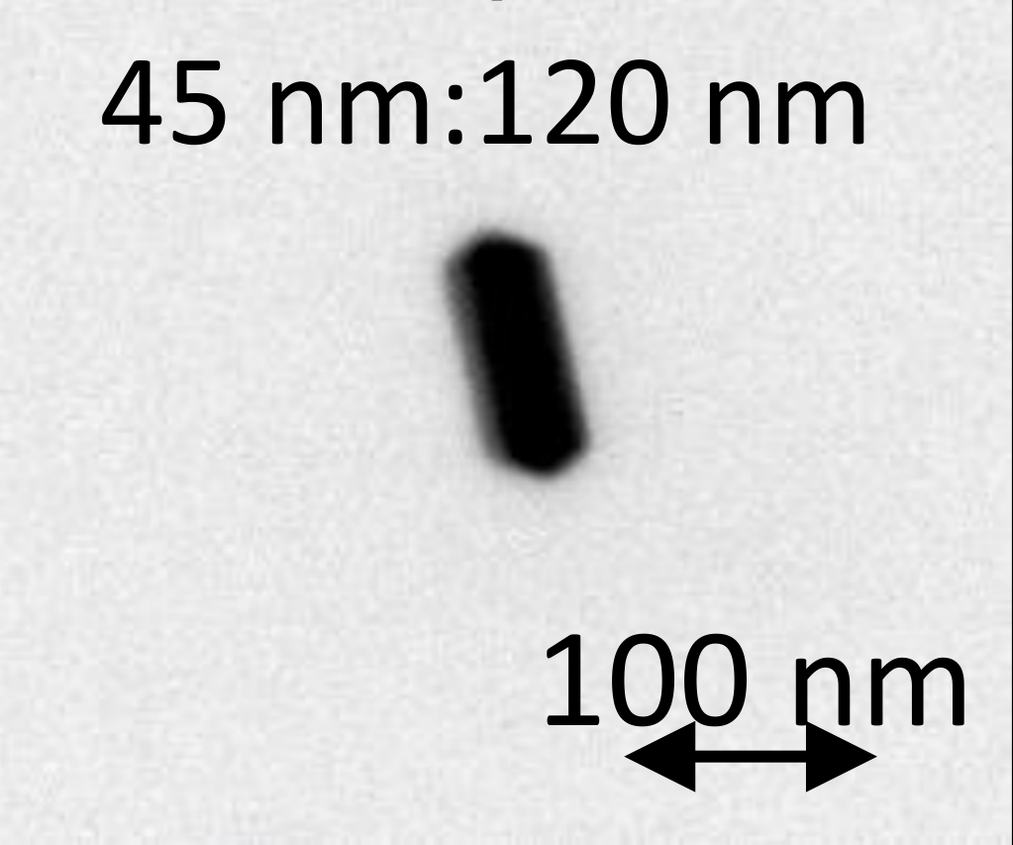
LSP (Localized Surface Plasmon resonance)
dipole in metalic particle
Colored optical image of silver rod
*polarization rotating
dipole moment
45x80
45x120
resonance
100 nm
5pix
100 nm
Annu. Rev. Phys. Chem. 58 (2007) 267-297
polarization
reflecting wave
~45 nm : blue
~80 nm : green
~45 nm : blue
~120 nm :orang–red
90°
the shape of particle affect to resonance
particle direction → resonance pol angle
particle length → resonance wavelength
0°
metallic particle
Appl. Phys. Lett. 80, 1826 (2002)

Slide 19
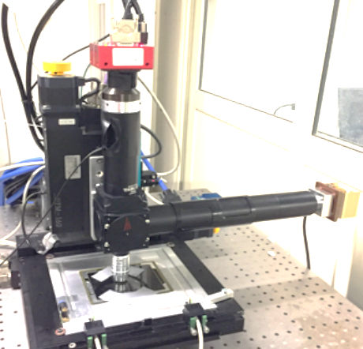
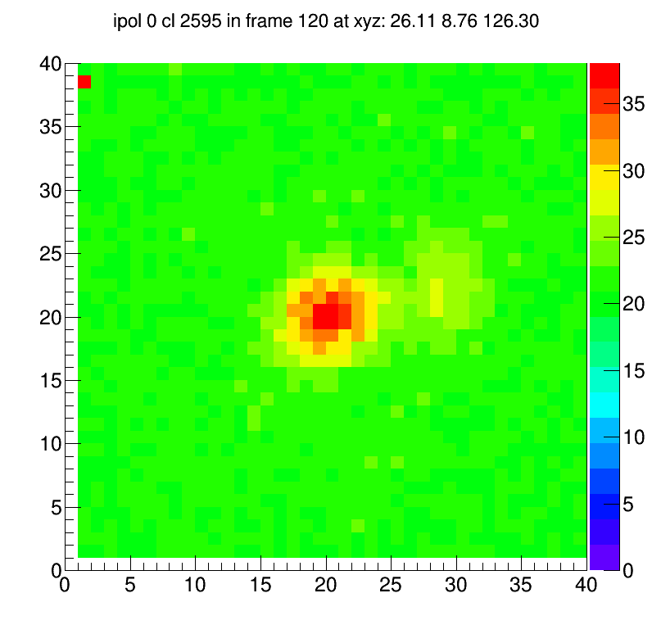




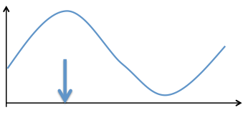
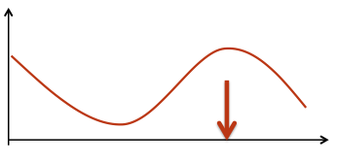
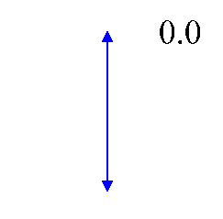
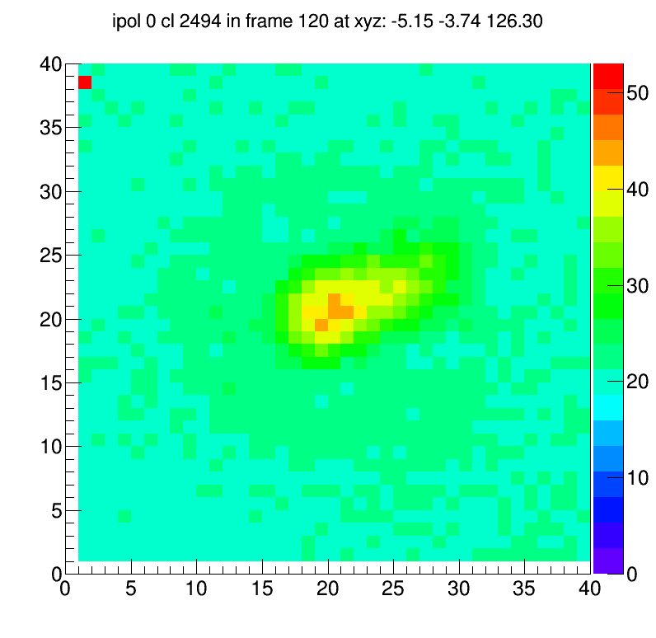
Super resolution analysis with LSP polarization
New Microscope
Equipped with liquid crystal polarizer
100 keV Carbon track
Exit polarizer plate
LC Polarization Rotator
polarization direction
polarization direction
200 nm
Scattering intensity
Scattering intensity
pol angle
φ
polarization direction of incident light
polarization direction of incident light
The positions of indistinguishable silver grains
can be measured as barycenter moving
200 nm
We are evaluating this new system now
pixel

Slide 20
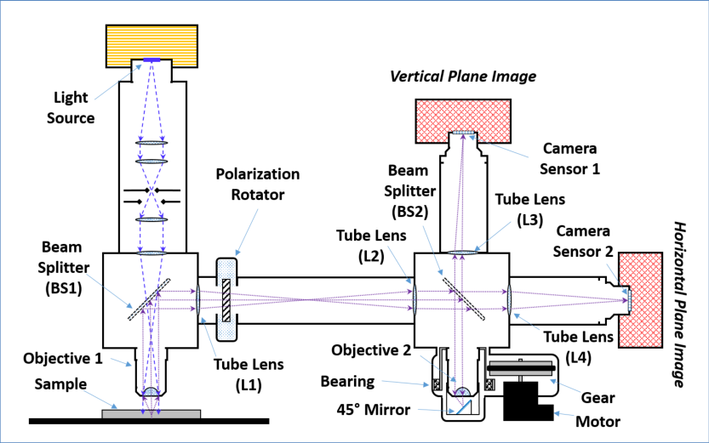
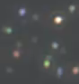
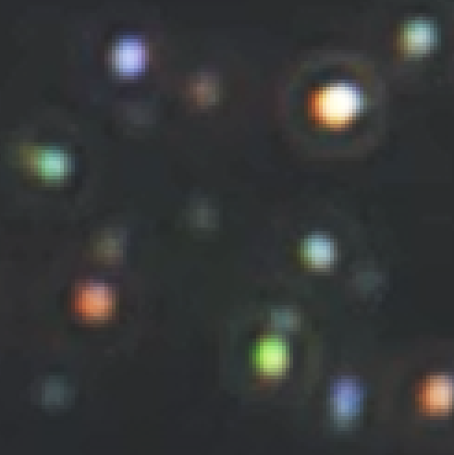
R&D of further analysis
Vertical
ξZ plane image
Setup for 3D Plasmon Analysis
Sensor 1
Illumination
Polarizer
L3
L1
L2
L4
Sensor 2
Horizontal
XY plane image
color camera image
of carbon tracks
BS1
BS2
Objective 1
Objective 2
Z
Sample
Y
Mirror
X
ξ
3D reconstruction
  super-resolved analysis with LSP of z axis
multi-wavelength analysis
  super-resolution by color difference
  dE/dx information by grain length
1um

Slide 21
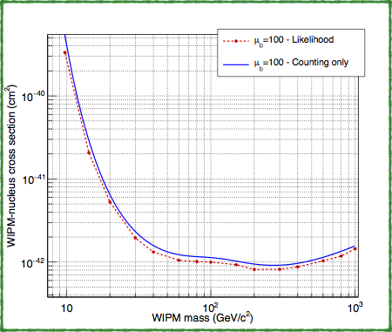
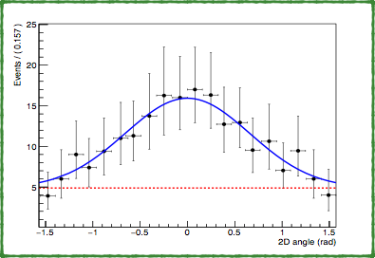

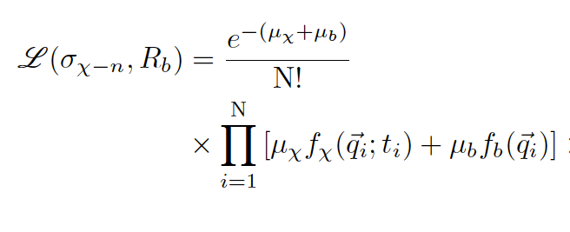
Exploit Directionality
Evaluation of upper limit and sensitivity based on the profile likelihood ratio test
Signal
Background
Likelihood function
Threshold = 100 nm
Straggling estimated by TRIM
Exposure= 100 kg years
N_{background} = 100
expected number of WIMP events
expected number of BG events
background pdf
signal pdf
total number of observed events
set of observables
arXiv:1705.00613

Slide 22
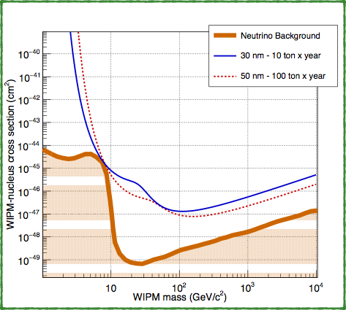


Towards Neutrino Floor
Discrimination based on measurement of recoil direction
Unique possibility to search for WIMP signal beyond “neutrino floor”
Neutrino coherent scattering indistinguishable from WIMP interactions
Phys.Rev.D89 (2014) no.2, 023524 (Xe/Ge target)
REQUIREMENTS
Reduction of track length threshold
Ultra-NIT (25nm crystal) has 40 nm theoretical resolution
high resolution analysis with LSP
Larger mass scale detector
further high speed scanning system
extreme low BG detector
The neutrino bound is reached with:
➡10 ton x year exposure if 30 nm threshold
➡100 ton x year exposure if 50 nm threshold

Slide 23





pilot-run
Gran Sasso underground laboratory, Italy
polyethylene
cooling system
lead shield
Temperature monitor for BG run
-10 - -20 ℃ operating
(system will be upgraded for next run)
0.3 kg・day technical run
38 days

Slide 24
summary
Directionality is good parameter to discover WIMP
NEWSdm is directional dark matter search experiment using many new techniques
  super-high resolution detector of nuclear emulsion
  multiple readout with high-speed/high-precision
We are now R&D status and performed pilot run at Gran Sasso in 2017 and analyzing it now
We plan to start physics run of kg⋅year scale exposure in 2019

