Slide 1
ECRs and requests
28 July 2016

Slide 2
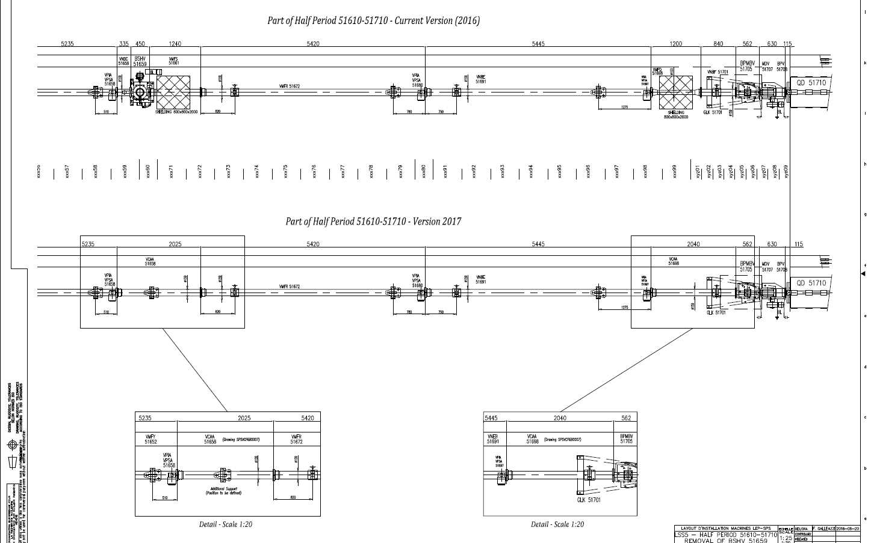
Removal of the scraper BSHV.51659 from LSS5 of the SPS

Slide 3
Removal of the scraper BSHV.51659 from LSS5 of the SPS
Proposed recommendation: Approved
Comment
“comment from the impedance Working Group: the replacement of the scraper by straight DN159 pipes is expected to be beneficial for the impedance of the SPS. Our comments were requested well in advance and were implemented in the proposed version of the layout, in particular the removal of the pipe with ID103 (with its transitions) to avoid unnecessary changes of diameter. If feasible, it would be useful to perform impedance bench measurements of the scraper after removal to also remove its potential contribution from the SPS impedance model”

Slide 4
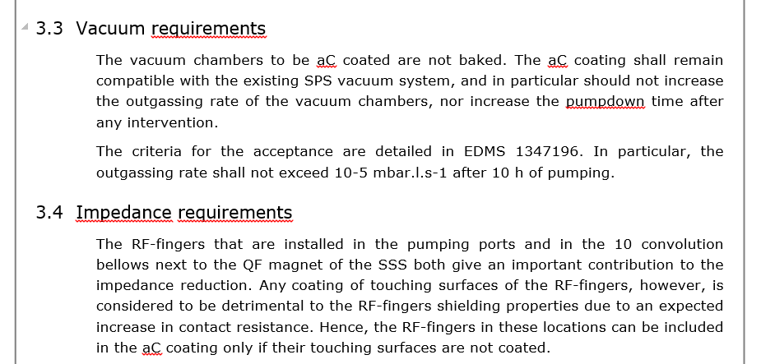
Requirements for Amorphous Carbon Coating of SPS vacuum chambers
Proposed recommendation: Approved
Any additional comment to be added?

Slide 5
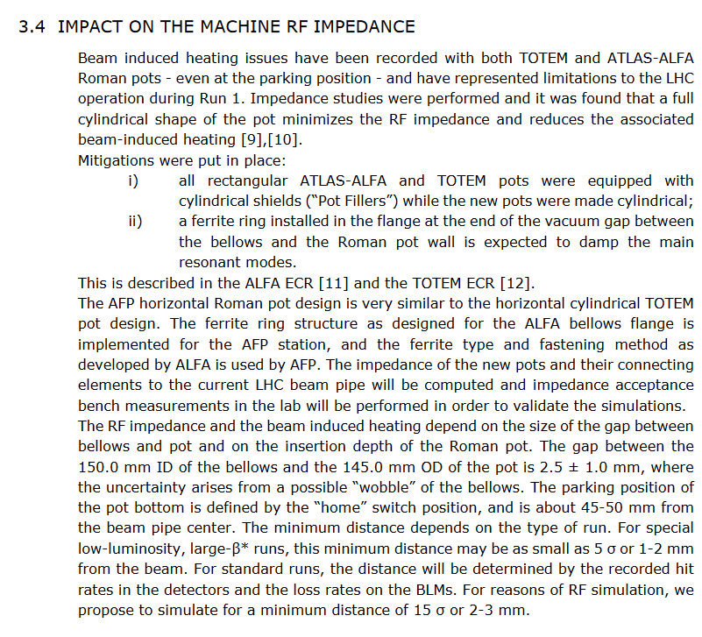
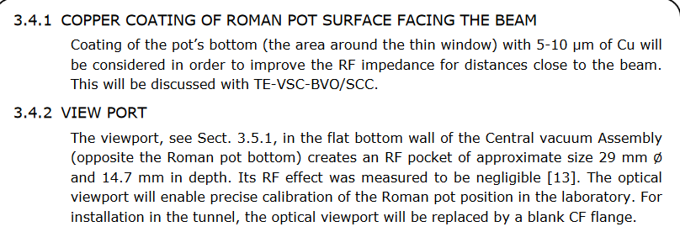
Installation of the ATLAS/AFP stations, Phase-2
In principle same as phase 1 (actually paragraph for impedance was not changed!).
New stripline BPM + 2 new Roman pot stations
Not easy to check the final vacuum layout, but seems all shielded and 80 mm throughout. Will confirm with Josef Sestak.
Propose to request to add results from previous bench measurements and experience of running with currently installed stations.

Slide 6
ECRs with no impact
PSB: Installation of a Wideband Pickup in the BTP Transfer Line
Installation of New Power Converters for the 40MHz RF Cavities in the PS Ring
→ no mention of impact on beam surrounding
PSB BCER Switchboards and Distribution → no mention of impact on beam surrounding
New Alcove Construction for PSB Injection BSW Power Converter's Pulse Transformers
→ no mention of impact on beam surrounding

Slide 7
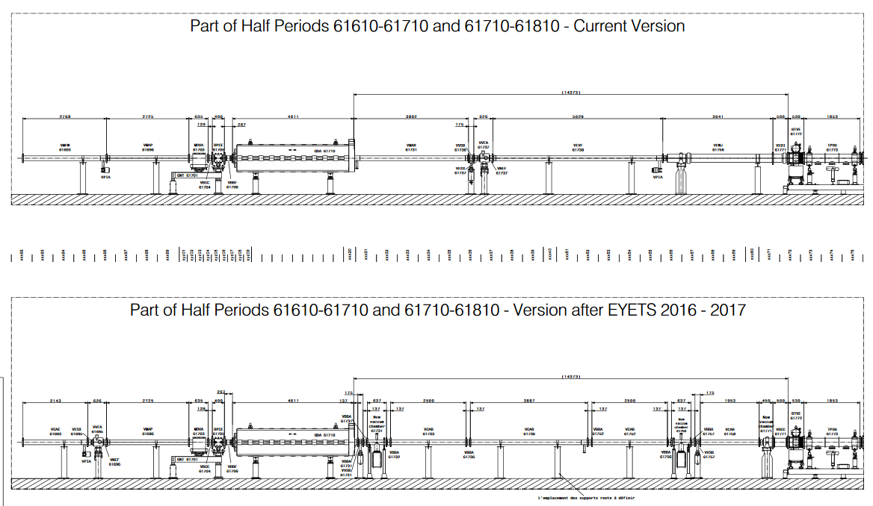
Space reservations
no need for impedance to approve, but good time to discuss
Crab-cavity cryomodule and related infrastructure in SPS LSS6 (EYETS 2016-2017) → will need to insist on minimizing the unnecessary changes of diameters. → seen

Slide 8
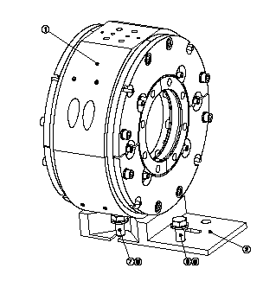
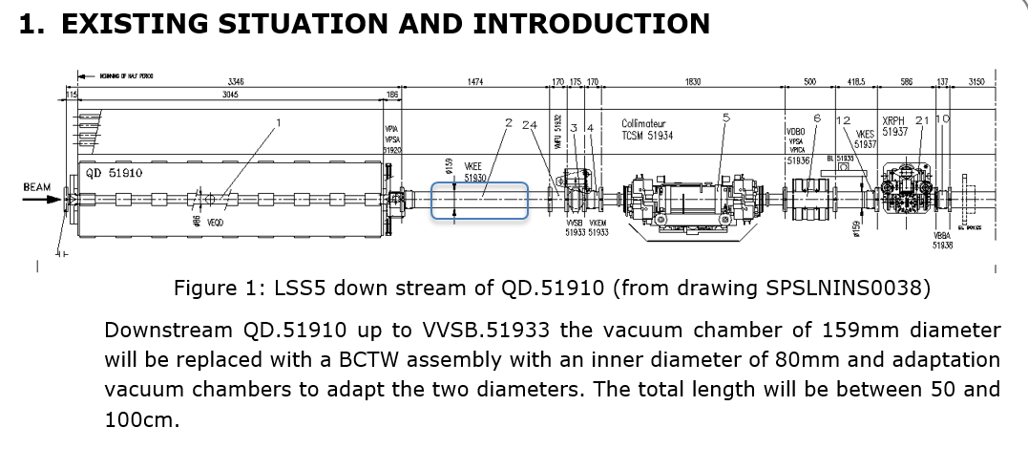
New Fast BCT for SPS LSS5 (EYETS 2016-2017)
2 issues:
BCT model not evaluated (to my knowledge)
→ quite likely ok though as installed in LHC without major issues
→ should still be evaluated to evaluate the impact and potential modes, if it was not done before for the LHC
The integration foresees installation right after a QD with ID80 and a pipe of ID159
→ creates a cavity
→is this ID159 pipe necessary?
→ if yes, need to know the length of the cavity, and to compute the modes
→ BI (Lars Soby) proposes tapers, need to check if useful.

Slide 9
New Fast BCT for SPS LSS5 (EYETS 2016-2017)
Proposed recommendation: Seen (as only space reservation)
Comments
“Comments from the impedance WG:
- The impedance of the BCTW design will need to be estimated with simulations (if it was not already done). However, it would be surprising that impedance is an issue since a similar design is installed in LHC, for which impedance constraints are much more stringent.
- The new ID80 BCTW would create an ID159 cavity (between itself and the ID80 QD beam pipe). Would it be feasible to have ID80 all along instead of moving to ID159?”

Slide 10
New ECRs for LHC (got access only yesterday)
TCPP: primary collimators with buttons (already studied and presented at impedance meeting in August 2014 → ok from tapering point of view if design has not changed)
TCSPM: additional prototype collimator with stripes and BPM→ no mention of ferrite or RF finger
Two wire collimator to replace TCT → no expected change
Ionization Gauge Integration in Vacuum Sector A1L8.X for SMOG Accuracy → need more information

Slide 11
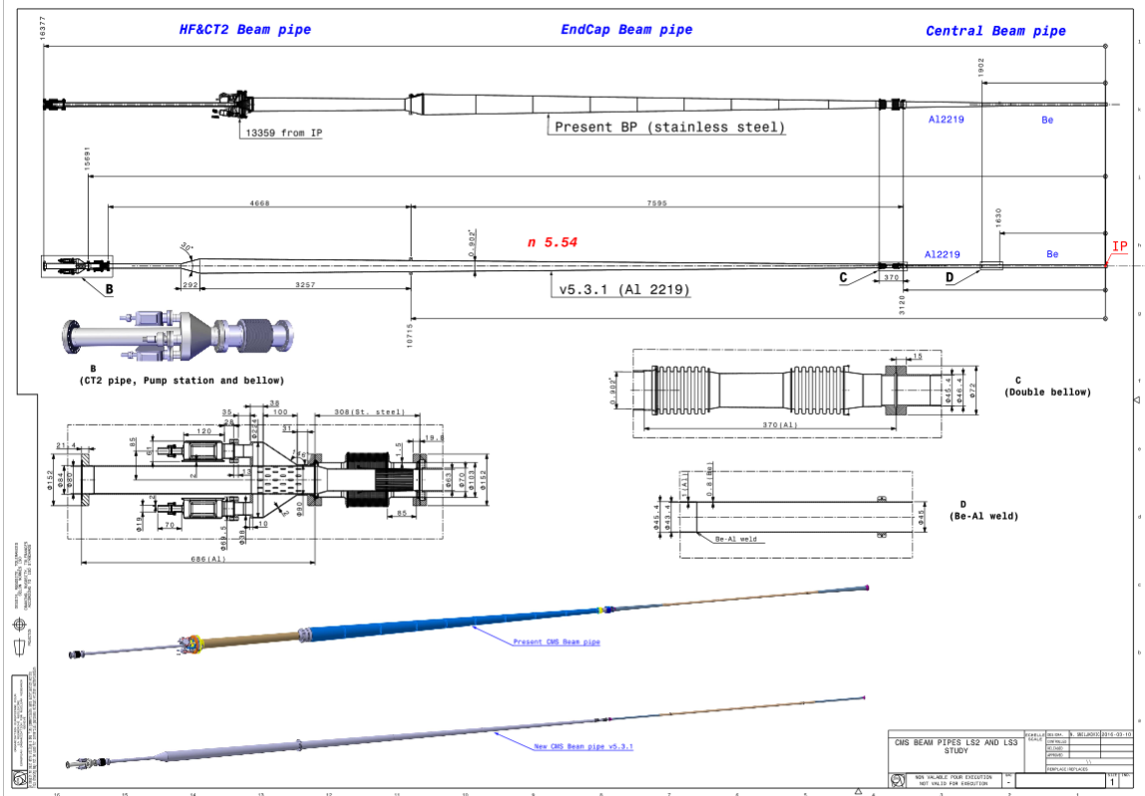
New request: CMS beam pipe

