Slide 1


Early Minimum Bias physics at Atlas
Prafulla K. Behera
(On Behalf of Atlas Collaboration)
University of Iowa
@Berkeley Workshop on Physics Opportunities with Early LHC Data

Slide 2
Overview
Minimum Bias Events at ATLAS
Analysis Goals at Start up
Monte Carlo Analysis Studies
Minimum bias Trigger
Analysis strategy
Conclusions and Outlook

Slide 3
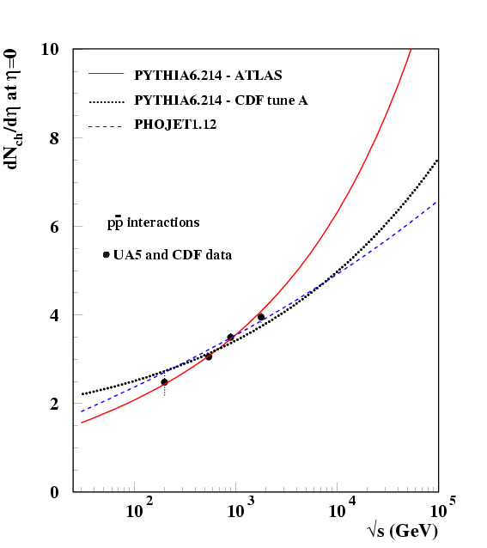
Minimum bias event at ATLAS
At the LHC, studies on minimum-bias should be done early on, at low luminosity to remove the effect of overlapping proton-proton collisions!
 | Cross-section (mb)@14Tev
Process | PHOJET | PYTHIA
Non-Diff. | 69 | 55
Single Diff. | 11 | 14
Double Diff. | 4 | 10
Central Diff. | 1 | -
Inelastic | 85 | 79
Elastic | 35 | 23
Total | 120 | 102
EPJ C 50, 435 (2007)
Modeling of minimum bias pile-up necessary tool for high p_{T} physics!
  Physics: improve our understanding of QCD effects, total cross-section, saturation, jet cross-sections, mass reconstructions,…
  Experiments : occupancy, pile-up, backgrounds,…
Notes:
Central diffractive cross-section has been ignored for this measurement as It is very small compared to others.

Slide 4
Physics goal at Start up
Charged particle dN/dη, dN/dp_{T} (~10K)
Charged particle multiplicity (KNO) (~400K)
<P_{T}> vs N (1M)
UE distributions (E_{T} up to 150GeV) (10M) (Triggered event estimation based on statistical error.)
Time needed to perform analysis is dependant on bandwidth allocated
Notes:
Number of events are indicative for first measurement and more events allow to measure tail of the distribution.

Slide 5
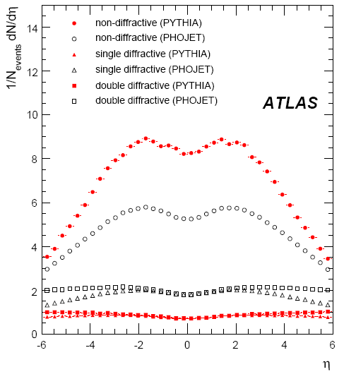
Predicted Properties
arXiv:0901.0512

Slide 6
Minimum Bias Event
What do we want in our final minimum bias event?
  Non-single diffractive inelastic event.
What are the backgrounds to be rejected?
  Empty events (trigger based on bunch crossings);
  Elastic events, Single-diffractive interactions;
  Beam-gas;
  Beam-halo (interactions in the tertiary collimators in the accelerator)
  Pile-up (Not an issue early on but important for higher luminosity)

Slide 7
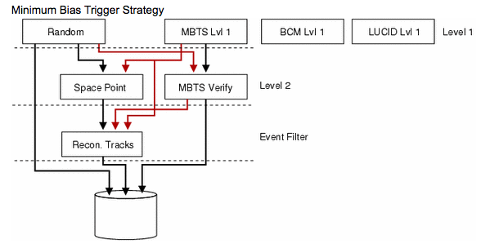
Triggering on Minimum bias
ZDC

Slide 8
Triggering on Minimum Bias
Inner Detector Space Points
Minimum Bias Trigger Scintillators
Cerenkov Detector (LUCID)
Select events with minimal bias using level 1 and level 2 trigger items.
Zero degree calorimeter (ZDC)
8.3 ➔∞

Slide 9
Random trigger (initial runs)
75ns bunch spacing at the start up.
  Probability of 1pp event per bunch crossing (~10%).
  Triggering on random bunch crossing at LVL1 and make the selection in the HLT.
  Use Event Filter (EF) to remove empty events:
    Eg. Pixel/Silicon hits, track reconstruction

Slide 10
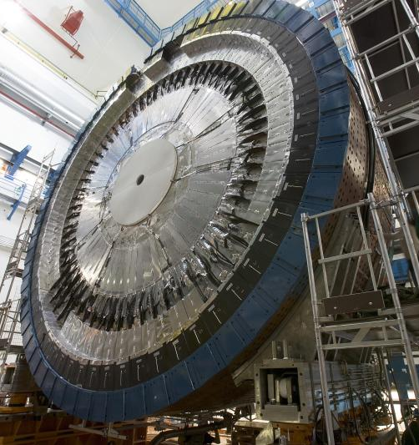
Minimum Bias Trigger Scintillators
Minimum Bias Trigger Scintillators (MBTS)
2.12 < |η| < 2.83
2.83 < |η| < 3.8

Slide 11
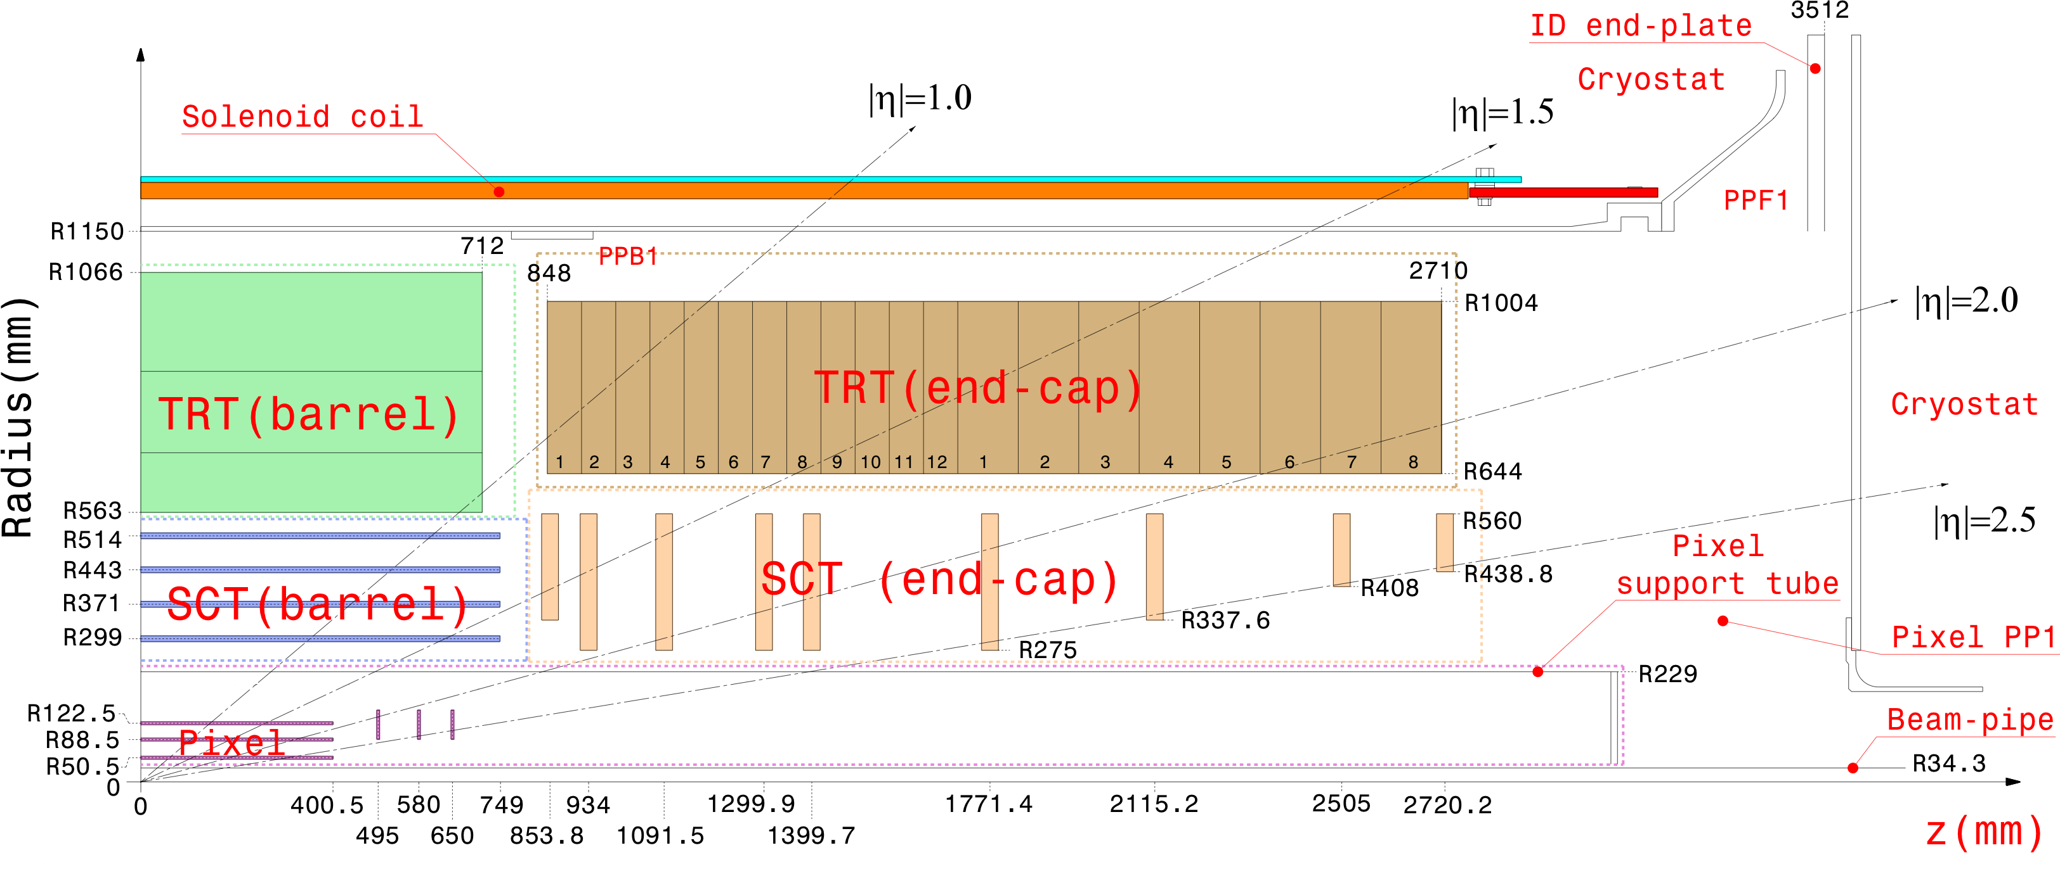
Space Points and Tracks
Pixel and silicon micro strip (SCT) detectors provide space points at level 2.
ATLAS Inner Detector

Slide 12
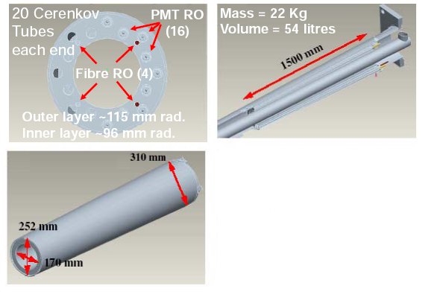
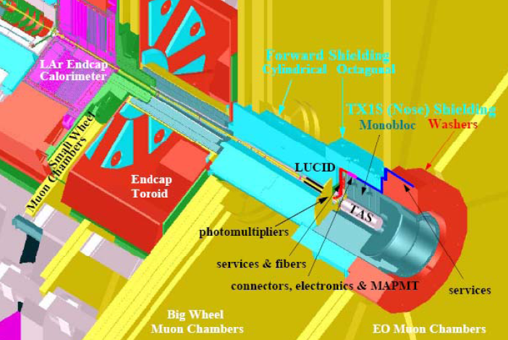
LUCID
Cerenkov Detector (LUCID)
+/-17m from IP
5.61 < |I| < 5.93
Require 1 or more
tube one side

Slide 13
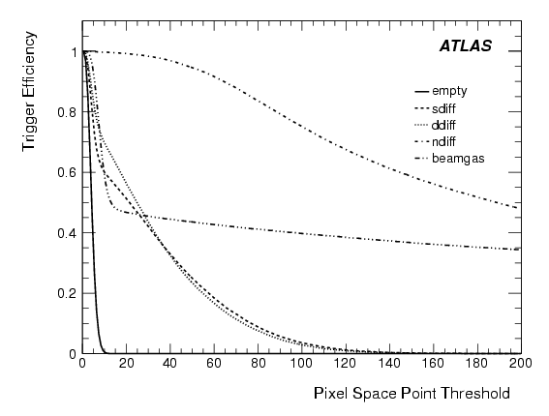
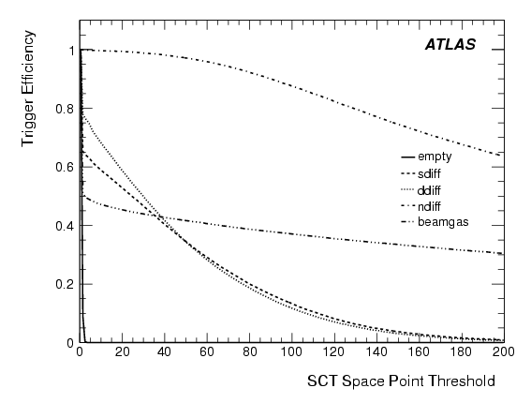
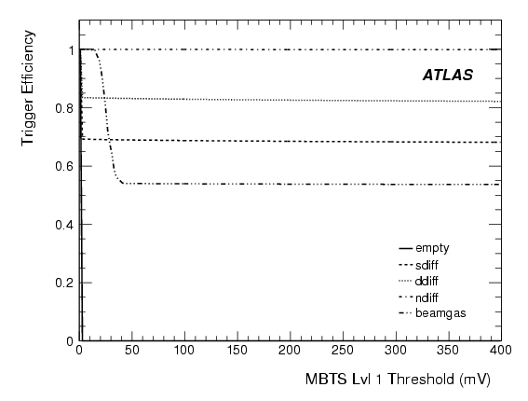
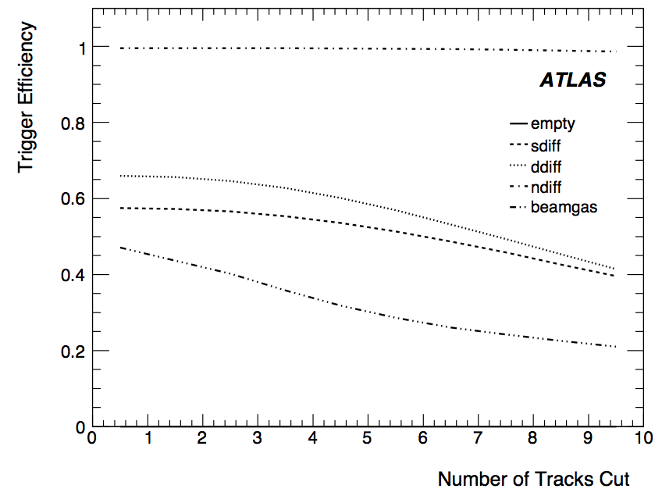
Trigger Efficiency
Pixel SP >= 12
arXiv:0901.0512
SCT SP >=3
Track z0<200 mm
Threshold 40mV

Slide 14
Trigger Efficiency
 | MBTS_2 | SP
Ndiff | 100% | 100%
Ddiff | 83% | 66%
Sdiff | 69% | 57%
B. Gas | 54% | 47%
MBTS ≥ 2 (of 32), Threshold @ 40mV from cosmic data
Space Point (SP) trigger SCT ≥ 3 & Pixel ≥ 12

Slide 15
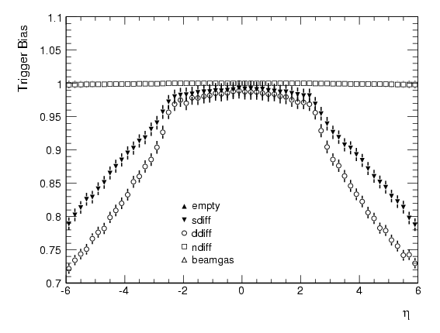
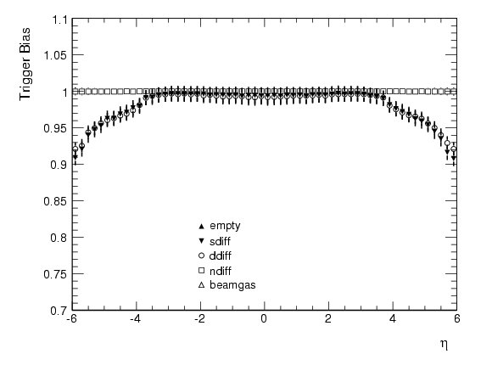
Trigger Bias
arXiv:0901.0512
ATLAS
ATLAS
MBTS ≥ 2 (of 32)
Threshold @ 40mV
Space Point Trigger
SCT ≥ 3 & Pixel ≥ 12

Slide 16
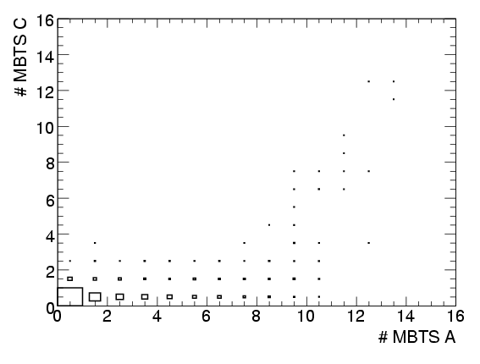
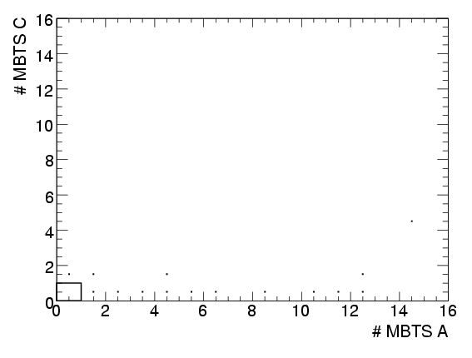
MBTS readiness
During September ATLAS was triggering on beam pickups and MBTS
Saw single beam collimator splashes and stable single beam
MBTS A in time, MBTS C out of time.
Plot MBTS A and C side multiplicities
arXiv:0901.0512
ATLAS
ATLAS
Beam 2 with collimator "splashes", few turns only before being lost
Injecting and circulating Beam 2
MBTS provides a stable activity trigger
(Lvl1 MBTSA timed in with opposite side BPTX)

Slide 17
Analysis Strategy dN/dη, dN/dp_{T}
Record events with Minimum Bias trigger
  Selection required while N_{inter} << 1
  Combination of MBTS and Inner Detector space point
  Comparisons with LUCID
  Diffractive content estimation ZDC
Measurement with tracks
  Utilise low p_{T} tracking down to 100MeV
  Efficiency studies with track insertion cross checked with K_{s} → π⁺π⁻
  Sensitive to material model and misalignment

Slide 18
Track Selection
Using loose track cuts to
  Remove fake and secondary tracks
  Select tracks with reasonable fits
arXiv:0901.0512
Using Gaussian fits to parameters, cuts are 3σ

Slide 19
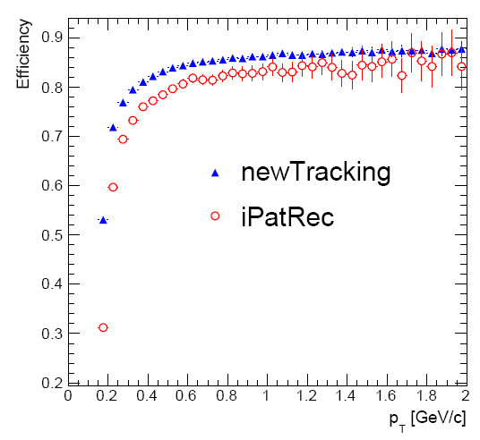

Tracking Efficiencies
Truth probability ≥ 50% => Matched
ATLAS
ATLAS
Low pt tracking
Default tracking
P_{T} > 150MeV
|η| < 2.5

Slide 20
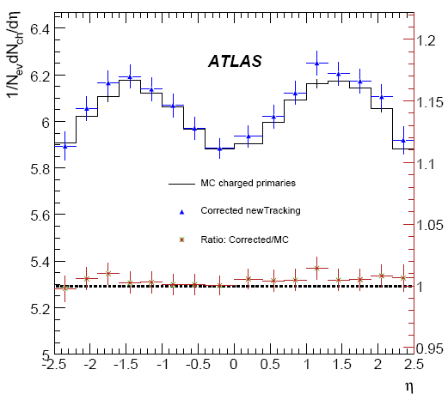
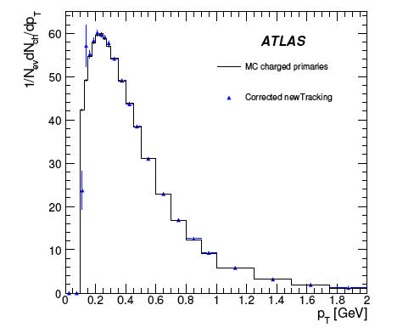
Results
arXiv:0901.0512
P_{T} > 150MeV
Name | Estimated Uncertainty
Track Selection Cuts | 2%
Mis-estimate of Secondaries | 1.5%
Vertex Reconstruction Bias | 0.1%
Misalignment | 6%
Beam-gas and pileup | 1%
Particle Composition | 2%
Diff. Cross Sections (NSD) | 4%
Total | 8%
NSD sample
NSD sample
Track-to-particle
Vertex reconstruction
Trigger bias
Corrections:
Notes:
Alignment of tracker is much better known using last years cosmic data and we expect these error to improve.

Slide 21
Summary and conclusions
Trigger is ready for minimum bias measurement from early data.
Single beam showed MBTS stability
Last year cosmic data were used to tune the ID and expect better results from simulation.
Early measurement can be done with as little as 10K minimum bias events.

