Slide 2
Linac4-PSB 160 MeV Connection Readiness Review
Tuesday 30 August 2016

Slide 3
LIU-PSB 160 MeV Readiness
K. Hanke
Table of Contents:
LIU-PSB activities for Linac4 connection before LS2
CONS items linked to LIU-PSB connection and status
Status of HST and timeline
When will LIU-PSB be ready for a possible early connection
Risks & Mitigation

Slide 4
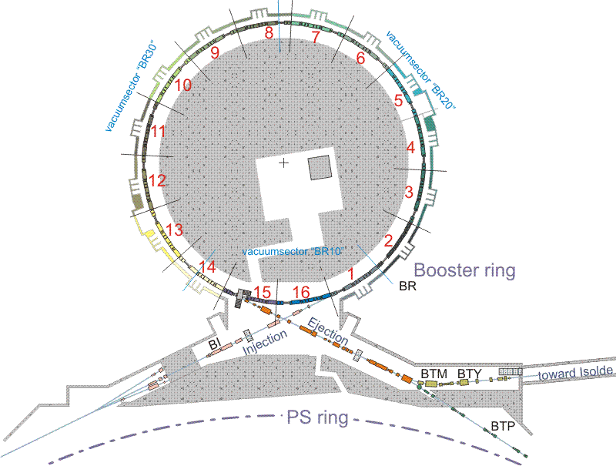
Areas covered in this Talk
BI Line
injection period in the PSB
items in the PSB rings which are mandatory for commissioning/operation with Linac4
general infrastructure items

Slide 5
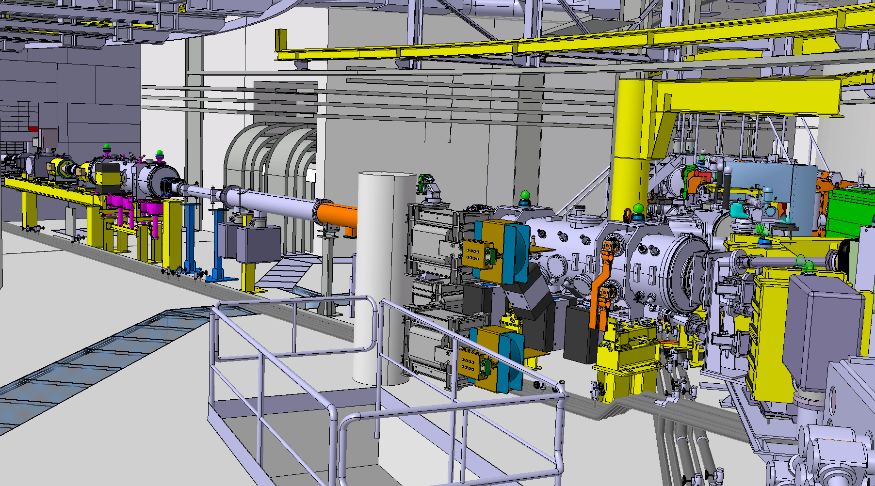
BI Line

Slide 6
BI Line
item/activity | status
upgraded PSB distributor BI.DIS10 | ready end 2016
upgraded vertical distribution septum BI.SMV10 | ready end 2016
BI.SMV position measurement plates | ready
head/tail dumps | ready
Booster injection magnets BI.BVT and powering | ready end 2016
Booster injection corrector magnets and powering | ready end 2016
other diagnostics (BCTs, BLMs…) | ready end 2016
BI beam stoppers | installation of a Linac4 type beam stopper to replace the two existing ones; time scale LS2 but no show stopper

Slide 7
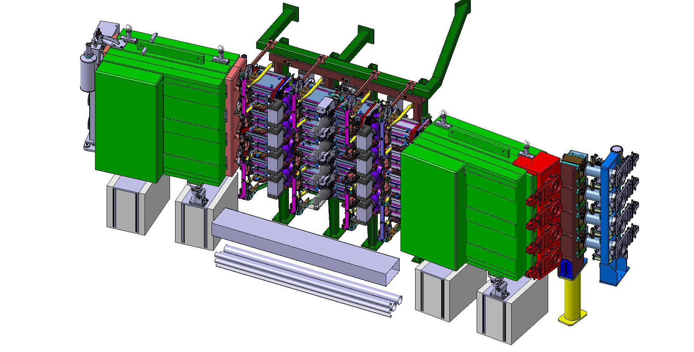
PSB Injection Region

Slide 8
PSB Injection Region
item/activity | status
painting bump magnets and powering (KSW) | ready end 2016
chicane bump magnets and powering (BSW) | being manufactured; ready end 2016
new injection main dipole BHZ.INJ | spare is configured as a special injection magnet ready for L4 connection
foil holder | ready end 2016
H⁰/H⁻ dumps | ready end 2016
beam profile and foil inspection | ready
H0/H- current monitor | mechanics ready, electronics being tested
BLMs | ionisation chambers ready, diamonds expected ~2017

Slide 9
PSB Rings

Slide 10
PSB Rings
item/activity | status
TFB for 160 MeV operation | being worked on; ready mid 2017; to be followed closely
new RF bypasses | 4 to be installed EYETS, rest LS2
special RF bypasses for injection | design in progress*
turn-by-turn matching monitor | electronics being tested; OK for installation EYETS
new ring trajectory system | being debugged, many issues solved
new tune pick-up | tight schedule for end 2016
new powering for Q-strips periods 3 & 14 | ready end 2016
*can run with existing bypasses for present intensity

Slide 11
General Infrastructure
item/activity | status
racks including support and other infrastructure | new rack space and infrastructure created
new bunker for BSW transformers | in progress; ready in the course of 2017
minor civil engineering activities | done
cabling and de-cabling | de-cabling planned for EYETS; most cabling to be done in the moment of connection

Slide 12
Consolidation Items
the H- Injection into the PSB is new and therefore not a consolidation item
some of the hardware items are budget wise shared
item/activity | status
handling equipment | has been consolidated
rack infrastructure | has been consolidated
beam stoppers across the complex | EN-STI request to CONS; strongly endorsed by LIU (reliability issue)
removal of obsolete piping in the tunnel, clean up… | lots of work done

Slide 13
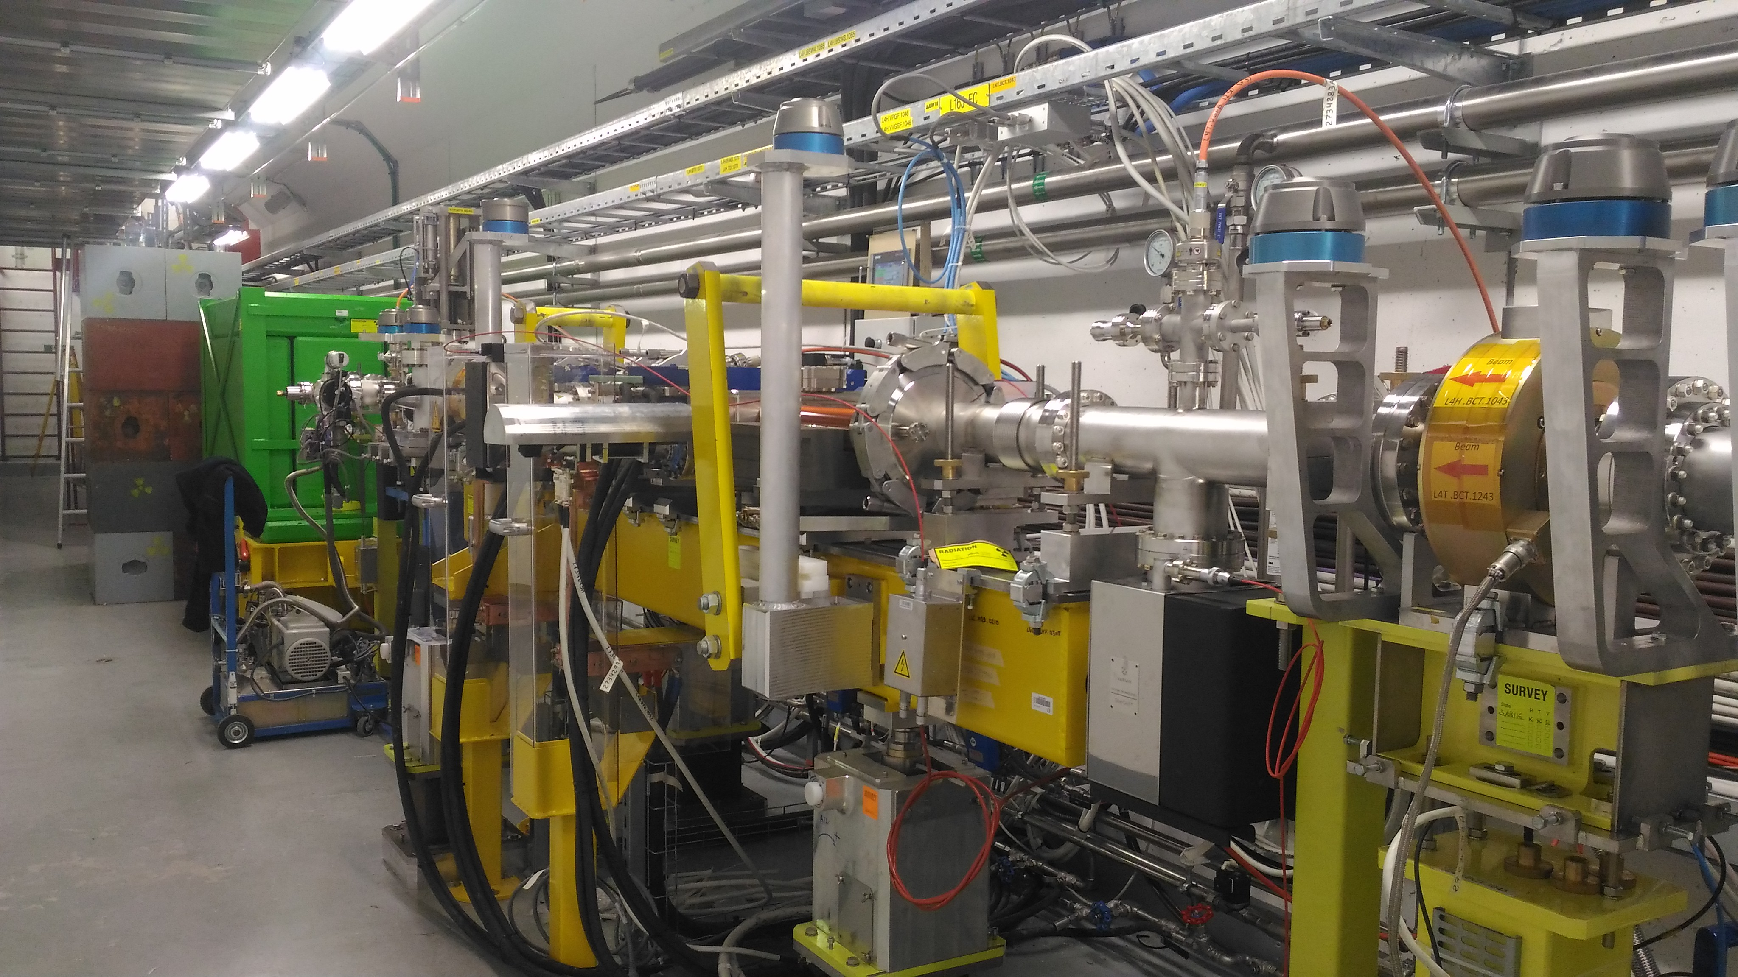
HST Status and timeline
HST Installation completed: July-August 2016
August |  |  |  |  |  | September |  |  |  |  | October |  |  |  |  |  | November |  |  |  |  | December
31 | 32 |  | 33 | 34 | 35 |  | 36 | 37 | 38 | 39 |  | 40 | 41 | 42 | 43 | 44 |  | 45 | 46 | 47 | 48 |  | 49 | 50 | 51 | 52
 |  |  |  |  |  |  | DR | 160 MeV beam commissioning
 |  | HW tests |  |  |  |  |  |  |  |  |  |  | HST beam commissioning
HST HW commissioning: August 2016
HST cold checkout: September 2016 (in principle no more tunnel access…)
HST beam tests from October 2016 in parallel with 160 MeV beam commissioning; HST will continue from January 2017 for ~2 more months depending on the progress
G. Guidoboni

Slide 14
HST importance
installation lessons
Vacuum issues with stripping foil loader; still to be solved (status of 16/08/2016)
H0/H- Dump connector: new design for the connector or vacuum chamber for the PSB installation
Close inspection of all welds and mechanical tolerances immediately upon reception of Iconel vacuum chambers (for BSW magnets).
beam commissioning lessons
Not started yet. The HST will be fundamental to learn how to control the stripping mechanism and beam instrumentation (no experience at CERN with charge-exchange injection)
if not done?
The PSB H- injection will be a very compact installation and we will be under time pressure (risk of delays if unforeseen issues are encountered)
G. Guidoboni

Slide 15
Time Line for Connection
was reviewed in October 2013 (RLIUP workshop, https://indico.cern.ch/event/260492/)
time lines to be updated with recent information (see presentations about the detailed timeline, the hardware and beam commissioning at this Review)

Slide 16
Risks & Mitigation
every single item has been checked for readiness, but how will it all work together?
is Linac4 sufficiently integrated in the controls environment?
we have no operational experience with H- injection
what will the uptime be as compared to Linac2
→ Half Sector Test
→ Linac4 reliability run from the CCC

Slide 17
Risks & Mitigation (2)
will the instrumentation in the PSB be commissioned and debugged before we re-commission with Linac4
joint effort of OP and BI
will we have sufficient expert manpower during the commissioning phase
help from outside? (e.g. ISIS)
has sufficient time be allocated for the commissioning and what is expected when (LHCPILOT or full spectrum of beams)

Slide 18
Conclusion
on the Booster side the equipment will be ready by end 2016 for 160 MeV H- injection
the items which are critical are no show stoppers
the HST is very beneficial
a reliability run from the CCC would also be desirable

