Slide 2
Linac4-PSB 160 MeV connection readiness review
Tuesday 30 August 2016

Slide 3
Requirements and timeline for beam commissioning activities to operational beam
Vincenzo Forte – TE/ABT/BTP
Acknowledgements:
A. Apollonio, E. Benedetto, C. Bracco, A. Findlay, B. Goddard, G. P. Di Giovanni, G. Guidoboni, A. Lombardi, E. Matli, M. Meddahi, B. Mikulec, G. Rumolo, J. Sanchez-Alvarez, J. Uythoven

Slide 4
Goals of beam commissioning
To be able to reproduce, with the Linac4 early connection, the beams currently available in the machine
To review the process and the timeline foreseen for the beams commissioning with focus on the PSB injection phase
Goals of the presentation
Outline
The PSB users (2016)
Injection lines beam commissioning
  HST
  The Machine Checkout online tool
Pre-requisites for PSB operational beam commissioning
The PSB operational beam commissioning phases:
  Phase 1 - first injections
  Phase 2 - first turn and closed orbit
  Phase 3 - optics and aperture
  Phase 4 - accelerate and extract
  Phase 5 - LHCPROBE
  Phase 6 - higher intensity: LHC
  Phase 7 - fix target beams: ISOLDE
Control room applications needed for beam commissioning
Global timeline and final remarks

Slide 5
The PSB users (2016*)
* https://wikis.cern.ch/display/PSBOP/Beam+Docs+2016
Beam | Bunch intensity [e10 ppr] | H | Extr. bunch Length [ns] | Δp/p [1e-3] | ε_{l} [eVs] | ε_{h} [mm mrad] | ε_{v} [mm mrad] | PSB Ring | Dest.
LHCPROBE | 0.5 - 2 | 1 | 70 | 0.45 | ~0.2 | ~0.8 | ~0.8 | 3 | LHC
LHCINDIV | 2 - 12 | 1 | 85 | 0.55 | 0.3 | <2 | <1.5 | 3 (or 1-4) | SPS, LHC
LHC50DB | ~80 | 1 | 180 | 1 | 1.3 | 1.5 | 1 | 1-4 | LHC
LHC25DB | 165 | 1 | 180 | 1 | 1.3 | 3 | 2 | 1-4 | LHC
BCMS25 | 85 | 1 | 150 | 0.8 | 0.9 | <1.1 | <1.2 | 1-4 | LHC
SFTPRO_MTE | <600 | 2 | 160 | 1.1 | 1.3 | <12 | <7 | 1-4 | North area
SFTPRO_CT (MTE backup) | <600 | 2 | 160 | 1.1 | 1.3 | 6-8 | 5-6 | 1-4 | North area
EAST1 | <50 | 1 | 170 | <1 | <1.3 | <1.5 | <1.5 | 3 | East area
EAST2 | <50 | 1 | 170 | <1 | <1.3 | 1.1 | 1.1 | 3 | East area
NORMGPS/HRS | 900 | 1 | <230 | ~1.1 | <1.8 | <15 | <8 | 1-4 | ISOLDE
STAGISO | ~200/350 | 1 | 230 | 1.35 | <1.6 | <5 | <4 | 2-4 | ISOLDE
AD | 400±50 | 1 | 170 | <1 | 1.3 | 9 | 5 | 1-4 | AD
TOF | 900 | 2 | 210 | 1.1 | 1.7 | 12 | 9 | 2 | nTOF

Slide 6
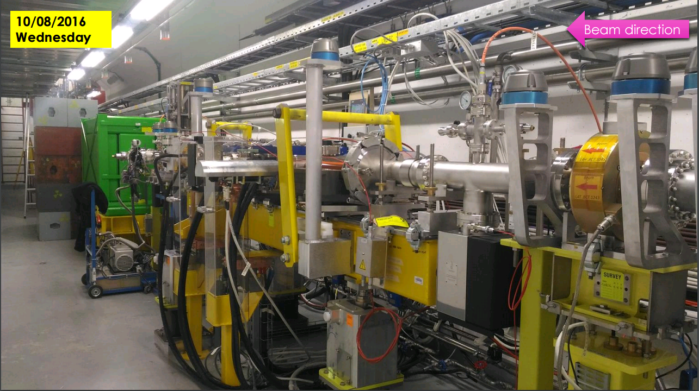
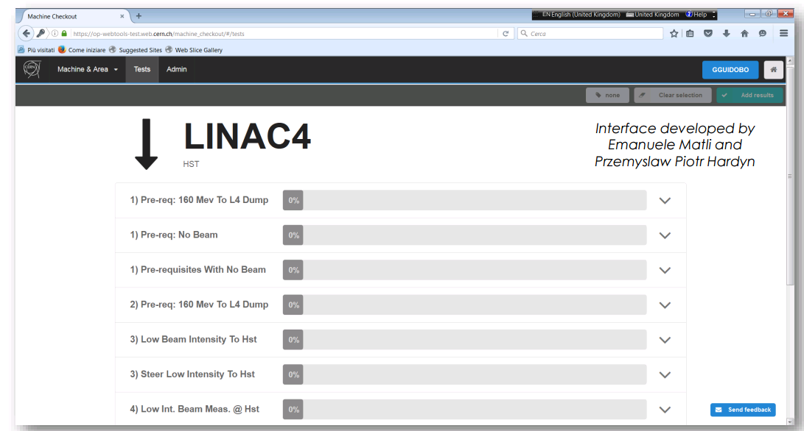
Injection line beam commissioning
The Linac4 transverse lines components are all available.
160 MeV beam commissioning is planned until week 46 (mid November).
The L4T (Linac4 to Linac2) line is half-commissioned (up to the HST).
HST (in L4T) tests are planned from October until end of 2016 → gain experience with the new injection HW/SW
Machine checkout web-application is useful for beam commissioning management and tracking → Also for PSB!
LT-LTB lines will not change substantially
After HST tests the beam is commissioned to LBE for transverse emittance evaluation.
LBS will not be upgraded → The energy spread will be evaluated through BSM (to set up the de-buncher settings).
Line optics set in order to produce achromatic bending and put the dispersion to 0 → check through L4 energy sweep until no beam displacement in the sem-grids.
A commissioning beam starting for zero dispersion optics should be ready in ~2 weeks with the following characteristics:
500 ns pulse – I = 5e9 ÷ 1e10 H⁻ - ΔE = 403 keV rms - no energy modulation
https://op-webtools-test.web.cern.ch/machine_checkout/#/tests
HST installation - Courtesy G. Guidoboni

Slide 7
Pre-requisites for PSB operational beam commissioning
Reliability of the Linac4 (commissioned up to LBE line dump) and characterization of the commissioning beam
Full connection and hardware commissioning performed
The control infrastructure, CCC-OP and experts applications ready
Machine checkouts list and logging ready
The new 160 MeV → 1.4 GeV magnetic cycle ready
The Linac4 beam must be synchronized with all injection systems in the BI transfer line and in the ring
The optics models are ready and available to the commissioning team (physicists, operators…)
Constant support by all the specialists involved in devices and functionalities development
Interlock systems ready and tested before first injection from Linac4

Slide 8
Phase 1: first injections – 2 weeks estimated
Main steps:
Verify as far as possible the BIS, especially for the “new” injection phase:
  IN GENERAL: Interlock systems can differ between operational state and “special” commissioning tasks.
    Someone (better a small team with mixed expertises) has to handle exceptions, documenting masks to avoid forgetting them.
    Users must be ready (from hw and thresholds point of view) and (when already possible) in the final state to provide inputs.
Steer a low intensity beam through the BI line to the PSB injection point for ring 3:
  Kick response measurements in the BI line
  Pulse the DIS and adjust timings.
  Minimise beam loss along the line.
  Adjusting Beam Instr. synchronisation and pulse equipment in the beam position (through OASIS)
  Steer the beam with the last two (orthogonal) steerers in the BI line and regulating BSW2/3 to centre the beam on the screen, at the stripping foil location.
Centre the beam on the H⁰/H⁻ dump (masking foil position interlock)
Calibrate the H⁰/H⁻ intensity monitor
Define and verify the interlock thresholds of the H⁰/H⁻ monitors and the BLMs in the injection section. Interlock with SIS the KSW amplitude to avoid foil heating
Repeat steps 1 to 3 for the other 3 rings

Slide 9
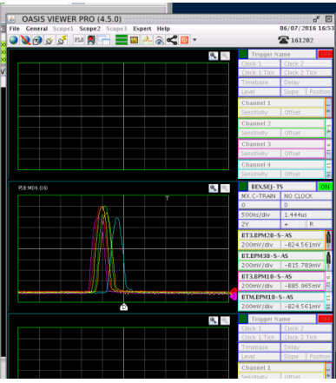
Phase 2: First turn and closed orbit – 4 weeks estimated
Entry conditions:
Injection elements synchronized with Linac4 beam
Turn-by-turn acquisition of orbit pickups must be ready
BI trajectories and losses corrected and under control
PSB ring equipment functional including the RF.
Beam of 4 rings centred on the H0/H⁻ dumps
Flat KSW function (decay in ~20 turns), flat B field and constant active compensation (nominal vertical beta-beating correction)
Main steps:
Insert the stripping foil, constantly monitoring the stripping efficiency (comparing BCTs in line and ring) → 95-98% expected
Achieve a closed orbit using the ring orbit correctors and YASP.
Try to extract the beam after ~20 turns to the external dump
→ 160 MeV beam already dumped in MD nowadays!
Basic RF setup and capture: bunch-to-bucket transfer with adiabatic capture as backup
160 MeV extraction to beam dump–
V. Forte, G.P. Di Giovanni, B. Mikulec
MSWG 08/07/2016
Perform tune measurement if possible and achieve few thousand turns.
  On the critical path: readiness of the new tune pickup for low intensity beams (like LHCPROBE)
Optimize angle/position to minimise injection oscillations → new application to subtract the first turn from the closed orbit.
Adjust BSW-KSW bump closure to minimize the COD difference with turn-by-turn pickups → new application for BSW/KSW functions
Match the injection trajectory to closed orbit to minimise inj. oscillations with turn-by-turn pickups and BSW/KSW/steerers → BSW/KSW as additive knobs for YASP, as in other machines (see PS).
Commissioning of the injection watchdog.

Slide 10
Phase 3: Optics and aperture – 1 week estimated
Entry conditions:
Beam can be injected into the four PSB rings, captured and makes a few thousand turns
Closed orbit achieved to max ±7 mm rms
KSW functions optimised
Injection steering optimised for minimum oscillations
Main steps:
Adjust beta-beating to < 30% through turn-by-turn data analysis
Measure the transverse emittance with the wirescanner and compare with expectations
Iterated aperture checks (through BLMs) of the incoming and circulating beams → comparison with theoretical aperture models
Repeat for all the rings
The installation of the matching monitor in ring 3 is foreseen in LS2

Slide 11
Phase 4: Accelerate and extract – 3 days estimated (for the early connection)
The acceleration process, including resonance compensation and beam extraction and dumping, completes the complete production phase before going to specific users
This phase is not covered in this presentation (more confidence on this phase by experience).

Slide 12
Phase 5: Low intensity LHCPROBE production – 3 days estimated
Beam | Bunch intensity [e10 ppr] | H | Extr. bunch Length [ns] | Δp/p [1e-3] | ε_{l} [eVs] | ε_{h} [mm mrad] | ε_{v} [mm mrad] | PSB Ring
LHCPROBE | 0.5 - 2 | 1 | 70 | 0.45 | ~0.2 | ~0.8 | ~0.8 | 3
Injection of 1 turn from Linac4 with reduced intensity (>2e10 p) (through LEBT optics + pulse length)
  Transverse painting not possible with 1 turn injection
Increase the transverse emittance through injection mismatch or approaching the working point close to a resonance:
  Tune measurement would need the new tune pickup for low-intensity
Final longitudinal emittance can be achieved through longitudinal shaving

Slide 13
Phase 6: LHC– 2 weeks estimated
Beam | Bunch intensity [e10 ppr] | H | Extr. bunch Length [ns] | Δp/p [1e-3] | ε_{l} [eVs] | ε_{h} [mm mrad] | ε_{v} [mm mrad] | PSB Ring
LHC50DB | ~80 | 1 | 180 | 1 | 1.3 | 1.5 | 1 | 1-4
LHC25DB | 165 | 1 | 180 | 1 | 1.3 | 3 | 2 | 1-4
BCMS25 | 85 | 1 | 150 | 0.8 | 0.9 | <1.1 | <1.2 | 1-4
Intensity increase: 11 turns needed for standard LHC25 beams production with ~60% chopping factor (40 mA unchopped)
The energy spread (de-buncher) can be set to 400-450 keV rms
Beam injected in a double-RF bucket in antiphase
All beam interlocks must be tested due to the intensity increase
Transverse painting can be performed through horizontal offset (or KSWs variation) and vertical offsets to obtain the target emittances
  Wirescanner measurements are needed to verify emittance
Losses, foil heating, apertures and stripping efficiency must be monitored
Due to higher injection energy, the injection working point might be safely put below the 2Q_{y}=9 line → no half-integer correction

Slide 14
Phase 7: Fix target beams: ISOLDE – >3 days estimated
Beam | Bunch intensity [e10 ppr] | H | Extr. bunch Length [ns] | Δp/p [1e-3] | ε_{l} [eVs] | ε_{h} [mm mrad] | ε_{v} [mm mrad] | PSB Ring
NORMGPS/HRS | 900 | 1 | <230 | ~1.1 | <1.8 | <15 | <8 | 1-4
High intensity beams: ~60 turns needed at 40 mA unchopped
For high intensity, PSB rings must be synchronised to the individual start of ring injections as magnetic fields and RF frequencies are different ring-by-ring → individual synch. energy compensation through L4 energy modulation (2 PIMS).
Both transverse and longitudinal painting are foreseen:
  Additional set-up time for longitudinal painting: 4-6 weeks
  Chopping pattern calculation program needed
  The maximum Linac4 energy modulation amplitude is reduced to ±0.8 MeV (instead of ±1.2 MeV) → Studies are on-going for impact on beam dynamics for high-intensity beams

Slide 15
Control room applications needed for beam commissioning
Application | Tasks
Tomoscope and BSM | Longitudinal characterization
Wirescanner and sem-grids | Transverse characterization
OASIS | Raw signals and beam synchronization (timings) – Diamond BLM at injection
Q-meter | Tune and chromaticity
BLMs | Interlock and aperture checks
Injection trajectory monitor | Check the status of the BPMs in the injection lines
YASP | Fundamental for injection trajectories and oscillations optimization (KSW and BSW could be added as knobs) – dispersion measurements at turn 1
BSW chicane height | Application to compute chicane height by strength of bends
“Cruise Control” | Substitutes the OP display integrating infos about chopping patterns, injection timings, and KSW functions for painting, injection BLMs
Space charge incoherent tune spread monitor | Estimate the Space charge tune spread from intensity, emittance and longitudinal profile

Slide 16
Global timeline and final remarks
The global timeline considers turnkey beams
Problems (thus contingencies) are not considered in the timeline
The total beam carnet production is available in 7 months – beams available sequentially
Every beam must have a ‘nominal production scheme’ prepared in advance
The machine is going to be substantially changed, thus all the experts must be ready to help from dry runs on and face probable delays during the commissioning
The interlock system must be checked very carefully: if it has to be optimised (hw/sw thresholds), this is the moment!
This connection scenario differs from the final one as last changes will occur up to the end of LS2 (i.e. 2 GeV extraction)
Phase | Estimated duration for early Linac4 connection
Phase 1: First injections | 2 weeks
Phase 2: First turn and closed orbit | 4 weeks
Phase 3: Optics and aperture | 1 week
Phase 4: Accelerate and extract | 0.5 weeks
Phase 5: Produce LHCPROBE beam | 0.5 weeks
Phase 6: Increase the intensity and produce SFTPRO and LHC beams | 2 weeks
Phase 7: All other physics beams | 12 weeks
Phase 8: Longitudinal painting | 4-6 weeks
TOTAL TIME | 28 weeks (7 months)

