Slide 1

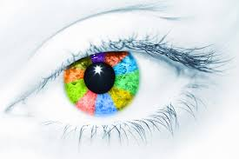


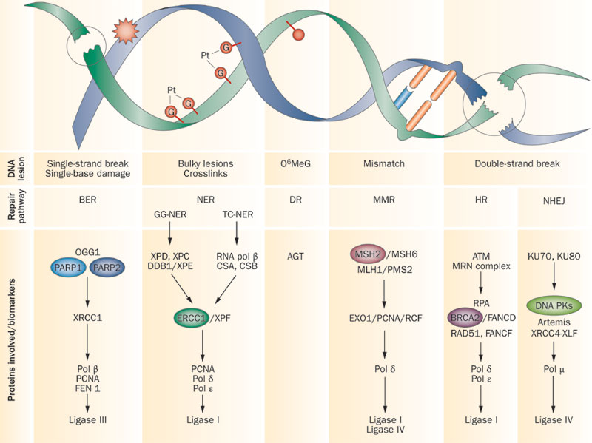
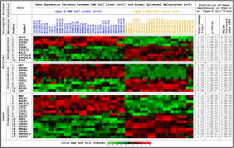
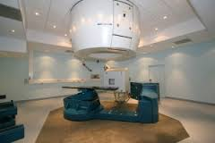
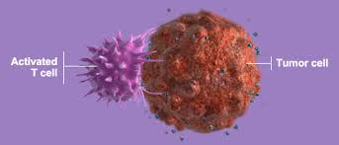

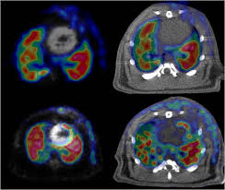
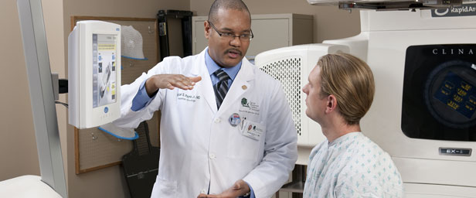




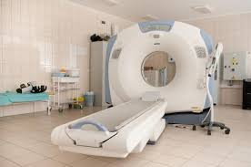
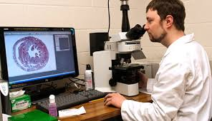


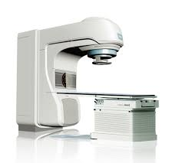
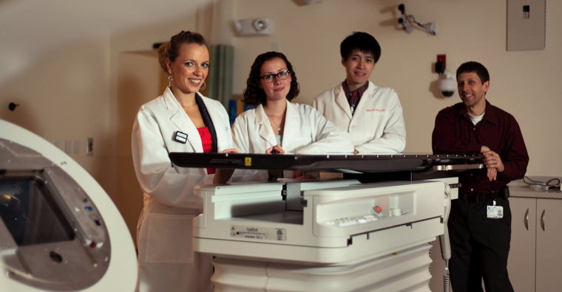
What’s next
Vision driven, implementation
:
Phase 3-
Biology-driven rad oncology; hadrons.
Policy, outreach
Overarching direction of radiation sciences & technology
Global connectivity
Phase 2-
Implementing improved Rx:
Solid science & technology
Buried complexity- systems; software; novel technology
Molec
image
Computer geeks
Technology development
Phase 1-
Equipment purchase
Mentoring, build capacity & capability
industry

