Slide 1
“Although we have to start with more advantaged countries lending a hand to nations earlier in their development, the aspirational goal of international educational endeavors in radiation oncology is that eventually the learning will be a two-way street, with ideas and knowledge flow in both directions.”
Brian Kavanagh
ASTRO President, 2016

Slide 2
ASTRO Strategic Initiatives
Goal 1: ASTRO will provide state-of-the-art education and lifelong professional development in the effective use of radiation as a tool for the treatment of patients with cancer and benign disease.
Goal 2: ASTRO will publish the premier scientific and practice journals in radiation oncology.
Goal 3: ASTRO will advance the science through research and innovation to improve clinical outcomes for each patient.
ASTRO will promote advances in research to raise the profile of the specialty.
Goal 4: ASTRO will be the premier voice for advocacy and health policy for radiation oncology.
Goal 5: ASTRO will shape the framework for the delivery of safe, high-quality, high-value health care to all patients (cancer, benign disease) by the radiation oncology team.

Slide 3
Goal 1: ASTRO will provide state-of-the-art education and lifelong professional development in the effective use of radiation as a tool for the treatment of patients with cancer and benign disease.
ASTRO will be the primary source for the educational needs of radiation oncology and will continue to organize the world’s leading radiation oncology scientific meeting.
ASTRO will support continuous certification by increasing the number of available online/live SAMS and encouraging member participation as a critical component of maintaining clinical skills.
ASTRO will continue the support and development of small meetings as appropriate for the needs of the specialty.
ASTRO will continue to provide educational resources for all radiation oncology trainees and interested medical students.
ASTRO will work with radiation oncology societies globally to coordinate educational opportunities.

Slide 4
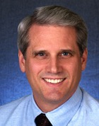
Leadership Interest/Awareness
Tim R. Williams, MD, FASTRO
ASTRO President, 2008-9
Chair 2009-2010*
Immediate past-Chair, 2010-11**
**Tasked when leaving the BoD with figuring out a roadmap ahead for international activities

Slide 5
IES Mission Statement
The objective of the ASTRO International Education Subcommittee (IES) is to assist in the realization of the Society’s strategic plan with respect to international activities. IES not only plays the important role of educational exchange for radiation oncology professionals between USA and other countries, but also serves as the centralized resource to promote fellowship, research and clinical expertise on multiple levels with physicians, physicists, therapists and ancillary supportive representatives from other countries. IES coordinates and identifies novel approaches to answer the increasing interest in global outreach from ASTRO members by serving as the international hub and coordination of its global health efforts and those of U.S. institutions, medical specialty societies, individuals and other international societies. Representatives from other major oncology societies including ESTRO, JASTRO, ASCO, CSTRO, CARO, TASTRO, SASCRO, and RANZCR, as well as NCI/NIH, IAEA, RTOG, SCAROP, ADROP, and ARRO, will play key roles in the IES efforts and activities.

Slide 6
Re-organized ASTRO International Education Subcommittee
new group
India WG (10):
David Morgan, MD, ChB (Chair)
Akila Viswanathan, MD (V-Chair)
Latin America WG (8):
Beatriz Amendola, MD,FASTRO (Chr)
Higinia Cardenes, MD, PhD (V-Chair)
China WG (11):
Nancy Lee, MD (Chair)
Zhongxing Liao, MD (V-Chair)
South East Asia WG (13):
Miriam Calaguas, MD (Chair)
Jiade Lu, MD, MBA (VChair)
Africa WG (15):
Terry Wall, MD,JD,FASTRO (Chair)
Mack Roach, MD (V-Chair)
Nina Mayr, MD, FASTRO (Chair)
Kenneth Hu, MD (Vice-Chair)
Timothy Williams, MD, FASTRO (Ex-Officio)
Sylvia Formenti, MD (SCAROP)
Mark Langer, MD (ADROP)
Mirah Shah, MD (ARRO)
Norman Coleman, MD, FASTRO (NCI)
Mitchell Machtay, MD (RTOG)
Special Interest Work Group
Host Representative Work Groups
International Liaison Work Group
IES/IT
Work Group
Bhadrasain Vikram, MD (Chair) (IAEA)
Felipe Calvo, MD (Vice-Chair) (ESTRO)
Soren Bentzen, DSc, PhD (ESTRO)
Edward ‘Ted’ Trimble, MD (NCI/NIH)
Susan Miesfeldt, MD (ASCO)
Kenji Nemoto, MD (JASTRO)
Chris Milross, MD FRANZCR FRACMA (RANZCR)
Jason Chia-Hsien Cheng, MD (TASTRO)
Raymond Abratt, MD (SASCRO)
Eduardo Rosenblatt, MD (IAEA)
Bernard Cummings, MB (CARO)
Ancillary Services
Work Group
Jeff Yue, PhD (Chair)
Francine Halberg, MD, FASTRO (V-Chair) (7)
Jatinder Palta, PhD, FASTRO (Chair)
Cynthia Eccles, CMD, RT (V-Chair) (7)

Slide 7
Initial charge to the 5 Regional Work Groups:
Educational Needs Assessment
3 Top Priorities | Technology Assessment: Treatment delivery and planning, QA | Ancillary Services: Therapists, physicists, dosimetrists, nurses, support staff | IT Infrastructure across region, methods of information exchange
Proposed Strategies
3 Top Priorities | Overall strategies to improve education in region | 3 ways ASTRO can improve education (in order of priority) | Metrics to track educational success?
Notes:
Additional articles followed, highlighting the potential dangers of radiation and lack of regulation in both therapeutic and diagnostic radiology.

Slide 8
Terry Wall
Mack Roach
Example of early observations:
Africa – Educational Needs Assessment
Top Priorities (2013)
Establish direct contact/relationships with centers in countries other than those with well-established programs Need for collaboration with AAPM to enhance Medical Physics training Need for ASTRO resources to Ministries of Health in nations with limited or no radiation therapy

Slide 9




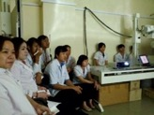
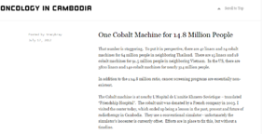


ASTRO/ARRO Global Health Scholars Program https://www.astro.org/arro/global-health-initiative/global-health-scholar-program.aspx
Launched in 2011
allows senior residents to work on a resident-designed clinical, outreach/educational or research project in a developing nation.
Intended to foster a global perspective of oncology and encourage ongoing outreach, research and progress in developing countries
http://tracybray.tumblr.com/

Slide 10

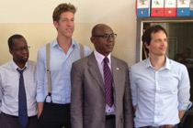
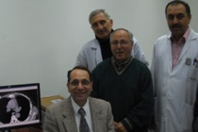
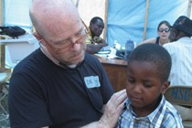
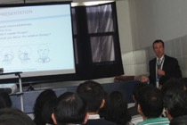
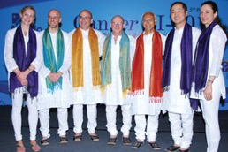
Summer 2013
Dr. Brandon Fisher (right) and Adam Shulman (third from right), Radiating Hope Senegal project director, meet with the directors of Institut Curie de L’Hospital Aristide Le Dantec (IC) in Dakar, Senegal.
Dr. Muthana Al-Ghazi (seated) and physicists and radiation oncologists from the Baghdad Radiotherapy and Nuclear Medicine Hospital work in the treatment planning suite.
Dr. Tom Eichler treats a young patient in Haiti.
Dr. Daniel Schiffner lectures at the Peruvian Society of Radiation Oncology and Medical Physics’ annual meeting.

Slide 11
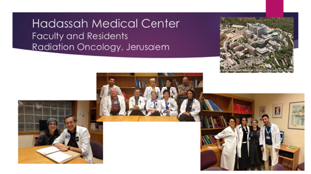
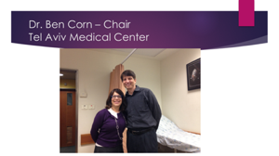
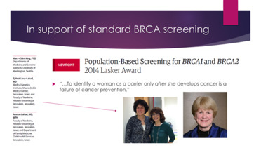
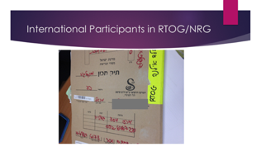
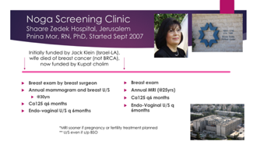
Aspirational goal: International Education as
Rachel Rabinovitch, MD
Visiting Professor in Israel, December 2014-Jan 2015

Slide 12
2015-2016 IES highlights
Ken Hu, Zhongxing Liao
ASTRO Annual meeting
  Two 90-minute educational sessions
    How could/should U.S. methods be adapted in LMIC’s?
  Summary courses in Mandarin and Spanish
eContouring Initiative
  Ambassadors traveling to train international practitioners
    Onyi Balogun, Armenia; Mauricio Gamez, Mexico; Christine Fisher, Southeast Asia; Ray Mailhot, Argentina
Chartrounds.com
  review of treatment management and planning for the purpose of education expansion to the international community
iTreatSafely- Todd Pawlicki
  a website with physics-based videos and comments
  Lawrence Court organizing videos for use by the workgroups

Slide 13
2015: IES workgroup activities
Latin America
  Best of Astro, Mexico
  Annual meeting courses in Spanish
Ind
  Needs survey published IJROBP, S Grover et al
  Best of Astro meeting, India
China
  Mandarin refresher course at annual meeting
  Various web-based educational activities
Southeast Asia
  Plans for Best of ASTRO session at a Federation of Asian organizations in Radiation Oncology (FARO) meeting
Africa
  Dr Surbhi Grover, of U Penn, now in Botswana, inviting residents
  Needs assessment project underway
Turkey
  Best of ASTRO in Istanbul hosted by Dr Ugur Selek

Slide 14
ASTRO IES activity at annual meeting
Building on interest
2016
International breakfast demonstrating growing international membership
Meeting for members from India focus group
Afternoon session and dinner for members from China, in Mandarin
Day long Latin America course in Spanish
    Double auditorium filled to capacity

Slide 15

Pilot Programs reviewed and vetted host program speakers
2017--IES members partnered with host organizers
  *Philippines—Calaguas/SEAROG/FARO/PROS
  *India—Kataria/Viswanathan
  Turkey—Selek
  *BOA in conjunction with Econtouring

Slide 16
Panel for our International Session at the ASTRO Annual Meeting, 2016-Boston
Dad Luqman: moderator and organizer
Partnering to transform global cancer care: International Cancer Expert Corps
C. Norman Coleman, MD, FASTRO
Improving quality and safety in Radiation Medicine: iTreatSafely
Todd Pawlicki, PhD, FASTRO
Empowering our Future: Trainee Action in Global Health-AARO
Trevor J Royce, MD, MS
Linking Oncology Globally: Chartrounds.com
Patricia Hardenbergh, MD
Inspiring and Empowering ASTRO membership To Be Involved in Global Health.
Mary Gospodarowicz, MD, FASTRO

Slide 17
IES 2016

Slide 18
Regional Workgroup Priorities Refined
SE Asia
  Current Treatment Protocols
  Integrating advanced technologies IMRT/IGRT/SBRT
India
  Clinical Trials Workshop in conjunction with AROI
  BOA + Econtouring
  Web-based Chart Rounds
Africa
  Needs survey —physician, dosimetrists, physics
  Gabon—Econtouring—breast
  Ethiopia—Facilitate a modern radiation facility at Mekelle University
China
  Quality assurance and safety survey
  Survey for acceptance of Multidisciplinary Tumor Boards
  Best of ASTRO with CISTRO Annual Meeting
Latin America
  Promote Educational Hubs
  Collaborate with eCancer/SEOR to develop online interactive training for therapists/dosimetrists in Spanish

Slide 19
Publication of IES initiatives in Seminars in Radiation Oncology edited by Norm Coleman and Tim Williams.
  Bridging innovation and outreach to overcome global gaps in Radiation Oncology through Information and Communication Tools (ICTs), Trainee Advancement, Engaging Industry, Attention to Ethical Challenges, and Political Advocacy.
  Luqman Dad, MD¹, Trevor J. Royce, MD, MS², Zachary Morris, MD, PhD³, Meena Moran, MD,⁴ Todd Pawlicki PhD⁵, Deepak Khuntia, MD⁶, Patricia Hardenbergh, MD⁷, Bernard Cummings, MB, ChB⁸, Nina Mayr, M.D⁹. Kenneth Hu, MD¹⁰
  ^{Publication projected} ^{in Spring 2017}

Slide 20

Future
Distance learning/peer review
  International web-based chart rounds (Hardenbergh)
  Resource Adapted NCCN Guidelines(Moran)
  Safety and Quality Assurance Regional Platform (Palta)
Networking
  IAEA—ASTRO endorsement ICARO 2
  NCI—Career pathways in Global Health
  ASCO—Multidisciplinary Management

