Slide 1


Workshop on Improving global access to radiation therapy:
Next Steps
Norman Coleman, Manjit Dosanjh, David Pistenmaa
CERN and ICEC

Slide 2
Complex problem:
Many interested parties, need for action.
Cancer care, Security of nuclear material (Co-60, Cs-137), World peace
Cancer groups:
Union International Cancer Care (UICC): Global Task Force for Radiation for Cancer Control
Professional Societies:
ASTRO, ESTRO, others
U.S.:
National Cancer Institute
Department of Energy
Health & Human Services
International:
International Atomic Energy Agency
World Health Organization
Industry:
Varian
Elekta
Accuray
Non-proliferation:
James Martin Foundation
Individuals:
Broad societal interest
1. Cancer societies, academia, global health
2. Agencies,
Ministries of Health
3. Industry and individuals

Slide 3
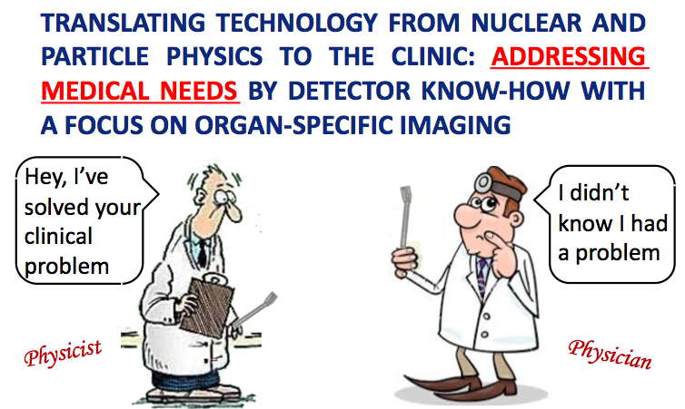
Courtesy D. Townsend

Slide 4
Collaboration is key
talking, listening , hearing, understanding, brainstorming, arriving at a common vision, common goal, strategy…….continued dialogue, action, parameters keeping changing, a long journey ahead…. “but a road worth travelling that will make a difference ….. “
Courtesy D. Townsend

Slide 5
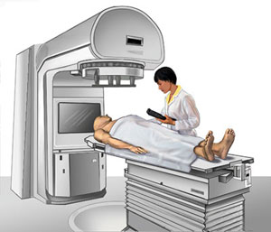
Trans-disciplinary and multi-stake holder collaboration
Epidemiologists
Imaging centres
Biologists
Research institutes
Hospitals
Physicists
& Medical physicists
ICT
Funding agencies
Academic institutes
Industry
Policy makers
Doctors

Slide 6
Next Steps…….
Preparation of a Summary Workshop Report:
    Provide input by 14th November
    First draft report by 5th Dec
    Final Report in December
    Publish in Lancet, Nature ……????
Dissemination of information from the workshop:
    How and where
Technical publication on the accelerator sessions

Slide 7
Next Steps continued…….
Convene working groups for discussion and implementation with a staged approach
Technical input on ideas for future machine with trans-disciplinary expertise
Future meeting for follow up
Additional actions …financing …Jeep… i-phone??

Slide 8
Organise panels emphasising the need for technology development, improved access, capacitance building, training …. :
ECOSOC (UN Economic and Social Council) 2017 at UN New York:
Sustainable Development (10-14 and 17-19 July)
WHO, World Health Assembly 2017
Geneva, 20-26 May
Raising awareness beyond ……………

Slide 9
Future is coming but she needs a little help from all of you……………..

Slide 10

