Slide 1



Utilization of radioisotope trackers to determine the local environment of Hg(II) in dithiocarbamate functionalized nanoparticles
C. O. Amorim¹, J. N. Gonçalves¹, D. S. Tavares², C. B. Lopes², A. S. Fenta^{1,3},
N. M. Fortunato¹, J. Schell^{4,5}, T. Trindade², E. Pereira², J. G. Correia⁶, V. S. Amaral¹
1. Physics Department and CICECO, University of Aveiro, 3810-193 Aveiro, Portugal
2. Department of Chemistry, CICECO and CESAM, Aveiro Institute of Nanotechnology, University of Aveiro, 3810-193 Aveiro, Portugal
3. KU Leuven, Instituut voor Kernen Stralingsfysica, 3001 Leuven, Belgium
4. CERN, Geneva, Switzerland
5.Institut für Materialwissenschaft, Fakultät für Ingenieurwissenschaften, Universität Duisburg-Essen, Germany
6. Centro de Ciências e Tecnologias Nucleares, Instituto Superior Técnico, Universidade de Lisboa, 2686-953, Sacavém, Portugal
IS 515:Radioactive probe studies of coordination modes of heavy metal ions from natural waters to functionalized magnetic nanoparticles
Spokesman: V. S. Amaral Contact person: J.G. Correia
T. Trindade¹, A. L. Daniel-da-Silva¹, C. Lopes¹, E. Pereira¹, V. S. Amaral¹, J. N. Gonçalves¹, J. P. Araújo², C. T. Sousa², A. M. L. Lopes³, J. G. Correia⁴, J. Roeder⁴, M. Stachura⁵ and L. Hemmingsen⁵
Aveiro¹, Copenhagen⁵, Lisboa³, Porto², Sacavém⁴, and ISOLDE/CERN

Slide 2



Outline
Utilization of PAC radioisotope trackers and DFT calculations to determine local environment of Hg(II) in dithiocarbamate functionalized particles for magnetic removal of Hg2+ from water
Introduction
  Motivation
  Functionalized Magnetic Nanoparticles
Radioactive Trackers (How much Hg sorption?)
  Quantitative sorption analysis
Hyperfine/Local properties (Hg coordination?)
  DFT modeling
  PAC Spectroscopy
Conclusions
  DFT and PAC crossover

Slide 3
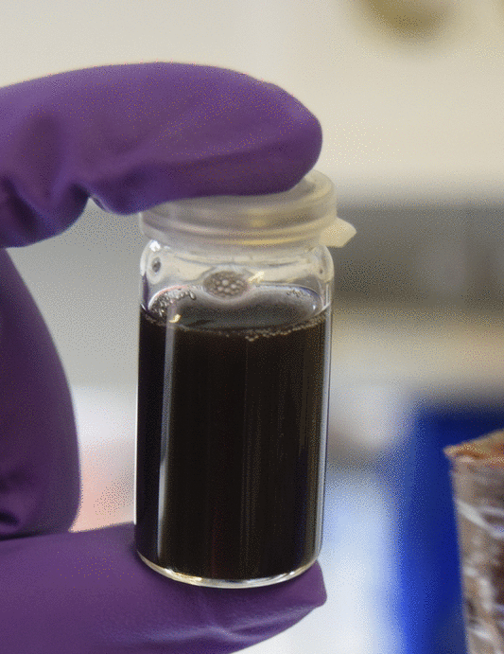
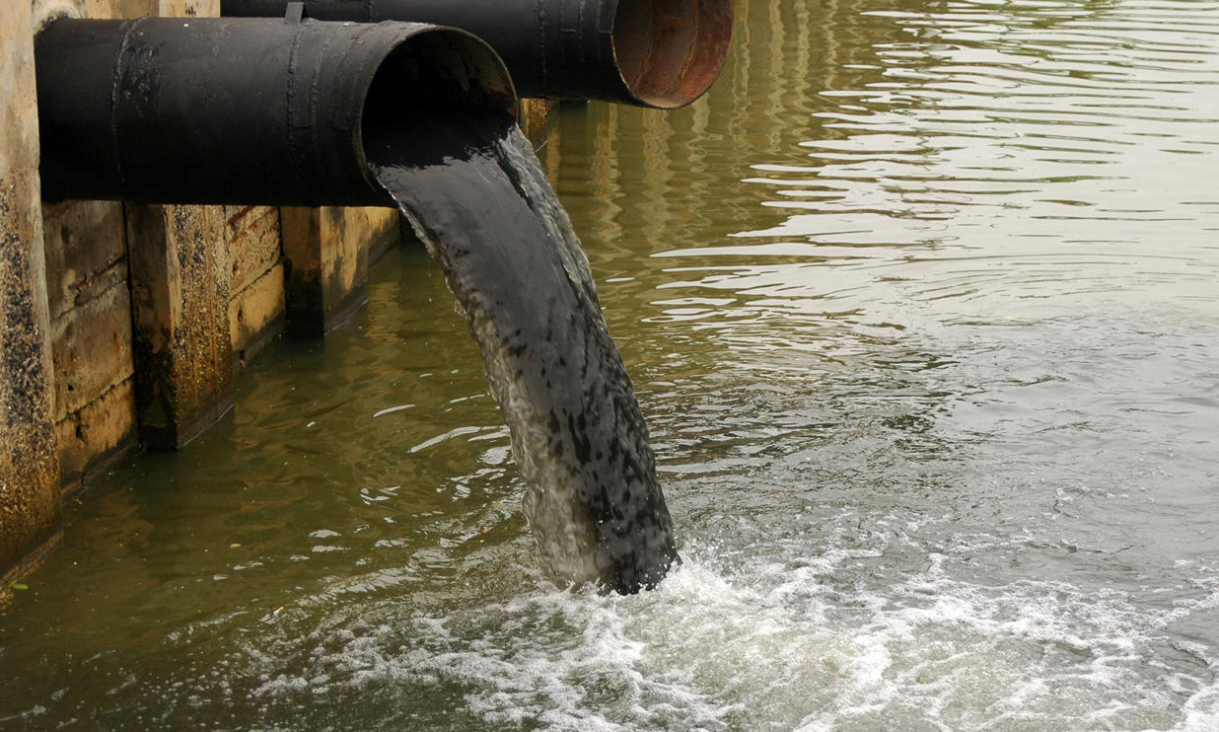
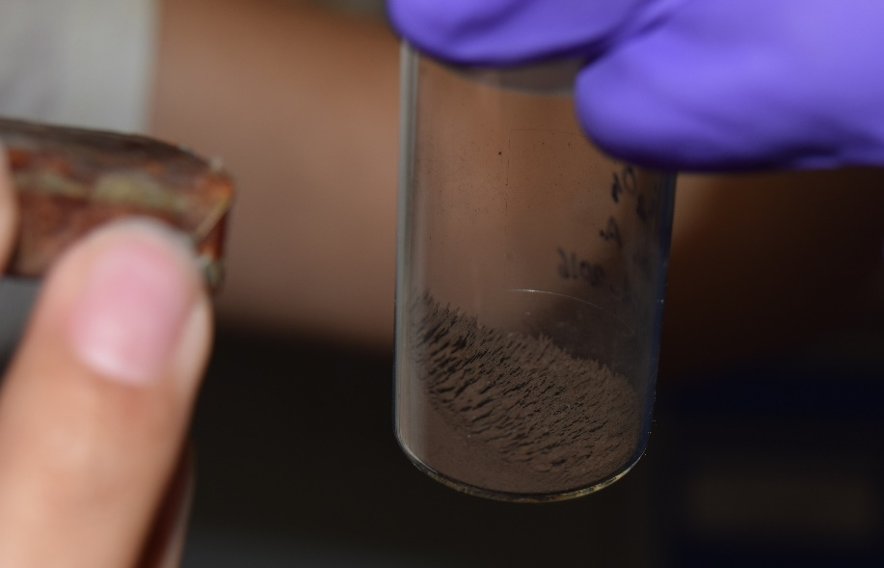
Motivation
Water pollution by heavy metal ions is a serious environmental problem
Growing interest in sorbents for water decontamination
Magnetic Nanoparticles
  Easy separation using a magnetic field
  High effective surface area
  Easy and cheap to produce

Slide 4
Functionalized Magnetic Nanoparticles
Magnetite Nanoparticles (NP) functionalized with dithiocarbamate (DTC)
Two different geometries were used:
“A” type nanoparticles
  Cubic geometry with ≈ 100 nm side
  Diferent types of functionalizations
“B” type nanoparticles
  Spheric geometry with ≈ 50nm diameter
  Diferent types of functionalizations
SiO₂

Slide 5
Functionalized Magnetic Nanoparticles
NH_{n}
NH_{n}
NH_{n}
A₁
A₂
A₃
NH_{n}
NH_{n}
NH_{n}
SiO₂
NH_{n}
SiO₂
NH_{n}
NH_{n}
NH_{n}
Fe₃O₄
Fe₃O₄
NH_{n}
Fe₃O₄
NH_{n}
NH_{n}
NH_{n}
NH_{n}
NH_{n}
NH_{n}
NH_{n}
NH_{n}
NH_{n}
A₄
A₅
DTC-Na
DTC-Na
DTC-Na
DTC-Na
DTC
DTC-Hg
DTC
DTC-Hg
Na-DTC
DTC-Na
DTC
DTC-Hg
NH_{n}
NH_{n}
NH_{n}
NH_{n}
NH_{n}
NH_{n}
NH_{n}
NH_{n}
SiO₂
NH_{n}
NH_{n}
NH_{n}
NH_{n}
NH_{n}
NH_{n}
SiO₂
NH_{n}
Hg-DTC
NH_{n}
SiO₂
Na-DTC
DTC-Na
NH_{n}
NH_{n}
NH_{n}
DTC
NH_{n}
DTC-Hg
Na-DTC
DTC-Na
NH_{n}
NH_{n}
Fe₃O₄
NH_{n}
Hg-DTC
NH_{n}
Fe₃O₄
DTC
Na-DTC
DTC-Na
NH_{n}
DTC
NH_{n}
DTC
Na-DTC
NH_{n}
NH_{n}
DTC-Na
DTC-Hg
NH_{n}
NH_{n}
NH_{n}
NH_{n}
NH_{n}
NH_{n}
NH_{n}
NH_{n}
NH_{n}
DTC-Na
NH_{n}
NH_{n}
NH_{n}
DTC-Hg
Na-DTC
DTC-Na
DTC-Na
DTC-Na
Hg-DTC
DTC-Na
DTC-Hg
DTC-Hg
DTC
DTC-Hg

Slide 6
Functionalized Magnetic Nanoparticles
NH_{n}
NH_{n}
B₁
B₂
B₃
NH_{n}
NH_{n}
SiO₂
NH_{n}
SiO₂
NH_{n}
NH_{n}
Fe₃O₄
NH_{n}
Fe₃O₄
Fe₃O₄
NH_{n}
NH_{n}
NH_{n}
NH_{n}
NH_{n}
NH_{n}
NH_{n}
B₄
DTC-Na
B₅
DTC-Hg
NH_{n}
Na-DTC
DTC-Na
DTC
DTC-Hg
Na-DTC
NH_{n}
NH_{n}
DTC-Na
Hg-DTC
NH_{n}
DTC
NH_{n}
Fe₃O₄
NH_{n}
NH_{n}
NH_{n}
DTC-Na
NH_{n}
DTC-Hg
Na-DTC
NH_{n}
SiO₂
NH_{n}
DTC
NH_{n}
SiO₂
NH_{n}
NH_{n}
DTC-Na
NH_{n}
DTC-Hg
Fe₃O₄
NH_{n}
NH_{n}
Na-DTC
NH_{n}
NH_{n}
Fe₃O₄
NH_{n}
Hg-DTC
NH_{n}
NH_{n}
DTC-Na
DTC
NH_{n}
Na-DTC
NH_{n}
NH_{n}
NH_{n}
NH_{n}
DTC-Na
DTC
NH_{n}
NH_{n}
NH_{n}
NH_{n}
DTC-Hg
Na-DTC
NH_{n}
Hg-DTC
NH_{n}
DTC-Na
DTC-Hg
Na-DTC
DTC-Na
DTC
DTC-Hg

Slide 7
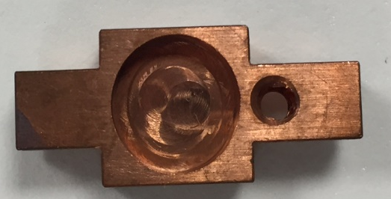

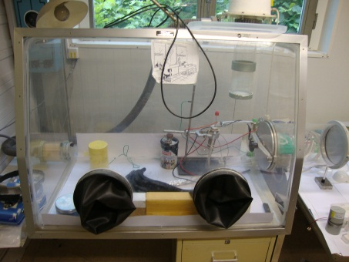
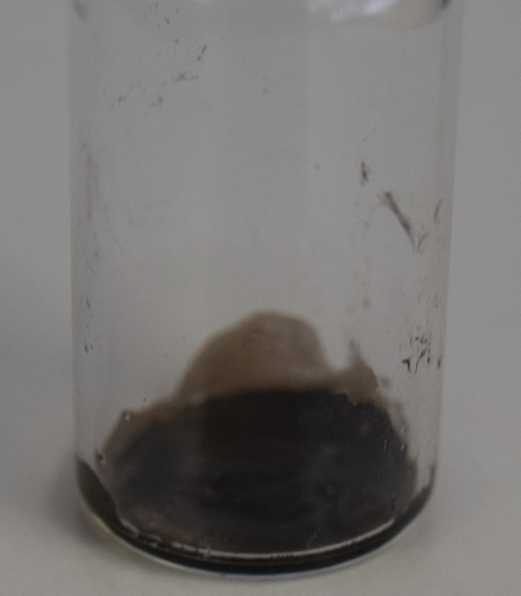
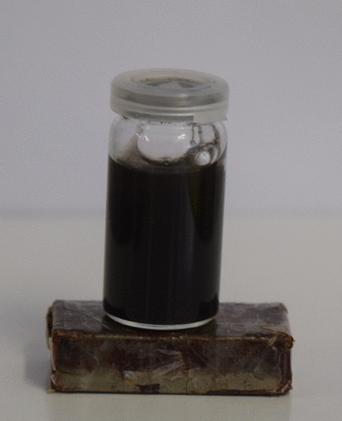
Radioactive Trackers
1. Implantation of ^{199m}Hg on ice
2. We melted the radioactive ice and added it to the NP suspension (Ultra-sonication during 20 minutes)
3. We measure the activity of the radioactive water + NP (which are in a test tube) in a HPGe detector gamma spectrometer.
4. NP separation from the solution using a strong magnet
5. We measure the remaining activity of the dry NP

Slide 8
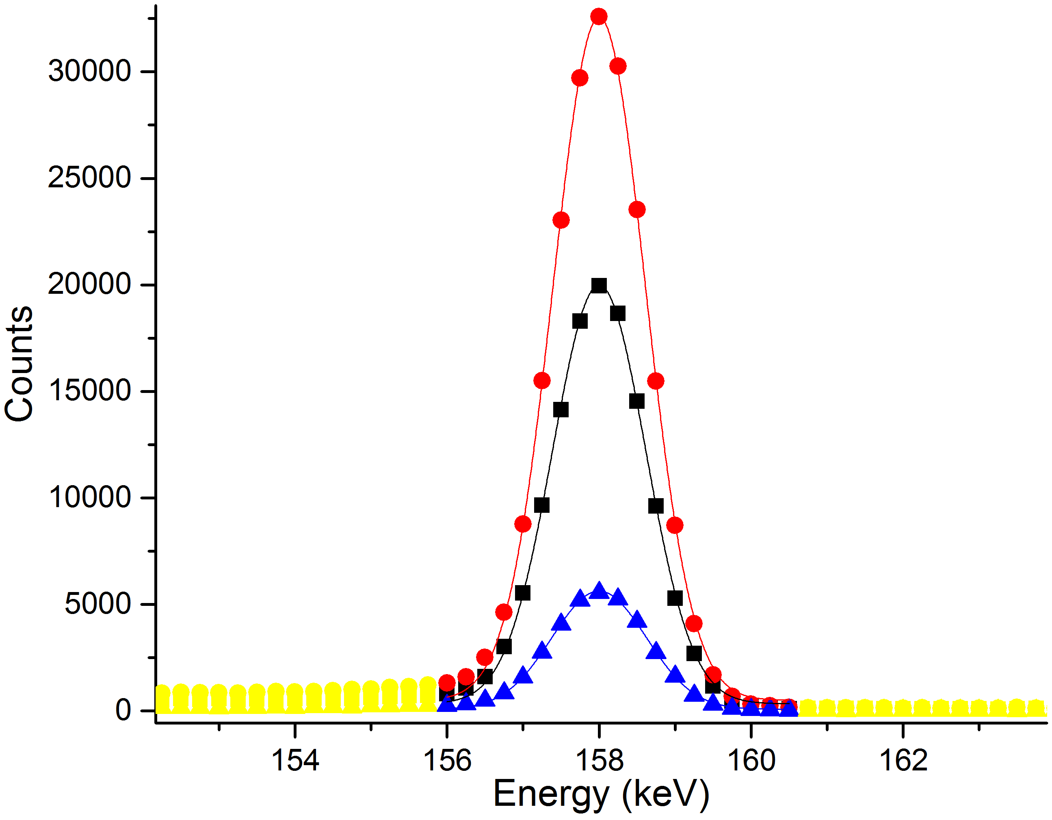
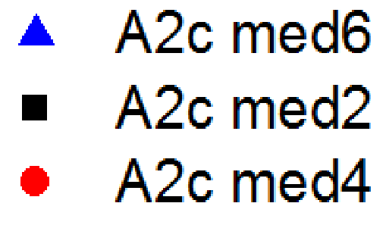
Radioactive Trackers
^{199m}Hg
^{199m}Hg
13/2+
532.48KeV
42.6m
ϒ1
374.10KeV
6. We integrate the measured activities to determine the absolute activity measured in the spectrometer.
7. We calculate the loss due to radioactive decay to compensate the loss measured and then we obtain the sorption percentage.
8. We repeat several times to add statistics to the sorption measurements .
5/2-
158.38KeV
2.47ns
ϒ2 (I_{γ}=52.3%)
158.38KeV
1/2-
0KeV
stable
¹⁹⁹Hg
¹⁹⁹Hg

Slide 9
Radioactive Trackers
Hg sorption percentage for different types of NP measured with the gamma spectrometer for 20 minutes sonication
NP | Sorption (S) | ∆S
A2 | 14% | 5%
A4 | 73% | 5%
B2 | 25% | 6%
B4 | 50% | 1%
Non-functionalized
Cubic larger
Functionalized with DTC
Spherical smaller
Concentrations of ≈ 1ng/dm³
  Legal limit concentration for Hg in drinking water = 2 µg/dm³
  Rain water concentration: 5-100 ng/dm³

Slide 10
Radioactive Trackers
Advantages of Radioactive Trackers
Physical non intrusive measurement
  Chemical analysis usually needs processing which can alter the desired conditions of Hg environment
Direct measurement of Hg
  Recycling sorbent NP (difficult to infer with traditional methods)
  Study of external factors in the NP (such as temperature)
  Tracking of Hg
  Hg mapping would be possible
    Plants/animals Hg retention mapping
Very high sensitivity ( C < 1 pg/dm³, in comparison with ng/dm³ with fluorescence spectroscopy)

Slide 11
PAC Spectroscopy
To infer the coordination/local environment of Hg²⁺ PAC Spectroscopy was made
^{199m}Hg Isotope used
Cascade of 2 γ photons
Intermediate state perturbed by local environment
Perturbation affects angular correlation of γ photons
^{199m}Hg
^{199m}Hg
13/2+
532.48KeV
42.6m
ϒ1
374.10KeV
5/2-
158.38KeV
2.47ns
ϒ2
158.38KeV
1/2-
0KeV
stable
¹⁹⁹Hg
¹⁹⁹Hg

Slide 12
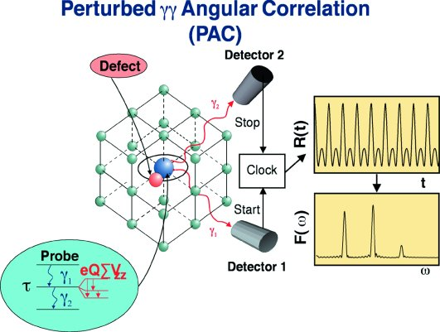


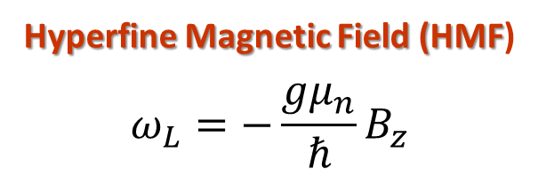
PAC Spectroscopy
Local and/or external fields induce Hyperfine splitting
Information given by Hyperfine splitting:
Hyperfine Magnetic Field (HMF)
$$ω_{L}=−\frac{gμ_{n}}{ℏ}B_{z}$$
Electric Field Gradient (EFG)
$$ω_{Q}=\frac{eQV_{zz}}{4I\left(2I−1\right)ℏ}$$
Asymmetry parameter (ƞ)
$$η=\frac{V_{xx}−V_{yy}}{V_{zz}}$$

Slide 13
PAC Results
Experimental Ratio Plot + Fitted curve
Fourier Transform

Slide 14

DFT Modeling
Density Functional Theory calculations were performed using the software VASP©.
Method
  Projector Augmented Wave (PAW)
Functional
  Generalized Gradient Approximation – PBE (GGA-PBE)
  Local Density Approximation (LDA)
Input
  Structural parameters
  Atoms
  PAW Atomic Potentials
  (∆EFG < 7%)
Output
  Electric Field Gradient (EFG)
  Total Energy
  Relaxed Structure coordinates

Slide 15
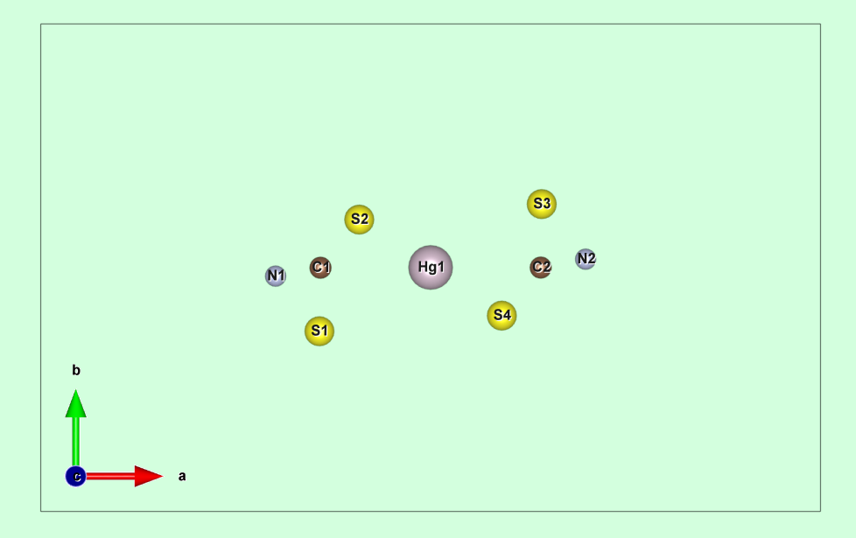
DFT Modeling
Calculated Local Environment:
DTC1
distance
distance
SiO₂
Fe₃O₄

Slide 16
DFT Results
DTC1

Slide 17
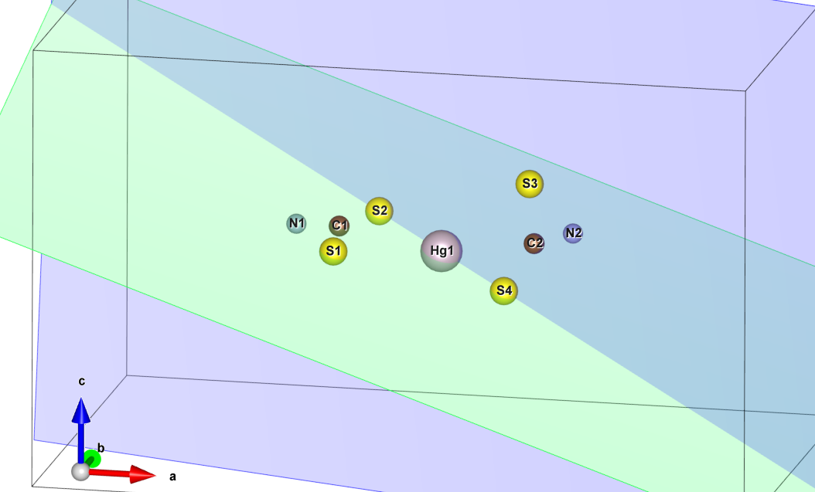
DFT Modeling
Calculated Local Environment:
DTC2
distance
SiO₂
Fe₃O₄

Slide 18
DFT Results
DTC2

Slide 19
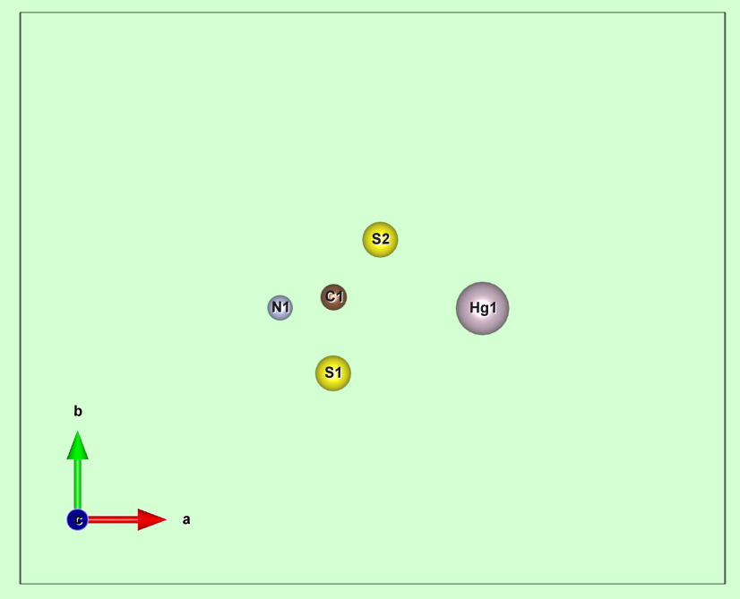
DFT Modeling
Calculated Local Environment:
DTC3

Slide 20
DFT Results
DTC3

Slide 21
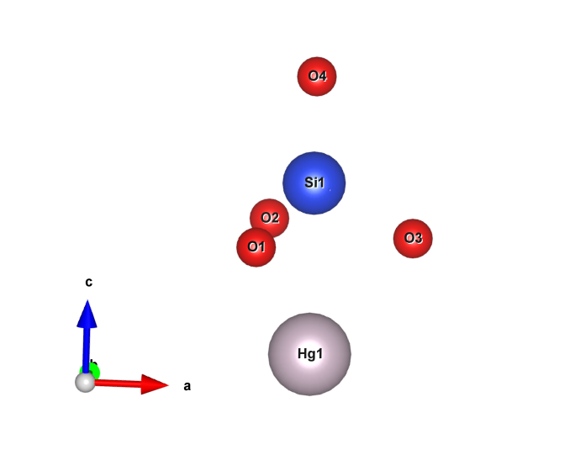
DFT Modeling
Calculated Local Environment:
SiO₃Hg
+D

Slide 22
DFT Results
SiO₃Hg

Slide 23
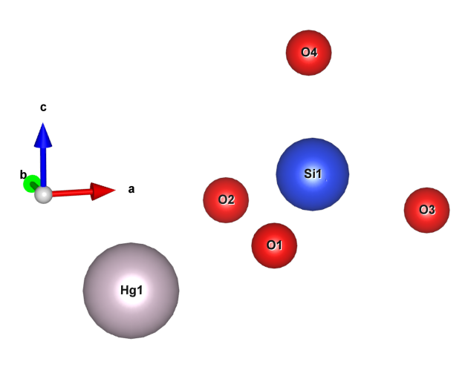
DFT Modeling
Calculated Local Environment:
SiO₂Hg
+D

Slide 24
DFT Results
SiO₂Hg

Slide 25
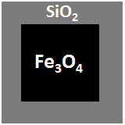
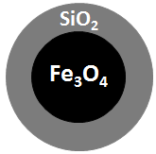
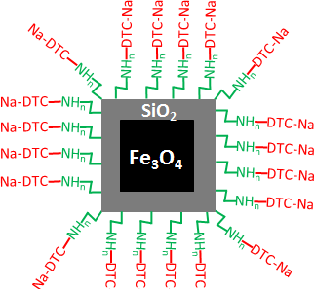
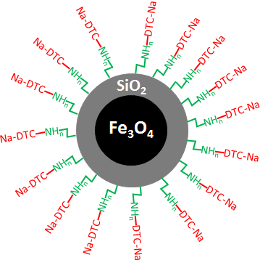
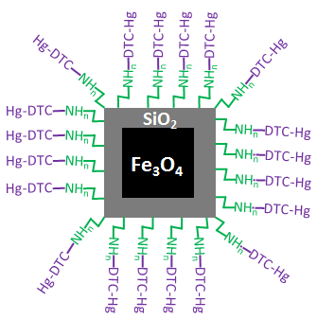
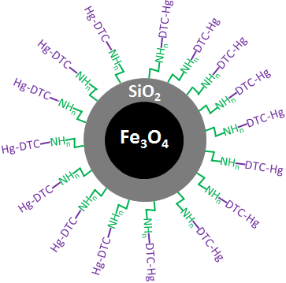

PAC Results

Slide 26
PAC Results

Slide 27
PAC Results
D=+5 pm
D=0 pm
DFT
D=-15 pm

Slide 28
PAC Results
D=+5 pm
D=+5 pm
D=0 pm
D=0 pm
DTC₂
DTC₁
D=-15 pm
D=-15 pm

Slide 29
PAC Results
D=-5 pm
D=0 pm
DTC₂
D=-15 pm

Slide 30
PAC Results
D=-25 pm
DFT
D=0 pm

Slide 31
PAC Results
D=0 pm
DFT
D=50 pm

Slide 32
PAC Results
D=0 pm
D=0 pm
DFT
D=10 pm
D=50 pm

Slide 33
PAC Results

Slide 34
Conclusions
Radioactive Trackers allowed us to study different kinetics of sorption.
Fe₃O₄/SiO₂/DTC functionalized NP (A4 and B4) have much higher sorption efficiency than Fe₃O₄/SiO₂ NP (A2 and B2)

Slide 35
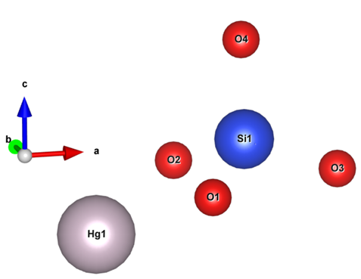
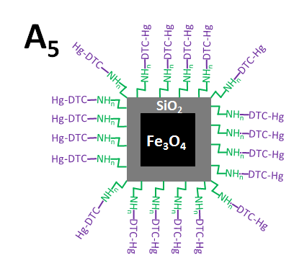
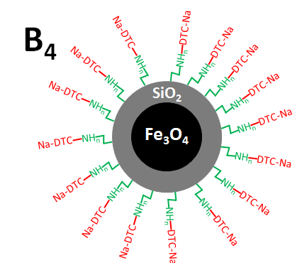
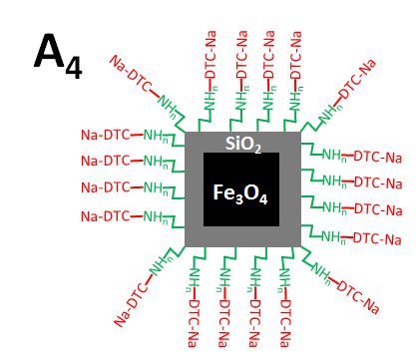
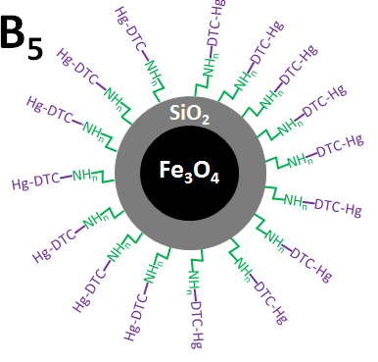
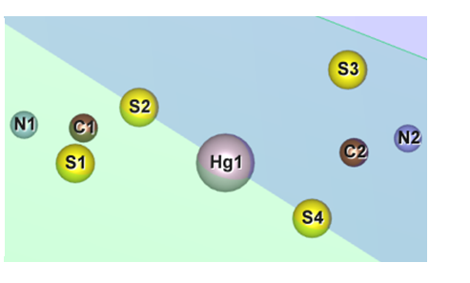
Conclusions
The local environment/coordination of Hg²⁺ was determined by PAC-DFT crossover
In A2 and B2 NP, Hg mostly coordinates in SiO₂Hg local environment.
In A4 and B4 NP (as well as in the Reference powders), Hg mostly coordinates in DTC2 local environment.
In A5 and B5 NP, Hg coordinates in SiO₂Hg, SiO₃Hg and DTC2 local environments.
A₂
B₂
SiO₂
SiO₂
Fe₃O₄
Fe₃O₄

Slide 36


Acknowledgements
This work was developed within the scope of the project CICECO-Aveiro Institute of Materials, POCI-01-0145-FEDER-007679 (FCT Ref. UID /CTM /50011/2013), financed by national funds through the FCT/MEC and when appropriate co-financed by FEDER under the PT2020 Partnership Agreement. We would like to acknowledge the SFRH/BD/93336/2013 and SFRH/BD/84743/2012 FCT grants, and BMBF through grants 05K13TSA, 05K13MG1, and funding by ENSAR.

